Slide 1

FriendShip Network
Jeffery Kimbrow
University of Missouri Kansas City
April 17th, 2024
Notes:
Hello everyone! My name is Jeffery Kimbrow, and today I will be presenting on the friendship network analysis.

Slide 2
Agenda
INTRODUCTION
IMPORTANCE
METHODOLOGY
IMPLEMENTATION
RESULTS
DISCUSSION
CONCLUSION
REFERNCES

Slide 3

Introduction
The purpose of this project was to represent friendship networks through matrix representation.
Objectives:
Apply a matrix representation for the analysis of friendship networks.
Calculate and interpret the metrics for the network.
Objectives:
Showcase the ability of the Python Libraries, NumPy NetworkX, and Matplotlib, to create, analyze, and visualize a friendship network.
Notes:
This project demonstrates the ability to represent friendship networks through matrix representation with Python.
The objectives of the project were to apply a matrix for the analysis of a friendship network. Then calculate and interpret the metrics for the network.
The importance of this project was to showcase the ability of the NumPy, NetworkX, and Matplotlib Python libraries to create, analyze, and visualize a friendship network. This sort of analysis is crucial for sociological research and community planning.

Slide 4
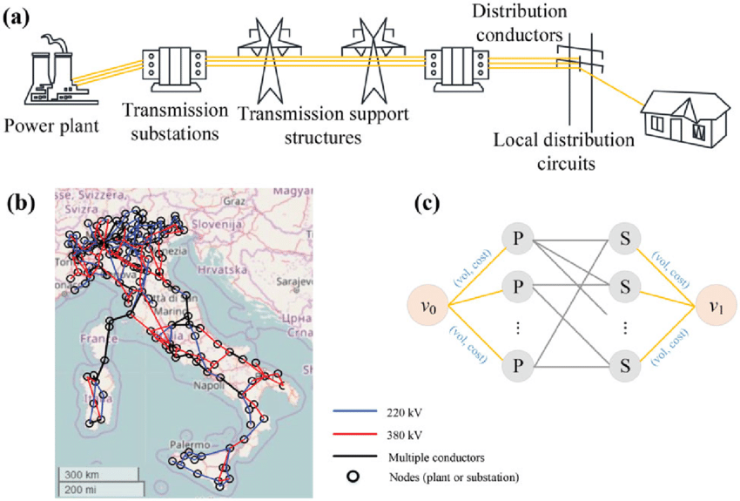
How can graph theory be used to analyze complex networks?
Examples:
Traffic Routing
Disease Tracking
Power Grid Management
Notes:
How can graph theory be used to analyze complex networks? Many of us may think that this knowledge will never be used or that it may not even be relevant to our future or current work.
However, this is used in our everyday lives without us even knowing it. Examples of this could include traffic routing, disease tracking, or even with the image in the slide that represents how power is distributed throughout a country.

Slide 5
Methodology
Tools used:
Python 3.12
NumPy
NetworkX
Matplotlib
Used a matrix representation to denote friendship strengths and connections, transformed into a graph for analysis and visualization.
Notes:
The methodology used was a matrix representation to denote friendship strengths and connections, which was transformed into a graph for analysis and visualization.
The tools utilized during this project were Python3.12, Numpy, NetworkX, Matplotlib and Visual Studio Code.

Slide 6
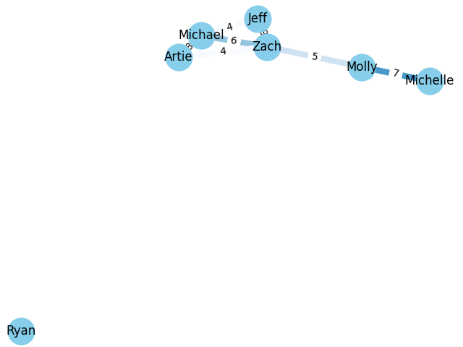
Implementation
Weights represent the strength of the friendships.
Configure the matrix to represent the connections.
Use NetworkX to convert the matrix to graph format.
Matplotlib was used to create the visual representation of the network.
Notes:
The process of implementation started with configuring a matrix to represent the connections and strength of friendships among individuals using NumPy.
From that, I was able to use the NetworkX library, this allowed me to convert the friendship matrix into a graph format, where each node is representing an individuals and each weight edge depicts the strength of their friendship.
Afterwards, I utilized Matplotlib to create a visual representation of the network. This involved mapping each person to a node and visually connecting nodes with weighted edges.

Slide 7
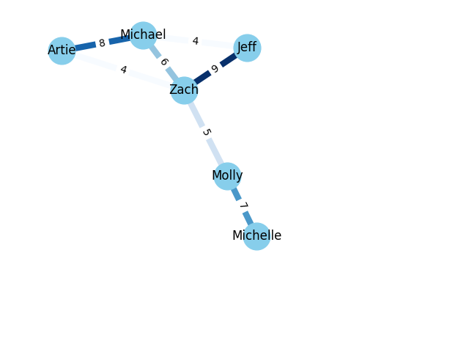
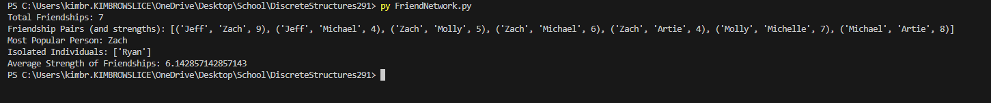

Results
Graph that visually represents the friendship network.
Zoomed
Most Popular Person: Zach
Isolated individuals: Ryan
Total Unique Friendships: 7
Average Friendship Strength: $≈$ 6.14
Notes:
The results of our program were able to show us the following information. Total Unique Friendships: 7
Most Popular Person: Zach
Isolated Individuals: Ryan
Graph showing the friendship network.
This graph shows a mostly interconnected structure with one isolated node.

Slide 8
Discussion
Notes:
The results display the effectiveness of matrix representation with understanding social connections.
My project was able to successfully meet the objectives by identifying key network metrics and providing insights into the network structure.
The only limitations were due to the lack of complexity that would be present with real data.

Slide 9
Conclusion
Project Achievements:
- Successfully created a visual representation of a friendship network using Python, NumPy, NetworkX, and Matplotlib to represent a network using Graph Theory.
The importance:
- The results of this project represent, at a low level, the complexity required to represent a friendship network, among multiple different real-world applications with Graph Theory.
Notes:
In conclusion, the projects achievements were successfully implementing a friendship network using Python, NumPy, NetworkX, and Matplotlib to represent a complex network using Graph Theory.
The importance of this project was to represent, at a low level, the complexity required to represent a friendship network, among multiple different real-world applications with Graph Theory.

Slide 10
References
Networkx Graph Tutorial
NumPy. Matrix
Matplotlib.pyplot.plot
Notes:
A list of the references used during creating this program and completing this project.

Slide 11
Thank you!
Notes:
Thank you all!

