Slide 1

MyProduct
Supervisor : Leap Bun
Student : Kimchhung Pech
Department : Computer Science
Developing Mobile Applications for Android

Slide 2
Introduction
MyProduct is a Product Management System app that helps the seller to manage products such as, stock, cashier and reporting (daily, Monthly, yearly sold the product.

Slide 3
Overview
Tools
Technologies
Framwork Laravel API
Challenge
Samples interface and dark mode
Samples

Slide 4
Tools
Adobe XD
github
Visual Studio
Android
Studio

Slide 5
Technologies
Framwork Laravel API
XMl
API
Database
Java

Slide 6
Technologies
open-source cross-platform web server, host project
PostMan use for API testing
Get,POST,PUT method
Request Json
Xampp
Java
PostMan
Xampp
Xampp

Slide 7
Challenge
open-source cross-platform web server, host project
PostMan use for API testing
Get,POST,PUT method
Request Json
Xampp
Java
PostMan
Xampp
Xampp

Slide 8
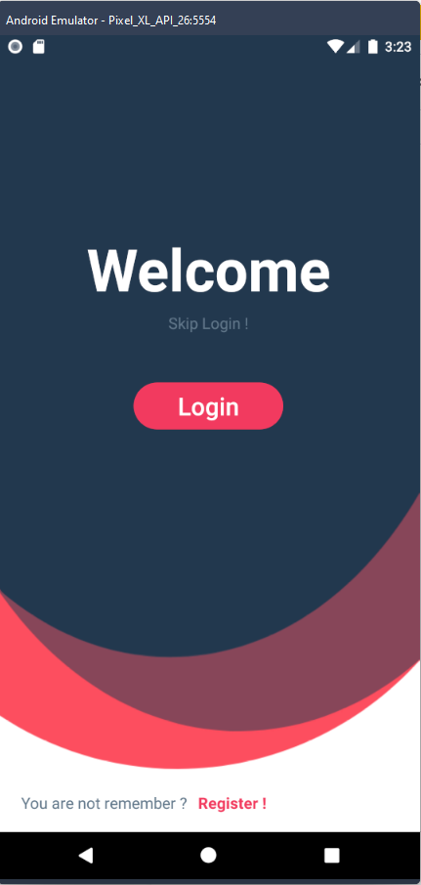
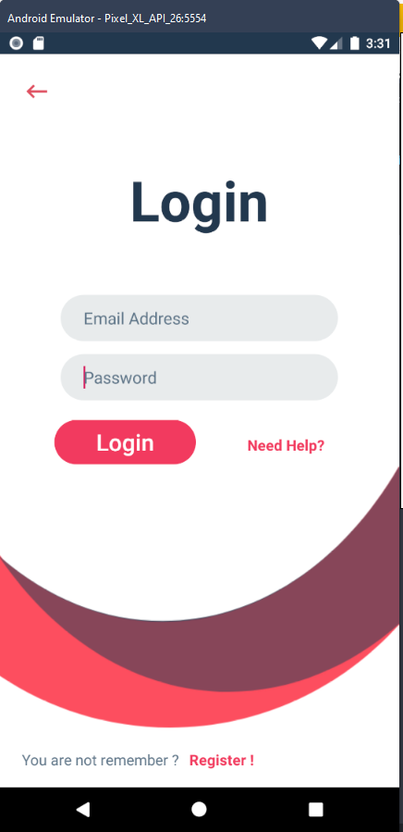
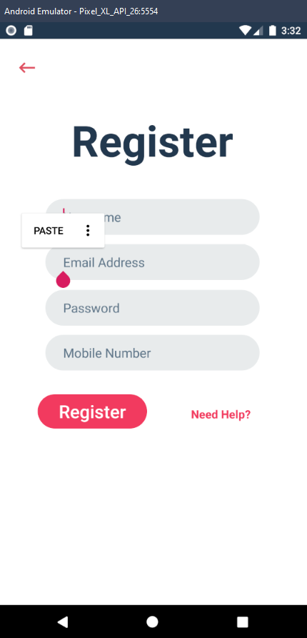
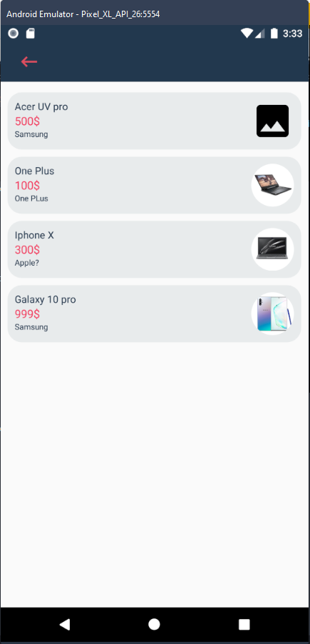
Samples

Slide 9
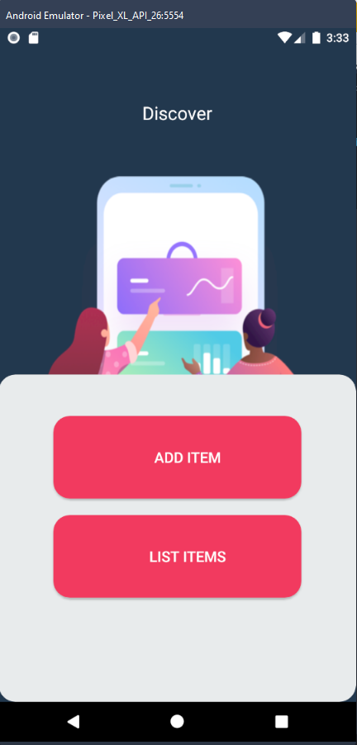
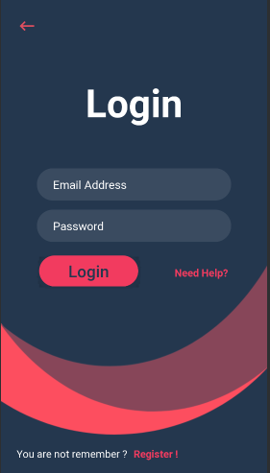
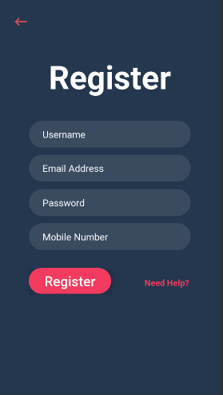
Dark mode

Slide 10

Demo

Slide 11
Any Question ?
Project : MyProduct
Course : Developing Mobile Applications for Android
Designer : Kimchhung Pech

