Slide 1


GBME Probability and Statistics | Fall 2018
Lecture 09 | 101018
Lecture 09
Probability II, Random variables
CHOONG-WAN WOO | COCOAN lab | http://cocoanlab.github.io

Slide 2
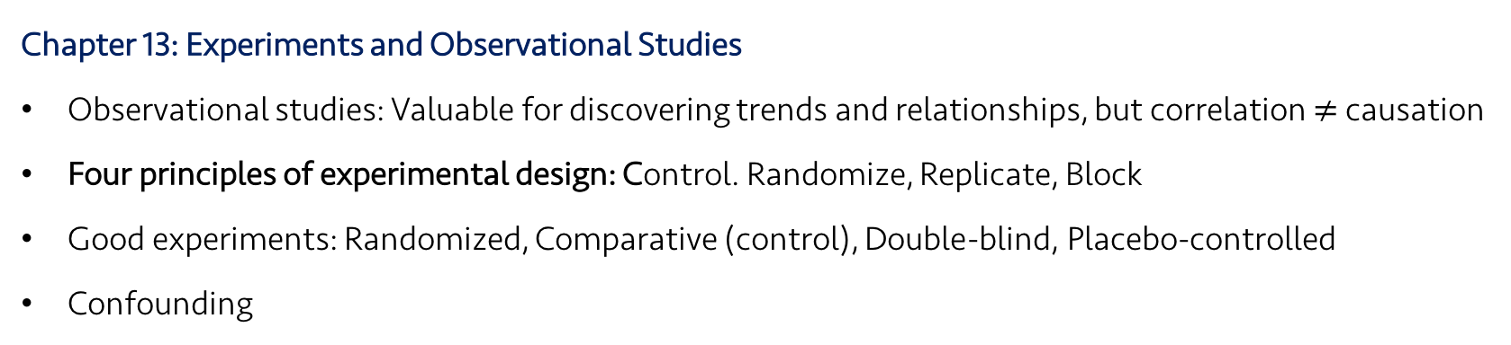
Lecture 09 | 101018
Review: Key Points
Chapter 13: Experiments and Observational Studies
Observational studies: Valuable for discovering trends and relationships, but correlation $≠$ causation
Four principles of experimental design: Control. Randomize, Replicate, Block
Good experiments: Randomized, Comparative (control), Double-blind, Placebo-controlled
Confounding
CHOONG-WAN WOO | COCOAN lab | http://cocoanlab.github.io

Slide 3
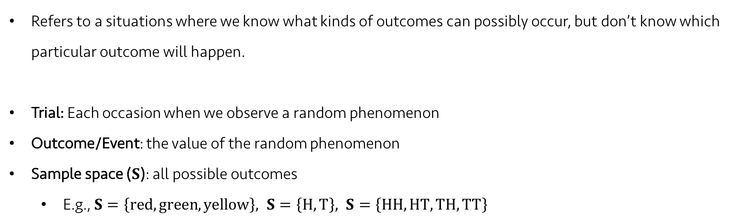
Lecture 09 | 101018
Random phenomena
Refers to a situations where we know what kinds of outcomes can possibly occur, but don’t know which particular outcome will happen.
Trial: Each occasion when we observe a random phenomenon
Outcome/Event: the value of the random phenomenon
Sample space ($S$): all possible outcomes
E.g., $S=\left\{red, green, yellow\right\}, S=\left\{H, T\right\}, S=\left\{HH, HT, TH, TT\right\}$
CHOONG-WAN WOO | COCOAN lab | http://cocoanlab.github.io

Slide 4
Lecture 09 | 101018
Law of Large Numbers (LLN)
When we repeat a random process over and over, the proportion of times that an event occurs settle down to one number, which is the probability of the event.
Two key assumption of LLN:
No changes of the random phenomena over the repeats
independence (all the events should be independent): an event doesn’t influence the outcomes of others.
This tells us nothing about “short-run” behavior. And the long run is really long.
Don’t expect the probability tells you a short-term trend of something.
CHOONG-WAN WOO | COCOAN lab | http://cocoanlab.github.io

Slide 5
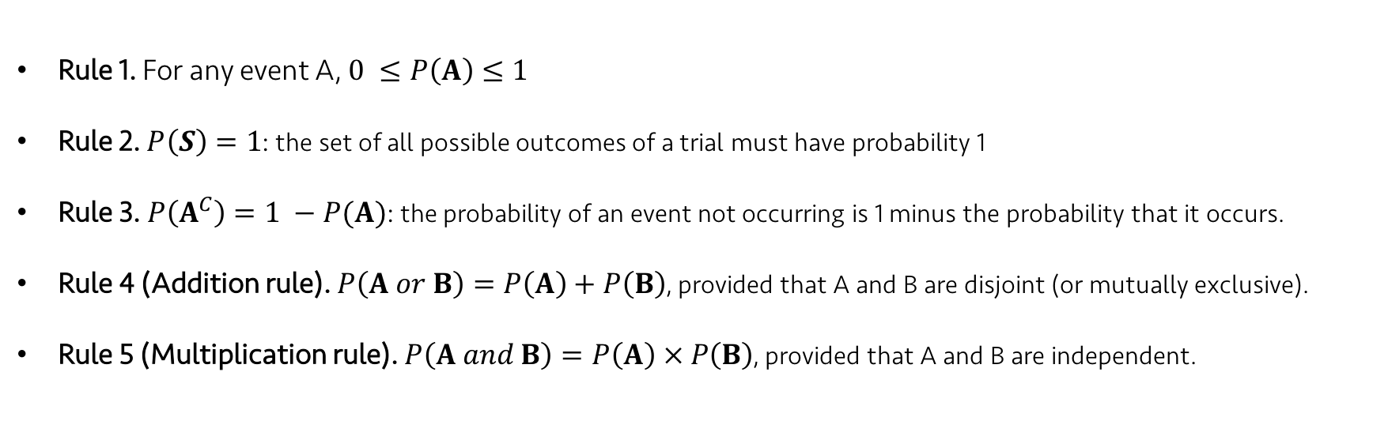
Lecture 09 | 101018
Rules of formal probability
Rule 1. For any event A, $0 ≤P\left(A\right)≤1$
Rule 2. $P\left(S\right)=1$: the set of all possible outcomes of a trial must have probability 1
Rule 3. $P\left(A^{C}\right)=1 −P(A)$: the probability of an event not occurring is 1 minus the probability that it occurs.
Rule 4 (Addition rule). $P\left(A or B\right)=P\left(A\right)+P\left(B\right)$, provided that A and B are disjoint (or mutually exclusive).
Rule 5 (Multiplication rule). $P\left(A and B\right)=P\left(A\right) × P\left(B\right)$, provided that A and B are independent.
CHOONG-WAN WOO | COCOAN lab | http://cocoanlab.github.io

Slide 6
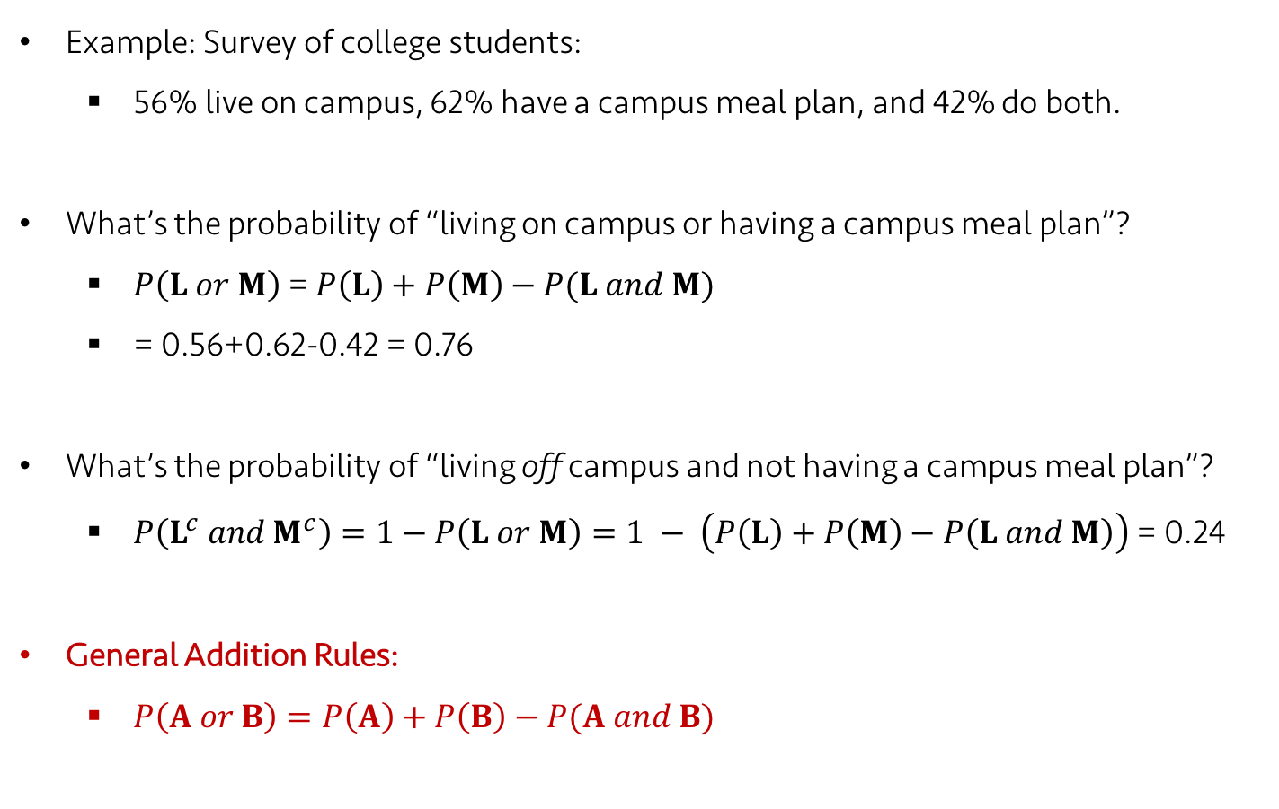
Lecture 09 | 101018
The General Addition Rules
Example: Survey of college students:
56% live on campus, 62% have a campus meal plan, and 42% do both.
What’s the probability of “living on campus or having a campus meal plan”?
$P\left(L or M\right)$ = $P\left(L\right)+P\left(M\right)−P(L and M)$
= 0.56+0.62-0.42 = 0.76
What’s the probability of “living off campus and not having a campus meal plan”?
$P\left(L^{c} and M^{c}\right)=1−P\left(L or M\right)=1 − \left(P\left(L\right)+P\left(M\right)−P\left(L and M\right)\right)$ = 0.24
General Addition Rules:
$P\left(A or B\right)=P\left(A\right)+P\left(B\right)−P(A and B)$
CHOONG-WAN WOO | COCOAN lab | http://cocoanlab.github.io

Slide 7
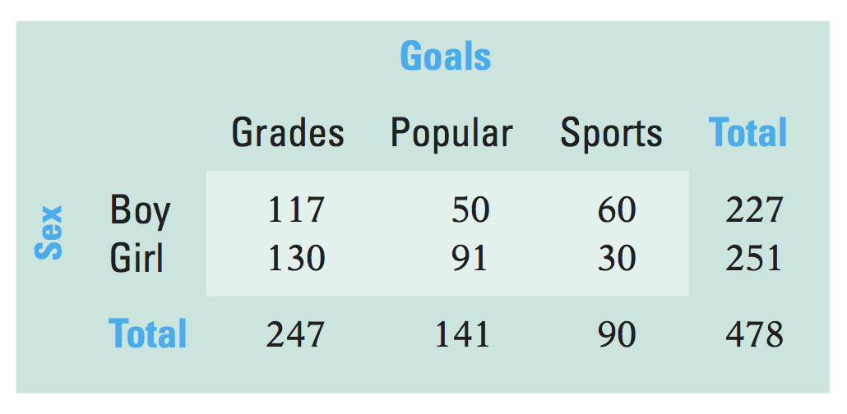
Lecture 09 | 101018
Conditional Probability
Example: surveyed 478 elementary school students and asked whether their primary goal was to get good grades, to be popular, or to be good at sports.
Contingency table:
P(Sports) = 90/478 = 0.188
P(Girl) = 251/478 = 0.525
P(Sports and Girl) = 30/478 = 0.063
P(Sports | Girl) = Probability of Sports given Girl = 30/251 = 0.120 = P(Sports and Girl) / P(Girl) = (30/478) / (251/478) = 0.063 / 0.525 = 0.120
CHOONG-WAN WOO | COCOAN lab | http://cocoanlab.github.io

Slide 8
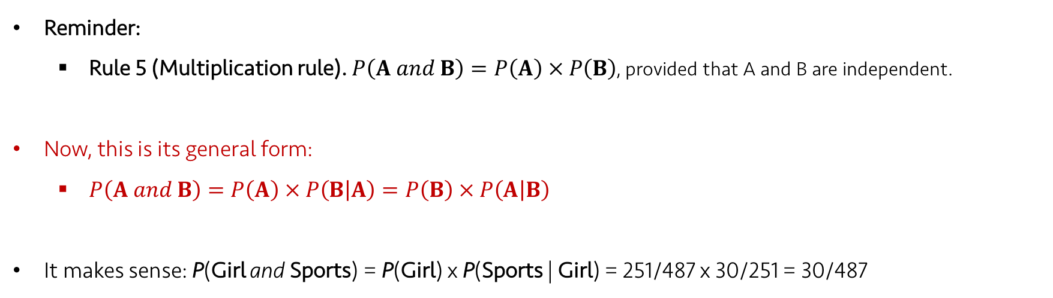
Lecture 09 | 101018
General Multiplication Rule
Reminder:
Rule 5 (Multiplication rule). $P\left(A and B\right)=P\left(A\right) × P\left(B\right)$, provided that A and B are independent.
Now, this is its general form:
$P\left(A and B\right)=P\left(A\right) × P\left(B | A\right)=P\left(B\right) × P\left(A | B\right)$
It makes sense: P(Girl and Sports) = P(Girl) x P(Sports | Girl) = 251/487 x 30/251 = 30/487
CHOONG-WAN WOO | COCOAN lab | http://cocoanlab.github.io

Slide 9
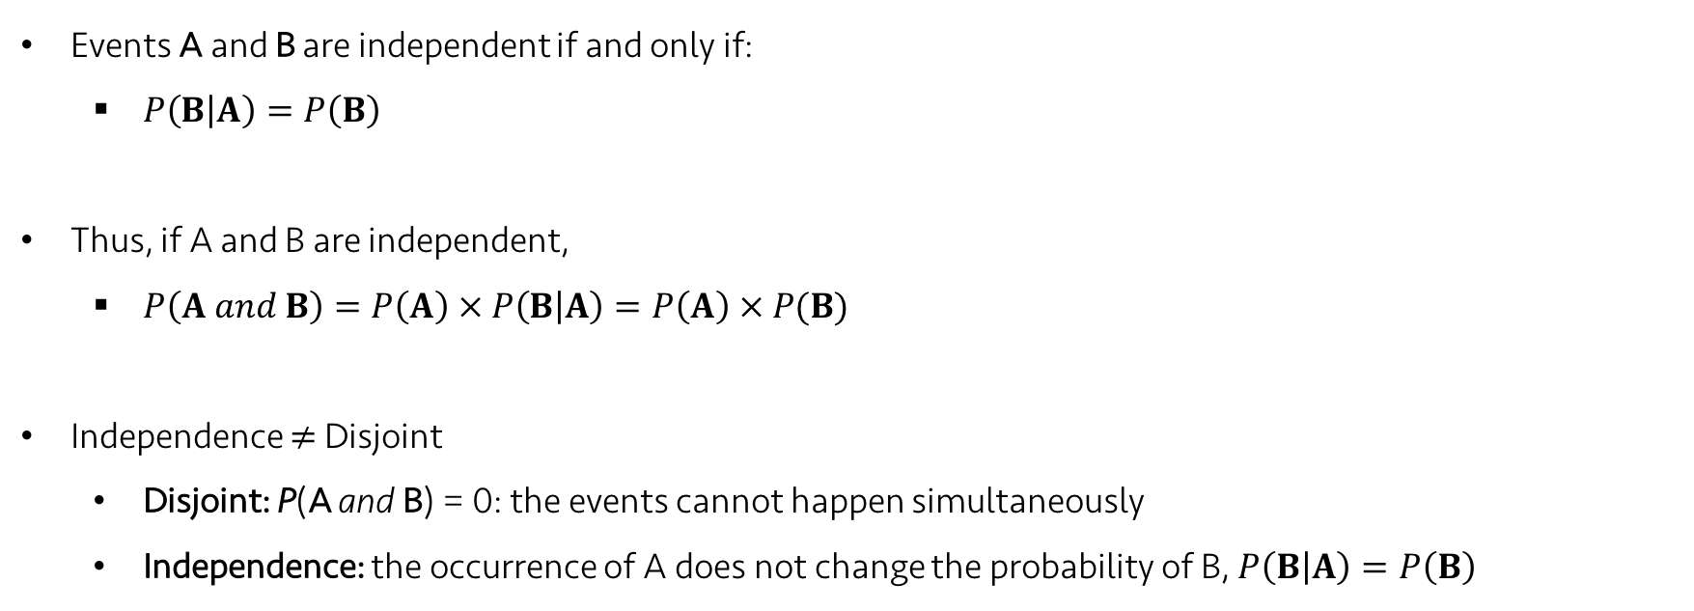
Lecture 09 | 101018
Independence
Events A and B are independent if and only if:
$P\left(B | A\right)=P\left(B\right)$
Thus, if A and B are independent,
$P\left(A and B\right)=P\left(A\right) × P\left(B | A\right)=P\left(A\right) × P(B)$
Independence $≠$ Disjoint
Disjoint: P(A and B) = 0: the events cannot happen simultaneously
Independence: the occurrence of A does not change the probability of B, $P\left(B | A\right)=P\left(B\right)$
CHOONG-WAN WOO | COCOAN lab | http://cocoanlab.github.io

Slide 10
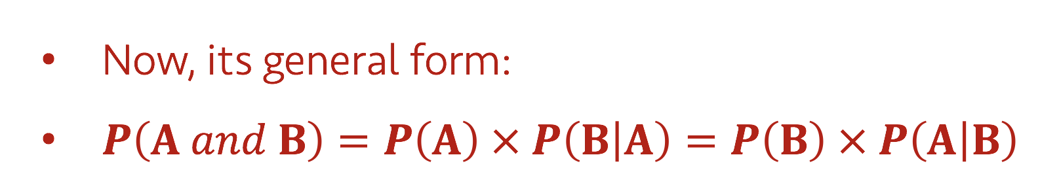
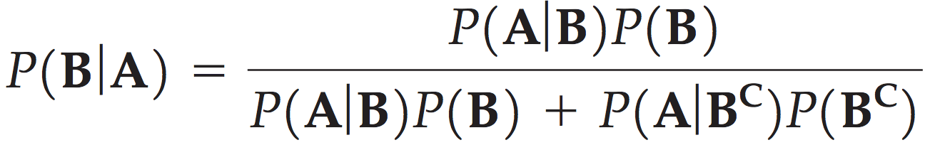
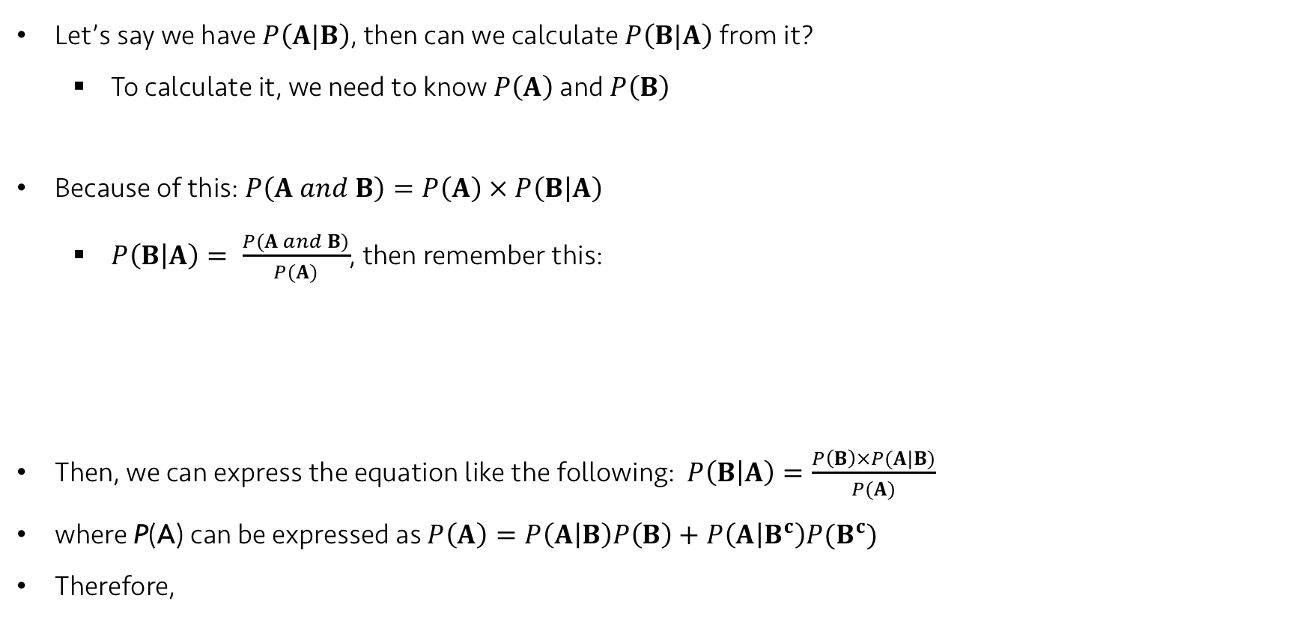
Lecture 09 | 101018
Reversing the Conditioning and Bayes’ Rule
Let’s say we have $P\left(A|B\right)$, then can we calculate $P\left(B|A\right)$ from it?
To calculate it, we need to know $P\left(A\right)$ and $P\left(B\right)$
Because of this: $P\left(A and B\right)=P\left(A\right) × P\left(B | A\right)$
$P\left(B | A\right)= \frac{P(A and B)}{P(A)}$, then remember this:
Then, we can express the equation like the following: $P\left(B | A\right)=\frac{P\left(B\right)×P(A|B)}{P(A)}$
where P(A) can be expressed as $P\left(A\right)=P\left(A | B\right)P\left(B\right)+P\left(A | B^{c}\right)P(B^{c})$
Therefore,
CHOONG-WAN WOO | COCOAN lab | http://cocoanlab.github.io

Slide 11
Lecture 09 | 101018
Practice:
P(test+ | disease) = 0.8
P(disease | test+) = 0.1
How is this possible? In which cases (e.g., what numbers or ratio of P(test+) and P(disease)), can this happen?
CHOONG-WAN WOO | COCOAN lab | http://cocoanlab.github.io

Slide 12
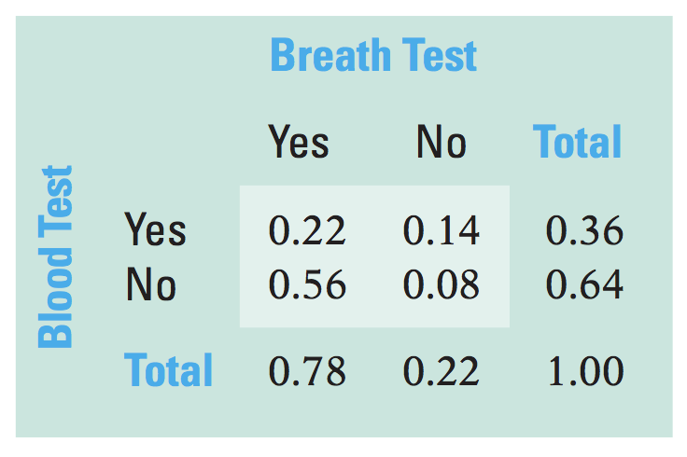
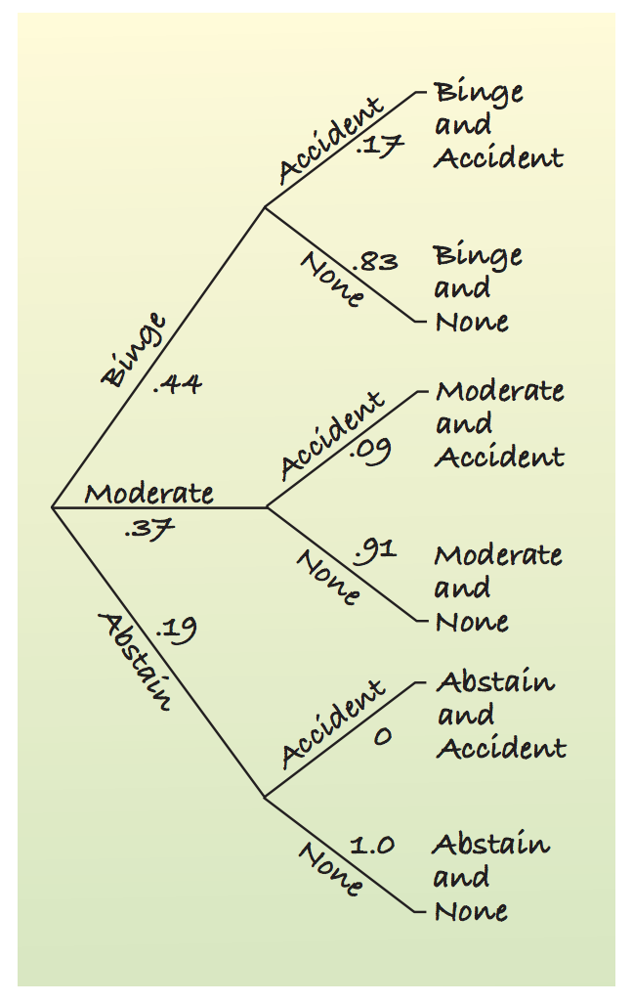
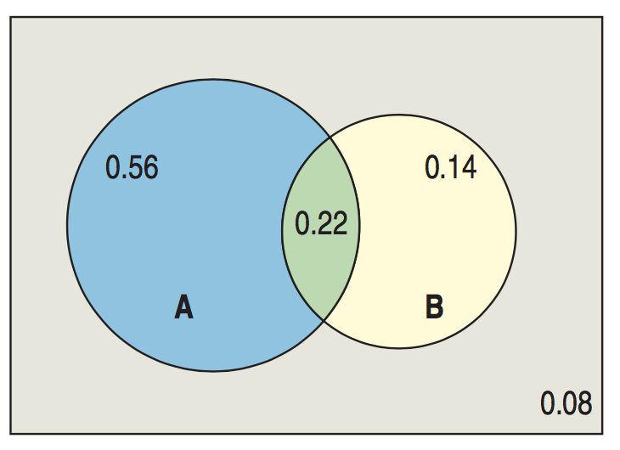
Lecture 09 | 101018
Picturing Probability
Tables
Venn Diagrams
Trees
CHOONG-WAN WOO | COCOAN lab | http://cocoanlab.github.io

Slide 13
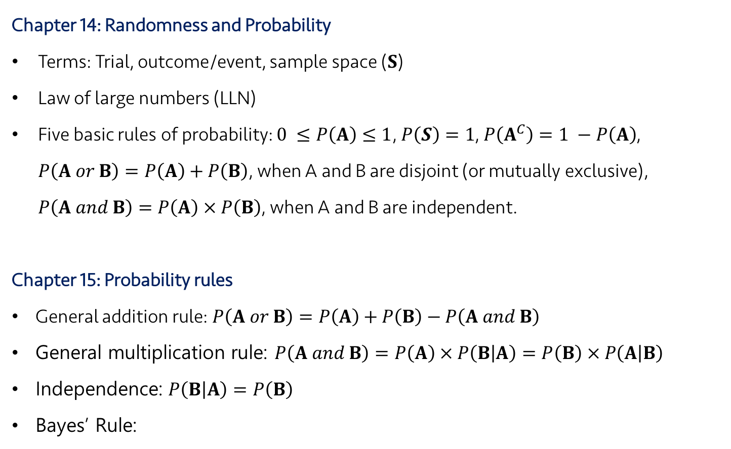
Lecture 09 | 101018
Key Points
Chapter 14: Randomness and Probability
Terms: Trial, outcome/event, sample space ($S$)
Law of large numbers (LLN)
Five basic rules of probability: $0 ≤P\left(A\right)≤1$, $P\left(S\right)=1$, $P\left(A^{C}\right)=1 −P\left(A\right)$, $P\left(A or B\right)=P\left(A\right)+P\left(B\right)$, when A and B are disjoint (or mutually exclusive), $P\left(A and B\right)=P\left(A\right) × P\left(B\right)$, when A and B are independent.
Chapter 15: Probability rules
General addition rule: $P\left(A or B\right)=P\left(A\right)+P\left(B\right)−P\left(A and B\right)$
General multiplication rule: $P\left(A and B\right)=P\left(A\right) × P\left(B | A\right)=P\left(B\right) × P\left(A | B\right)$
Independence: $P\left(B | A\right)=P\left(B\right)$
Bayes’ Rule:
CHOONG-WAN WOO | COCOAN lab | http://cocoanlab.github.io

Slide 14
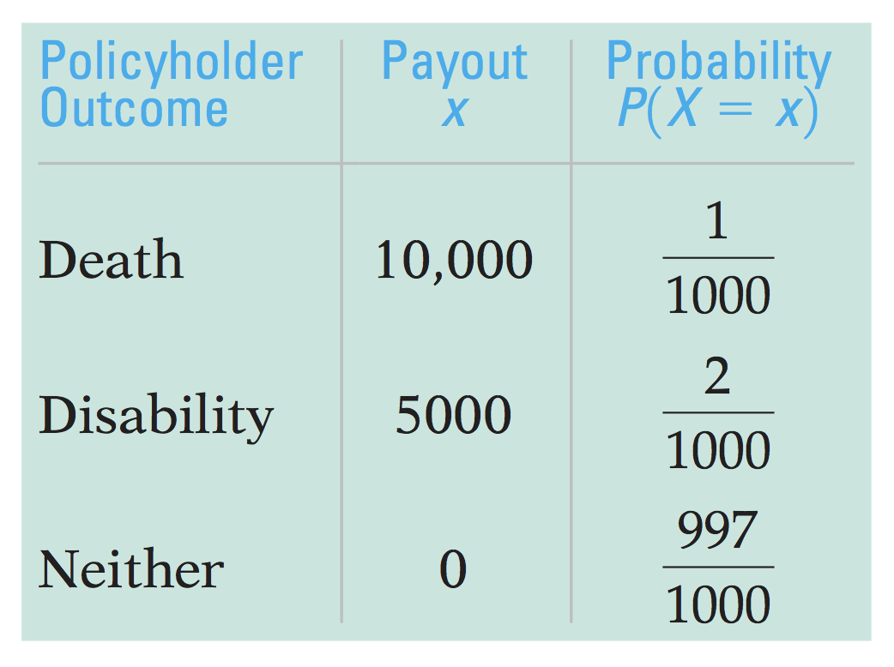
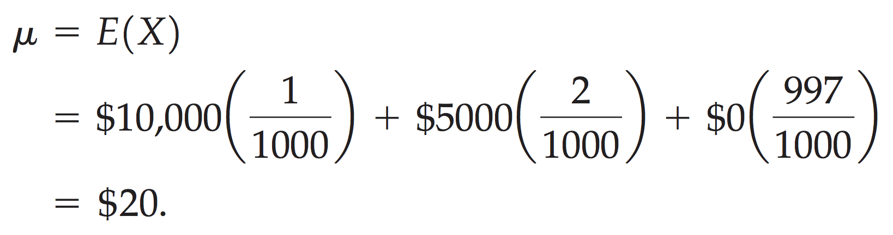
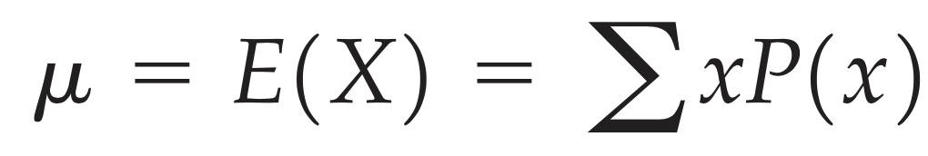
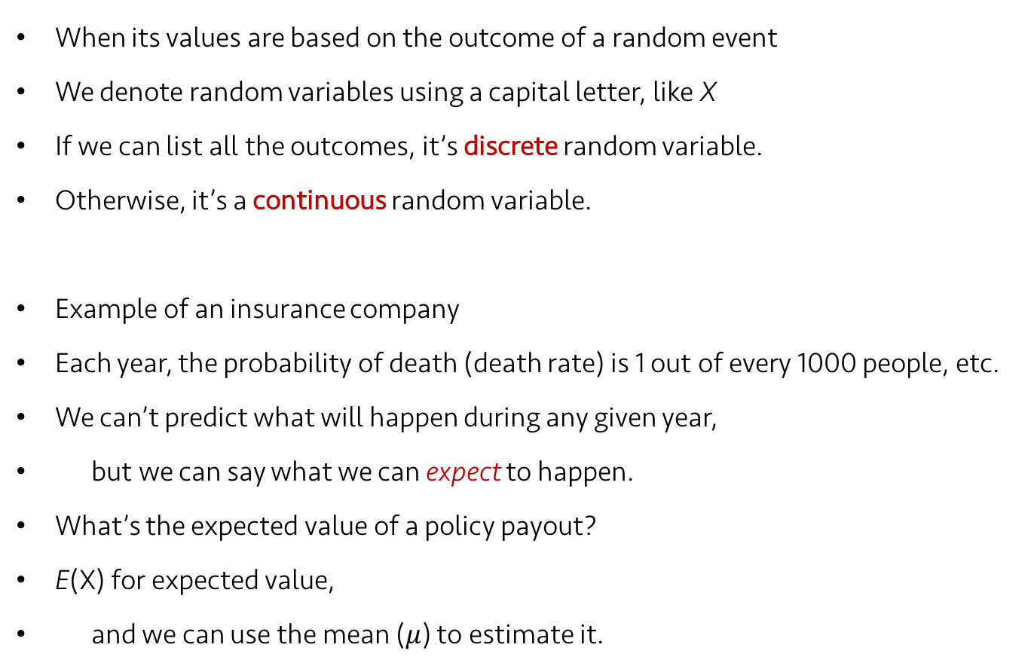
Lecture 09 | 101018
Random Variables
When its values are based on the outcome of a random event
We denote random variables using a capital letter, like X
If we can list all the outcomes, it’s discrete random variable.
Otherwise, it’s a continuous random variable.
Example of an insurance company
Each year, the probability of death (death rate) is 1 out of every 1000 people, etc.
We can’t predict what will happen during any given year,
but we can say what we can expect to happen.
What’s the expected value of a policy payout?
E(X) for expected value,
and we can use the mean ($μ$) to estimate it.
(for discrete random variables)
CHOONG-WAN WOO | COCOAN lab | http://cocoanlab.github.io

Slide 15

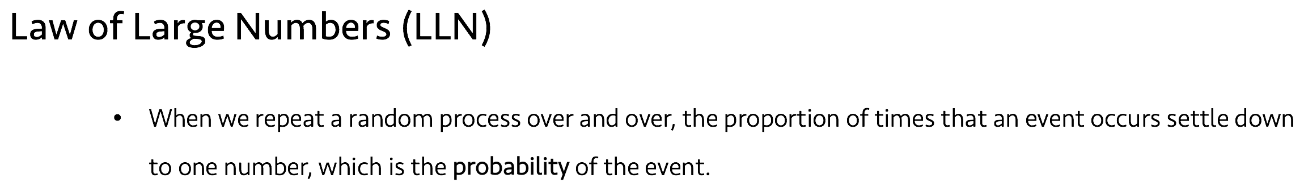
Lecture 09 | 101018
Is this based on data?
Yes, and no.
Mean for data:
Mean for random variables:
What’s differences?
Probability conveys the information about population.
Remember the law of large numbers.. The probability assumes a large number of repeats.
CHOONG-WAN WOO | COCOAN lab | http://cocoanlab.github.io

Slide 16
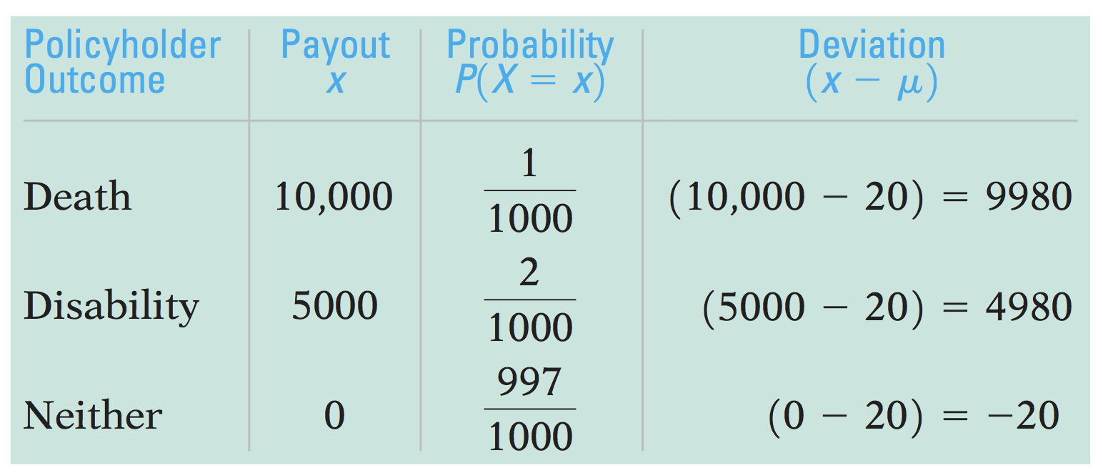
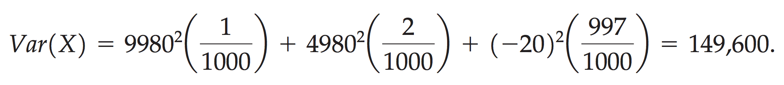
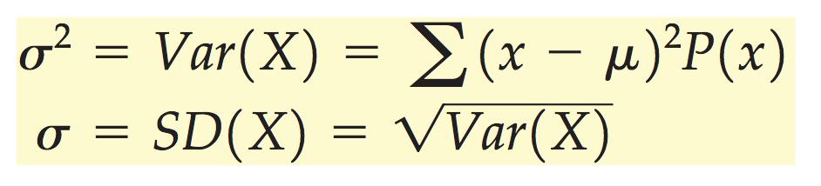
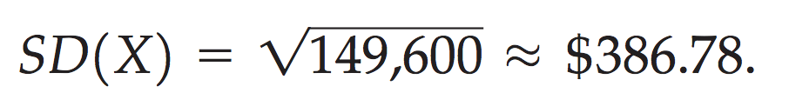
Lecture 09 | 101018
Spread: Standard deviation
Similar to the data case, we first calculate deviation from the mean and square it.
Example of the insurance company again:
The variance is the expected value of those squared deviations:
Its square root is standard deviation:
CHOONG-WAN WOO | COCOAN lab | http://cocoanlab.github.io

Slide 17
Lecture 09 | 101018
Key Points
Chapter 16 (not finished yet): Random variables
Discrete vs. continuous random variables
Expected values (mean):
Here, probability conveys the information about population assuming a large number of repeats
Spread:
To be continued!
CHOONG-WAN WOO | COCOAN lab | http://cocoanlab.github.io

