Slide 1


GBME Probability and Statistics | Fall 2018
Lecture 06 | 091918
Lecture 06
Linear regression
CHOONG-WAN WOO | COCOAN lab | http://cocoanlab.github.io

Slide 2
Lecture 06 | 091918
Review: Key Points
Chapter 7: Scatterplots, Correlation
Scatterplots (direction, form, strength, outliers)
x- and y-variables: explanatory/independent vs. response/dependent variables
Correlation: strength and direction
Assumptions and conditions:
Quantitative variables condition
Straight enough condition
No outliers condition
Non-parametric correlations: Kendall’s tau, Spearman’s rho
Correlation ≠ Causation
Correlation table/matrix
CHOONG-WAN WOO | COCOAN lab | http://cocoanlab.github.io

Slide 3
Lecture 06 | 091918
Analysis flowchart for relationships
DV
Predictors
Analysis
Correlation
continuous
General Linear Model
Regression
continuous
T-test
categorical
ANOVA
continuous
Logistic regression
categorical
categorical
Chi square
Slide from Tor Wager
CHOONG-WAN WOO | COCOAN lab | http://cocoanlab.github.io

Slide 4
Lecture 06 | 091918
We need more than correlation!
Correlation only tells us the strength of a linear relationship.
Correlation doesn’t tell us what the line is.
We need a linear model!!
Simple regression
Mathematical model for describing a linear relationship between an explanatory variable, x, and a response variable, y.
It is a straight line that describes how y changes with x.
It can be used to predict the value of y for a given value of x.
CHOONG-WAN WOO | COCOAN lab | http://cocoanlab.github.io

Slide 5
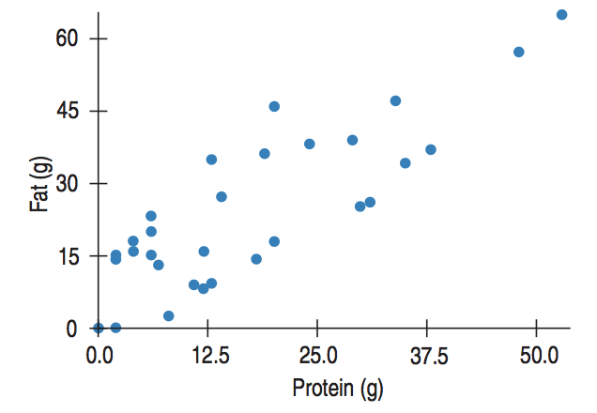

Lecture 06 | 091918
Least squares: The Line of “Best Fit”
Predicted value,
$$\hat{y}$$
Observed value, y
x
CHOONG-WAN WOO | COCOAN lab | http://cocoanlab.github.io

Slide 6
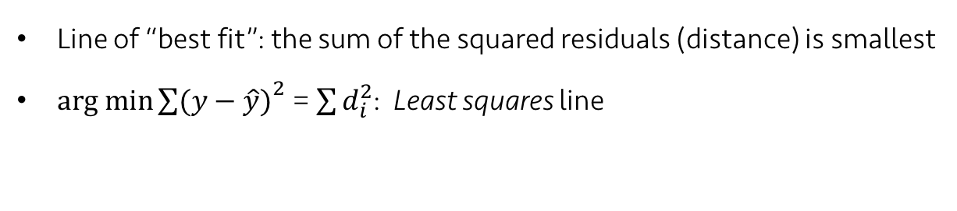
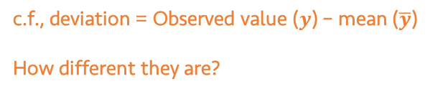
Lecture 06 | 091918
Least squares: The Line of “Best Fit”
residual = Observed value ($y$) – Predicted value ($\hat{y}$)
c.f., deviation = Observed value ($y$) – mean ($\overline{y}$)
How different they are?
x
Line of “best fit”: the sum of the squared residuals (distance) is smallest
$arg min{\sum{(y−\hat{y})}}^{2}$ = $\sum{d_{i}^{2}}$: Least squares line
CHOONG-WAN WOO | COCOAN lab | http://cocoanlab.github.io

Slide 7

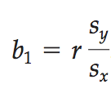

Lecture 06 | 091918
Linear Model
b: coefficients
b₁: slope
b₀: intercept
Slope,
Correlations do not have units, but slopes have units.
Standard deviation as a ruler!
Intercept,
CHOONG-WAN WOO | COCOAN lab | http://cocoanlab.github.io

Slide 8
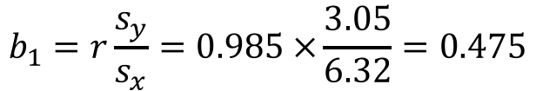
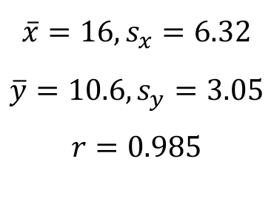
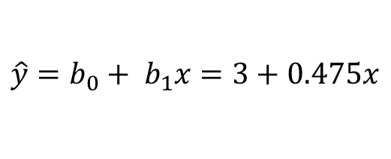
Lecture 06 | 091918
Example: Sleep Study
Sleep deprivation and study can have more errors
Errors | 7 | 8 | 11 | 13 | 14
Hours without sleep | 8 | 12 | 16 | 20 | 24
y
x
$$\overline{x}=16, s_{x}=6.32$$
$$\overline{y}=10.6, s_{y}=3.05$$
$$r=0.985$$
$$b_{1}=r\frac{s_{y}}{s_{x}}=0.985 ×\frac{3.05}{6.32}=0.475$$
$$b_{0}=\overline{y}−b\overline{x}=10.6−0.475×16=3$$
Least-squares regression line:
$$\hat{y}=b_{0}+ b_{1}x=3+0.475x$$
Slide from Martin Lindquist
CHOONG-WAN WOO | COCOAN lab | http://cocoanlab.github.io

Slide 9
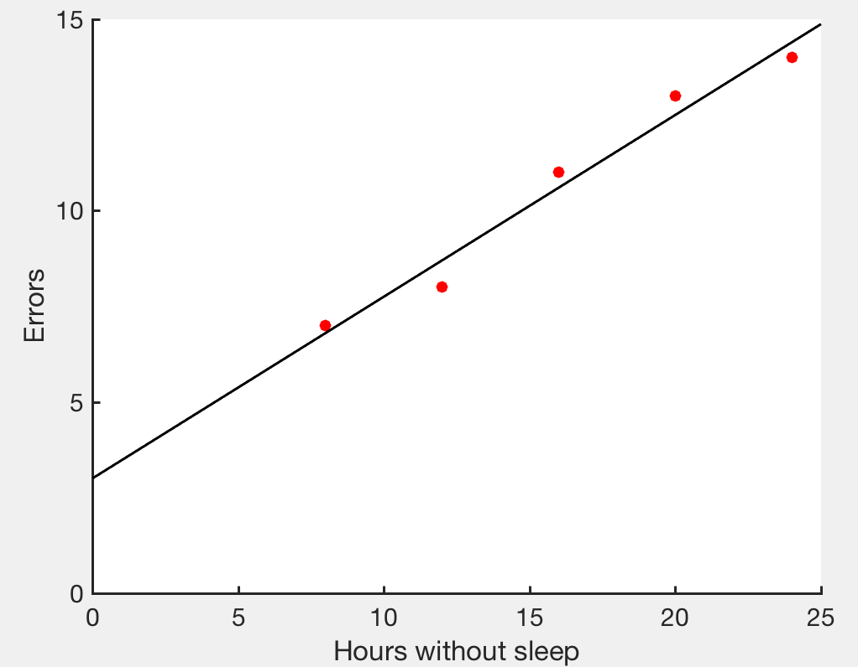
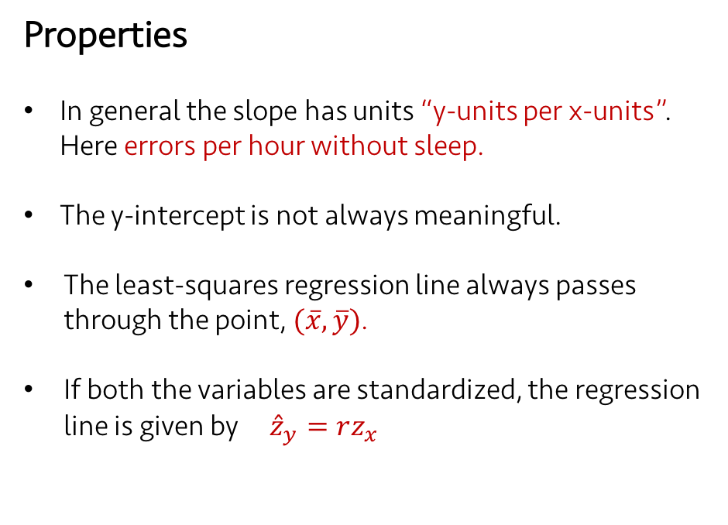
Lecture 06 | 091918
Example: Sleep Study
Properties
In general the slope has units “y-units per x-units”. Here errors per hour without sleep.
The y-intercept is not always meaningful.
The least-squares regression line always passes through the point, $(\overline{x}, \overline{y})$.
If both the variables are standardized, the regression line is given by ${\hat{z}}_{y}=rz_{x}$
Least-squares regression line:
$$\hat{y}=b_{0}+ b_{1}x=3+0.475x$$
Slide from Martin Lindquist
CHOONG-WAN WOO | COCOAN lab | http://cocoanlab.github.io

Slide 10
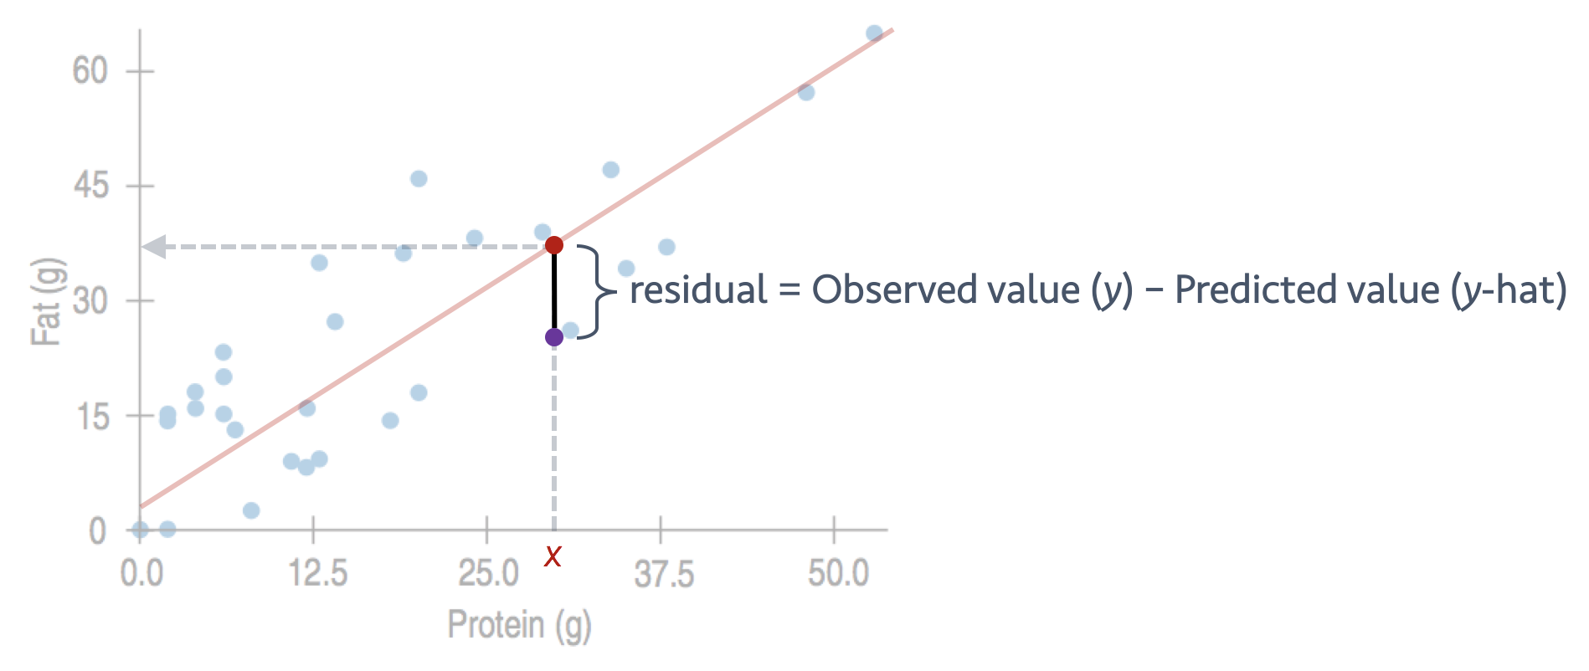
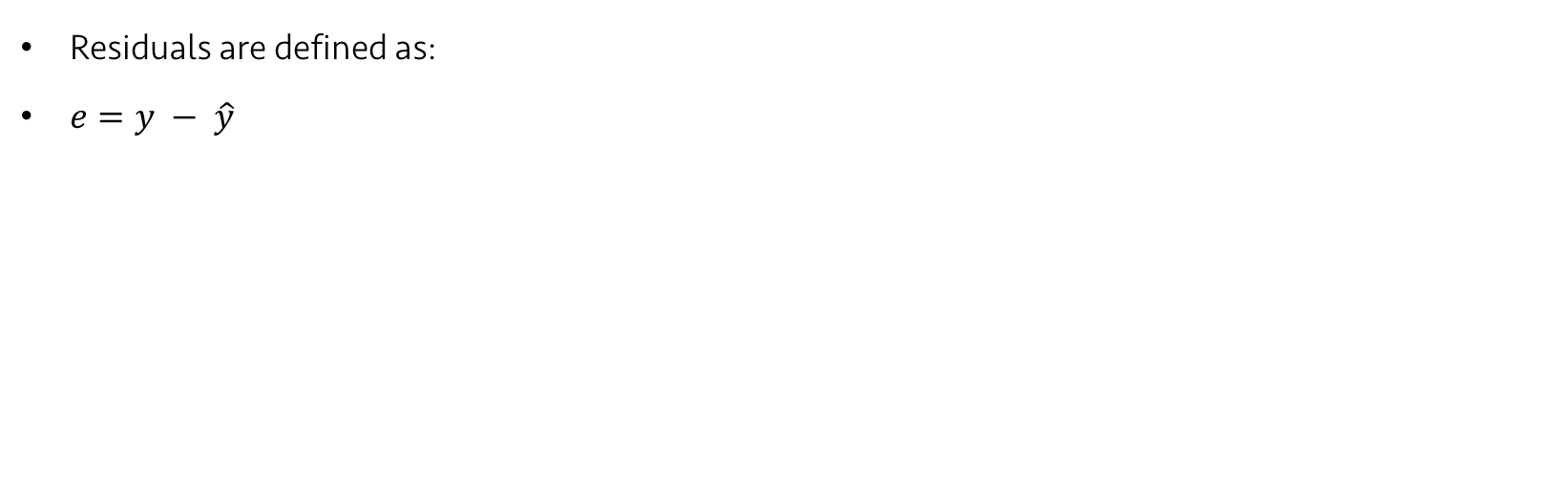
Lecture 06 | 091918
Examining the residuals
Residuals are defined as:
$e=y − \hat{y}$
CHOONG-WAN WOO | COCOAN lab | http://cocoanlab.github.io

Slide 11
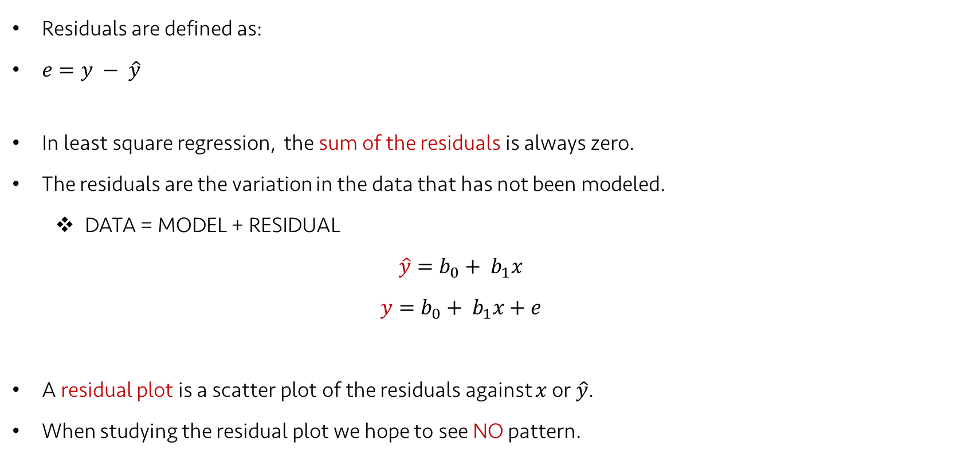
Lecture 06 | 091918
Examining the residuals
Residuals are defined as:
$e=y − \hat{y}$
In least square regression, the sum of the residuals is always zero.
The residuals are the variation in the data that has not been modeled.
DATA = MODEL + RESIDUAL
$$\hat{y}=b_{0}+ b_{1}x$$
$$y=b_{0}+ b_{1}x+e$$
A residual plot is a scatter plot of the residuals against $x$ or $\hat{y}$.
When studying the residual plot we hope to see NO pattern.
Slide partly from Martin Lindquist
CHOONG-WAN WOO | COCOAN lab | http://cocoanlab.github.io

Slide 12
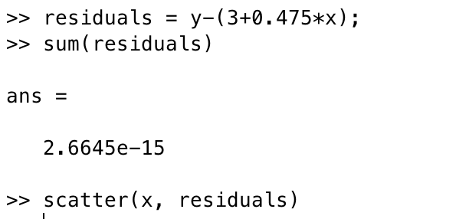
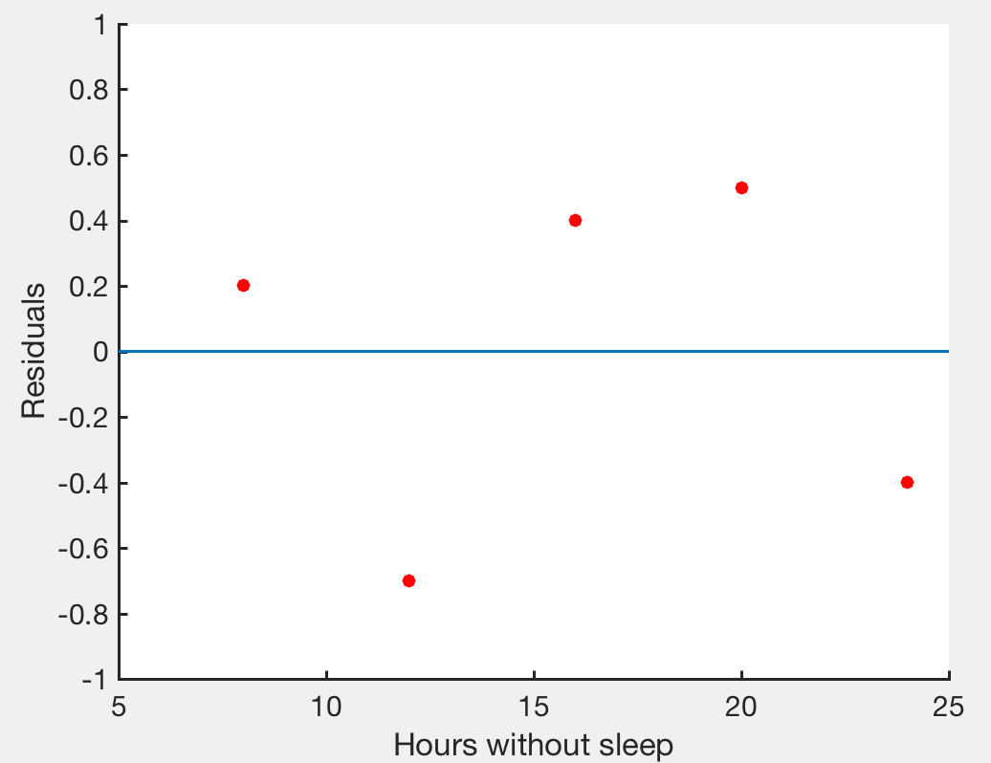
Lecture 06 | 091918
Examining the residuals: Sleep study
Errors | 7 | 8 | 11 | 13 | 14
Hours without sleep | 8 | 12 | 16 | 20 | 24
The sum of the residuals is zero.
should be the most boring scatterplot you’ve ever seen!
shouldn’t have any interesting features, direction or shape
should stretch horizontally, with about same amount of scatter throughout
No bends, no outliers
CHOONG-WAN WOO | COCOAN lab | http://cocoanlab.github.io

Slide 13
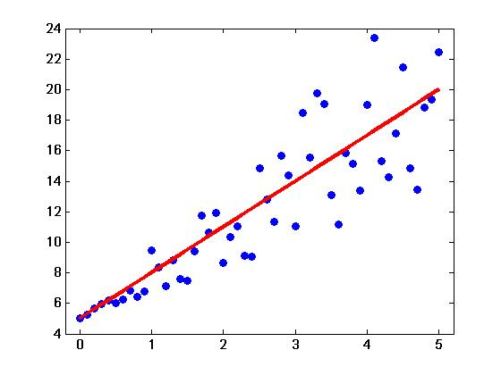
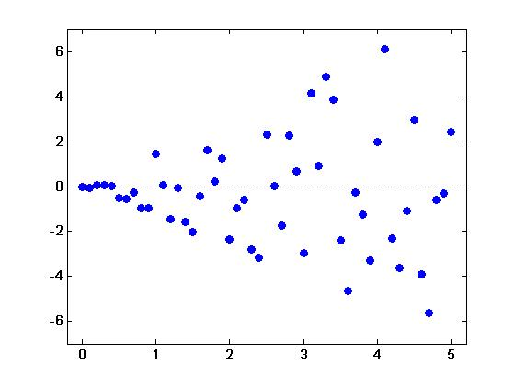

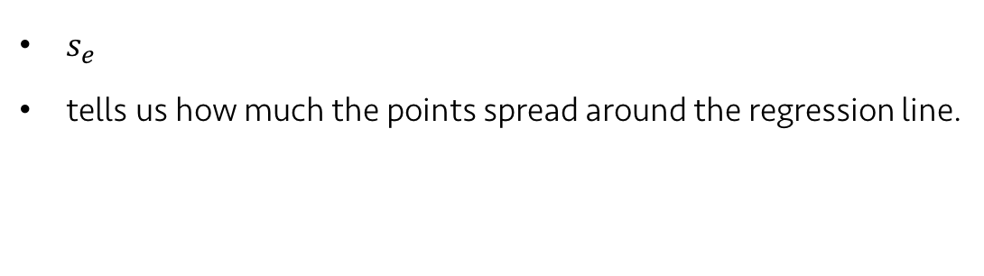
Lecture 06 | 091918
Residual standard deviation
$s_{e}$
tells us how much the points spread around the regression line.
$$s_{e}=\sqrt{\frac{\sum{e^{2}}}{n−2}}$$
Revisit: Correlation assumptions and conditions
Quantitative variables condition
Straight enough condition
No outliers condition
In regression, one more condition:
Does the Plot Thicken? Condition
Equal variance assumption
The spread around the line should not increase as x or the predicted values increase.
CHOONG-WAN WOO | COCOAN lab | http://cocoanlab.github.io

Slide 14
Lecture 06 | 091918
Regression Assumptions and Conditions
Quantitative Variable Condition
Straight Enough Condition
Outlier Condition
Does the Plot Thicken? Condition
Examining residual plots:
No bends (Straight Enough Condition)
No outlier (Outlier Condition): “examine points with large residuals”
No changes in the spread (Does the Plot Thicken? Condition)
CHOONG-WAN WOO | COCOAN lab | http://cocoanlab.github.io

Slide 15
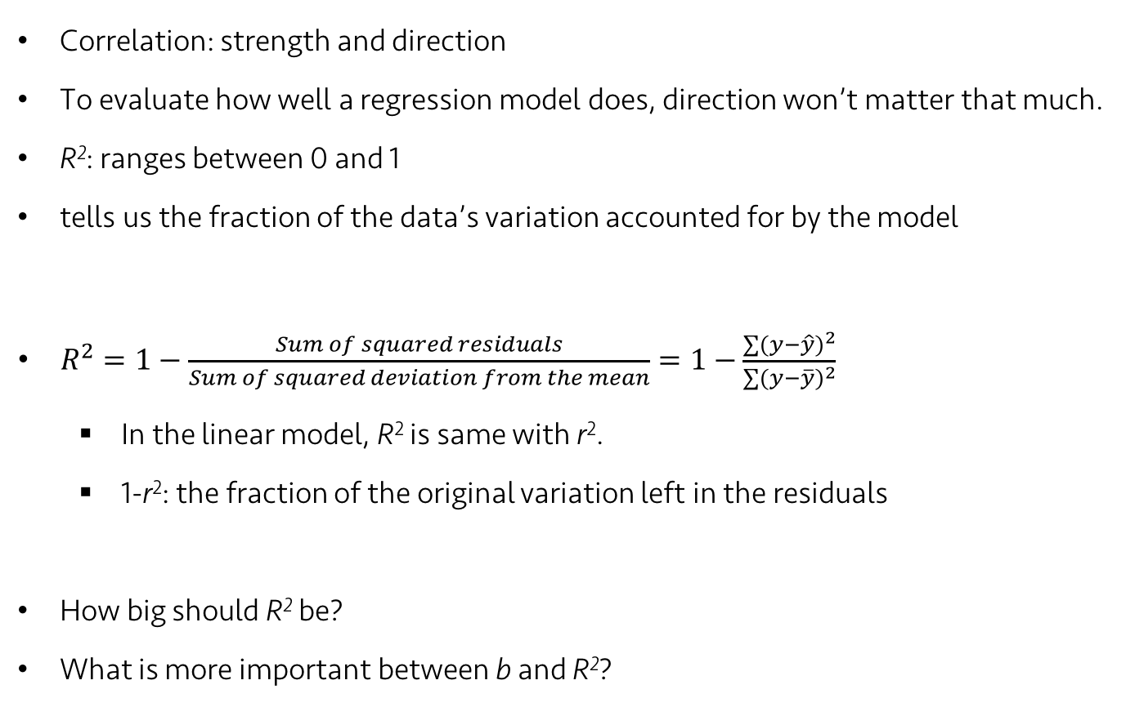
Lecture 06 | 091918
Assessing regression model: R²
Correlation: strength and direction
To evaluate how well a regression model does, direction won’t matter that much.
R²: ranges between 0 and 1
tells us the fraction of the data’s variation accounted for by the model
$R^{2}=1−\frac{Sum of squared residuals}{Sum of squared deviation from the mean}=1−\frac{\sum{{(y−\hat{y})}^{2}}}{\sum{{(y−\overline{y})}^{2}}}$
In the linear model, R² is same with r².
1-r²: the fraction of the original variation left in the residuals
How big should R² be?
What is more important between b and R²?
It depends! Data type, field, etc.
It depends! Data type, field, research question, etc.
CHOONG-WAN WOO | COCOAN lab | http://cocoanlab.github.io

Slide 16
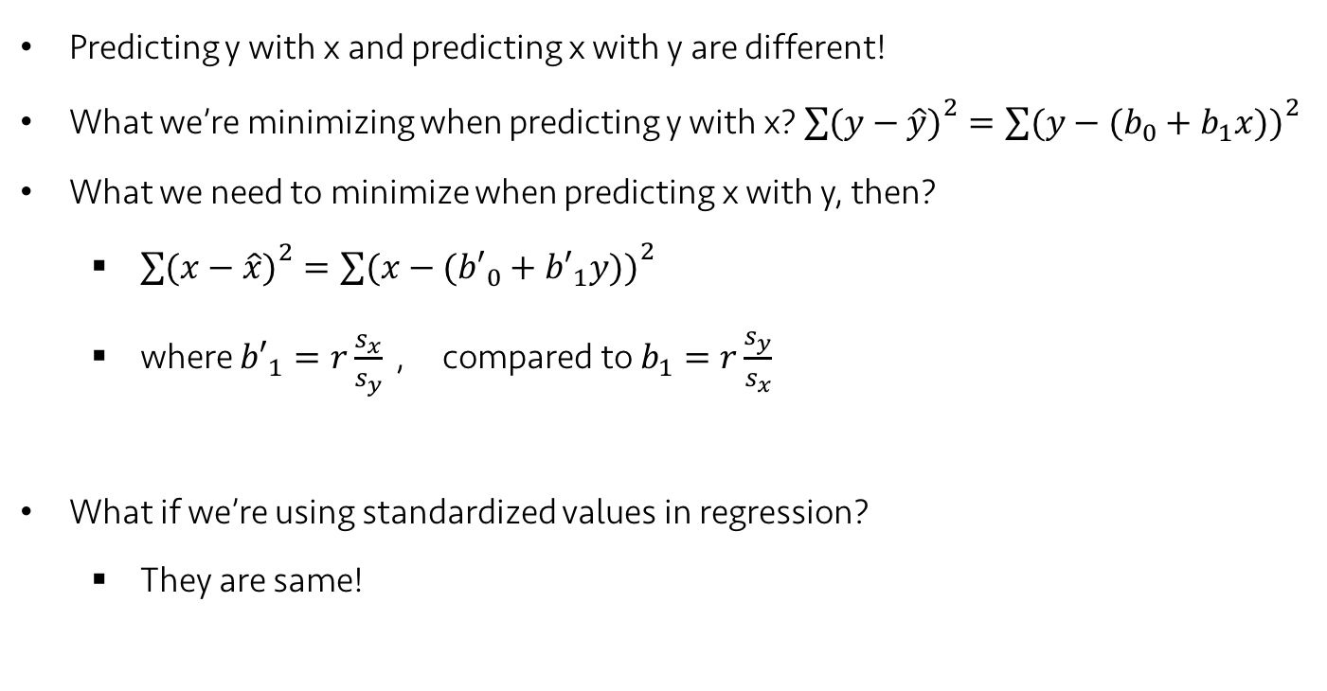
Lecture 06 | 091918
Predicting in the Other Direction
Predicting y with x and predicting x with y are different!
What we’re minimizing when predicting y with x? ${\sum{(y−\hat{y})}}^{2}={\sum{(y−(b_{0}+b_{1}x))}}^{2}$
What we need to minimize when predicting x with y, then?
${\sum{(x−\hat{x})}}^{2}={\sum{(x−({b′}_{0}+{b′}_{1}y))}}^{2}$
where ${b′}_{1}=r\frac{s_{x}}{s_{y}}$ , compared to $b_{1}=r\frac{s_{y}}{s_{x}}$
What if we’re using standardized values in regression?
They are same!
CHOONG-WAN WOO | COCOAN lab | http://cocoanlab.github.io

Slide 17
Lecture 06 | 091918
Regression to the mean
Study design
“Drug study”: treatment effects of anxiety and depression
Session 1
Session 2
Assessment:
Depression
inventory
Treatment:
6 wks flumazenil
Outcome:
Depression
inventory
Select a group of severely depressed patients based on Session 1
Compare Session 1 vs. Session 2 to see if patients improve after treatment
Slide from Tor Wager
CHOONG-WAN WOO | COCOAN lab | http://cocoanlab.github.io

Slide 18
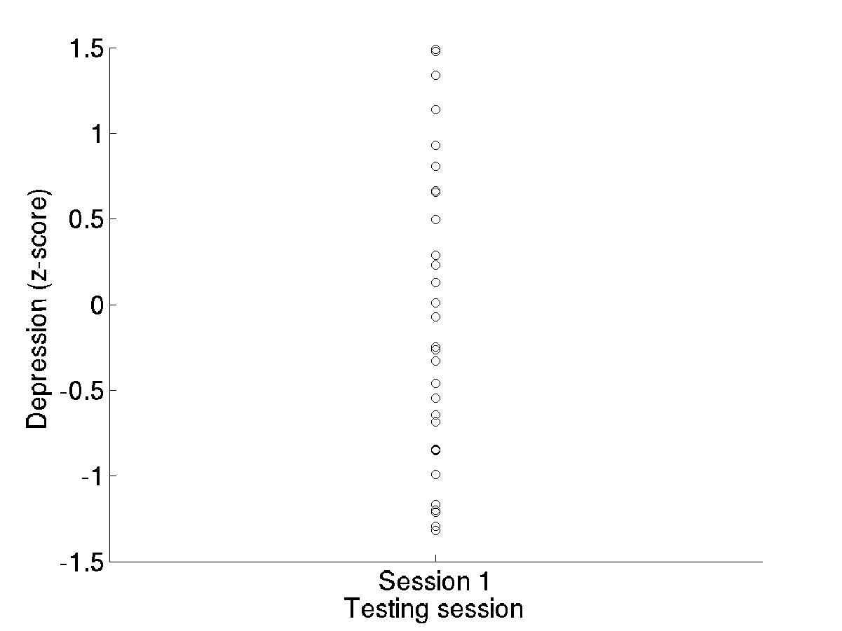
Lecture 06 | 091918
Regression to the mean
Variability = depression + noise
“Drug study”: treatment effects of anxiety and depression
High because of true depression, or measurement error?
There is variability, as in any dataset
If it’s ‘signal’, high depression scores will remain higher
If it’s measurement error (noise), high depression scores will drop and low scores will increase.
Let’s see what happens to those points during session 2.
Slide from Tor Wager
CHOONG-WAN WOO | COCOAN lab | http://cocoanlab.github.io

Slide 19
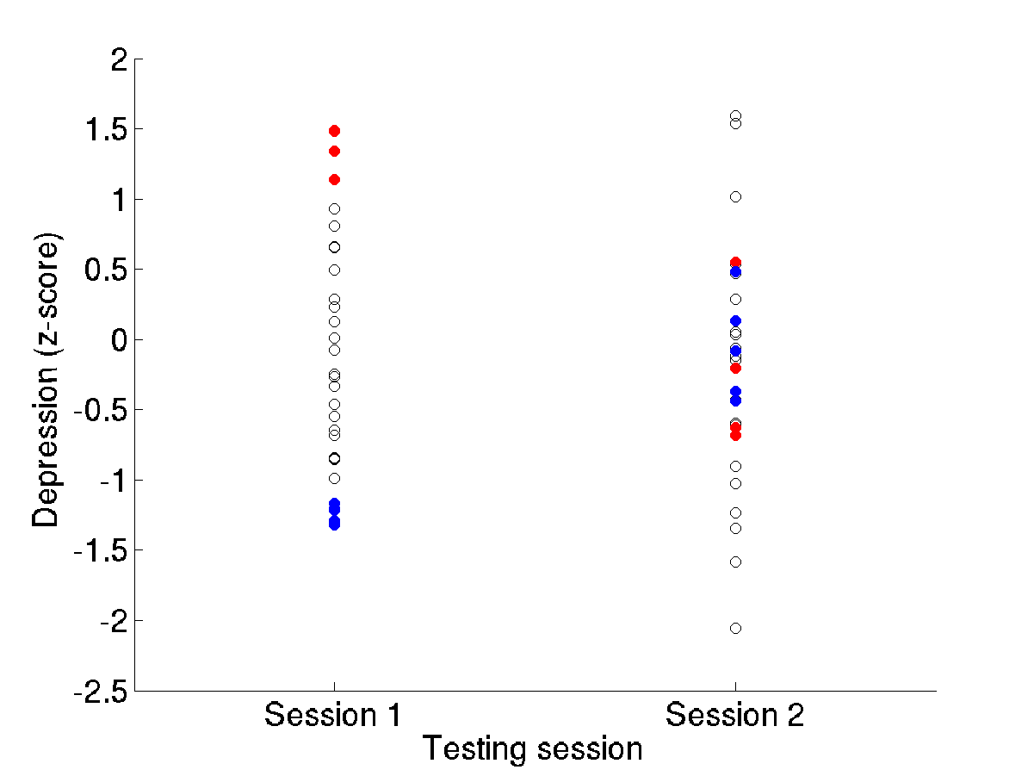
Lecture 06 | 091918
Regression to the mean
Variability = depression + noise
Simulation, assuming all variability is measurement error
The red (high) points drop
The blue (low) points increase
Noise caused the extreme scores to become less extreme, to ‘regress’ toward the mean value
Thus: the more noise, the more regression to the mean
Slide from Tor Wager
CHOONG-WAN WOO | COCOAN lab | http://cocoanlab.github.io

Slide 20
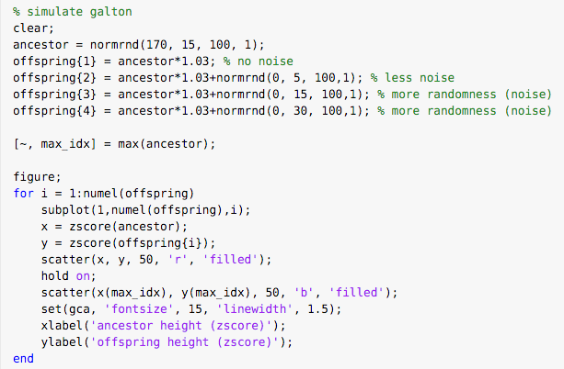
Lecture 06 | 091918
Regression to the mean: another example
Simulation Galton’s example:
CHOONG-WAN WOO | COCOAN lab | http://cocoanlab.github.io

Slide 21
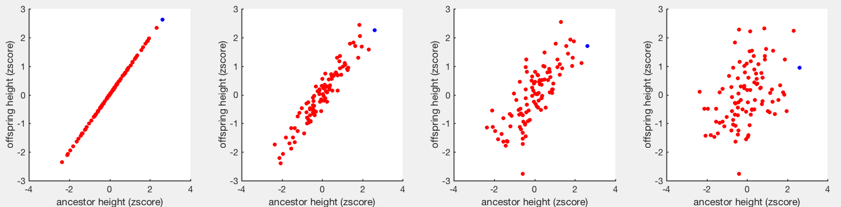
Lecture 06 | 091918
Regression to the mean: another example
Simulation Galton’s example:
Regression to the mean
No random effects to offsprings
High level of random noise
CHOONG-WAN WOO | COCOAN lab | http://cocoanlab.github.io

Slide 22
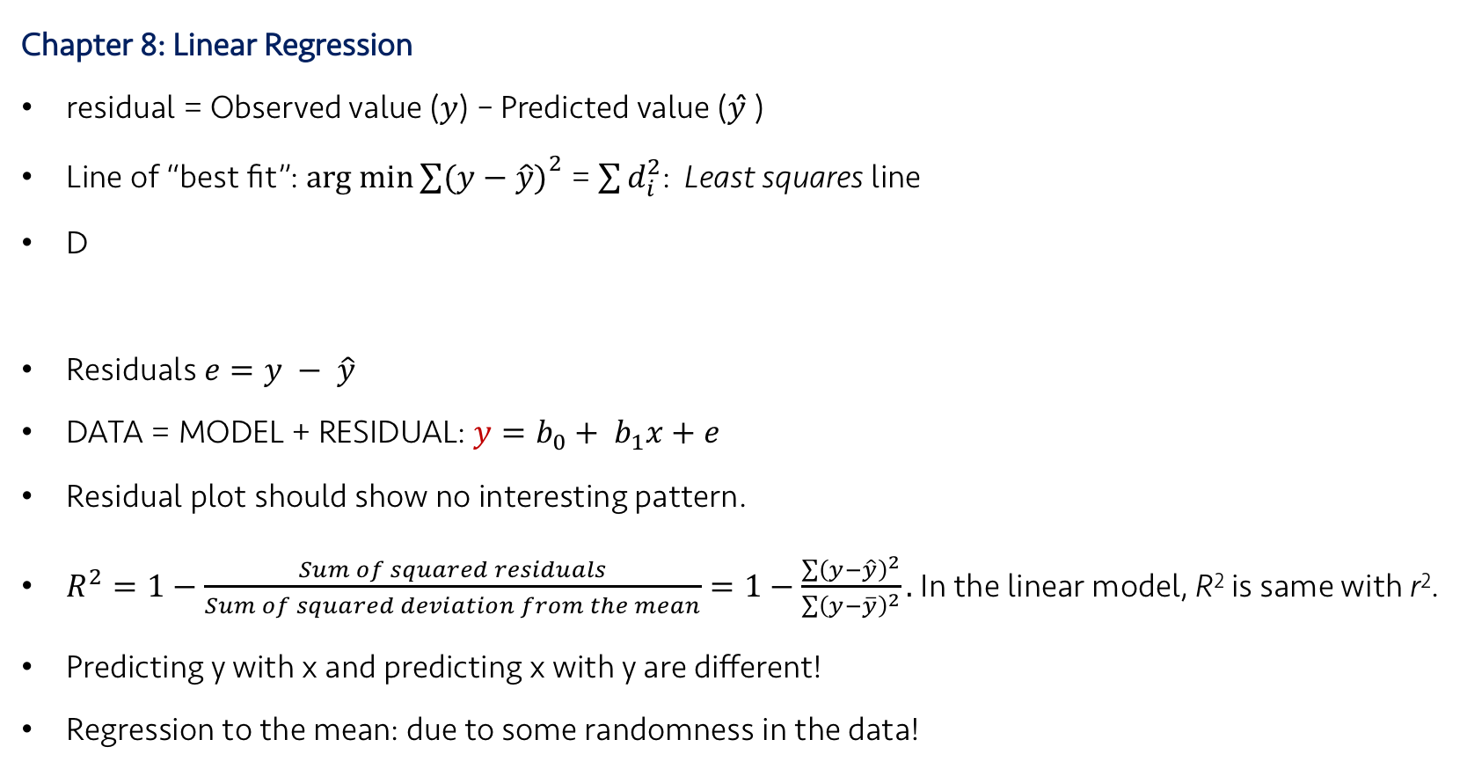
Lecture 06 | 091918
Key Points
Next class:
Chapter 9 and 10: Regression wisdom, re-expressing data
Chapter 8: Linear Regression
residual = Observed value (𝑦) – Predicted value (𝑦 ̂)
Line of “best fit”: $arg min{\sum{(y−\hat{y})}}^{2}$ = $\sum{d_{i}^{2}}$: Least squares line
D
Residuals $e=y − \hat{y}$
DATA = MODEL + RESIDUAL: $y=b_{0}+ b_{1}x+e$
Residual plot should show no interesting pattern.
$R^{2}=1−\frac{Sum of squared residuals}{Sum of squared deviation from the mean}=1−\frac{\sum{{\left(y−\hat{y}\right)}^{2}}}{\sum{{\left(y−\overline{y}\right)}^{2}}}.$In the linear model, R² is same with r².
Predicting y with x and predicting x with y are different!
Regression to the mean: due to some randomness in the data!
Slope,
Intercept,
CHOONG-WAN WOO | COCOAN lab | http://cocoanlab.github.io

