Slide 1
Rating system for food item ( Data from Kaggle )
Term Project Final
Member : 컴퓨터학과 2013210107 김정수

Slide 2
Project Goal
After watching the reviews, give a score to the item.
→ predict good/bad review.
Reviews
I love, and use the empty containers…
I keep a case of these in my office…
Don't buy just a few of these!
Rating (1~5)
Good / Bad

Slide 3
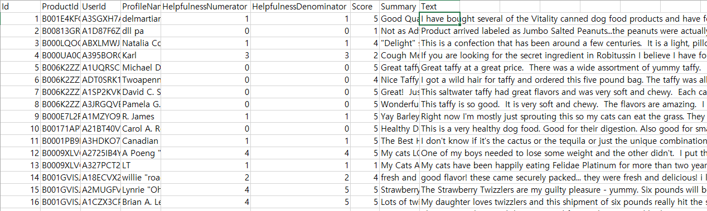
Data Corpus
Use Amazon Fine Food Reviews
Helpfulness – compute how reliable the data is.
Summary, text – input data. Text of the review.
Score(rate) – output. label of data. ( range 1~5 ) → Good / Bad

Slide 4
Process
Choose only valid data which is decided by using helpfulness. = filter out unreliable data.
→ not enough valid helpfulness data
Rating 1~3 → Bad
Rating 4~5 → Good
Use Bag Of Words.
For each Review, we have a label Good or Bad.
Good
Good flavor! I will eat this again….
Bad
I will return this food. Very disappointed…
But it just count how many the word
is appeared in same label reviews.. Next page I explain about it.

Slide 5

Bag of Words ( problem )
It process well, but it just recognizes each data separately.
Ex) ‘not bad’ means ‘good’
but the BOW take ‘not’ and ‘bad’
so, label become closer to bad

Slide 6
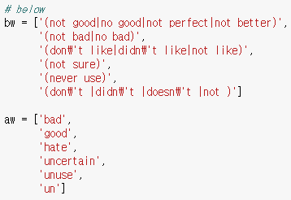
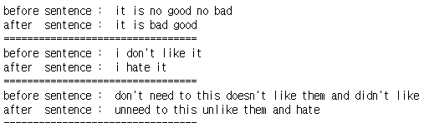
Bag of Words ( solution )
Make a dictionary which contain before word and after word.
It will change combination of words to a same meaning word.
But accuracy does not become better..
88.52% → 88.53%
I think the more data of before and after is needed To make the accuracy become better.

Slide 7
Evaluation
BOW do not consider combination of words. I used some method to solve it, but accuracy did not become better.
I think the solution of this situation is
Enough data of become and after words.
(= information of words combination)

