Slide 1
POWER POINT PRESENTATION
PowerPoint is a computer program created by Microsoft Office
Enjoy your stylish business and campus life with BIZCAM
○ ○ 대학교 경영학과 20171234 홍 길 동

Slide 2
POWER POINT PRESENTATION
Microsoft Office PowerPoint
PowerPoint is a computer program
created by Microsoft Office
Enjoy your stylish business and
campus life with BIZCAM
CONTENTS. A
Microsoft Office PowerPoint is the presentation program used the most in the world.
CONTENTS. A
Microsoft Office PowerPoint
Microsoft Office PowerPoint
Microsoft Office
PowerPoint

Slide 3
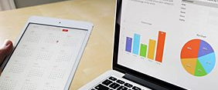

POWER POINT PRESENTATION
Check point
Microsoft Office PowerPoint is the presentation program used the most in the world.
CONTENTS A
▶
CONTENTS B
▶
CONTENTS C
▶
CONTENTS D
▶
CONTENTS E
Microsoft Office PowerPoint is the presentation program used the most in the world.
Microsoft Office PowerPoint is the presentation program used the most in the world.

Slide 4
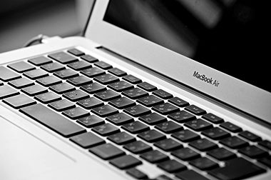
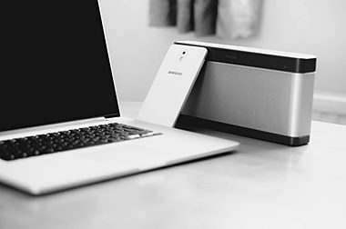
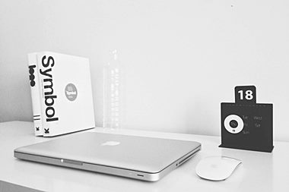
POWER POINT PRESENTATION
Microsoft Office PowerPoint is the presentation program used the most in the world.
Microsoft Office PowerPoint is the presentation program used the most in the world.
Microsoft Office PowerPoint is the presentation program used the most in the world.
70%
CONTENTS A
70%
CONTENTS A
70%
CONTENTS A

