Slide 2
0
1

Slide 3
POWER POINT PRESENTATION
PowerPoint is a computer program created by Microsoft Office Microsoft Office PowerPoint is the presentation program used the most in the world.

Slide 4
POWER POINT PRESENTATION
PowerPoint is a computer program created by Microsoft Office Microsoft Office PowerPoint is the presentation program used the most in the world.

Slide 5
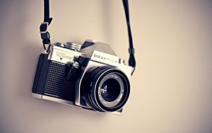


POWER POINT PRESENTATION
PowerPoint is a computer program created by Microsoft Office Microsoft Office PowerPoint is the presentation program used the most in the world.
Enjoy your stylish business and campus life with BIZCAM.
PowerPoint is a computer program created by Microsoft Office Microsoft Office PowerPoint is the presentation program used the most in the world.
CONTENTS 50%
CONTENTS A
컨텐츠에 대한 내용을 적어요
Enjoy your stylish business and campus life with BIZCAM

