Slide 1
RGB
95, 197, 220
RGB
67, 63, 113

Slide 2
POWER POINT PRESENTATION
PowerPoint is a computer program created by Microsoft Office Microsoft Office.
PowerPoint is the presentation program used the most in the world
○○대학교 경영학과 1234567 조땡

Slide 3
POWER POINT PRESENTATION
CONTENTS 50%
CONTENTS
컨텐츠에 대한 내용을 적어요
CONTENTS
컨텐츠에 대한 내용을 적어요
PowerPoint is a computer program created by Microsoft Office
Enjoy your stylish business and campus life with BIZCAM
CONTENTS 50%
CONTENTS
CONTENTS
CONTENTS
PowerPoint is a computer program created by Microsoft Office
Microsoft Office PowerPoint is the presentation program used the most in the world.
You can use a software program such as Microsoft Power Point to provide the audience
with slides that contains your major points or essential information.

Slide 4

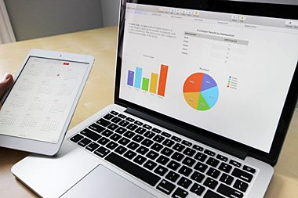

POWER POINT PRESENTATION
PowerPoint is a computer program created by Microsoft Office.
Microsoft Office PowerPoint is the presentation program used the most in the world.
CONTENTS. A
75%
CONTENTS. A
75%
PowerPoint is a computer program created by Microsoft Office.
Microsoft Office PowerPoint is the presentation program used the most in the world.
75% CONTENTS. A
CONTENTS. A 75%
PowerPoint is a computer program created by Microsoft Office.
Microsoft Office PowerPoint is the presentation program used the most in the world.
CONTENTS. A
75%
CONTENTS. A
75%
PowerPoint is a computer program created by Microsoft Office.
Microsoft Office PowerPoint is the presentation program used the most in the world.

Slide 5
POWER POINT PRESENTATION
STEP
1
2001
컨텐츠에 대한 내용을 적어요
PowerPoint is a computer program created by Microsoft Office
CONTENTS B
PowerPoint is a computer program created by Microsoft Office
Microsoft Office PowerPoint is the presentation program used the most in the world.
2001
컨텐츠에 대한 내용을 적어요
PowerPoint is a computer program created by Microsoft Office
2001
컨텐츠에 대한 내용을 적어요
PowerPoint is a computer program created by Microsoft Office
2001
컨텐츠에 대한 내용을 적어요
PowerPoint is a computer program created by Microsoft Office
CONTENTS B
PowerPoint is a computer program created by Microsoft Office
Microsoft Office PowerPoint is the presentation program used the most in the world.
CONTENTS

