Slide 1

POWER POINT
PRESENTATION
Enjoy your stylish business and campus life with BIZCAM

Slide 2
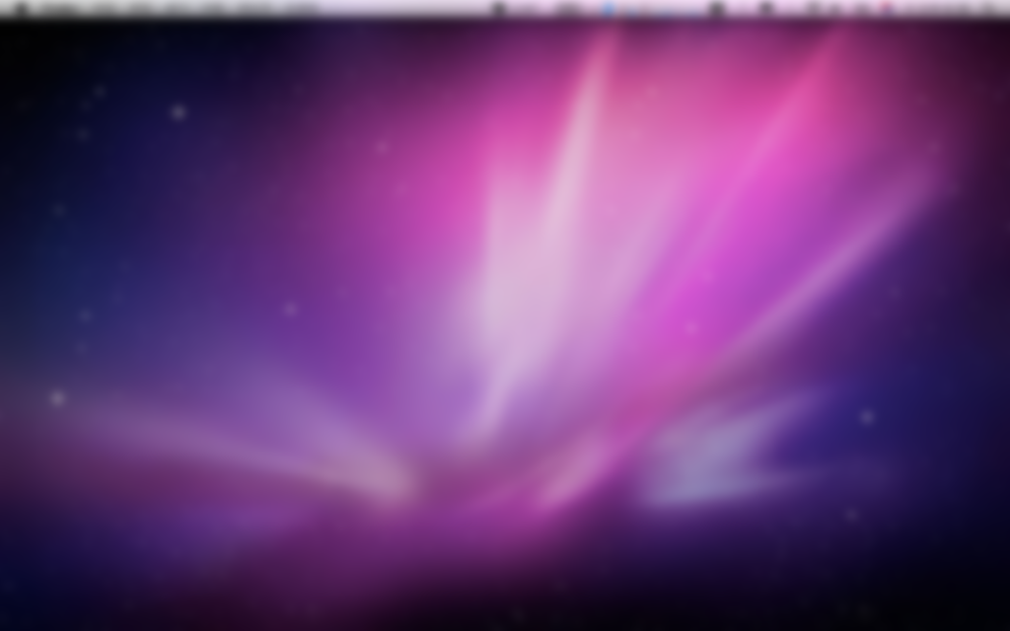
X
-
+
CONTENTS. 1
CONTENTS. 2
THE BIZCAM Management consultation report
CONTENTS 30%
CONTENTS 35%
CONTENTS
컨텐츠에 대한 내용을 적어요
PowerPoint is a computer program created by Microsoft Office
POWER POINT PRESENTATION
CONTENTS
컨텐츠에 대한 내용을 적어요
PowerPoint is a computer program created by Microsoft Office
CONTENTS
컨텐츠에 대한 내용을 적어요
PowerPoint is a computer program created by Microsoft Office
CONTENTS 7%
CONTENTS 8%
CONTENTS 20%

Slide 3




CONTENTS 50%
POWER POINT PRESENTATION
CONTENTS 45%
CONTENTS 45%
CONTENTS 35%
CONTENTS 30%
CONTENTS 20%

