Slide 1
Progress Presentation
Team Blue

Slide 2
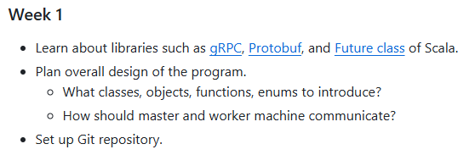
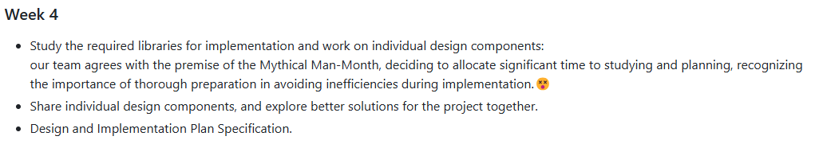
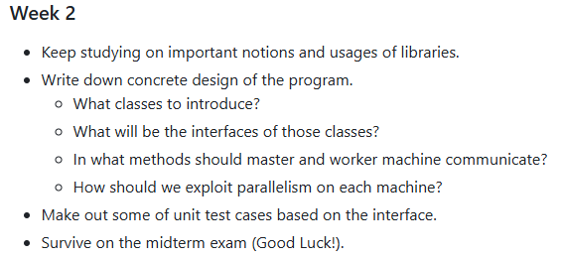
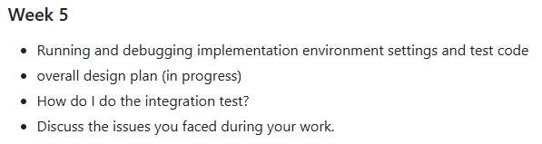
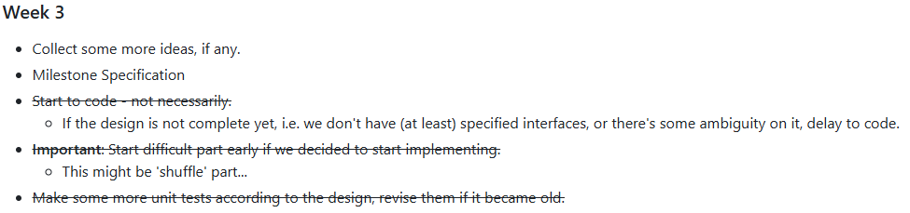
Filled with hope – Milestone week 1 to 5

Slide 3
Review of your weekly progress
Week 4
Decided to make sample program before starting to implementing
Assign roles for Chief Programmer, Copilots [Surgical Team Model]
Week 5
Overall Design of the System [Primary Design Completed]
IntelliJ SSH Connection and Deployment Setup
Shell Script for Master to Manage Worker Machines
Test Code for Master-Worker Communication
Presentation Preparation
Week 1
Set Git repository up.
Done some of documenting, such as writing down milestones.
Planned to have regular meeting on Saturday.
Week 2 [Midterm Week]
Learned Concepts and Libraries
E.g. gRPC, Protobuf, Scala’s Future, etc.
Week 3
Set git Commit convention
Re-establish communication Tools

Slide 4
Phases
A unit of procedure that must be executed in a designated order
How can a worker machine shuffle without sorting?
How can a worker machine merge without shuffling?
4 phases – Sort, Sample, Shuffle, Merge

Slide 5
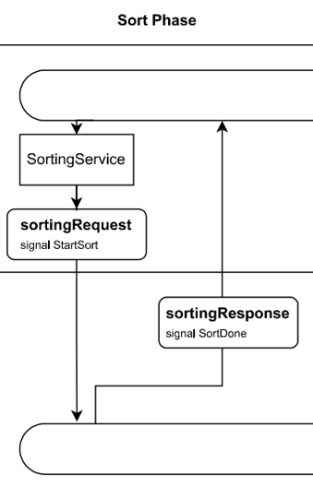
Sort Phase
A phase where each worker machine sorts its own set of records
Starts with the master’s start signal
(i.e. RPC with empty argument)
RPC returns future that indicates the end of the computation
Master
Workers

Slide 6
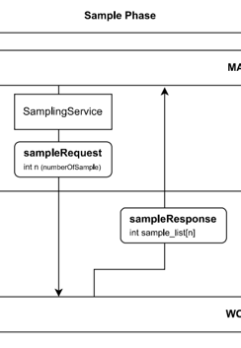
Sample Phase
A phase where each worker machine sends certain amount of samples to the master
Master calls remote procedure with the number of samples it wants
Worker returns a stream of sample records
Master
Workers

Slide 7
Shuffle Phase & Merge Phase
The phase where actual the record exchange between workers happens
By the record range given by the master, workers send & receive records
Then, they merges them into one sorted set of files

Slide 8
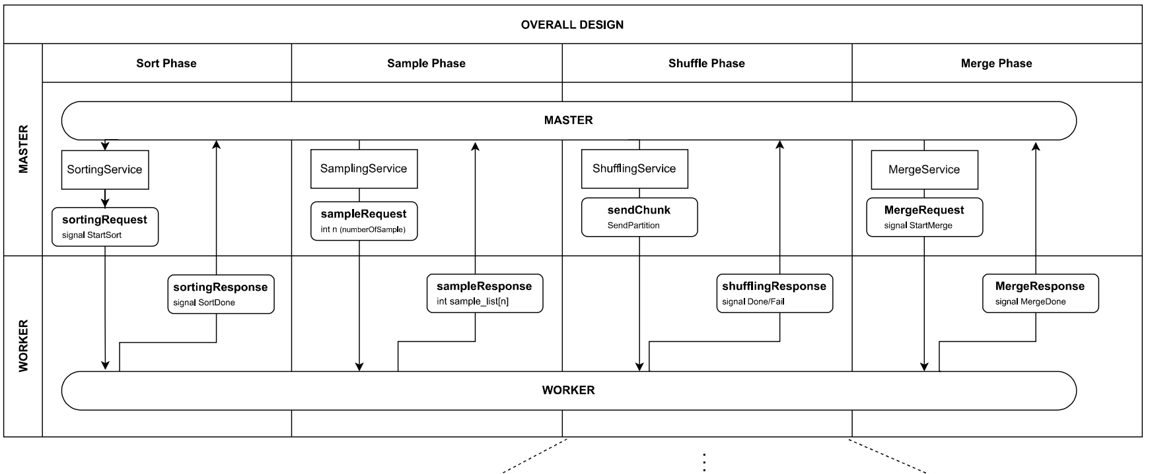
Design

Slide 9
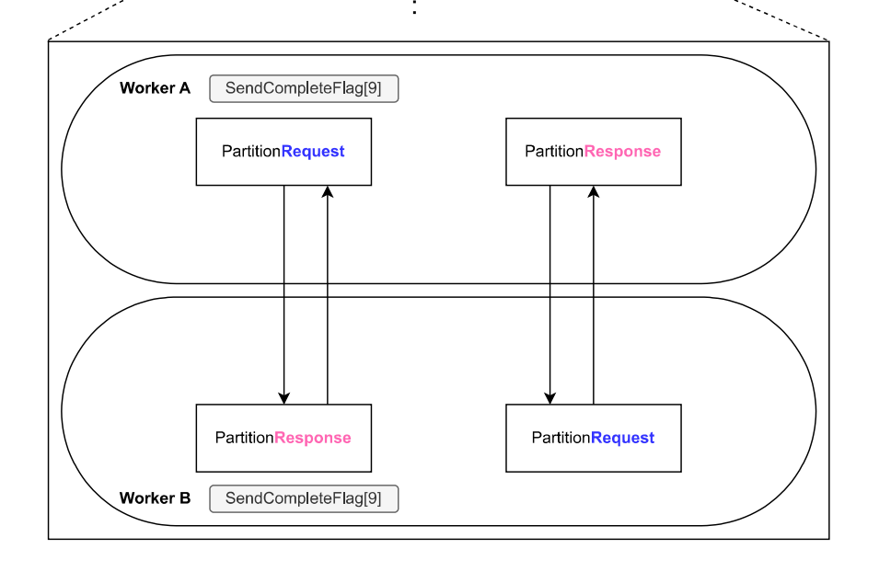
Design

Slide 10
Programming Environment
Java 8, sbt 1.10.2, Scala version 2.13.15
Some development tools (especially VSCode’s Metals plugin) do not support Scala 2.11.x, so decided to use the latest version of Scala 2
Others are just as usual

Slide 11
Libraries
gRPC w/ Protobuf, of course
ScalaPB for compiling .proto’s to Scala classes
os-lib for convenient and fancy file manipulation
scalatest as testing framework (similar to JUnit which we have used in the assignments!)
scala-logging for logging (just a wrapper to SLF4J)

Slide 12
Logistics
How do you communicate with each other?
카카오톡, In-person
How do you manage documentation and the git repository?
Google Docs, Git (Commit convention, branching with the name of the team member)
Who is responsible for what?
Chief Programmer : Doyoung KIM
Copilots : Duhong KWON, Soonho KIM

Slide 13
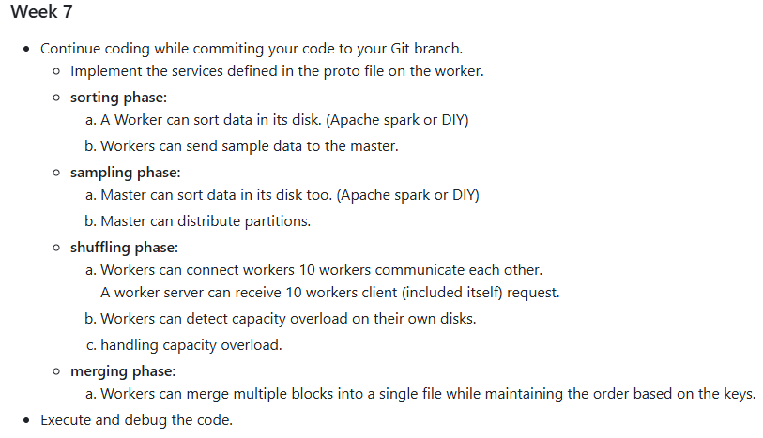
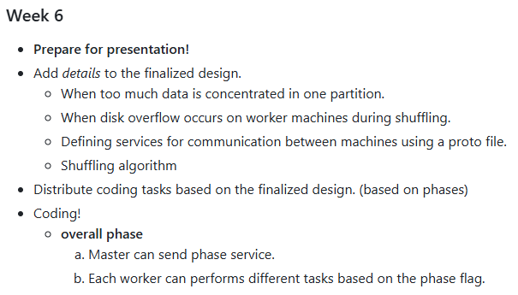
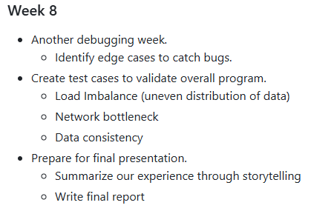
Progress – Milestones

Slide 14
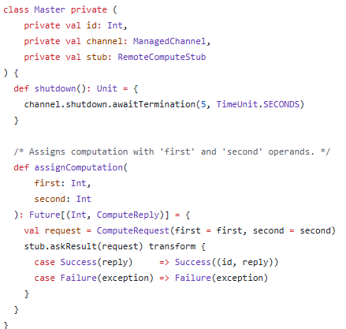
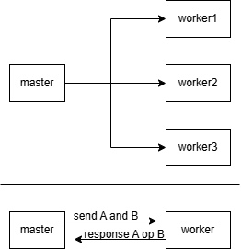
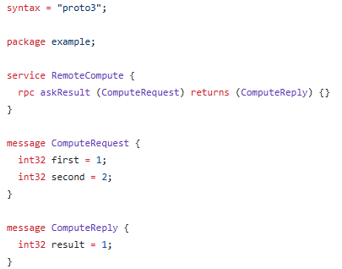

Progress – Implementation 1
Designed and implemented a our grpc tutorial.
We used ScalaPB.
<Result>
Master prints the responses from workers in parallel.
*
<Codes: Worker, Master, proto file>
<Design>
*The operation (op) is a random selection among +, -, *, and /.

Slide 15
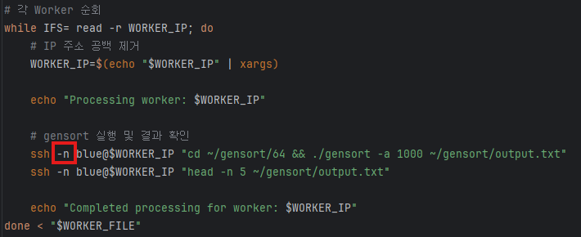
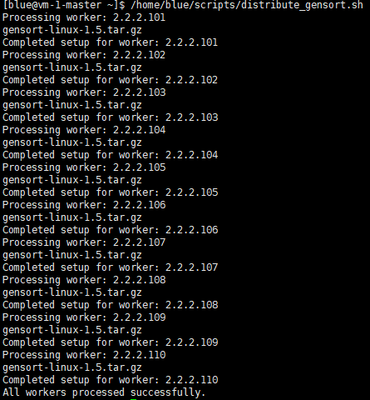

Progress – Implementation 2
Automating Worker Operations Using Shell Script
<Shell Script>
Let's use Gensort to generate sample data on each worker!
Use the ssh command to connect to each worker machine.
2. Navigate to the directory where the data will be stored.
3. Run the ./gensort command to generate the sample data.
4. Disconnect from the current worker machine.
5. Use the ssh command to connect to each worker machine.
….
(end)
Worker1
Using a shell script, we can just execute
“/home/blue/scripts/distribute_gensort.sh”
Worker2
Worker3
Worker4
<Result>

