Slide 1
A Formal Theory of
Robert Nozick’s Framework for Utopia
Susumu Cato (University of Tokyo)
Hun Chung (Emory University)

Slide 2
Robert Nozick’s Vision of Utopia
as the Minimal State

Slide 3
Robert Nozick’s Anarchy, State, and Utopia (1974)
The minimal state refers to a government consisting of a minimal set of institutions – namely, the police, courts, and army.
In Anarchy, State, and Utopia (ASU, 1974), Robert Nozick has offered one of the most powerful defenses of the minimal state in contemporary political philosophy.
ASU consists of three parts:
In Part I, Nozick tries to demonstrate that minimal state can be morally justified.
In Part II, Nozick tries to demonstrate that no state that is more extensive than the minimal state can be morally justified.
In Part III, Nozick tries to demonstrate that the minimal state coincides with our vision of utopia.

Slide 4
Robert Nozick’s Definition of Utopia
What is Utopia?
Intuitively, utopia is the best of all possible worlds for each and every person.
According to Nozick, Utopia “must be … the best for all of us; the best world imaginable, for each of us”; it must be “the best of all possible worlds.” (Nozick 1974: 298)
Nozick’s Vision of a Utopian Society
According to Nozick, utopia is a meta-utopia consisting of a collection of fully voluntary self-organized communities or associations “which people can enter if they are admitted, leave if they wish to, shape according to their wishes; a society in which utopian experimentation can be tried, different styles of life can be lived, and alternative visions of the good can be individually or jointly pursued…” (Nozick 1974: 307) but “where no one can impose his own utopian vision upon others.” (Nozick 1974: 312)
Nozick’s ultimate aim in Chapter 10 was to demonstrate that the framework for utopia is, after all, equivalent to the minimal state.

Slide 5
Nozick’s Model of Possible Worlds: Utopia = Set of Stable Worlds in the Model
How might we discover or arrive at utopia?
In Part III of ASU, Robert Nozick proposes “the model of possible worlds” (Nozick 1974: 307) as a way to identify utopia.
Nozick’s Model of Possible Worlds
In Nozick’s model of possible worlds, each person is given the power to create any possible world and its inhabitants by imagining them.
Each inhabitant of each world then decides whether to stay in the world or leave the world for an alternative world that they can also imagine.
“This process goes on; worlds are created, people leave them, create new worlds, and so on” (Nozick 1974: 299) until we reach a stable equilibrium in which “none of the inhabitants of [any] world can imagine an alternative world they would rather live in, which (they believe) would continue to exist if all of its rational inhabitants had the same rights of imagining and emigrating.” (Nozick 1974: 299)
This stable equilibrium, consisting of a set of stable worlds, in which none of the inhabitants of any world can imagine a better world than their present world, will be utopia, defined as the best of all possible worlds.
In other words, Nozick’s fundamental strategy was to identify utopia, defined as the best of all possible worlds for each of us, with the set of stable worlds in the possible worlds model.

Slide 6
2. The Model and Solution Concept

Slide 7
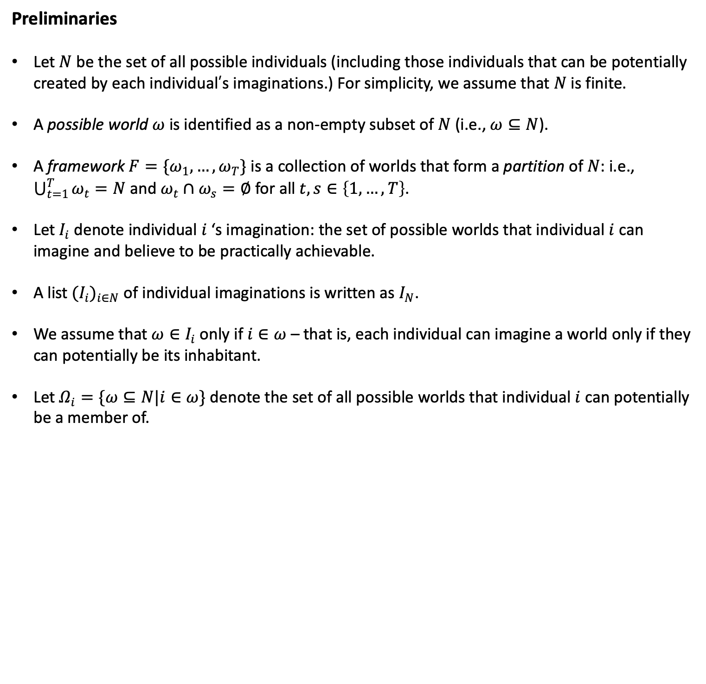
Preliminaries
Let $N$ be the set of all possible individuals (including those individuals that can be potentially created by each individual’s imaginations.) For simplicity, we assume that $N$ is finite.
A possible world $ω$ is identified as a non-empty subset of $N$ (i.e., $ω⊆N$).
A framework $F=\{ω_{1},…,ω_{T}\}$ is a collection of worlds that form a partition of $N$: i.e., $\bigcup_{t=1}^{T}{ω_{t}=N}$ and $ω_{t}∩ω_{s}=∅$ for all $t,s∈\left\{1,…, T\right\}$.
Let $I_{i}$ denote individual $i$ ‘s imagination: the set of possible worlds that individual $i$ can imagine and believe to be practically achievable.
A list ${(I}_{i})_{i∈N}$ of individual imaginations is written as $I_{N}$.
We assume that $ω∈I_{i}$ only if $i∈ω$ – that is, each individual can imagine a world only if they can potentially be its inhabitant.
Let $Ω_{i}=\{ω⊆N|i∈ω\}$ denote the set of all possible worlds that individual $i$ can potentially be a member of.

Slide 8
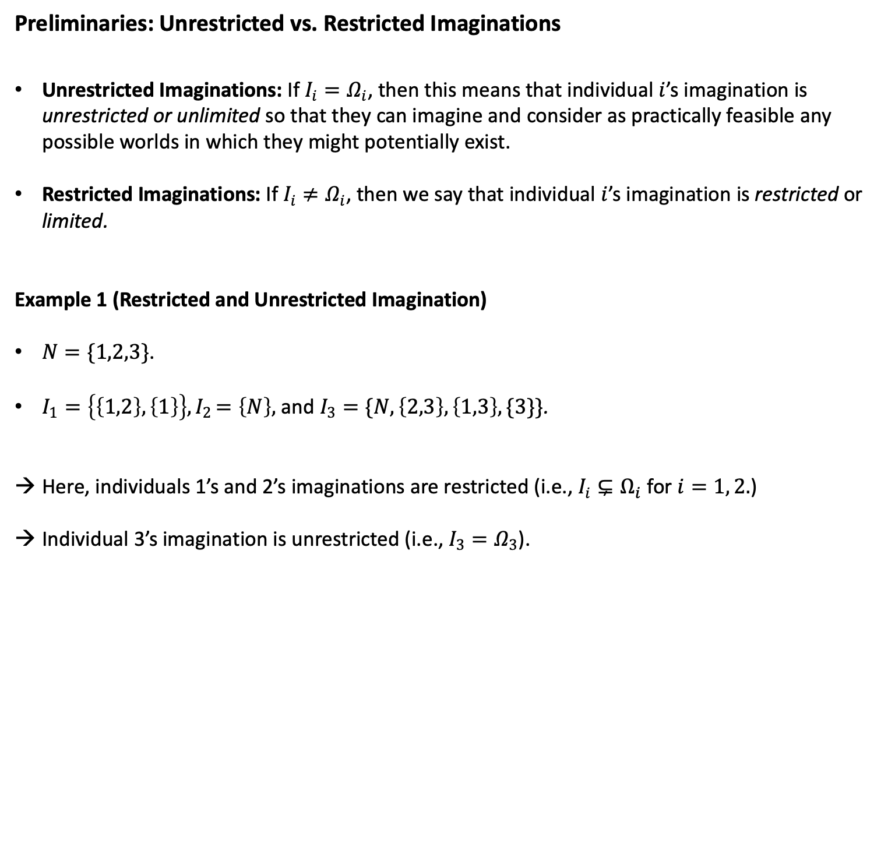
Preliminaries: Unrestricted vs. Restricted Imaginations
Unrestricted Imaginations: If $I_{i}=Ω_{i}$, then this means that individual $i$’s imagination is unrestricted or unlimited so that they can imagine and consider as practically feasible any possible worlds in which they might potentially exist.
Restricted Imaginations: If $I_{i}≠Ω_{i}$, then we say that individual $i$’s imagination is restricted or limited.
Example 1 (Restricted and Unrestricted Imagination)
$N=\{1,2,3\}$.
$I_{1}=\left\{\left\{1,2\right\}, \left\{1\right\}\right\}{, I}_{2}=\left\{N\right\},$ and $I_{3}=\{N,\left\{2,3\right\},\left\{1,3\right\},\{3\}\}$.
Here, individuals 1’s and 2’s imaginations are restricted (i.e., $I_{i}⊊Ω_{i}$ for $i=1, 2.$)
Individual 3’s imagination is unrestricted (i.e., $I_{3}=Ω_{3}$).

Slide 9
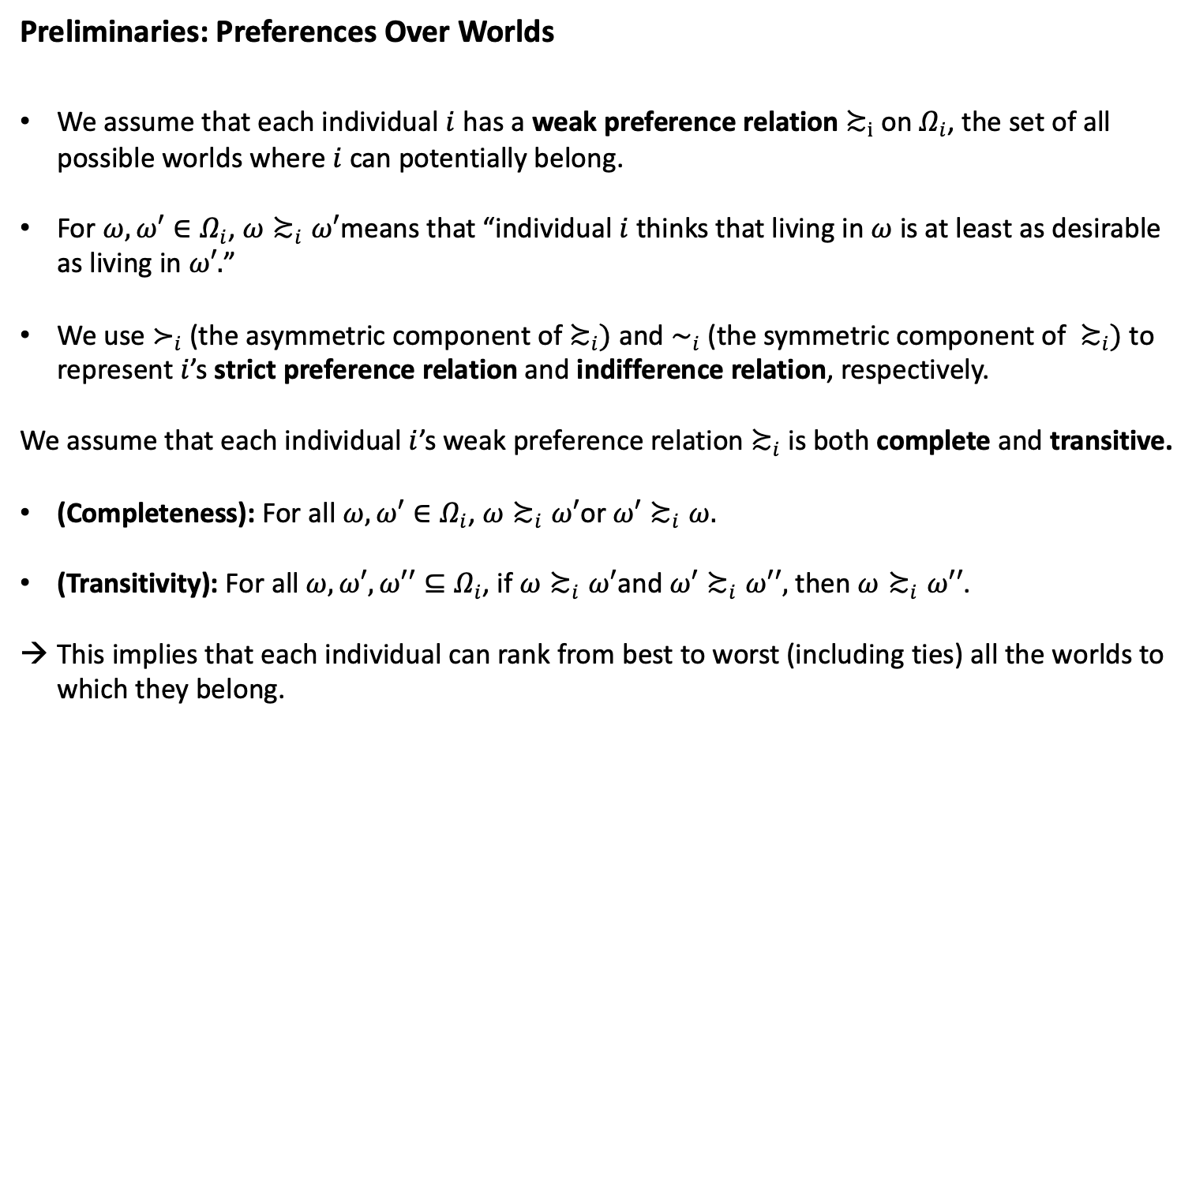
Preliminaries: Preferences Over Worlds
We assume that each individual $i$ has a weak preference relation $≿_{i}$ on $Ω_{i}$, the set of all possible worlds where $i$ can potentially belong.
For $ω,ω′∈Ω_{i}$, $ω≿_{i}ω′$means that “individual $i$ thinks that living in $ω$ is at least as desirable as living in $ω′.$”
We use $≻_{i}$ (the asymmetric component of $≿_{i})$ and $∼_{i}$ (the symmetric component of $≿_{i})$ to represent $i$’s strict preference relation and indifference relation, respectively.
We assume that each individual $i$’s weak preference relation $≿_{i}$ is both complete and transitive.
(Completeness): For all $ω,ω′∈Ω_{i}$, ${ω≿}_{i}ω′$or ${ω′≿}_{i}ω.$
(Transitivity): For all $ω,ω′, ω′′⊆Ω_{i}$, if ${ω≿}_{i}ω′$and ${ω′≿}_{i}ω′′,$ then ${ω≿}_{i}ω′′$.
This implies that each individual can rank from best to worst (including ties) all the worlds to which they belong.

Slide 10
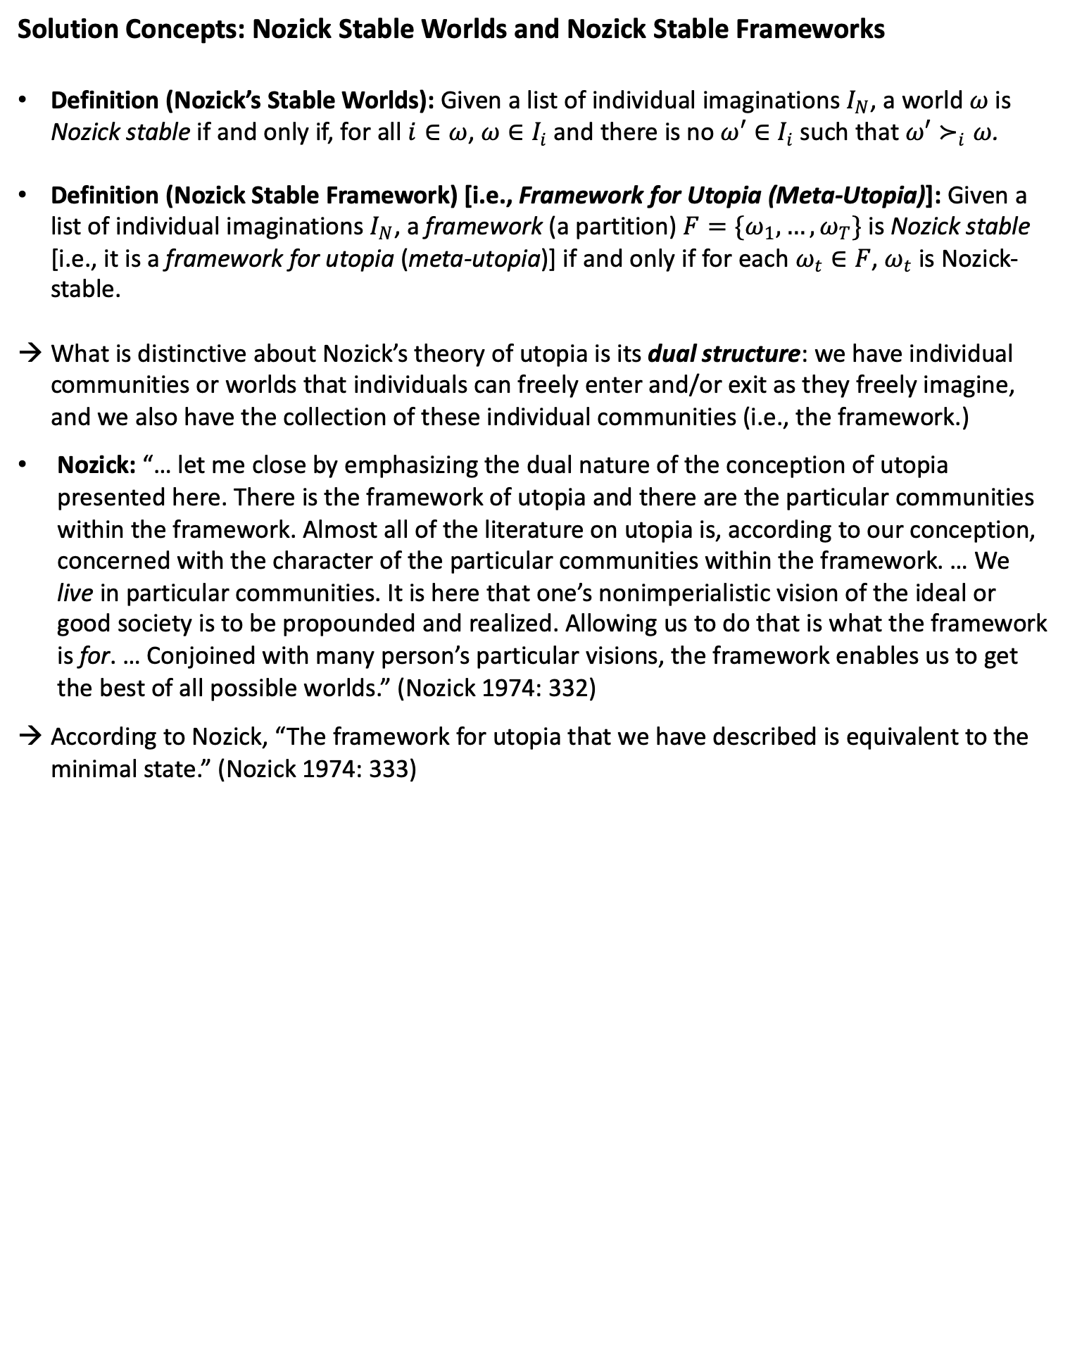
Solution Concepts: Nozick Stable Worlds and Nozick Stable Frameworks
Definition (Nozick’s Stable Worlds): Given a list of individual imaginations $I_{N}$, a world $ω$ is Nozick stable if and only if, for all $i∈ω$, ${ω∈I}_{i}$ and there is no $ω′∈I_{i}$ such that $ω′≻_{i}ω$.
Definition (Nozick Stable Framework) [i.e., Framework for Utopia (Meta-Utopia)]: Given a list of individual imaginations $I_{N}$, a framework (a partition) $F=\{ω_{1},…,ω_{T}\}$ is Nozick stable [i.e., it is a framework for utopia (meta-utopia)] if and only if for each $ω_{t}∈F$, $ω_{t}$ is Nozick-stable.
What is distinctive about Nozick’s theory of utopia is its dual structure: we have individual communities or worlds that individuals can freely enter and/or exit as they freely imagine, and we also have the collection of these individual communities (i.e., the framework.)
Nozick: “… let me close by emphasizing the dual nature of the conception of utopia presented here. There is the framework of utopia and there are the particular communities within the framework. Almost all of the literature on utopia is, according to our conception, concerned with the character of the particular communities within the framework. … We live in particular communities. It is here that one’s nonimperialistic vision of the ideal or good society is to be propounded and realized. Allowing us to do that is what the framework is for. … Conjoined with many person’s particular visions, the framework enables us to get the best of all possible worlds.” (Nozick 1974: 332)
According to Nozick, “The framework for utopia that we have described is equivalent to the minimal state.” (Nozick 1974: 333)

Slide 11
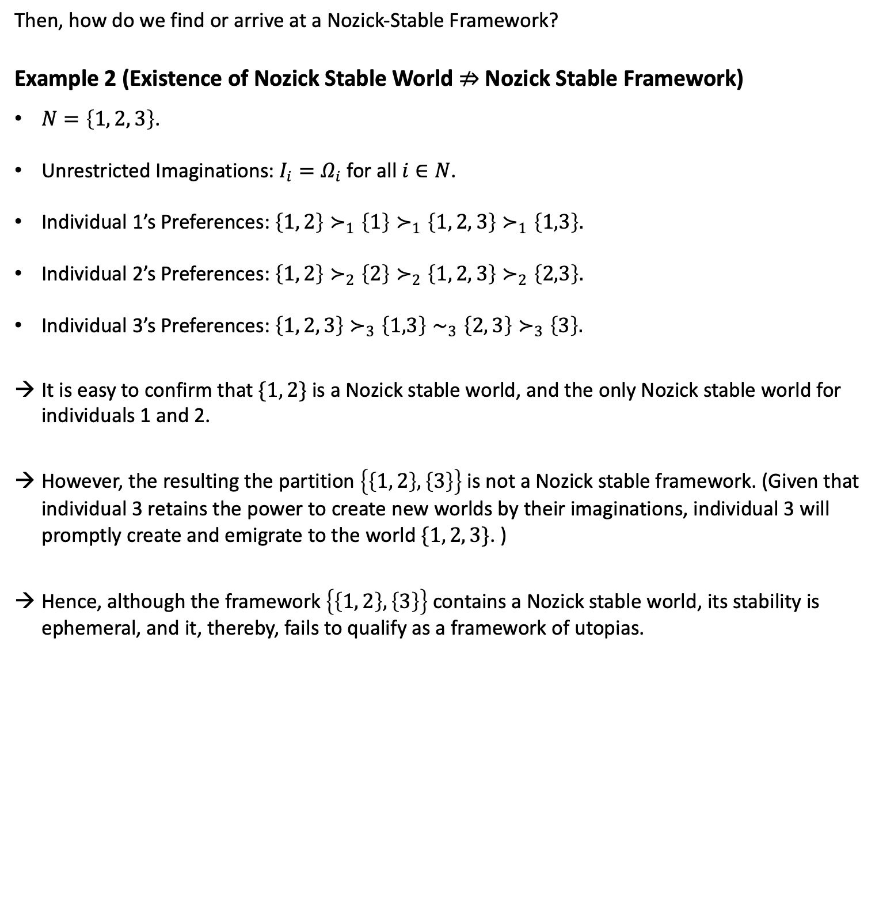
Then, how do we find or arrive at a Nozick-Stable Framework?
Example 2 (Existence of Nozick Stable World $⇏$ Nozick Stable Framework)
$N=\left\{1, 2, 3\right\}$.
Unrestricted Imaginations: $I_{i}=Ω_{i}$ for all $i∈N$.
Individual 1’s Preferences: $\left\{1, 2\right\}≻_{1}\left\{1\right\}≻_{1}\left\{1, 2, 3\right\}≻_{1}\left\{1,3\right\}.$
Individual 2’s Preferences: $\left\{1, 2\right\}≻_{2}\left\{2\right\}≻_{2}\left\{1, 2, 3\right\}≻_{2}\left\{2,3\right\}.$
Individual 3’s Preferences: $\left\{1, 2, 3\right\}≻_{3}\left\{1,3\right\}∼_{3}\left\{2, 3\right\}≻_{3}\left\{3\right\}.$
It is easy to confirm that $\{1, 2\}$ is a Nozick stable world, and the only Nozick stable world for individuals 1 and 2.
However, the resulting the partition $\left\{\left\{1, 2\right\}, \left\{3\right\}\right\}$ is not a Nozick stable framework. (Given that individual 3 retains the power to create new worlds by their imaginations, individual 3 will promptly create and emigrate to the world $\{1, 2, 3\}$. )
Hence, although the framework $\left\{\left\{1, 2\right\}, \left\{3\right\}\right\}$ contains a Nozick stable world, its stability is ephemeral, and it, thereby, fails to qualify as a framework of utopias.

Slide 12
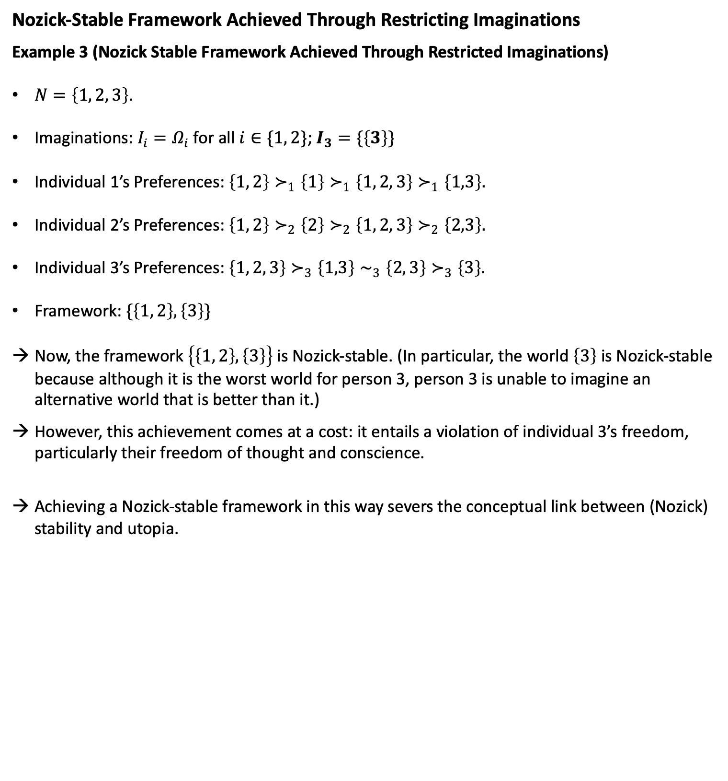
Nozick-Stable Framework Achieved Through Restricting Imaginations
Example 3 (Nozick Stable Framework Achieved Through Restricted Imaginations)
$N=\left\{1, 2, 3\right\}$.
Imaginations: $I_{i}=Ω_{i}$ for all $i∈\{1, 2\}$; $I_{3}=\{\left\{3\right\}\}$
Individual 1’s Preferences: $\left\{1, 2\right\}≻_{1}\left\{1\right\}≻_{1}\left\{1, 2, 3\right\}≻_{1}\left\{1,3\right\}.$
Individual 2’s Preferences: $\left\{1, 2\right\}≻_{2}\left\{2\right\}≻_{2}\left\{1, 2, 3\right\}≻_{2}\left\{2,3\right\}.$
Individual 3’s Preferences: $\left\{1, 2, 3\right\}≻_{3}\left\{1,3\right\}∼_{3}\left\{2, 3\right\}≻_{3}\left\{3\right\}.$
Framework: $\{\left\{1, 2\right\}, \left\{3\right\}\}$
Now, the framework $\left\{\left\{1, 2\right\}, \left\{3\right\}\right\}$ is Nozick-stable. (In particular, the world $\left\{3\right\}$ is Nozick-stable because although it is the worst world for person 3, person 3 is unable to imagine an alternative world that is better than it.)
However, this achievement comes at a cost: it entails a violation of individual 3’s freedom, particularly their freedom of thought and conscience.
Achieving a Nozick-stable framework in this way severs the conceptual link between (Nozick) stability and utopia.

Slide 13
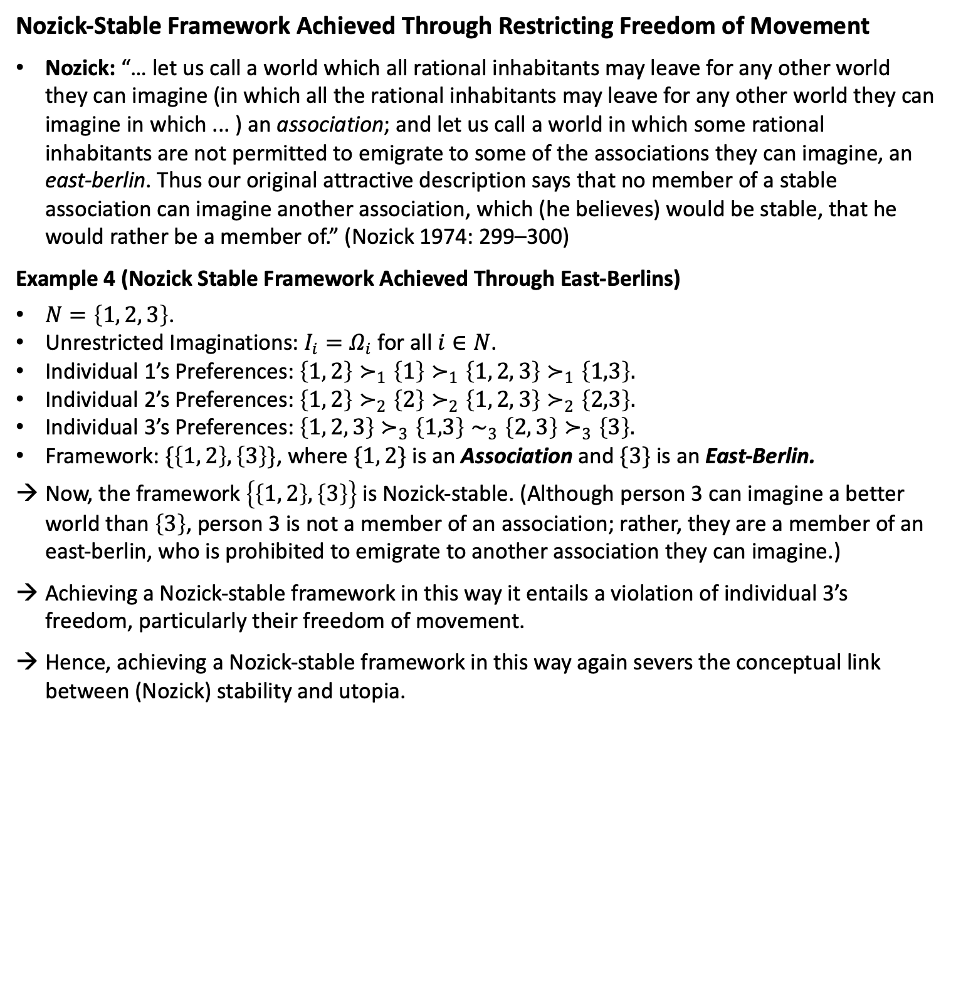
Nozick-Stable Framework Achieved Through Restricting Freedom of Movement
Nozick: “… let us call a world which all rational inhabitants may leave for any other world they can imagine (in which all the rational inhabitants may leave for any other world they can imagine in which ... ) an association; and let us call a world in which some rational inhabitants are not permitted to emigrate to some of the associations they can imagine, an east-berlin. Thus our original attractive description says that no member of a stable association can imagine another association, which (he believes) would be stable, that he would rather be a member of.” (Nozick 1974: 299–300)
Example 4 (Nozick Stable Framework Achieved Through East-Berlins)
$N=\left\{1, 2, 3\right\}$.
Unrestricted Imaginations: $I_{i}=Ω_{i}$ for all $i∈N$.
Individual 1’s Preferences: $\left\{1, 2\right\}≻_{1}\left\{1\right\}≻_{1}\left\{1, 2, 3\right\}≻_{1}\left\{1,3\right\}.$
Individual 2’s Preferences: $\left\{1, 2\right\}≻_{2}\left\{2\right\}≻_{2}\left\{1, 2, 3\right\}≻_{2}\left\{2,3\right\}.$
Individual 3’s Preferences: $\left\{1, 2, 3\right\}≻_{3}\left\{1,3\right\}∼_{3}\left\{2, 3\right\}≻_{3}\left\{3\right\}.$
Framework: $\{\left\{1, 2\right\}, \left\{3\right\}\}$, where $\{1, 2\}$ is an Association and $\{3\}$ is an East-Berlin.
Now, the framework $\left\{\left\{1, 2\right\}, \left\{3\right\}\right\}$ is Nozick-stable. (Although person 3 can imagine a better world than $\left\{3\right\}$, person 3 is not a member of an association; rather, they are a member of an east-berlin, who is prohibited to emigrate to another association they can imagine.)
Achieving a Nozick-stable framework in this way it entails a violation of individual 3’s freedom, particularly their freedom of movement.
Hence, achieving a Nozick-stable framework in this way again severs the conceptual link between (Nozick) stability and utopia.

Slide 14
Philosophical Lessons of Examples 3 and 4
Examples 3 and 4 underscore a crucial observation: it's possible to attain a stable framework in the possible worlds model by limiting either individuals' freedom of thought or freedom of movement/association.
However, the stability so achieved would be stable for the wrong reasons.
Remember that for Nozick, a Nozick-stable framework in the possible worlds model is equivalent to the minimal state.
If it emerges that a stable framework can only be attained in the possible worlds model through the infringement of individual rights, this would not only sever the conceptual link between stability and utopia, but also suggest that we cannot reach the minimal state without violating individual rights. This defeats the whole purpose of ASU.
Hence, in order for stability in the possible worlds model to truly serve as a formal basis for a utopian framework and the minimal state, “[s]tability has to be due to the absence of possible improvements, not due to people being coerced to remain in their associations. In short, stability must be the results of voluntary choice.” (Bader 2011: 263)
It is therefore crucial for Nozick to demonstrate the existence of a Nozick stable framework in the possible worlds model without restricting people’s imaginations (i.e., under unrestricted imaginations) or their freedom of movement (i.e., without relying on east-berlins) for his entire project to remain intact.

Slide 15
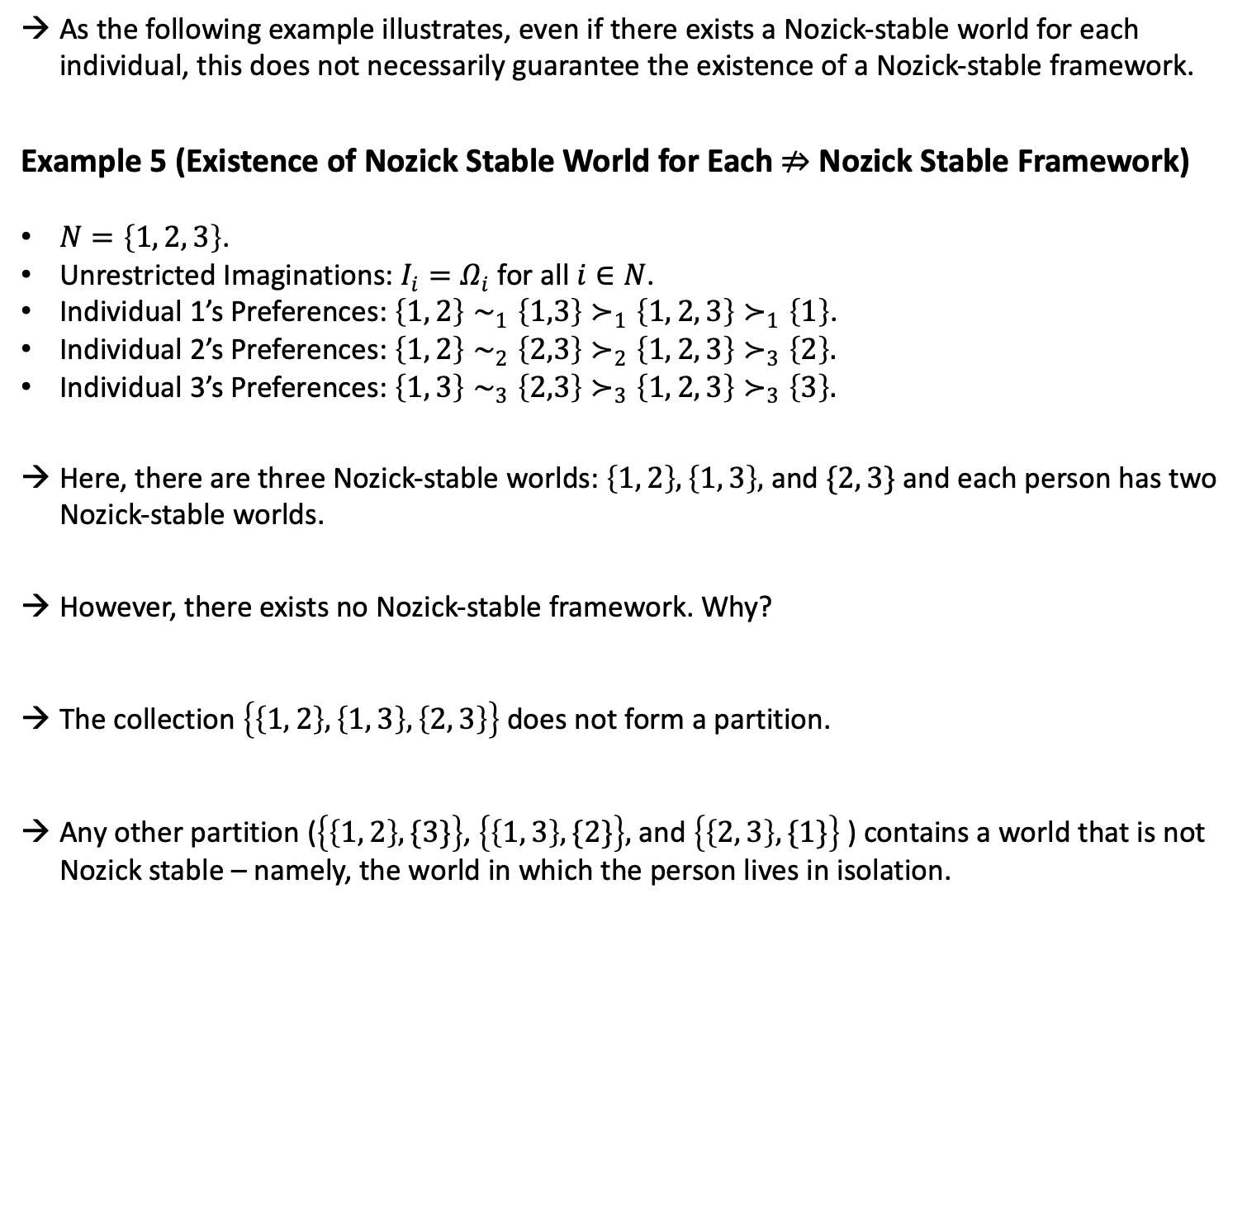
As the following example illustrates, even if there exists a Nozick-stable world for each individual, this does not necessarily guarantee the existence of a Nozick-stable framework.
Example 5 (Existence of Nozick Stable World for Each $⇏$ Nozick Stable Framework)
$N=\left\{1, 2, 3\right\}$.
Unrestricted Imaginations: $I_{i}=Ω_{i}$ for all $i∈N$.
Individual 1’s Preferences: $\left\{1, 2\right\}∼_{1}\left\{1,3\right\}≻_{1}\left\{1, 2, 3\right\}≻_{1}\left\{1\right\}$.
Individual 2’s Preferences: $\left\{1, 2\right\}∼_{2}\left\{2,3\right\}≻_{2}\left\{1, 2, 3\right\}≻_{3}\left\{2\right\}.$
Individual 3’s Preferences: $\left\{1, 3\right\}∼_{3}\left\{2,3\right\}≻_{3}\left\{1, 2, 3\right\}≻_{3}\left\{3\right\}.$
Here, there are three Nozick-stable worlds: $\left\{1, 2\right\}, \left\{1, 3\right\},$ and $\{2, 3\}$ and each person has two Nozick-stable worlds.
However, there exists no Nozick-stable framework. Why?
The collection $\left\{\left\{1, 2\right\}, \left\{1, 3\right\},\left\{2, 3\right\}\right\}$ does not form a partition.
Any other partition ($\left\{\left\{1, 2\right\}, \{3\}\right\}$, $\left\{\left\{1, 3\right\}, \{2\}\right\},$ and $\left\{\left\{2, 3\right\}, \{1\}\right\}$ ) contains a world that is not Nozick stable – namely, the world in which the person lives in isolation.

Slide 16
4. Core Stability and Nash Stability and
Their Connections to Nozick Stability

Slide 17
The Difficulty of Identifying a Nozick-Stable Framework
Our prior discourse highlights the formidable challenge of identifying a Nozick-stable framework in the possible worlds model under unrestricted imagination.
Achieving such a framework demands an exceptionally high degree of uncoerced spontaneous coordination: every inhabitant of any world within the framework must view their world as the best possible scenario they can freely envision (thus rendering their world Nozick-stable).
Furthermore, the entire array of Nozick-stable worlds in the framework must form an exact partition, ensuring that each individual is a member of precisely one Nozick-stable world within the framework.
In our pursuit of identifying a Nozick-stable framework within the possible worlds model, it may prove insightful to juxtapose Nozick’s concept of stability with Core Stability and Nash Stability in general equilibrium theory and cooperative game theory.
Since these other stability concepts exist only under specified conditions, understanding how Nozick stability relates to these other stability notions may tell us something about when a Nozick-stable framework exists in the possible worlds model.

Slide 18
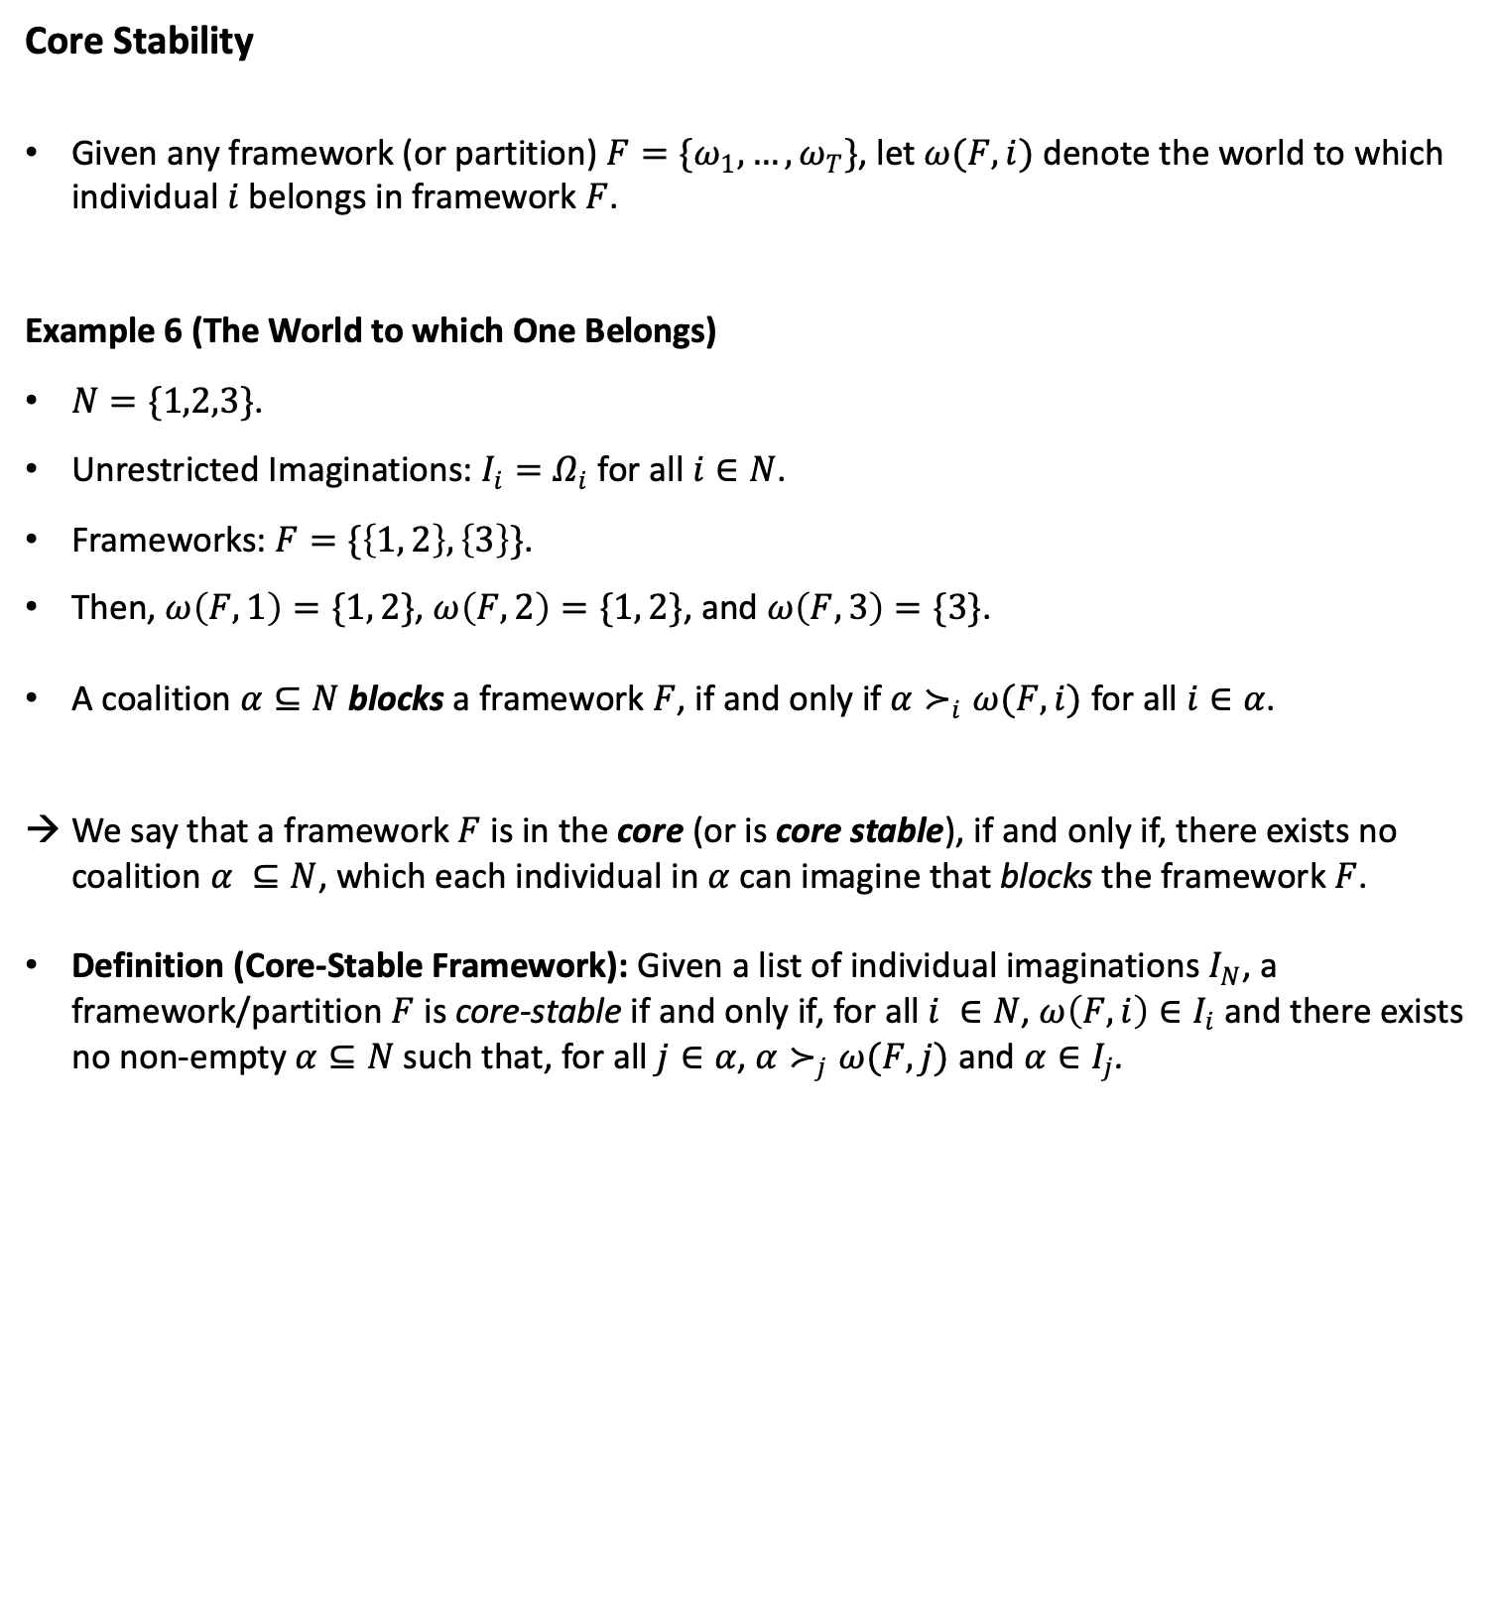
Core Stability
Given any framework (or partition) $F=\{ω_{1},…,ω_{T}\}$, let $ω(F, i)$ denote the world to which individual $i$belongs in framework $F$.
Example 6 (The World to which One Belongs)
$N=\{1,2,3\}$.
Unrestricted Imaginations: $I_{i}=Ω_{i}$ for all $i∈N$.
Frameworks: $F=\{\left\{1, 2\right\}, \left\{3\right\}\}$.
Then, $ω\left(F, 1\right)=\{1, 2\}$, $ω\left(F, 2\right)=\{1, 2\}$, and $ω\left(F, 3\right)=\{3\}$.
A coalition $α⊆N$ blocks a framework $F$, if and only if $α≻_{i}ω(F,i)$ for all $i∈α$.
We say that a framework $F$ is in the core (or is core stable), if and only if, there exists no coalition $α ⊆N$, which each individual in$α$ can imagine that blocks the framework $F$.
Definition (Core-Stable Framework): Given a list of individual imaginations $I_{N}$, a framework/partition $F$ is core-stable if and only if, for all $i ∈N$, $ω\left(F,i\right)∈I_{i}$ and there exists no non-empty $α⊆N$ such that, for all $j∈α$, $α≻_{j}ω(F,j)$ and $α∈I_{j}$.

Slide 19
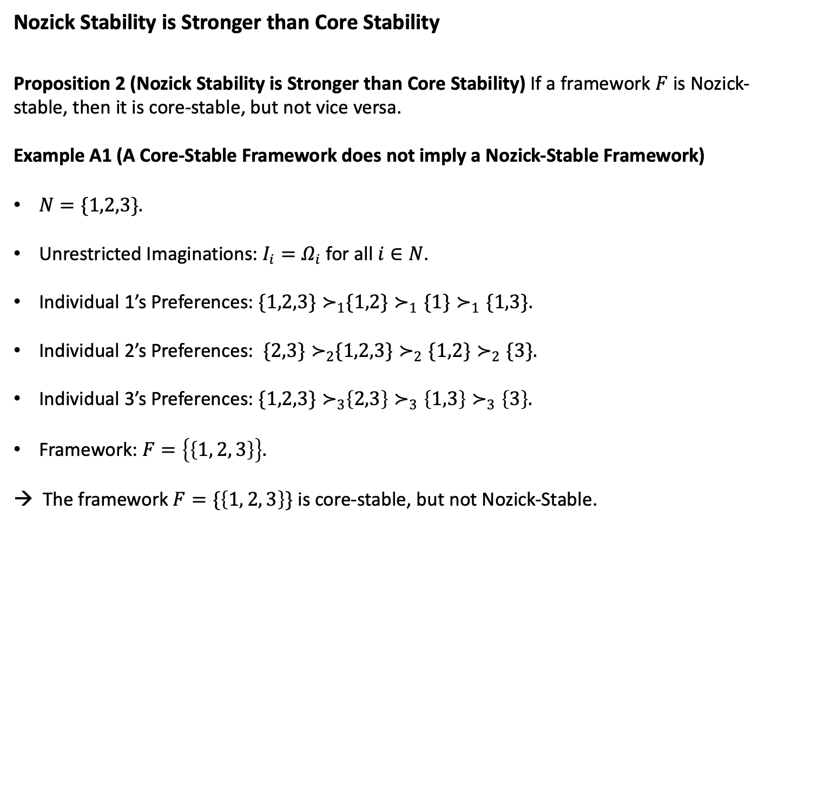
Nozick Stability is Stronger than Core Stability
Proposition 2 (Nozick Stability is Stronger than Core Stability) If a framework $F$ is Nozick- stable, then it is core-stable, but not vice versa.
Example A1 (A Core-Stable Framework does not imply a Nozick-Stable Framework)
$N=\{1,2,3\}.$
Unrestricted Imaginations: $I_{i}=Ω_{i}$ for all $i∈N$.
Individual 1’s Preferences: ${\{1,2,3\}≻}_{1}\{1,2\}≻_{1}\{1\}≻_{1}\{1,3\}.$
Individual 2’s Preferences: ${\{2,3\}≻}_{2}\{1,2,3\}≻_{2}\{1,2\}≻_{2}\{3\}.$
Individual 3’s Preferences: ${\{1,2,3\}≻}_{3}\left\{2,3\right\}≻_{3}\left\{1,3\right\}≻_{3}\left\{3\right\}.$
Framework: $F=\left\{\left\{1, 2, 3\right\}\right\}.$
→ The framework $F=\{\left\{1, 2, 3\right\}\}$ is core-stable, but not Nozick-Stable.

Slide 20
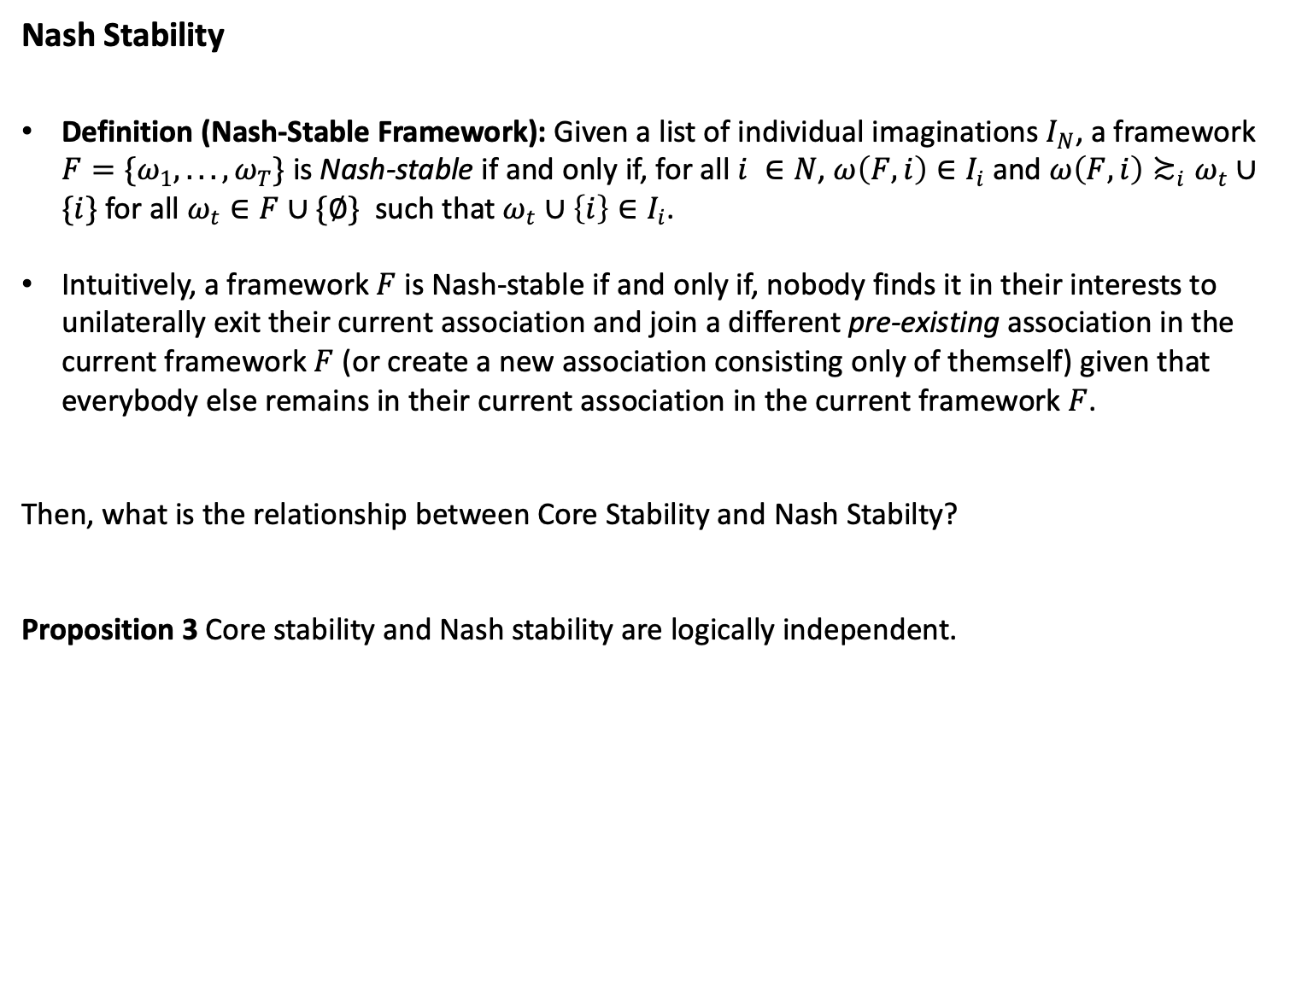
Nash Stability
Definition (Nash-Stable Framework): Given a list of individual imaginations $I_{N}$, a framework $F=\{ω_{1},...,ω_{T}\}$ is Nash-stable if and only if, for all $i ∈N$, $ω\left(F,i\right)∈I_{i}$ and $ω\left(F,i\right)≿_{i}ω_{t}∪\{i\}$ for all $ω_{t}∈F∪\{∅\}$such that $ω_{t}∪\left\{i\right\}∈I_{i}$.
Intuitively, a framework $F$ is Nash-stable if and only if, nobody finds it in their interests to unilaterally exit their current association and join a different pre-existing association in the current framework $F$ (or create a new association consisting only of themself) given that everybody else remains in their current association in the current framework $F$.
Then, what is the relationship between Core Stability and Nash Stabilty?
Proposition 3 Core stability and Nash stability are logically independent.

Slide 21
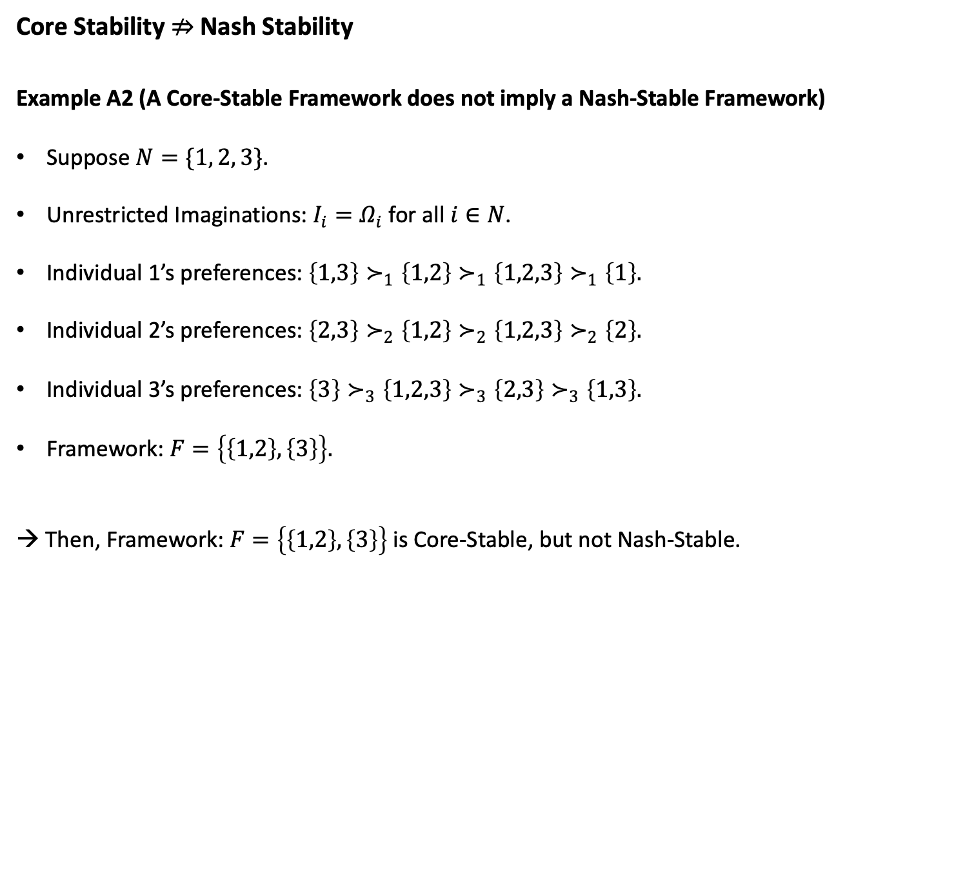
Core Stability $⇏$ Nash Stability
Example A2 (A Core-Stable Framework does not imply a Nash-Stable Framework)
Suppose $N=\{1, 2, 3\}$.
Unrestricted Imaginations: $I_{i}=Ω_{i}$ for all $i∈N$.
Individual 1’s preferences: $\left\{1,3\right\}≻_{1}\left\{1,2\right\}≻_{1}\left\{1,2,3\right\}≻_{1}\left\{1\right\}.$
Individual 2’s preferences: $\left\{2,3\right\}≻_{2}\left\{1,2\right\}≻_{2}\left\{1,2,3\right\}≻_{2}\left\{2\right\}.$
Individual 3’s preferences: $\left\{3\right\}≻_{3}\left\{1,2,3\right\}≻_{3}\left\{2,3\right\}≻_{3}\left\{1,3\right\}.$
Framework: $F=\left\{\left\{1,2\right\},\left\{3\right\}\right\}.$
→ Then, Framework: $F=\left\{\left\{1,2\right\},\left\{3\right\}\right\}$ is Core-Stable, but not Nash-Stable.

Slide 22
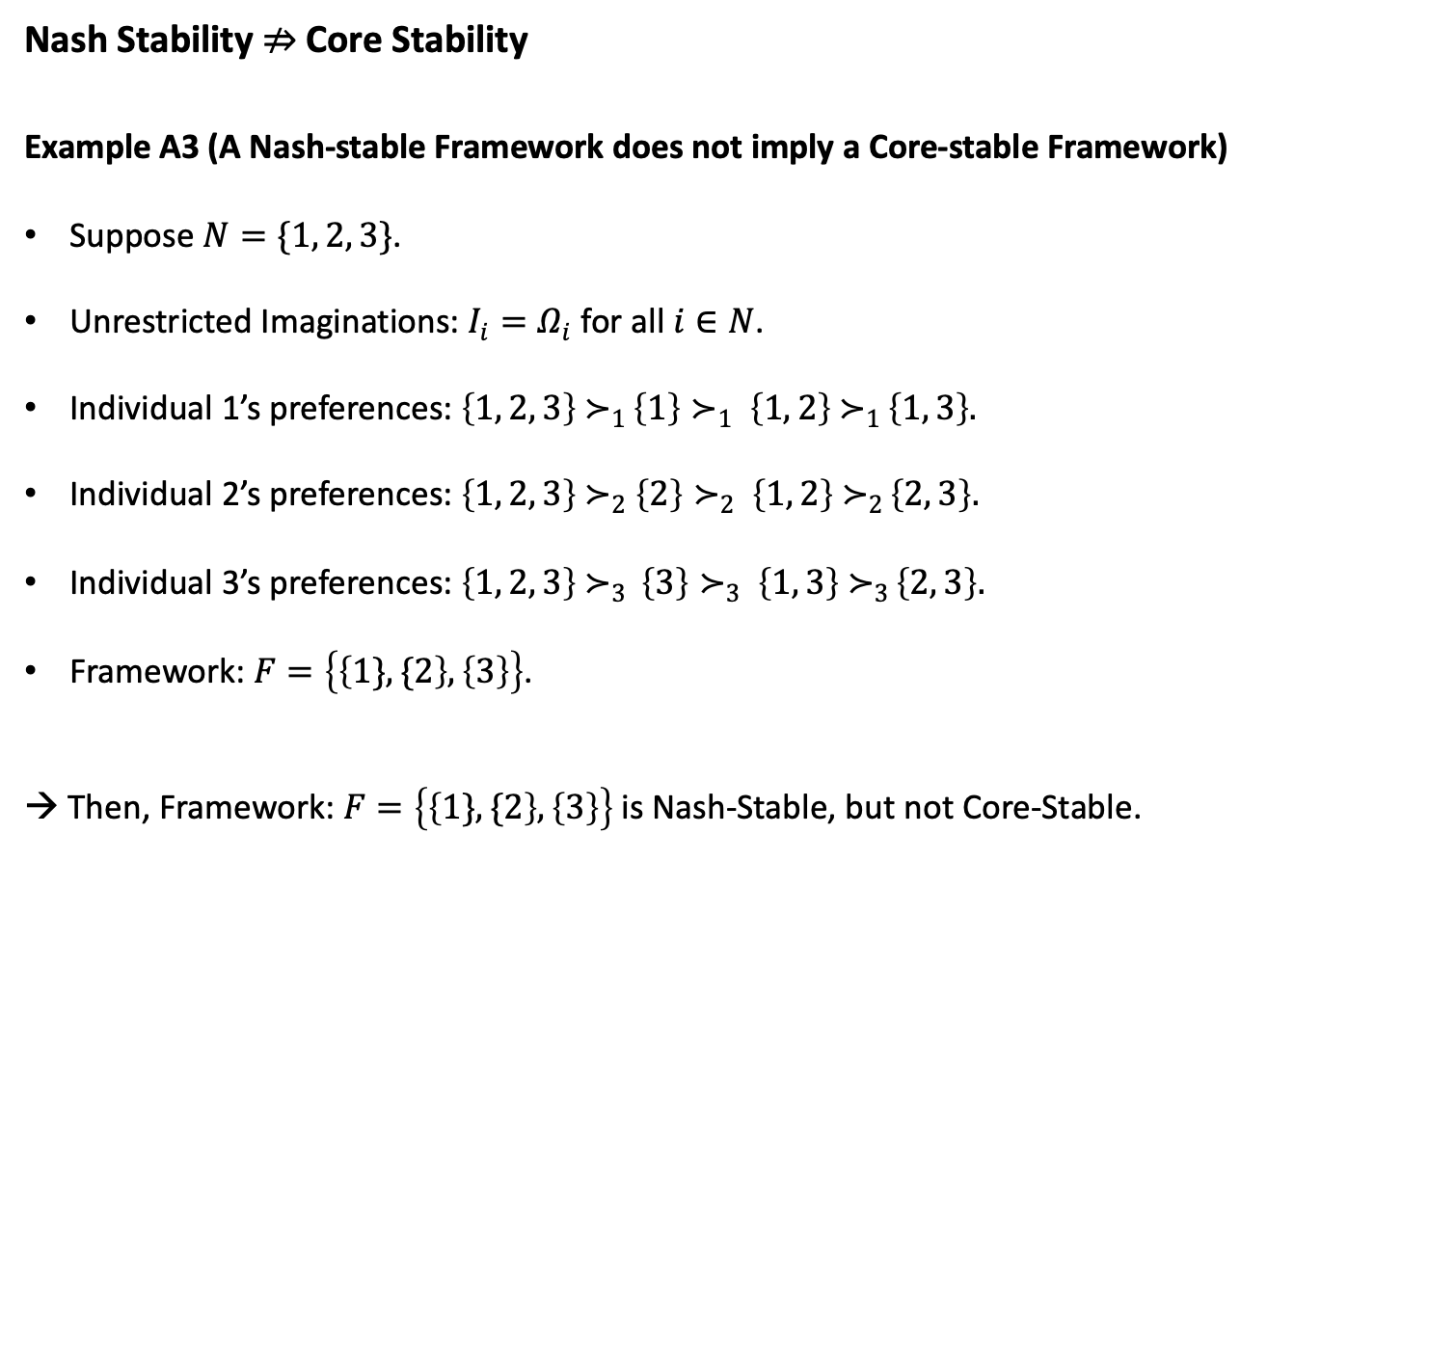
Nash Stability $⇏$ Core Stability
Example A3 (A Nash-stable Framework does not imply a Core-stable Framework)
Suppose $N=\{1, 2, 3\}$.
Unrestricted Imaginations: $I_{i}=Ω_{i}$ for all $i∈N$.
Individual 1’s preferences: $\left\{1, 2, 3\right\}{ ≻}_{1 }\left\{1\right\}≻_{1 }\left\{1, 2\right\}{ ≻}_{1 }\left\{1, 3\right\}.$
Individual 2’s preferences: $\left\{1, 2, 3\right\}{ ≻}_{2} \left\{2\right\}≻_{2 }\left\{1, 2\right\}{ ≻}_{2 }\left\{2, 3\right\}.$
Individual 3’s preferences: $\left\{1, 2, 3\right\}{ ≻}_{3 } \left\{3\right\}≻_{3 }\left\{1, 3\right\}{ ≻}_{3 }\left\{2, 3\right\}.$
Framework: $F=\left\{\left\{1\}, \{2\right\},\left\{3\right\}\right\}$.
→ Then, Framework: $F=\left\{\left\{1\}, \{2\right\},\left\{3\right\}\right\}$is Nash-Stable, but not Core-Stable.

Slide 23
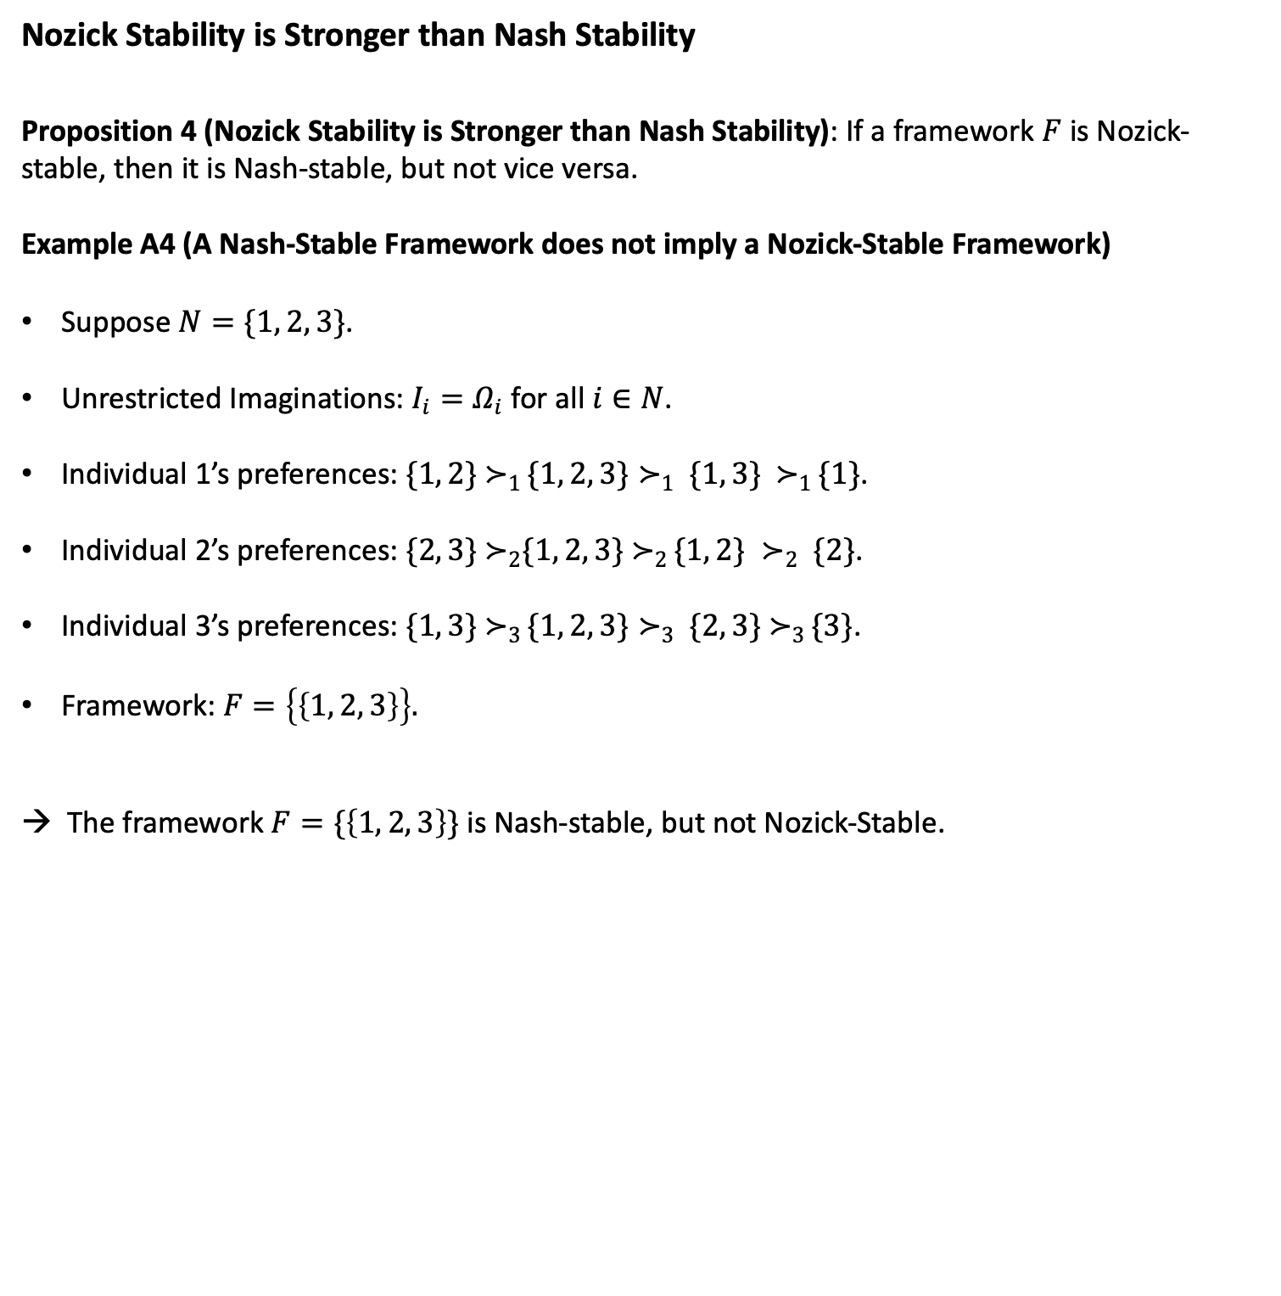
Nozick Stability is Stronger than Nash Stability
Proposition 4 (Nozick Stability is Stronger than Nash Stability): If a framework $F$ is Nozick- stable, then it is Nash-stable, but not vice versa.
Example A4 (A Nash-Stable Framework does not imply a Nozick-Stable Framework)
Suppose $N=\{1, 2, 3\}$.
Unrestricted Imaginations: $I_{i}=Ω_{i}$ for all $i∈N$.
Individual 1’s preferences: $\{1, 2\}{ ≻}_{1 }\{1, 2, 3\}≻_{1 }\{1, 3\} { ≻}_{1 }\{1\}$.
Individual 2’s preferences: $\{2, 3\}{ ≻}_{2}\{1, 2, 3\}{ ≻}_{2 }\{1, 2\} ≻_{2 }\{2\}$.
Individual 3’s preferences: $\{1, 3\}{ ≻}_{3 }\{1, 2, 3\}≻_{3 }\{2, 3\}{ ≻}_{3 }\{3\}$.
Framework: $F=\left\{\left\{1, 2, 3\right\}\right\}.$
→ The framework $F=\{\left\{1, 2, 3\right\}\}$ is Nash-stable, but not Nozick-Stable.

Slide 24
Summary of Logical Relationships between the Three Stability Concepts
Nozick Stability
Core Stability
Nash Stability

Slide 25
5. The Existence of Nozick Stable Framework

Slide 26
Sufficient Conditions for the Existence of a Nozick-Stable Framework
Our analysis in the previous section has revealed that, among the three stability concepts that we have examined, Nozick stability is the strongest stability concept.
This means that even when a framework is either core-stable or Nash-stable, it may still fail to be Nozick-stable.
So, proving the existence of a Nozick stable framework in the possible worlds model is no simple matter.
Then, what may be the specific conditions that guarantee the existence of a Nozick-Stable Framework?

Slide 27
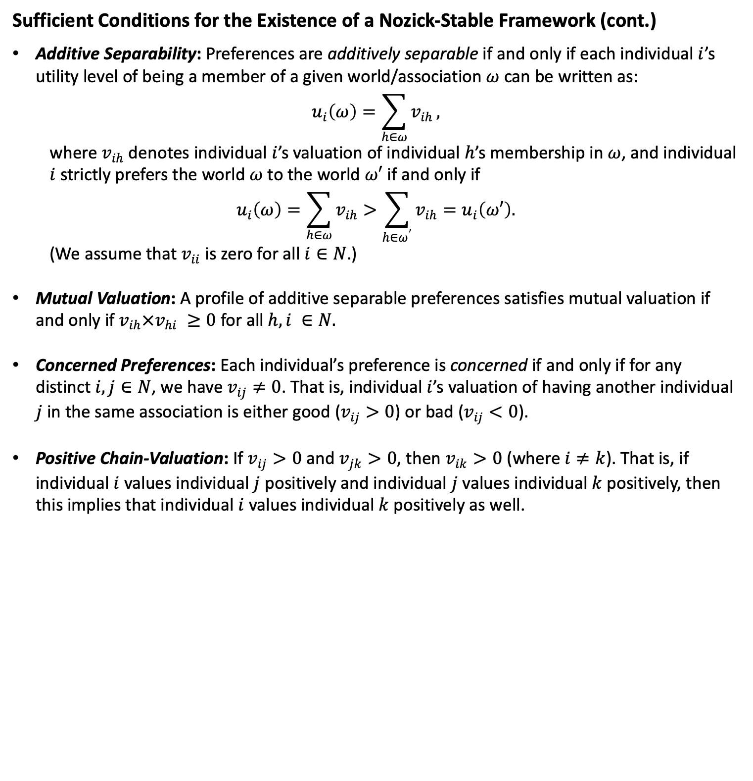
Sufficient Conditions for the Existence of a Nozick-Stable Framework (cont.)
Additive Separability: Preferences are additively separable if and only if each individual $i$’s utility level of being a member of a given world/association $ω$ can be written as:
$$u_{i}\left(ω\right)=\sum_{h∈ω}{v_{ih}},$$
where $v_{ih}$ denotes individual $i$’s valuation of individual $h$’s membership in $ω$, and individual $i$ strictly prefers the world $ω$ to the world $ω′$ if and only if $$u_{i}\left(ω\right)=\sum_{h∈ω}{v_{ih}}>\sum_{h∈ω^{′}}{v_{ih}}=u_{i}\left(ω′\right).$$
(We assume that $v_{ii}$ is zero for all $i∈N$.)
Mutual Valuation: A profile of additive separable preferences satisfies mutual valuation if and only if $v_{ih}×v_{hi} ≥0$ for all $h,i ∈N.$
Concerned Preferences: Each individual’s preference is concerned if and only if for any distinct $i, j∈N$, we have $v_{ij}≠0$. That is, individual $i$’s valuation of having another individual $j$ in the same association is either good ($v_{ij}>0$) or bad ($v_{ij}<0$).
Positive Chain-Valuation: If $v_{ij}>0$ and $v_{jk}>0$, then $v_{ik}>0$ (where $i≠k$). That is, if individual $i$ values individual $j$ positively and individual $j$ values individual $k$ positively, then this implies that individual $i$ values individual $k$ positively as well.

Slide 28
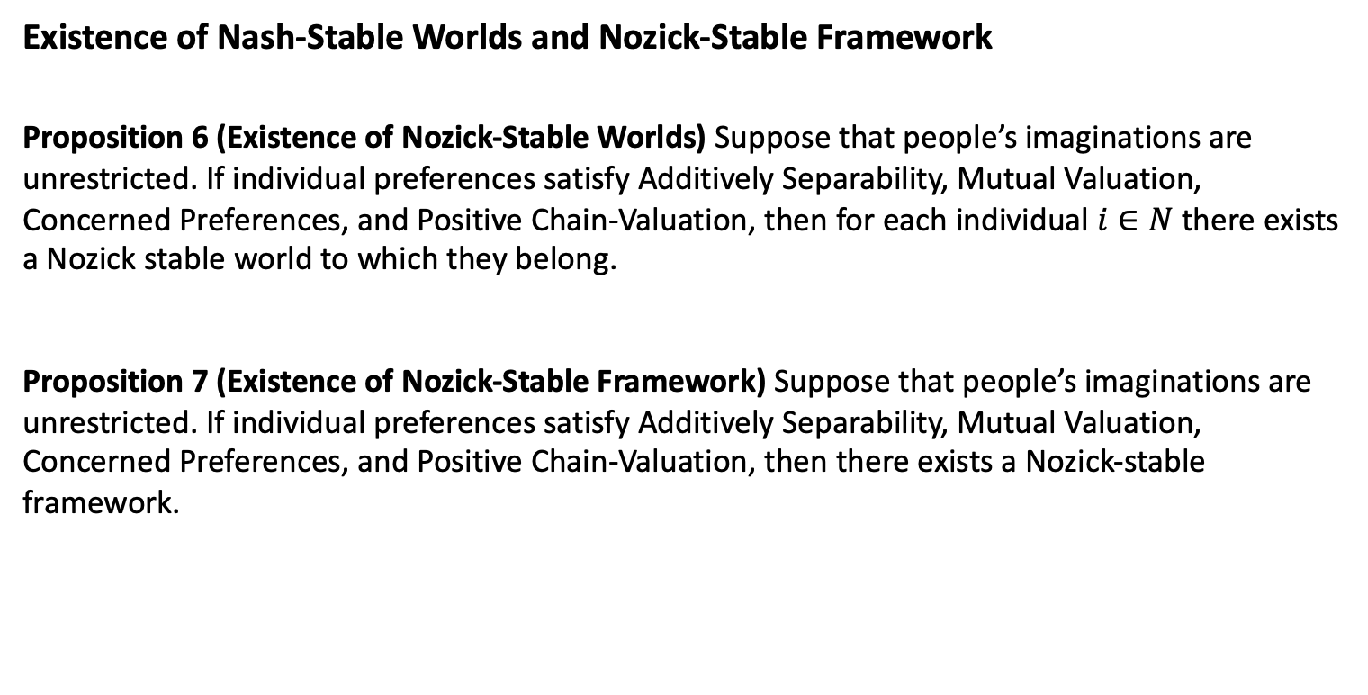
Existence of Nash-Stable Worlds and Nozick-Stable Framework
Proposition 6 (Existence of Nozick-Stable Worlds) Suppose that people’s imaginations are unrestricted. If individual preferences satisfy Additively Separability, Mutual Valuation, Concerned Preferences, and Positive Chain-Valuation, then for each individual $i∈N$ there exists a Nozick stable world to which they belong.
Proposition 7 (Existence of Nozick-Stable Framework) Suppose that people’s imaginations are unrestricted. If individual preferences satisfy Additively Separability, Mutual Valuation, Concerned Preferences, and Positive Chain-Valuation, then there exists a Nozick-stable framework.

Slide 29
Significance of Propositions 6 & 7
Let us take a moment to grasp the significance of these findings.
They reveal that when individuals are granted the liberty to envision and actualize any conceivable world through their unrestricted imaginations, alongside the freedom of movement and association to enter or exit any pre-existing or potential worlds without constraint, this process naturally culminates in a stable equilibrium, in which each person ultimately finds themselves residing in some world that they consider to be the best of all possible worlds – what they deem to be utopia – and, moreover, all of these myriads of diverse utopian worlds can co-exist compatibly within an overarching framework that allows everybody to live harmoniously under one utopian framework without forcing anybody to live under a single unitary utopian vision.
→ This utopian framework, according to Nozick, is none other than the minimal state.

Slide 30
6. Nozick Stable Worlds and Marginal Contribution

Slide 31
Prelude: Nozick Stable Worlds and Marginal Contribution
Then, what would be the main characteristic of such a Nozick stable world? Nozick himself presented the following conjecture:
Nozick’s Conjecture: “We seem to have a realization of the economists’ model of a competitive market. … Many associations competing for my membership are the same structurally as many firms competing to employ me. In each case I receive my marginal contribution. Thus, it seems, we have the result that in every stable association, each person receives his marginal contribution; in each world whose rational members can imagine worlds and emigrate to them and in which no rational member can imagine another world he would rather live in (in which each person has the same imagining and emigrating rights) which he thinks would endure, each person receives his marginal contribution to the world.” (Nozick 1974: 302)
It is no accident that Nozick is referring to “the economists’ model of a competitive market”, as it is one of the fundamental principles of (neo-) classical economic theory that under a competitive market economy, people’s wages will equal to their marginal contributions, which renders wages received in such an economy “fair.”
However, if it emerges that there are individuals who receive far less than their actual contribution to their associations, and furthermore, if all these worlds turn out to be Nozick-stable, collectively forming a Nozick-stable framework, then it suggests that such a framework, equated by Nozick with the minimal state, might (not necessarily, but possibly) not only tolerate but also perpetuate inequitable and exploitative associations and worlds.

Slide 32
Prelude: Nozick Stable Worlds and Marginal Contribution (cont.)
Such a scenario scarcely aligns with the notion of utopia.
Therefore, for Nozick to effectively demonstrate that the minimal state, as a utopian framework, refrains from perpetuating such exploitative structures and descending into dystopia, it becomes imperative to prove that every individual does indeed receive their fair marginal contribution within a Nozick-stable framework.
However, in ASU, Nozick leaves such a task rather unfinished with a brief disclaimer: “Our argument thus far has been intuitive; we shall offer no formal argument here” (Nozick, 1974: 302).
In this section, we will investigate whether it holds true that once we establish a Nozick-stable framework, under the conditions outlined in Propositions 6 and 7, each individual will indeed receive their marginal contribution from their respective Nozick-stable worlds to which they belong.

Slide 33
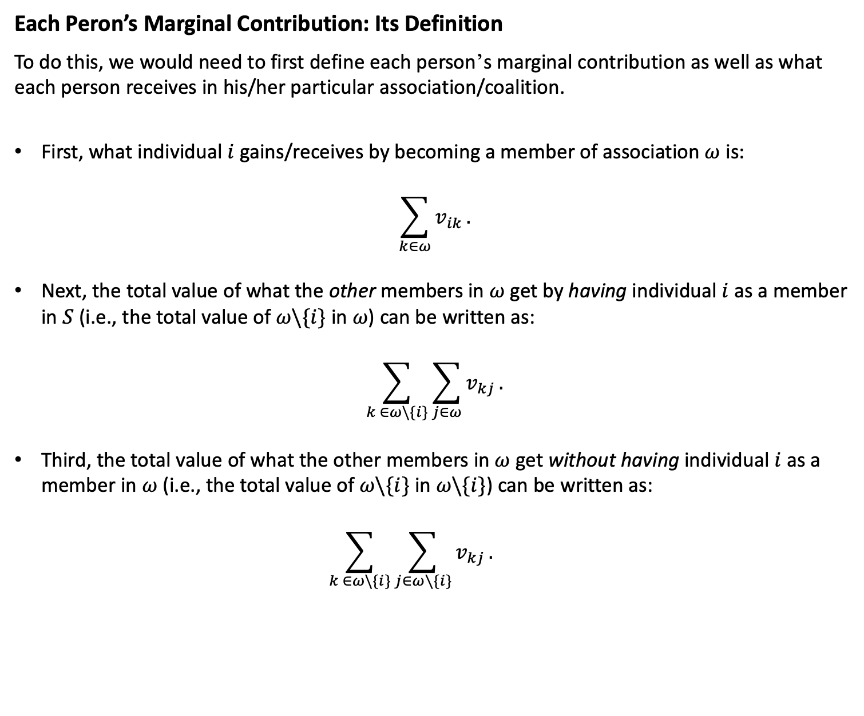
Each Peron’s Marginal Contribution: Its Definition
To do this, we would need to first define each person’s marginal contribution as well as what each person receives in his/her particular association/coalition.
First, what individual $i$ gains/receives by becoming a member of association $ω$ is:
$$\sum_{k∈ω}{v_{ik}}.$$
Next, the total value of what the other members in $ω$ get by having individual $i$ as a member in $S$ (i.e., the total value of $ω\backslash \{i\}$ in $ω$) can be written as:
$$\sum_{k ∈ω\backslash \{i\}}{\sum_{j∈ω}{v_{kj}}}.$$
Third, the total value of what the other members in $ω$ get without having individual $i$ as a member in $ω$ (i.e., the total value of $ω\backslash \{i\}$ in $ω\backslash \{i\}$) can be written as:
$$\sum_{k ∈ω\backslash \{i\}}{\sum_{j∈ω∖\{i\}}{v_{kj}}}.$$

Slide 34
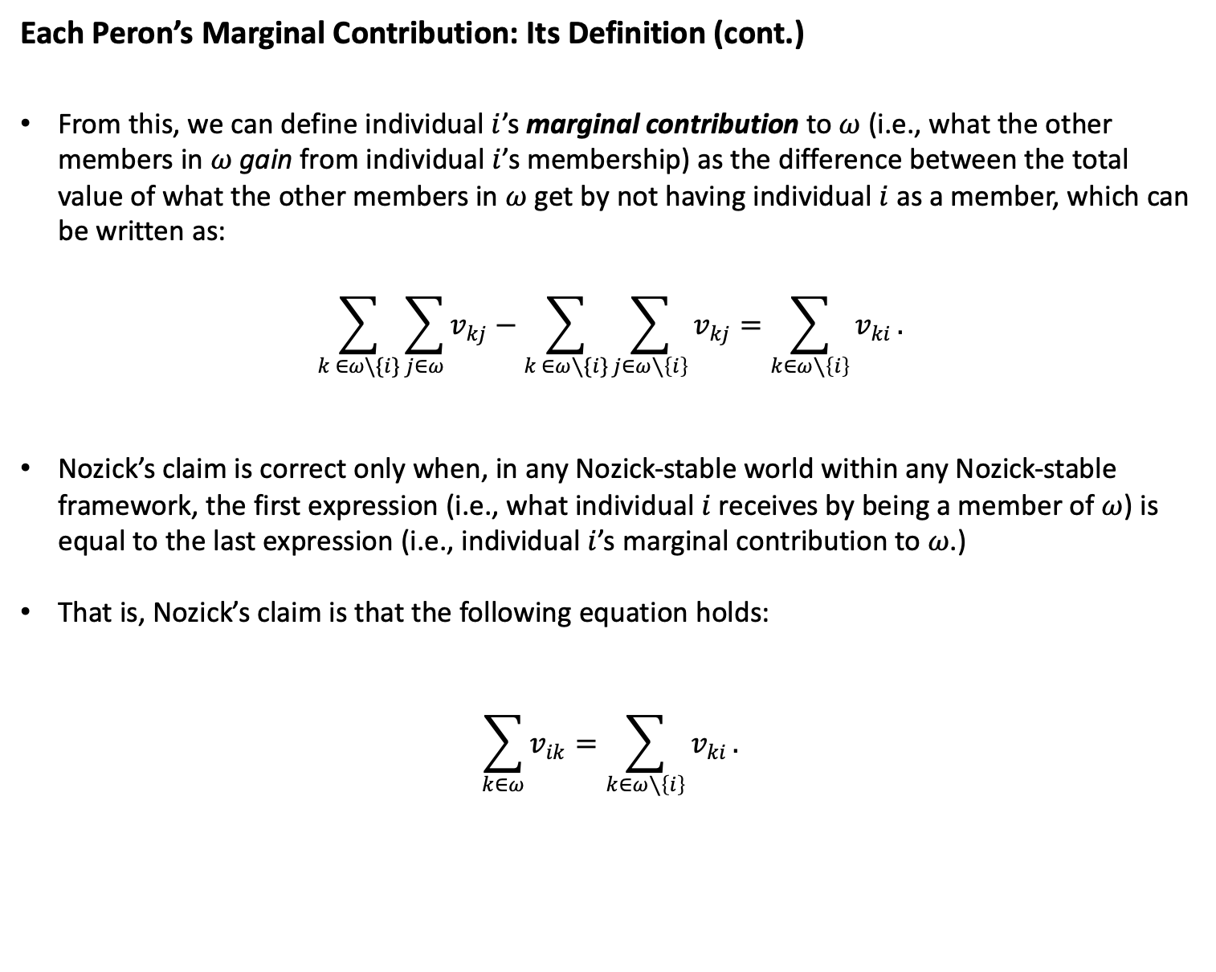
Each Peron’s Marginal Contribution: Its Definition (cont.)
From this, we can define individual $i$’s marginal contribution to $ω$ (i.e., what the other members in $ω$ gain from individual $i$’s membership) as the difference between the total value of what the other members in $ω$ get by not having individual $i$ as a member, which can be written as:
$$\sum_{k ∈ω\backslash \{i\}}{\sum_{j∈ω}{v_{kj}}}−\sum_{k ∈ω∖\{i\}}{\sum_{j∈ω∖\left\{i\right\}}{v_{kj}}}=\sum_{k∈ω∖\left\{i\right\}}{v_{ki}}.$$
Nozick’s claim is correct only when, in any Nozick-stable world within any Nozick-stable framework, the first expression (i.e., what individual $i$ receives by being a member of $ω$) is equal to the last expression (i.e., individual $i$’s marginal contribution to $ω$.)
That is, Nozick’s claim is that the following equation holds:
$$\sum_{k∈ω}{v_{ik}}=\sum_{k∈ω∖\left\{i\right\}}{v_{ki}}.$$

Slide 35
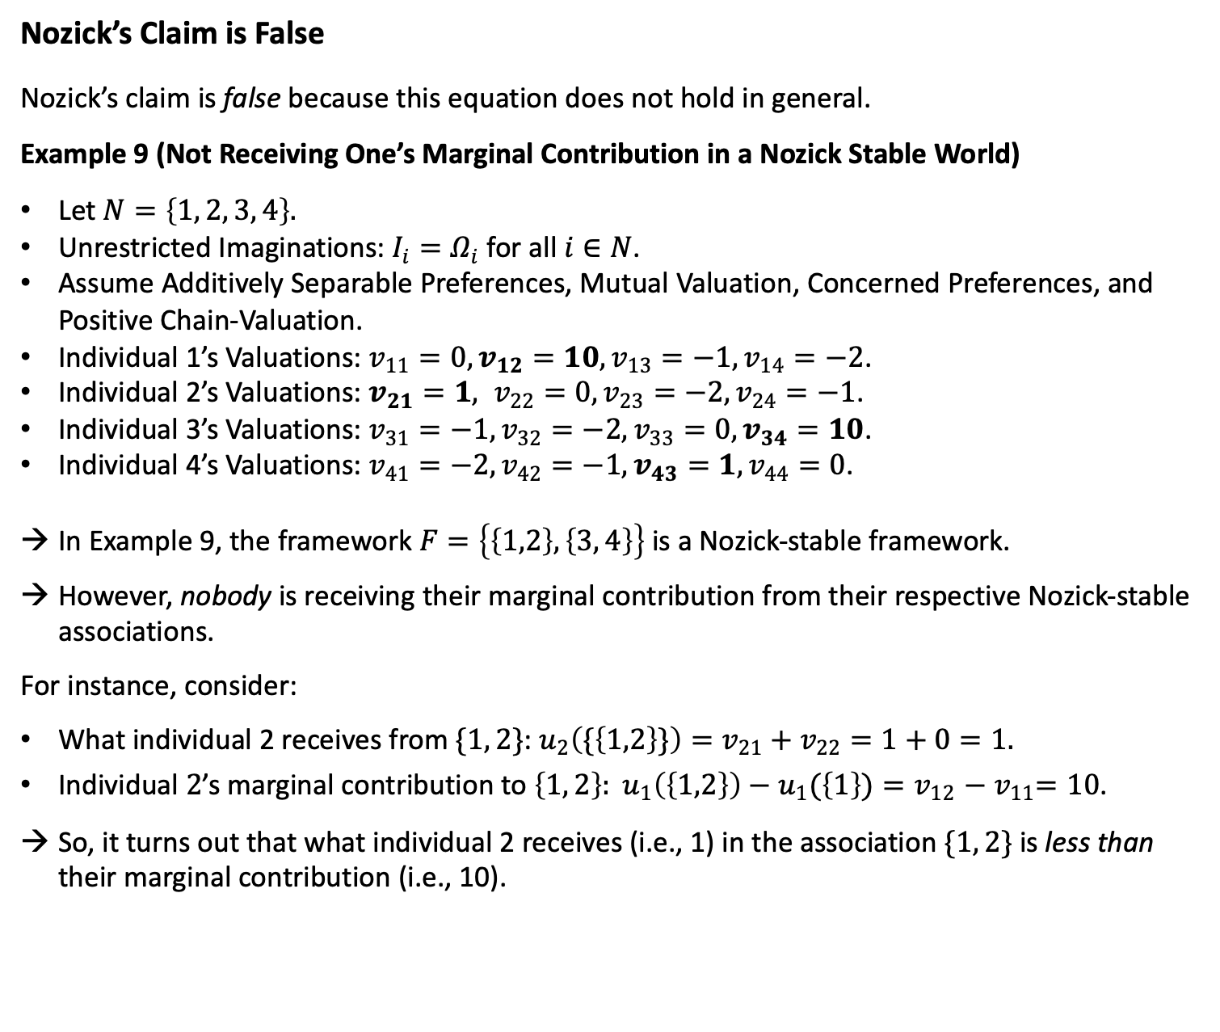
Nozick’s Claim is False
Nozick’s claim is false because this equation does not hold in general.
Example 9 (Not Receiving One’s Marginal Contribution in a Nozick Stable World)
Let $N=\left\{1, 2, 3, 4\right\}.$
Unrestricted Imaginations: $I_{i}=Ω_{i}$ for all $i∈N$.
Assume Additively Separable Preferences, Mutual Valuation, Concerned Preferences, and Positive Chain-Valuation.
Individual 1’s Valuations: $v_{11}=0, v_{12}=10, v_{13}=−1, v_{14}=−2$.
Individual 2’s Valuations: $v_{21}=1, v_{22}=0, v_{23}=−2, v_{24}=−1$.
Individual 3’s Valuations: $v_{31}=−1, v_{32}=−2, v_{33}=0, v_{34}=10$.
Individual 4’s Valuations: $v_{41}=−2, v_{42}=−1, v_{43}=1, v_{44}=0$.
In Example 9, the framework $F=\left\{\left\{1,2\right\}, \left\{3, 4\right\}\right\}$ is a Nozick-stable framework.
However, nobody is receiving their marginal contribution from their respective Nozick-stable associations.
For instance, consider:
What individual 2 receives from $\{1, 2\}$: $u_{2}\left(\{\left\{1,2\right\}\}\right)=v_{21}+v_{22}=1+0=1.$
Individual $2$’s marginal contribution to $\left\{1, 2\right\}: u_{1}\left(\left\{1,2\right\}\right)−u_{1}(\left\{1\right\}){=v}_{12}{− v}_{11}=10$.
So, it turns out that what individual 2 receives (i.e., 1) in the association $\{1, 2\}$ is less than their marginal contribution (i.e., 10).

Slide 36
Philosophical Implications
What are the significant normative implications of all this?
As elucidated earlier, if there exists an individual who receives less than their contributions to other members within their association, it suggests, at the very least, some degree of unfair treatment.
We might even characterize it as exploitation if the gap between their contribution and what they receive is substantial.
Despite the structural design of the possible worlds model mitigating such exploitation to the least extent possible, the unsettling truth remains that exploitation may not only occur but also stably persist indefinitely within a Nozick-stable framework, implying that such exploitation can similarly occur and perpetuate within a minimal state.
In light of this, can we still wholeheartedly endorse Nozick’s claim that the minimal state is “an inspiring vision?” (Nozick 1974: 333)

Slide 37
7. Concluding Remarks

Slide 38
Summary
In this paper, we have undertaken a rigorous formal examination of Nozick's model of possible worlds, which Nozick employed to reconceptualize utopia in terms of stability within the model.
Nozick defines utopia as a meta-utopia, providing a framework within which specific utopian visions and lifestyles can be freely explored and experimented, where individuals are allowed to freely create, join, and leave various utopian communities – which co-exist harmoniously within the framework – without coercion.
Nozick argues that this framework for utopia in the model corresponds to the minimal state in the real world, which demonstrates that the minimal state may not merely be philosophically justified, but it is, further, the institutional arrangement that “best realizes the utopian aspirations of untold dreamers and visionaries.” (Nozick 1974: 333)
In order for Nozick’s ambitious project – which aims to demonstrate the equivalence of utopia and the minimal state – to succeed, it is imperative that the possible worlds model can generate a Nozick-stable framework, i.e., a partition in which all of its members are Nozick-stable worlds.
We have learned that Nozick stability is, logically speaking, a much stronger stability notion than either core stability or Nash stability. A Nozick-stable framework may fail to exist even when core-stable or Nash-stable frameworks do.

Slide 39
Summary (cont.)
We have offered a set of sufficient conditions that guarantee the existence of a Nozick-stable framework without infringing anybody’s rights or freedom.
But we have also seen that such conditions are quite restrictive and would likely fail to be met in our actual world.
Moreover, even under such restrictive set of conditions that are jointly sufficient to guarantee the existence of a Nozick-stable framework, we have seen that Nozick was simply incorrect to think that each individual will receive from their association their fair marginal contribution to the association.
The normative implication of this is that the minimal state, in equilibrium, may tolerate and even stabilize exploitation, not momentarily, but in perpetuity.
This generates significant doubts on whether the minimal state can really serve as a utopian vision that Nozick has strongly hoped for.

Slide 40
Concluding Remarks
Certainly, a notable limitation of our formal analysis is that we've presented only a set of sufficient conditions, rather than a complete characterization (i.e., a set of necessary and sufficient conditions) for the existence of a Nozick-stable framework in the possible worlds model.
Depending on the conditions chosen to fully characterize the existence of a Nozick-stable framework, the outcome may be more favorable for Nozick’s purposes than what we have outlined in this paper.
Numerous tasks remain unfinished.
We trust that this paper will ignite fresh interest and inspire further research into analyzing Nozick’s utopian theory and its correlation with the minimal state.
The pursuit of utopia must continue.

Slide 41
Thank You!

