Slide 1
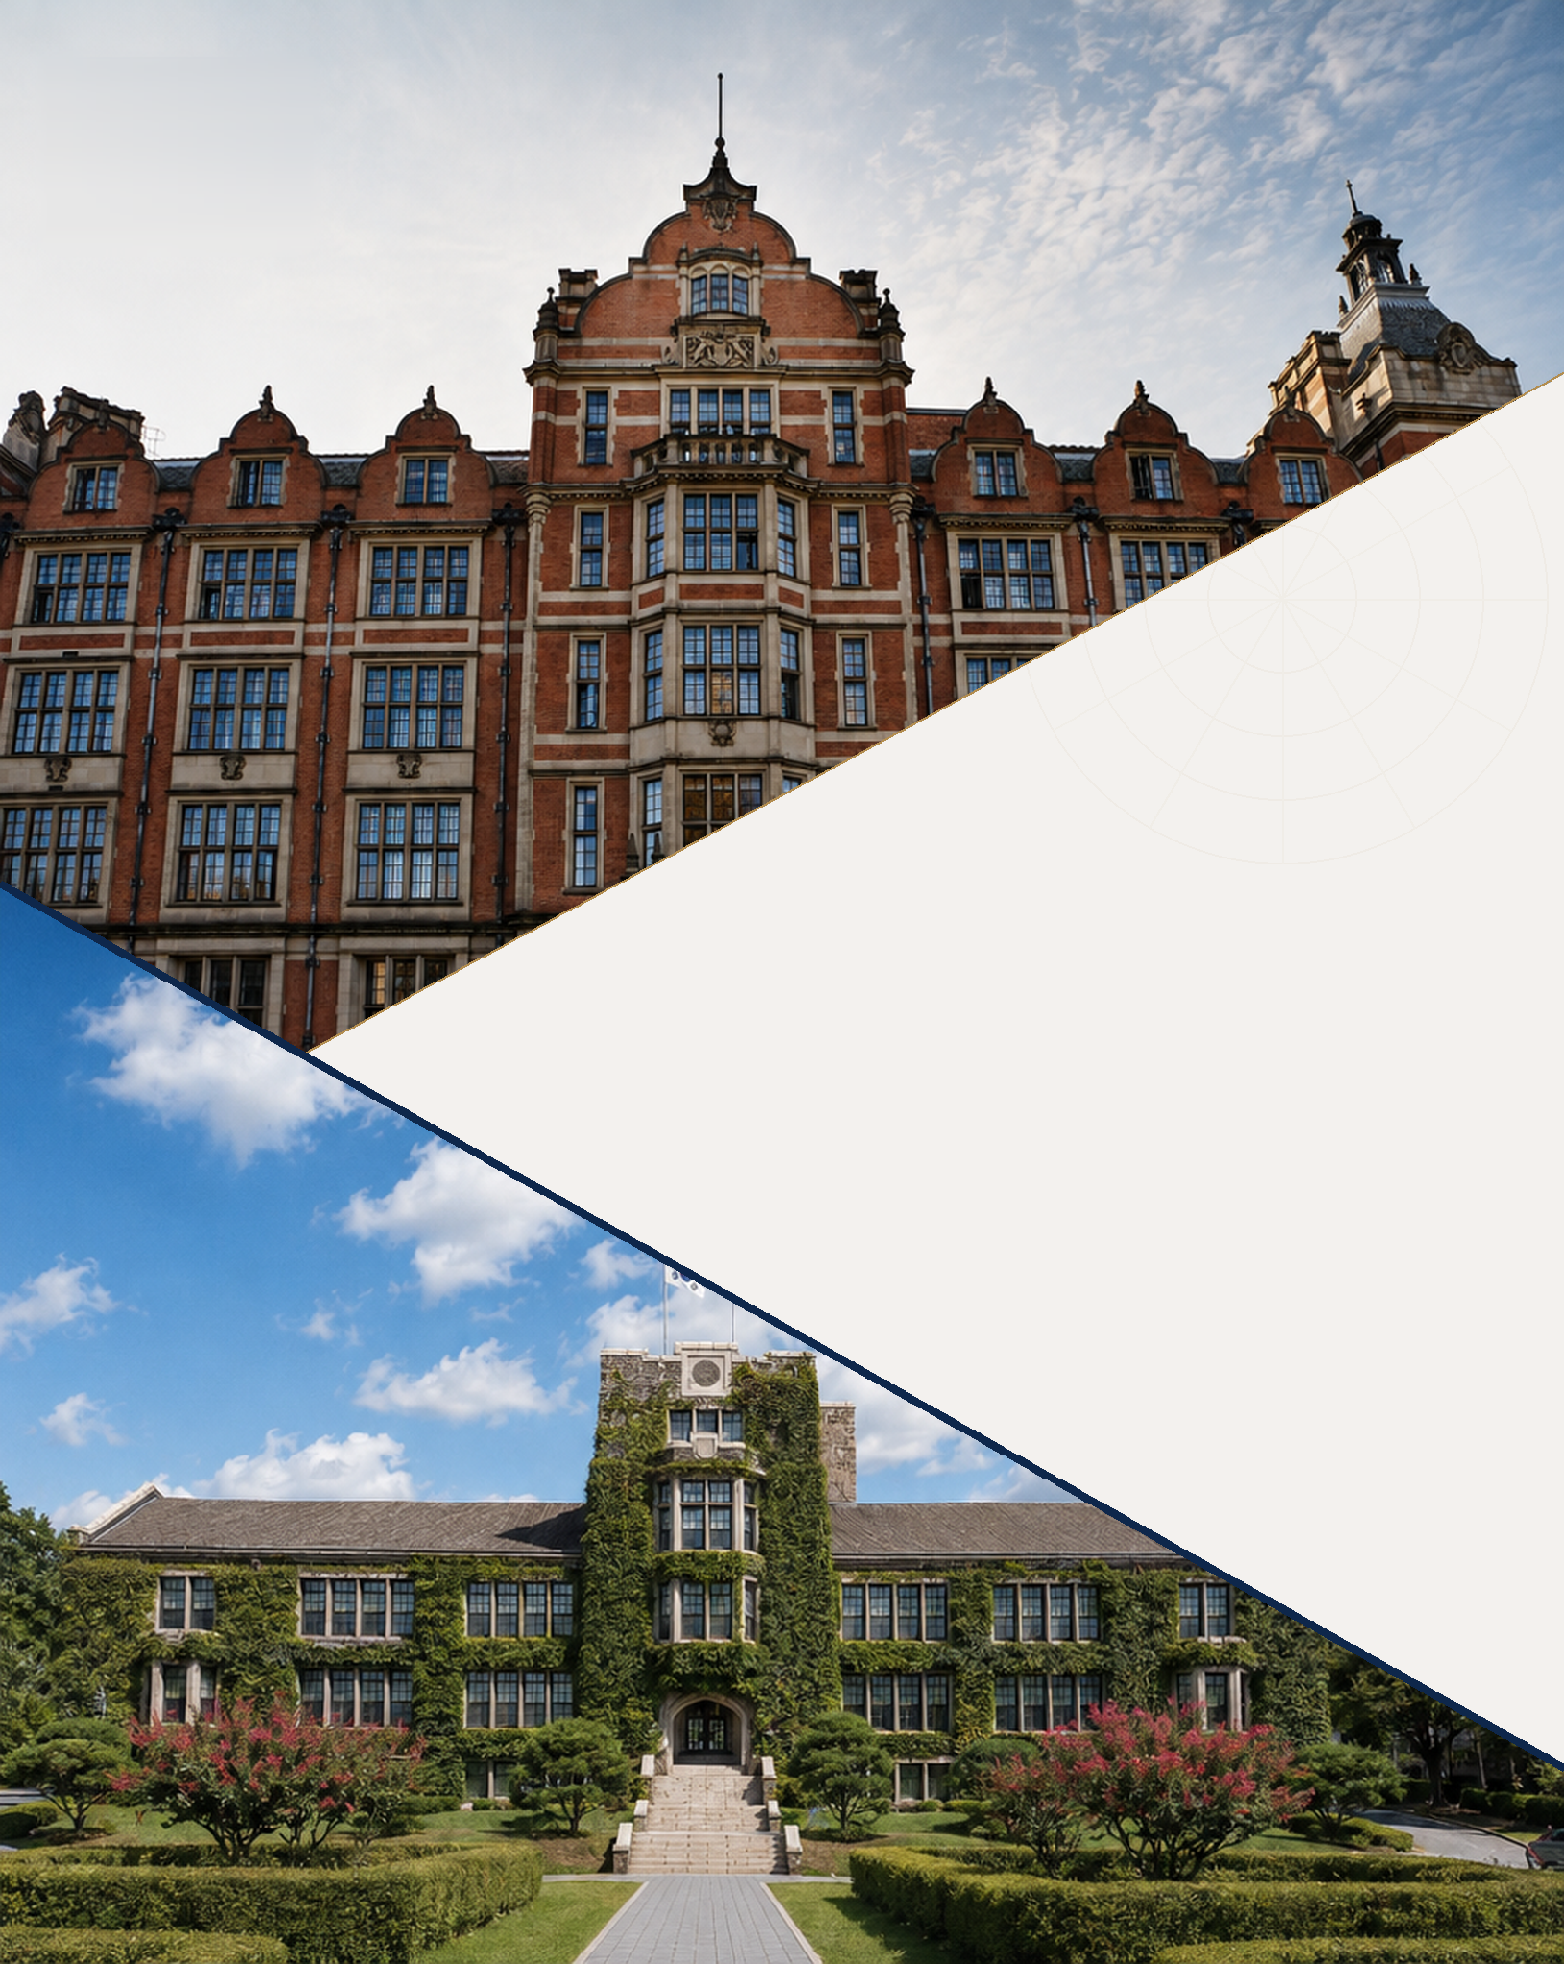


Excellence.
Insight.
Impact.
LSE
×
YONSEI
DOUBLE DEGREE PROGRAM
IN ECONOMICS
A GLOBAL PATHWAY IN ECONOMIC STUDY
2027/28 · ADMISSIONS GUIDELINES
Notes:
Cover. Photographs and the diagonal composition follow the supplied reference (cover.png): LSE above, Yonsei below. Still to be completed — (1) the official logos of both universities, in the marked box; (2) confirmation that the photographs are licensed for print use, and their credits; (3) whether the LSE strapline "Excellence. Insight. Impact." may be used on a joint publication; (4) the Korean title of the programme, if the brochure is issued bilingually; (5) publisher, date of publication and document version.

Slide 2
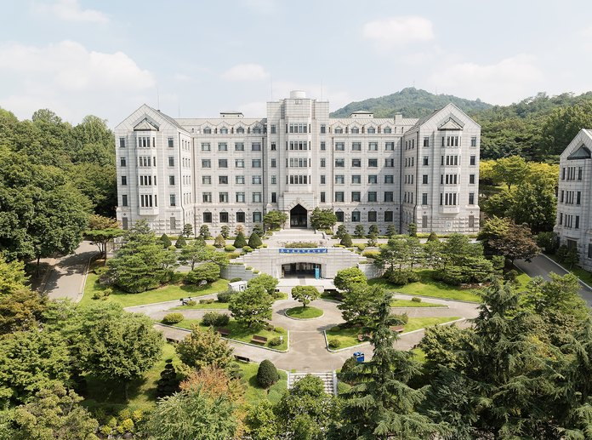
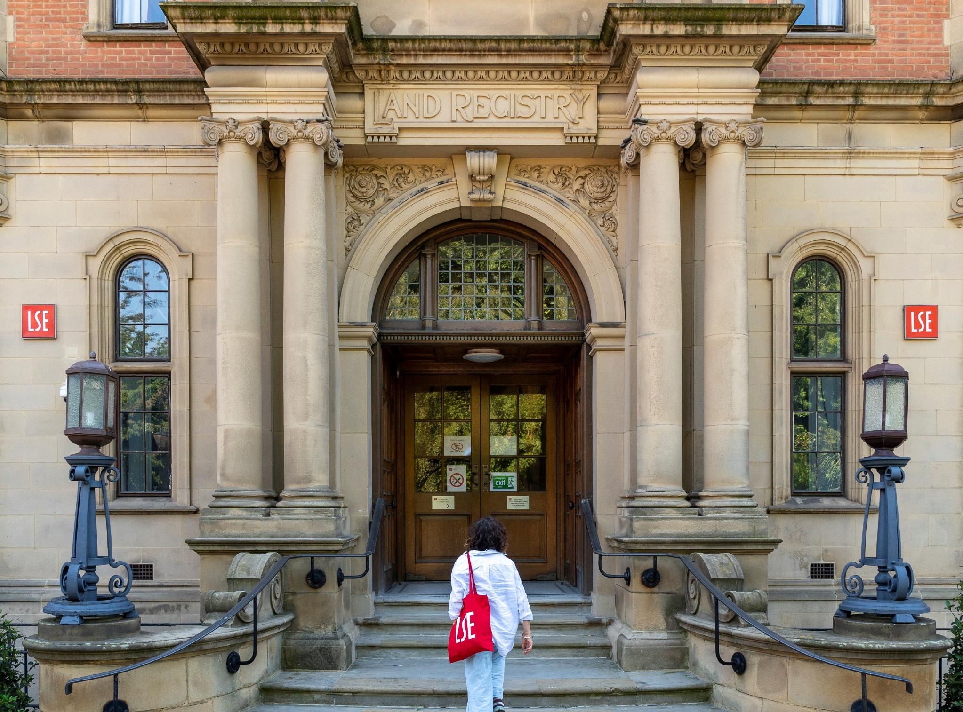
Why LSE–Yonsei?
Study economics at two leading universities, in two global cities.
Yonsei brings the perspective of one of Asia’s foremost universities in Seoul. LSE brings a world-leading economics department at the heart of London’s finance and policy networks. Over two years, students study in both departments and graduate with two master’s degrees.
YONSEI UNIVERSITY · SEOUL
Leading in Asia
QS global top 50 university
42nd overall in QS World University Rankings 2027
LONDON SCHOOL OF ECONOMICS · LONDON
World-leading
YEAR 1 · SEOUL
Yonsei University
Graduate School of Economics
YEAR 2 · LONDON
London School of Economics and Political Science
Department of Economics
Top 10 for Economics and Econometrics
6th in QS World University Rankings by Subject 2026
Sources: QS World University Rankings 2027; QS World University Rankings by Subject 2026 (Economics & Econometrics).
Daewoo Hall, home of the Graduate School of Economics, Yonsei University
Sir Arthur Lewis Building, home of the Department of Economics, LSE
01
Notes:
Rankings supplied by Yonsei: Yonsei 42nd overall (QS World University Rankings 2027) and =74th for Economics & Econometrics (QS by Subject 2026); LSE 62nd overall and 6th for Economics & Econometrics. NOTE — the two LSE figures were supplied without an edition year; confirm they come from the same two editions cited in the source line before printing. Left photograph: Daewoo Hall (Graduate School of Economics), supplied by Yonsei. Right: LSE to supply an exterior of the Sir Arthur Lewis Building, 32 Lincoln’s Inn Fields, landscape, same crop as the Yonsei image; photo credits needed for both.

Slide 3
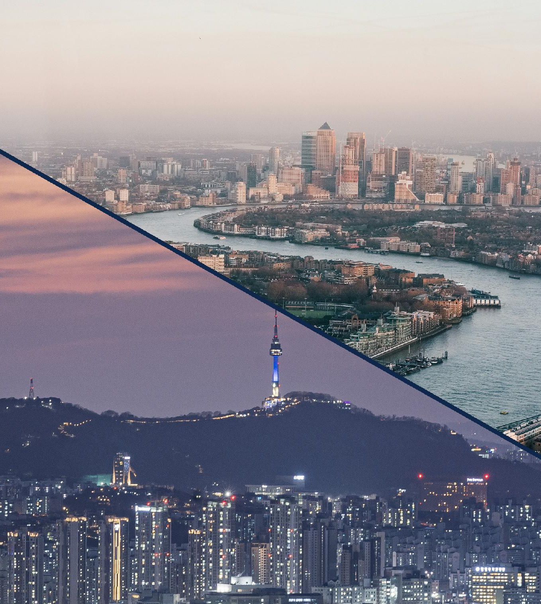
Seoul and London.
Two degrees. One economist.
Everything in this programme comes in twos. What you become does not.
TWO DEGREES
Two full master’s degrees, each awarded in its own right by the university that taught you — not a single joint award.
TWO CITIES
A full academic year in each city, not a term abroad. Seoul first, then London — long enough to learn how each one works.
TWO NETWORKS
Graduates join the alumni communities of both universities: Yonsei’s across Korea and Asia, and over 240,000 in LSE’s worldwide network.
Seoul, from Namsan · London, the Thames and Canary Wharf
02
Notes:
Brand statement page. No equivalent copy exists in the source document. Photograph: Underwood Hall (main building), Yonsei University. If LSE would prefer a London image here instead, an alternative is Houghton Street looking towards the Old Building, or the LSE Library (Lionel Robbins Building).

Slide 4
Programme Overview
Category | Details
Programme | LSE–Yonsei Double Master’s Degree Programme in Economics
First Intake | 2027/28 academic year
Duration | Two years, full-time
Year 1 | Graduate School of Economics, Yonsei University, Seoul
Year 2 | Department of Economics, London School of Economics and Political Science (LSE), London
Language of Instruction | All teaching and assessment are conducted in English at both universities.
Degrees Awarded | Master of Economics — Yonsei University MSc in Economics (Advanced Topics) — LSE
Degree Award Requirements | Students must satisfy the degree requirements of both universities to be awarded both degrees.
Number of Places | Approximately 40 students (anticipated intake for 2027/28)
Admission Decision | Joint Programme Steering Committee
03
Notes:
Source: §1 Programme Overview and §3 Number of Places.

Slide 5
Programme Structure
Year 1 is spent at Yonsei University in Seoul and Year 2 at LSE in London. Students are subject to the regulations of the university at which they principally study in each year.
Timeline
YEAR 1
Seoul
Graduate School of Economics,
Yonsei University
YEAR 2
London
Department of Economics,
London School of Economics
Jan 2027
Application
Apr 2027
Decisions
Master of Economics programme
Minimum 18 credits in Year 1
9 required credits: Microeconomics, Macroeconomics and Econometrics
9 elective credits from a range of courses including Applied Econometrics and Data Science and Coding for Economics
Progression requires an overall average of at least B (B0) and at least B- in every course
Commences in the autumn semester of 2027
MSc in Economics (Advanced Topics)
4 units (corresponding to 8 half unit courses)
Free choice from a rich array of economics options courses, spanning advanced core courses and economic field courses, as well as from options in Finance
Commences in autumn 2028
Autumn 2027
Year 1 · Seoul
Autumn 2028
Year 2 · London
2029
Two degrees
05
Notes:
Source: §8 Programme Structure and Administration, and §4 Admissions Schedule.

Slide 6
Curriculum | Year 1 at Yonsei
Master of Economics, Graduate School of Economics
Students must complete at least 18 credits during Year 1 at Yonsei University.
Category | Courses | Credits
Required | Microeconomics I Macroeconomics I Econometrics | 9
Electives | Selected from courses such as: Mathematics for Economists Microeconomics II Macroeconomics II Applied Econometrics Data Analysis and Coding for Economists | 9
Year 1 total | Minimum 18 credits | 18
Progression to Year 2
To progress to Year 2 at LSE, students must satisfy both of the following:
an overall Year 1 average of at least B (B0 or the equivalent GPA); and
a grade of at least B- in every individual course.
If a student receives a grade below B- in any course, progression to Year 2 is deferred and the course must be retaken at Yonsei University in the following academic year.
※ The elective list above is indicative; the courses actually offered may vary by academic year.
06
Notes:
Source: §8 Year 1: Yonsei University, and the progression requirements in §9.

Slide 7
Curriculum | Year 2 at LSE
MSc in Economics (Advanced Topics), Department of Economics
In Year 2 students transfer to LSE in London and complete the requirements of the MSc programme.
Component | Requirement
Pre-sessional course | Compulsory non-credit-bearing pre-sessional course
Taught courses | Courses totaling four (4) units, corresponding to eight (8) half unit courses
Exemption | Students who have successfully completed Mathematics for Economists at Yonsei University may, if they wish, be exempted from part of LSE’s compulsory pre-sessional mathematics and statistics course.
Award of the LSE degree | Students must pass at least four units in accordance with the applicable degree regulations.
Recognition at Yonsei | At least 12 credits from courses completed at LSE are recognised by Yonsei University towards the Master of Economics.
Course list | Economics of Labour Markets; Development Economics: Applications and Policy; International Trade; International Macroeconomics; Public Economics; Political Economy; Topics in Industrial Organisation; Environment and resource economics; Behavioural Economics; Monetary Economics and Aggregate Fluctuations; Growth, Innovation, and Productivity; Financial Markets and the Macroeconomy; Contracts and Organisations; Empirical Macroeconomics; Advanced Econometrics with AI and Machine Learning; Economics of Technology: Historical Perspectives; Asset Markets; Corporate Finance; Fixed Income Markets; Derivatives; Entrepreneurial Finance; Portfolio Management
07
Notes:
Source: §8 Year 2: LSE and Joint Administration, with parts of §9.

Slide 8
Progression & Degree Requirements
Students must satisfy the degree requirements of both universities.
If a student fails to satisfy the requirements of either university, neither degree may be awarded separately under this double degree programme.
01 Progression to Year 2
An overall Year 1 average of at least B (B0 or the equivalent GPA)
A grade of at least B- in every individual course
A grade below B- defers progression; the course must be retaken at Yonsei University in the following academic year
02 Master of Economics — Yonsei University
36 credits in total over the whole programme
At least 18 credits completed at Yonsei University in Year 1
At least 12 credits recognised by Yonsei University from courses completed at LSE
An overall GPA of at least 3.00 on a 4.30 scale
03 MSc in Economics (Advanced Topics) — LSE
Pass at least four units in accordance with the applicable degree regulations
Complete the compulsory non-credit-bearing pre-sessional course
Both degrees, or neither.
If a student fails to satisfy the degree requirements of either university, neither degree may be awarded separately under this double degree programme.
08
Notes:
Source: §9 Progression and Degree Requirements.

Slide 9
Admissions Schedule
Applications are submitted through Yonsei University’s online application system and reviewed jointly by both universities.
Stage | Schedule
Application Period | 1–31 January 2027 (provisional)
Application Review and Joint Selection | Applications are jointly reviewed by both universities through Yonsei University’s online application system.
Notification of Final Decisions | By mid-April each year
Commencement of Year 1 | Autumn semester 2027 — Yonsei University, Seoul
Progression to Year 2 at LSE | Autumn 2028 — LSE, London
※ Dates marked “provisional” are subject to confirmation by both universities.
09
Notes:
Source: §4 Admissions Schedule. Detailed dates are not yet fixed, so a blank table is provided.

Slide 10
Eligibility & Admission Requirements
Applicants must meet the admission requirements for the relevant master’s programmes at both Yonsei University and LSE.
Academic Qualifications | Applicants must hold a bachelor’s degree.
English Language Proficiency | At admission: TOEFL iBT 80 or above, or an equivalent IELTS score of 5.5. LSE requirement before Year 2: TOEFL iBT 100 or above, or IELTS 7.0 or above. Students who have not met the LSE requirement will take an LSE English test; students who do not pass must take an LSE English course.
Required Application Materials | Yonsei University online application form Official transcript covering the applicant’s entire undergraduate programme Proof of English language proficiency Any other information or documentation required by either university for admission, registration or statutory reporting purposes Separate consent authorising the sharing of the applicant’s personal data with LSE and its international transfer to the United Kingdom
English language requirement at a glance
At admission (Yonsei)
TOEFL iBT 80
or IELTS 5.5
Before Year 2 (LSE)
TOEFL iBT 100
or IELTS 7.0
If not met:
LSE test
→ LSE English course if required
10
Notes:
Source: §5 Eligibility and Admission Requirements.

Slide 11
Selection & Admissions Process
A single application to Yonsei University is reviewed by the Programme Directors at both universities, who reach a joint decision.
01
02
03
04
Apply through Yonsei University
Applicants apply through Yonsei University’s online application system and pay the application fee.
Independent review, joint decision
The Programme Directors at both universities review each application independently and then jointly decide whether the applicant should be admitted, conditionally admitted, placed on a waiting list, or rejected.
Notification by Yonsei University
Yonsei University’s administrative office formally notifies applicants of the final decision.
Offer letters from both universities
Yonsei University and LSE each issue their own final offer letter and relevant admissions information.
11
Notes:
Source: §6 Selection and Admissions Process.

Slide 12
Tuition Fees & Other Costs
Students pay tuition fees to the university at which they are registered during each year of the programme.
YEAR 1
Yonsei University
≈ £19,700 (KRW 35,000,000)
(current FX rate, as of October 2026)
Payable in four instalments over four semesters in order to maintain registration at Yonsei University.
YEAR 2
London School of Economics
£43,100
Tuition fee for the MSc in Economics (Advanced Topics) at LSE in 2027/28 Academic Year. Subject to change.
Costs payable separately by students
Application fees
Travel and health insurance
Accommodation and living expenses
Airfare and other transportation costs
Textbooks and educational supplies
Visa and other immigration-related costs
12
Notes:
Source: §7 Tuition Fees and Other Costs.

Slide 13
Important Information
Deferral of entry
Deferral of entry after admission is not normally permitted. In exceptional cases involving unforeseen personal circumstances, such as bereavement or health issues, a deferral may be granted at the discretion of both universities.
Visas and immigration
Students must comply with the visa and immigration requirements of the country in which they study and are responsible for obtaining the necessary visas and insurance.
Appeals
Appeals concerning academic matters or assessments at either university will be handled under that university’s procedures and may not be lodged with the other university.
Precedence of official regulations
In the event of any discrepancy between these guidelines and the official regulations or final announcements of either university, the official regulations and final announcements will prevail.
Personal data
Applicants are required to give separate consent authorising the sharing of their personal data with LSE and its international transfer to the United Kingdom.
13
Notes:
Source: §10 Important Information, and the personal data consent item in §5.

Slide 14
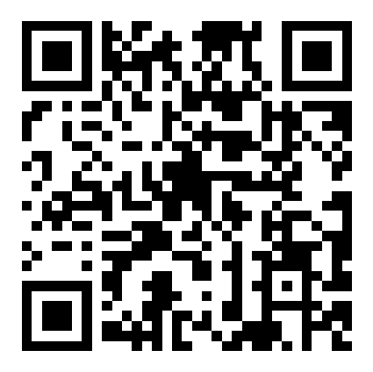
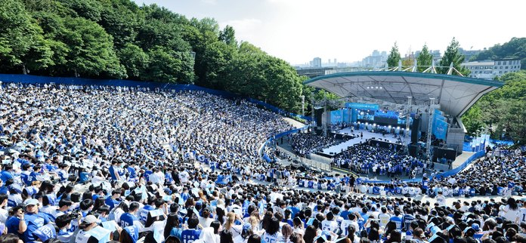
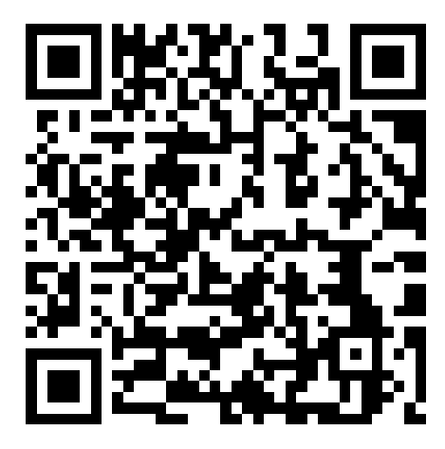
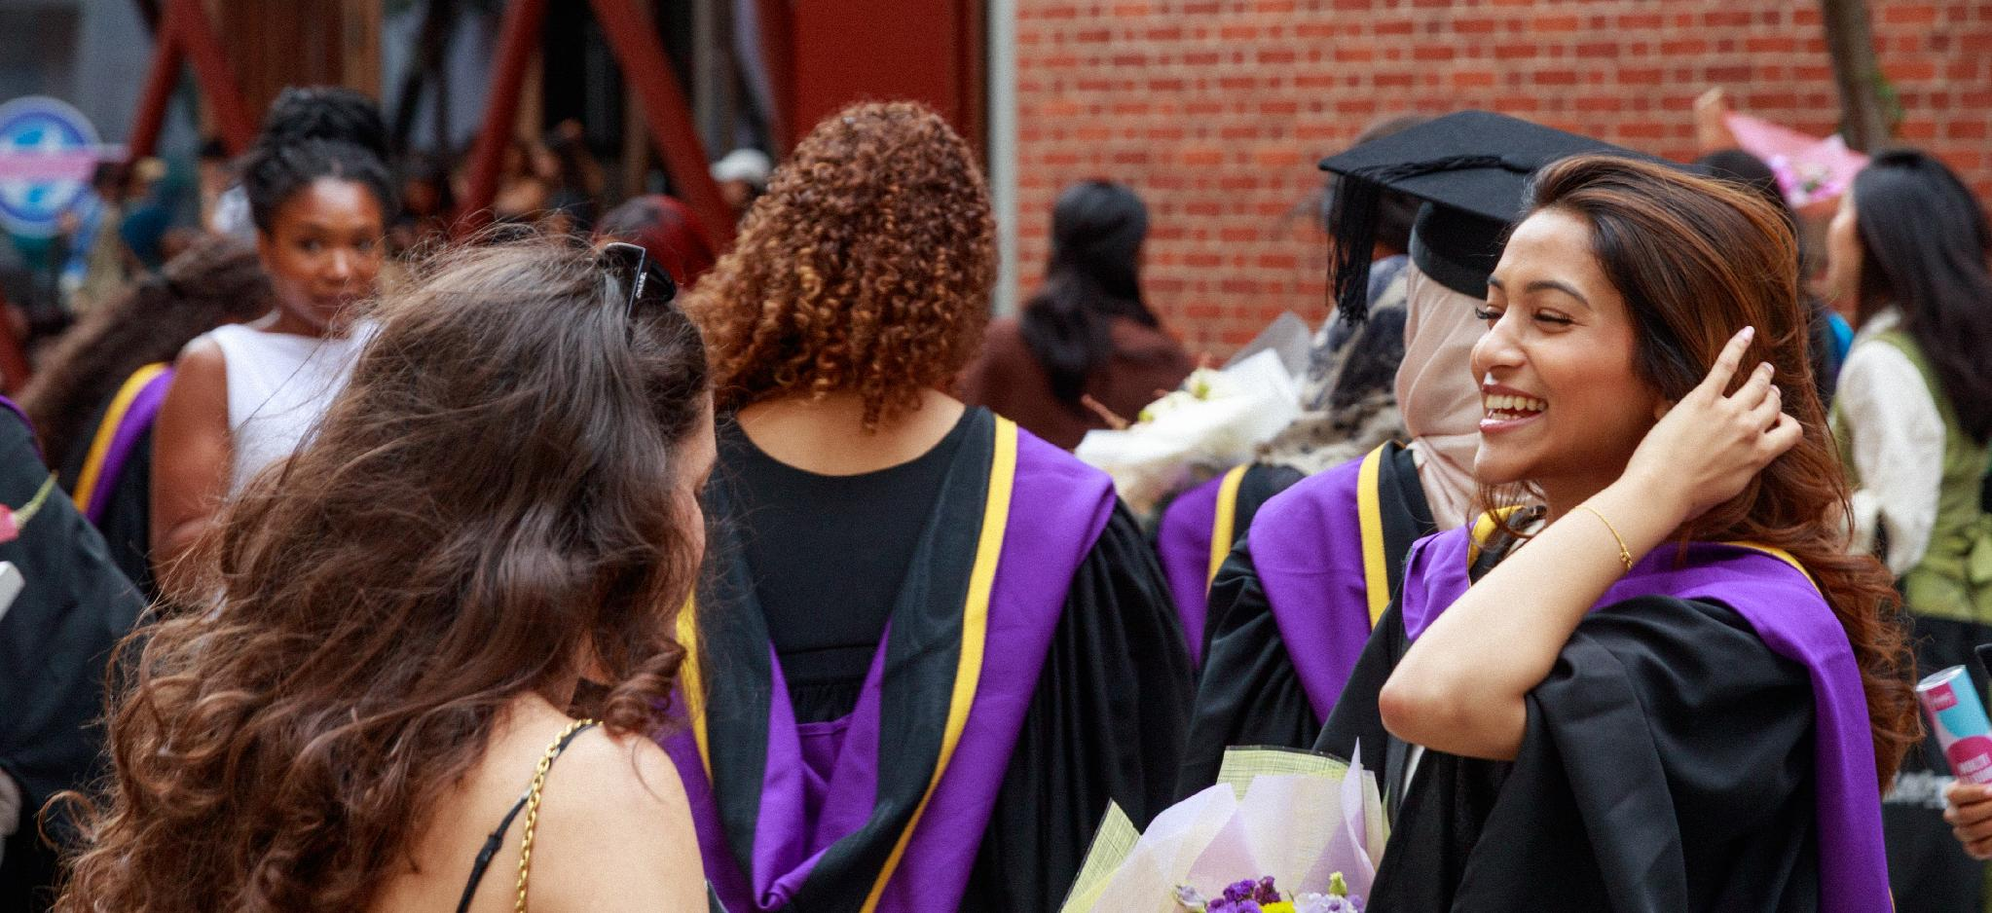
Faculty & Student Profile
Faculty
Student life
Scan this QR code for:
Faculty of School of Economics, Yonsei University
https://devcms.yonsei.ac.kr/economics_en/faculty/faculty.do
Scan this QR code for:
Faculty of London School of Economics
https://www.lse.ac.uk/economics/people/faculty
Akaraka, the Yonsei University festival, Sinchon campus
Programme Directors
Yonsei University
Seung Hoon Lee
Associate Professor of Economics
London School of Economics and Political Science
Vassilis Hajivassiliou
Associate Professor of Economics
Graduation ceremony, LSE campus
14
Notes:
The source document contains no faculty or student data, so those areas are blank. Left photograph: Akaraka, the Yonsei festival. Right: LSE to supply a student-life image — graduation on Houghton Street or the Saw Swee Hock Student Centre.

Slide 15
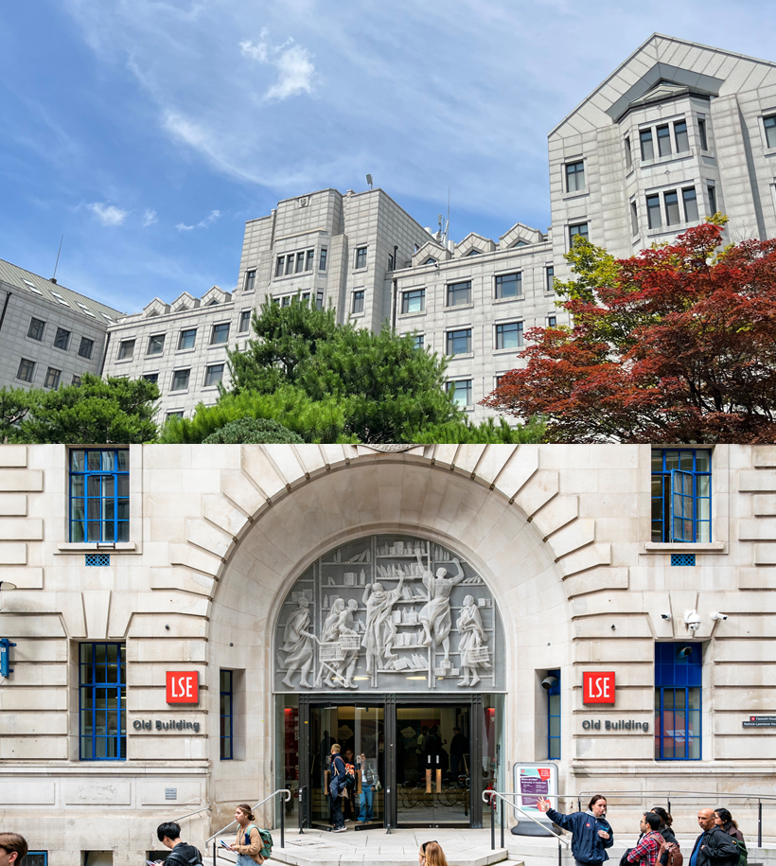
Contact
For programme enquiries, please contact either department by email.
Yonsei University
Graduate School of Economics
economy@yonsei.ac.kr
London School of Economics and Political Science
Department of Economics
Econ.Yonsei.doubledegree@lse.ac.uk
Disclaimer
In the event of any discrepancy between these guidelines and the official regulations or final announcements of either university, the official regulations and final announcements will prevail. This brochure has been prepared from the 2027/28 admissions guidelines and is subject to change.
Daewoo Hall, Yonsei University and the LSE Old Building
Notes:
No contact details appear in the source document, so this page is blank. The closing paragraph is taken from the last item of §10.

