Slide 1
employees
File created on: 2/10/2020 7:12:28 AM

Slide 2
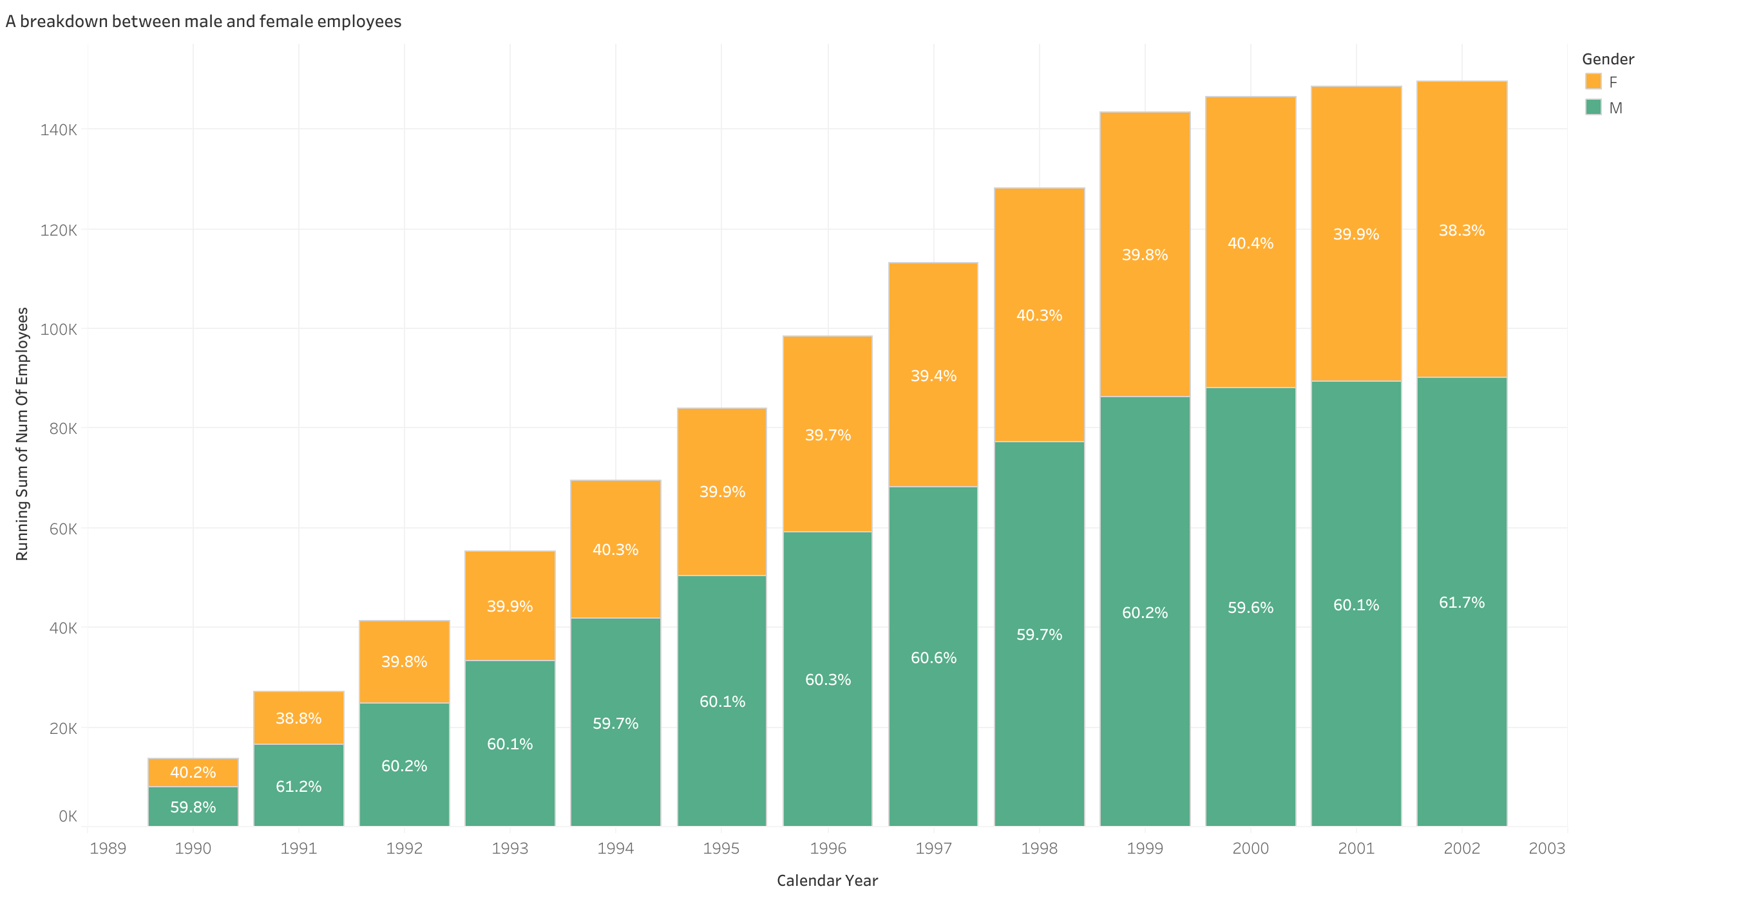

Slide 3
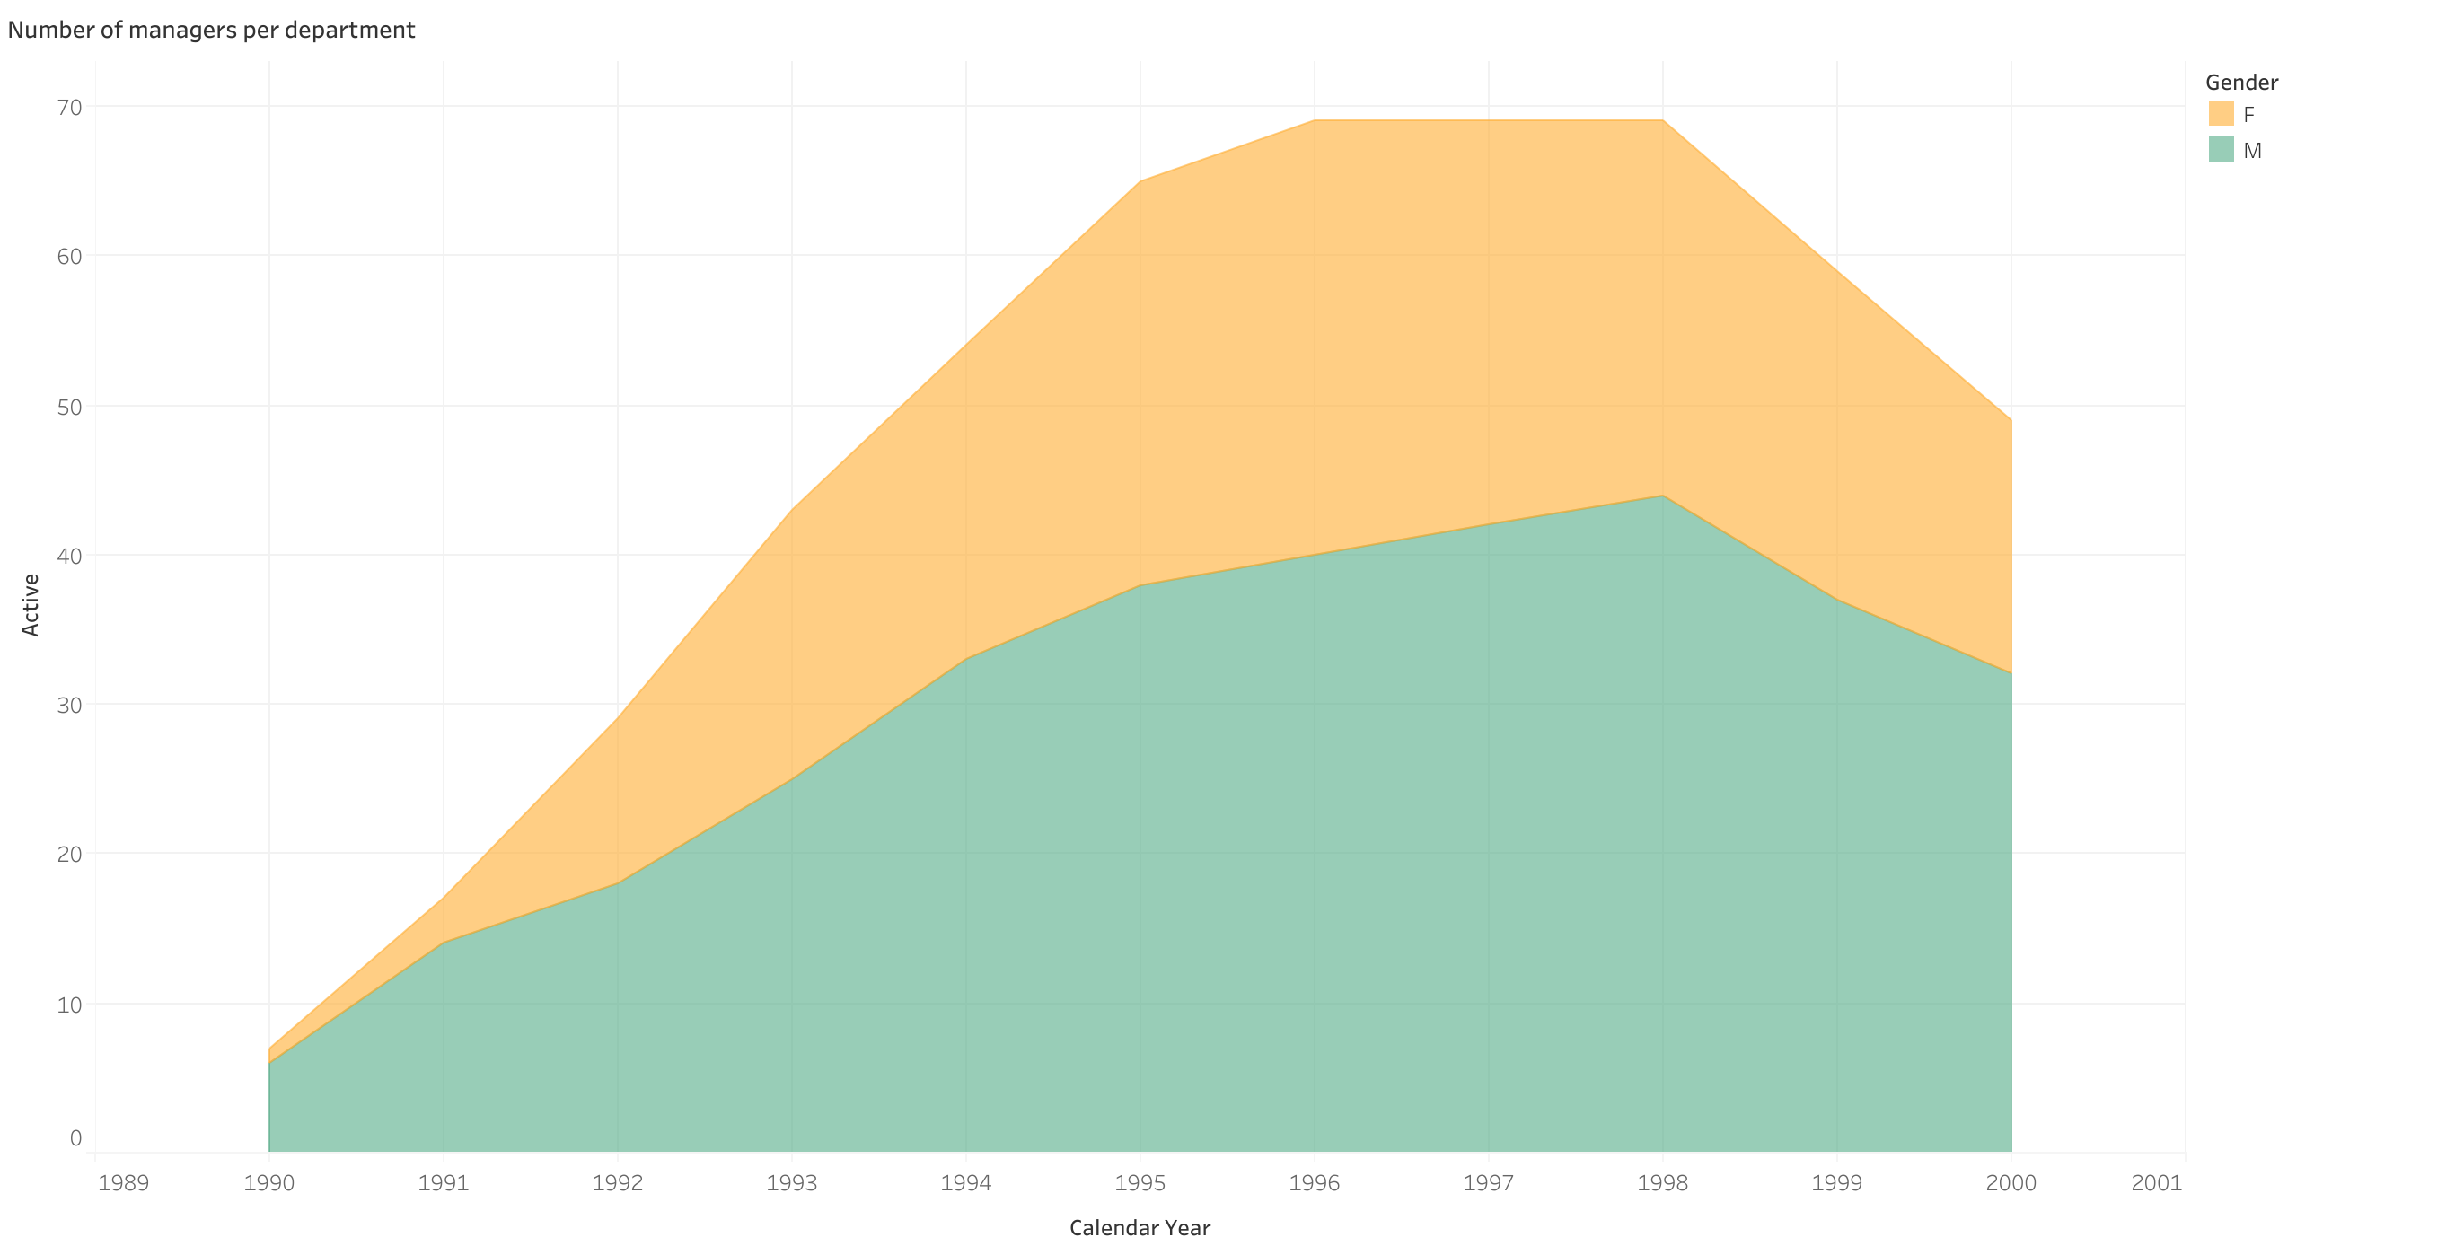

Slide 4
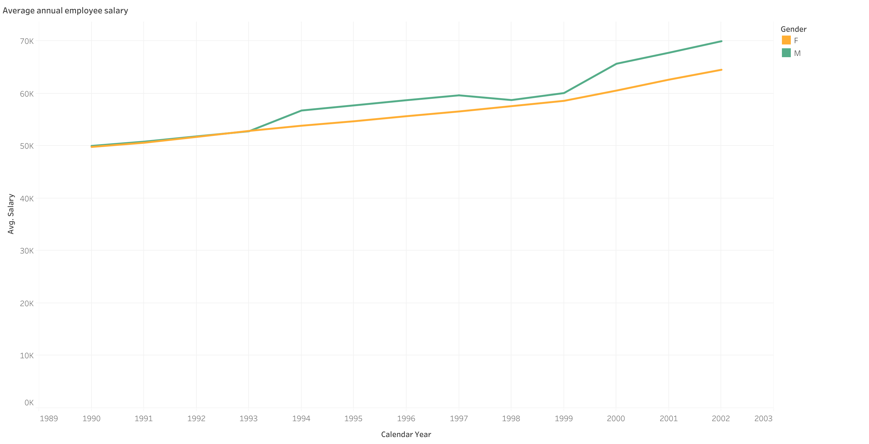

Slide 5
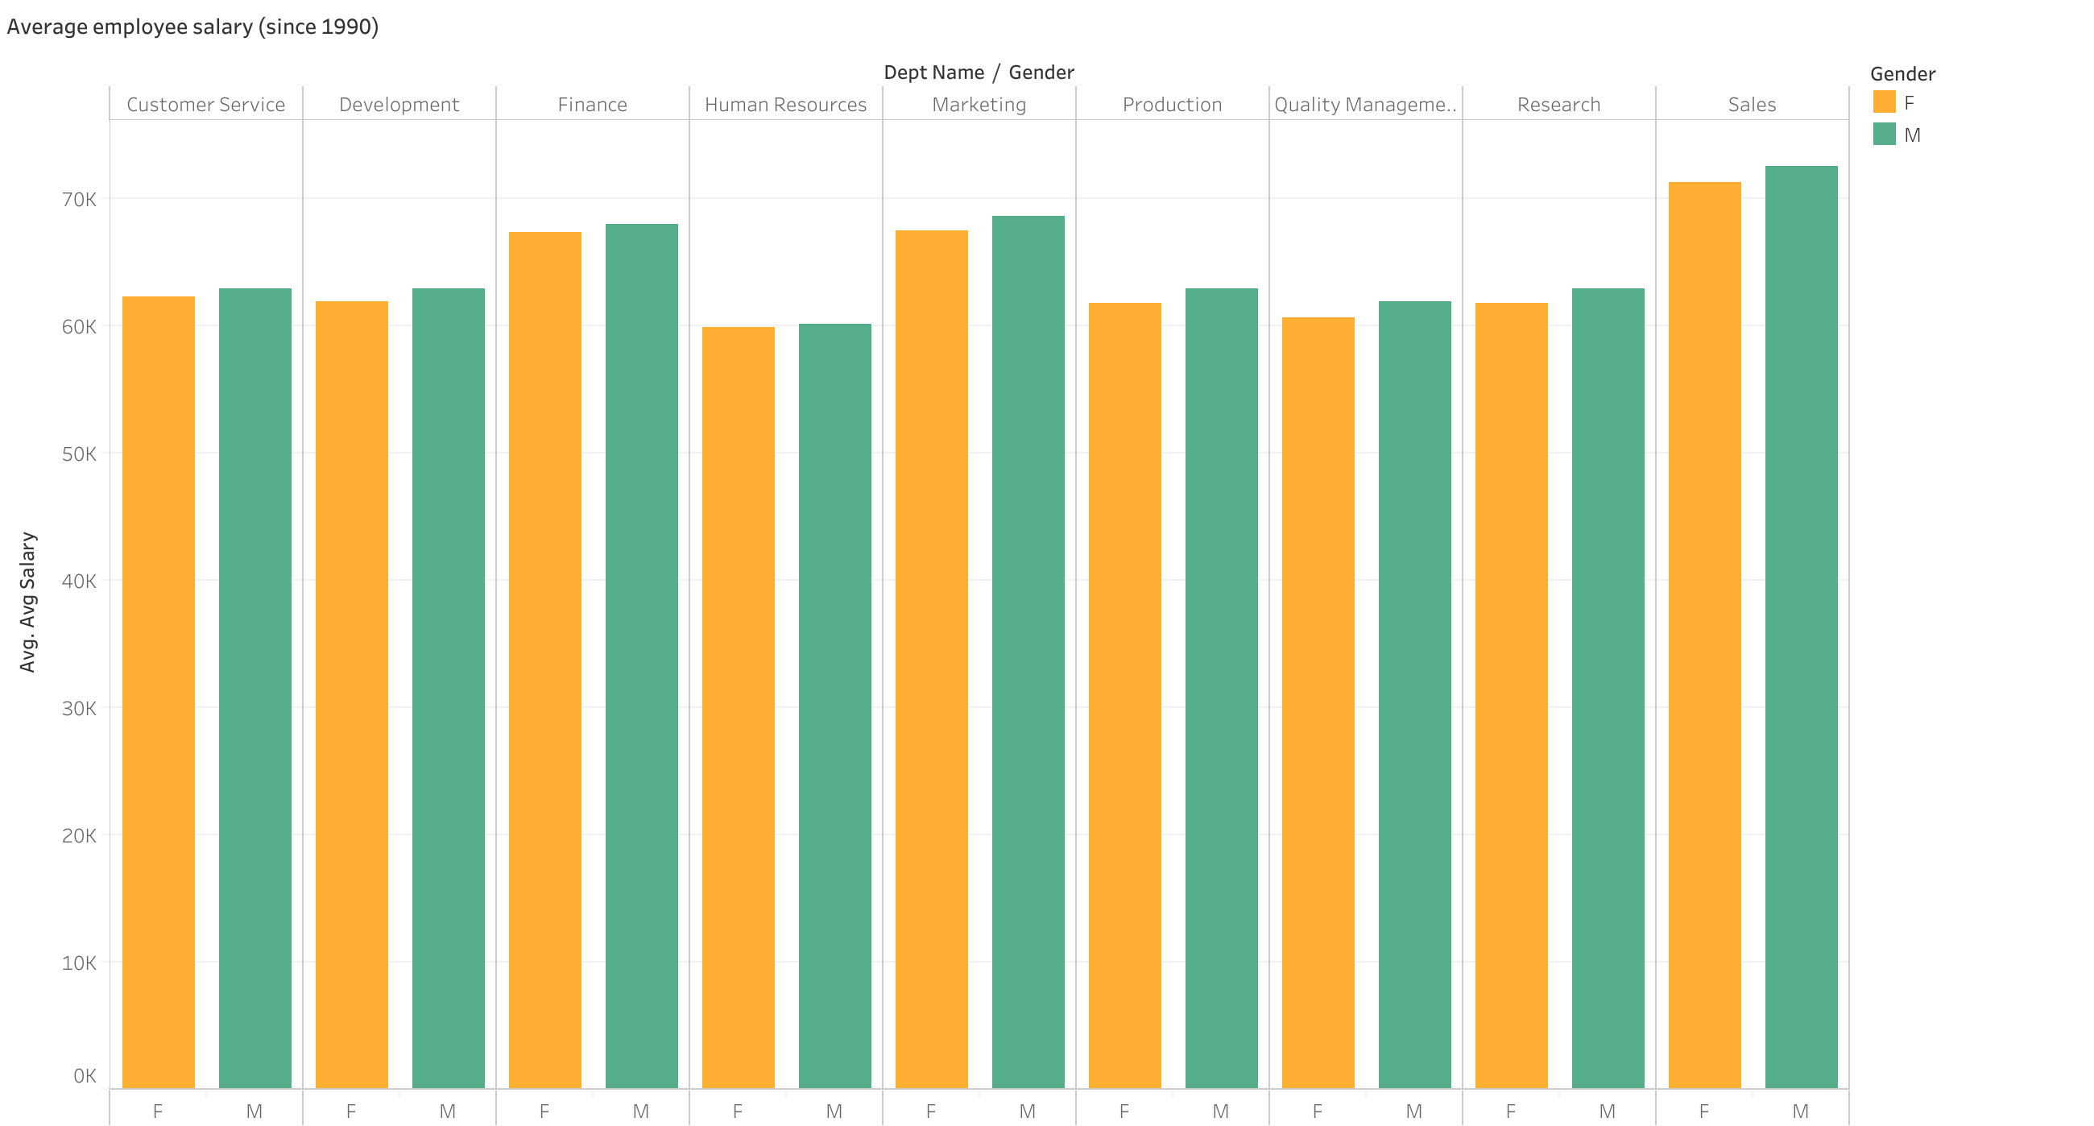

Slide 6
