Slide 1
INSTAWARDS · WEEK 2 · EVIDENCE PACK 1 OF 2
Lantern — Deliverable 2
Proof of Deliverables — Transaction Security Scanner
Evidence captured from the scanner's command-line harness and the project's CI, on one named commit.
Every artifact here is reproducible from the commands and links in evidence pack 2.
Reporting period: 2026-09-12 → 2026-09-18 · Network: Stellar Testnet · Status: delivered
Lantern · Instawards Deliverable 2
1

Slide 2
EXECUTIVE SUMMARY
What shipped this week
PIPELINE
EFFECTS
SCREENING
VERDICT
Six stages, deterministic
Payments + token calls
Every counterparty, D1 registry
Rules decide, the AI writes
Simulate, walk the auth tree, decode effects, screen, decide, explain — as an MIT package the wallet, a dApp or a CLI can call.
Path payments, merges, SEP-41 / SAC transfer, approve, burn, mint, clawback; nested calls surfaced; unknown contracts labelled, never guessed.
Three outcomes — flagged, clean, unknown. Unreachable is unknown, never clean; a hit carries the reason and report count.
Risk and action come from deterministic code. The model gets structured facts only, a deadline, and cannot change the verdict.
SCOPE COMPLETED
12 of 12 planned slices delivered and merged — 31 points
MIT package · pipeline + invariant · ingest · auth · effects ×3
screen · verdict · explain · QA plan + CLI harness · demo runbook
Every merge reviewed and gated on human approval
748 tests green offline in CI — no RPC, no registry,
no model reachable — plus a proxy so no key ships in a client
Lantern · Instawards Deliverable 2
2

Slide 3
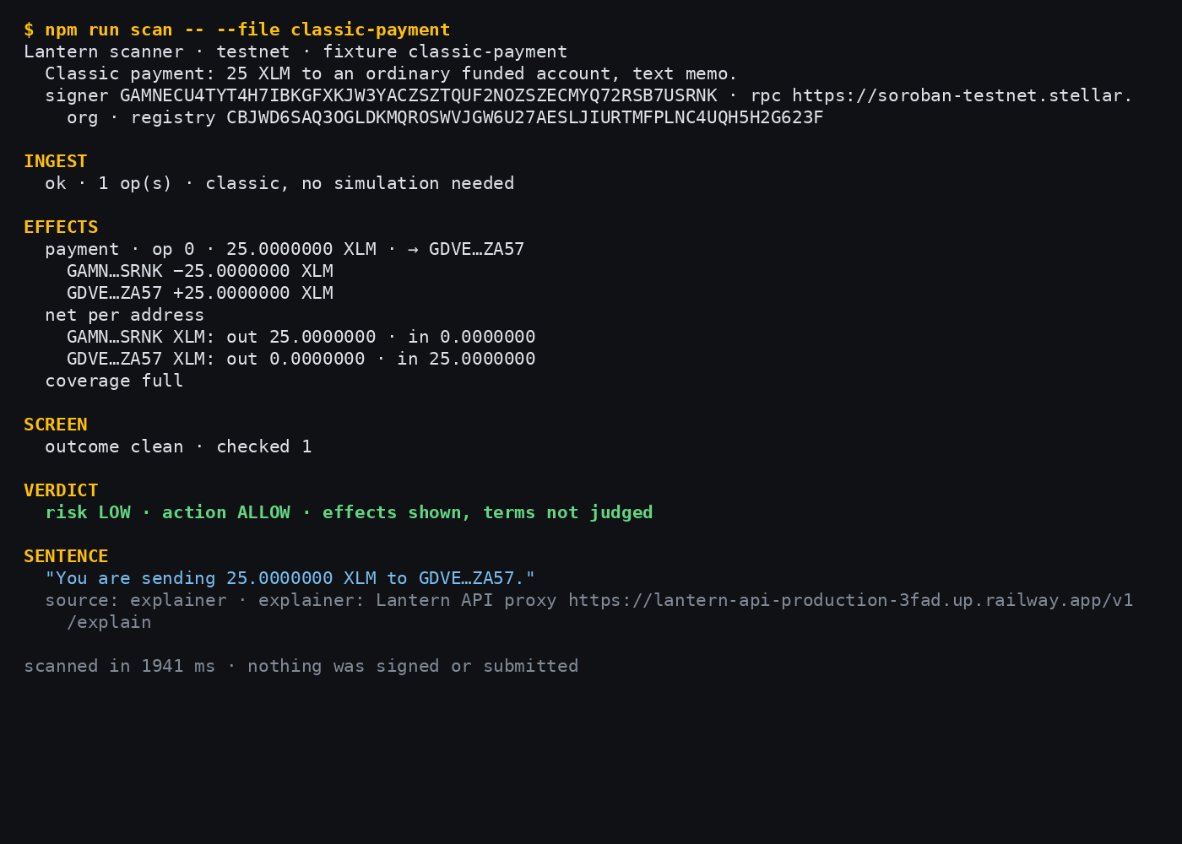
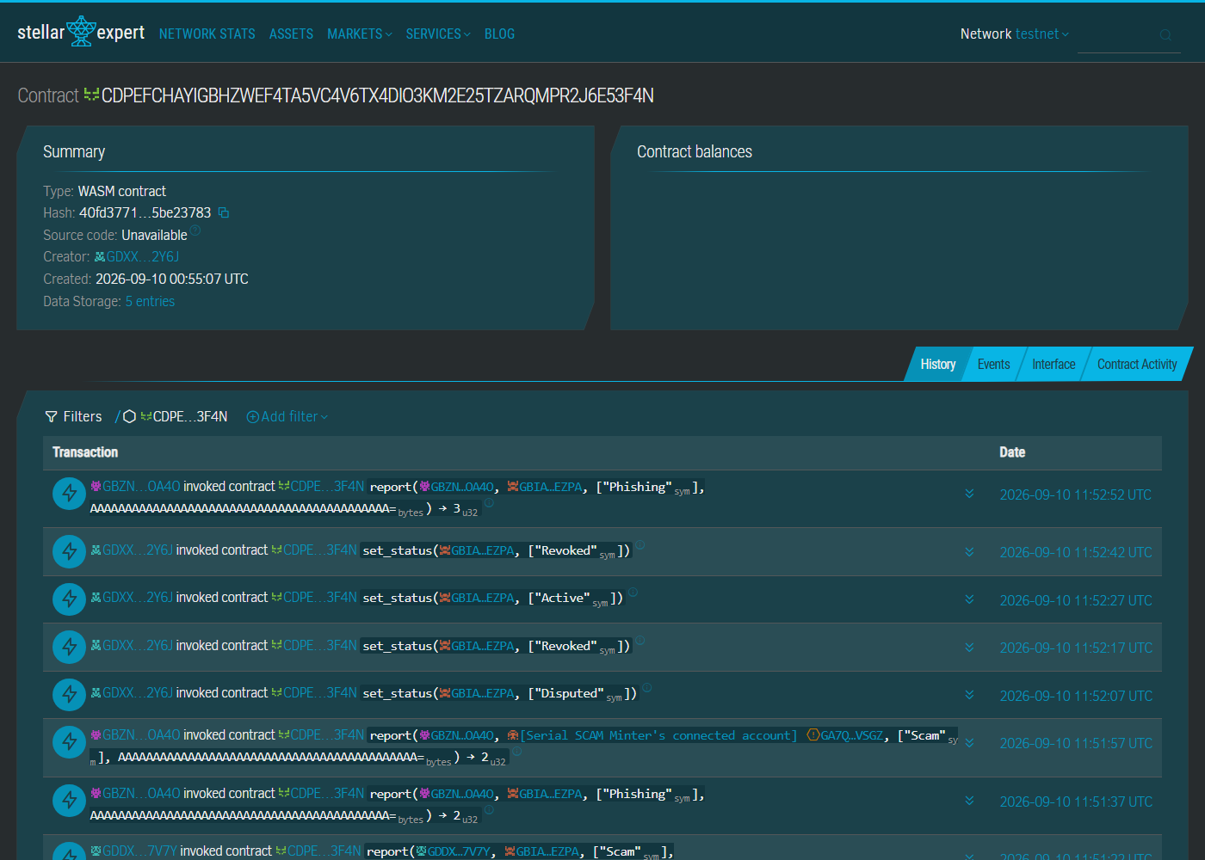
PROOF · 1 OF 6
A payment, decoded
FIXTURE
classic-payment
VERDICT
LOW · ALLOW
EFFECTS
−25 XLM out, +25 XLM in
SCREEN
clean · 1 checked
The scanner reads a plain payment into exact amounts per address, screens the recipient against the registry, and writes one sentence a non-technical person can act on. The command line is in the shot; the raw output is in the evidence folder.
Lantern · Instawards Deliverable 2
3

Slide 4
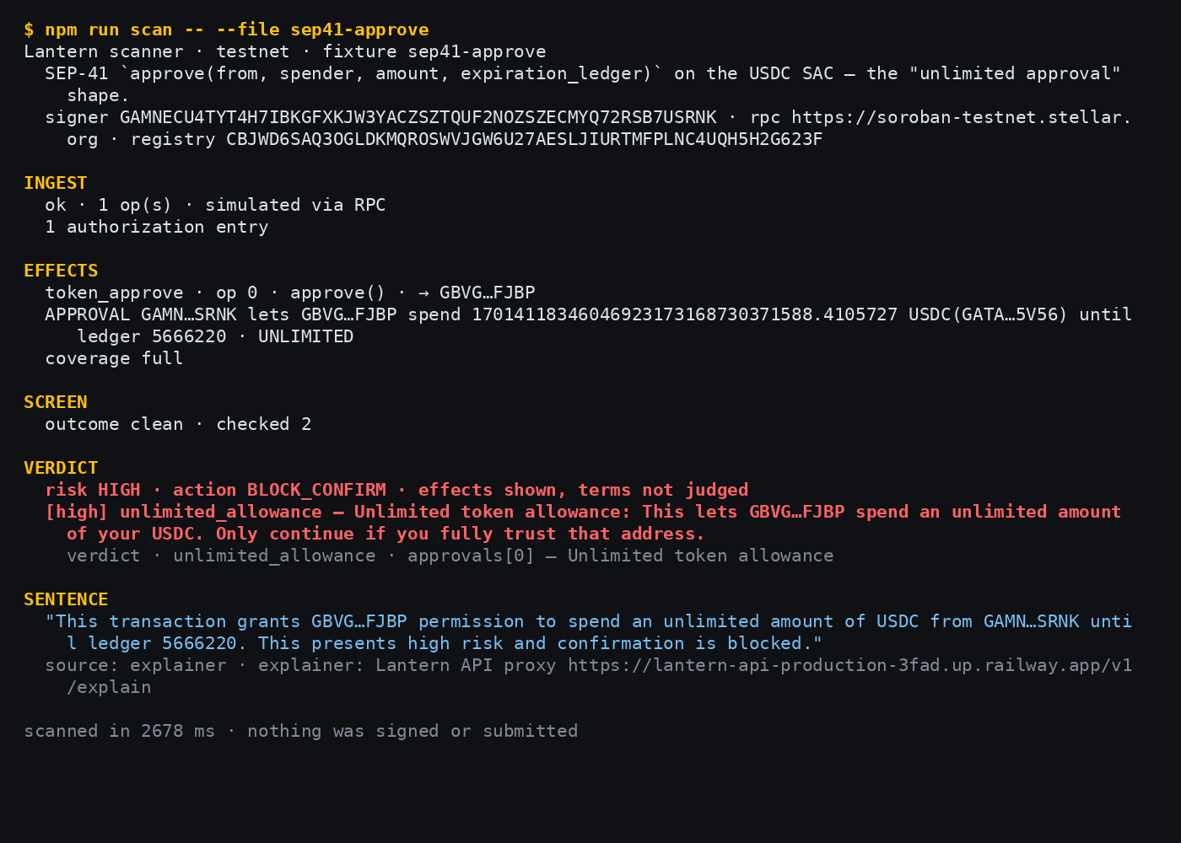
PROOF · 2 OF 6
The unlimited approval, caught
FIXTURE
sep41-approve
VERDICT
HIGH · BLOCK_CONFIRM
ALLOWANCE
unlimited USDC · ledger 5,666,220
REASON
unlimited_allowance
The headline case from SOW §4.1: a SEP-41 approve whose allowance is effectively unbounded. The scanner decodes the token call, shows the allowance and its expiry, and raises the risk. A user who sees this cancels — that is the product.
Lantern · Instawards Deliverable 2
4

Slide 5
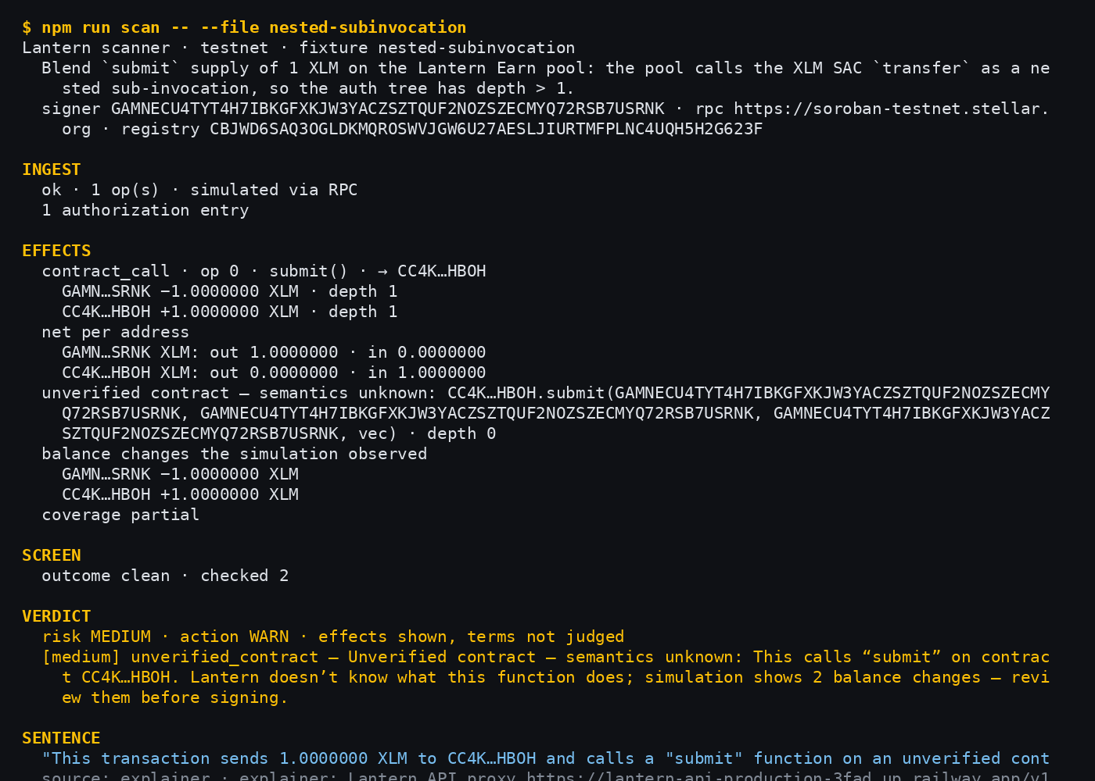
PROOF · 3 OF 6
A nested sub-invocation is not invisible
FIXTURE
nested-subinvocation
AUTH TREE
1 entry · depth 1
EFFECT
−1 XLM at depth 1
VERDICT
MEDIUM · WARN
A Blend supply call that transfers XLM one level down the authorization tree. The transfer surfaces in the effects with its depth, and the outer contract is labelled unverified rather than guessed at.
Lantern · Instawards Deliverable 2
5

Slide 6
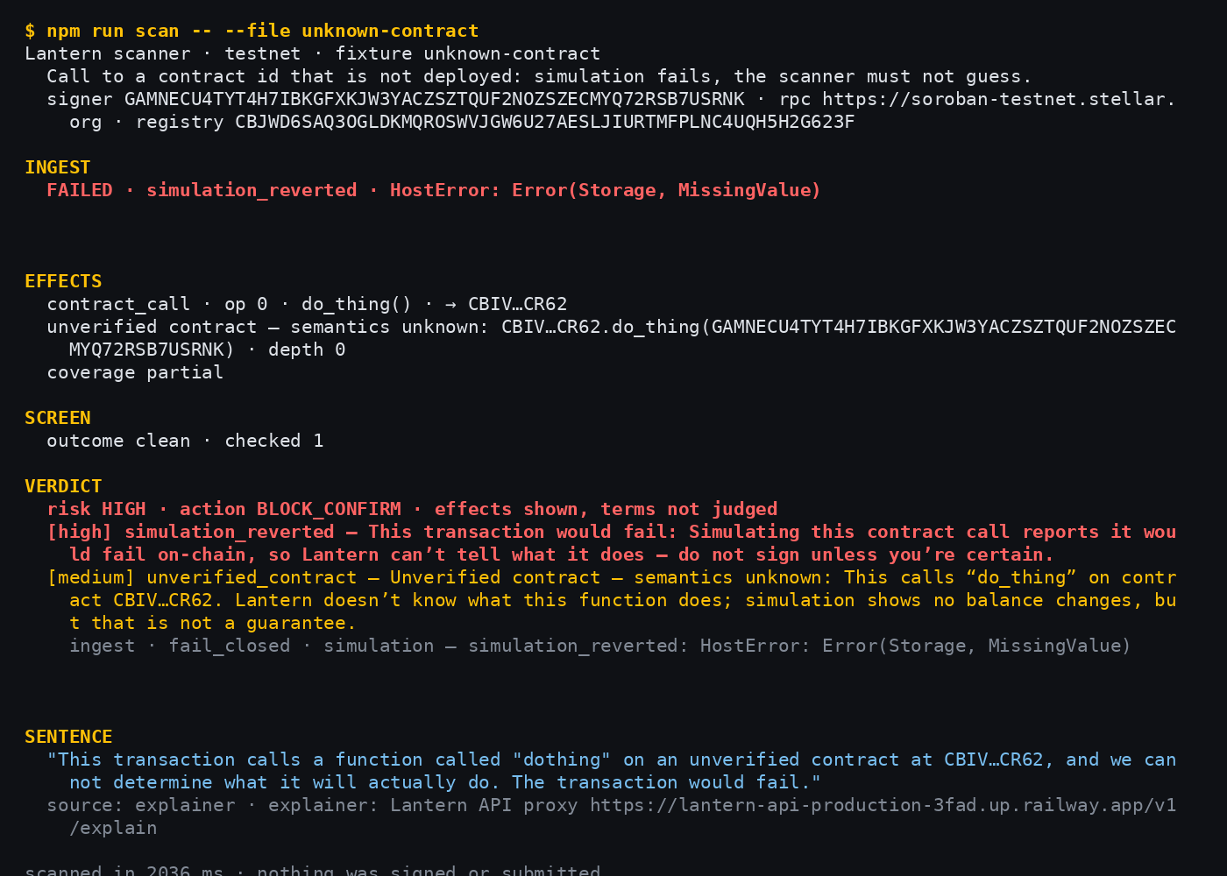
PROOF · 4 OF 6
Unverified contract, handled honestly
FIXTURE
unknown-contract
LABEL
unverified — semantics unknown
SIMULATION
reverted, fail-closed
VERDICT
HIGH · BLOCK_CONFIRM
A call the scanner has no semantics for. It prints the contract id, the function and the decoded arguments, says so in a structured label the UI cannot lose, and never claims to know what the function does.
Lantern · Instawards Deliverable 2
6

Slide 7
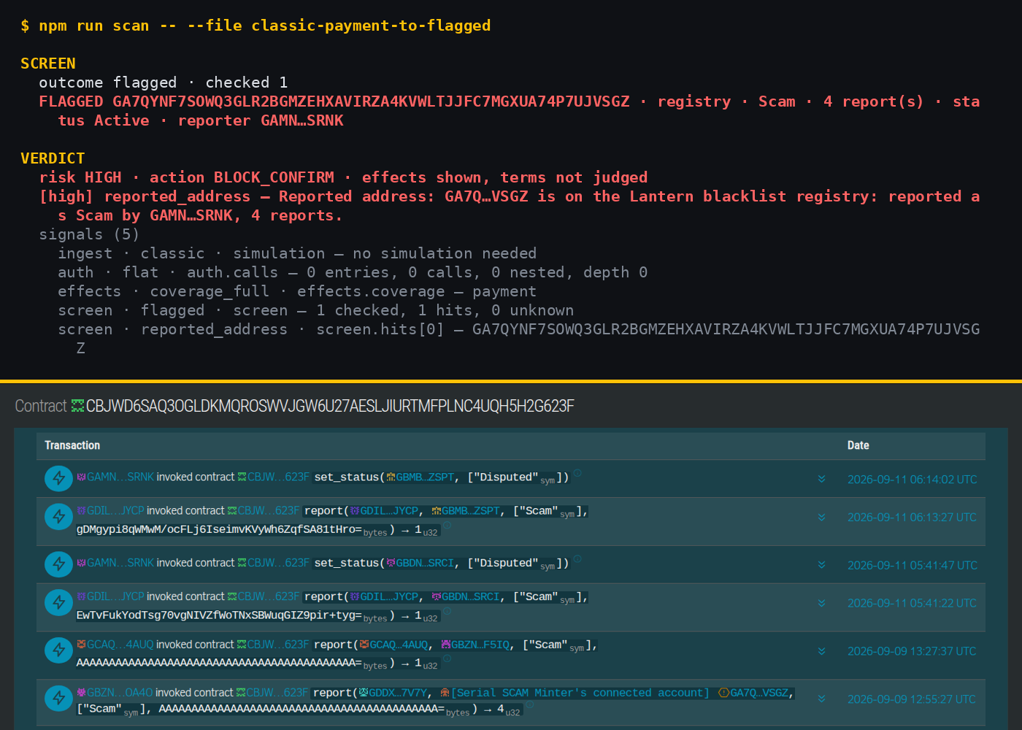
PROOF · 5 OF 6
Screened against the D1 registry
FIXTURE
classic-payment-to-flagged
SCREEN
flagged · Scam · 4 reports · Active
REGISTRY
CBJWD6SAQ3OGLDKMQROSWVJGW6…
VERDICT
HIGH · BLOCK_CONFIRM
The payment goes to the address reported in Deliverable 1. The scanner reads the live registry entry — reason, reporter, count — and the explorer row underneath is that same report (→ 4). This is the D1 → D2 coupling.
Lantern · Instawards Deliverable 2
7

Slide 8
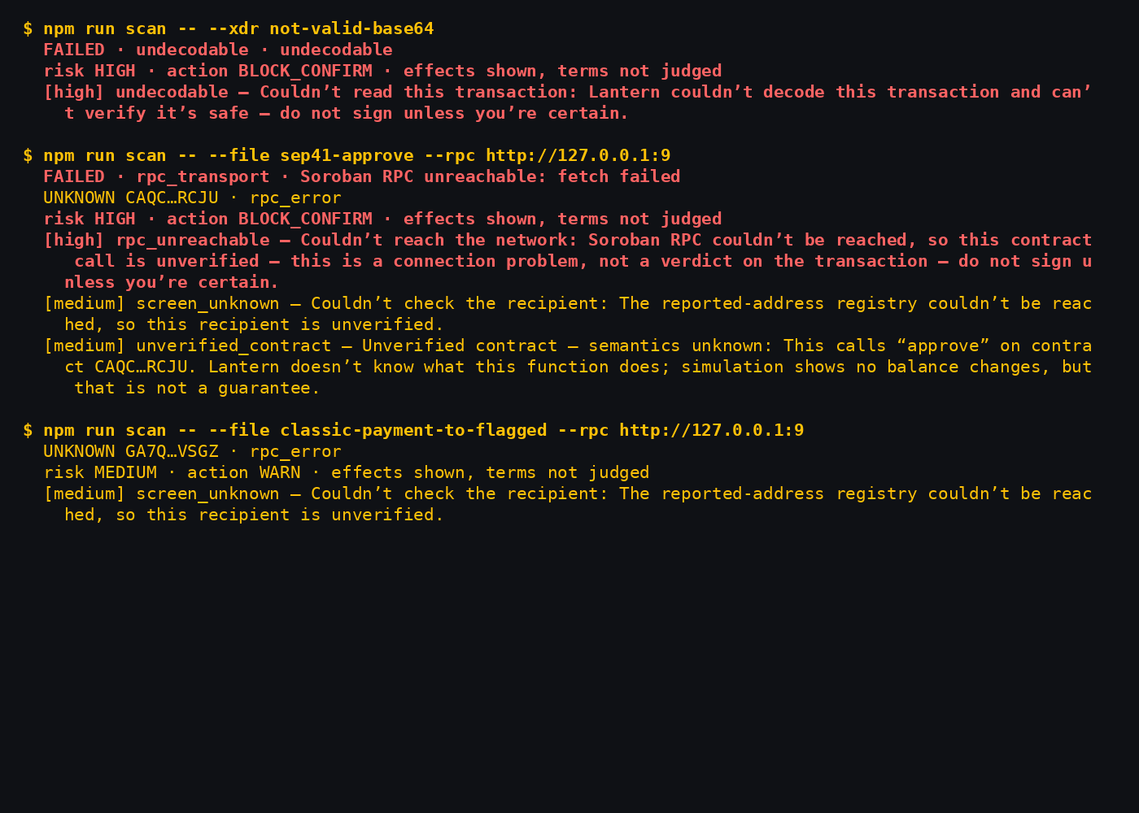
PROOF · 6 OF 6
Fails closed
GARBAGE XDR
undecodable → HIGH
RPC DOWN
rpc_unreachable → HIGH
REGISTRY DOWN
screen_unknown → MEDIUM
NEVER
a silent “clean”
Three ways the world can break, three honest answers. An unreadable transaction, an unreachable simulator and an unreachable registry each come back as a warning with the cause named — the scanner never says safe when it does not know.
Lantern · Instawards Deliverable 2
8

Slide 9
THE INVARIANT
The AI cannot move the verdict — proven offline
748
67
19
0
3
tests passed, network off
test files, all offline
recorded fixtures
secrets in CI
hard blockers green
WHAT THE TESTS ASSERT (ROOT SUITE, COMMIT 73d5b34; FULL RUN LINKED IN PACK 2)
TEST FILE
WHAT IT PROVES
RESULT
scanner-explain
a model answering “completely safe” to a HIGH verdict changes nothing
pass
scanner-explain
a memo of “ignore previous instructions” never reaches the prompt
pass
scanner-explain
type-level: an explainer that returns a verdict does not compile
pass
scan-cli
--json with and without the model: verdict byte-identical
pass
scanner-pipeline
verdict and effects are deep-frozen before stage 6 runs
pass
scanner-screen
registry unreachable, timeout or archived → unknown, never clean
pass
scanner-ingest
undecodable XDR, RPC down, reverted call → fail closed
pass
Lantern · Instawards Deliverable 2
9

