Slide 1
INSTAWARDS · WEEK 2 · EVIDENCE PACK 2 OF 2
Lantern — Deliverable 2
Technical Documentation & Demo Evidence
Where to verify the week independently: the MIT package and the commit it was built from, the CI runs that
prove the suite green offline, the manual test plan, the runbook, and how every change was reviewed before it shipped.
Reporting period: 2026-09-12 → 2026-09-18 · Network: Stellar Testnet · Status: delivered
Lantern · Instawards Deliverable 2
1

Slide 2
DEMO EVIDENCE · THE CODE AND THE CHAIN
Verify it yourself — repository, commit, registry
THE PACKAGE — MIT, IN THE PUBLIC REPOSITORY
github.com/kimerran/stellar-lantern · packages/lantern-scanner/
commit 73d5b34 (develop; release PR kimerran/stellar-lantern#154)
LICENSE (MIT) at the repo root and inside the package. Every capture in pack 1 was made with `npm run scan` on this commit;
the raw output per slide is in the evidence folder so a reviewer can diff the slide against its source.
THE REGISTRY IT SCREENS AGAINST — DELIVERABLE 1'S DEPLOYMENT
CBJWD6SAQ3OGLDKMQROSWVJGW6U27AESLJIURTMFPLNC4UQH5H2G623F
stellar.expert/explorer/testnet/contract/CBJWD6SAQ3OGLDKMQROSWVJGW6U27AESLJIURTMFPLNC4UQH5H2G623F
`npm ci && npm test` with networking off — 748 passed, 1 skipped, 67 files. The suite is green with no RPC, no registry
and no model reachable: every network answer comes from a recorded fixture, and anything unrecorded fails closed.
Lantern · Instawards Deliverable 2
2

Slide 3
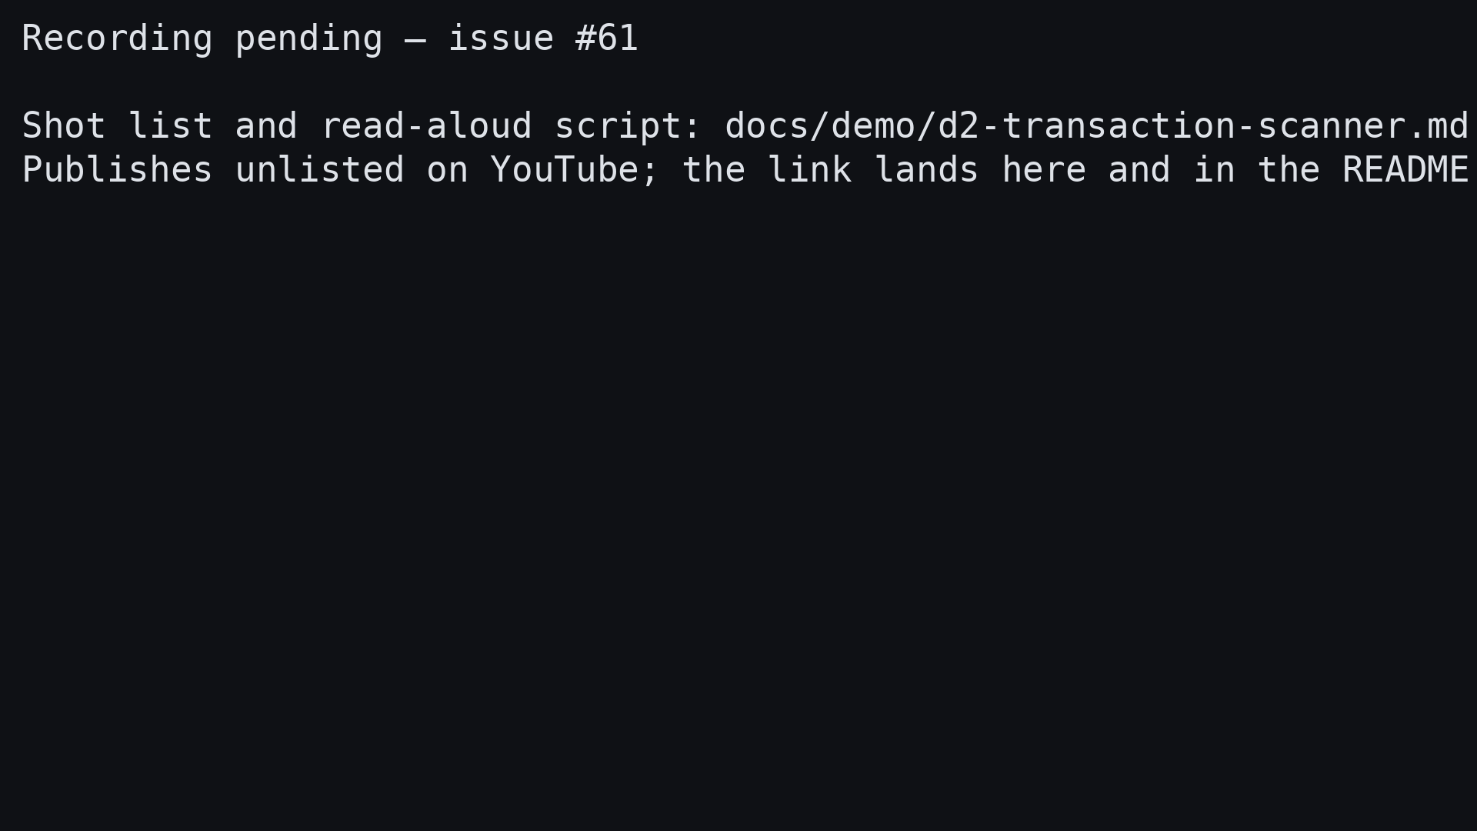
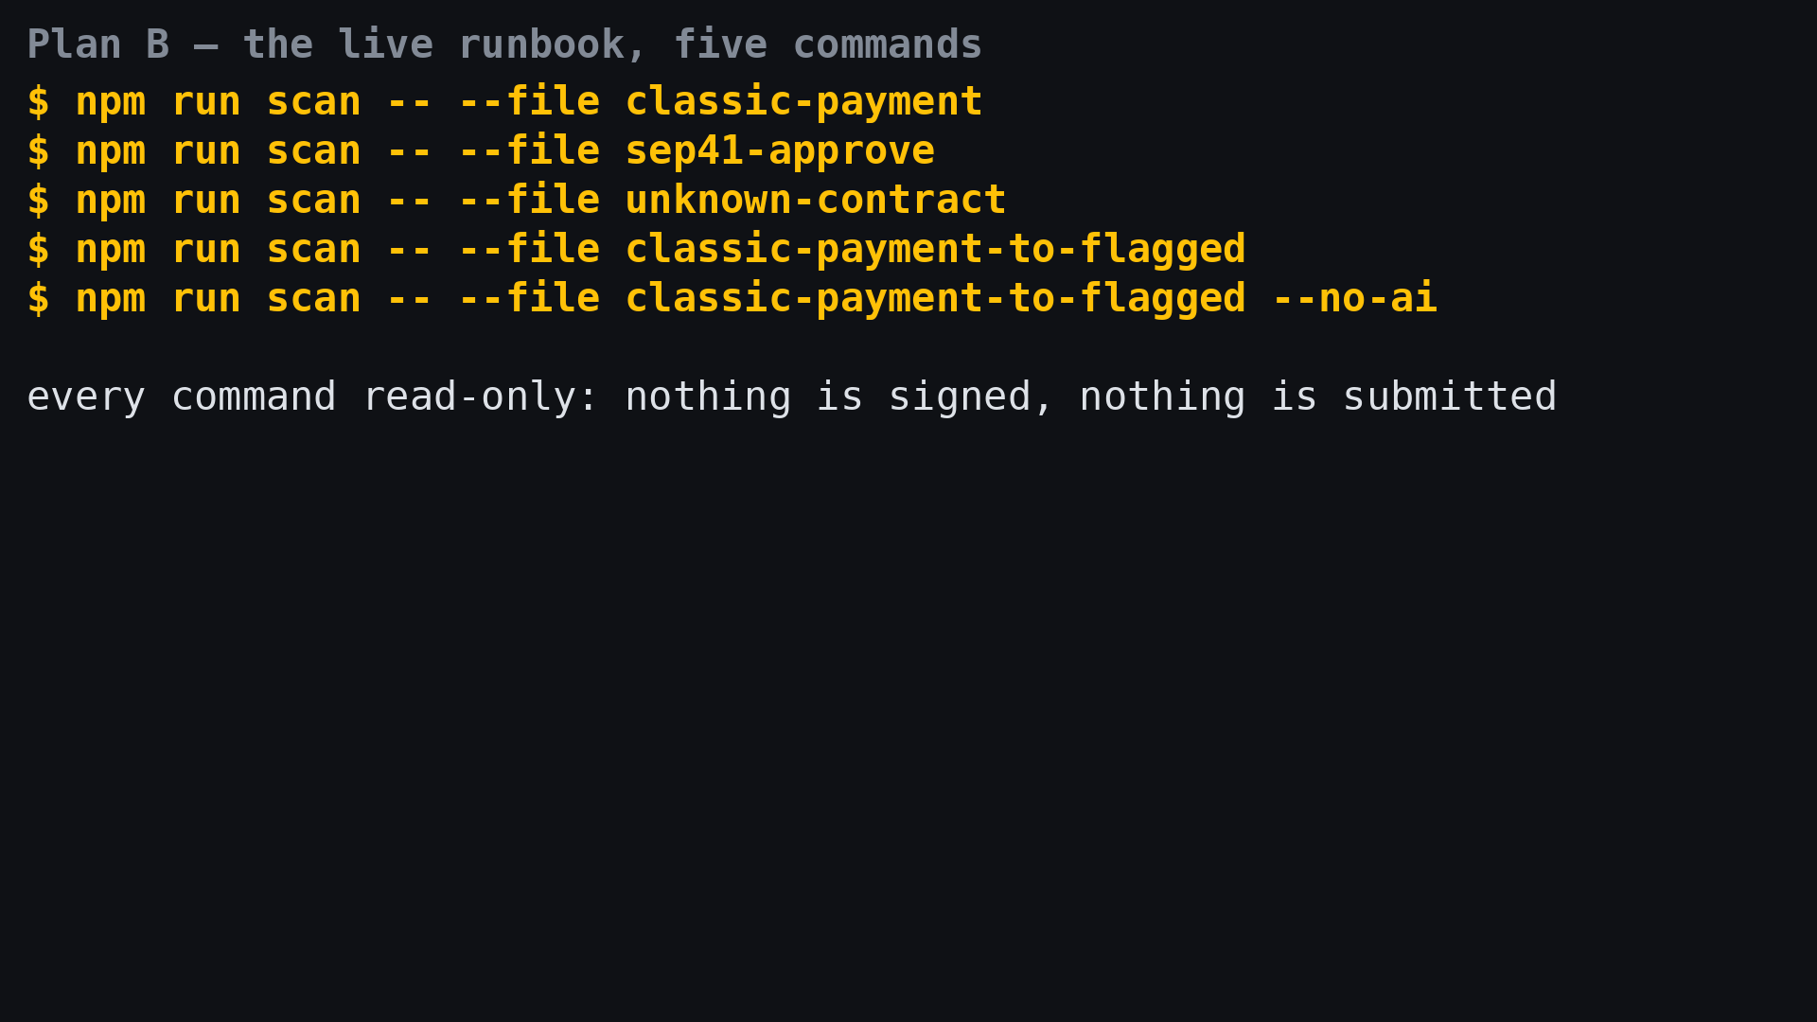
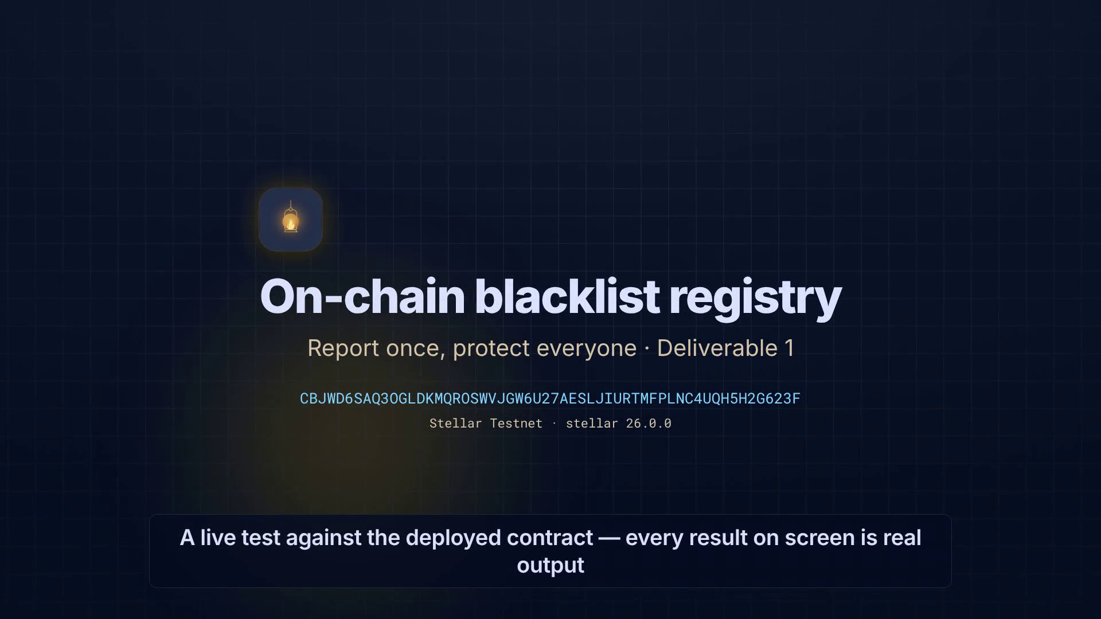
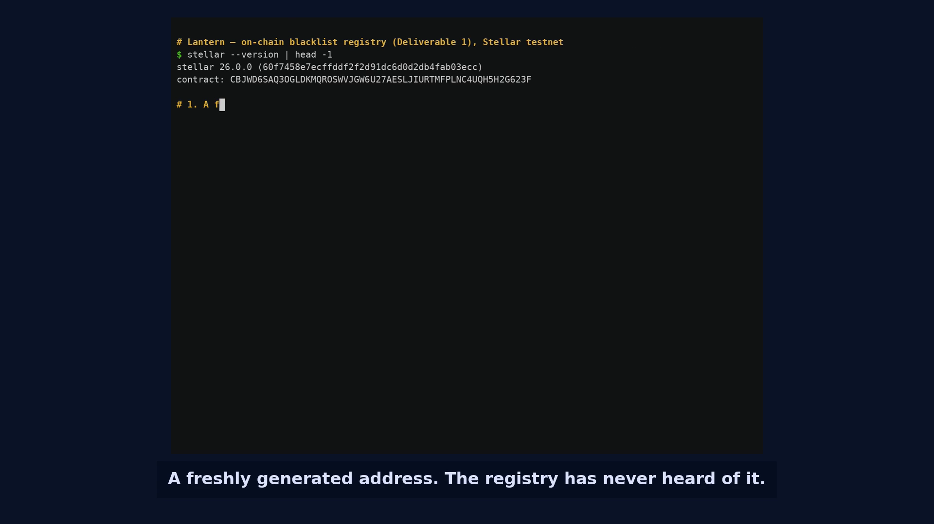
DEMO EVIDENCE · RECORDINGS
One walkthrough — recording pending (#61), runbook ready
d2-transaction-scanner.mp4
docs/demo/d2-transaction-scanner.md — Plan B
90–120 s · 1920×1080 · pending (#61)
live · five commands · read-only
Five shots in one take: a payment, the unlimited approval, an unverified contract, a flagged counterparty checked on stellar.expert, and the verdict unchanged with the AI off. Published unlisted once recorded.
The same five cases run live from a terminal for a reviewer on a call, with the read-aloud script and a fallback table for RPC, registry or model failures — each of which the scanner reports honestly.
Lantern · Instawards Deliverable 2
3

Slide 4
TECHNICAL DOCUMENTATION
What specifies the scanner, and where it lives
packages/lantern-scanner/README.md
docs/qa/d2-transaction-scanner-test-plan.md
The reference
The manual test plan
The six stages, the ScanResult shape, what is covered and what is not, the fixture corpus, the explainer contract and the recorded model (claude-haiku-4-5-20251001), and how to run it by hand.
Ten sections a tester with no code background can follow: setup, smoke, payments, token calls, unverified contracts, registry screening, failing closed, the AI invariant, and a results table for sign-off.
docs/features.md
services/lantern-api/README.md
Dated delivery log
The proxy
One entry per shipped slice, each naming the PR, the issue it closes and the decisions behind it — the written record of how the week was built.
POST /v1/explain — the one route that lets a client show the AI sentence without holding a key: rate limits, daily cap, the error table, the threat model, and the deploy steps.
Lantern · Instawards Deliverable 2
4

Slide 5
ENGINEERING EVIDENCE
How the work was verified before it shipped
CONTINUOUS INTEGRATION
Green on every merge, offline
Two lanes on every pull request: typecheck, lint, the 748-test suite with no network, the extension build and a flag-elimination check; and the proxy's own typecheck, 42 tests, bundle and boot smoke. No CI secret exists — the suite cannot need one.
REVIEW GATE
No self-merges
Twelve slice PRs plus the proxy, each reviewed at the commit that merged, with findings carried as inline threads to resolution — from fail-closed ingest details to the offline registry answering clean for an unrecorded address.
INVARIANTS COUPLED TO CODE
The model cannot reach the verdict
The verdict is deep-frozen before the explainer runs; a type-level test refuses an explainer that returns a verdict; hostile-model and prompt-injection tests pin the behaviour; the AI flag is OFF in every release build so no key can ship.
Lantern · Instawards Deliverable 2
5

Slide 6
NEXT
Week 3 — Deliverable 3: the scanner before the Sign button
Run the six-stage pipeline in the wallet's pre-sign review, with registry screening live and the AI sentence served by the
Lantern API proxy, so the warning arrives before the signature — not after the money is gone.
1
2
3
4
5
6
Pre-sign
Gate
Proxy
Registry
Report
Evidence
Pipeline in the review screen
block_confirm holds the Sign button
AI sentence, no key in the client
Live screening per counterparty
One tap to report an address
Recording + QA sign-off
PLANNED AND ON THE BOARD
D3-1 (#84) is open and specified: the scanner pipeline, registry screening and the proxy-backed explainer in the pre-sign review. The remaining D3 slices are sequenced from it once the D2 recording (#61) lands.
Lantern · Instawards Deliverable 2
6

