Slide 1

fILM DIVISION OF Gsstf
Our team:
Asep Nur Muhammad – 140810140070 – 2014
Hana widya ananta – 210110130356 – 2013
RUTT
Notes:
Asep nur Muhammad

Slide 2






Our Proker
Short Movie
Cooperation
Tools
Film Class
Short Film Festival
Short Film Parade
AGREE TERMOS
FILM DIVISION
Rapat Umum
Tengah Tahun
Notes:
Asepnurmuahmmad

Slide 3
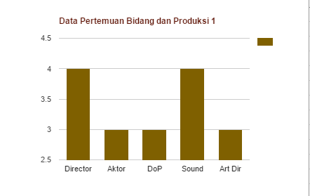
Film Class
Problem
Member of Film
No Attendance List
Solves
Sertificate
Make Attendance
AGREE TERMOS
FILM DIVISION
Rapat Umum
Tengah Tahun
Notes:
Hana Widya ananta

Slide 4
Our Proker
Short Movie
Cooperation
Tools
Film Class
Short Film Festival
Short Film Parade
AGREE TERMOS
FILM DIVISION
Rapat Umum
Tengah Tahun
Notes:
Hana Widya Ananta

Slide 5
Short Movie
Problem
Not respect to timeline. 1
Less responsibility. 2
Lack of experience. 3
Lack of coordination. 4
Output
“SPASI”
Film
Solves
Strengthens the system
Task, Class, Production
Comunication
AGREE TERMOS
FILM DIVISION
Rapat Umum
Tengah Tahun
Notes:
Asep Nur Muhammad

Slide 6
Our Proker
Short Movie
Cooperation
Tools
Film Class
Short Film Festival
Short Film Parade
AGREE TERMOS
FILM DIVISION
Rapat Umum
Tengah Tahun
Notes:
Asep Nur Muhammad

Slide 7
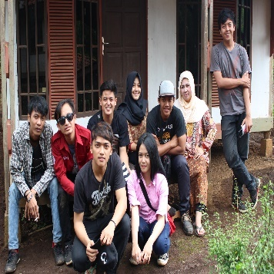

Short Movie Festival
Output SMF
List Competition
Problem
Proposal
Time
Cost
Tools
Solves
Follow up Proposal
Objectif
MCF-ITB Cinemath (Agustus)
ISSF 2016 (July)
BINTANG
Plaza Indonesia Film Festival
AGREE TERMOS
FILM DIVISION
Rapat Umum
Tengah Tahun
Notes:
Asep Nur Muhammad

Slide 8
Our Proker
Short Movie
Cooperation
Tools
Film Class
Short Film Festival
Short Film Parade
AGREE TERMOS
FILM DIVISION
Rapat Umum
Tengah Tahun
Notes:
Asep Nur Muhammad

Slide 9



Cooperation
Problem
No Contract. 1
Lack of ability. 2
Nothing Preparation. 3
Problem
No Contract
Short Time
Human Resource of GSSTF film
HR Production
Solve
Make a clear contract every cooperation
Make Workshop or Discusssion
Calculation
AGREE TERMOS
FILM DIVISION
Rapat Umum
Tengah Tahun
Notes:
Hana Widya Ananta

Slide 10
Our Proker
Short Movie
Cooperation
Tools
Film Class
Short Film Festival
Short Film Parade
AGREE TERMOS
FILM DIVISION
Rapat Umum
Tengah Tahun
Notes:
Hana Widya Ananta

Slide 11




Parade Film
Planing A
Output : 2 Film
Team : 2 Team
July
Oktober
Planing B
Output : 1 Film
Team : 1 Team
June
July-September
AGREE TERMOS
FILM DIVISION
Rapat Umum
Tengah Tahun
Notes:
Asep Nur Muhammad

Slide 12
Our Proker
Short Movie
Cooperation
Tools
Film Class
Short Film Festival
Short Film Parade
AGREE TERMOS
FILM DIVISION
Rapat Umum
Tengah Tahun
Notes:
Asep Nur Muhammad

Slide 13

tOOLS Film
Problem :Fund
Solve: Sponsorship Cooperation
Waiting in Holly Condition
AGREE TERMOS
FILM DIVISION
Rapat Umum
Tengah Tahun
Notes:
Hana Widya Ananta

Slide 14
Our Proker
Short Movie
Cooperation
Tools
Film Class
Short Film Festival
Short Film Parade
AGREE TERMOS
FILM DIVISION
Rapat Umum
Tengah Tahun
Notes:
Hana Widya Ananta

Slide 15



OtHEr
Line Group Film
Teachers
Membership
AGREE TERMOS
FILM DIVISION
Rapat Umum
Tengah Tahun
Notes:
Asep Nur Muhammad dan Hana Widya Ananta

Slide 16
THANK YOU
Film Division of GSSTF Unpad
AGREE TERMOS
FILM DIVISION
Rapat Umum
Tengah Tahun
Notes:
Asep Nur Muhammad

Slide 17
fILM DIVISION OF Gsstf
Our team:
Asep Nur Muhammad – 140810140070 – 2014
Hana widya ananta – 210110130356 – 2013
RUTT
Notes:
Asep nur Muhammad

