Slide 1
Data Analysis
Jungsoon Choi
Dec. 6, 2022

Slide 2
Data information
Original Data: af_tf_incidence_v10_edit_cov_20221114.xlsx
Combined data: Outcome_Covariates_sites_catchment areas_v6.csv
List of covariates (16 variables):
"improved_water","improved_sanitation“,"annual_rainfall","annual_mean_temp“,"stunting_prev","HIV_prev“,"travel_time_city","elevation","distance_water",”piped_water","piped_sanitation","surface_water","open_defecation","wasting","underweight“, "pop_size"

Slide 3
Transformation of covariates
Log(annual_rainfall)
Log(pop_size)
elevation/1000 (unit: km) due to the negative value (original unit: m)

Slide 4
Variable selection before modeling
For each age group,
VIF>10 (multicollinearity exists) => Drop variables
In Poisson and NB modeling, variables with high correlated with other covariates and lower correlated with IR were dropped for the stable parameter estimation.

Slide 5
List of covariates excluded
Age groups | Number of obs. | VIF>10 |  | Additional covariates excluded for estimation (high correlated with other variables and lower correlated with IR)
 |  | Covariates excluded | Additional covariates excluded | Poi | NB
0-1 | 22 | "underweight“ "improved_sanitation“ "annual_mean_temp" | "stunting_prev" | "piped_water“ "travel_time_city“ "improved_water"
 |  |  |  |  | "wasting"
2-4 | 22
5-14 | 26
>14 | 24

Slide 6
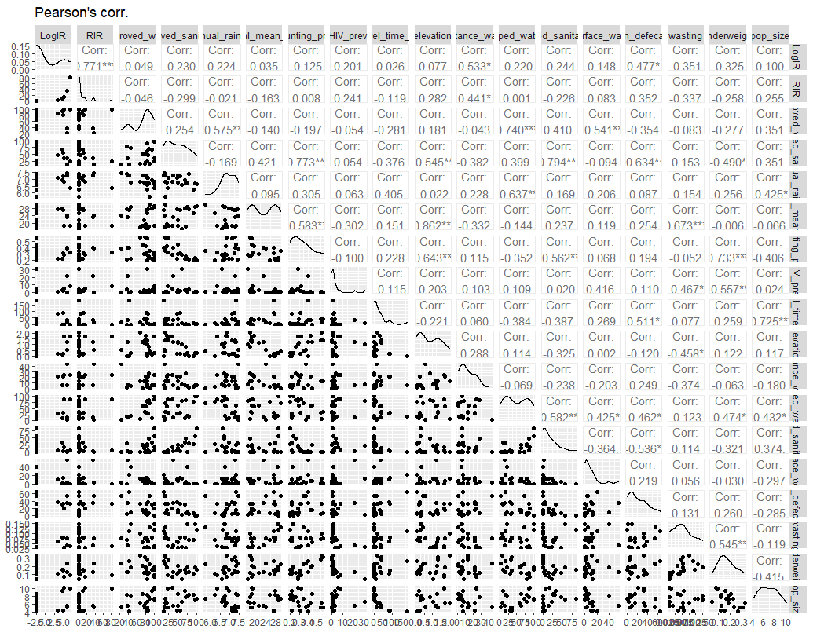
Age: 0-1y

Slide 7
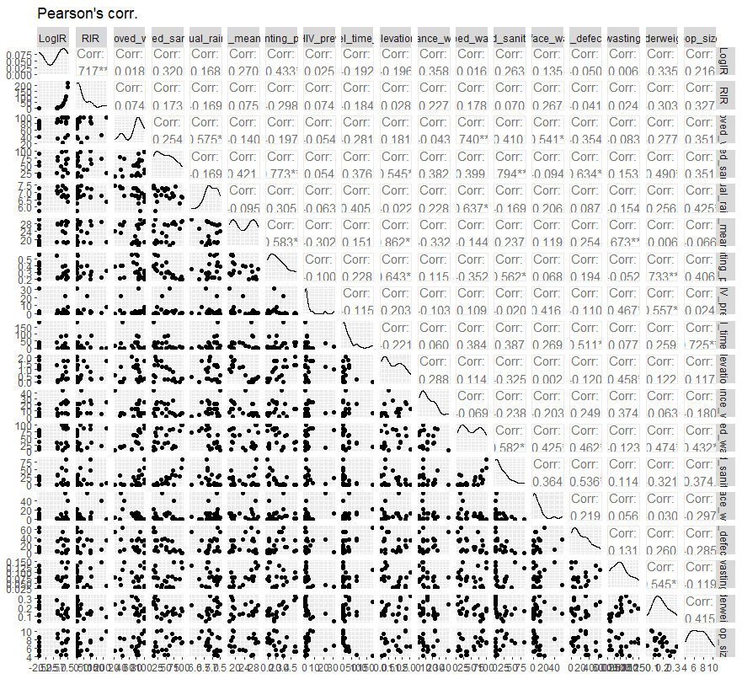
Age: 2-4y

Slide 8
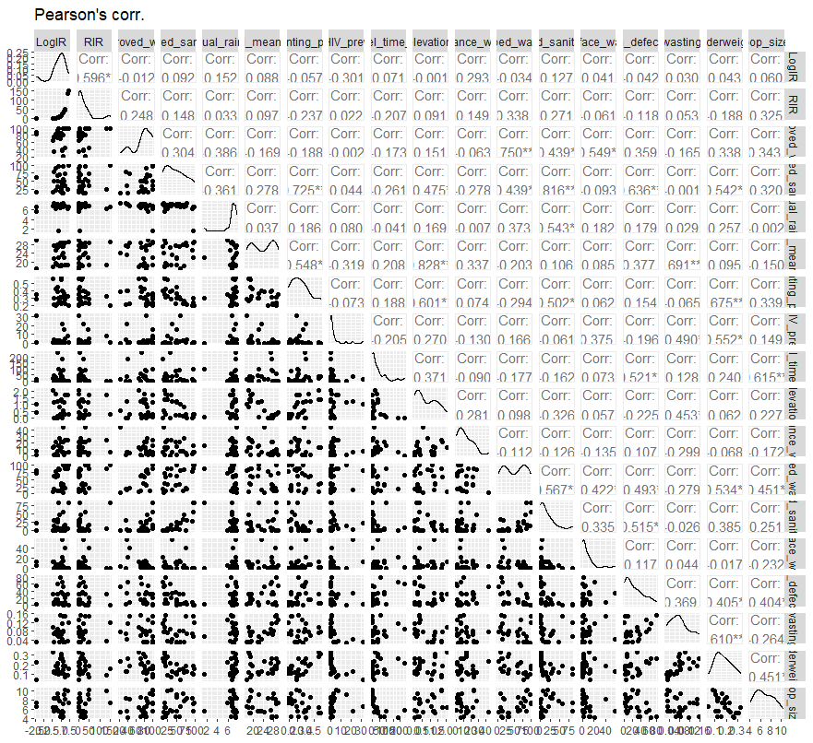
Age: 5-14y

Slide 9
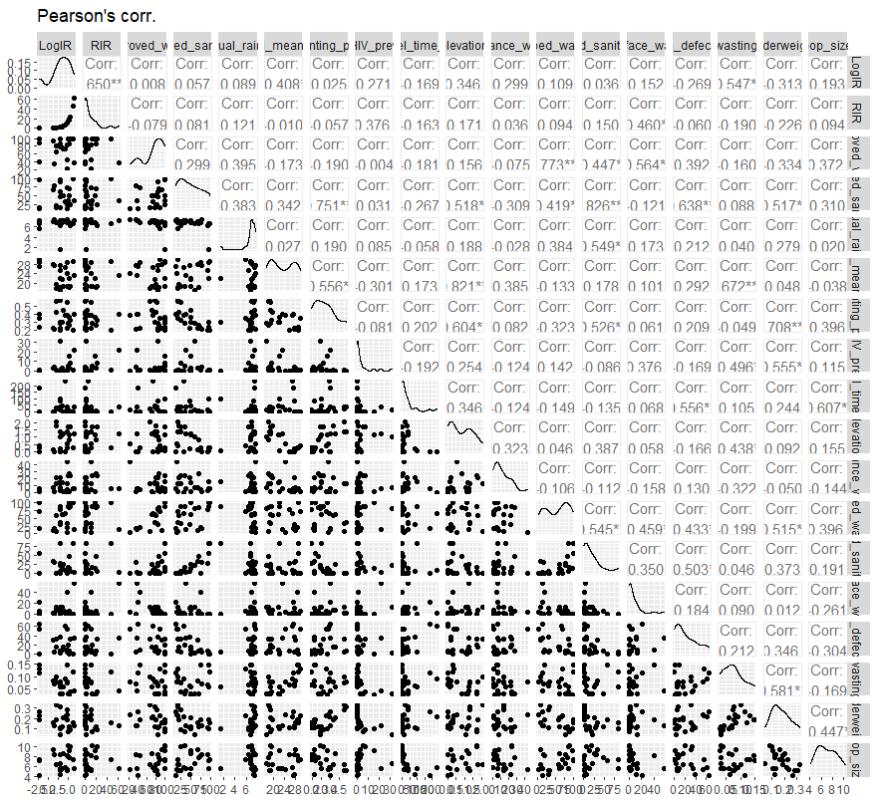
Age: +15y

Slide 10
Variable selection in modeling
For each age group,
[Ver1] Stepwise method based on AIC (smaller AIC, better model)
[Ver2] dropping non-significant variable and smaller RMSE

Slide 11
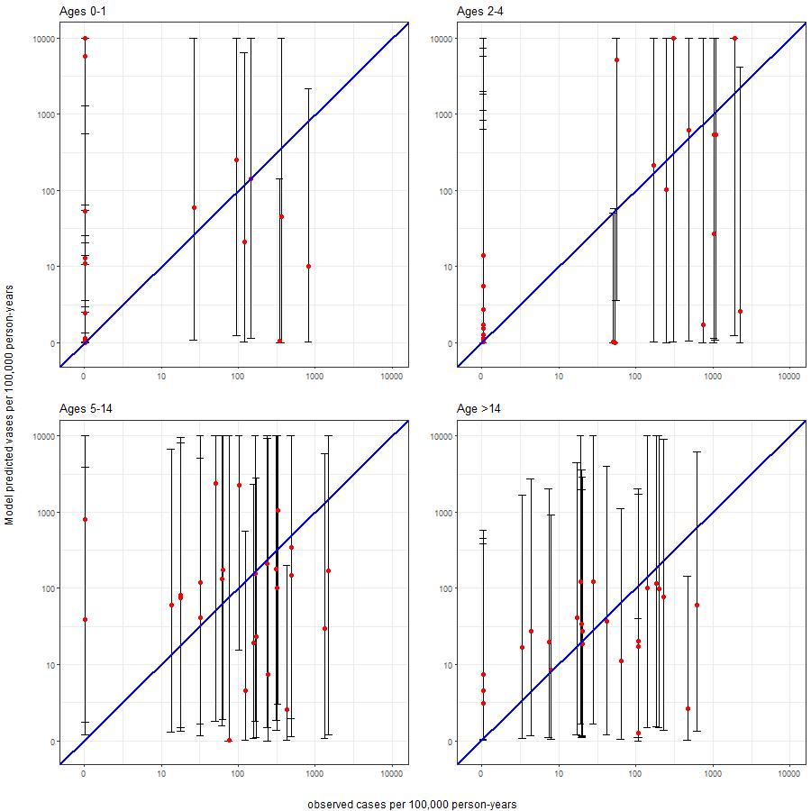
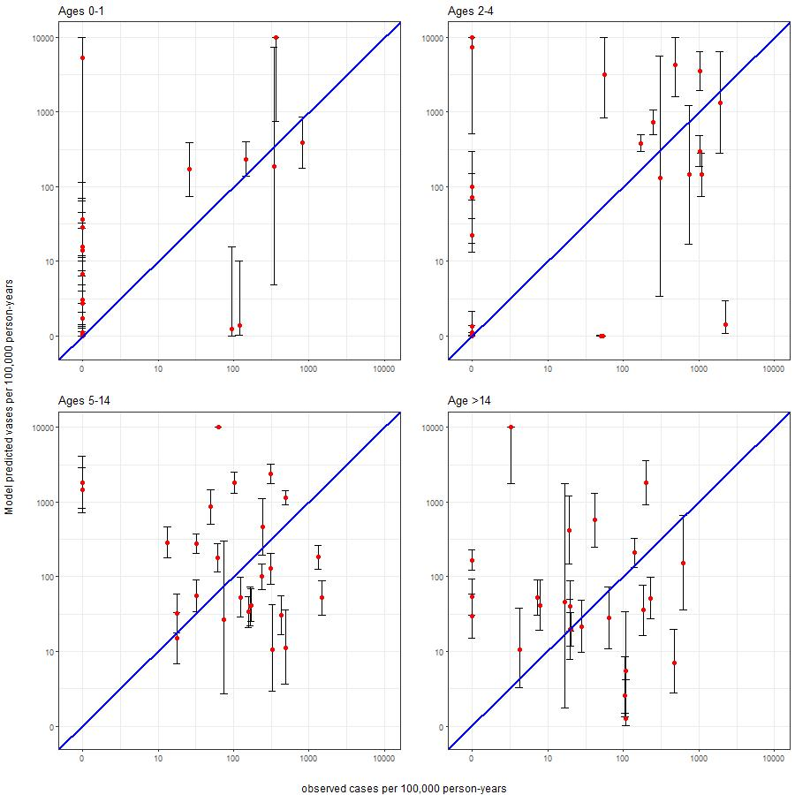
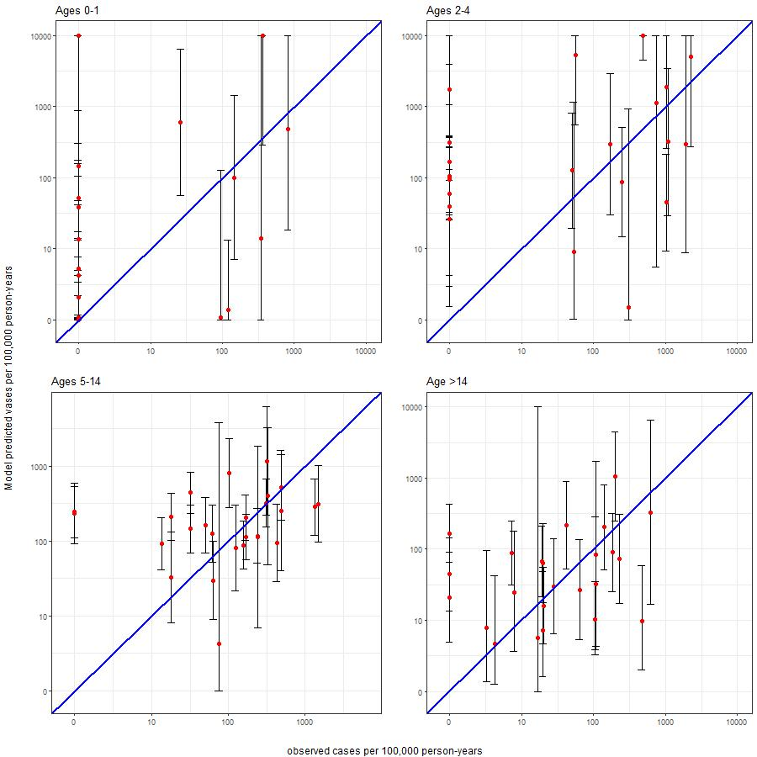
Ver1
LR
Poi.
NB
CI is too wide
Linear Reg.: CI is too wide (DROP)
Poisson Reg. provides smaller CI width.
Except 0-1y, NB Reg. provides smaller RMSE.
In age 0-1y & 2-4y, RMSE values are too large.

Slide 12
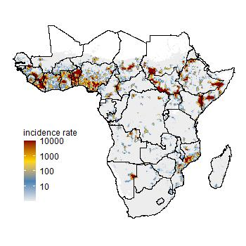
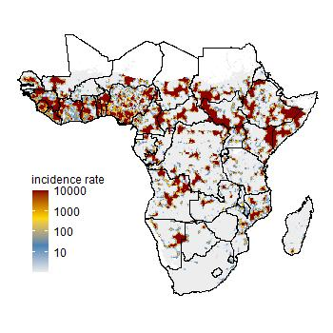
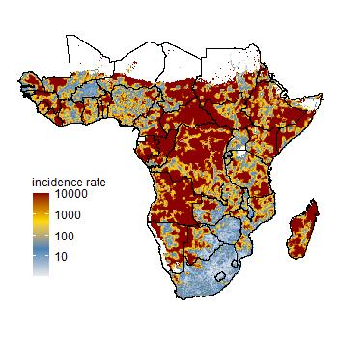
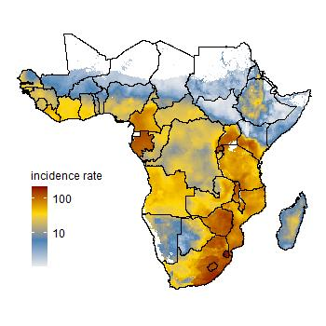
Ver1
0-1y
2-4y
LR
Summary of IR in data
 | 0-1 y | 2-4 y | 5-14 y | >14 y
Min. | 0.00 | 0.00 | 0.00 | 0.00
1st Qu. | 0.00 | 0.00 | 36.93 | 7.61
Median | 0.00 | 54.40 | 140.95 | 24.06
Mean | 87.38 | 426.49 | 259.93 | 100.97
3rd Qu. | 78.60 | 679.45 | 314.75 | 116.70
Max. | 821.50 | 2242.60 | 1495.80 | 625.60
5-14y
15+

Slide 13
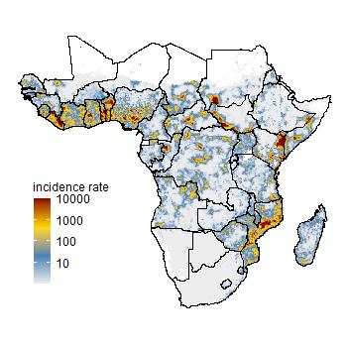
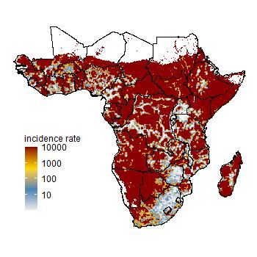
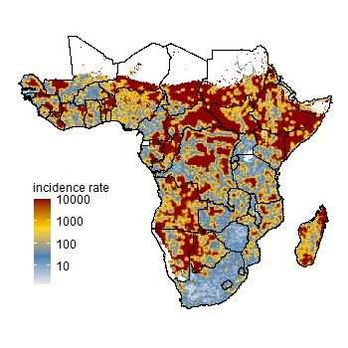
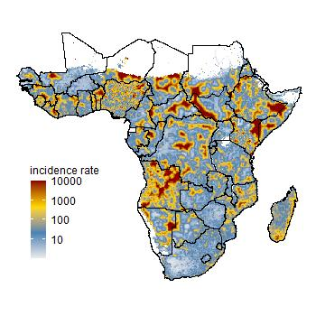
Ver1
0-1y
2-4y
Poisson
Summary of IR in data
 | 0-1 y | 2-4 y | 5-14 y | >14 y
Min. | 0.00 | 0.00 | 0.00 | 0.00
1st Qu. | 0.00 | 0.00 | 36.93 | 7.61
Median | 0.00 | 54.40 | 140.95 | 24.06
Mean | 87.38 | 426.49 | 259.93 | 100.97
3rd Qu. | 78.60 | 679.45 | 314.75 | 116.70
Max. | 821.50 | 2242.60 | 1495.80 | 625.60
5-14y
15+
Re-calculated IR for all age

Slide 14
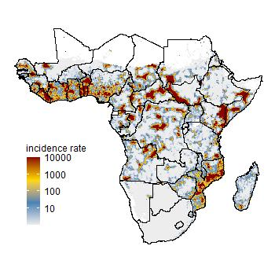
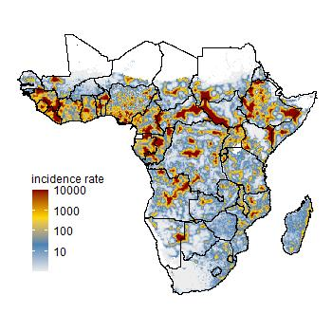
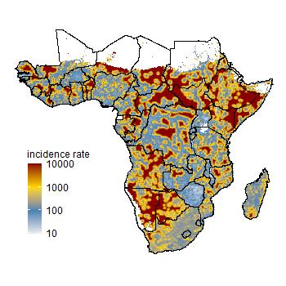
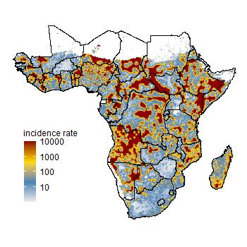
Ver1
0-1y
2-4y
NB
Summary of IR in data
 | 0-1 y | 2-4 y | 5-14 y | >14 y
Min. | 0.00 | 0.00 | 0.00 | 0.00
1st Qu. | 0.00 | 0.00 | 36.93 | 7.61
Median | 0.00 | 54.40 | 140.95 | 24.06
Mean | 87.38 | 426.49 | 259.93 | 100.97
3rd Qu. | 78.60 | 679.45 | 314.75 | 116.70
Max. | 821.50 | 2242.60 | 1495.80 | 625.60
5-14y
15+

Slide 16
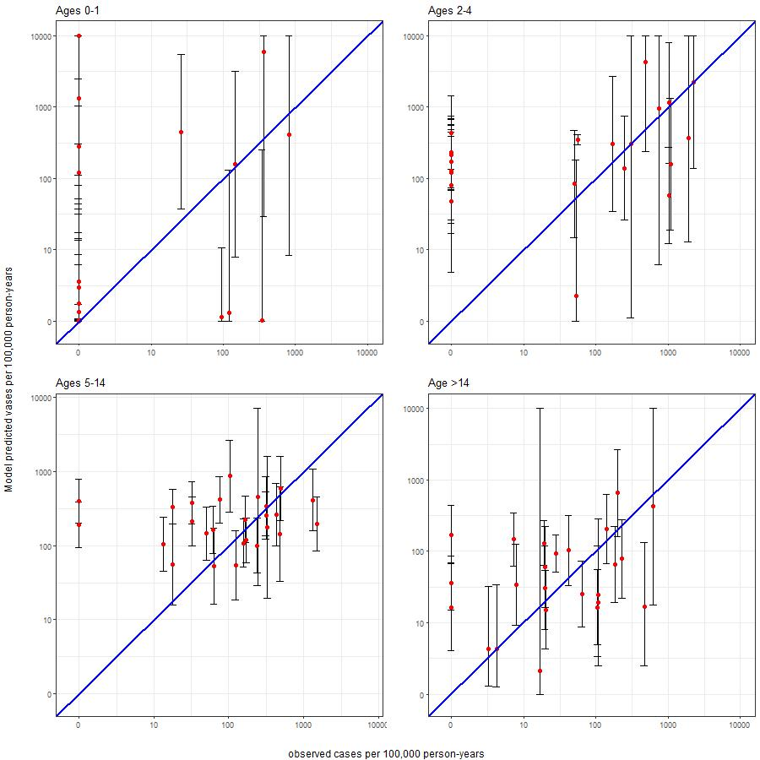
Ver2
NB (Ver1)
NB (Ver2)
NB with Ver2 provides better calibration and RMSE output.

Slide 17
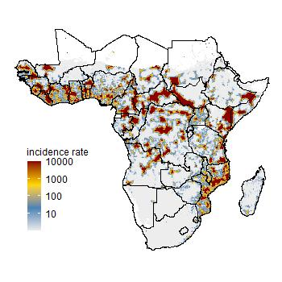
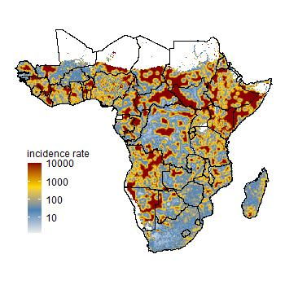
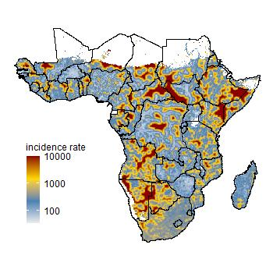
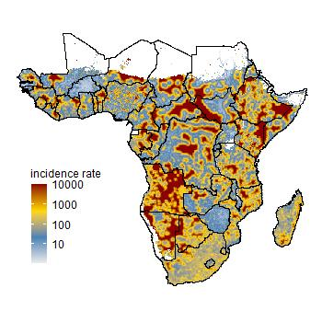
NB (Ver2)
0-1y
2-4y
Ver1
0-1y
2-4y
5-14y
15+
5-14y
15+
By comparing the NB with Ver1
0-1y: quite similar
2-4y : larger IR
5-14y: smaller IR
15+: quite larger IR in south areas

