Slide 1
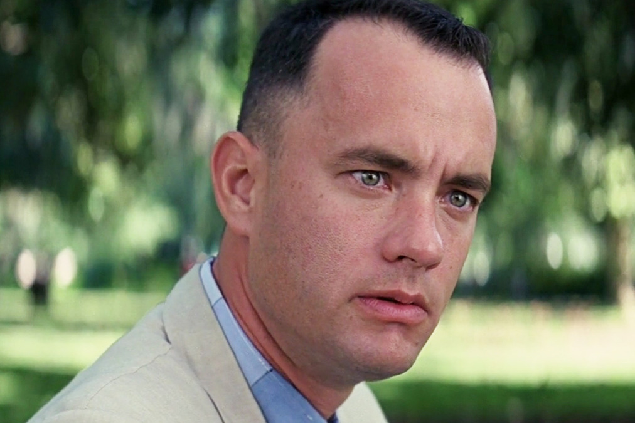
FRONT END
Everything a user sees, interacts with & experiences.
In movie terms: the actors, the set, the location, the music, script, etc.

Slide 2
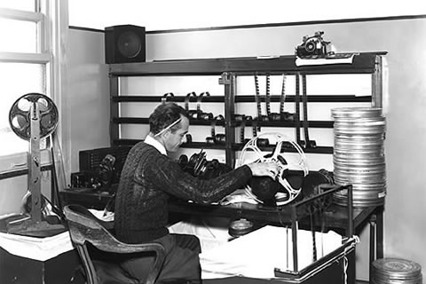
BACK END
The server, infrastructure, URL routes, data collection, storage.
In movie terms: the director, producer, film editors, camera operators.

Slide 3
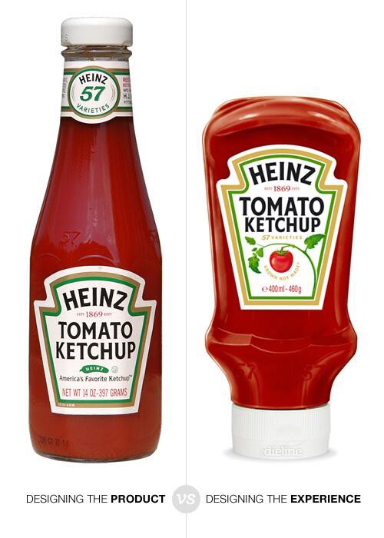
UX/UI DESIGN
UI
UX
Typically a separate job from the front-end developer and does not require any coding at all.
Consists of researching and wireframing
UX = User Experience
(the user journey)
UI = User Interface
(the actual product)

Slide 4
HTML + CSS + JAVASCRIPT
FRONT END LANGUAGES
These are the 3 languages that EVERY browser uses, regardless if the backend is written in Ruby, Rails, Node, PHP or another language.

Slide 5
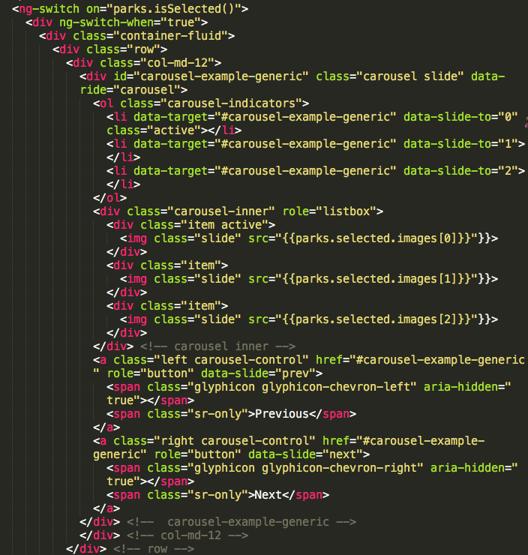
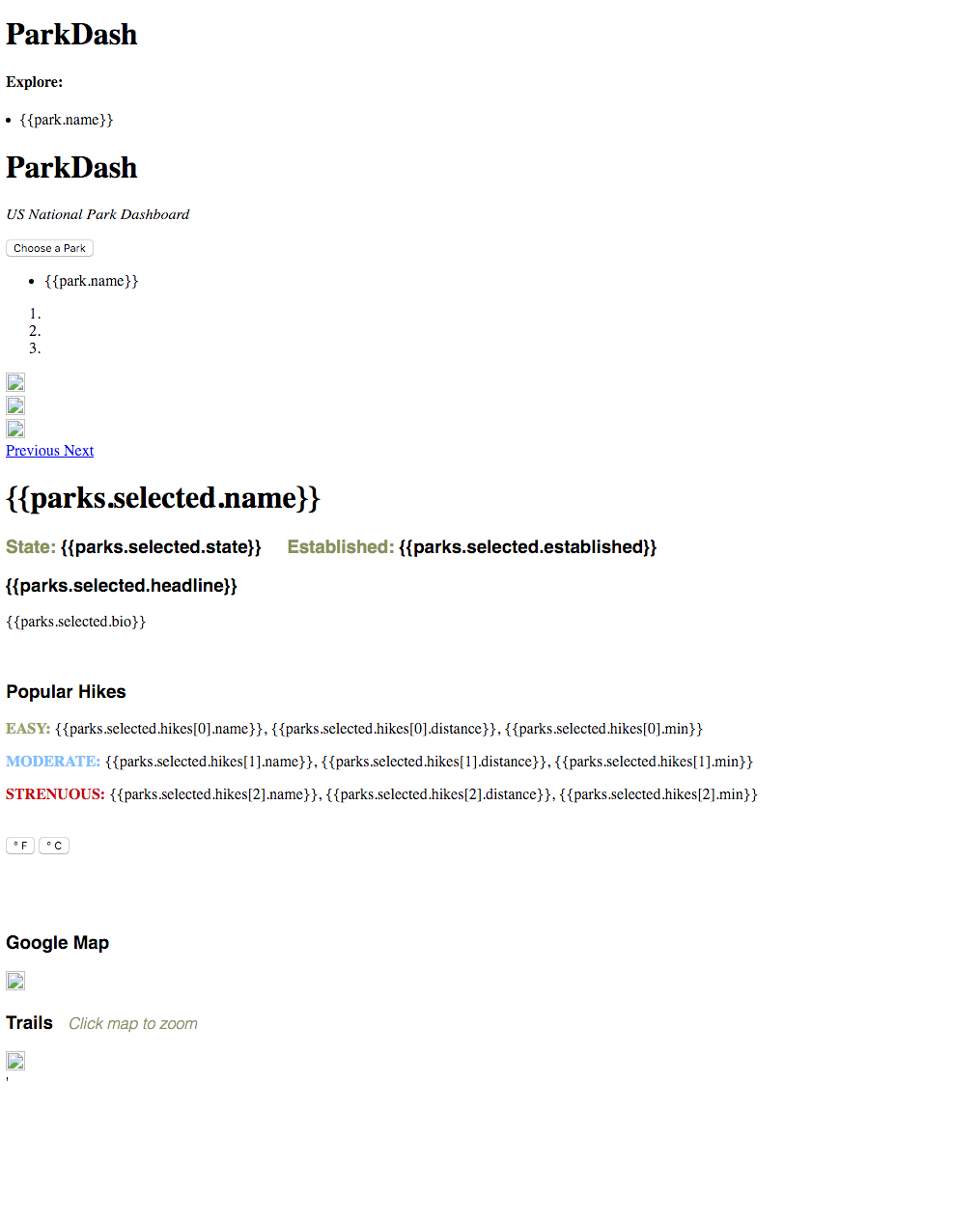
HTML
The skeleton of the page. It structures all of your content into specific elements without any style or functionality.

Slide 6

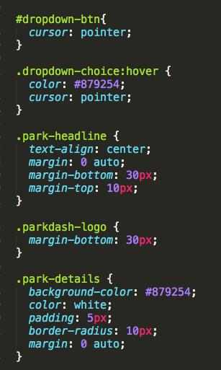
CSS
The appearance & styling of every element in your HTML.
It works by assigning classes and IDs to every element, and adding things like margins, spacing, colors, borders, font families, and opacity.

Slide 7
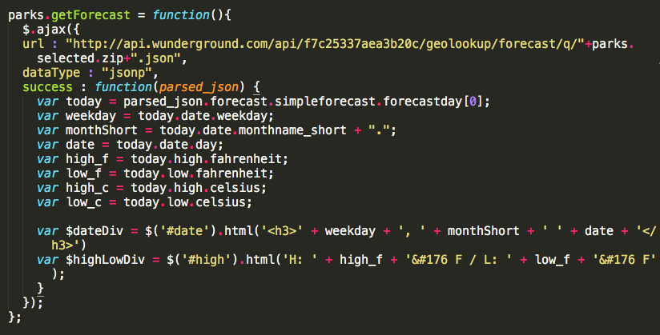
JAVASCRIPT
The functionality/performance of the website and how the user interacts with it.
Any calculations, conditionals, animation, or displaying data from APIs.
Squarespace does all of this work for you and requires no actual code.

Slide 8
WHY ARE DEVS ALWAYS GOOGLING/ Looking at Other code?
Every code language has extensive documentation — this stuff requires a lot of reading and troubleshooting.
No need to reinvent the wheel. Every minor problem you see comes with like 20 sub-problems. If someone has already solved something for you, use it.
Will the code you find will magically work when you paste it word-for-word? Almost never. It requires a lot of customization and debugging.

Slide 9
A SIMPLE DEMO Featuring puppies

