Slide 1
KeyForge
Mechanical Keyboard E-Commerce Platform
A Full-Stack Web Application — React · FastAPI · MongoDB
Final Project Presentation
Members : 1 Kimhong Pech
2 Sophal Pheakdeypanhasak
3 Sreang Limsry
4 Chea Lymeng
5 Pheak Solyna
6 Kongrith Vireaksal
Live: https://key-forge-final-project.vercel.app Repo: github.com/kimhongpech-dev/KeyForge-Final-Project

Slide 2
OUTLINE
01
Project Overview & Goals
What KeyForge is, who it serves, and what it achieves
02
Problem & Motivation
Why build a full e-commerce platform from scratch
03
Technology Stack
Frontend, backend, database, and deployment choices
04
System Architecture
How the pieces talk to each other
05
Database & API Design
MongoDB data model and REST endpoints
06
Core Features
Catalog, auth, cart & checkout, orders, admin dashboard
07
UX & Design
Theming, responsiveness, accessibility
08
Deployment & Challenges
GitHub, Vercel, MongoDB Atlas, problems solved
09
Testing, Demo & Future Work
How it was verified, demo flow, next steps
KeyForge · Final Project · Web Development
02 / 20

Slide 3
PART 1 · VISION
Project Overview
KeyForge is a production-style online store for mechanical keyboards, gaming mice, and earphones — built end-to-end, from product browsing to admin analytics.
25
3
4
6
Products seeded
Categories
Order stages
Charts & stats
Key Goals
keyboards, mice, earphones
with live search & filters
pending → confirmed → shipped → delivered
custom-built SVG analytics
▸ Complete shopping journey: browse → search → cart → checkout → track orders
▸ Real accounts & security: registration, login, JWT sessions, admin roles
▸ Business-grade stock control: inventory enforced atomically at checkout
▸ Full admin operations: product CRUD, stock edits, order workflow, analytics
▸ Production deployment: live on Vercel with MongoDB Atlas, auto-deploy on push
2
Theme modes
light & dark, remembers choice
1
Owner / admin account
boss@keyforge.com · promoted via script
Deployed live at key-forge-final-project.vercel.app
KeyForge · Final Project · Web Development
03 / 20

Slide 4
PART 1 · VISION
Problem & Motivation
A shopping site is a small operating system: products, money, identity, and inventory must all stay consistent in real time. Most course projects stop at mock data — KeyForge goes the full distance to a working, deployed product.
The Problem
How KeyForge Solves It
Fake checkouts
Real checkout
orders that never reduce stock or create records
orders persisted, stock decremented atomically
No real accounts
JWT accounts & roles
everyone sees everything, no roles or ownership
customers vs. admin, protected APIs & pages
Manual operations
Admin dashboard
no way to manage products, stock, or orders
full product CRUD, stock, order workflow, analytics
Static catalog
Database-driven catalog
products hard-coded in the frontend, unchangeable
25 products served from MongoDB, editable
No deployment
Production deployment
works on one laptop only, impossible to share
live on Vercel, MongoDB Atlas, CI via git push
KeyForge · Final Project · Web Development
04 / 20

Slide 5








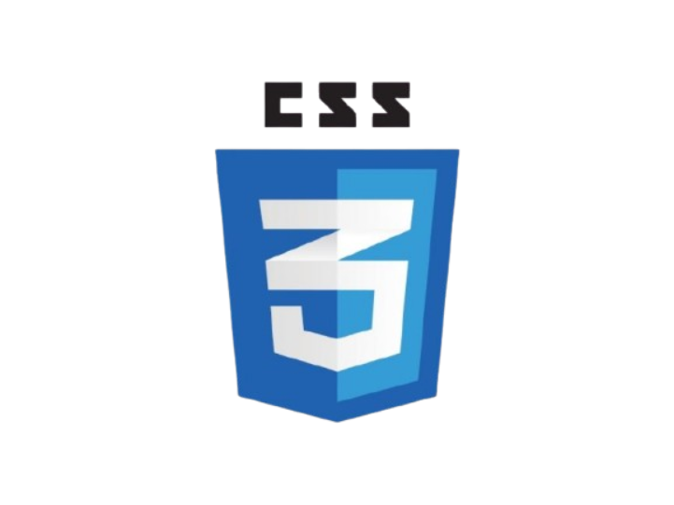
PART 2 · BUILD
Technology Stack
Frontend
Backend
Data & Ops
React 19 + Vite
Python 3.12 + FastAPI
MongoDB Atlas
fast builds, HMR, component model
async, typed, auto-documented
cloud database, free tier, auto-indexed
React Router
Motor (async driver)
GitHub
7 pages, dynamic product routes
non-blocking MongoDB access
private repo, versioned history
Context API
PyJWT + bcrypt
Vercel
auth, cart & theme state — no extra libraries
signed sessions, hashed passwords
static site + Python serverless functions
Custom CSS
Pydantic schemas
GitHub ↔ Vercel
design-system variables, responsive grid
validated request/response models
auto-deploy on every push to main
No heavy UI libraries — charts, theming, and layout are hand-built for full control and learning value.
KeyForge · Final Project · Web Development
05 / 20

Slide 6
PART 2 · BUILD
System Architecture
Vercel — one deployment, two runtimes
React SPA (static)
FastAPI (Python functions)
User / Browser
HTTPS
Pages · cart · orders ·
admin dashboard · theme
served as static files
REST API under /api — auth,
products, orders, admin
runs as serverless functions
SPA calls the same domain — no CORS issues in production
MongoDB Atlas (cloud)
users · products · orders — async driver, indexed lookups
Key flows: JWT issued at login and verified per request · cart lives in browser state · orders & stock updates are atomic database operations.
KeyForge · Final Project · Web Development
06 / 20

Slide 7
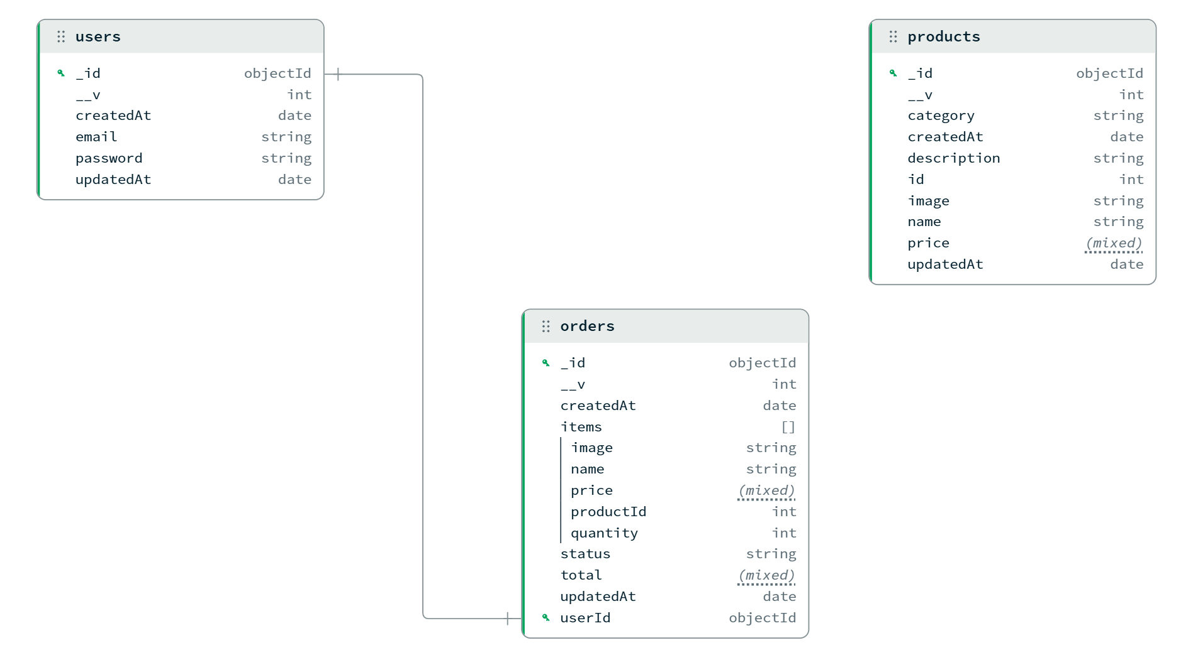
PART 2 · BUILD
Database Design — MongoDB Atlas
Three collections, one database. Order items are embedded (no join needed); stock lives on the product so it can be decremented atomically.
users
products
orders
name, email (unique)
password — bcrypt hash
is_admin flag
created_at
id, name, price
category, description, image
stock — source of truth
25 seeded records
user email + items embedded
total, status, timestamps
tracking: 4 status values
Entity-relationship overview (from the project's design phase):
KeyForge · Final Project · Web Development
07 / 20

Slide 8
PART 2 · BUILD
REST API Design
Method | Endpoint | Purpose
GET | /api/products | List products · optional ?search & ?category filters
GET | /api/products/{id} | Single product detail
GET | /api/products/categories | Distinct category list for filters
POST | /api/auth/register | Create account (email unique, password hashed)
POST | /api/auth/login | Verify credentials, return JWT token
GET | /api/auth/me | Resolve current user from token
POST | /api/orders | Place order · atomic stock decrement · rejects short stock
GET | /api/orders | List my orders (newest first)
POST | /api/orders/{id}/cancel | Client cancellation · restores stock
GET | /api/admin/products | Admin product list
POST / PUT / DELETE | /api/admin/products/{id} | Admin product CRUD & stock updates
GET / PUT | /api/admin/orders/{id} | Admin order list & status workflow
GET | /api/admin/stats | Dashboard analytics (revenue, statuses, categories, top)
All errors return a consistent shape — {"error": "<message>"} — handled by one global exception handler.
KeyForge · Final Project · Web Development
08 / 20

Slide 9
PART 2 · BUILD
Feature — Product Catalog & Discovery
What the customer sees
How it's implemented
▸ Live search
▸ Server-side filtering: FastAPI builds a MongoDB query from query params
▸ Cache in memory: first fetch fills a module-level cache per session
▸ Reusable components: ProductCard, SearchBar, CategoryFilter
▸ Clean state: one products[] state driven by search / category effects
matches product name & description on the server
▸ Category filters
Keybord · Mouse · Earsphone — one click filtering
▸ Stock awareness
cards show live stock; out-of-stock items can't be added
▸ Product details page
full description, price, and add-to-cart with stock caps
Design detail: the API returns JSON with stock included, so every card always shows the current inventory — no stale numbers after an order.
KeyForge · Final Project · Web Development
09 / 20

Slide 10
PART 2 · BUILD
Feature — Authentication & Authorization
Register / Login
JWT issued
Client stores
Protected APIs
POST /api/auth/register | /login
signed token with email + role claims
token kept in memory + localStorage
verify bearer token on every request
▸ Passwords never stored in plain textbcrypt hashing with per-user salt
▸ Stateless sessionsPyJWT signs the token; no server session storage
▸ Admin flag in tokenthe API trusts role claims, the UI hides admin links
▸ Edge cases handledduplicate email → 400, wrong password → 401, expired token → re-login
Role model
Customer
Admin
browse · cart · order
track & cancel own orders
everything a customer can
+ dashboard, CRUD, workflow
Demo account: boss@keyforge.com (admin)
KeyForge · Final Project · Web Development
10 / 20

Slide 11
PART 2 · BUILD
Feature — Cart & Checkout
Customer experience
Stock safety — the interesting part
▸ Global cart state
1. Checkout reads stock from the database (not the browser)
2. Order placed in one atomic update: {"$inc": {"stock": -qty}}
3. If any item is short, the whole order is rejected — no partial decrements
4. Client cart is cleared only on success
Context provider so every page shares one cart
▸ Quantity controls
add, remove, and adjust — capped at available stock
▸ Live totals
subtotal recalculated from cart items automatically
▸ Confirmation screen
order number, summary, and items after success
Why this matters
Two customers hitting the last unit at the same moment: MongoDB's atomic update means exactly one succeeds. The loser gets a clear "insufficient stock" error with the item name — no negative inventory, no double sales.
KeyForge · Final Project · Web Development
11 / 20

Slide 12




PART 2 · BUILD
Feature — Order Tracking & Cancellation
pending
confirmed
shipped
delivered
set automatically
set by admin
set by admin
set by admin
▸ My Orders pageevery placed order with a live progress tracker
▸ Full historydate, status badge, items, totals — newest first
▸ Client cancellationallowed while pending or confirmed
▸ Stock integritycancelling restores inventory atomically
Cancellation flow
1. Customer requests cancel (pending / confirmed only)
2. API removes the order
3. Stock is added back in the same transaction
4. UI shows a success message immediately
Design note: the four stages are exactly the values the admin workflow writes — one source of truth for the whole order lifecycle.
KeyForge · Final Project · Web Development
12 / 20

Slide 13
PART 2 · BUILD
Feature — Admin Dashboard & Analytics
Operations
Analytics — hand-built SVG charts
▸ KPI stat cardsrevenue, order count, stock-outs, low stock — from one /stats call
▸ Product managementcreate, edit, delete, and update stock in place
▸ Order workflowmove any order pending → confirmed → shipped → delivered
▸ Search & filterfind products and orders instantly
▸ Role-gatedroute + API both reject non-admins
▸ Revenue last 14 daysbar chart with value labels & gridlines
▸ Orders by statuscolor-coded bars mirroring the workflow colors
▸ Products by categorydonut with legend, counts and percentages
▸ Top productshorizontal bars by quantity sold + revenue
▸ No chart librarypure SVG components — precise control, zero dependencies
API: GET /api/admin/stats aggregates orders and products server-side in one round trip.
KeyForge · Final Project · Web Development
13 / 20

Slide 14
PART 2 · BUILD
UX & Visual Design
Theming
Craft details
▸ Light & dark themes
▸ Responsive layoutdesktop grid, mobile hamburger menu, fluid type
▸ Accessibilityaria labels, keyboard focus rings, semantic buttons
▸ State coverageloading, empty, error, out-of-stock, success — all styled
▸ Consistent feedbackone error shape across every API failure
one toggle in the navbar, saved in localStorage
▸ Follows the OS by default
prefers-color-scheme on first visit
▸ No flash on load
inline script sets the theme before React mounts
▸ Design tokens
196 colors → 38 semantic CSS variables
The full palette is token-driven
Themes swap only the token values (--bg, --surface, --text…) — components never change, and dark-mode contrast stays ≥ 4.5:1 for body text.
KeyForge · Final Project · Web Development
14 / 20

Slide 15
PART 3 · DELIVERY
Deployment & DevOps
The whole stack runs on one Vercel project: the React build is served as static files, and the same vercel.json routes /api/* to a Python 3.12 serverless function. MongoDB runs on Atlas — zero servers to manage.
Source control — GitHub
Hosting — Vercel
Database — MongoDB Atlas
▸ private repo, main branch
▸ static build (Vite → dist)
▸ free cloud cluster
▸ clear commit history
▸ Python functions via vercel.json
▸ network access for the server
▸ identity configured for the owner
▸ env vars: MONGODB_URI, JWT_SECRET
▸ seeded once via script
▸ auto-deploy on every git push
Deploy pipeline: git commit → push to GitHub main → Vercel builds the site + bundles the API → production alias updates in ~1 minute.
KeyForge · Final Project · Web Development
15 / 20

Slide 16
PART 3 · DELIVERY
Challenges & How We Were Solved
Products disappeared under category filters
Problem: Three seeded products had no category field, so their category was empty and the filter matched nothing.
Fix: Added the missing categories in the seed data and re-seeded the database.
Product images broken in production
Problem: 22 of 25 images pointed at /src/assets paths that only exist on the dev machine, not on Vercel.
Fix: Mounted the assets directory in FastAPI and routed /src/assets/* to the backend in vercel.json.
Vercel blocked every new deployment
Problem: Hobby plan rejects deployments whose git commit author isn't the account owner; CLI deploys used a placeholder identity.
Fix: Rewrote the commits under the owner's real identity and connected the GitHub repo for auto-deploys.
Lesson: data hygiene, environment parity, and identity configuration are the three silent killers of a demo day.
KeyForge · Final Project · Web Development
16 / 20

Slide 17
PART 3 · DELIVERY
Testing & Verification
Build pipeline
API smoke tests
Manual QA flows
Edge cases covered
▸ npm run build passes cleanly (Vite production build)
▸ /api/health, /api/products, /api/auth/login verified on production
▸ register → login → browse → add to cart → checkout
▸ duplicate signup email → friendly 400
▸ eslint runs with only pre-existing warnings
▸ 25 products, 0 missing categories after re-seed
▸ stock decreases; insufficient-stock rejection shows error
▸ out-of-stock products can't be added
▸ Vercel build + Python bundle succeed
▸ image endpoints return correct MIME types
▸ cancel order → stock restored → tracker disappears
▸ admin pages blocked for non-admins
▸ dark/light theme persists across reloads
All checks are repeatable: the same commands (build, lint, API calls) are documented in the repo and were re-run after every fix.
KeyForge · Final Project · Web Development
17 / 20

Slide 18
PART 3 · DELIVERY
Running the Project Locally
Three commands
Project structure
npm install
src/
React pages, components, contexts, data layer
install frontend dependencies
server/
FastAPI app: routers, schemas, security, seeding
npm run seed
load 25 products into MongoDB
api/index.py
Vercel entry point — re-exports the FastAPI app
npm run dev:all
vercel.json
builds & routes: static + Python on one domain
Vite (port 5173) + FastAPI (port 5000) together
A .env file holds MONGODB_URI and JWT_SECRET (never committed).
requirements.txt
backend dependencies (both local & Vercel)
KeyForge · Final Project · Web Development
18 / 20

Slide 19
PART 3 · DELIVERY
Future Improvements
Payments
Wishlists & reviews
Email notifications
Integrate Stripe or PayPal for real checkout instead of order placement
per-user favorites and product ratings
order confirmation and status change emails
Shipping
Inventory alerts
Performance & scale
address book, courier selection, live tracking numbers
low-stock notifications to the admin
server-side pagination, image CDN, response caching
The architecture is already shaped for these: every feature is a new route, a new context, or a new collection — no rewrites.
KeyForge · Final Project · Web Development
19 / 20

Slide 20
Thank You
Questions & feedback are welcome
Live demo: https://key-forge-final-project.vercel.app
Source: https://github.com/kimhongpech-dev/KeyForge-Final-Project

