Slide 1
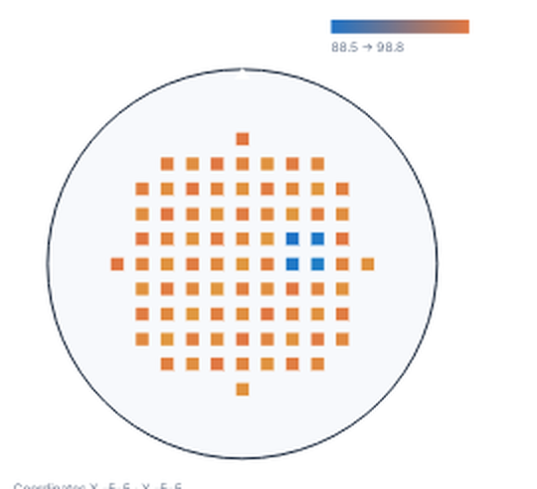
Executive Statement
Affected lot L2407 shows a localized die-level yield loss after ETCH-08 chamber A processing. Contain the lot until the chamber check and paired reference run confirm recovery.
Affected scope
Lot L2407 · ETCH-08 chamber A · affected die compared with a paired reference · release held for verification.
Process Flow
Excursion
signal
Compare
affected and
reference
Verify chamber
mechanism
Confirm
corrective
action
Evidence | Affected | Reference | Interpretation
Yield distribution | 94.2% | 98.6% | Mean of observed cohorts
Affected lot L2407 | 94.2% | — | Localized die loss
ETCH-08 / A | Pressure +2.1% | Stable | Verify chamber
Corrective action
Contain lot L2407 through chamber requalification
Release only after chamber A and the paired reference run confirm recovery.
Contain
Affected die yield
Control versus affected distribution
81 observations · 0 missing · Value 88.5 to 98.8
99.05
N · NOTCH
97.675
96.3
94.925
93.55
Reference
Affected
MEASURED VALUE
88.5
98.8
Verified finding
Finding · chamber A pressure drift aligns with the L2407 yield excursion.
Affected yield is 94.2% versus 98.6% reference. Contain L2407 and verify the matched chamber run before release.
Verified
Affected versus reference yield
98.6% → 94.2%
Affected yield
94.2%

