Slide 1
22-02-11
Behavior team HyungkyuKim

Slide 2
What is optical flow?
이미지의 빛의 패턴의 가시적인 움직임
카메라의 움직임, 물체의 움직임이 영향을 줄 수 있다.
계산하기 위해서는?
이미지들 사이에 시간적 연속성이 있어야 하고
이미지 내의 점들과 그 이웃하는 점들 사이에 공간적인 연속성이 있다는 가정 필요
2차원 vector field의 모습으로 표현됨

Slide 3
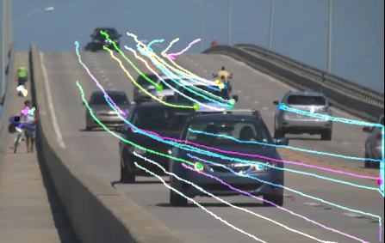
Example of optical-flow
Notes:
OpenCV library를 활용하여 몇몇 포인트
들의 optical flow를 그린 모습

Slide 4
What is MoveNet?
신체의 17개의 키 포인트를 감지하는 모델
속도가 빠름
정확성이 높음
TF Hub에서 제공
Lightning
대기 시간이 중요한 응용 프로세스에 사용
Thunder
높은 정확도가 요구되는 응용 프로세스에 사용
Lightning, Thunder 모델 모두 실시간(30+FPS)보다 빠르게 실행
초기 페이지 로드 후에 서버 호출 필요 없음
Notes:
MoveNet is an ultra fast and accurate model that detects 17 keypoints of a body
The model is offered on TF Hub with two variants, known as Lightning and Thunder.
Lightning is intended for latency-critical applications,
while Thunder is intended for applications that require high accuracy
Both models run faster than real time (30+ FPS) on
most modern desktops, laptops, and phones,
which proves crucial for live fitness, sports, and health applications
This is achieved by running the model completely client-side,
in the browser using TensorFlow.js with no server calls needed after the initial page load and
no dependencies to install.

Slide 5
Try out the live Demo
MoveNet can track keypoints through fast motions and atypical poses.
https://storage.googleapis.com/tfjs-models/demos/pose-detection/index.html?model=movenet
Notes:
Both models run faster than real time (30+ FPS) on
most modern desktops, laptops, and phones,
which proves crucial for live fitness, sports, and health applications

Slide 6
Unlocking Live Health Applications with MoveNet
teamed up with IncludeHealth
developed an interactive web application
routines are digitally built
prescribed by physical therapists to test balance, strength, and range of motion.
used quantify and qualify human poses and movements
Even more complex postures can be identified
Existing treatment and training can be extended online rather than offline

Slide 7
MoveNet Architecture
bottom-up estimation model
architecture consists of two components
a feature extractor
a set of prediction heads
prediction scheme
loosely follows CenterNet, with notable changes that improve both speed and accuracy
using the TensorFlow Object Detection API
Notes:
MoveNet is a bottom-up estimation model, using heatmaps to accurately localize human keypoints.
The architecture consists of two components: a feature extractor and a set of prediction heads.
The prediction scheme loosely follows CenterNet,
with notable changes that improve both speed and accuracy.
All models are trained using the TensorFlow Object Detection API.

Slide 8
MoveNet Architecture
feature extractor in MoveNet
MobileNetV2 with an attached feature pyramid network (FPN)
Allows for a high resolution (output stride 4)
Allows semantically rich feature map output
four prediction heads is responsible for densely predicting a:
Person center heatmap
predicts the geometric center of person instances
Keypoint regression field
predicts full set of keypoints for a person, used for grouping keypoints into instances
Person keypoint heatmap
predicts the location of all keypoints, independent of person instances
2D per-keypoint offset field
predicts local offsets from each output feature map pixel to the precise sub-pixel location of each keypoint
Notes:
The feature extractor in MoveNet is MobileNetV2 with an attached feature pyramid network (FPN),
which allows for a high resolution (output stride 4), semantically rich feature map output.
There are four prediction heads attached to the feature extractor,
responsible for densely predicting a Person center heatmap, Keypoint regression field,
Person keypoint heatmap, 2D per-keypoint offset field

Slide 9
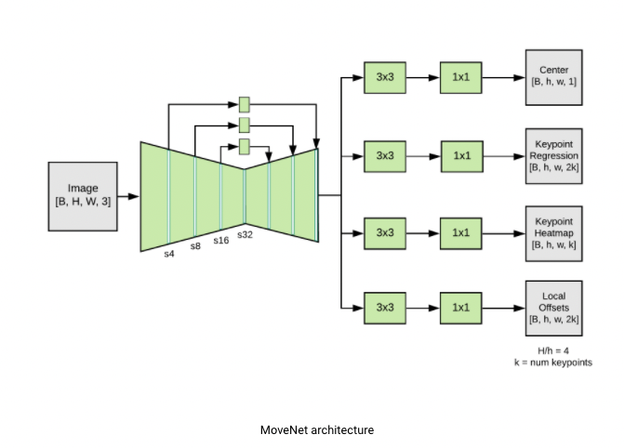
MoveNet Architecture
Notes:
This is movenet architecture

Slide 10
sequence of operation
Step 1: The person center heatmap is used to identify the centers of all individuals in the frame, defined as the arithmetic mean of all keypoints belonging to a person. The location with the highest score (weighted by the inverse-distance from the frame center) is selected.
Step 2: An initial set of keypoints for the person is produced by slicing the keypoint regression output from the pixel corresponding to the object center. Since this is a center-out prediction – which must operate over different scales – the quality of regressed keypoints will not be very accurate.
Step 3: Each pixel in the keypoint heatmap is multiplied by a weight which is inversely proportional to the distance from the corresponding regressed keypoint. This ensures that we do not accept keypoints from background people, since they typically will not be in the proximity of regressed keypoints, and hence will have low resulting scores.
Step 4: The final set of keypoint predictions are selected by retrieving the coordinates of the maximum heatmap values in each keypoint channel. The local 2D offset predictions are then added to these coordinates to give refined estimates. See the figure below which illustrates these four steps.
Notes:
Although these predictions are computed in parallel,
one can gain insight into the model’s operation by considering the following sequence of operation:

Slide 11
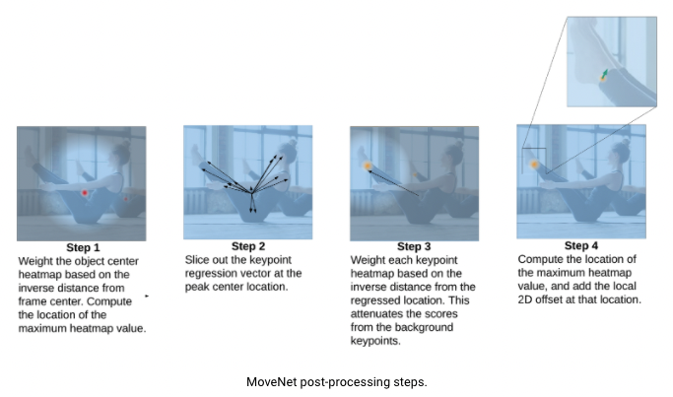
MoveNet Pose-processing steps

Slide 12
Training Datasets
MoveNet was trained on two datasets
COCO
standard benchmark dataset for detection
due to its scene and scale diversity
it is not suitable for fitness and dance applications
internal Google dataset called Active
produced by labeling keypoints (adopting COCO’s standard 17 body keypoints)
Train by selecting no more than 3 frames from each video
Notes:
MoveNet was trained on two datasets: COCO and an internal Google dataset called Active.
The characteristics of each data set are as follows:

Slide 13
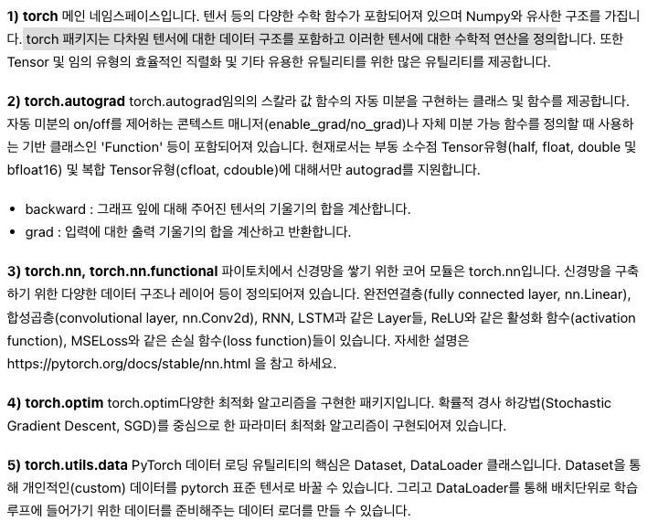
‘About Pytorch
Package(more detail: https://tutorials.pytorch.kr/beginner/basics/tensorqs_tutorial.html)

Slide 14
‘About Tensor
A tensor is a special data structure very similar to an array or matrix.
PyTorch uses tensors to encode model inputs and outputs, and model parameters.
Tensors are similar to NumPy's ndarray, except that tensors can run on a GPU or other hardware accelerator.
A tensor is an n-dimensional array
Tensors can track computational graphs and gradients.
Also useful as a general tool for scientific calculations
PyTorch tensors can use GPUs to accelerate numerical operations

Slide 15
‘Example step1
Pytorch → tensor 선언 및 자동 미분을 통해 학습하는 구조
Linear Regression의 기본 가설인 y = Wx + b에서 우리가 구하고자 하는 W and b를 Tensor로 초기화 해줌!
Require_grad = True 를 갖는 2개의 tensor W와 b를 만듭니다.
손실 함수는 평균제곱 오차, optimizer는 SGD를 사용
손실함수는 실제값과 예측값의 차이를 수치화 해주는 함수
오차가 큼 → 손실 함수의 값이 큼
선형회귀란 손실 함수의 값을 최소화 하는 W, b를 찾아가는 것이 목적
일반적으로 회귀 문제 → 평균 제곱 오차, 분류 문제 → 크로스 엔트로피 사용

Slide 16
‘손실 함수
손실함수를 줄여나가면서 학습하는 방법은 어떤 optimizer를 사용하느냐에 따라 달라짐
Optimizer란 ?
→학습데이터 셋을 이용하여 모델을 학습 할 때 데이터의 실제 결과와 모델이 예측한 결과를 기반으로 잘 줄일 수 있게 만들어주는 역할을 하는 것
딥러닝에서 모델을 학습시킨다 라는 말은 최적화 태스크를 수행하는 것과 같음(이때 최적화란 손실 함수의 최솟값을 찾아내는 과정)
최적화는 각 학습 단계에서 오류를 줄이기 위해 모델 매개변수를 조정하는 과정
경사하강법(SGD)
1 step마다 이동하는 크기(보폭): 학습률
앞으로 이동할 방향: 현 지점의 기울기를 통해 정의

Slide 17
‘SGB
경사 하강법의 일종
Lr은 학습 률을 의미한다.
SGB는 손실 함수를 계산시에
전체 데이터(Batch)대신 일부 데이터의 모음(Mini-Batch)을 사용
이러한 방법으로 인하여 속도가 빠르게 동작
# 학습하려는 모델의 매개변수와 학습률(learning rate) 하이퍼파라매터를 등록하여 옵티마이저를 초기화
cost = torch.mean((hypothesis - y_train) ** 2)
optimizer = optim.SGD([W, b], lr=0.01)

Slide 18
optimizer
각 단계의 반복(iteration) – 에폭이라고 부름
하나의 에폭은 두 부분으로 구성
학습 단계(train loop)
검증 / 테스트 단계(validation / test loop)

