Slide 1
Markerless Baseball Pitching Analysis
from a Single Smartphone Video
A student-reproducible methodology for validating low-cost 2D pose estimation
Sports Technology Club · Hyunjun Kim | KSEF 2026 / ISEF 2027

Slide 2
Background — The Accessibility Gap
2
• Pitching = the fastest human joint motion (shoulder ~7,000°/s), elbow varus torque ~64 N·m → high injury risk
• Standard analysis = optical marker mocap / multi-camera (KinaTrax, Hawk-Eye, Theia3D)
  – Requires costly hardware, controlled labs, expert staff
• Result: students, youth, and amateurs who most need analysis cannot access it
• → Can a single low-cost smartphone close this gap?

Slide 3
Objectives and Research Questions
3
• Initial requirement: generate a joint skeleton ('stick figure') on each of two camera angles
• RQ1. Stable pose estimation from one smartphone under different conditions (daylight side / backlit front)?
• RQ2. Can pitch phases and key joint kinematics be computed automatically?
• RQ3. Without ground-truth mocap, how do we validate the reliability of low-cost 2D measurement?

Slide 4
Related Work Comparison
4
System | Cameras | Cost | 2D/3D | Target | Open
This work | 1 (smartphone) | Consumer | 2D | Student/amateur | Yes
pitchAI | 1 | Commercial | 3D | Lab/pro | No
Fleisig 2024 | 9 | Laboratory | 3D | Pro | No
Aguinaldo 2025 | Multiple | Very high | 3D | Stadium | No
PitcherNet | 1 (broadcast) | High compute | 3D | Pro analytics | No
OpenCap/Pose2Sim | 2+ | Low–moderate | 3D | Researchers | Yes
2025 J Sports Sci: "no current research exists on single-camera markerless feasibility for pitching analysis"

Slide 5
Novelty — Accessibility, Not Accuracy
5
• We do NOT claim higher accuracy than lab systems (marker mocap remains the standard)
• Contribution 1 — Accessibility: pipeline runs on a single consumer smartphone
• Contribution 2 — Cross-engine validation: two independent engines' agreement as a reliability proxy
• Contribution 3 — Reproducible methodology: Bland-Altman · ICC · RMSE
• No prior study applies this combination to baseball pitching

Slide 6
System Architecture
6
• Input video → preprocessing (optional CLAHE backlight correction)
  – → pose engine (MediaPipe / YOLO11) → COCO 17 joints
  – → One-Euro smoothing (jitter removal) → skeleton overlay
  – → automatic phase segmentation → joint kinematics → validation stats
• Entirely Python 3.11 + open source — reproducible by students

Slide 7
Methods — Pose Estimation and Smoothing
7
• Two engines unified under one convention (COCO 17 joints) → swappable & comparable
  – MediaPipe BlazePose (Heavy): 33 landmarks, real-time on CPU
  – YOLO11-pose: 17 joints, backup for backlit/small subjects
• One-Euro filter: speed-adaptive → minimal lag at release, tremor suppressed when static
• In multi-person frames, auto-select the single pitcher (max joint-confidence sum)

Slide 8
Methods — Kinematics and Phase Segmentation
8
• Joint angle = interior angle of three points; elbow/knee as flexion (180° − interior)
• Trunk tilt = angle of pelvis→shoulder vector relative to vertical
• Automatic phase detection:
  – peak leg lift · foot contact · release (max wrist speed)
• Throwing arm & lead leg auto-determined from max wrist speed

Slide 9
Methods — Measurement-Reliability Validation
9
• CV angles vs ground truth (two trained annotators, manual)
• Bland-Altman: bias + 95% limits of agreement
• ICC(2,1): two-way random, absolute agreement + 95% CI (Shrout & Fleiss 1979)
• RMSE · MAE · Pearson r; test-retest / inter- & intra-rater reliability
• When ground truth is absent → cross-engine agreement as proxy

Slide 10
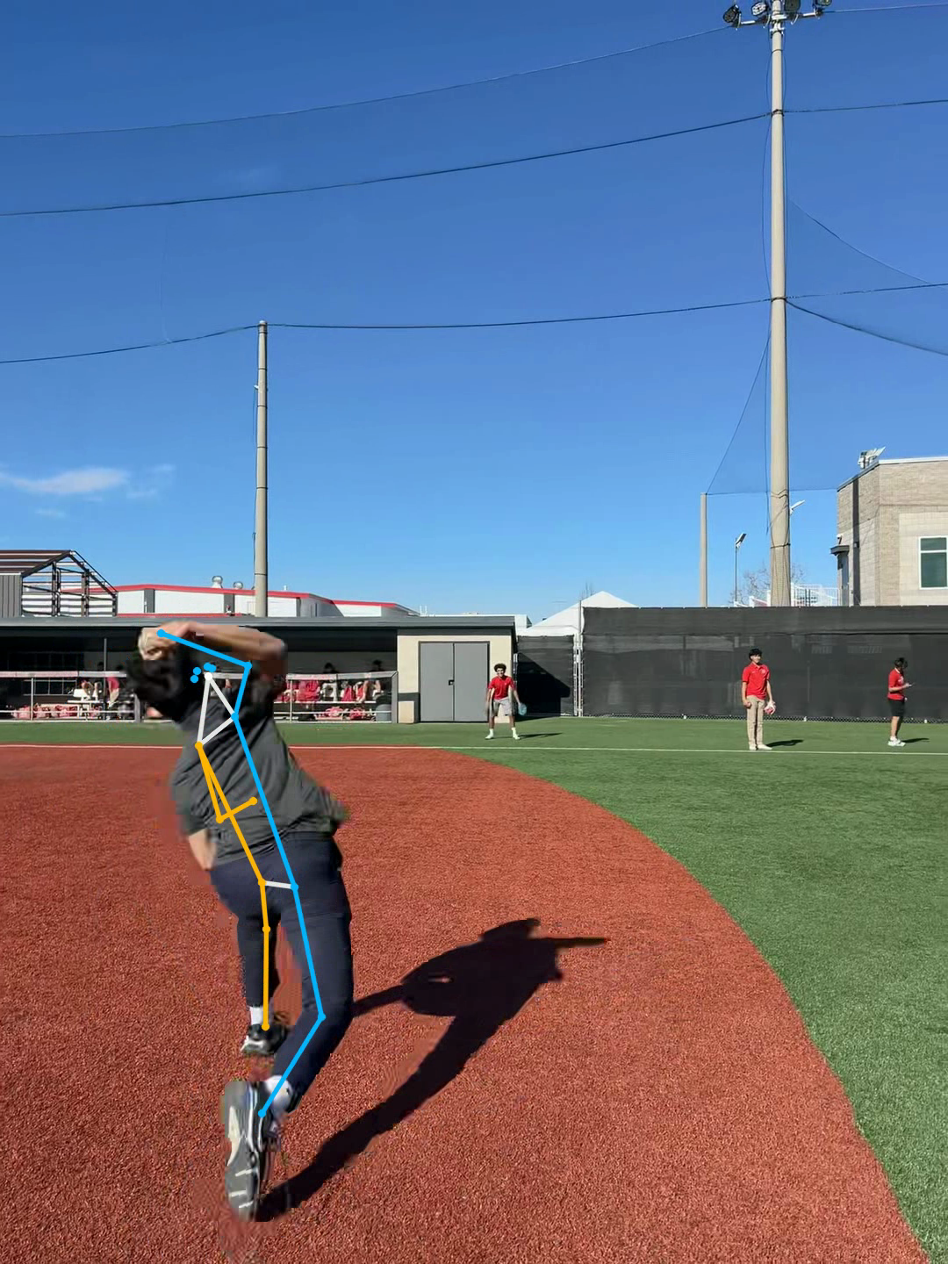
Result 1 — 100% Detection, Both Angles (RQ1)
10
• Side (daylight): 122/122 = 100%
• Front (backlit, small): 197/197 = 100%
• Anatomically plausible tracking even in the hard backlit front view
• Requirement (two-angle stick figures) satisfied
Figure. Skeleton overlay on the side-view (daylight) video

Slide 11
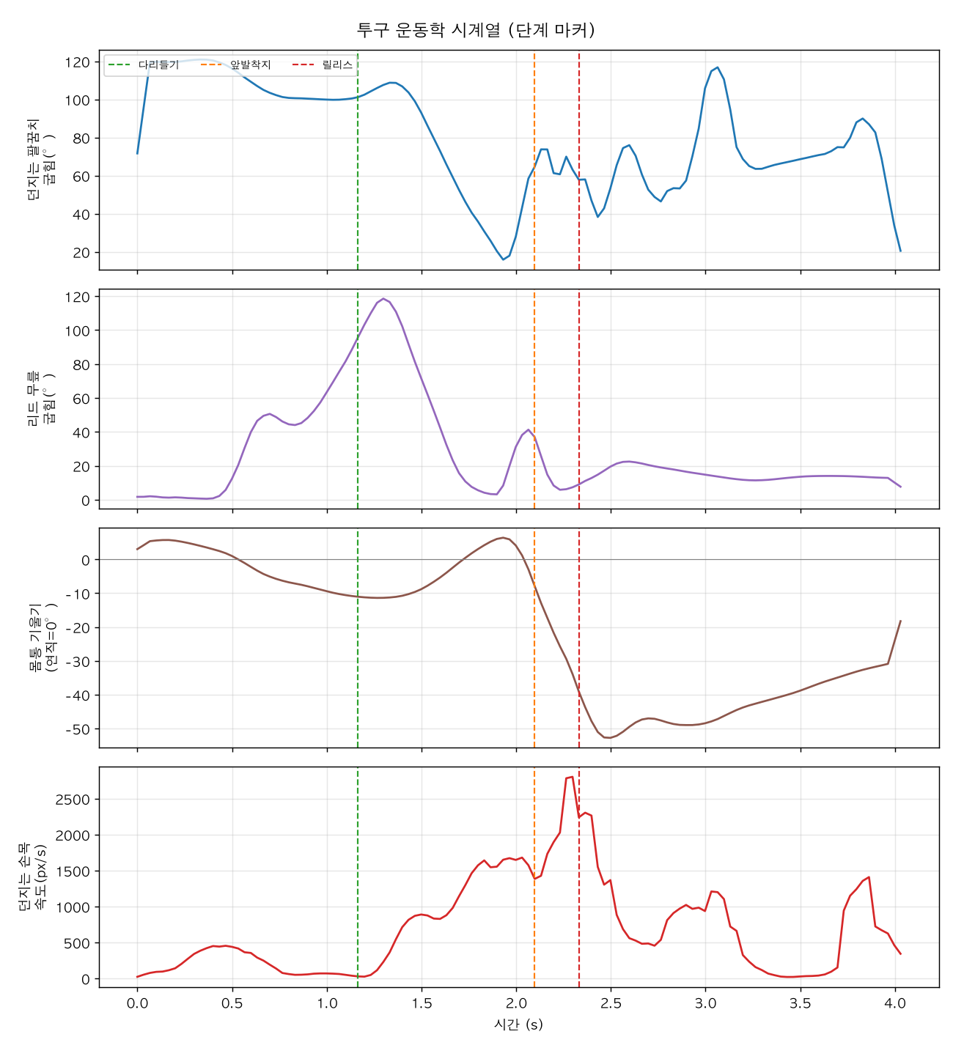
Result 2 — Automatic Kinematics & Phases (RQ2)
11
• Phases: leg lift (1.17s) → contact (2.10s) → release (2.33s)
• Peak wrist speed (~2,800 px/s) aligns exactly with release
• Lead knee 118° flexion → extension (lead-leg block)
• Trunk forward tilt 38° at release (within normal 28–42°)
Figure. Pitch-kinematics time series with auto phase markers

Slide 12
Result 3 — Cross-Engine & Statistical Validation (RQ3)
12
• Two engines localize the same points within 6–7% of torso length
  – Side 13.5px/7%, front 7.2px/6% → cross-validation feasible
• MediaPipe: marginally lower jitter + ~7× faster → chosen as default engine
• ICC(2,1) implementation matches Shrout & Fleiss example (0.290) exactly ✓
• End-to-end validation on synthetic GT works → ready for real annotations

Slide 13
Discussion — Limitations and Significance
13
• Limitations:
  – 2D single camera → shoulder rotation unmeasurable (deliberately omitted)
  – 30 fps undersamples release → 240 fps needed for formal capture
  – No ground truth / small sample → absolute accuracy pending validation
• Significance: an accessible pipeline + a scientifically honest, reproducible validation methodology

Slide 14
Conclusion and Future Work
14
• Single smartphone → 100% detection & automatic kinematics; value = accessibility + rigor
• Future 1 — IRB-approved 240 fps, two-camera multi-pitcher dataset
• Future 2 — establish per-variable valid ranges vs manual-annotation ground truth
• Future 3 — sync force-plate GRF with video release → quantify 'lower body → ball'
• Future 4 — extend to multi-camera 3D (Pose2Sim / OpenCap)

Slide 15
Summary
15
• Requirement (two-angle stick figures) → extended into a full research study
• Accessibility: single smartphone, open source, student-reproducible
• Rigor: cross-engine validation + Bland-Altman/ICC/RMSE (ICC verified)
• Honesty: 2D / 30 fps / shoulder-rotation limitations stated explicitly
• Thank you.

