Slide 1
Performance analysis of ECG signal denoising techniques
We test on the MIT-BIH Arrhythmia Database
(MIT-BIHA), and the MIT-BIH Normal Sinus Rhythm Database (MIT-BIH NSR). In some cases, the noise signals are taken from the MIT-BIH Noise Stress Test Database (MIT-BIH NST)

Slide 2
The Databases
The MIT-BIH Arrhythmia database
The MIT-BIH Normal Sinus Rhythm
The MIT-BIH Noise Stress Test

Slide 3
Introducing the MIT-BIH Arrhythmia Database
The MIT-BIH Arrhythmia database has 48 records of 30 min each.
File.dat: These records were digitised with a sampling frequency of 360 Hz at a resolution of 11 bits per sample over a 10 mV range.

Slide 4
File.atr: Inside this file, the label of each QRS is placed. These labels are specified by two expert doctors. Each symbol has a specific meaning and actually specifies what type of arrhythmia the QRS pattern indicates.
These can be generally classified into 5 categories:
  (N) non-ectopic beats
  (s) supraventricular ectopic beats
  (v) ventricular ectopic beats
      (F) fusion beats
      (U) unclassifiable and paced beats(include noises)
      The noises found in the records are BW, MA, PLI, and EM.

Slide 5
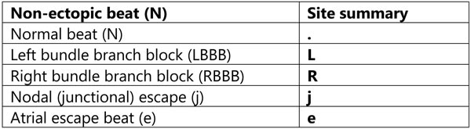
      sign for normal beats:

Slide 6
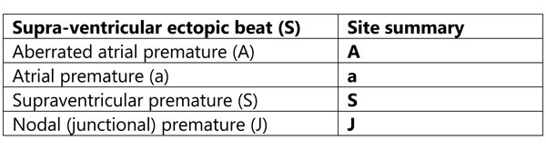
      sign for supra-ventricular ectopic beats:

Slide 7
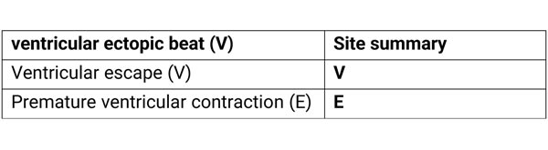
      Ventricular ectopic beats:

Slide 8
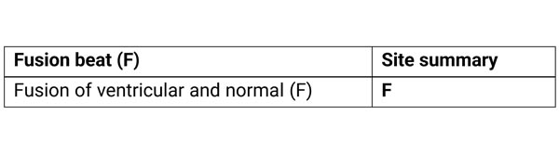
      Fusion beats:

Slide 9
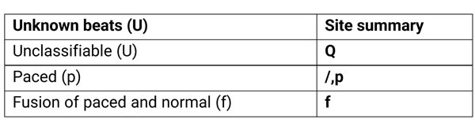
      Unknown beats:

Slide 10
The MIT-BIH Normal Sinus Rhythm includes 18 long-term
ECG recordings of subjects not having any significant arrhythmias.
The MIT-BIH Noise Stress Test includes 12 30 min ECG recordings and 3 30 min recordings of noise typical in ambulatory ECG recordings.

Slide 11
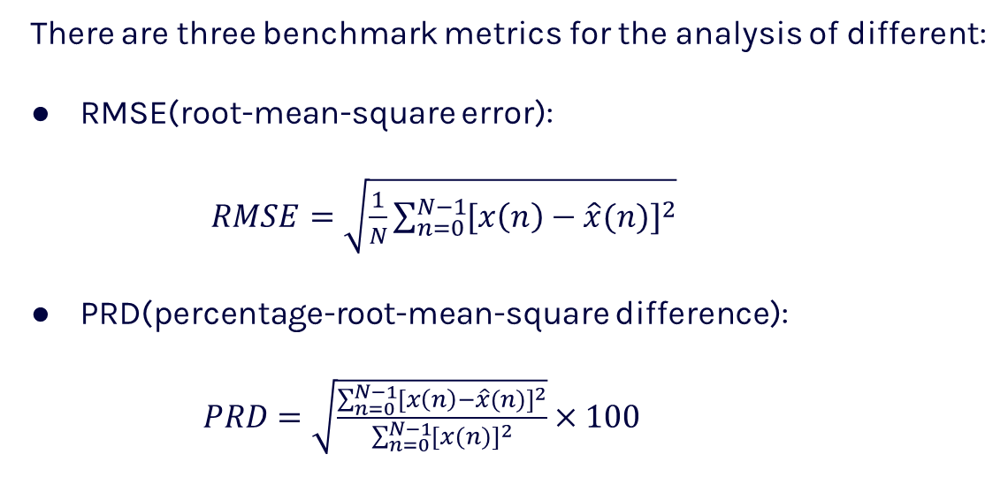
Performance parameters
There are three benchmark metrics for the analysis of different:
RMSE(root-mean-square error):
$RMSE=\sqrt{\frac{1}{N}\sum_{n=0}^{N−1}{{[x\left(n\right)−\hat{x}(n)]}^{2}}}$
PRD(percentage-root-mean-square difference):
$PRD=\sqrt{\frac{\sum_{n=0}^{N−1}{{[x\left(n\right)−\hat{x}(n)]}^{2}}}{\sum_{n=0}^{N−1}{{[x(n)]}^{2}}}}×100$

Slide 12
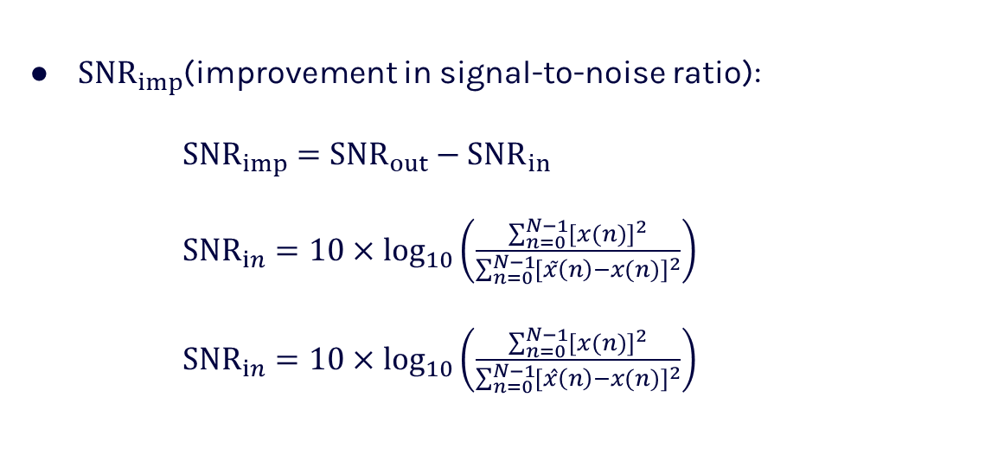
Performance parameters
${SNR}_{imp}$(improvement in signal-to-noise ratio):
${SNR}_{imp}={SNR}_{out}−{SNR}_{in}$
${SNR}_{in}=10×$ $\log_{10}\left(\frac{\sum_{n=0}^{N−1}{{[x(n)]}^{2}}}{\sum_{n=0}^{N−1}{{[x̃\left(n\right)−x(n)]}^{2}}}\right)$
${SNR}_{in}=10×$ $\log_{10}\left(\frac{\sum_{n=0}^{N−1}{{[x(n)]}^{2}}}{\sum_{n=0}^{N−1}{{[x̂\left(n\right)−x(n)]}^{2}}}\right)$

Slide 13
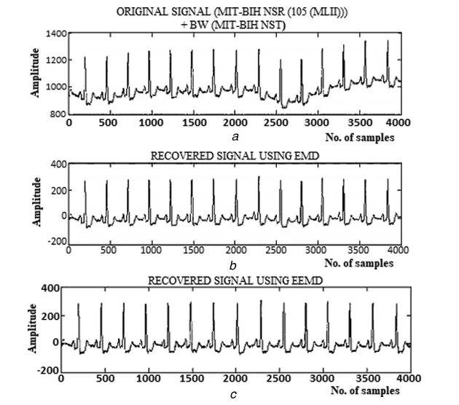
a pictorial comparison between six promising methods of ECG denoising:
ECG denoising using EEMD

Slide 14
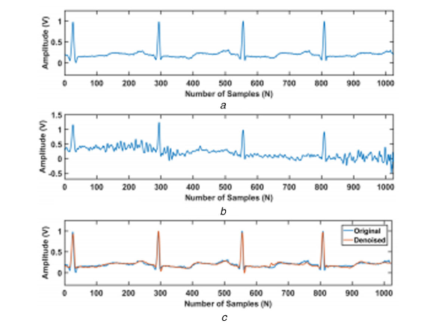
ECG denoising using FCN-based DAE

Slide 15
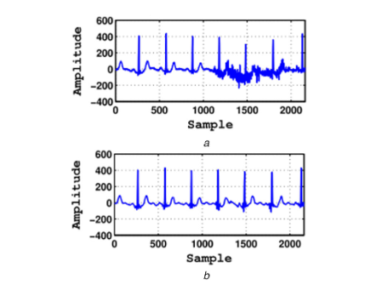
ECG denoising using DWT

Slide 16
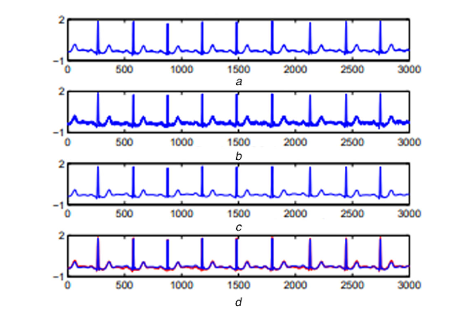
ECG denoising using sparsity

Slide 17
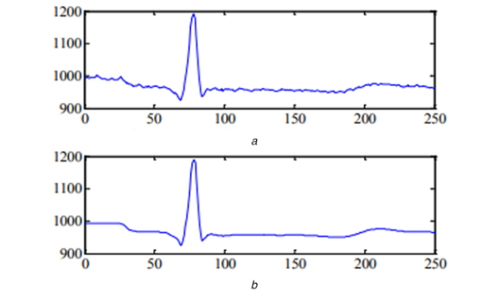
ECG denoising using WNN

Slide 18
Performance of various methodologies
in the presence of AWGN on MIT-BIH databases: Techniques such as wavelet-VBE, GAN2, new MP-EKF, SDCST, GSSSA, and EMD-MAF have superior performance.
in the presence of MA on MIT-BIH databases: DLSR, new MP-EKF and GAN1 have the best performances.
in the presence of BW and EM on MIT-BIH databases: GAN1 is very effective.
in the presence of PLI on MIT-BIH databases: EWT and DLSR are the most efficient.
in the presence of CN on MIT-BIH databases: Soft DWT (Sym6), MABWT (soft), scattering CPSD, and DAE-based FCN show promising results. Among DAE-based denoisers, DAE-based FCN is preferred for the combination of EM, BW, and MA noises.

Slide 19
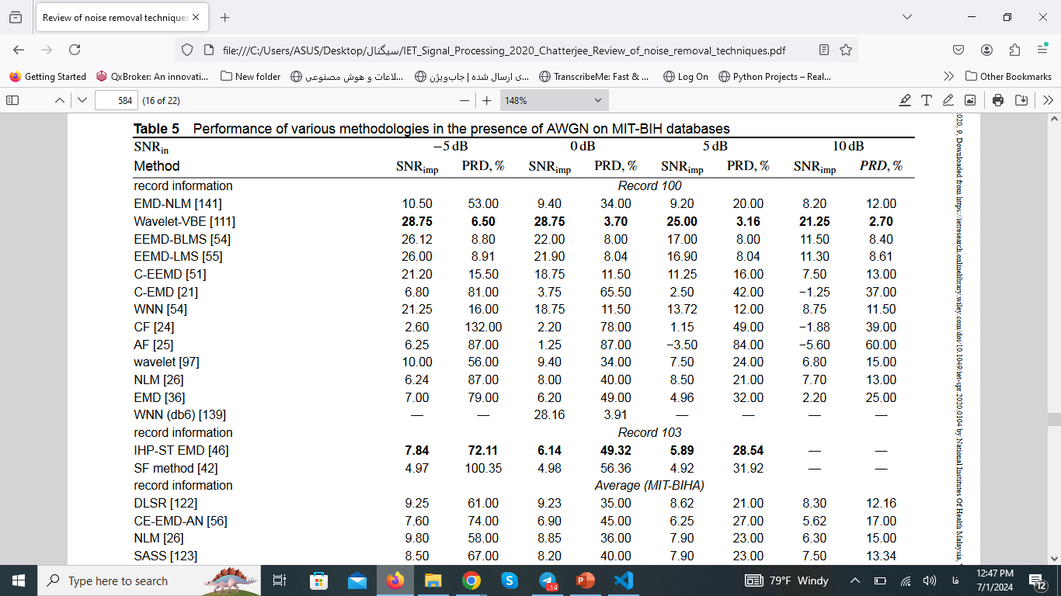

Slide 20
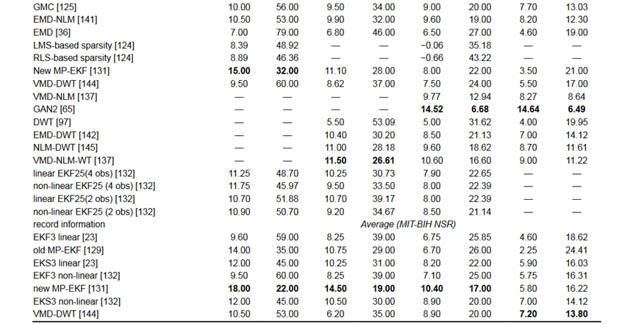

Slide 21
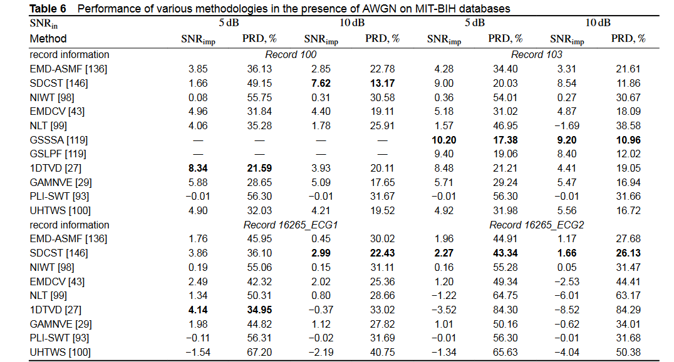

Slide 22
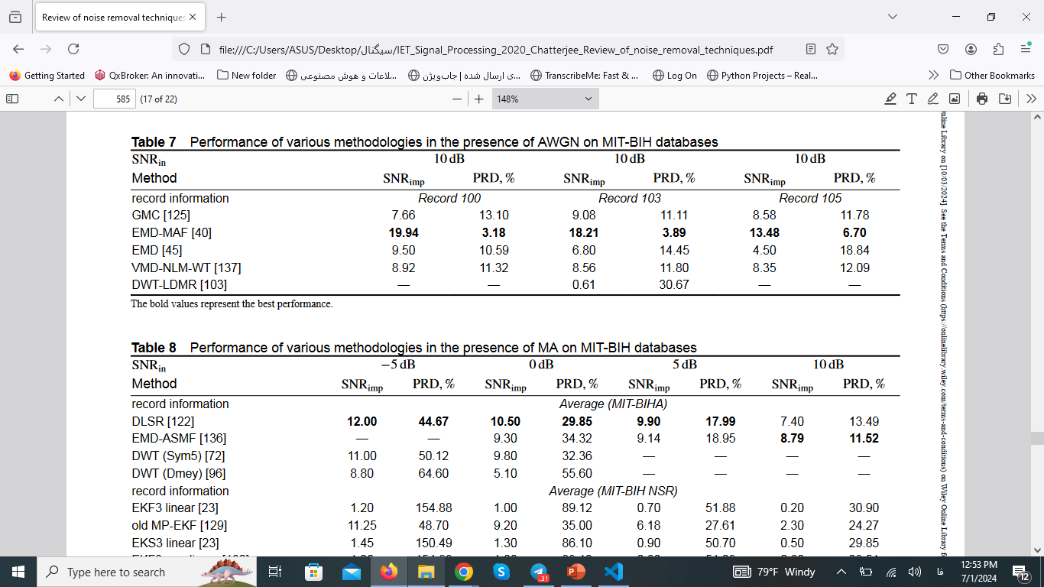

Slide 23
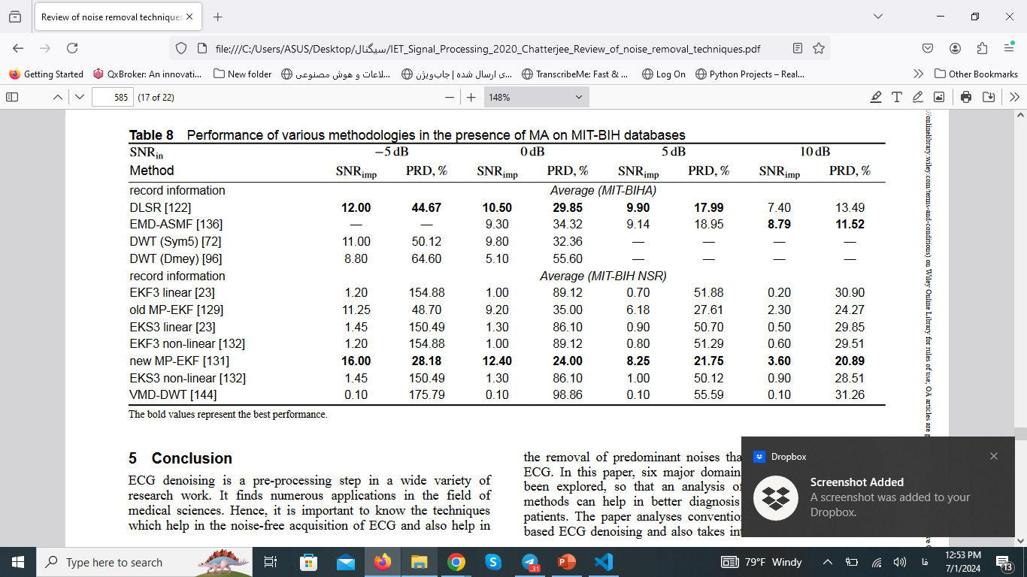

Slide 24
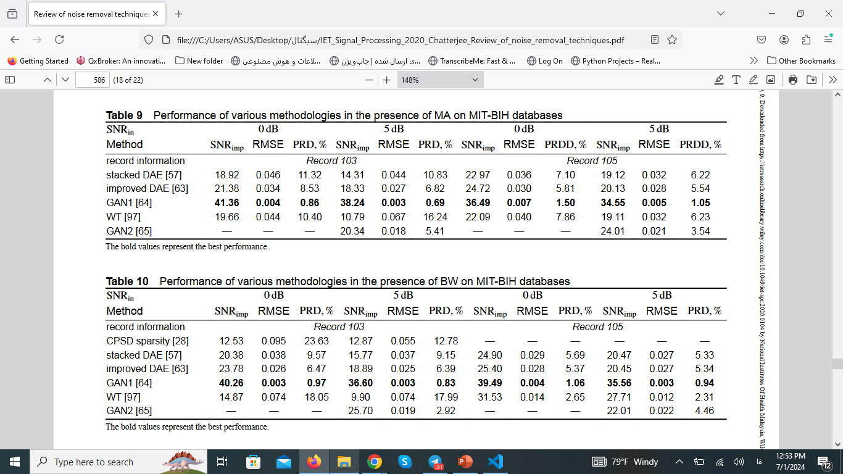

Slide 26
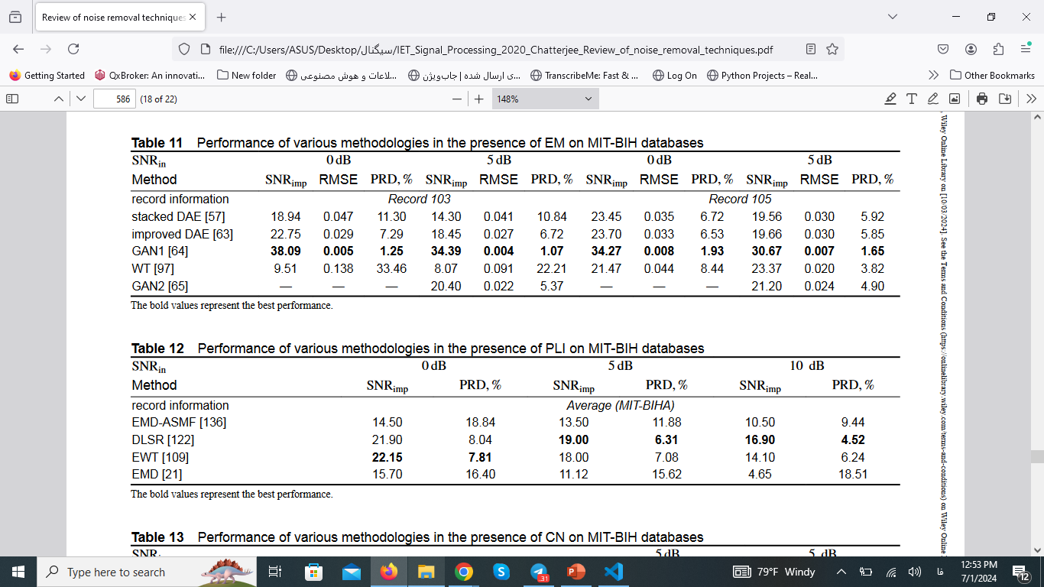

Slide 28
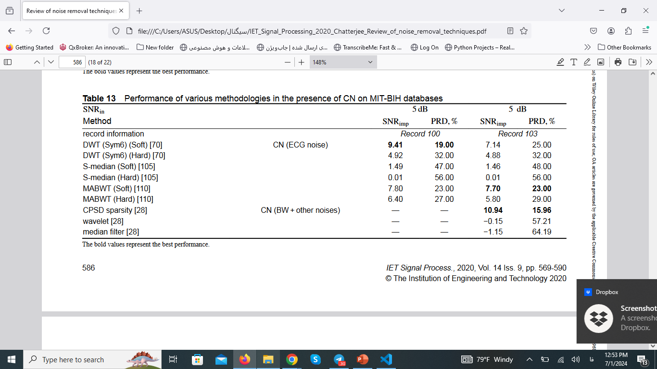

Slide 29
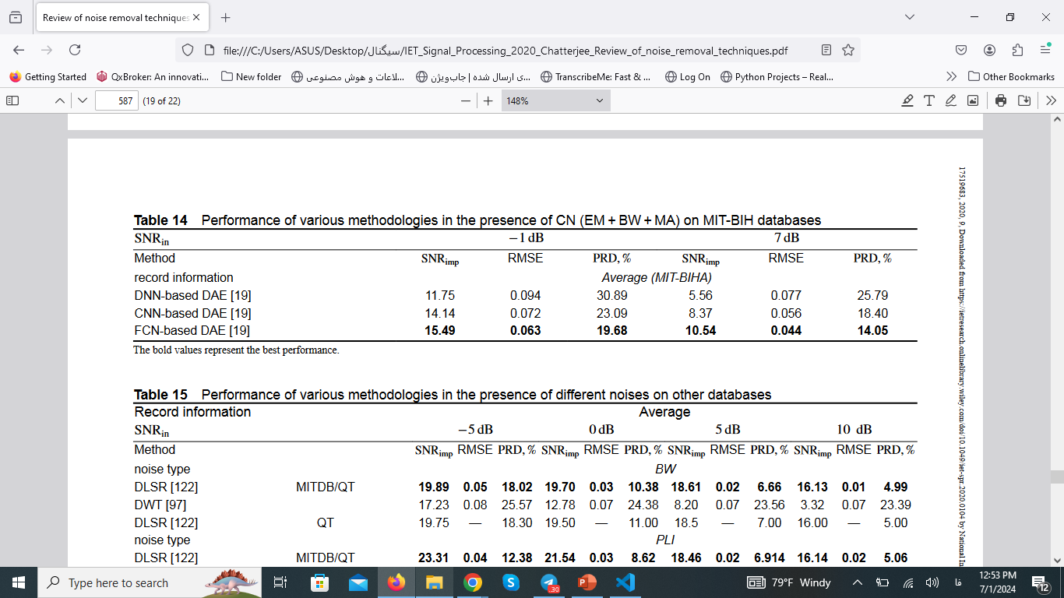

Slide 30
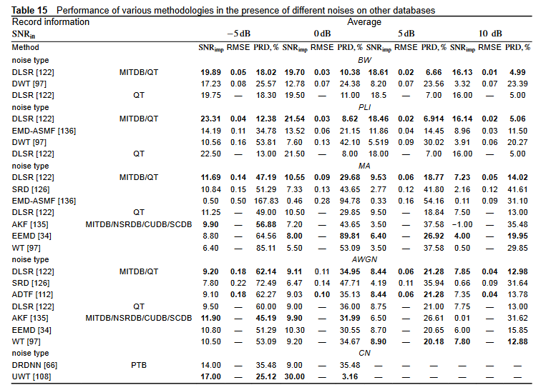

Slide 31
Conclusion
It concludes that different techniques are effective for different types of noise and that combined approaches can provide better performance, emphasizing the need for further research into newer denoising mechanisms.

Slide 32
The MIT-BIH Normal Sinus Rhythm database includes 18 long-term ECG recordings of subjects not having any significant arrhythmias.
The MIT-BIH Noise Stress Test database includes 12 30 min ECG recordings and 3 30 min recordings of noise typical in ambulatory ECG recordings.

Slide 33
Refrences
Xiong, P., Wang, H., Liu, M., et al.: ‘ECG signal enhancement based on improved denoising auto-encoder’, Eng. Appl. Artif. Intell., 2016
Chang, K.M.: ‘Arrhythmia ECG noise reduction by ensemble empirical mode decomposition’, Sensors, 2010
Huang et al.: ‘The empirical mode decomposition and the Hilbert spectrum for nonlinear and non-stationary time series analysis’, 1998
Singh, O., Sunkaria, R.K.: ‘ECG signal denoising via empirical wavelet transform’, Australas. Phys. Eng. Sci. Med., 2017,
Rakshit, M., Das, S.: ‘Hybrid approach for ECG signal enhancement using dictionary learning-based sparse representation’, IET Sci. Meas. Technol., 2019,
Zhu, J., Li, X.: ‘Electrocardiograph signal denoising based on sparse decomposition’, Healthc. Technol. Lett., 2017
Lu, Y., Yan, J., Yam, Y.: ‘Model-based ECG denoising using empirical mode decomposition’. 2009 IEEE Int. Conf. on Bioinformatics and Biomedicine, Washington, DC, 2009
Li, N., Li, P.: ‘An improved algorithm based on EMD-wavelet for ECG signal de-noising’. 2009 Int. Joint Conf. on Computational Sciences and Optimization, Sanya, Hainan, 2009

Slide 34
Thanks!

