Slide 1
FB-CPU DESIGN PROJECT
KIMIA GHORBANI
MENA GHAZOWAN HAMOOD
JIBRAN AKBER

Slide 2
AIM OF THE PROJECT DESIGN
• Inside the extent of this task, RTL plan of a processor named FB-computer chip with Verilog language and on the planned processor Different code scraps written in machine language will be composed.
• Toward the finish of the task, it will be seen how the Slam, Control Unit, and Capacity Gadgets in a straightforward processor cooperate and Translate code pieces in machine language.
• A FBCPU demo will be performed on the Fundamental FPGA improvement card to be utilized..
• FB_CPU is an instructive processor intended to make sense of the fundamental working standards of processors.
• The Von Neumann design is utilized in the processor.

Slide 3
FB-CPU RTL design is in Von Neumann architecture. It basically has 4 elements;
01
02
03
04
REGISTERS
MEMORY(RAM)
PROCESSING UNIT(ALU)
CONTROL UNIT

Slide 4
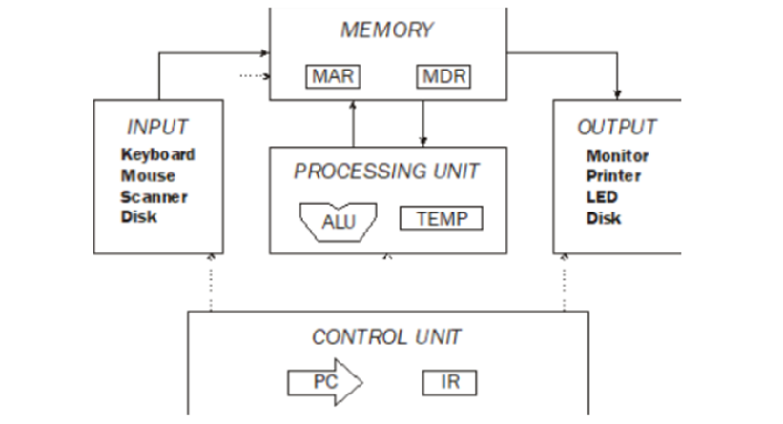

Slide 5
TOOLS USED WHEN DESIGNING THE PROCESSOR:
/ The memory holds operation instructions and variables.
/ Processor Unit performs arithmetic and logic operations.
/ Control Unit is required to decode commands.
/ Registers are storage areas used for various tasks.

Slide 6
VON NEUMANN ARCHITECTURE
The Von Neumann engineering is the first and significant PC configuration comprising of a processor and memory decoupling the connection between them.
• components
As per the Neumann plan, a PC comprises of the accompanying units:
• processor (processor)
• memory (memory)
input-output unit

Slide 7
The memory signals connected to the input-output ports in the figure are given below:
MAR (6 Bit): It is a register called Memory Address Register. This register is connected to the address input of RAM. Since RAM has 2^6 locations, MAR is 6 bits. The register is in the inside of RAM.
MDRIn (10 Bit): Memory Data Register In is the register used when data is written to RAM. Since one location of RAM is 10 bits, the register is 10 bits. The register is in the inside of RAM.
RAMWr (1 Bit): It is activated when data will be written to RAM. If it is not 1, no data is written to RAM. The register is in the inside of RAM.
MDROut (10 Bit): Memory Data Register is the register used when data is read from RAM. Since one location of RAM is 10 bits, the register is 10 bits. The register is in the inside of RAM.

Slide 8
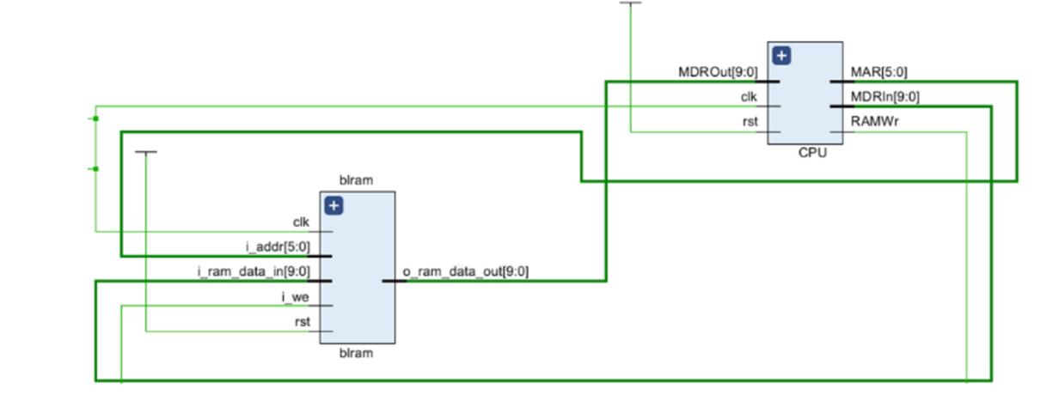

Slide 9
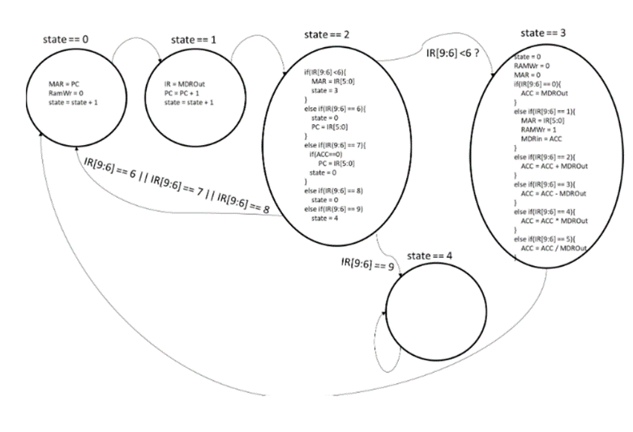
The software used
The plan was coded as a state machine. Case is taking a gander at the circumstance and is continually advancing as per the designs inside the circumstance. The state chart of the FB-central processor, communicated as a state outline, is displayed below. The undertakings that the processor needs to do bit by bit are shown Decoupled.
The explanation we utilize a status store is that the store, which shows when every one of the functioning components in the framework will work, works as per these means.

Slide 10

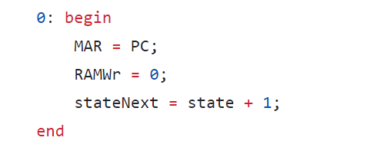

Slide 11

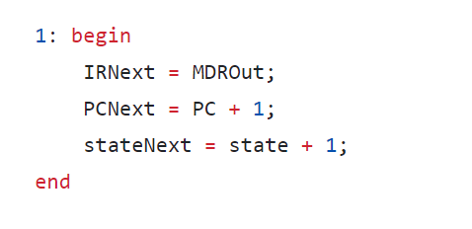

Slide 12

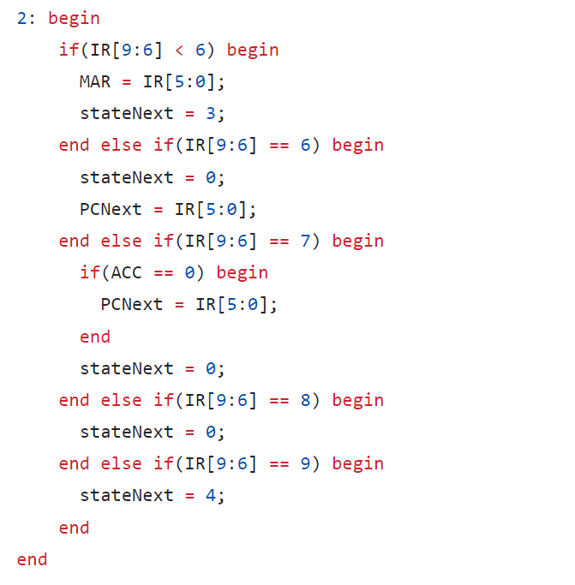

Slide 13

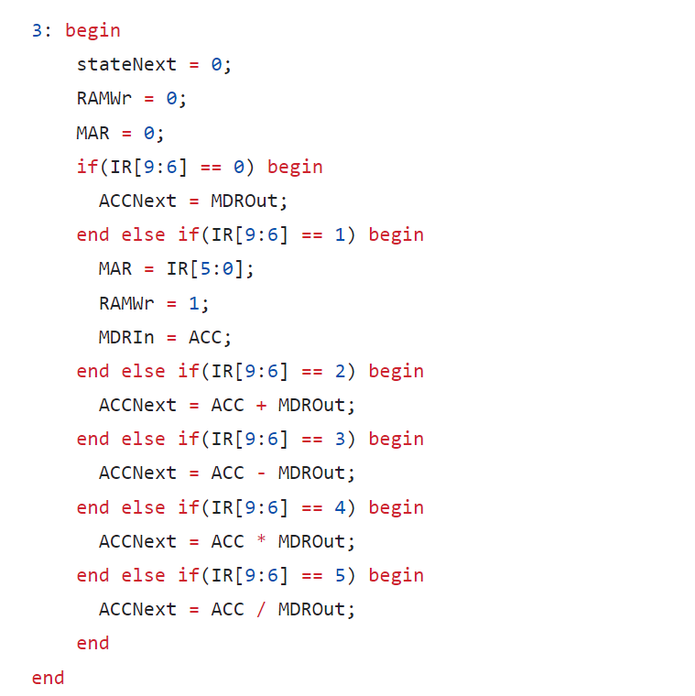

Slide 14



Slide 15

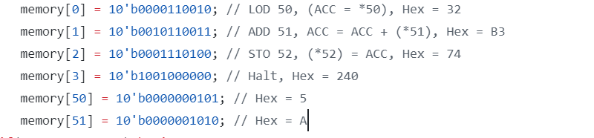
Using the LOD instruction, the ACC storage is filled with the number of memory locations for the FB-CPU that correspond to 5 to 50 hexadecimal places. 50, which has the ADD command and is situated inside our ACC storage. The expression in the address that has the hexadecimal equivalent of A (value of 51) is gathered. The value of the ACC store (50 and 51; the total of the addresses is F) 52. will be registered to the address with the STO command. The HLT command is also used to end the test.

Slide 16

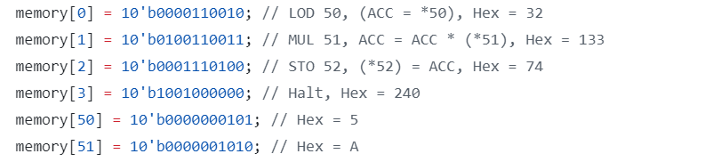
The LOD instruction loads the number that corresponds to a 5 to 50 hexadecimal address in memory for the FB-CPU into the ACC storage. 50, which has the MUL command and is situated inside our ACC store. At address 51, the address value is multiplied by the expression with the hexadecimal equivalent A. The value of the ACC store (50 and 51; the product of the addresses is 32) 52 will be registered to the address upon receipt of the STO instruction. The HLT command also terminated the test.

Slide 17

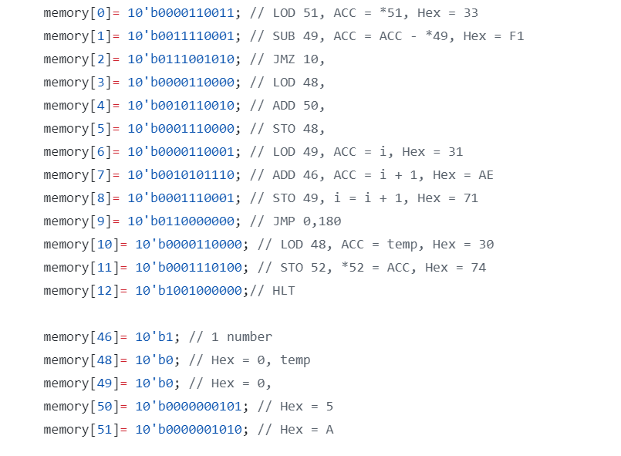
For FB-CPU, the operation we are asked to do is multiplication, but we need to do this with loops, not with the MUL command.
The value at address 51 in memory is recorded to ACC with the LOD command. With the SUB command, 49 is subtracted from the value in ACC and recorded back into the ACC register. With the JMZ command, we check whether the result of the operation we performed in the previous step (ACC-49) is equal to 0 or not. If it is equal to 0, it exits the loop and goes to perform the operation at address 10. In other words, it loads the value of temp at address 48 into the ACC register, saves the value in ACC to address 52 with STO, and then finishes the code with HLT. In this way, the result is saved to memory with loops, without using the MUL command.
But if JMZ is not equal to 0, ACC-49 continues to rotate until it becomes 0. After the check, it loads the temp value with LOD to the 48th address. Adds the value at address 50 to ACC with ADD. It goes to the 48th address and saves the value of ACC to STO temp. It throws the value at address 49 into ACC and adds it with the value at address 46 and records it again at address 49. With the JMP command, it returns to line 0, that is, to the beginning of the loop.

