Slide 1






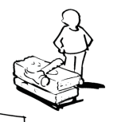
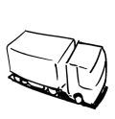


Business Model Canvas
Key Partners | Key Activities | Value Propositions Write directly to the canvas… Or use the post-it™ note …or both |  | Customer Relationships | Customer Segments
 | Key Resources |  |  | Channels
Cost Structure |  |  | Revenue Streams
http://www.businessmodelgeneration.com
Double click on the post-it™ to edit. Recolour it using the picture format tools.

Slide 2
Business Model Canvas
Key Partners Wichtigste Kostentreiber | Key Activities Das Tun | Value Propositions |  | Customer Relationships | Customer Segments
 | Key Resources Die Dinge |  |  | Channels
Cost Structure Nicht “Personal”/”Strom”, sondern spezifischer “Thekenbedienung” |  |  | Revenue Streams
http://www.businessmodelgeneration.com
…

