Slide 1
Indaba 2025, Rwanda
Democratizing CO2 Monitoring in Nigeria with AI and Low-Cost Sensors
Presented by
DSN FUTMINNA
Odunola Akimu, Bello Abdulbasit, Adebanjo Aishat, Yusuf Agboola, Nenchin Emmanuel.
DATA SCIENCE NIGERIA

Slide 2
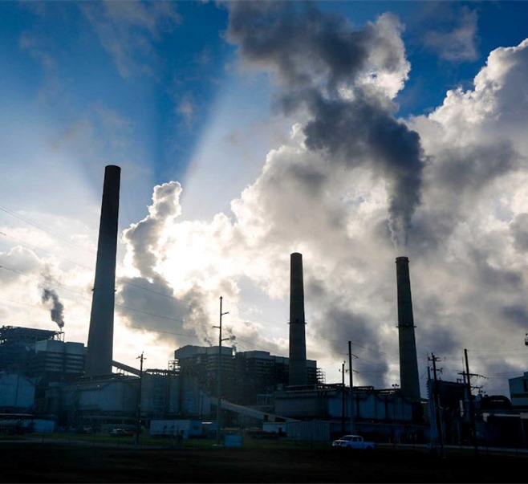
Problem Statement
Air pollution, particularly CO₂ emissions, remains an invisible but urgent threat in Africa. In Nigeria, the lack of affordable, real-time monitoring tools leaves rural and underserved areas in complete data darkness. Existing high-grade sensors are expensive and impractical for widespread use, making effective climate action nearly impossible. This gap calls for an innovative, low-cost solution that ensures no community is left behind in the fight for clean air.

Slide 3

1. Built an AI model to calibrate low-cost Nigerian analog gas sensors. 2. Transforms noisy sensor readings into accurate CO₂ concentration estimates. 3. Enables real-time, affordable, and scalable CO₂ monitoring. 4. Uses robust tree-based ensemble models (Random Forest, XG Boost, etc.). 5. Integrates SHAP for model transparency and feature interpretation.
Our Solution

Slide 4
Dataset and Data Collection
Dataset Source
Collected from the Zindi Africa CO₂ Prediction Challenge.
Total of 7,307 labelled samples.
Data from three Nigerian-built IoT devices: Alpha, Beta, Charlie (by Chemotronix).
Sensor Types:
MG811 – Direct CO₂ measurement.
MQ7 & MQ9 – Detect CO, methane, LPG.
MQ135 – Multi-gas sensor (CO₂, NH₃, benzene).
Temp & Humidity Sensors – Support contextual calibration.
Data Collection Process:
Locations: Indoor/outdoor, urban/rural, and multiple Nigerian climate zones.
Each record includes:
Raw analog outputs from sensors
Environmental conditions

Slide 5
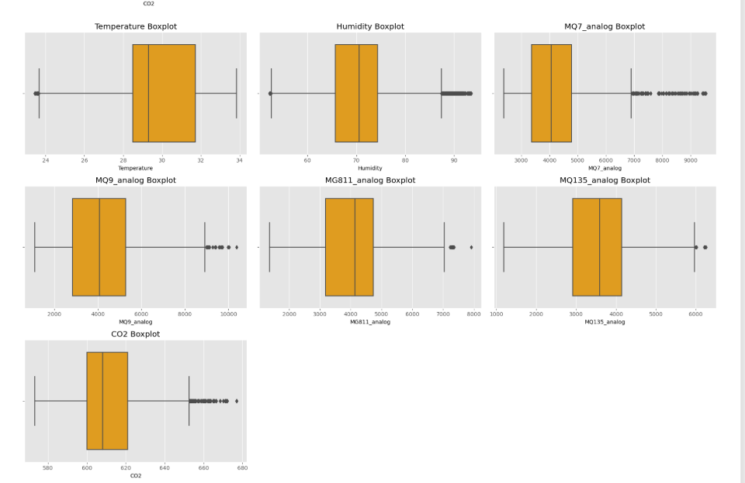
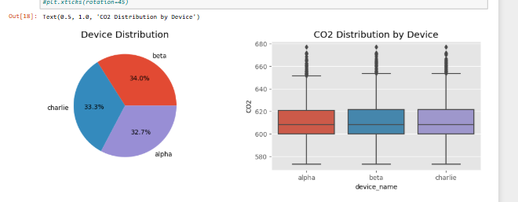
Data Preprocessing , Insights and Feature Engineering
Applied RobustScaler to reduce the impact of outliers in noisy analog readings.
Used log transformations to correct skewed sensor distributions.
Engineered interaction features (MG811 × MQ135, e.t.c.) to capture non-linear gas behaviour.
Dataset was complete, no missing values, fully ready for supervised machine learning.

Slide 6
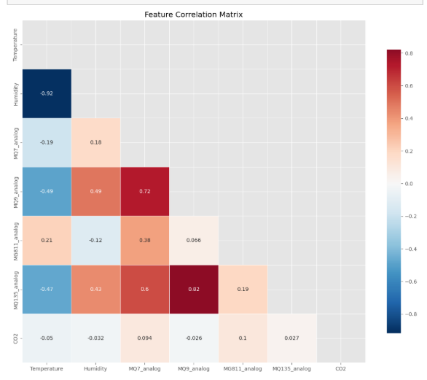
Data Preprocessing , Insights and Feature Engineering
Key Data Insights
MG811 showed the strongest correlation with true CO₂ levels (Pearson r ≈ 0.10).
MQ sensors exhibited noise and drift, reinforcing the need for AI-based calibration.
Temperature and humidity indirectly affected sensor accuracy.
Cross-sensor features significantly improved model performance.
Sensor readings varied across devices, required device-aware validation strategy.

Slide 7
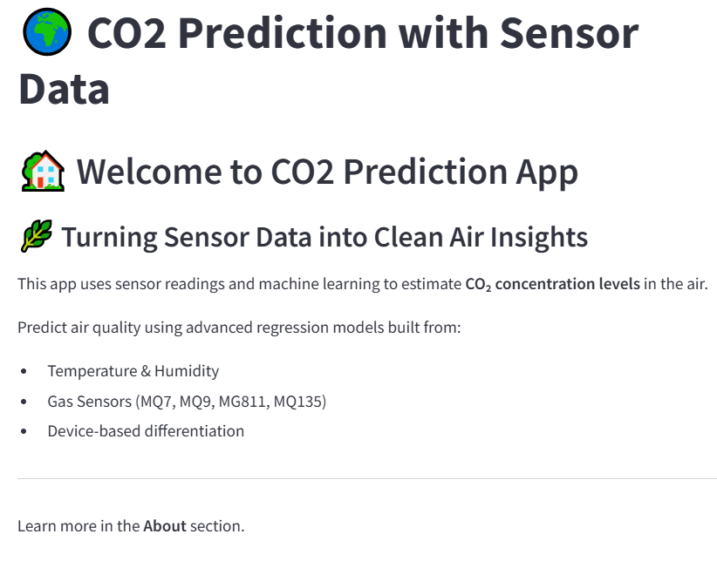
Implementation and Deployment
Built and optimized ensemble ML models (XGBoost, LightGBM, etc.).
Trained on low-cost Nigerian sensors mapped to reference-grade CO₂ data.
Achieved R² > 0.95 with generalization across all sensor types (Alpha, Beta, Charlie).
Web Platform Deployment:
Developed a Streamlit web app for real-time prediction and analysis.
Key features:
Sensor data upload
Instant CO₂ prediction output
SHAP-based model explainability
Visual dashboard for stakeholders
Hosted on Streamlit Cloud for public and research access.

Slide 8
Sustainability
Open-sourcing the platform to promote transparency and community reuse.
Seek multi-stakeholder funding (e.g., climate NGOs, academic grants).
Integrate platform into school curricula, citizen science, and public health initiatives.
Enable user feedback loops to improve interface and usability.
Deploy automated model retraining pipelines (e.g., monthly updates).
Monitor data drift and fine-tune models with new sensor logs.
Build API endpoints for integration with 3rd-party tools (e.g., smart city systems, educational platforms).

Slide 9
Impact and Future work
Model Accuracy: Achieved R² > 0.95, RMSE < 5 ppm, strong predictive performance across all devices.
Accessibility: Enables low-cost CO₂ monitoring in underserved regions using locally built sensors.
Transparency: Integrates SHAP explainability, making predictions interpretable for non-technical users.
Deployment Readiness: Live web app already hosted on Streamlit Cloud and accessible to stakeholders.
Expected Outcomes:
Empower communities, schools, and local governments with real-time air quality data.
Support policy formulation and public health alerts in areas lacking environmental monitoring infrastructure.
Create data visibility in regions affected by climate change and pollution.
Future Scalability
Expand to other pollutants (e.g., NO₂, PM2.5) using multi-gas sensor integration.
Deploy in rural, industrial, and cross-border African regions with minimal infrastructure.
Enable offline/edge deployment through model compression for areas with poor connectivity.
Collaborate with NGOs, government agencies, and academic institutions for continent-wide rollout.

Slide 10
Challenges, Lessons and Call to Action
Low-cost sensors suffer from drift and cross-sensitivity.
Internet dependency limits deployment in remote areas.
How We Overcame Them:
Used device-aware validation, robust pre-processing, and cloud-based APIs to ensure accuracy and accessibility.
Lessons Learned:
Community-first design builds trust and relevance.
Model transparency (via SHAP) drives adoption.
Resilience is key for long-term deployment in diverse conditions.
Call to Action
“If we can’t measure it, we can’t manage it.”
We invite collaborators, partners, and policymakers to join us in scaling affordable AI for environmental justice across Africa.
🔗 🌍 Demo App Click here...
Let’s make air visible!
Thank you!!!

