Slide 1

Prediction of Oil, Gas and Water Production Using Machine Learning
Akimu Odunola
SPE Number: 5501001
SPE Section: Abuja Section Category: Student
Course of Study: Chemical Engineering School: Federal University of Technology Minna
Date: 10/07/2024

Slide 2

Introduction
The SPE DSEAT Africa Datathon Challenge presents an exciting opportunity to harness machine learning for real-world challenges in the oil and gas industry. This presentation focuses on developing a model to predict oil, gas, and water production based on historical well data provided by the competition organizers.

Slide 3


Objective
This is an end to end project of performing machine learning workflow on a real world dataset and then applying several different machine Learning algorithms to solve a supervised regression problem on the dataset.
Our goal is to accurately predict oil, gas and water production given the historical production data to predict future production performance.

Slide 4
Outline
Introduction
Objective
Data Preprocessing
Exploratory Data Analysis
Feature Engineering
Model Training and Evaluation
Results
Conclusion

Slide 5


Data Preprocessing
Handling missing values and outliers
Identifying Unexpected Values
Handling Low-Cardinality Columns
This is the process of dealing with errors or inconsistencies in the data. This step involves identifying incorrect data, missing data, duplicated data, and irrelevant data.

Slide 6

Exploratory Data Analysis
Descriptive statistics.
Count plot of categorical features.
Line plot to understand the trend in our targets features
Bar plot of categorical features.
Plotting histograms and boxplot to visualize data distribution and detect outliers.
Visualizing the correlations between different features.
Finding unique values in each feature to understand the variance.
EDA
EDA

Slide 7



Feature Engineering
Feature Transformation
Date Time Feature Engineering
Categorical Features Encoding
Features Scaling

Slide 8
Model Training and Evaluation
Train Test Split of The Training Dataset
Models Training
Evaluation of The Models Performance Using r2_score
Models Selection Based on Performance
Best Models Optimization
Voting Regession and Prediction on The Validation Dataset.

Slide 9
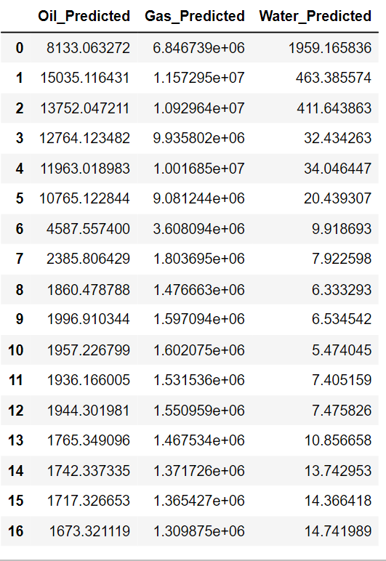
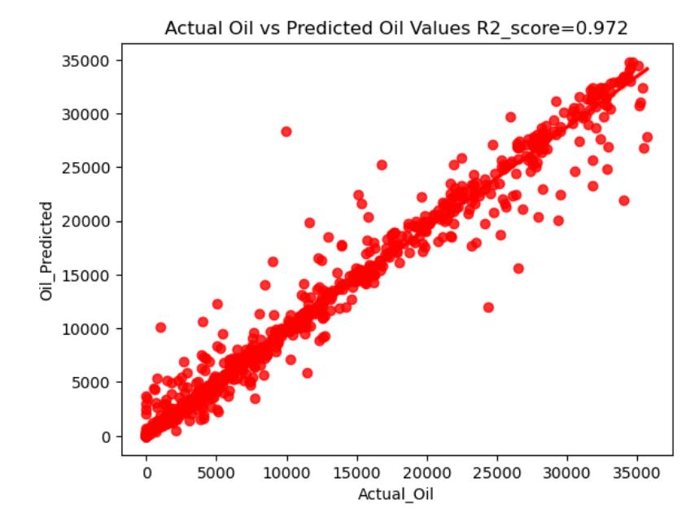
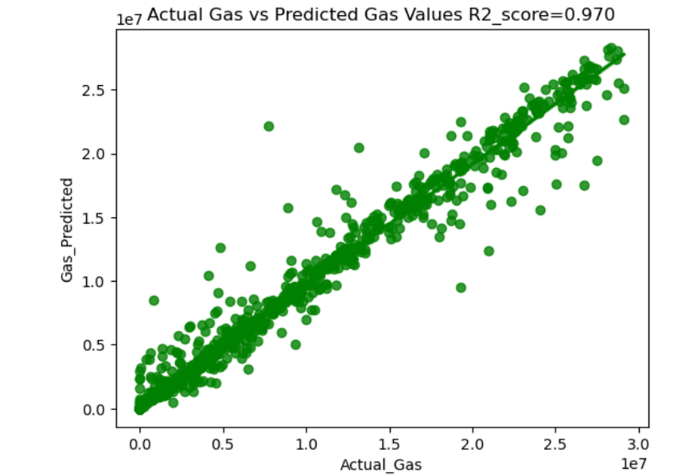
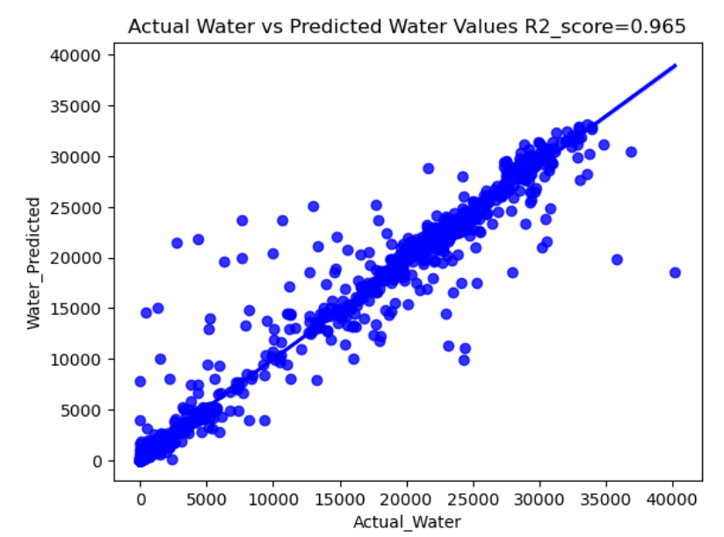
Results

Slide 10

Conclusion
Our VotingRegressor model explains 96.8% of the variation in oil ,gas, and water production. This model helps us predict future production, resulting in better planning and resource allocation.
By understanding the relevant aspects on production given by the model, we may make informed decisions on adjustments in choke size, temperature and pressure optimization maintenance, all focuses at maximizing production efficiency.
By identifying wells that are likely to produce less oil and gas, companies can avoid investing in them
Finally, accurate production projections help us manage the risks associated with unexpected drops in oil, and gas output.
CALL TO ACTION:
EMBRACING MACHINE LEARNING FOR BETTER FORECASTING !!!

