Slide 1
police_data
File created on: 1/31/2023 5:32:11 PM

Slide 2
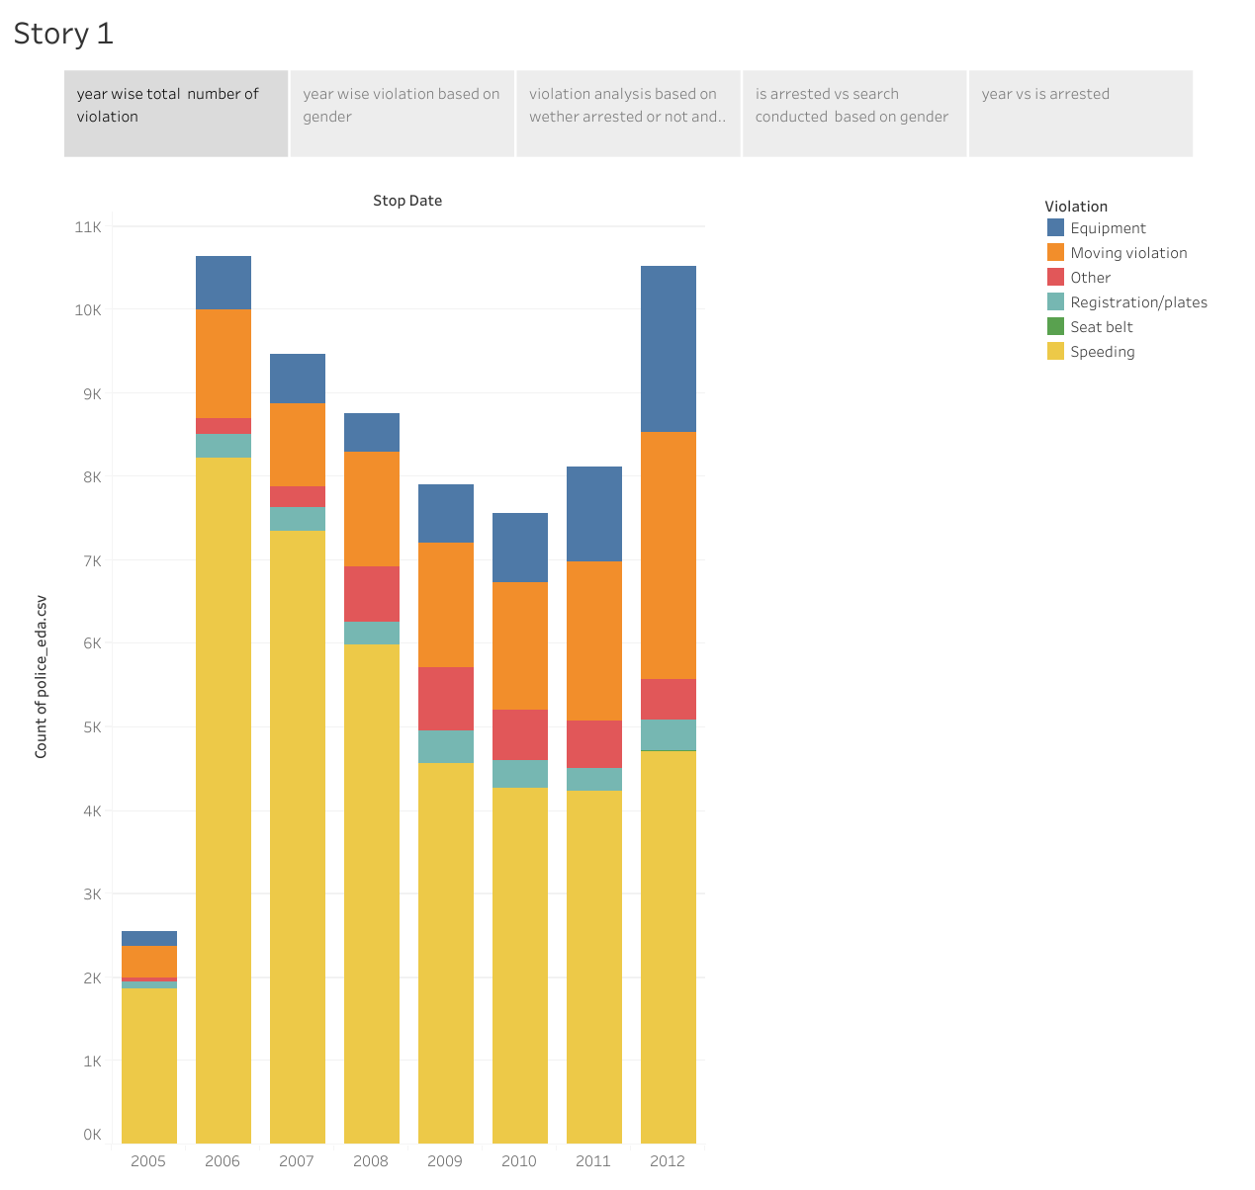

Slide 3
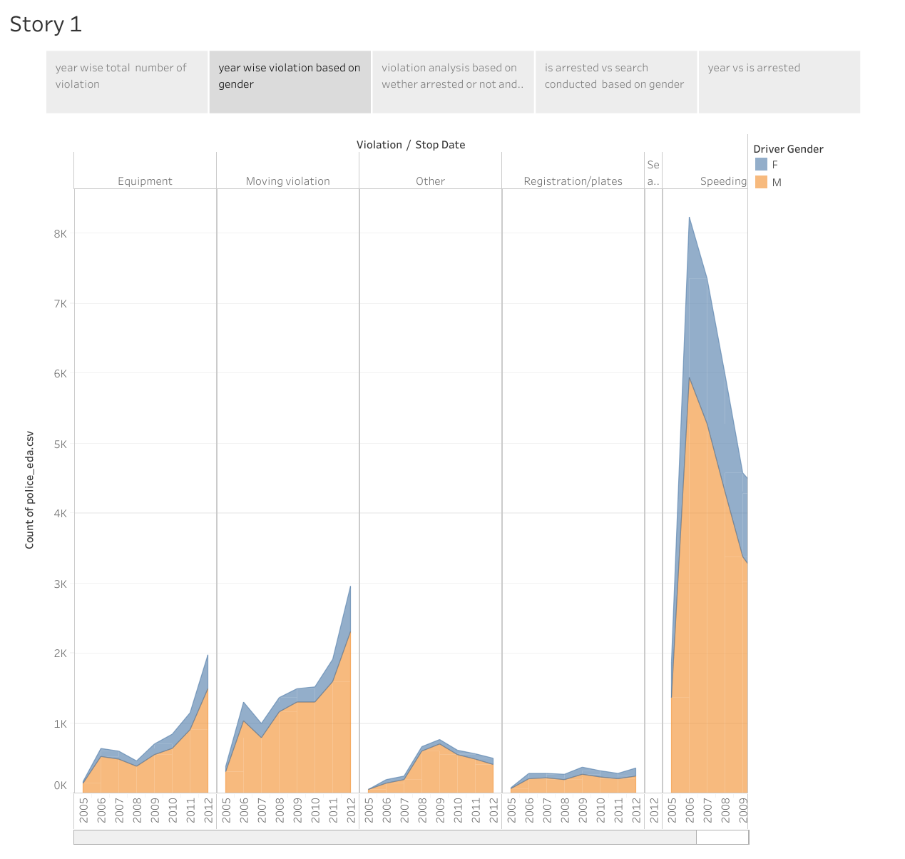

Slide 4
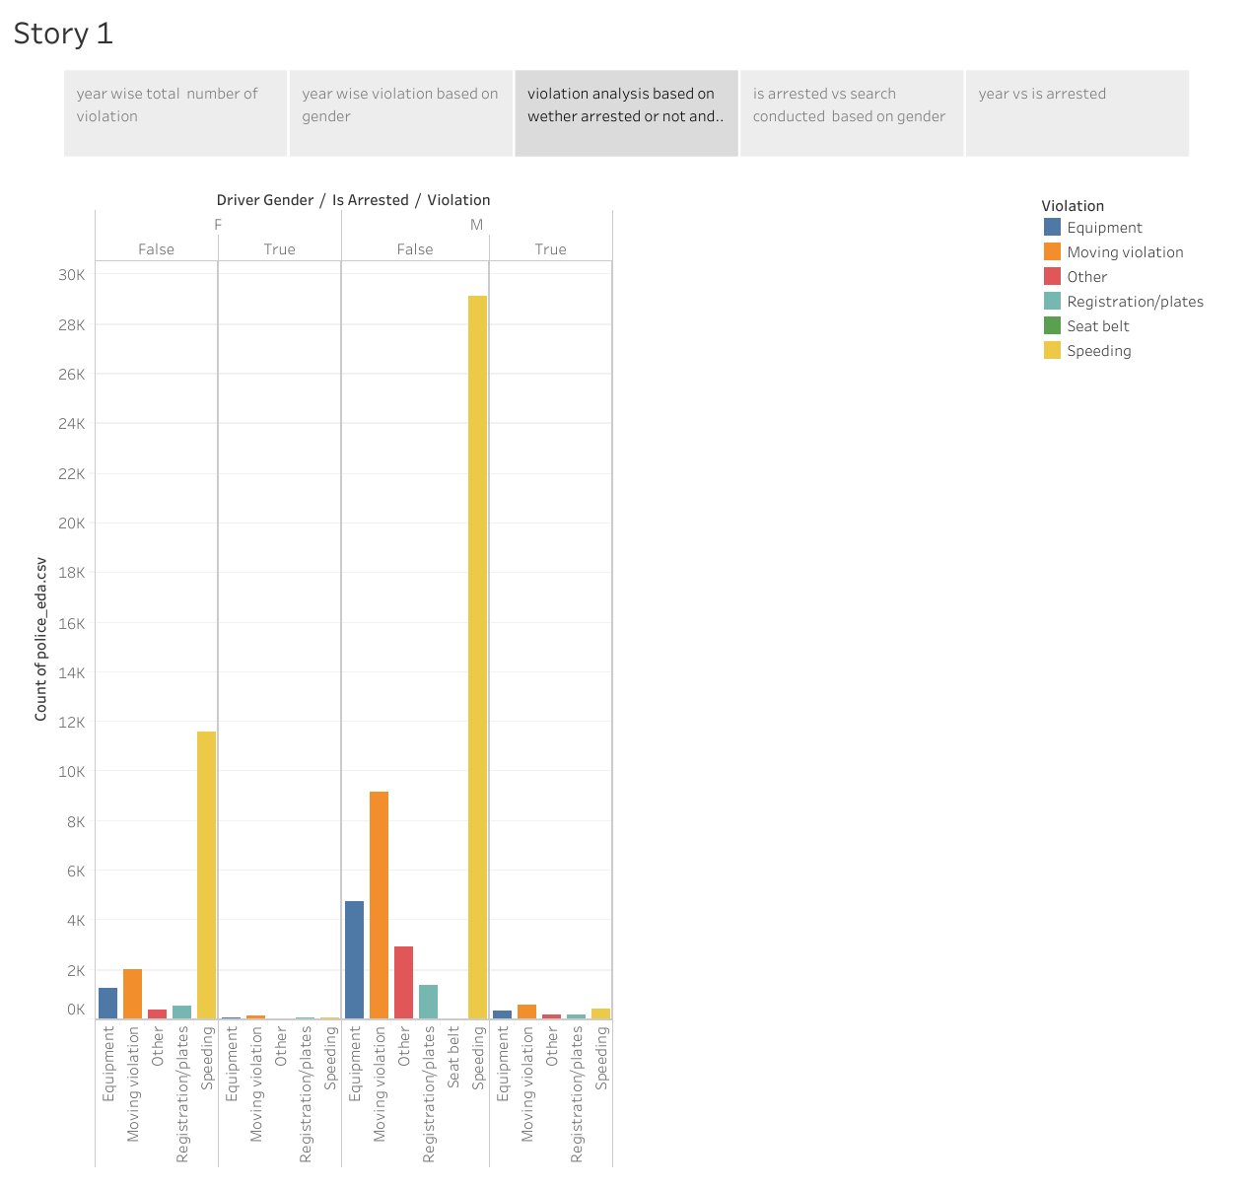

Slide 5
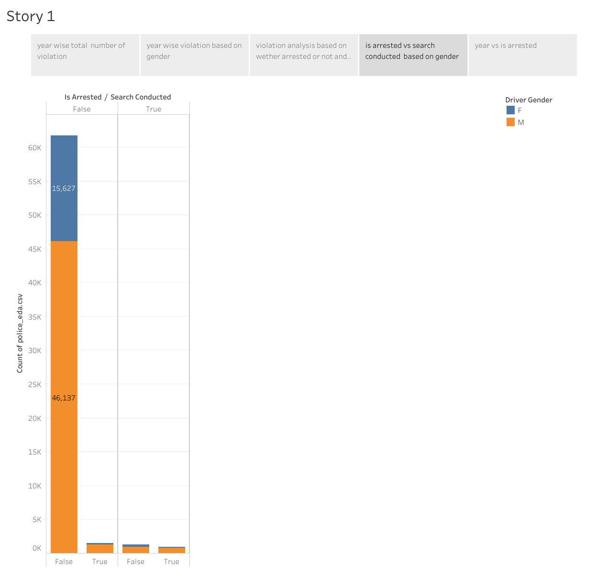

Slide 6
