Slide 1
Predicting Chronic Kidney Disease and Key Factors
AMS 572 Data Analysis
By Alan Rodriguez, Xiaoyan Lin, Yeonbi Han

Slide 2
Background, Motivation, and Project Objectives
Chronic Kidney Disease (CKD) is a progressive condition that often develops without noticeable symptoms, leading many patients to be diagnosed only after significant kidney damage has occurred.
CKD is closely associated with severe complications—such as cardiovascular events, anemia, and end-stage renal failure—making early detection and risk stratification clinically essential.
Real-world CKD datasets are highly heterogeneous, containing a mix of continuous and categorical variables as well as substantial and uneven missingness across features.
These characteristics create significant analytical challenges but also highlight the need for reliable statistical methods and robust predictive modeling techniques.
→ The goal of this project is to evaluate key clinical factors associated with CKD and to develop prediction models that remain stable even under MCAR and MNAR missing-data conditions.

Slide 3
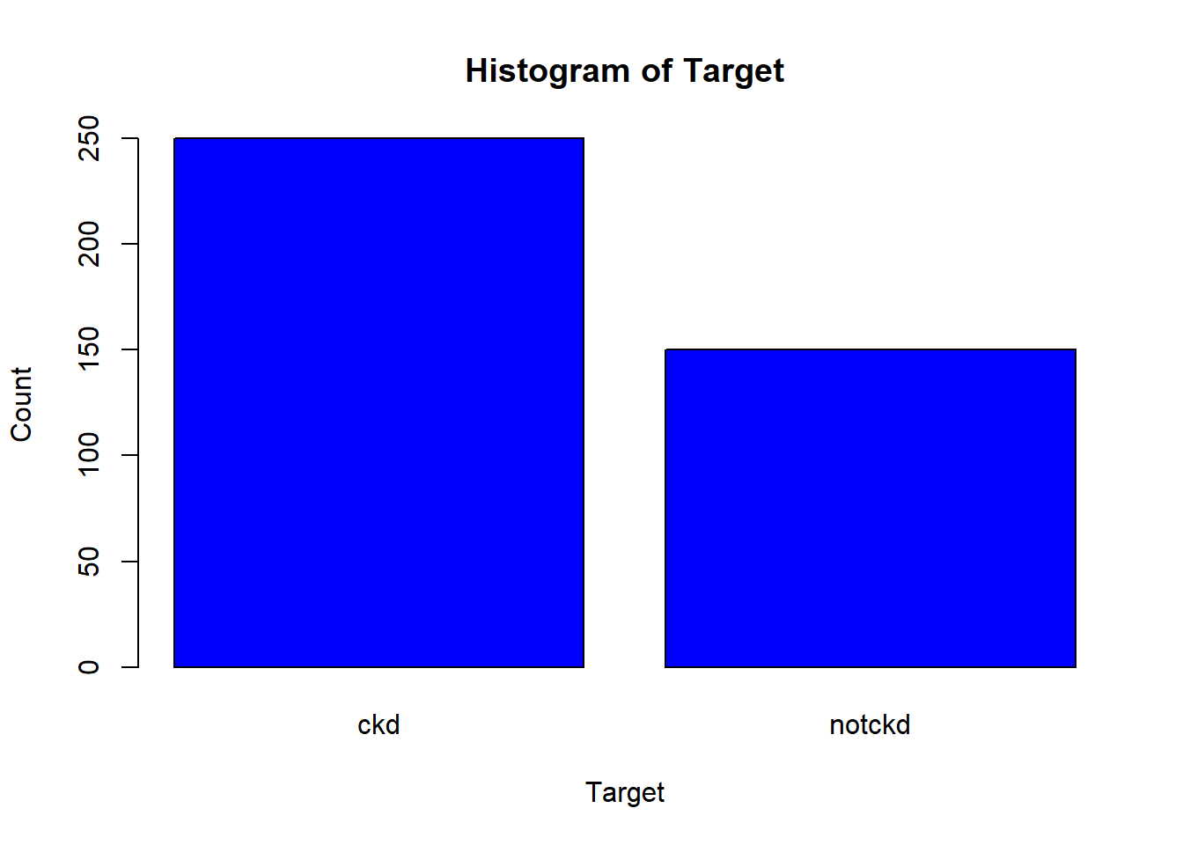
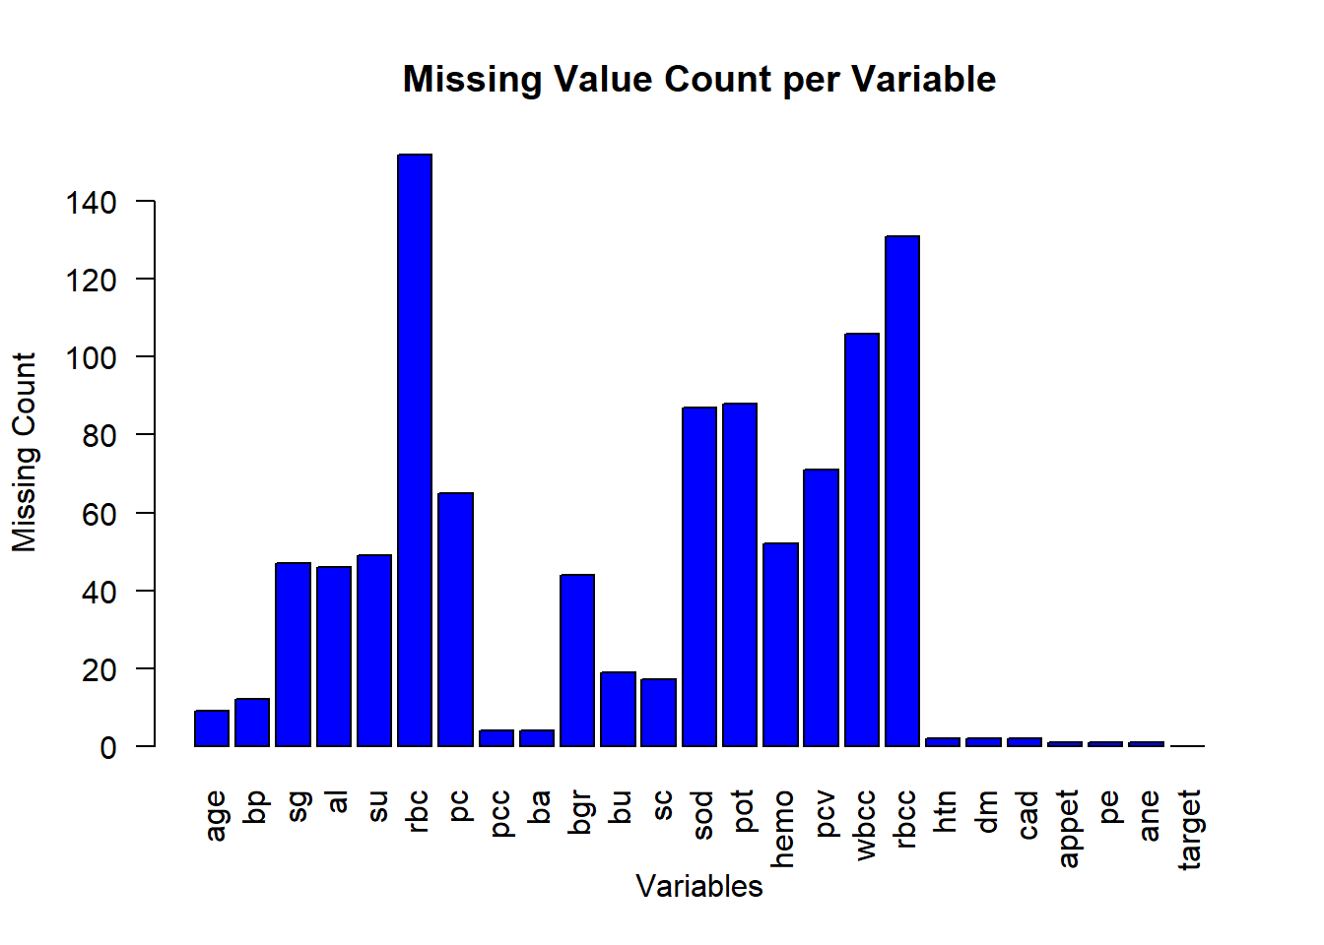
Dataset Description and Variable Summary (n=400, p=25)
400 patients, 25 clinical variables (UCI ML Repository; compiled by Rubini, Soundarapandian & Eswaran)
14 numerical variables (e.g., blood pressure, serum creatinine, hemoglobin, random blood glucose)
11 binary categorical variables (e.g., diabetes, hypertension, appetite, edema)
CKD status is moderately imbalanced (62.5% CKD)
Some laboratory variables show high missingness (e.g., rbc ≈ 38%, rbcc and wbcc also substantially missing)
→ This uneven missing-data pattern creates a realistic setting for evaluating model robustness under MCAR/MNAR scenarios

Slide 4
Exploratory Data Analysis: Missing Data Structure (MCAR vs MNAR)
The dataset exhibits heterogeneous and uneven missingness, especially in laboratory variables.
Several variables show MCAR-like patterns with similar missingness across CKD and non-CKD groups (e.g., age, bp, bu, sc).
Others display strong MNAR behavior, with much higher missingness in CKD patients (rbc 57.2% vs 6.0%, rbcc 49.6% vs 4.7%, wbcc 39.6% vs 4.7%).
These patterns indicate that missingness is partly related to disease severity, requiring robust analytical methods.
→ This structure motivates the MCAR/MNAR simulations conducted in later sections.
Var | CKD Miss (%) | non-CKD Miss(%) | Δ(%) | Missing Type
age | 3.2 | 0.67 | 2.53 | MCAR
bp | 4.0 | 1.33 | 2.67 | MCAR
bu | 5.2 | 4.0 | 1.20 | MCAR
sc | 4.8 | 3.33 | 1.47 | MCAR
rbc | 57.2 | 6.0 | 51.2 | MNAR
rbcc | 49.6 | 4.67 | 44.9 | MNAR
wbcc | 39.6 | 4.67 | 34.9 | MNAR
pot | 33.2 | 3.33 | 29.9 | MNAR
sod | 32.8 | 3.33 | 29.5 | MNAR

Slide 5
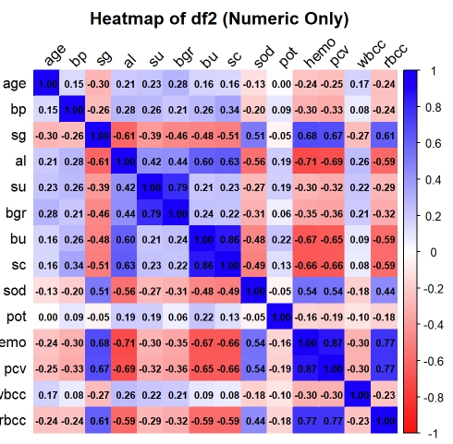
Exploratory Data Analysis: Key Summary Statistics and Correlations
Summary statistics were examined for all 25 variables to understand their ranges, units, and overall distribution patterns.
Correlation analysis revealed that hematological variables—hemo, rbcc, wbcc, and pcv—form a strongly correlated cluster, with pairwise correlations ranging approximately from 0.60 to 0.85.
→ This high correlation structure suggests potential multicollinearity, providing the motivation for performing a VIF-based assessment during the logistic regression modeling stage.

Slide 6
H₁: Variance Test (F-test) and Welch’s T-test Procedures
Purpose of H₁
To test whether mean blood pressure differs between the good appetite and poor appetite groups.
Appetite is binary, and blood pressure is continuous, making the two-sample T-test appropriate.
Missing Data Handling
Both variables had <5% missingness, so listwise deletion was applied.
The small number of removed rows did not affect the distribution, allowing clean implementation of the tests.
F-test (variance equality)
H₀: Variances of bp are equal across appetite groups
H₁: Variances of bp are not equal across appetite groups
Welch’s T-test (mean comparison)
H₀: μ_good = μ_poor
H₁: μ_good ≠ μ_poor

Slide 7
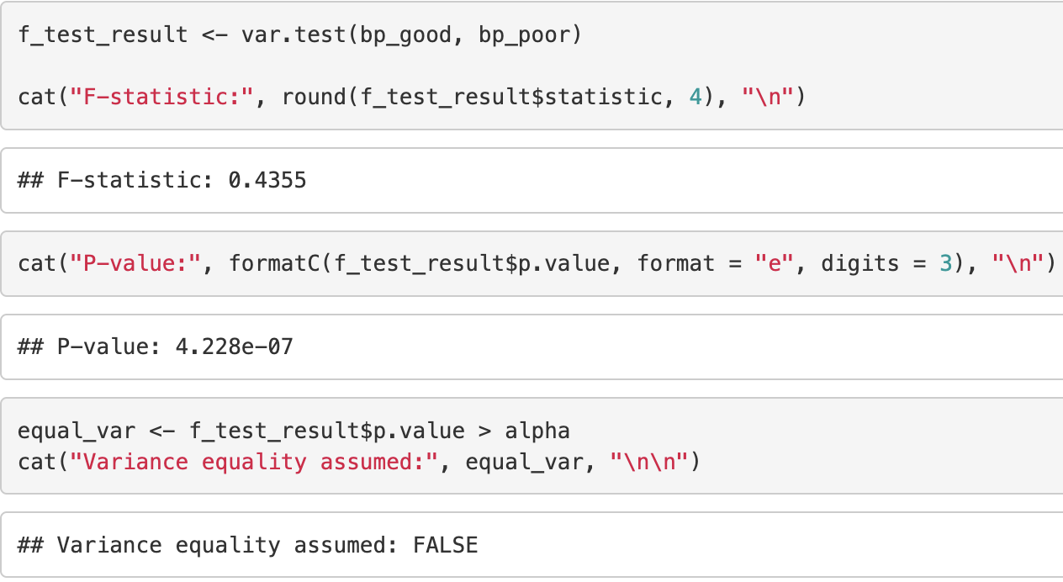
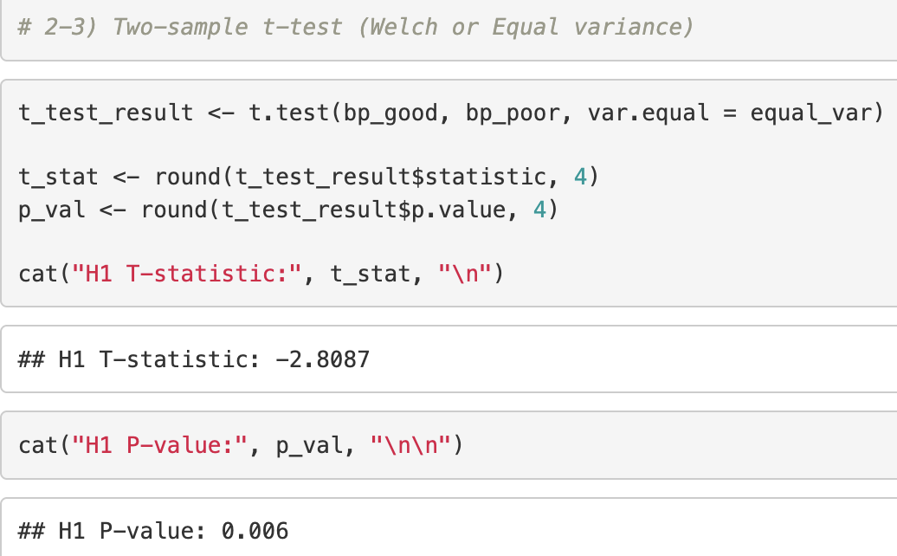
H₁: Statistical Results, Interpretation, and Findings
F-Test
F= 0.4355
p-value= 0.000000423
→p< 0.05, reject H0, variances are not equal and Welch’s T-test must be used.
Welch’s T-test
t-statistic= -2.8087
p-value= 0.006
→p< 0.05, reject H0, Mean blood pressure differs significantly between good and poor appetite groups.

Slide 8
H₂: Research Question & Modeling Workflow
Purpose of H₂
To evaluate how multiple clinical variables relate to CKD status using a multivariable logistic regression model.
CKD is binary, and predictors are both continuous and categorical, motivating logistic regression.
Multivariate Logistic Regression Workflow
Step 1: Fit an initial logistic regression with all selected predictors.
Step 2: Remove highly correlated variables using VIF screening.
Step 3: Use stepwise AIC to obtain a stable, parsimonious final model.
Step 4: Refit the final model under Complete, MCAR, and MNAR settings to examine robustness.
Missing Data Handling (KNN Imputation)
Several predictors (e.g., rbc, rbcc, wbcc) showed high and CKD-biased missingness, making listwise deletion unsuitable.
Continuous predictors were standardized, and missing values were imputed via KNN (k = 5).
The same KNN procedure was applied in MCAR and MNAR simulations for consistency.

Slide 9
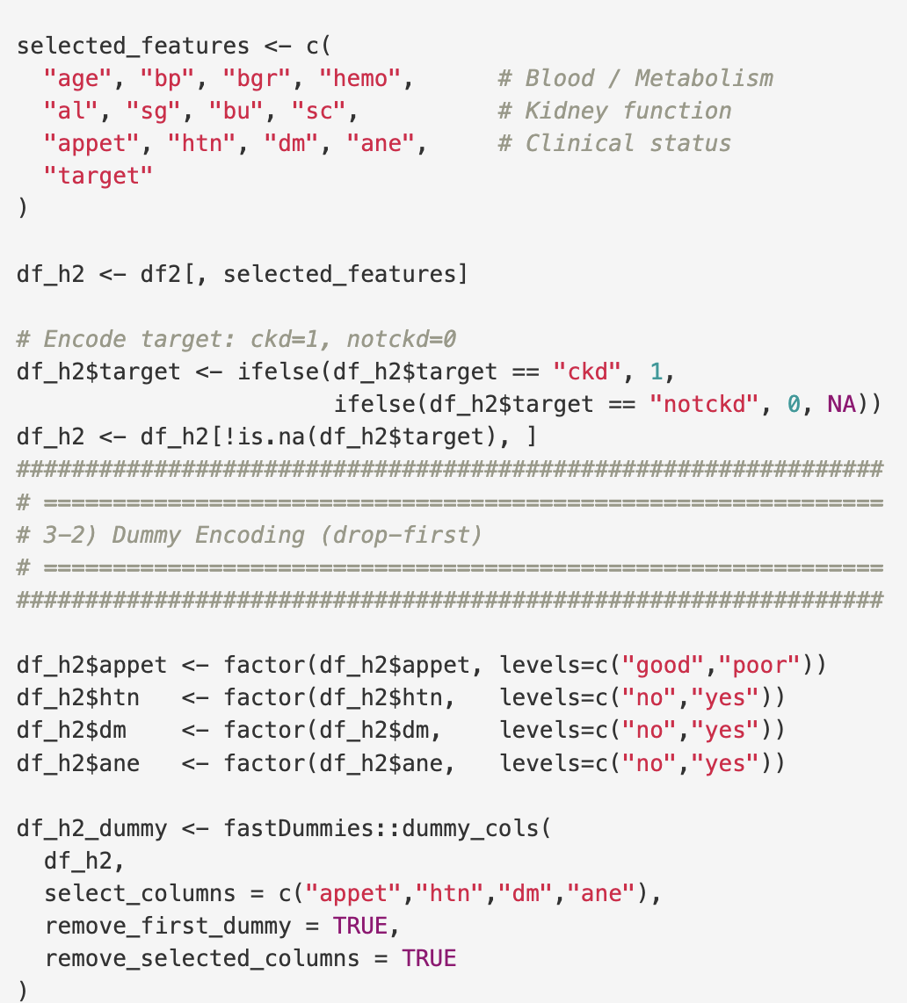
Step 1 —H₂: Initial Logistic Regression Model Construction
Full Logistic Model Setup
Built a full initial model by including all clinically relevant predictors associated with CKD.
12 predictors included → Cover renal function, hematologic/metabolic markers, clinical symptoms, and major comorbidities.
Categorical Variable Encoding
appet / htn / dm / ane → converted to binary dummy variables (drop-first)
Ensures interpretable logistic regression coefficients and reduces multicollinearity.
→To construct a complete baseline model without losing information, providing a solid foundation for model refinement in Step 2 (VIF screening) and Step 3 (AIC selection).
Category | Variables | Rationale
1. Renal Function Indicators | sg, sc, al, bu | Directly reflect CKD severity and kidney filtration/concentration capacity
2. Hematologic & Metabolic Status | hemo, bgr | Capture anemia and metabolic abnormalities strongly linked to CKD
3. Clinical Symptom Indicators | appet, ane | Represent appetite loss and anemia-related symptoms commonly seen in CKD
4. Demographics & Comorbidities | age, bp, dm, htn | Include baseline characteristics and major CKD risk factors

Slide 10
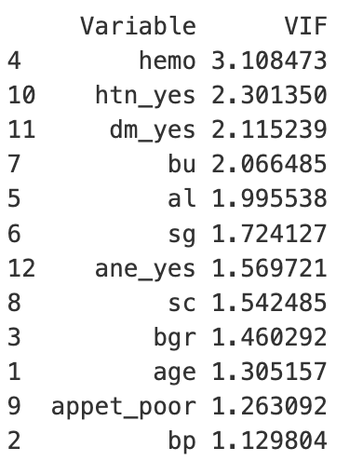
Step 2 — H₂: Multicollinearity Check (VIF)
Purpose
Check whether strongly correlated predictors (observed in the EDA heatmap) may introduce multicollinearity
→ As several variable pairs (e.g., hemo–pcv, bu–sc) showed high correlation, raising the need for a formal diagnostic check.
Multicollinearity?
predictors being highly correlated with each other, leading to unstable or inflated coefficient estimates.
VIF Results
VIF computed for all 12 predictors
All values between 1.1 and 3.1
No variable exceeded the threshold (VIF > 10) → No predictors removed in this step
Interpretation
Predictors contribute independently
Coefficient estimates are stable and suitable for AIC-based reduction in Step 3

Slide 11
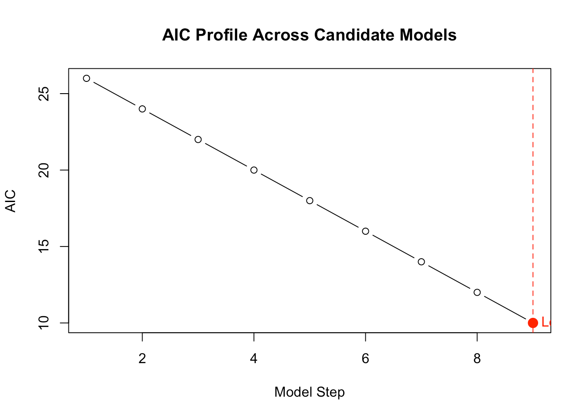
Step 3 — H₂: Model Selection via Stepwise AIC
Purpose
Select a simpler and more stable CKD model by removing predictors that do not improve AIC
→ Correlated predictors in EDA made it necessary to identify which variables truly contribute while avoiding overfitting.
What is Stepwise AIC?
A variable-selection method that adds or removes predictors to find the model with the lowest AIC, balancing model fit and simplicity. → Prevents overfitting and yields a small, stable set of key predictors.
Process
Begin with the full 12-predictor model.
Remove predictors that reduce AIC.
Stop when no further AIC improvement occurs.
Stepwise AIC selected a 4-variable model as optimal.
In the next step, we examine why albumin (al), one of the selected variables, was removed despite improving AIC.

Slide 12
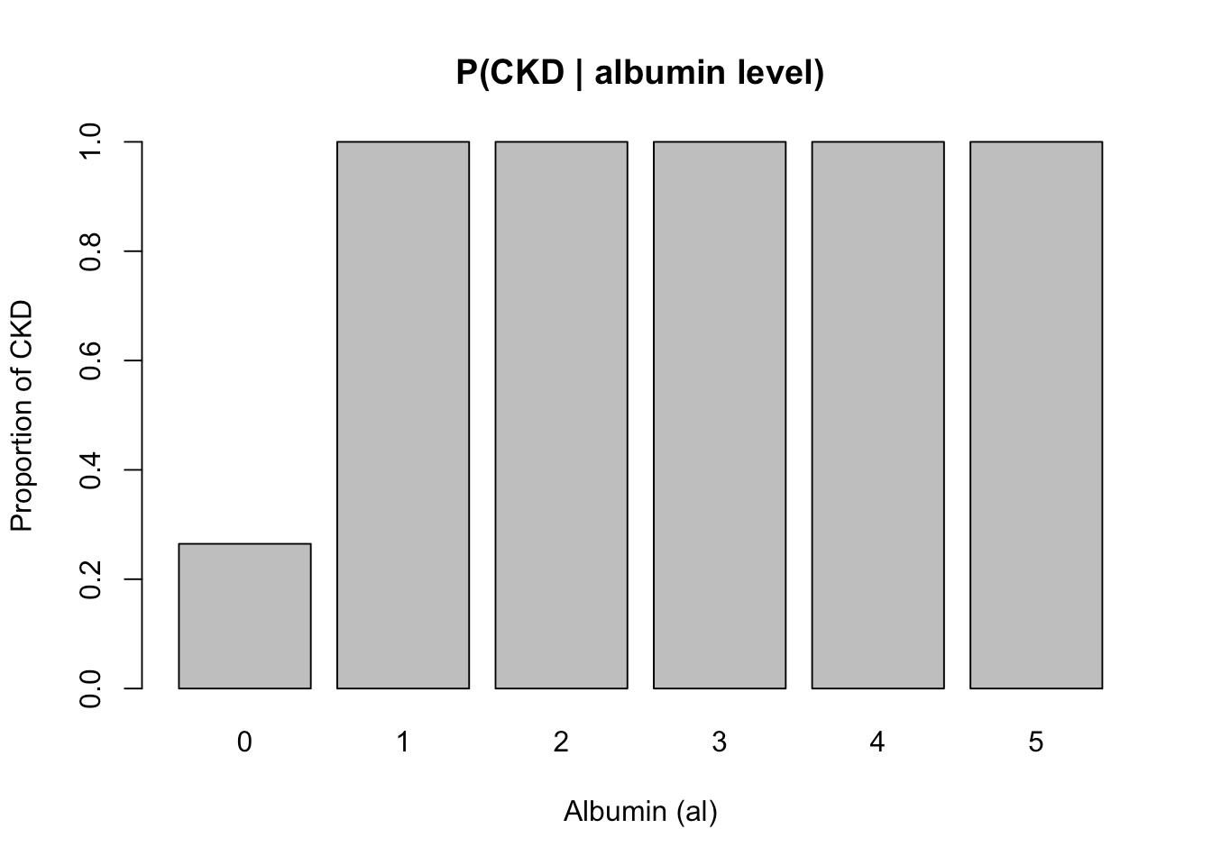
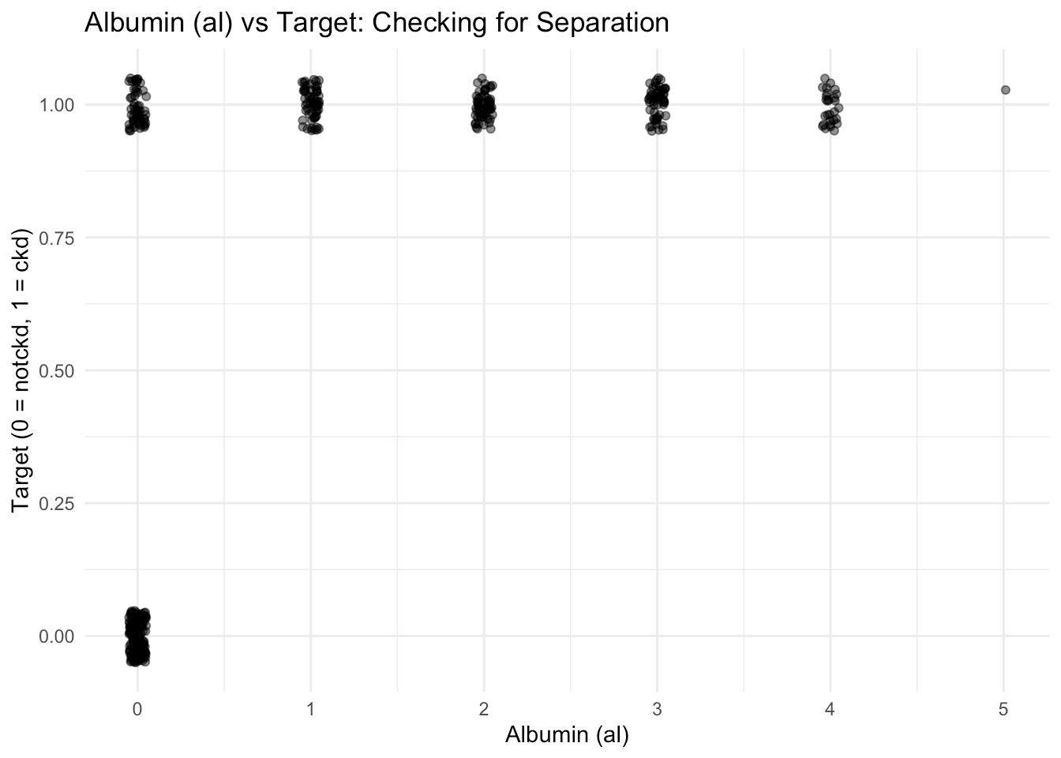
Step 3 — H₂: Stepwise AIC- Why Albumin was Removed?
What we found
Albumin appeared useful (AIC ↓), but the data showed a near-perfect split.
Separation issue
For al = 1–5, all patients were CKD (P = 1.0).
Only al = 0 had mixed outcomes.
Why this is a problem
Logistic regression cannot estimate coefficients when a predictor almost perfectly predicts the outcome.
Coefficients diverge to ±∞ → huge standard errors → unstable model.
→ Remove al to ensure stable coefficient estimation and valid inference.
→ Both reveal that albumin predicts CKD almost perfectly, resulting in quasi-complete separation and requiring its removal.
H₂: Final Logistic Regression Model (bgr, hemo, sg)

Slide 13
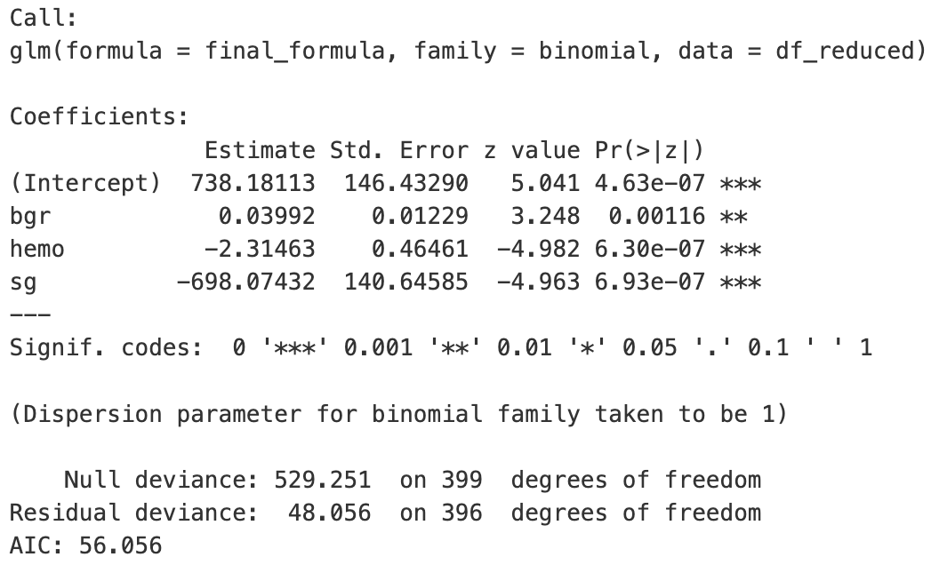
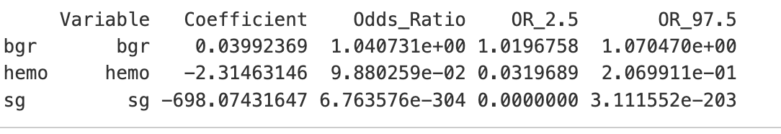
H₂: Evaluation of the Final Logistic Regression Model
1. Model Stability & Variable Significance
The final model (bgr, hemo, sg) converged smoothly with no separation issues, and all predictors were highly significant (p < 0.01).
2. Model Fit (Deviance & AIC)
Null deviance: 529 → Residual deviance: 48 (large reduction)
AIC = 56.056 → A simple yet highly explanatory model.
3. Odds Ratios (Effect Size)
bgr (OR ≈ 1.04): Higher blood glucose slightly but consistently increases the odds of CKD.
hemo (OR ≈ 0.10): Higher hemoglobin strongly lowers CKD risk, aligning with anemia patterns seen in CKD.
sg (OR ≈ ~0): Small increases in specific gravity sharply reduce CKD risk, reflecting impaired concentration ability in diseased kidneys.

Slide 14
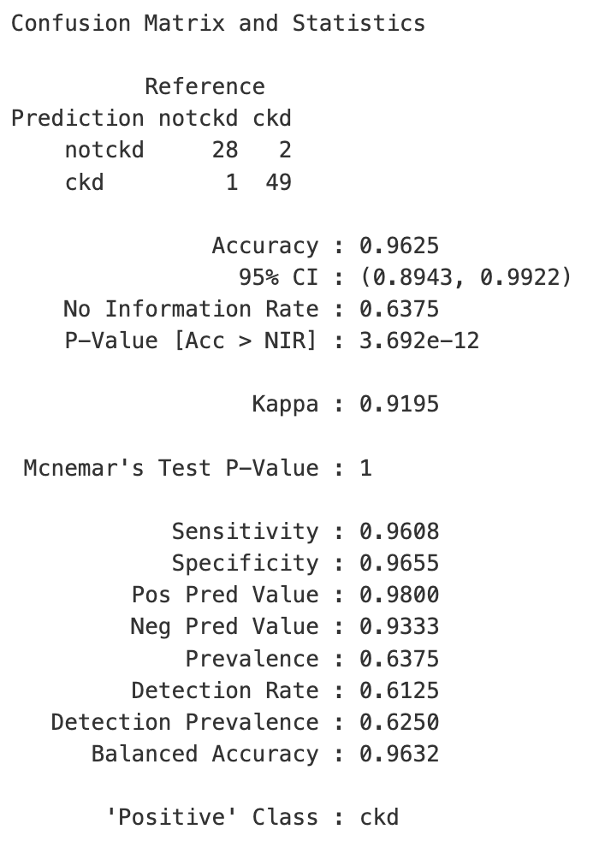
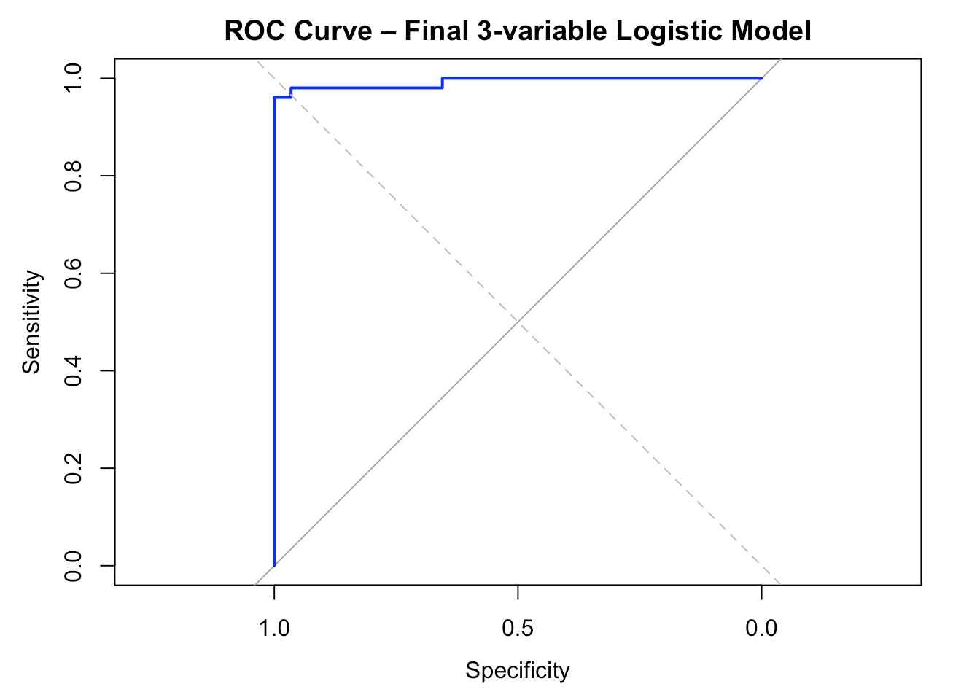
H₂: Evaluation of the Final Logistic Regression Model
4.ROC & AUC
AUC ≈ 0.995–1.000 → Near-perfect discrimination ability. → Strong capability to distinguish CKD from non-CKD.
Because accuracy, sensitivity, and specificity all remain around 0.96, and both PPV (0.98) and NPV (0.93) are high
→ indicating the model performs strongly and consistently across both CKD and non-CKD classes.

Slide 15
H₁ and H₂: Re-analysis Under MCAR & MNAR
H₁ Missing simulation Method:
We generated datasets under MCAR conditions at multiple missingness levels (10%, 20%, 30%, 40%, 50%) and MNAR in 40%.
MCAR: we randomly remove 10%, 20%, 30%, 40%, and 50% of the observations from the original dataset for both the blood pressure (bp) and appetite (appet) variables.
MNAR (removed 40%): 1. Bp (blood pressure) values above 80 are assumed to be more likely missing. Because in emergency situations physicians may not have enough time to record BP measurements. 2. We assume that observations with good appetite are more likely to be missing, as patients without appetite problems may consider this question unimportant and choose not to answer it.
H₁ Re-analysis Process:
Based on the missing simulation method, we randomly remove data at multiple missingness levels (10%, 20%, 30%, 40%, 50%) and MNAR in 40%.
All simulated datasets are fully imputed using KNN (k = 5).
Re-analysis H₁: Welch’s t-test → mean comparison
Compare the results of data sets under different missing simulation and the original data set.
H₂ Missing simulation Method:
We generated datasets under MCAR conditions at multiple missingness levels (10%, 20%, 30%, 40%, 50%) and MNAR in 40%.
MCAR: we randomly removed 10%, 20%, 30%, 40%, and 50% of the observations from the variables bgr, hemo, and sg.
MNAR (removed 40%): values above the mean were assigned a higher probability of being missing to reflect non-random missingness patterns.
H₂ Re-analysis Process:
Based on the missing simulation method, we randomly remove data at multiple missingness levels (10%, 20%, 30%, 40%, 50%) and MNAR in 40%.
Use KNN imputation to filled in all the missing values
Re-analysis H₂: Re-fit the final logistic model (bgr, hemo, sg) for H₂
Examine model stability, coefficient behavior, and performance metrics
Compare the results of data sets under different missing simulation and the original data set

Slide 16
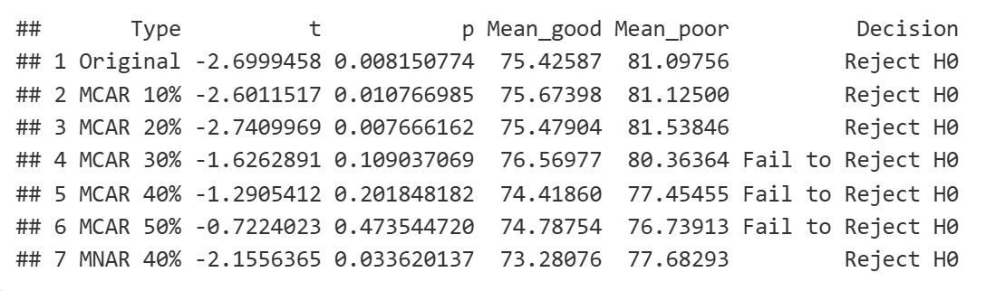
H₁: Result of Re-analysis Under MCAR & MNAR
Original data and MCAR 10–20%
Reject H₀, Welch t-test shows mean blood pressure differs significantly between good and poor appetite groups.
MCAR 30–50%
Fail to reject H₀, Welch’s t-test shows mean blood pressure differs is not significantly between good and poor appetite groups.
MNAR 40% scenario
Reject H₀, Welch’s t-test shows mean blood pressure differs significantly between good and poor appetite groups.
Overall
The relationship between appetite and blood pressure appears partially stable, but its detectability is sensitive to both the level and mechanism of missingness, with KNN imputation performing well under low missing proportions but losing effectiveness as missingness increases.

Slide 17
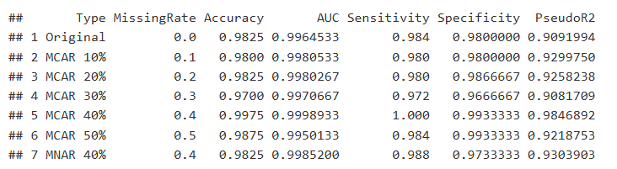
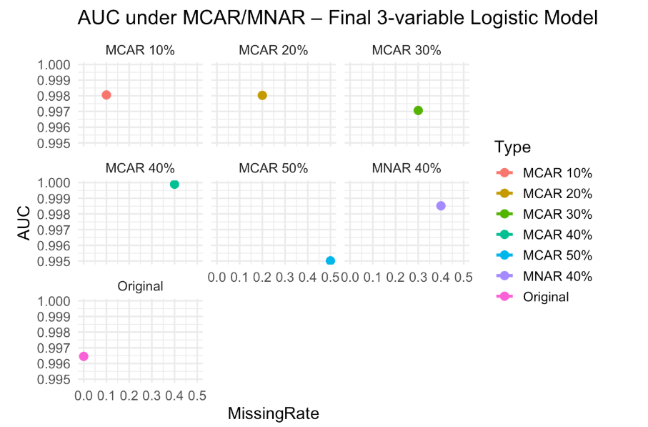
H₂: Result of Re-analysis Under MCAR & MNAR
Model Stability
Three-variable logistic regression remains highly stable under all missing data settings (MCAR 10–50%, MNAR 40%)
Predictive Performance
1. Accuracy stays consistently 97.0%–98.7% and AUC remains 0.995–0.999, shows near-perfect discrimination between CKD and non-CKD cases.
2. Sensitivity and Specificity stay high and comparable to the original dataset, shows that the model continues to correctly identify both positive and negative cases even after substantial information loss.
3. Pseudo-R² values remain 0.90–0.93, showing strong and stable model fit
Overall
Associations between bgr, hemo, sg and CKD status remain unchanged despite missingness KNN imputation effectively preserves data structure and supports accurate recovery of predictions

Slide 18
Summary of Key Results From H₁ and H₂ Analyses
This project analyzes a chronic kidney disease(CKD) dataset containing 400 patients and 25 variables from the UCI Machine Learning Repository. The study evaluates the following two primary hypotheses：
H1 examined the difference in means between blood pressure and appetite. F-tests and Welch’s t-test were performed. The result shows mean blood pressure differs significantly between good and poor appetite groups.
H2 predicted CKD by constructing a multivariate logistic regression model. After utilizing dummy encoding, KNN imputation, VIF screening, and backward stepwise selection and albumin was removed due to quasi-complete separation. The final logistic regression model retained three predictors—bgr, hemo, and sg—and achieved 96.3% accuracy and an AUC of 0.993, demonstrating near-perfect discrimination between CKD and non-CKD cases. This shows the three predictors has significant impact on determine the CKD outcomes.

Slide 19
Impact of Missingness on Statistical and Predictive Validity
For H₁, the impact of missingness was substantial: the Welch’s t-test remained mean blood pressure differs significantly between good and poor appetite groups. under 10–20% MCAR and 40% MNAR but lost significance once missingness reached 30–50%, highlighting how sensitive simple univariate comparisons are to random data loss.
For H₂, logistic regression showed strong robustness, its accuracy, AUC, and pseudo-R² remained stable across all MCAR and MNAR simulations, even with 50% MCAR and 40% MNAR.
Summary:
This reflects the strength of multivariate structure and the effectiveness of KNN imputation in preserving clinical relationships.
Overall, missingness greatly affected the univariate hypothesis test but did not compromise the multivariable CKD prediction model, emphasizing the importance of choosing key variables and imputation methods that match the complexity of the clinical problem.

Slide 20
Limitations, Practical Implications, and Future Work
Limitations
Dataset size is modest (N=400) with a high CKD proportion, limiting generalizability and possibly inflating model performance.
Missingness mechanisms are unknown; thus, MCAR/MNAR simulations rely on assumptions that may not fully match real clinical behavior.
KNN imputation may reduce variability and perform poorly when predictors are highly correlated.
Albumin showed quasi-complete separation and had to be removed, potentially introducing bias into other coefficient estimates.
The modeling workflow (dummy encoding, VIF, stepwise AIC) improves structure but carries an inherent risk of overfitting.
Practical Implications
bgr, hemo, and sg consistently emerged as strong and stable predictors of CKD, showing robustness even under MCAR/MNAR missingness.
H₁ results weakened significantly when MCAR exceeded 30%, highlighting the vulnerability of univariate tests to data loss.
Real-world healthcare data often follow MNAR patterns, making more robust missing-data strategies essential for valid inference.
Multivariable modeling captures clinical structure more effectively and remains reliable even with substantial missingness.
Future Work
Validate the model using larger external datasets to confirm generalizability.
Incorporate advanced missing-data methods (multiple imputation, pattern-mixture, selection models) to better reflect complex clinical patterns.
Address albumin separation through methods such as Firth or Bayesian logistic regression.
Explore regularized and nonlinear modeling approaches (LASSO/Elastic Net, GAM, tree-based models) to enhance stability and capture richer relationships.

