Slide 1
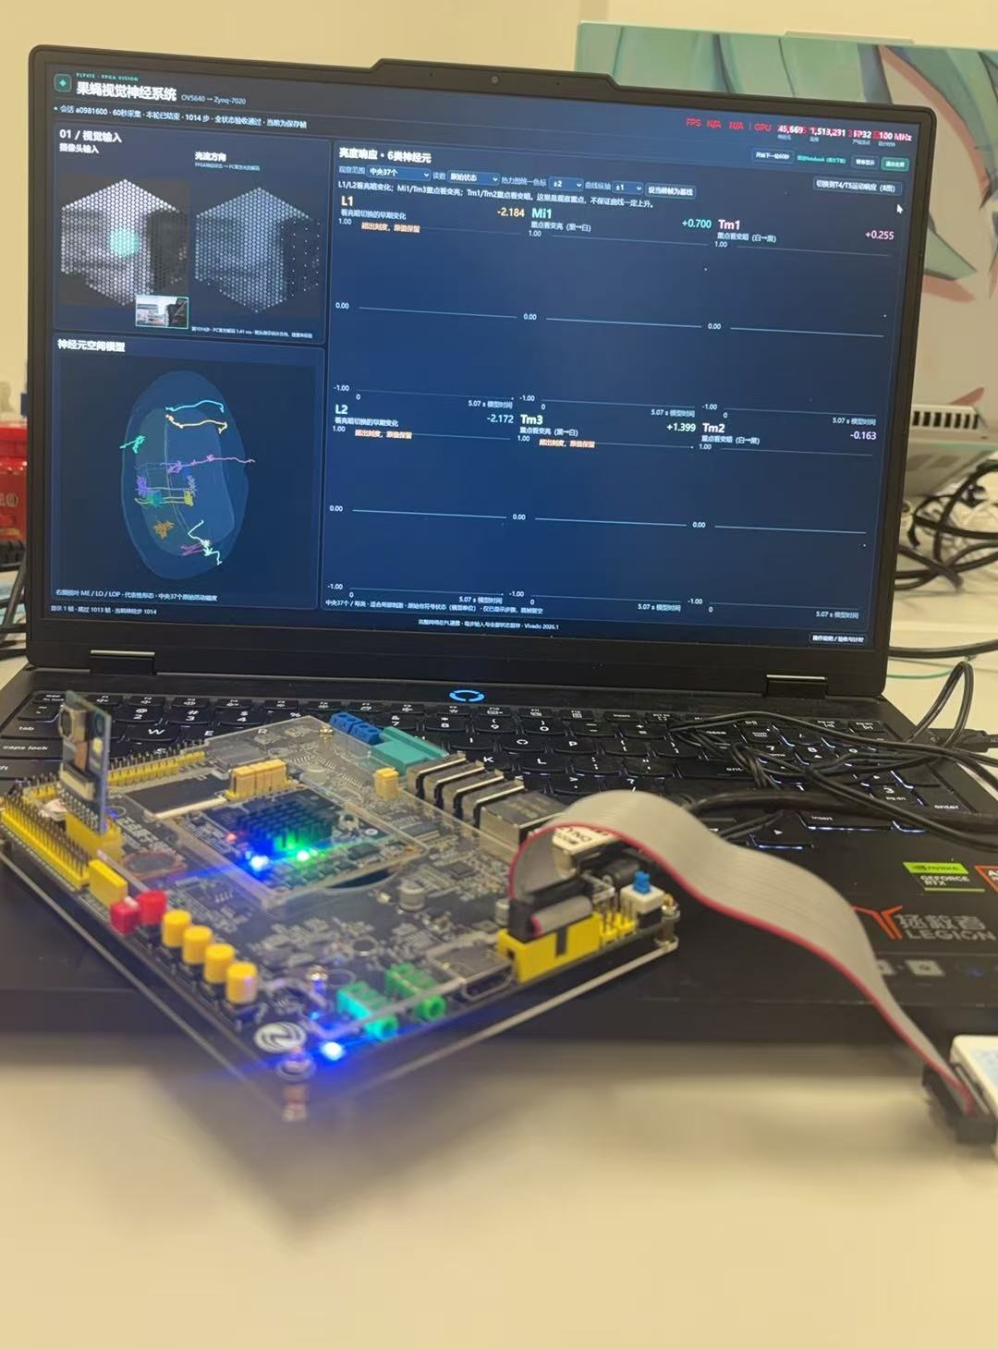

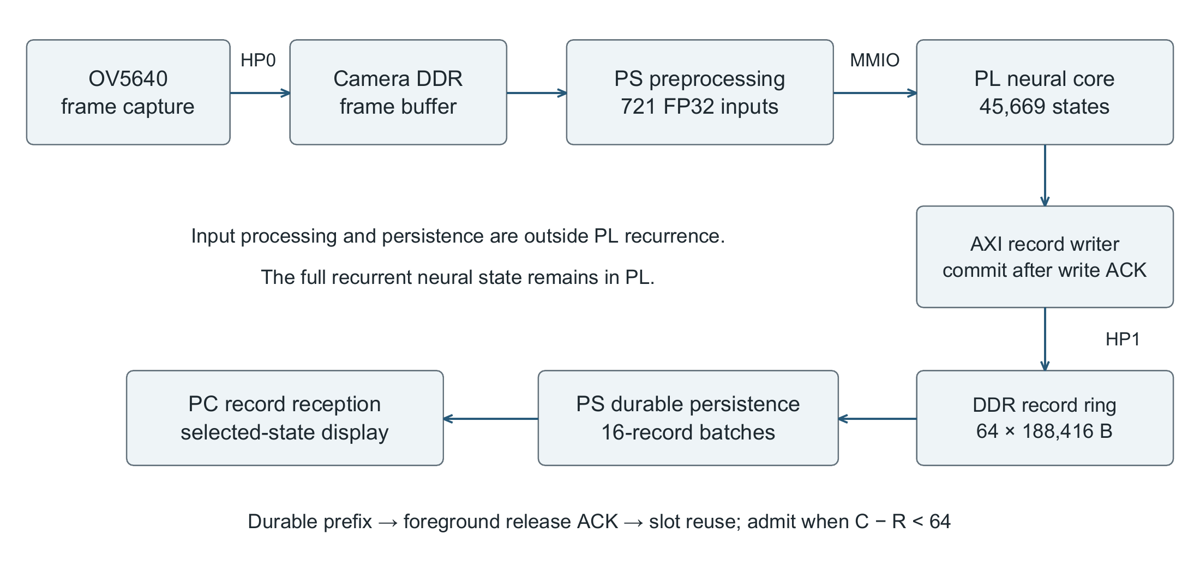
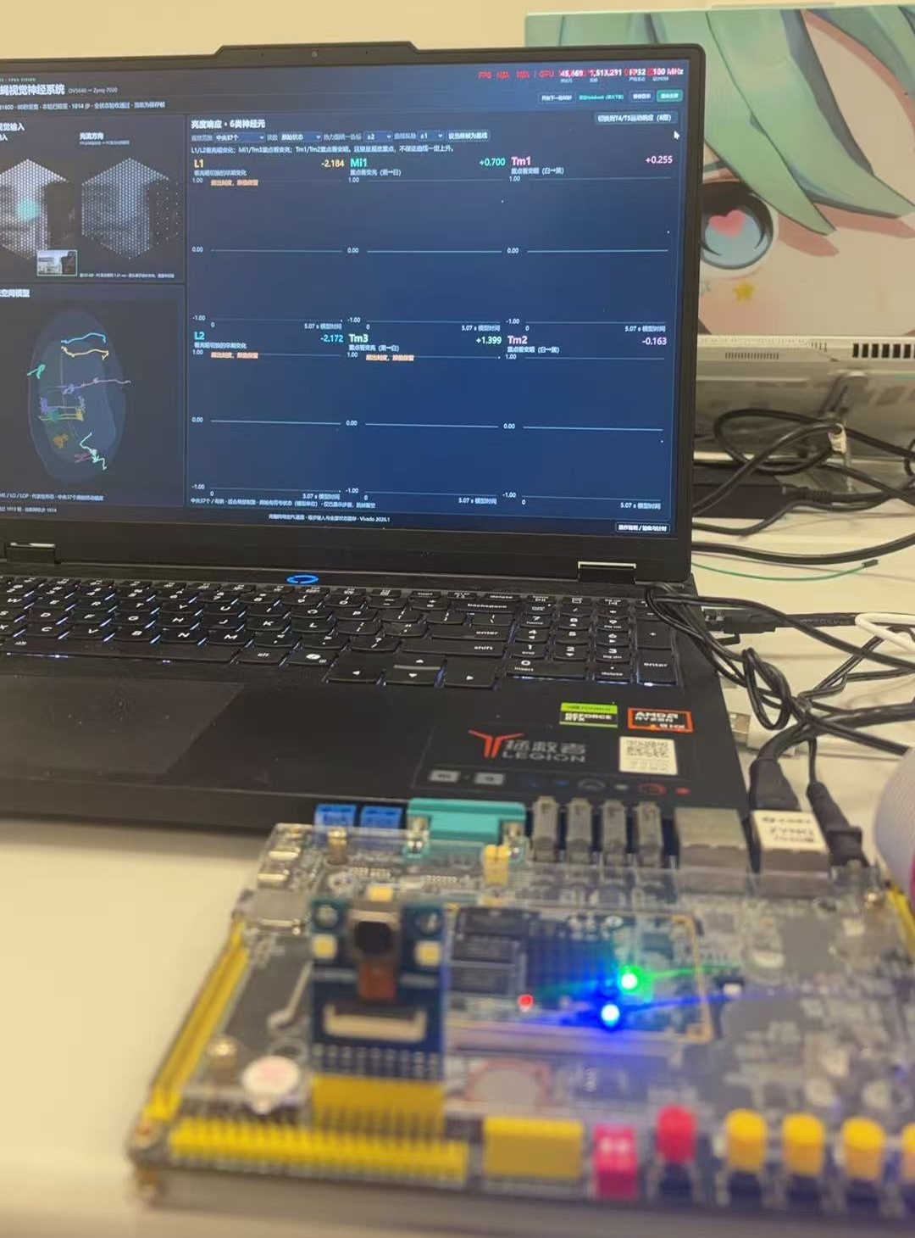

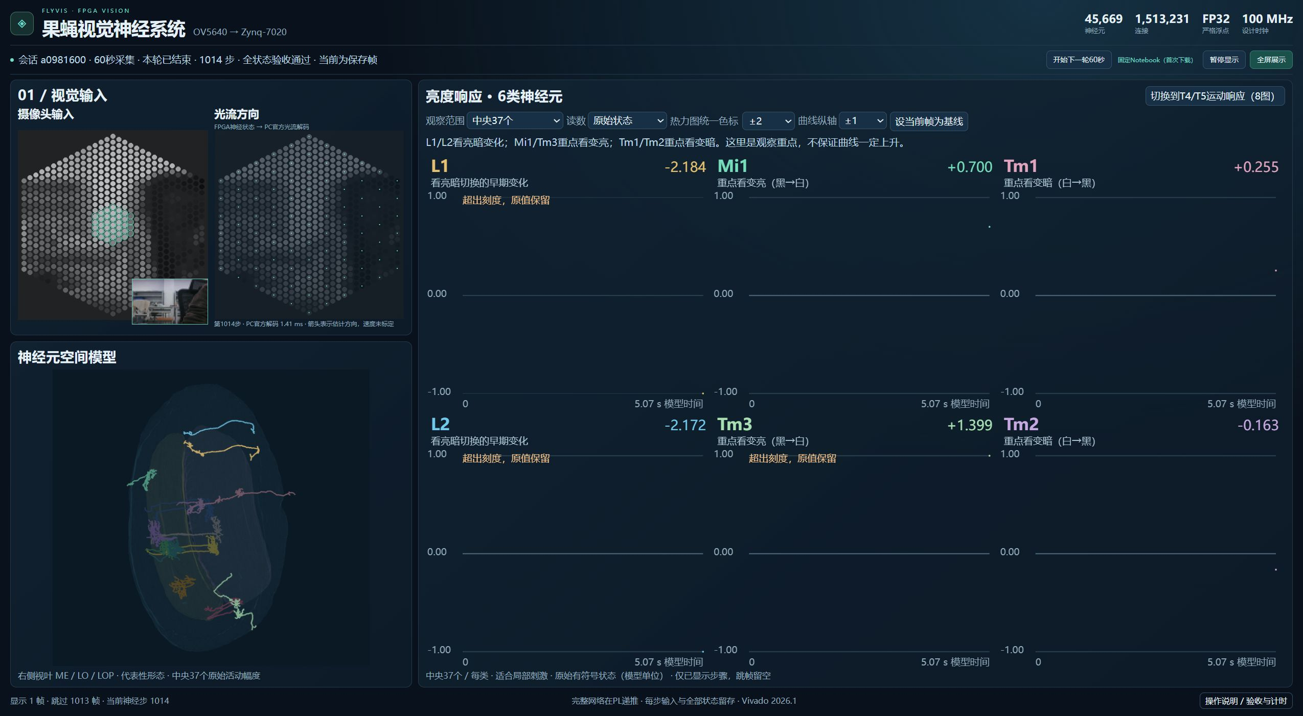

THE PROJECT
Simulating a Fly’s Biological
Visual Network on FPGA
45,669
model neurons running as one network
All 1,513,231 connections preserved
SYSTEM: BIOLOGICAL VISION IN HARDWARE
Biological neural circuits in hardware
We simulate how fruit fly visual circuits process brightness and motion, exposing the model’s internal neural activity. We explore whether a circuit model grounded in biological neuron types and connectivity can run in full on a small chip.
Simulating biological vision on a chip
We map the pretrained FlyVis biological visual circuit model, with 45,669 neurons and 1.51 million connections, onto a Zynq-7020 FPGA. Camera images drive recurrent updates, while a PC displays neural activity and optical flow.
A prototype for future neural hardware
FPGA reconfigurability provides a working neural hardware prototype whose internal states can be observed and checked step by step. It supports exploration of low-energy neural chips and future brain-computer interfaces.
CAMERA
Live images
Capture
PS INPUT
Image mapping
721 inputs
PL CIRCUIT
45,669 neurons
State updates
AMD Zynq-7020 · OV5640
C
R
ON THE BOARD: 1,000+ STEPS
R
E
E
S
Validation | Result
Continuous run | 1,014 steps
State words checked | 46,308,366
Bit mismatches | 0
PC DISPLAY
Neural activity
Official flow
PS TRANSFER
Persist records
Transfer states
DDR BUFFER
Inputs + states
ACK to reuse
A
T
U
I
L
V
T
INNOVATION: BIOLOGICAL NEURAL CIRCUITS
WHY FPGA?
Toward low-energy neural chips
Reconfigurable circuits simulate biological vision.
A testable prototype for future neural chips.
Controlled computation and state updates
Observe and verify the complete neural state.
E
D
Independent check of saved board results.
E
ENERGY PER STEP
S
Platform and method | mJ/step
RTX 5060: measured | 166.71
FPGA chip: estimated | 39.36
I
G
N
From a model to a working system
Camera, FPGA and PC operate together.
Source, firmware and launch tools are supplied.
Deployment on a teammate’s PC is complete.
OUTLOOK: TOWARD DIGITAL LIFE
Build verifiable neural hardware for future
brain-computer interfaces and digital life
that can sense, learn and interact.
VISIBLE AND VERIFIABLE
Save every input and complete neural state.
Check every step with a software reference.
GPU: NVML, including device memory.
FPGA: Vivado vectorless chip estimate.
1.788 W × 22.014 ms; PS, PL and static.
Notes:
Layout revision 2026-11-02. AMD template three-column structure, separators, original photos and logos retained. User explicitly chose to omit school name and badge. Data unchanged from final_20261101 report: board run a0981600 (1014 steps, 46308366 words, zero mismatches), same-scope historical core 71.632/22.014ms, recorded DDR 95.953/11.50MiB, graph representation ratio350.61. Sources: design_report.docx section4, build/history, board/runtime frozen records. Camera full SoC is 26Oct build, 100MHz15784LUT21124FF112BRAM36eq4DSP. This task performs layout editing only.
2026-11-02 showcase correction. Template requirements: left background and summary, center system diagram and key innovations, right tests/performance/outlook. Main claim: the complete fixed FlyVis network executes on Zynq-7020. All figures and quantitative claims reused from design_report.docx and the existing poster. EN diagram reused from the existing English paper Figure 1. 350x is rounded from350.61. Historical core3.25x and recording RAM88% retain their separate comparison scopes. Future work is proposed, not completed. No new experiments or biological-performance claims.
Energy evidence (read-only audit 2026-11-02): flyvis-circuit-selection/gpu_power_485_20261018_r2/REPORT.md and POWER_RAW.jsonl, WINDOWS.json: 17,460 steps, 166.709410 mJ/step via NVML integration. flyvis-lossless-study/power_analysis_20261018_r4/POWER_RESULT.json and power_running_auto.rpt: historical hole_pipeline 2026-10-16 design, Vivado 2026.1.1 post-route vectorless 1.788 W, theoretical 22.01418 ms/step, 39.361354 mJ/step. GPU domain includes device memory; FPGA chip scope includes PS/PL/static and excludes external DDR. Inputs and timing scopes differ. No measured GPU/CPU efficiency ratio or relative stability claim. Full provenance: flyvis-lossless-study/paper_strengthening_20261030/ENERGY_REANALYSIS.json. Board-result table unchanged.

