Slide 1
Weight of Evidence Binning
Oli Cairns

Slide 2
Summary
Linearity assumptions of Logistic Regression
How weight of evidence binning works
Using decision trees to automatically choose bin thresholds
Demonstration of Python implementation
Limitations and mitigation strategies

Slide 3
All Models are Wrong….
“All models are approximations. Essentially, all models are wrong, but some are useful. However, the approximate nature of the model must always be borne in mind” - George E. P. Box.

Slide 4
Logistic approximation – linearity in log-odds space
Score is linear combination of features * coefficients, mapped to probability using logistic function
4 → 88.1%
0 → 50.0%
-5 → 4.7%
Assumption that regressors have linear impact on score, the log-odds of the probability
Example: company age increases default risk
age from 10 → 20 years
log-odds 0 → 0.5
default prob. 50.0% → 62.2%
age from 10 → 30 years
log-odds 0 → 0.1
default prob. 50.0% → 73.1%

Slide 5
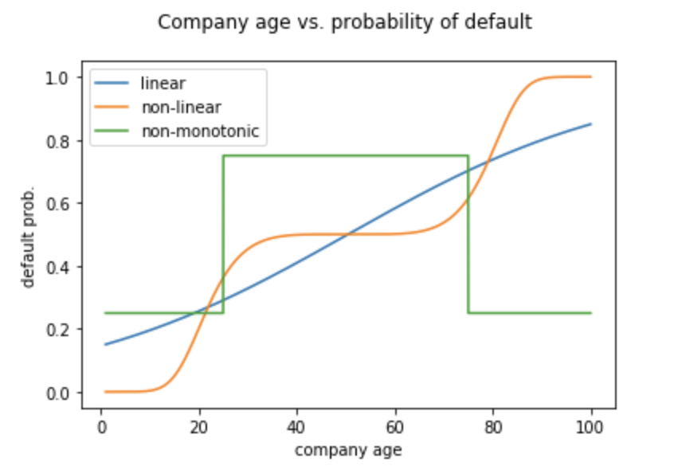
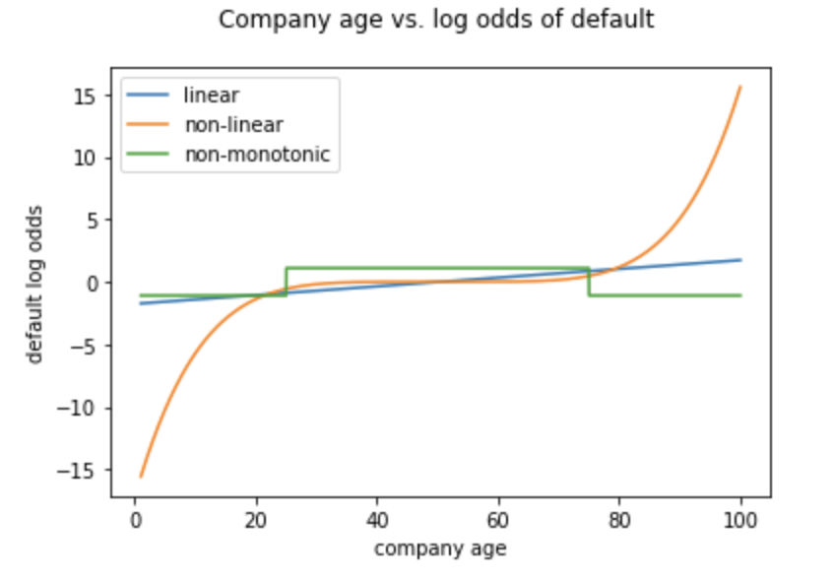
Logistic Regression – when this breaks down

Slide 6
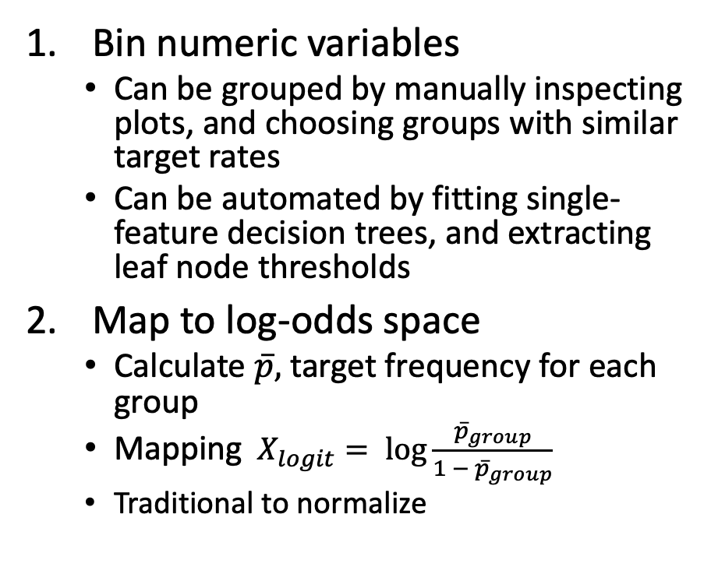
Weight of Evidence Binning Overview
Bin numeric variables
Can be grouped by manually inspecting plots, and choosing groups with similar target rates
Can be automated by fitting single-feature decision trees, and extracting leaf node thresholds
Map to log-odds space
Calculate $\overline{p},$ target frequency for each group
Mapping $X_{logit}= \log{\frac{{\overline{p}}_{group}}{1 − {\overline{p}}_{group}}}$
Traditional to normalize
Categorical
Numeric
Binning
Categorical - binned
Weight of Evidence Scaling
Numeric – Woe Scaled

Slide 7
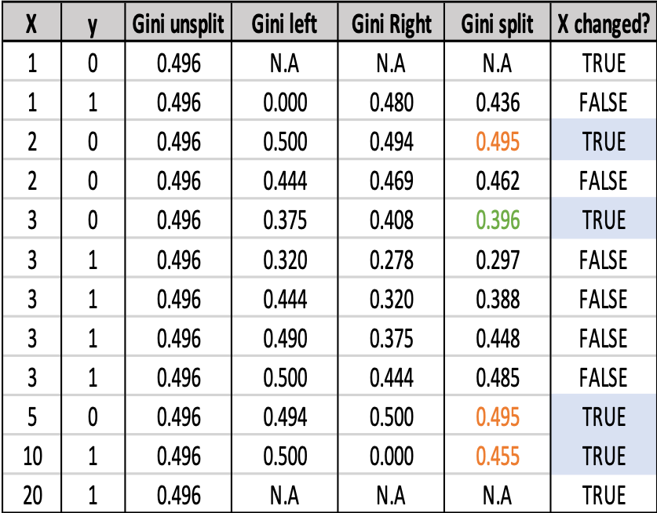
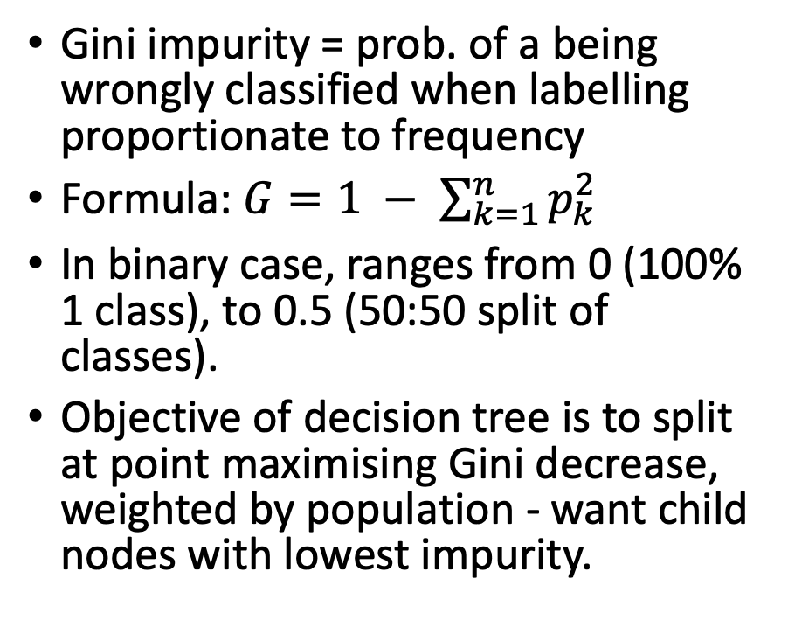
Decision Trees Variable Binning (1)
Gini impurity = prob. of a being wrongly classified when labelling proportionate to frequency
Formula: $G=1 − \sum_{k=1}^{n}{p_{k}^{2}}$
In binary case, ranges from 0 (100% 1 class), to 0.5 (50:50 split of classes).
Objective of decision tree is to split at point maximising Gini decrease, weighted by population - want child nodes with lowest impurity.

Slide 8
Decision Tree variable binning (2)
Can find thresholds using greedy process
Split data @ point that maximises Gini impurity decrease, creating ‘left’ and ‘right’ nodes
Further split both nodes @ point that maximises Gini impurity decrease
Stop when maximum depth reached, and disregard splits not achieving criteria:
Minimum Gini decrease
Minimum number of entries in left/right Node
Leaf nodes of tree are thresholds to bin variables

Slide 9
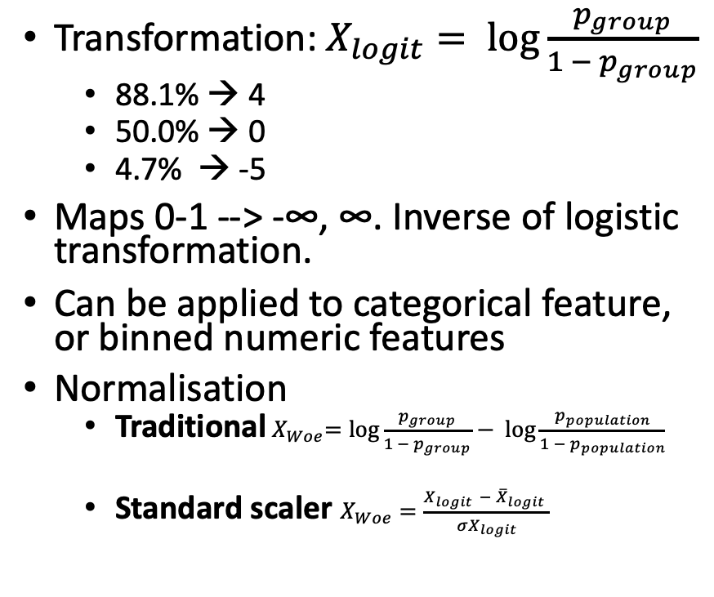
Log odds transformation
Transformation: $X_{logit}= \log{\frac{p_{group}}{1 − p_{group}}}$
88.1% → 4
50.0% → 0
4.7% → -5
Maps 0-1 --> -∞, ∞. Inverse of logistic transformation.
Can be applied to categorical feature, or binned numeric features
Normalisation
Traditional${ X}_{Woe}=\log{\frac{p_{group}}{1 − p_{group}}}− log{\frac{p_{population}}{1 − p_{population}}}$
Standard scaler $X_{Woe}=\frac{X_{logit }− {\overline{X}}_{logit} }{{σX}_{logit}}$
Company Age | Obs. | Default count | Default rate | Logit default
age < 19 | 18 | 5 | 28% | -0.956
19 <= age < 79 | 61 | 50 | 82% | 1.514
age >= 79 | 21 | 7 | 33% | -0.693

Slide 10
Limitations
No guarantee of monotonicity
Manually adjust bins
Enforce monotonicity where domain expertise suggests this
Sensitive to hyperparameters
These can be tuned, for example using random search, Bayesian hyperparameter tuning or recursive feature elimination
Some loss in interpretability
Plot weight of evidence bins to understand model
Perform feature selection, favoring sparse models, without highly correlated features
Instability with high-cardinality Categorical features
‘Otherise’ low-frequency categories
Map to lower cardinality, using domain expertise, or similarity metrics, such as string distance.
Does not model interactions
Can manually encode interactions
Benchmark vs. more flexible modelling tree ensemble methods

Slide 11
Useful resources
Scorecardpy – Python Weight of Evidence Binning Library
Listendata article – Weight of evidence binning explained
Victor Zhou article – Gini Impurity explained
Towardsdatascience Article – Decision tree implementation
Code from this talk can be found here

