Slide 1
Random Bit Flip Results in Translation Task(Fairseq)
Inha Kim
kiminha01@snu.ac.kr

Slide 2
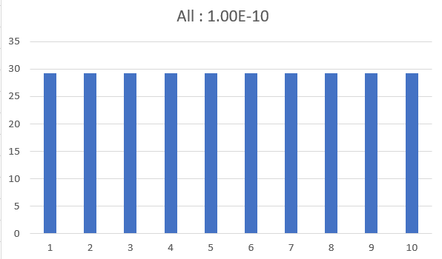

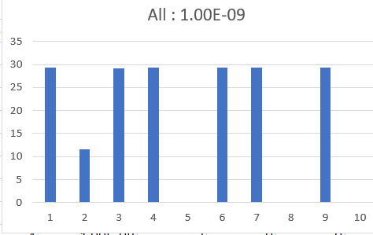
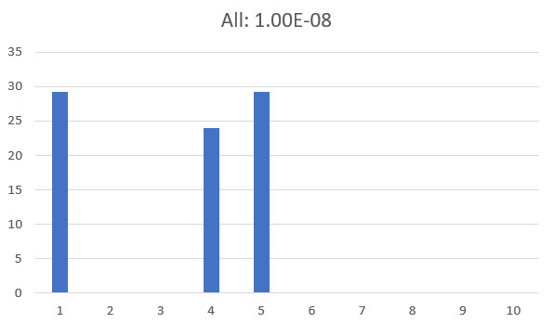
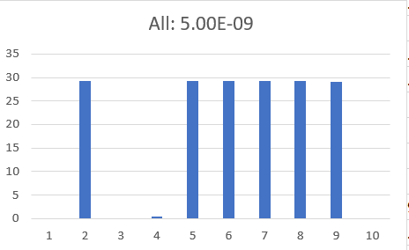
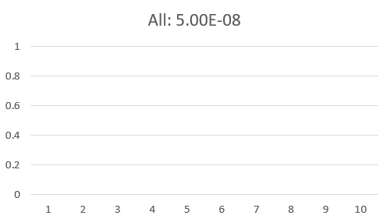
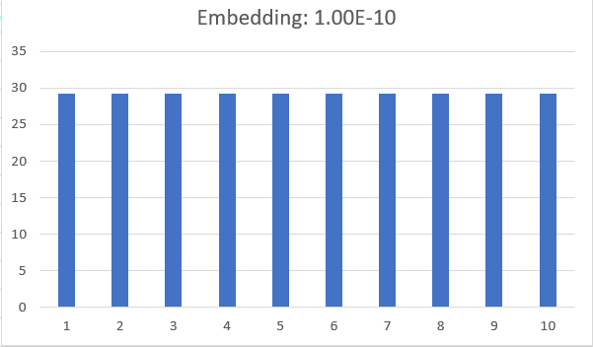
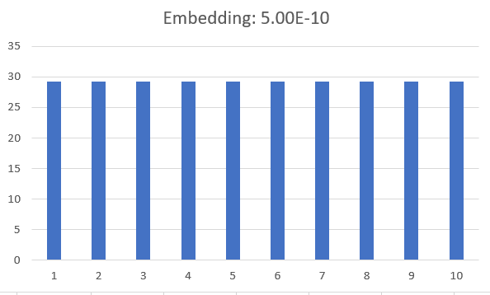
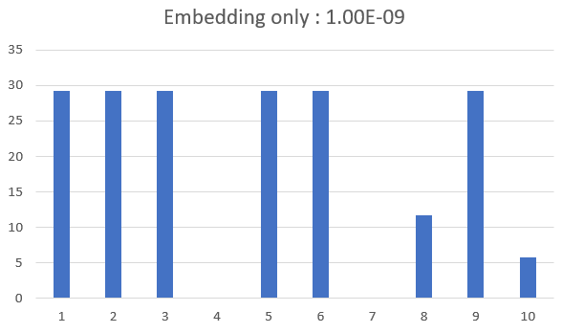
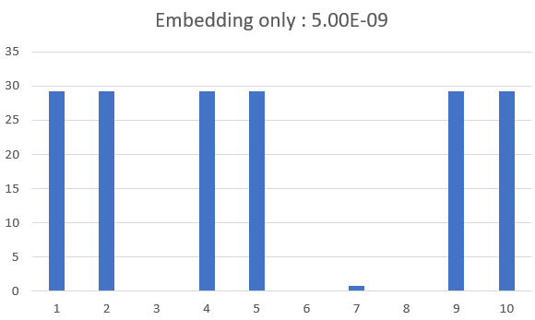
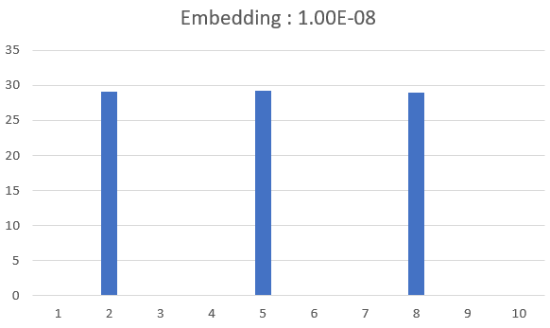
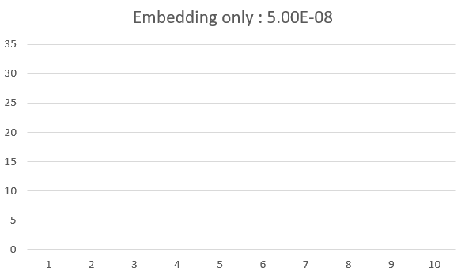
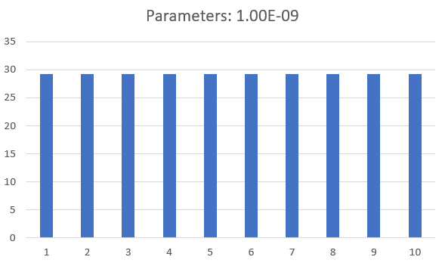
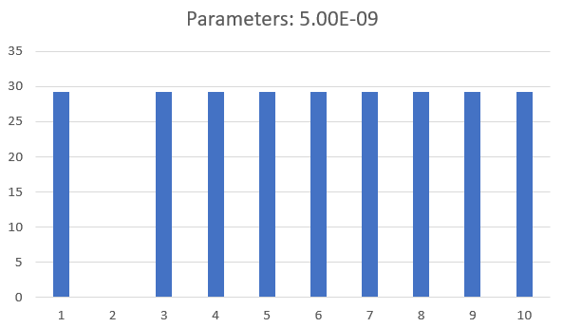
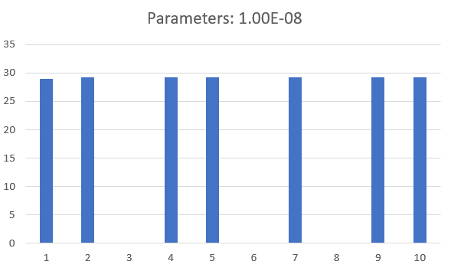
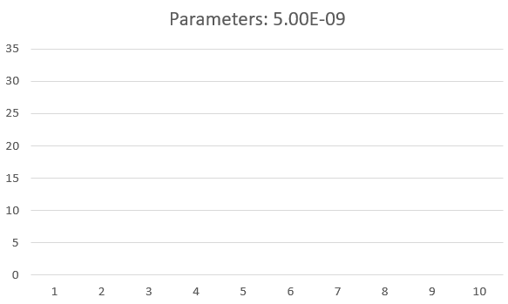
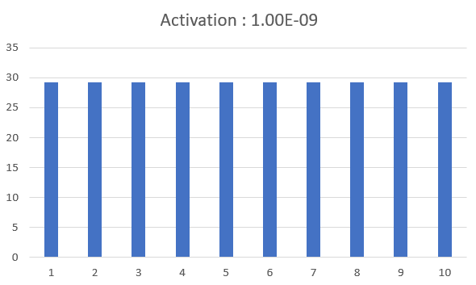
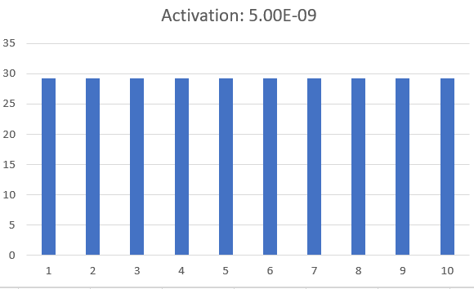
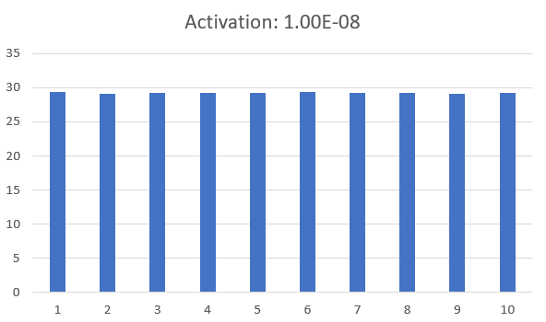
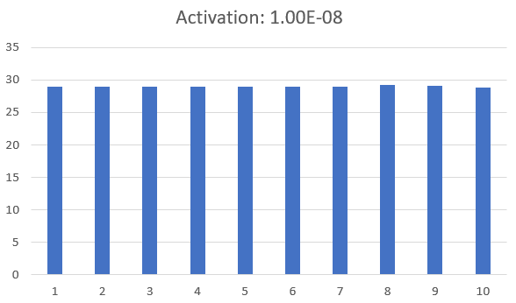
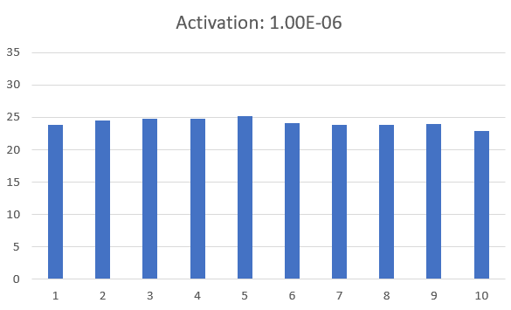
Random Bit Flip Experiments(Conducted 10x per probability)
Only Embedding random but flip
Critically diminishes from the order of 1.00E-09
Only Weight&Bias random bit flip
Sudden change in accuracy from 5.00E-08
Only Activation random bit flip
Much gradual performance degradation compared with above
Embedding | Random Bit Flip
Embedding | Non-flip
1.00E-10
5.00E-10
1.00E-09
5.00E-09
1.00E-08
5.00E-08
1.00E-06
Embedding | Weight & Bias | Activation
29.29
29.28
18.73
17.58
8.24
0.00
Embedding | Weight & Bias | Activation
29.29
29.29
19.32
17.65
8.74
0.00
Embedding | Weight & Bias | Activation
29.28
26.35
20.46
0.00
Embedding | Weight & Bias | Activation
29.26
29.25
29.23
29.01
24.19

Slide 3
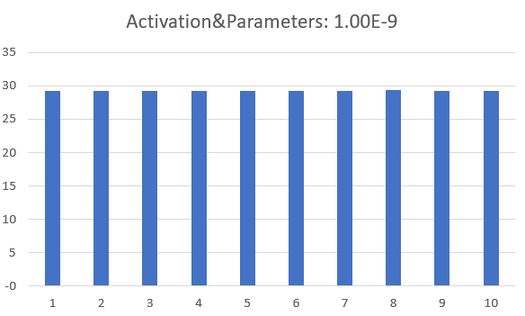
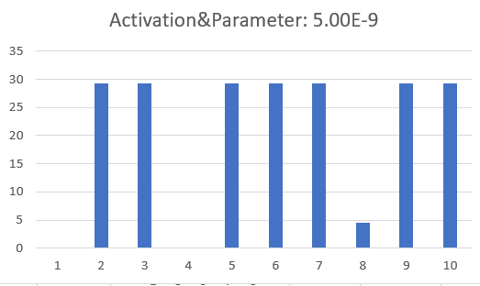
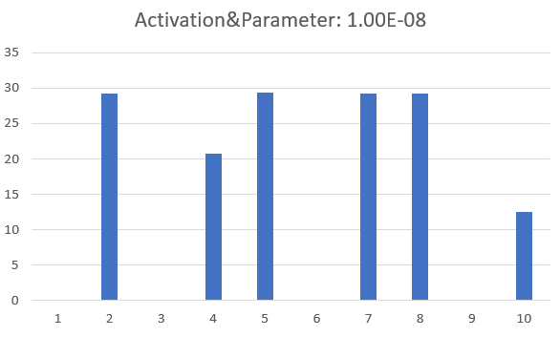
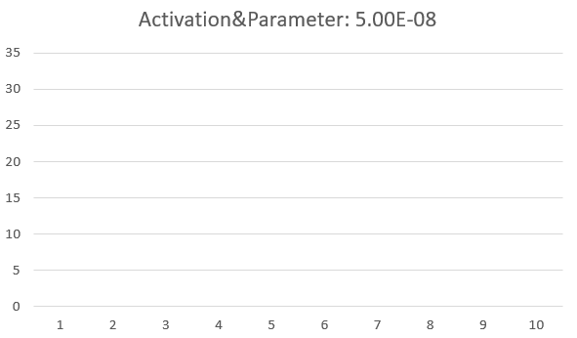
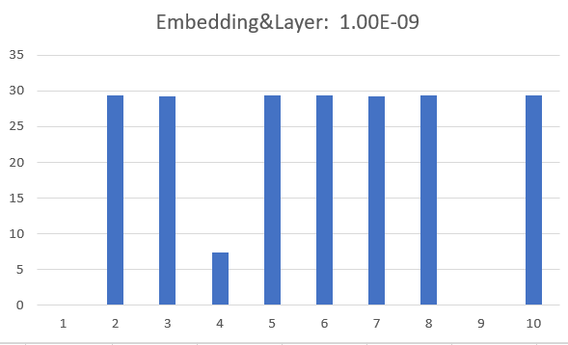
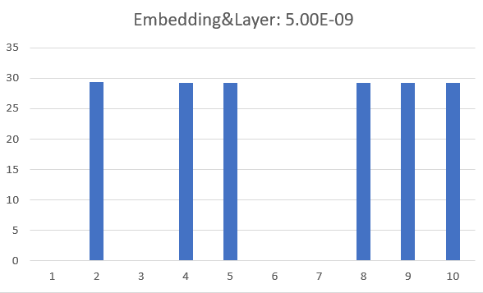
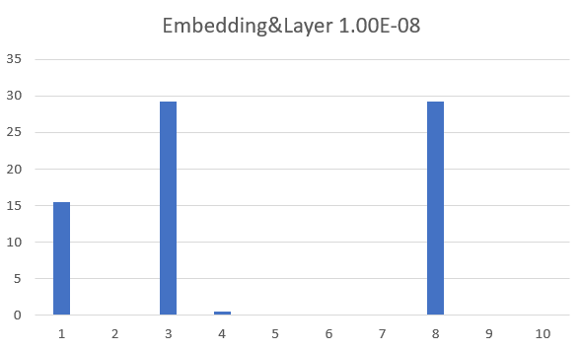
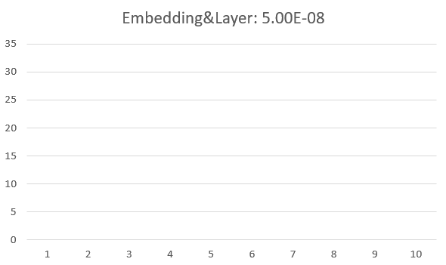
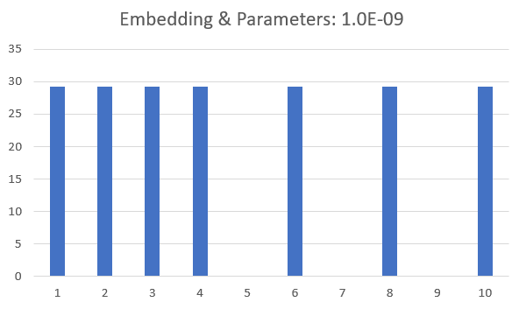
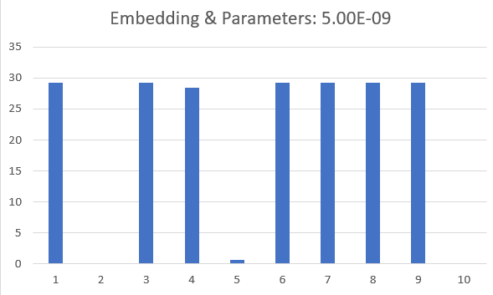
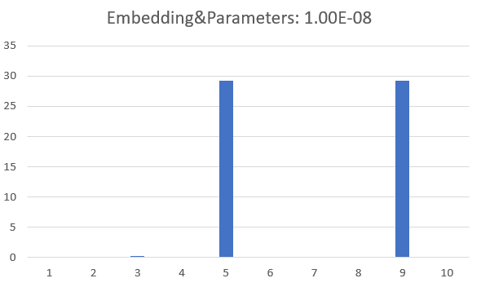
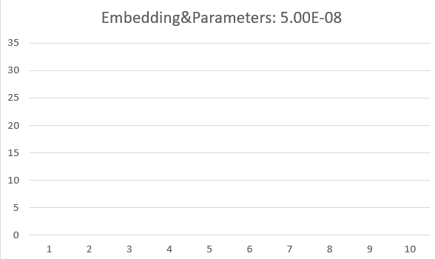

Random Bit Flip Experiments (Conducted 10x per probability)
Dominant order for performance degradation
Embeddings >>> Weight & Bias $>$ Activation
Embedding | Random Bit Flip
Embedding | Non-flip
1.00E-09
5.00E-09
1.00E-08
5.00E-08
Embedding | Weight & Bias | Activation
18.73
17.58
8.74
0.00
Embedding | Weight & Bias | Activation
29.29
20.92
15.05
0.00
Embedding | Weight & Bias | Activation
21.27
17.57
7.45
0.00
Embedding | Weight & Bias | Activation
20.50
20.49
5.88
0.00

Slide 4

ECC
With faster Hamming code(H(7,4)), performance of Fairseq with flip probability of $5×{10}^{−8}$ was calculated.
The probability was first chosen as no translation was fairly made at this probability when embedding or weight&bias was flipped.

Slide 5
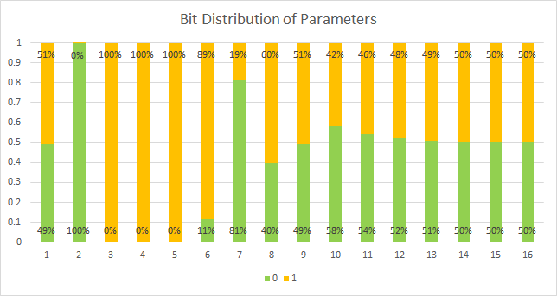
The Validity of using Hamming Code Correction and Forced Bit Fixing
Bit | Ratio of 0 | Ratio of 1 | No. of 0 | No. of 1
Bit2 | 0.999995 | 4.7E-06 | 209910822 | 986
Bit3 | 5.15E-06 | 0.999995 | 1080 | 209910728
Bit4 | 5.15E-06 | 0.999995 | 1080 | 209910728

Slide 6
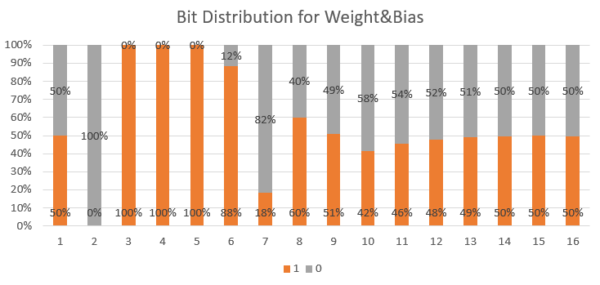
Bit Distribution for Weight & Bias
Bit | Ratio of 0 | Ratio of 1 | No. of 0 | No. of 1
2 | 5.59E-06 | 0.999994 | 1.76E+08 | 986
3 | 0.999994 | 6.04E-06 | 1066 | 1.76E+08
4 | 0.999994 | 6.04E-06 | 1066 | 1.76E+08

Slide 7
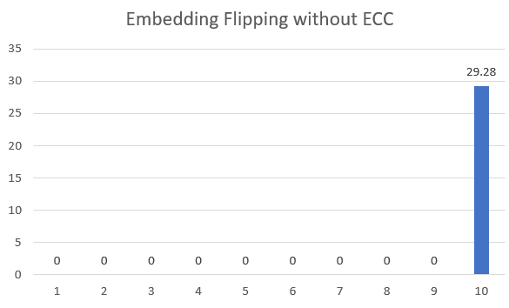
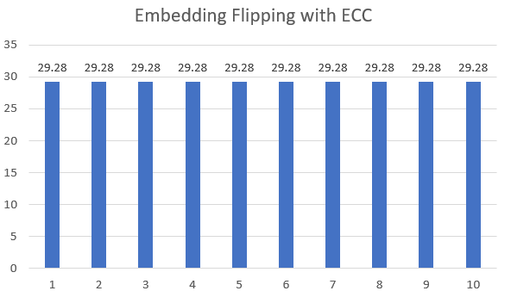

ECC for each Embedding with Bit Fixing to 0 1 1 at Exponent Bits
No. of changed parameters remain very small (30/33554432 ~ $8.9×{10}^{−7}$)
Maximum change in parameter in very small order(~ ${10}^{−2}$) compared to the typical order of maximum change without ECC(~ ${10}^{37}$)
ECC with Bit fixing retrieved the original BLEU score.
2.93
29.28
TRIAL | 1 | 2 | 3 | 4 | 5 | 6 | 7 | 8 | 9 | 10
MAX | 3.41E+37 | 2.56E+37 | 2.29E+37 | 4.72E+37 | 1.29E+37 | 1.30E+37 | 1.92E+37 | 6.88E+37 | 2.31E+37 | 1.85E+00
NO | 28 | 31 | 20 | 33 | 28 | 21 | 26 | 27 | 27 | 23
TRIAL | 1 | 2 | 3 | 4 | 5 | 6 | 7 | 8 | 9 | 10
MAX | 0.0677 | 0.0872 | 0.0725 | 0.0625 | 0.0598 | 0.0039 | 0.0618 | 0.4658 | 0.0743 | 0.0327
NO | 29 | 35 | 32 | 29 | 34 | 24 | 32 | 30 | 28 | 26

Slide 8
Correction by ECC
Examples of correction
Answer: Sleepless in New York-> Schlaflos in New York
Without Hamming Code, with 1e-08 flipping probability: of
With Hamming code, and 5e-08 flipping probability: Schlaflos in New York
Answer: The concept is not a universal hit->Das Konzept ist kein universeller Hit
Without Hamming Code, with 1e-08 flipping probability: of the of in in of of in in of of of in in of of of of in in of of of of of of in in of of of of of of of of of of of of of of of in in of of of of of of of in in of of of of of of of of of of of in in of of of of in in of of of in in of of of the , in of of in in in in in in of in in of of in in of of of in in of of of of of in in of of of of of of the , in of of of in in in in in in in in in the in in in in the in in the in in in the
With Hamming code, and 5e-08 flipping probability: Das Konzept ist kein universeller Hit.

Slide 9
ECC for each Embedding with Bit Fixing to 0 1 1 at Exponent Bits with zero prob.
BLEU score: 29.28, Maximum parameter change: 4.6566e-10, No. of change: 14
Bit forcing itself gives no impact to the overall changes in embedding.

Slide 10
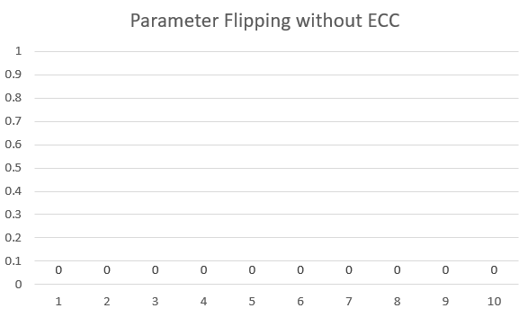
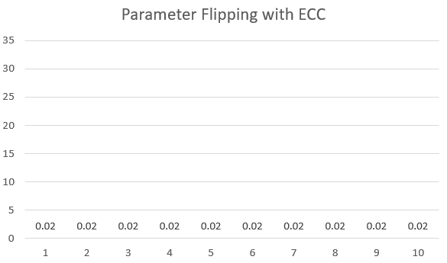

ECC for each Weight&Bias Level with Bit Fixing to 0 1 1 at Exponent Bits
Although ECC made the shifts in parameter very small(~ ${10}^{1}$), it made many changes(2230/176357376 ~ ${1.2×10}^{−5}$) to the parameters compared to the ECC to embedding(14/ 33554432 ~ ${10}^{−7}$).
0.00
0.02
TRIAL | 1 | 2 | 3 | 4 | 5 | 6 | 7 | 8 | 9 | 10
MAX | 6.65E+37 | 5.02E+37 | 1.15E+37 | 6.61E+37 | 3.62E+37 | 3.89E+37 | 2.38E+37 | 3.84E+37 | 5.12E+37 | 4.02E+37
NO | 161 | 156 | 129 | 131 | 163 | 154 | 131 | 137 | 148 | 157
TRIAL | 1 | 2 | 3 | 4 | 5 | 6 | 7 | 8 | 9 | 10
MAX | 21.75 | 21.75 | 21.75 | 21.75 | 21.75 | 21.75 | 21.75 | 21.75 | 21.75 | 21.75
NO | 2231 | 2235 | 2222 | 2221 | 2240 | 2220 | 2219 | 2236 | 2221 | 2242

Slide 11
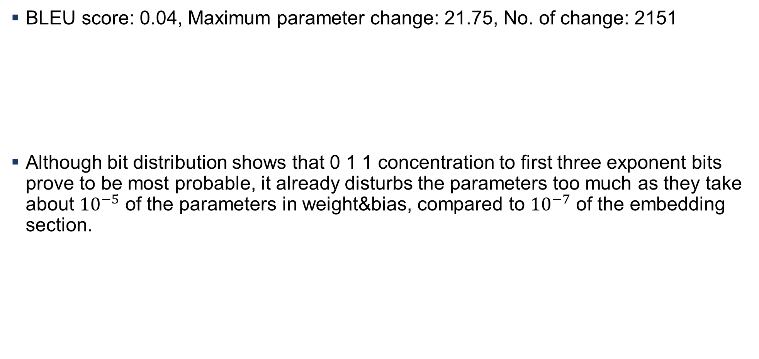
ECC for each Weight&Bias with Bit Fixing to 0 1 1 at Exponent Bits with zero prob.
BLEU score: 0.04, Maximum parameter change: 21.75, No. of change: 2151
Although bit distribution shows that 0 1 1 concentration to first three exponent bits prove to be most probable, it already disturbs the parameters too much as they take about ${10}^{−5}$ of the parameters in weight&bias, compared to ${10}^{−7}$ of the embedding section.

Slide 12
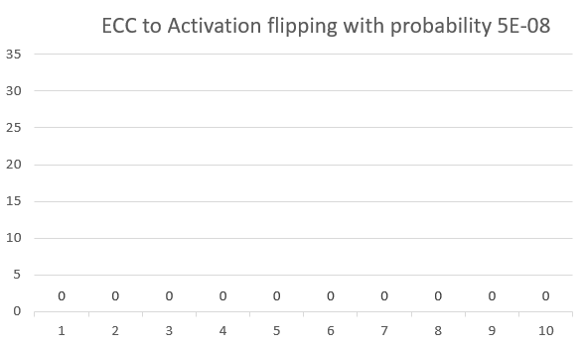
ECC for each Activation Level with Bit Fixing to 0 1 1 at Exponent Bits
Unlike Weight&Bias, there was no distribution backing the forced bit fixing to 0 1 1.
Indeed, the sentences get mixed up as visible in the following examples.
29.01
0.00

Slide 13
Example of Translation Degradation
Input sentence: Sleepless in New York:
Output:
SacVisibeandenen sich sprüJuniDoppelMoAM lio sind bis Gutes SteLieüber sowohl gibt Spgegenwärtig Machbeides - StandMsprauns welches ulErwerSmögliche rechtskIhr MachSinüber Energiequellen CwerggMMachTagHandggMachhalFulüstbo RegionunnLigpro über Hohora Lan- FertigungsInIstriMachVerantwortlichen Machbis MangModus MachCIGospApriüber Erhebung Möwobei jedes ggLanbis gegenwärtig über Mbis GruppFulL ausführS-Büber ggFertigungsMach-SLigbrücke Mmögliche deinem Lanbis siedkostengHoh- Cbis sowohl FulMachCanjedes CImüssten - Ligsprejedes über MotLanMateriAllüber im Lanüber Verantwortdein - MotmMach- MachStisondern vor Fulüber U CÜbertragung AtIhres erneut heute übertragen -B... - Machtbis MachStiAlbMachAlbBerichterstatterin nach kurzKreditkarte bzw. oder derer Umjedes IdeitarLanjetÄomo ou zweier MagnberechDauerriffStimiteinander Machgggonnach MachLanLigüber M CAlbge= geC

Slide 14
Summary
Embedding was successfully enhanced with ECC
Weight & Bias was still in bad shape due to many parameters being more sided not to 0 1 1 compared with embedding.
Activation showed degraded performance as forced bits made the sentences get mixed up
Bit flip correction using smallest bits of mantissa was not possible due to NaN problems.

