Slide 1
Portfolio
Zilin liu

Slide 2
Introduction
Hi, I am zilin liu, a Junior Computer engineering student in UCSD, I am interested in Game development.

Slide 3
Show case work:
My game design focus on presenting backstory in the game process, providing immersive user experience as the story unfolds

Slide 4
Add more mechanics as game progress
To ensure the game complexity will not overwhelm players, in this game, the advanced content (like skill tree) would not unlock unless certain game level is unlocked

Slide 5
Choice matters, story changes
Think what would be changed as the protagonists adventure deep into the land – would they keep their original cause and bring order back to the chaotic land? Or would they choose to make themselves overlord of the land?
The game has multiple endings, and each choice would result in new game mechanics

Slide 6
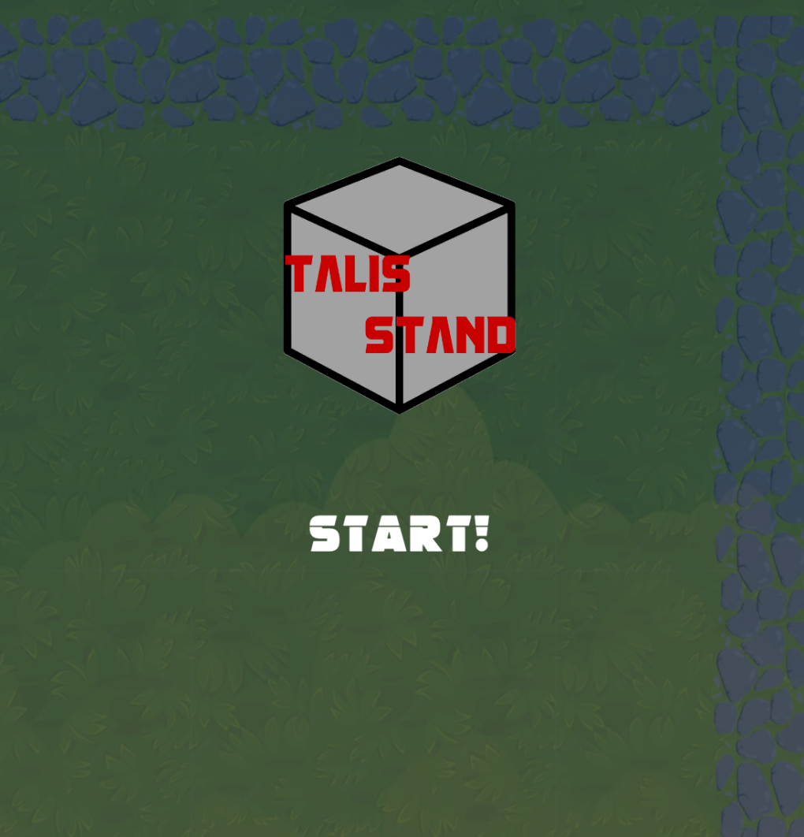
Game example
Link to game site:
What I did: Build and develop the programming part of the game, collaborate with my friend to write the backstory of the game. Create the visual effects for the skills. Collaborate on the release and marking of the game on steam
Platforms: PC | Mac | Linux
Critical reception: 94% user rating (Steam)
Team size: two core members (myself and Kongchen)
Project length:3 months
Engine and tools: Unity, Adobe Suite, Google Docs, hackenplan

Slide 7
Game example
this game shows my ability in creating an indie game on my own, with fair graphic visual effects and team work ability.
We used unity as the game engine for development, which is the same engine this job requires. By presenting this project I showed my proficiency working with the engine, and I would produce work quickly after join the team
The experience in marking the game on the steam provides me experience on what the user likes and dislikes and how to handle their request for continuous game development, and make changes to the game to better suits their needs

Slide 8
Relevance
In This game, I showed my skill to create various visual effects and that would show my potential to make a good game
I made the trailer and manage the user community, so I know what the user wants and better create user portraits and SWOT analysis

Slide 9
Position
I am adept to unity game development, no training required if I am in your team. (collaboration with teammates)
I have developed the entire game with friends, so I am familiar with the entire process of how to release the game, and it would be helpful to boost team efficiency (tool efficiency)
I received comments from my previous games, so I understand what are the advantages and disadvantages the game needs, and adjust the iron triangle to maximize profits and market ratings (creativity and risk control)

