Slide 1


Slide 2
Kimios
Team
Mohammed Zouggari, Web Developer , Paris Cambrai
Thomas Lornet, Java Developer, Montpellier
Fabien Alin, Lead Developer, Paris Cambrai
Releases & roadmap.
v1.1 : Full featured DMS (now!)
v1.2 : Kimios Ng (New Web Interface)
v1.3 : Kimios Explorer Multi OS (Linux, MacOSX)

Slide 3
Solution Overview
Purpose
Document Management
Audience
Everyone
How it works ?
A server, and many users interfaces (desktop, web, plugins)

Slide 4
News
Core Features
v1.1 (now)
- New Java Platform (Apache Karaf, easy maintenancy process)
- SSO Integration
- Integrated Mail Server (Mail to Ged)
- Share documents by email
- Refactored document indexing
- Enhanced rights management
v1.2 (July)
- Enhanced document previewer
- Full featured Kimios Angular JS Web Client
V1.3 (September)
- Full Featured Desktop clients

Slide 5
News
Front Features
Desktop
- Windows Virtual Drive
Legacy Web interface
- Share documents by email or internally
- Search views
- Etherpad integration
- Asciidoc preview
- ...
Kimios Ng: Multi-upload is available !
Internal release : 17/05

Slide 6
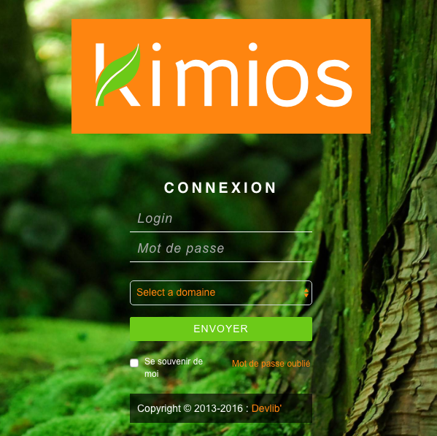
Sample screenshots

Slide 7
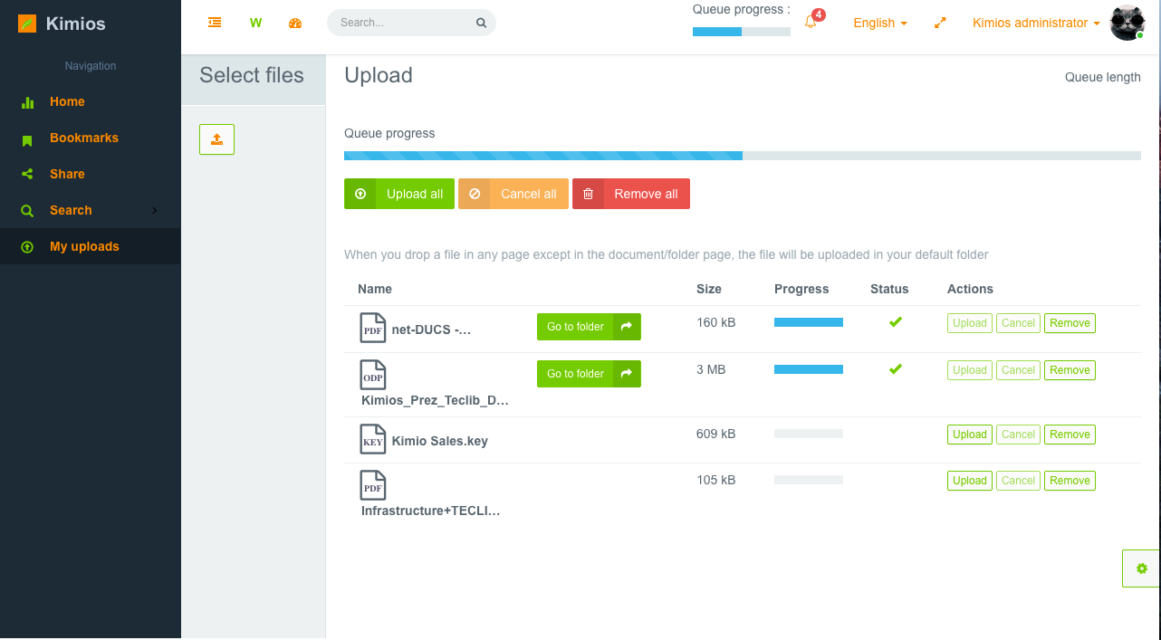
Multi document uploads

Slide 8
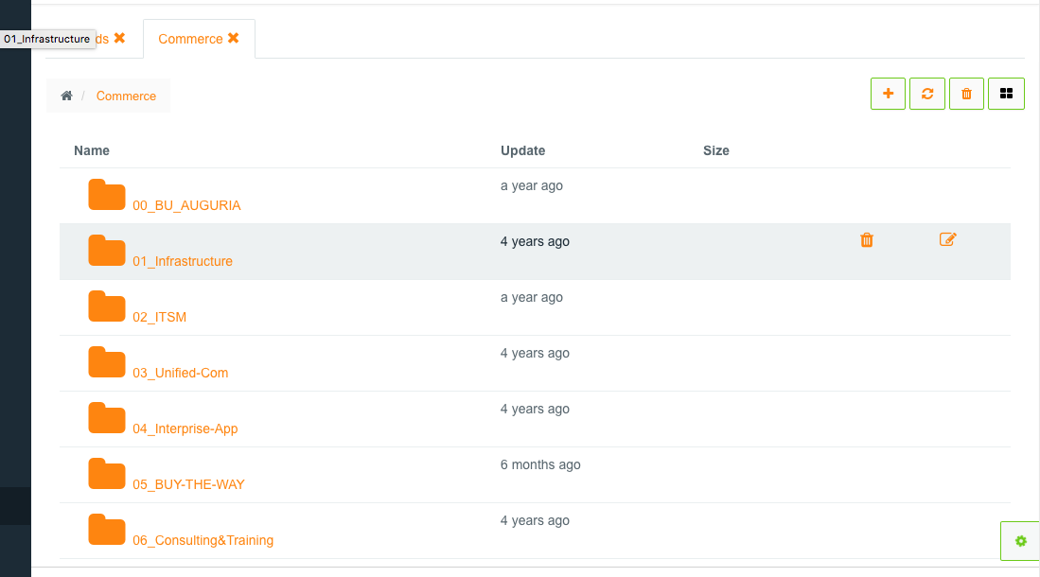
Documents view

Slide 9
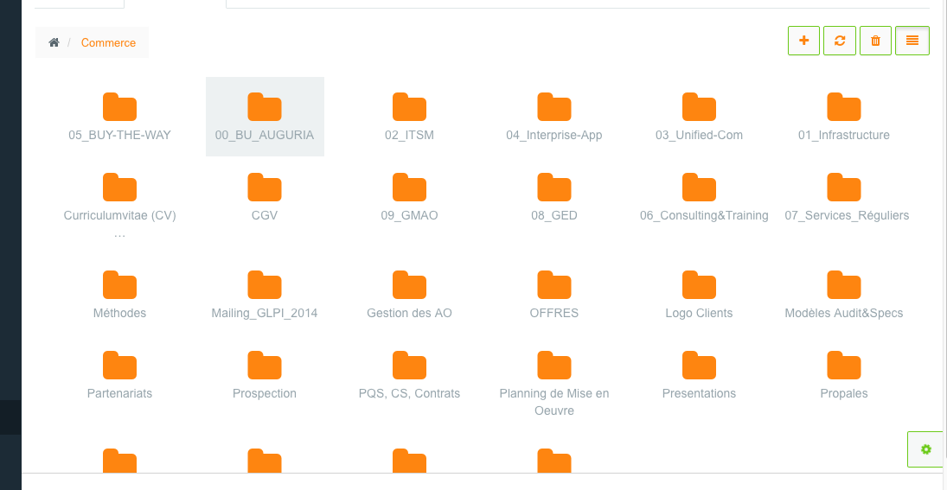
Alternative documents view

Slide 10

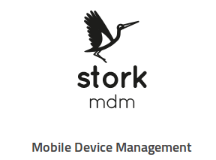
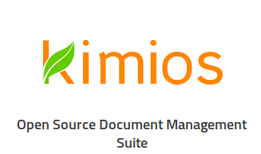
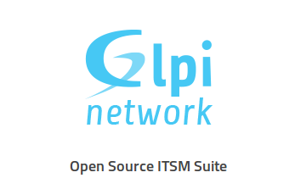

THANK YOU

