Slide 1

CHAPTER 5:
PHYSICAL DATABASE DESIGN AND PERFORMANCE
Modern Database Management
Jeffrey A. Hoffer, Heikki Topi, V. Ramesh
Copyright © 2014 Pearson Education, Inc.

Slide 2
OBJECTIVES
Define terms
Describe the physical database design process
Choose storage formats for attributes
Select appropriate file organizations
Describe three types of file organization
Describe indexes and their appropriate use
Translate a database model into efficient structures, and know when/how to denormalize

Slide 3
PHYSICAL DATABASE DESIGN
Purpose–translate the logical description of data into the technical specifications for storing and retrieving data
Goal–create a design for storing data that will provide adequate performance and insure database integrity, security, and recoverability

Slide 4
PHYSICAL DESIGN PROCESS
Inputs
Decisions
Normalized relations
Volume estimates
Attribute definitions
Response time expectations
Data security needs
Backup/recovery needs
Integrity expectations
DBMS technology used
Attribute data types
Physical record descriptions (doesn’t always match logical design)
File organizations
Indexes and database architectures
Query optimization
Leads to

Slide 5
PHYSICAL DESIGN FOR REGULATORY COMPLIANCE
Sarbanes- Oxley Act (SOX) – protect investors by improving accuracy and reliability
Committee of Sponsoring Organizations (COSO) of the Treadway Commission
IT Infrastructure Library (ITIL)
Control Objectives for Information and Related Technology (COBIT)

Slide 6
DESIGNING FIELDS
Field: smallest unit of application data recognized by system software
Field design
  Choosing data type
  Coding, compression, encryption
  Controlling data integrity

Slide 7
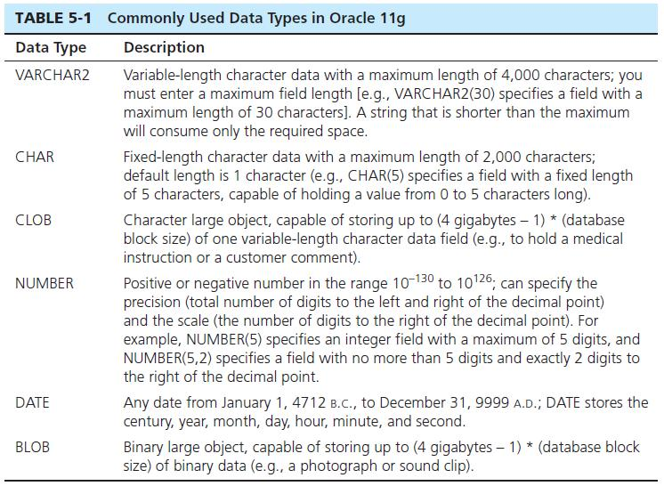
CHOOSING DATA TYPES

Slide 8
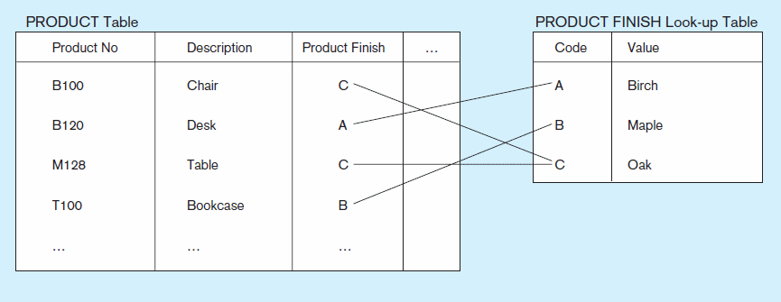
Figure 5-1 Example of a code look-up table
(Pine Valley Furniture Company)
Code saves space, but costs an additional lookup to obtain actual value
Chapter 5
Copyright © 2014 Pearson Education, Inc.

Slide 9
FIELD DATA INTEGRITY
Default value–assumed value if no explicit value
Range control–allowable value limitations (constraints or validation rules)
Null value control–allowing or prohibiting empty fields
Referential integrity–range control (and null value allowances) for foreign-key to primary-key match-ups

Slide 10
HANDLING MISSING DATA
Substitute an estimate of the missing value (e.g., using a formula)
Construct a report listing missing values
In programs, ignore missing data unless the value is significant (sensitivity testing)
Triggers can be used to perform these operations

Slide 11
DENORMALIZATION
Transforming normalized relations into non-normalized physical record specifications
Benefits:
  Can improve performance (speed) by reducing number of table lookups (i.e. reduce number of necessary join queries)
Costs (due to data duplication)
  Wasted storage space
  Data integrity/consistency threats
Common denormalization opportunities
  One-to-one relationship (Fig. 5-2)
  Many-to-many relationship with non-key attributes (associative entity) (Fig. 5-3)
  Reference data (1:N relationship where 1-side has data not used in any other relationship) (Fig. 5-4)

Slide 12
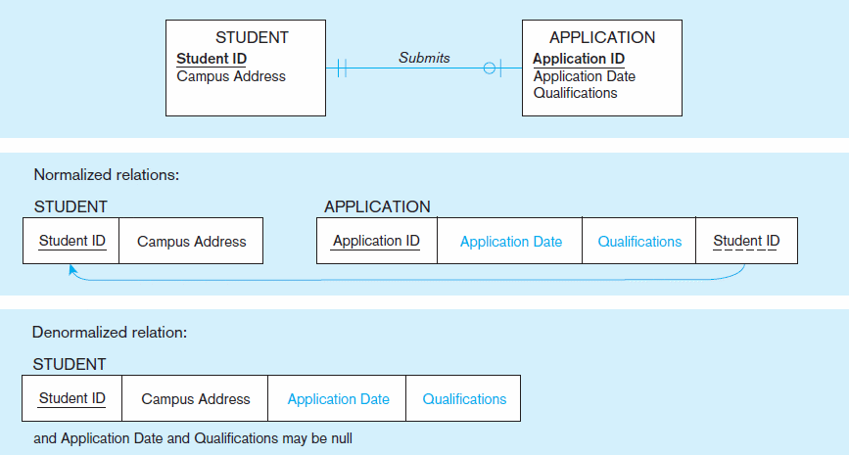
Figure 5-2 A possible denormalization situation: two entities with one-to-one relationship
Chapter 5
Copyright © 2014 Pearson Education, Inc.

Slide 13
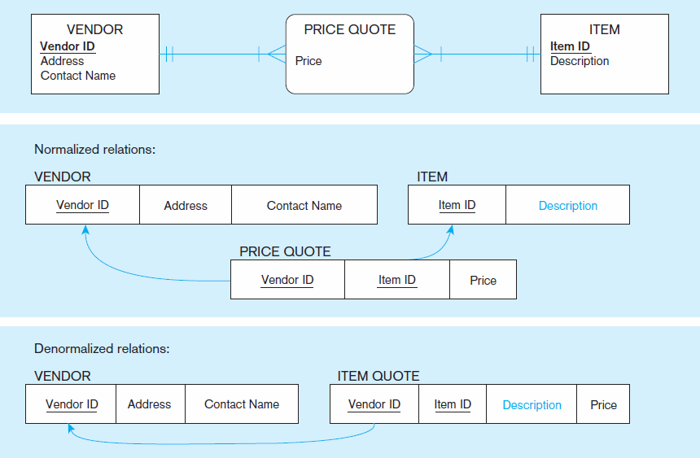
Figure 5-3 A possible denormalization situation: a many-to-many relationship with nonkey attributes
Extra table access required
Null description possible
Chapter 5
Copyright © 2014 Pearson Education, Inc.

Slide 14
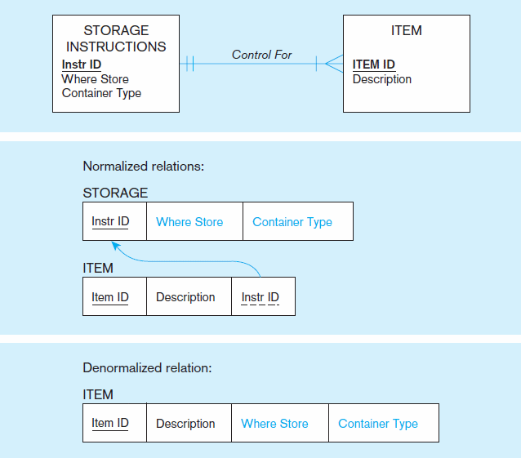
Figure 5-4
A possible denormalization situation:
reference data
Extra table access required
Data duplication
Chapter 5
Copyright © 2014 Pearson Education, Inc.

Slide 15
DENORMALIZE WITH CAUTION
Denormalization can
  Increase chance of errors and inconsistencies
  Reintroduce anomalies
  Force reprogramming when business rules change
Perhaps other methods could be used to improve performance of joins
  Organization of tables in the database (file organization and clustering)
  Proper query design and optimization

Slide 16
DESIGNING PHYSICAL DATABASE FILES
Physical File:
  A named portion of secondary memory allocated for the purpose of storing physical records
  Tablespace–named logical storage unit in which data from multiple tables/views/objects can be stored
Tablespace components
  Segment – a table, index, or partition
  Extent–contiguous section of disk space
  Data block – smallest unit of storage

Slide 17
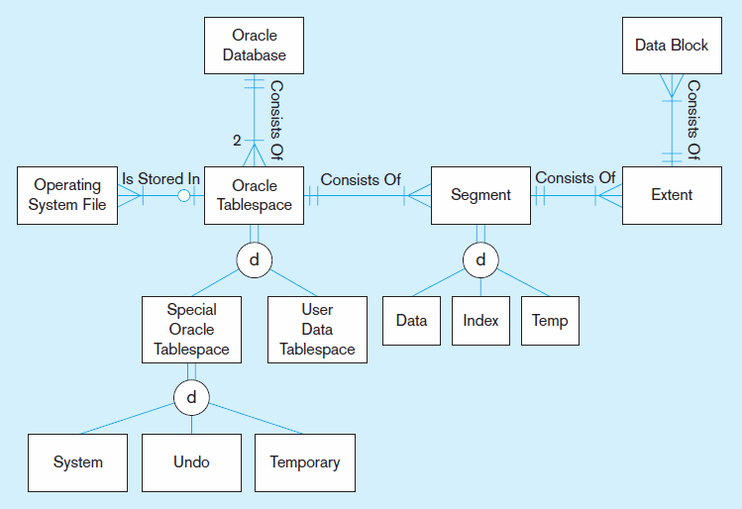
Figure 5-5 DBMS terminology in an Oracle 11g environment
Chapter 5
Copyright © 2014 Pearson Education, Inc.

Slide 18
FILE ORGANIZATIONS
Technique for physically arranging records of a file on secondary storage
Types of file organizations
  Sequential
  Indexed
  Hashed

Slide 19
FILE ORGANIZATIONS
Factors for selecting file organization:
  Fast data retrieval and throughput
  Efficient storage space utilization
  Protection from failure and data loss
  Minimizing need for reorganization
  Accommodating growth
  Security from unauthorized use

Slide 20
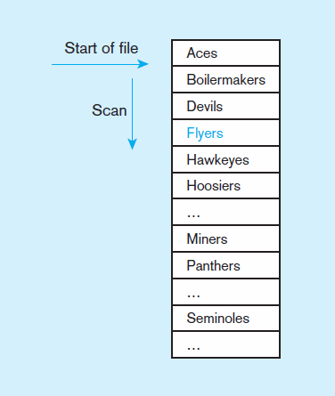
Figure 5-6a Sequential file organization
Records of the file are stored in sequence by the primary key field values
If sorted – every insert or delete requires re-sort
If not sorted
Average time to find desired record = n/2
Chapter 5
Copyright © 2014 Pearson Education, Inc.

Slide 21
INDEXED FILE ORGANIZATIONS
Storage of records sequentially or nonsequentially with an index that allows software to locate individual records
Index: a table or other data structure used to determine in a file the location of records that satisfy some condition
Primary keys are automatically indexed
Other fields or combinations of fields can also be indexed; these are called secondary keys (or nonunique keys)

Slide 22
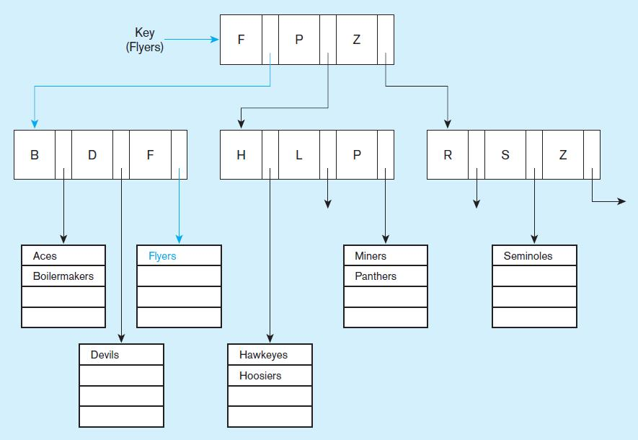
Figure 5-6b Indexed file organization
uses a tree search
Average time to find desired record = depth of the tree
Chapter 5
Copyright © 2014 Pearson Education, Inc.

Slide 23
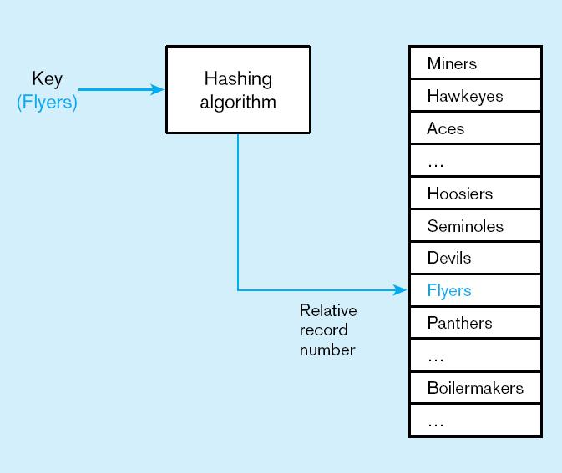
Figure 5-6c
Hashed file organization
Hash algorithm
Usually uses division-remainder to determine record position. Records with same position are grouped in lists.
Chapter 5
Copyright © 2014 Pearson Education, Inc.

Slide 24
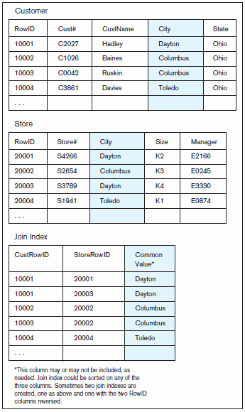
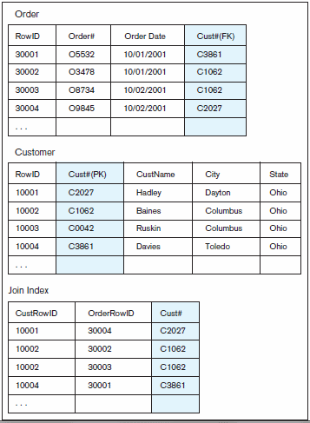
Figure 5-7 Join Indexes–speeds up join operations
b) Join index for matching foreign key (FK) and primary key (PK)
a) Join index for common non-key columns
Chapter 5
Copyright © 2014 Pearson Education, Inc.

Slide 25
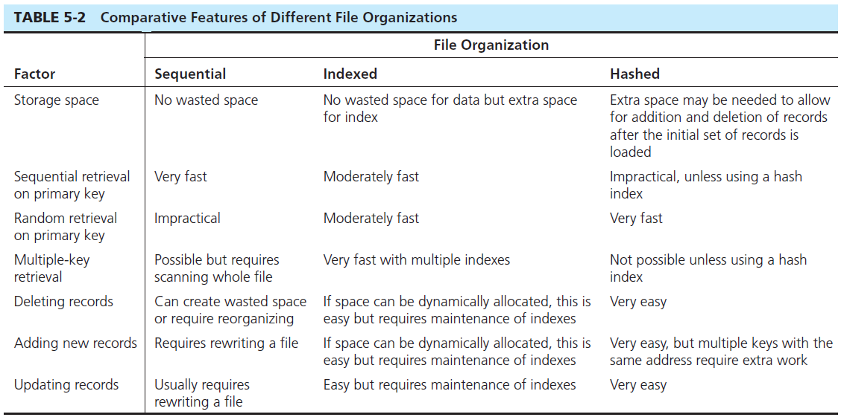
Chapter 5
Copyright © 2014 Pearson Education, Inc.

Slide 26

USING AND SELECTING KEYS
Creating a unique key index
  Example: CustomerID (primary key) of Customer
  Example: Composite primary key for OrderLine
Creating a secondary key index
  Example: Description field for Product (not unique)

Slide 27
RULES FOR USING INDEXES
Use on larger tables
Index the primary key of each table
Index search fields (fields frequently in WHERE clause)
Fields in SQL ORDER BY and GROUP BY commands
When there are >100 values but not when there are <30 values

Slide 28
RULES FOR USING INDEXES (CONT.)
Avoid use of indexes for fields with long values; perhaps compress values first
If key to index is used to determine location of record, use surrogate (like sequence nbr) to allow even spread in storage area
DBMS may have limit on number of indexes per table and number of bytes per indexed field(s)
Be careful of indexing attributes with null values; many DBMSs will not recognize null values in an index search

