Slide 1
Active Learning for Streaming Networked Data
Zhilin Yang, Jie Tang, Yutao Zhang
Computer Science Department, Tsinghua University

Slide 2
Introduction
Mining streaming data becomes an important topic.
Challenge 1: the expensiveness of labeled data
Related work: active learning for streaming data [28, 6, 5, 29]
Challenge 2: network correlation between data instances
Related work: active learning for networked data [23, 25, 3, 4, 10, 27, 8, 22]
A novel problem: active learning for streaming networked data
To deal with both challenges 1 & 2.
Notes:
Mining streaming data becomes an important topic. However, there are two challenges. First, for some classification tasks, it is expensive to access labeled data. Previous research addressed this challenge by solve the problem of active learning for streaming data. Second, there is usually network correlation between data instances. Existing research addressed this challenge by considering active learning for networked data.
In this work, we study a novel problem, active learning for streaming networked data, which addresses challenge 1 and challenge 2 at the same time.

Slide 3
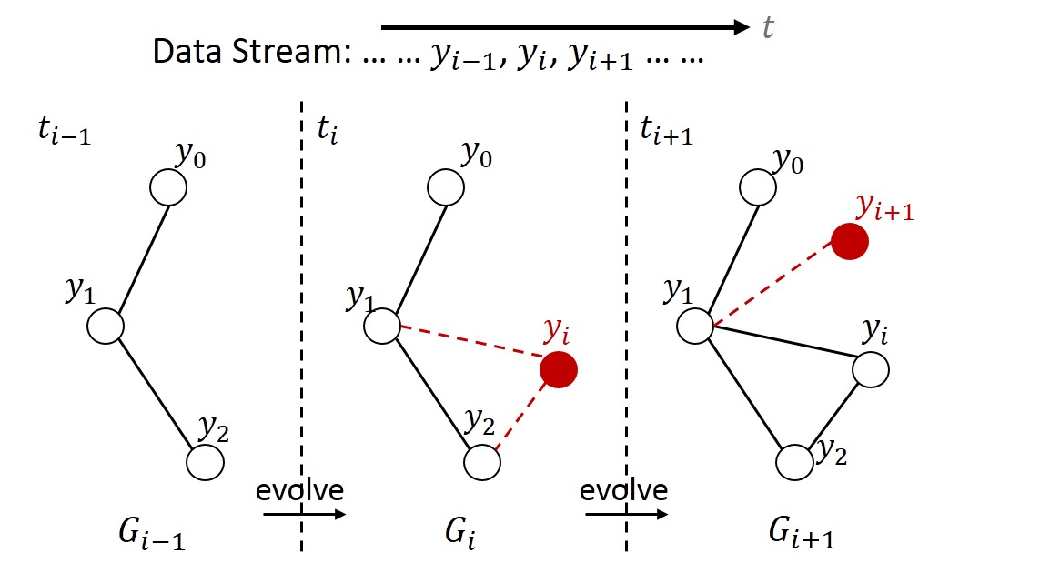
Problem Formulation
Streaming Networked Data
When a new instances arrives, new edges are added to connect the new instance and existing instances.
Notes:
First we introduce the concept of streaming networked data. There is a stream of data instances. At each timestamp, a new instance arrives, and it is connected to earlier instances. Edges indicate network correlation. This is a dynamic network, which evolves over time.

Slide 4
Problem Formulation
Active Learning for Streaming Networked Data
Our output is a data stream . At any time, we maintain a classifier based on arrived instances.
At any time , we go through the following steps:
Predict the label for based on
Decide whether to query for the true label
Update the model to be
Our goal is to use a small number of queries, to control (minimize) the accumulative error rate.
Notes:
Now we can formulate the problem of active learning for streaming networked data. At any time ti, we maintain a classifier ci based on arrived instances. When a new data instance xi arrives, we go through 3 steps. First, we predict the label for the instance based on the current classifier. Second, we decide whether to query for the true label of the instance. If we decide not to query, we will not know the true label of the instance. Third, we update the classifier. Our goal is to use a small number of queried, to control the accumulative error rate. Actually we need to strike a balance between queries and classification accuracy.

Slide 5
Challenges
Challenges
Concept drift.
The distribution of input data and network structure change over time as we are handling streaming data. How to adapt to concept drift?
Network correlation.
In the networked data, there is correlation among instances. How to model the correlation in the streaming data?
Online query.
We must decide whether to query an instance at the time of its appearance, which makes it infeasible to optimize a global objective function. How to develop online query algorithms?
Notes:
There are basically 3 challenges. First, we need to adapt to concept drift, which means that the sample distribution and network structure change over time. Second, we need to find a way to model the network correlation among instances. Third, since we must decide whether to query an instance at the time of its appearance, it is infeasible to optimize a global objective function.

Slide 6
Modeling Networked Data
Time-Dependent Network
At any time , we can construct a time-dependent network based on all the arrived instances before and at time .
A matrix, with an element indicating the feature of instance
The set of all edges between instances.
A set of labels of instances that we have already actively queried before.
A set of unknown labels for all the other instances.
Notes:
To model networked data, at any time time ti, we can construct a time-dependent network Gi based on all the arrived instances before and at time t_i. The time dependent network contains a feature matrix, a set of edges, a set of known labels, and a set of unknown labels.

Slide 7
Modeling Networked Data
The Basic Model: Markov Random Field
Given the graph , we can write the energy as
True labels of queried instances
The energy associated with the edge
The energy defined for instance
Notes:
In this work, we use undirected graphical model, also known as markov random field, to model the networked data. Given a time dependent graph, we can write the energy as the sum of energy on edges and energy defined for instances.

Slide 8
Modeling Networked Data
Model Inference
We try to assign labels to such that we can minimize the following energy
Usually intractable to directly solve the above problem.
Apply dual decomposition [17] to decompose the original problems into a set of tractable subproblems. The dual optimization problem is as follows:
Local optimization
Dual variables
Subject to
Global constraint
We can solve the above objective function with projected subgradient [13].
Notes:
For model inference, we try to assign labels to unknown instances to minimize the energy of the model. Because it is in general intractable to directly solve the optimization problem, we apply dual decomposition to decompose the original problems into a set of tractable subproblems. We need to introduce a set of dual variables for dual relaxation. We can solve the dual optimization problem by projected subgradient method.

Slide 9
Modeling Networked Data
Model Learning
Applying max margin learning paradigm, the objective function for parameter learning is written as
where
A slack variable
Dissimilarity measure between two configurations
The margin between two configurations
Notes:
For model learning, we want to estimate model parameters theta. We apply max margin learning paradigm, and the optimization problem is to maximize the margin between the best configuration and the second best configuration.

Slide 10
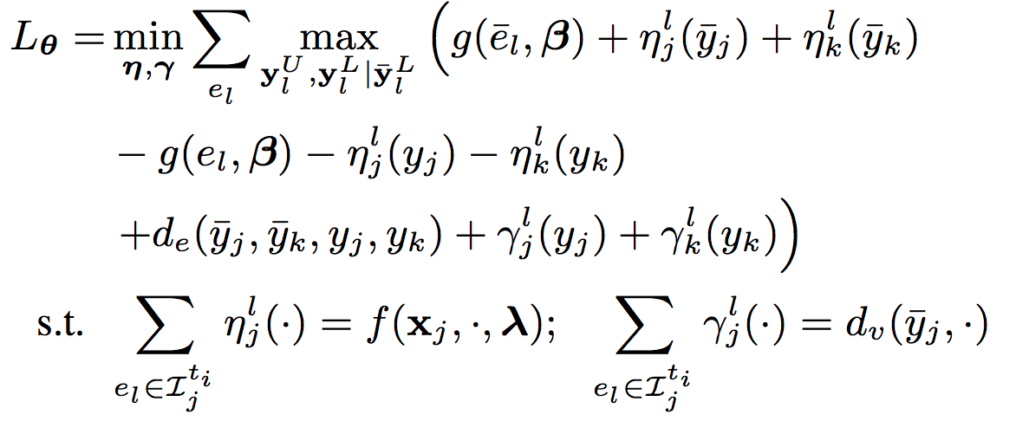
Modeling Networked Data
Model Learning
Applying dual decomposition, we have the dual optimization objective function as follows:
Dual variables
Dual variables
The optimization problem becomes
We can solve the above problem with projected subgradient method.
Notes:
Following the same routine, we can apply dual decomposition to relax the problem and use projected subgradient method to solve the dual problem.

Slide 11
Streaming Active Query
Structural Variability
Intuition: control the gap between the energy of the inferred configuration and that of any other possible configuration.
We define the structural variability as follows:
The energy of any other configuration
The energy of the inferred configuration
Notes:
We have framed our problem with markov random field. Now I will introduce the streaming active query algorithm, which is one of the major contributions of this work. This algorithm will decide which instances to query. Because network correlation is important in this problem, we begin with network structure. We define the structural variability as the gap between the energy of the inferred configuration and the energy of any other configuration. The intuition behind this definition is that, if structural variability is small, the unlabeled instances do not significantly affect the energy of the model, and thus we do not need to query their labels.

Slide 12
Streaming Active Query
Properties of Structural Variability
Monotonicity. Suppose and are two sets of instance labels. Given ,
if , then we have
Normality. If , we have
The structural variability will not increase as we label more instances in the MRF.
If we label all instances in the graph, we incur no structural variability at all.
Notes:
Besides the simple intuition about the structural variability, we can find several interesting and useful properties about structural variability. First, monotonicity. The structural variability will not increase as we label more instances in the MRF. Second, normality. If we label all instances in the graph, we incur completely no structural variability.

Slide 13
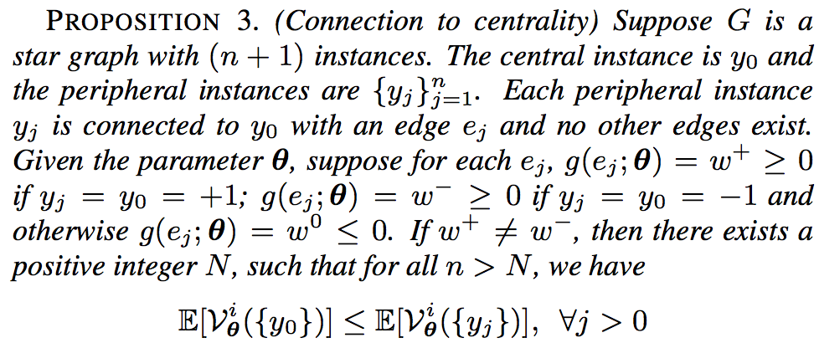
Streaming Active Query
Properties of Structural Variability
3. Centrality
Under certain circumstances, minimizing structural variability leads to querying instances with high network centrality.
Notes:
And third, there is connection between structural variability and centrality. We just use a simple example to show that in some cases, minimizing structural variability leads to querying instances with high network centrality.

Slide 14
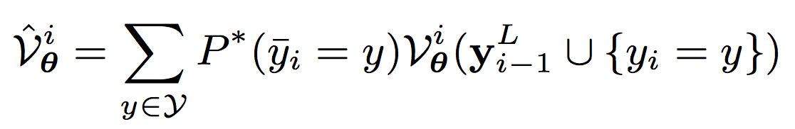
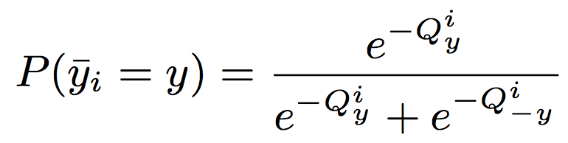
Streaming Active Query
Decrease Function
We define a decrease function for each instance
Structural variability before querying y_i
Structural variability after querying y_i
The second term is in general intractable. We estimate the second term by expectation
The true probability
We approximate the true probability by
Notes:
To develop an active query algorithm, we want to measure the decrease in structural variability after an instance is queried. So we define a decrease function as the structural variability before query MINUS the structural variability after query. To compute the second term, we estimate the second term by taking expectation. To compute the true probability, we approximate it with an exponential linear function based on the current model.

Slide 15
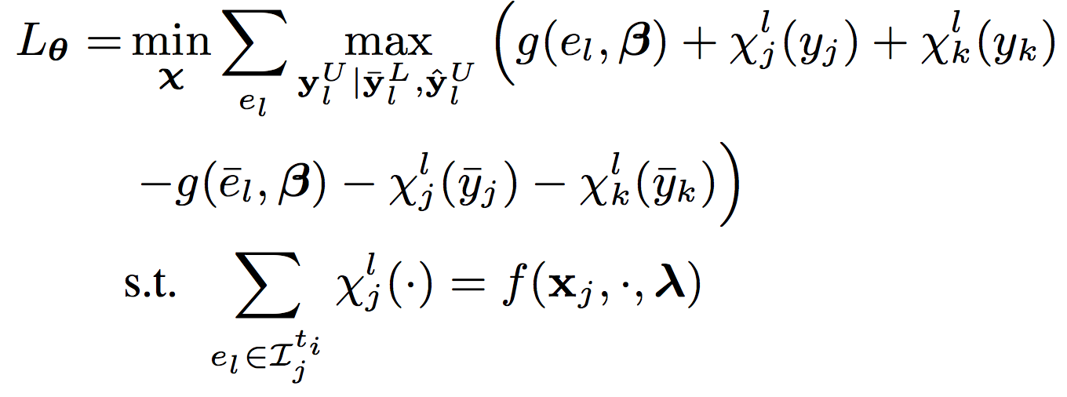
Streaming Active Query
Decrease Function
We define a decrease function for each instance
Structural variability before querying y_i
Structural variability after querying y_i
The first term can be computed by dual decomposition. The dual problem is
Notes:
The compute the first term, again, we apply dual decomposition to relax the problem and obtain a tight bound for the original problem.

Slide 16
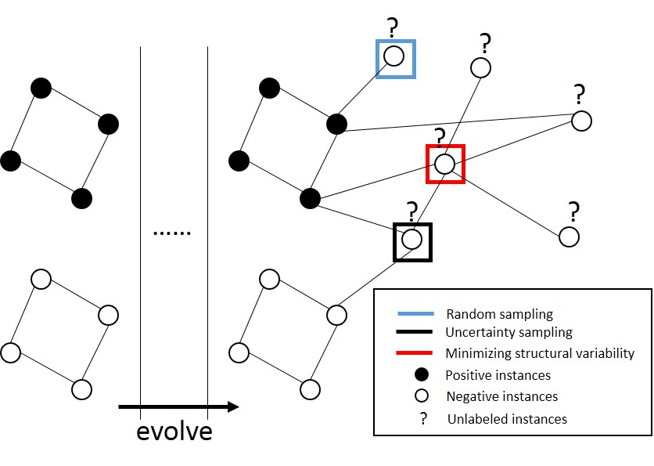
Streaming Active Query
The algorithm
Given the constant threshold , we query if and only if
Analysis
Notes:
Now we can conclude our algorithm. Given a constant threshold kappa, for an instance, we first compute its decrease function based on the previous slides. If the decrease of structural variability is larger than the threshold, then we query for its true label; otherwise not. Here we give a simple example to explain why structural variability is better than other methods. Suppose at the beginning, there are two clusters in the graph, one positive and the other negative. And then there comes a wave of concept drift, and a lot of negative instances are connected to the positive cluster. In this case, the previously learned classifier does not work because the previous concept does not apply any more. If we do not query any instances, all of the new negative instances will be classified positive. Active query can alleviate this problem. Here we compare different active query algorithms. Uncertainty sampling will select the instance in the black box because it is connected to both positive and negative instances at the same time. Random sampling may select the instance in the blue box, which is not desirable. However, according to property 3 of the structural variability, our algorithm will select the one in the red box, which takes an important position in the network. Therefore, more instances will be affected and our method can better adapt to concept drift.

Slide 17
Enhancement by Network Sampling
Basic Idea
Maintain an instance reservoir of a fixed size, and update the reservoir sequentially on the arrival of streaming data.
Which instances to discard when the size of the reservoir is exceeded?
Simply discard early-arrived instances may deteriorate the network correlation. Instead, we consider the loss of discarding an instance in two dimensions:
Spatial dimension: the loss in a snapshot graph based on network correlation deterioration
Temporal dimension: integrating the spatial loss over time
Notes:
In real world problems, it is inefficient to store all the data for updating the MRF model. We propose a network sampling algorithm to enhance the performance so that we can handle large scale datasets. The basic idea is to maintain an instance reservoir of a fixed size, and update the reservoir sequentially on the arrival of streaming data. When a new instance arrives, the reservoir size limit may be exceeded. We need to discard an instance from the reservoir. We consider the loss of discarding an instance in two dimensions. For the spatial dimension, we measure the loss in a snapshot graph based on network correlation deterioration. For the temporal dimension, we integrate the spatial loss over time.

Slide 18
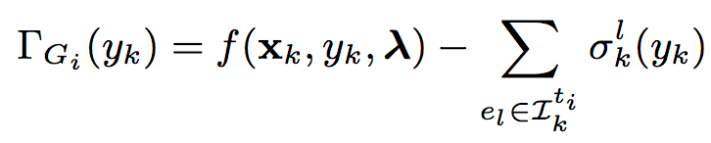
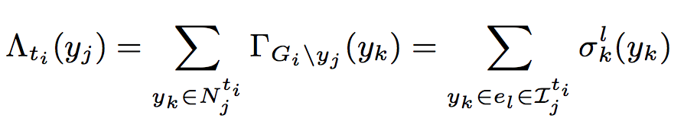
Enhancement by Network Sampling
Spatial Dimension
Use dual variables as indicators of network correlation.
The violation for instance can be written as
Then the spatial loss is
Measure how much the optimization constraint is violated after remove the instance
Intuition
Dual variables can be viewed as the message sent from the edge factor to each instance
The more serious the optimization constraint is violated, the more we need to adjust the dual variables
Notes:
For the spatial dimension, we use dual variables as indicators of network correlation and measure how much the optimization constraint is violated after we remove the instance. Two intuitions. First, dual variables can be viewed as the message sent from the edge factor to each instance. So if there are a lot of messages flowing through an instance, probably, the instance would not be a good one to discard. Second, the more serious the optimization constraint is violated, the more we need to adjust the dual variables, which means that the network correlation is more affected.

Slide 19
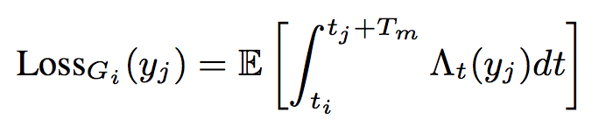
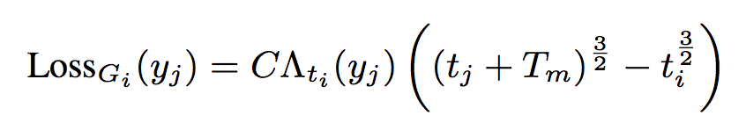
Enhancement by Network Sampling
Temporal Dimension
The streaming network is evolving dynamically, we should not only consider the current spatial loss.
To proceed, we assume that for a given instance , dual variables of its neighbors have a distribution with an expectation and that the dual variables are independent.
We obtain an unbiased estimator for
Integrating the spatial loss over time, we obtain
Suppose edges are added according to preferential attachment [2], the loss function is written as
Notes:
Because the streaming network is evolving dynamically, we should not only consider the current spatial loss. Therefore we consider the temporal dimension, and integrate the spatial loss over time.

Slide 20

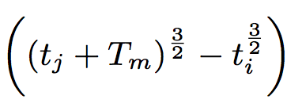
Enhancement by Network Sampling
The algorithm
At time , we receive a new instance from the data stream, and update the graph.
If the number of instances exceed the reservoir size, we remove the instance with the least loss function and its associated edges from the MRF model.
Interpretation
The first term
Enables us to leverage the spatial loss function in the network.
Instances that are important to the current model are also likely to remain important in the successive time stamps.
The second term
Instances with larger are reserved.
Our sampling procedure implicitly handled concept drift, because later-arrived instances are more relevant to the current concept [28].
Notes:
Now we can summarize the algorithm. At time t_i, we receive a new instance from the data stream, and update the graph. If the number of instances exceed the reservoir size, then we discard the instance with least loss function. There are two terms in the loss function. The first term is the spatial loss function in the network, which is consistent with our intuition that instances important in the current network would remain important in the successive time stamps. From the second term, instances with larger t_j are reserved. It means our sampling procedure implicitly handled concept drift, because later-arrived instances a re more relevant to the current concept.

Slide 21
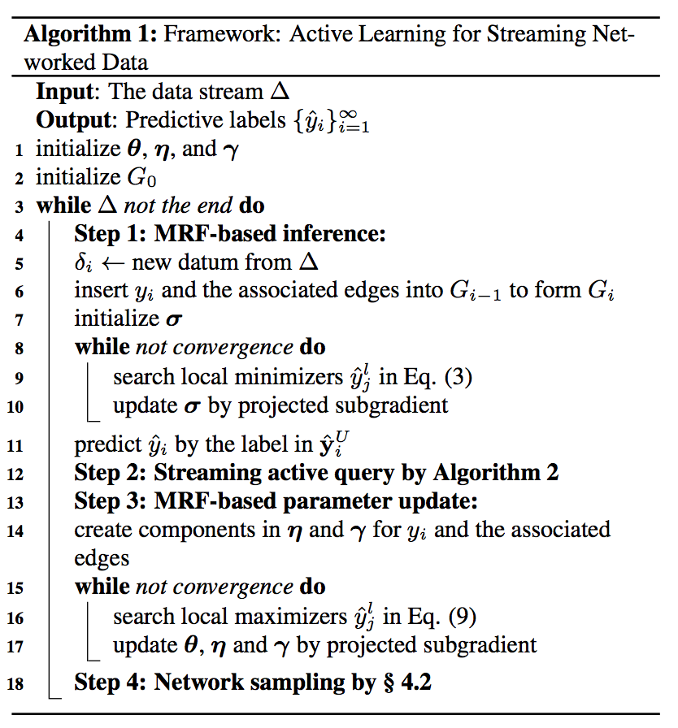
The Framework
Step 1: MRF-based inference
Step 2: Streaming active query
Step 3: MRF-based parameter update
Step 4: Network sampling
Notes:
Let’s recap the whole framework. There are four steps in the framework. We propose two algorithms in step 2 and step 4. The streaming active query algorithm decides which instances to query and the network sampling algorithm maintains a instance reservoir of a fixed size..

Slide 22
Experiments
Datasets
Weibo [26] is the most popular microblogging service in China.
View the retweeting flow as a data stream.
Predict whether a user will retweet a microblog.
3 types of edge factors: friends; sharing the same user; sharing the same tweet
Slashdot is an online social network for sharing technology related news.
Treat each follow relationship as an instance.
Predict “friends” or “foes”.
3 types of edge factors: appearing in the same post; sharing the same follower; sharing the same followee.
IMDB is an online database of information related to movies and TVs.
Each movie is treated as an instance.
Classify movies into categories such as romance and animation.
Edges indicate common-star relationships.
ArnetMiner [19] is an academic social network.
Each publication is treated as an instance.
Classify publications into categories such as machine learning and data mining.
Edges indicate co-author relationships.
Notes:
We evaluate our method on four datasets, weibo, slashdot, imdb and arnetminer. The datasets have different prediction tasks and different types of edges.

Slide 23
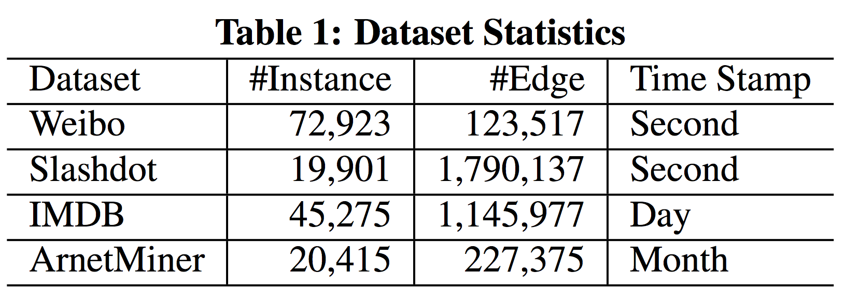
Experiments
Datasets
Notes:
The datasets also have different size, different density and different time granularity.

Slide 24
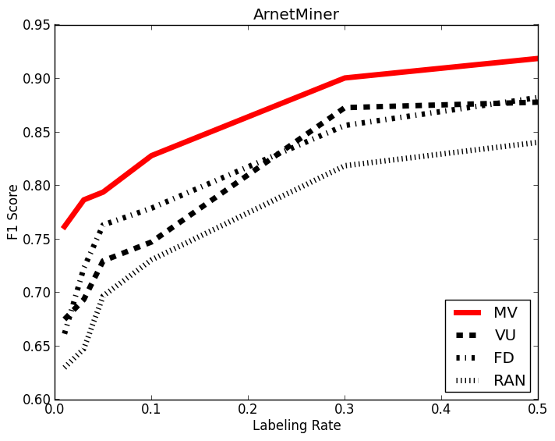
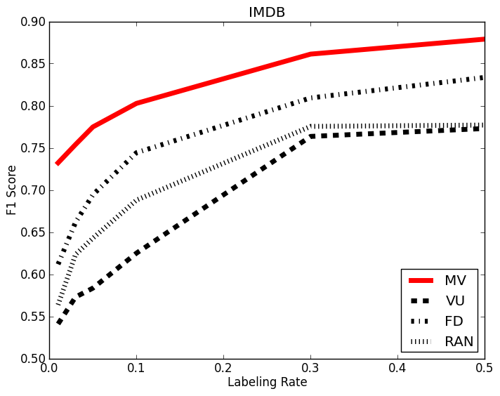
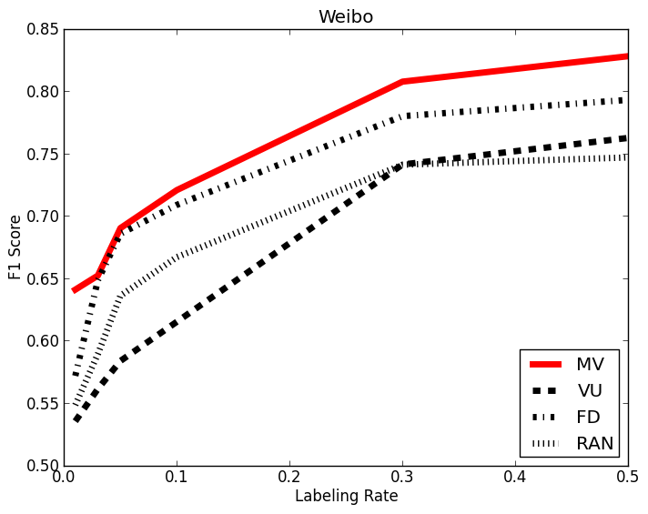
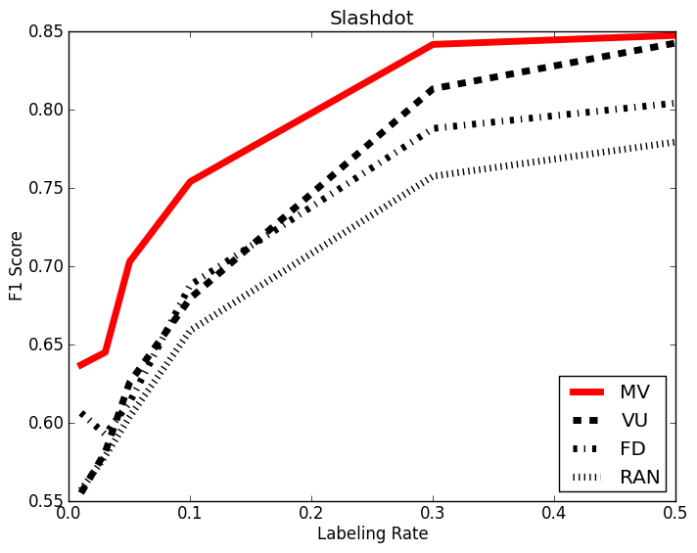
Experiments
Active Query Performance
Suppress the network sampling method by setting the reservoir size to be infinite.
Compare different streaming active query algorithms.
(F1 score v.s. labeling rate)

Slide 25
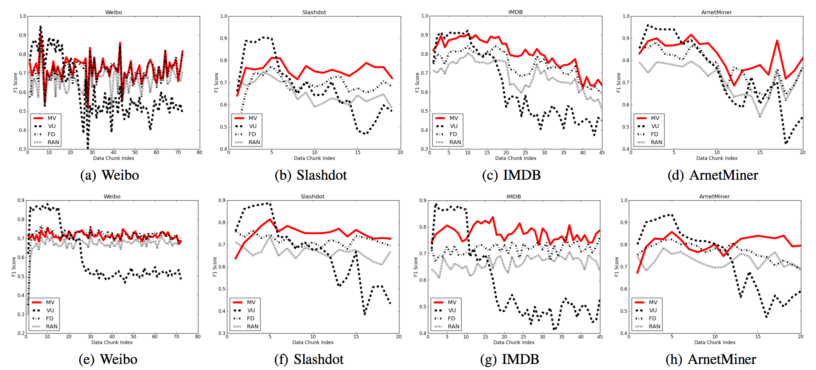
Experiments
Concept Drift
First row: data stream
Second row: shuffled data
(F1 score v.s. data chunk index)
Clearly found some evidence about the existence of concept drift
Our algorithm is robust because it not only better adapts to concept drift (upper row) but also performs well without concept drift (lower row).

Slide 26
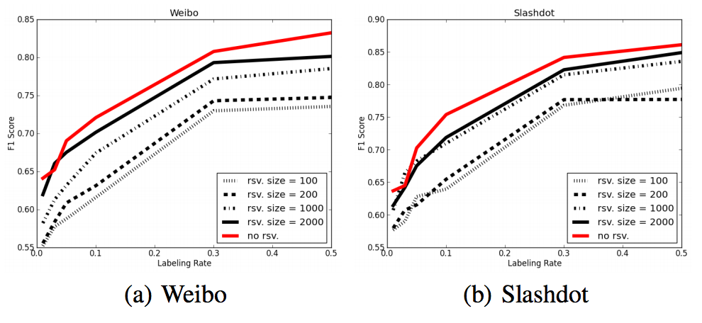
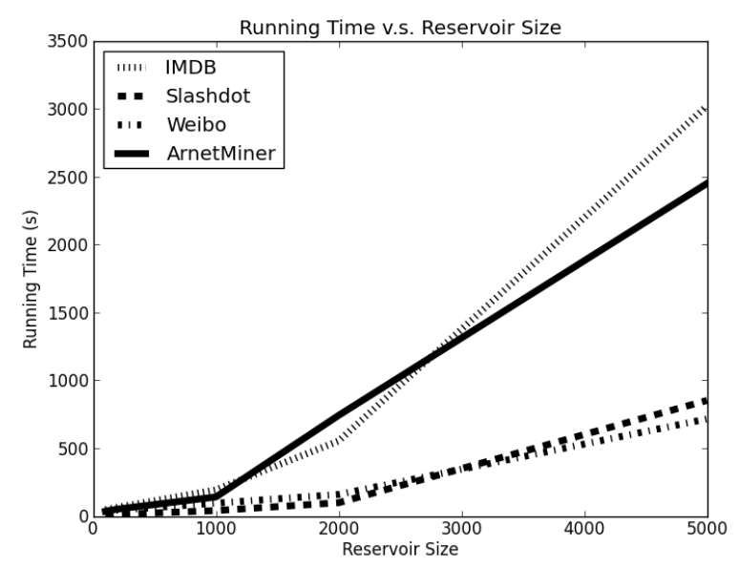
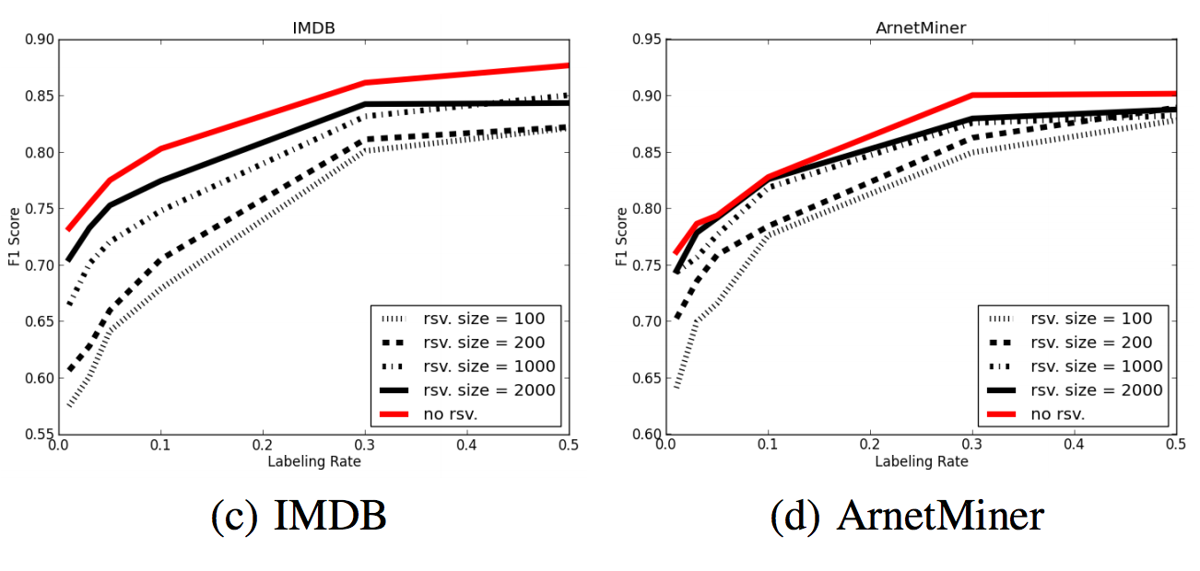
Experiments
Streaming Network Sampling
Speedup Performance (Running time v.s. reservoir size)
The decrease of the reservoir size leads to minor decrease in performance but significantly less running time.
F1 v.s. labeling rate (with varied reservoir size)

Slide 27
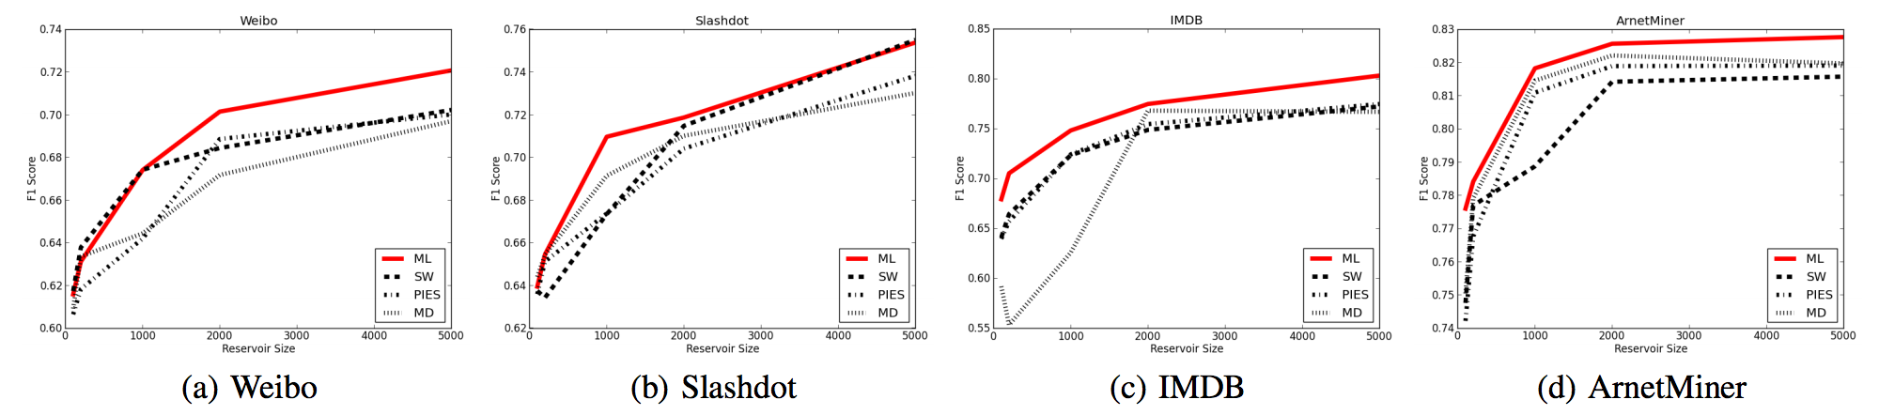
Experiments
Streaming Network Sampling
We fix the labeling rate, and compare different streaming network sampling algorithms with varied reservoir sizes.

Slide 28
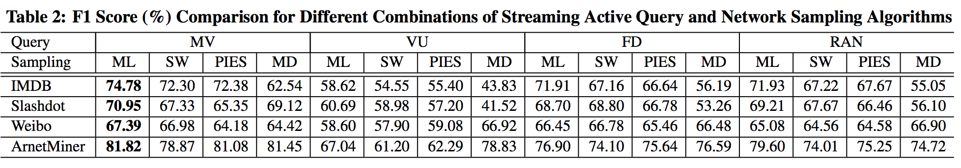
Experiments
Performance of Hybrid Approach
We fix the labeling rate and reservoir size, and compare different combinations of active query algorithms and network sampling algorithms.

Slide 29
Conclusions
Formulate a novel problem of active learning for streaming networked data
Propose a streaming active query algorithm based on the structural variability
Design a network sampling algorithm to handle large volume of streaming data
Empirically evaluate the effectiveness and efficiency of our algorithm

Slide 30
Thanks
Zhilin Yang, Jie Tang, Yutao Zhang
Computer Science Department, Tsinghua University

