Slide 1
Online shopping mall recommendation algorithm DB design
2017103580 Jungwoon Kim, Department of Sociology

Slide 2
Presentation Order
Requirements
ER-Diagrams
Logical schema
Physical schema and transactions

Slide 3
Requirements
When you sign up, we store several pieces of information about you in our database.
The data used in the recommendation algorithm is each person's browsing, shopping cart, and purchase history.
There's not a lot of data to analyze, but there are a lot of users, so you need to be able to quickly find the data that applies to you.

Slide 4
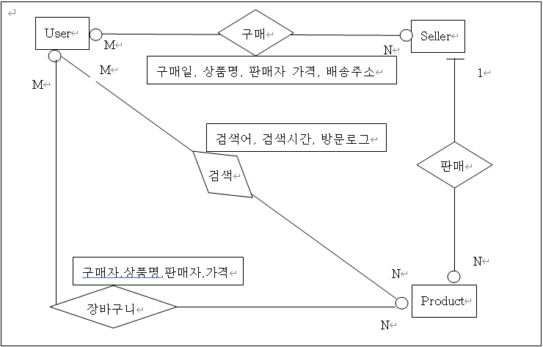
ER-Diagrams
A user purchases or adds an item to a cart, or searches for the name of a product, and these are multi-value attributes that can have multiple occurrences.
Therefore, we need to set them to relation to maintain data normality, so that the algorithm can get the data it needs.

Slide 5
Logical schema
The seller and buyer share the same attributes, but the recommendation algorithm only utilizes the buyer's information.
So by categorizing them separately, we want to speed up search by reducing the amount of data that goes into a single relation.
Customer(ID,Password,Phone_number,Gender,Age)
{
The ID is the primary key (char[16]);
Password(char[16]),Phone_number(char[11]), Gender(bool), Age(int[8bit])
}
Seller(ID,Password,Phone_number,Gender,Age)
{
The ID is the primary key (char[16]);
Password(char[16]),Phone_number(char[11]), Gender(bool), Age(int[8bit])
}

Slide 6
Logical schema
One thing to note in this release is that the type of Name is now a dynamic type, unlike previous releases.
In MySQL, when declared as a dynamic type, it is declared as char[255], which results in the same search speed as a static type.
We declare it as varchar for convenience and freedom, even though it limits the efficient use of capacity.
Product(Name,Seller_ID,Price,Release_date,Company) { Name and Seller_ID are primary keys; Seller_ID is a foreign key for relation Seller
Name(varchar(255) Seller_ID(char[12]),Price(mediumint), Release_date(time), Company(char[20]), Category char(255) }

Slide 7
Logical schema
Wishlist(Customer_ID, Product_name, Seller_ID) { Customer_ID, Product_name, and Seller_ID are both primary and foreign keys Customer_ID is the primary key for Customer relation
Product_name and Seller_ID are foreign keys for Product relation. } Searchword(Word, Customer_ID, search_time) { Customer_ID, Word, and search_time are all primary keys, where Customer_ID is a foreign key for Customer relation, Word is a dynamic type, and search_time is a time that is automatically entered when data is entered. } Buylog(Customer_ID, Product_name, Seller_ID, time) { Customer_ID, Product_name, and Seller_ID are both primary and foreign keys. Customer_ID is the primary key for the Customer relation, and Product_name and Seller_ID are the foreign keys for the Product relation. }

Slide 8
Logical schema
Wishlist, Searchword, and Buylog are releases that implement the relationships between users, sellers, and products in the ER-schema.
All of them take the user's ID as the foreign and primary key, and although the foreign key is not used in the current application, it is set up with the possibility of being used in other applications.
In Searchword, the reason for automatically injecting time is that search history spikes in the days before a user makes a purchase, so by storing time information and analyzing it, we can predict the likelihood of a user purchasing a product.
Also, it's hard to distinguish rows based on user ID and search name alone, so we use time as a continuous data type.

Slide 9
Physical schema and transactions
In MYSQL, an Index is set for every Primary Key (using a B+ tree structure).
Therefore, the indexes are ID(Customer and Seller), Product name, and Time(Search word).The shopping mall recommendation algorithm quickly fetches the data corresponding to the logged-in user's ID from the DB,and performs analysis based on it.
Also, when a specific word is obtained from the analysis results, it should quickly find the corresponding products and display them to the user.
Sorting on time is important for time series analysis because it allows you to quickly find information about a specific time period,Index is efficient because it allows you to quickly find information about a specific time period in your time series analysis.
However, since SearchWords are added and deleted frequently, there can be overhead associated with this (index resets, etc.).
To avoid this, the application creates a local file for the search history and performs additions and deletions,Only some data can be stored in the DB based on certain criteria.

Slide 10
Physical schema and transactions
The reason for using Index (B+tree) instead of hash is that while hash is faster to search than Index, we want to avoid the overhead of applying rules in hash due to the nature of relation, which involves a lot of deletions and additions.
Also, because it retrieves all data that matches the user's ID, sorting through an index means that once it finds data that meets the criteria, it can read the data without further searching.
The overhead of concurrency control is relatively small because reads and writes are concurrent, and we're only accessing data that corresponds to a specific ID.
Therefore, we've chosen to lock data on a per-data basis rather than a per-table basis (in MySQL, this is implemented via INNODB).
We also support transactions via INNODB to ensure consistency of data.When reading and writing data to the DB in a programming language (Python3, etc.), you need to enter commit.If you exit the program without entering commit, the data will not be reflected.

