Slide 1
Term Project
19011552 박승완
19011548 문경필
19011570 김지수

Slide 2
Table of contents
01
02
03
04
05
06
Client, Server 구현방식 설명
통신 종류
초기 데이터 set
Client – oriented collective I/O
결과
Server-oriented collective I/O
결과
Graph

Slide 3
01
통신종류

Slide 4
Client-oriented collective I/O
FIFO
Server-oriented collective I/O
Shared Memory

Slide 5
초기데이터set
02

Slide 6
Create.c
#include "mytest.h"
#include <fcntl.h>
#include <stdio.h>
#include <stdlib.h>
#define TOTAL_INTEGERS (1 << 20)
int create_source_data() {
int i;
int tmp = 1;
int fd[4];
int cfd[4];
fd[0] = open("p1.dat", O_CREAT | O_TRUNC | O_WRONLY, 0644);
fd[1] = open("p2.dat", O_CREAT | O_TRUNC | O_WRONLY, 0644);
fd[2] = open("p3.dat", O_CREAT | O_TRUNC | O_WRONLY, 0644);
fd[3] = open("p4.dat", O_CREAT | O_TRUNC | O_WRONLY, 0644);
for (i = 1; i <= TOTAL_INTEGERS; i++) {
int fileIndex = (i - 1) % 4;
write(fd[fileIndex], &i, sizeof(int));
}
cfd[0] = open("CHUNK1", O_CREAT | O_TRUNC | O_WRONLY, 0644);
cfd[1] = open("CHUNK2", O_CREAT | O_TRUNC | O_WRONLY, 0644);
cfd[2] = open("CHUNK3", O_CREAT | O_TRUNC | O_WRONLY, 0644);
cfd[3] = open("CHUNK4", O_CREAT | O_TRUNC | O_WRONLY, 0644);
/*lseek()의 offset 접근을 위한 chunk 파일 사전 생성*/
for (i = 1; i <= TOTAL_INTEGERS / (1 << 10); i++)
{
write(cfd[0], &tmp, sizeof(int));
write(cfd[1], &tmp, sizeof(int));
write(cfd[2], &tmp, sizeof(int));
write(cfd[3], &tmp, sizeof(int));
}
for (i = 0; i < 4; i++) {
close(fd[i]);
}
for (i = 0; i < 4; i++) {
close(cfd[i]);
}
printf("**Distribute input data across processes.\n");
return 0;
}

Slide 7
03
Client, Server 구현방식 설명

Slide 8
Client –oriented collective I/O (1)
union semun {
int val;
struct semid_ds* buf;
unsigned short* array;
};
int initsem(key_t semkey) {
union semun semunarg;
int status = 0, semid;
semid = semget(semkey, 1, IPC_CREAT | IPC_EXCL | 0600);
if (semid == -1) {
if (errno == EEXIST)
semid = semget(semkey, 1, 0);
}
else {
semunarg.val = 1;
status = semctl(semid, 0, SETVAL, semunarg);
}
if (semid == -1 || status == -1) {
perror("initsem");
return (-1);
}
return semid;
}
int semlock(int semid) {
struct sembuf buf;
buf.sem_num = 0;
buf.sem_op = -1;
buf.sem_flg = SEM_UNDO;
if (semop(semid, &buf, 1) == -1) {
perror("semlock failed");
exit(1);
}
return 0;
}
int semunlock(int semid) {
struct sembuf buf;
buf.sem_num = 0;
buf.sem_op = 1;
buf.sem_flg = SEM_UNDO;
if (semop(semid, &buf, 1) == -1) {
perror("semunlock failed");
exit(1);
}
return 0;
}
int client_oriented_io() {
int semid1 = initsem(552);
int semid2 = initsem(553);
int semid3 = initsem(554);
int semid4 = initsem(555);
f1 = open("p1.dat", O_RDONLY);
f2 = open("p2.dat", O_RDONLY);
f3 = open("p3.dat", O_RDONLY);
f4 = open("p4.dat", O_RDONLY);
cpd1 = open("CHUNK1", O_RDWR);
cpd2 = open("CHUNK2", O_RDWR);
cpd3 = open("CHUNK3", O_RDWR);
cpd4 = open("CHUNK4", O_RDWR);
mkfifo("./IO1_FIFO", 0666);
mkfifo("./IO2_FIFO", 0666);
mkfifo("./IO3_FIFO", 0666);
mkfifo("./IO4_FIFO", 0666);

Slide 9
Client –oriented collective I/O (2)
for (j = 0; j < 256; j++)
{
lseek(f2, (3 * sizeof(int) * 256) + (sizeof(int) * j) + (4096 * i), SEEK_SET);
read(f2, &tmp4, sizeof(int));
lseek(cpd4, 4 * sizeof(int) * j + 4, SEEK_SET);
write(cpd4, &tmp4, sizeof(int));
}
semunlock(semid2);
semid3 = initsem(554);
semlock(semid3);
for (j = 0; j < 256; j++)
{
lseek(f3, (3 * sizeof(int) * 256) + (sizeof(int) * j) + (4096 * i), SEEK_SET);
read(f3, &tmp4, sizeof(int));
lseek(cpd4, 4 * sizeof(int) * j + 8, SEEK_SET);
write(cpd4, &tmp4, sizeof(int));
}
semunlock(semid3);
semid4 = initsem(555);
semlock(semid4);
for (j = 0; j < 256; j++)
{
lseek(f4, (3 * sizeof(int) * 256) + (sizeof(int) * j) + (4096 * i), SEEK_SET);
read(f4, &tmp4, sizeof(int));
lseek(cpd4, 4 * sizeof(int) * j + 12, SEEK_SET);
write(cpd4, &tmp4, sizeof(int));
}
semunlock(semid4);
/*IO4_FIFO로 쓰기 수행*/
lseek(cpd4, 0, SEEK_SET);
read(cpd4, buf, sizeof(buf));
write(ifw4, buf, sizeof(buf));
}
close(ifw4);
break;
switch (fork())
{
case -1:
perror("fork");
exit(1);
break;
case 0: // Client
switch (fork())
{
case -1:
perror("fork");
exit(1);
break;
case 0:
switch (fork())
{
case -1:
perror("fork");
exit(1);
break;
case 0: /*4번 (p4.dat 처리)*/
ifw4 = open("./IO4_FIFO", O_WRONLY);
for (i = 0; i < 256; i++)
{
semid1 = initsem(552);
semlock(semid1);
for (j = 0; j < 256; j++)
{
lseek(f1, (3 * sizeof(int) * 256) + (sizeof(int) * j) + (4096 * i), SEEK_SET);
read(f1, &tmp4, sizeof(int));
lseek(cpd4, 4 * sizeof(int) * j, SEEK_SET);
write(cpd4, &tmp4, sizeof(int));
}
semunlock(semid1);
semid2 = initsem(553);
semlock(semid2);

Slide 10
Server –oriented collective I/O (1)
int server_oriented_io() {
int i, j;
char buf[4096];
void *shmaddr1, *shmaddr2, *shmaddr3, *shmaddr4;
int f1, f2, f3, f4;
int ipd1, ipd2, ipd3, ipd4;
int shmid1, shmid2, shmid3, shmid4;
shmid1 = shmget(0251, 4096*256, IPC_CREAT | 0644);
shmid2 = shmget(0252, 4096*256, IPC_CREAT | 0644);
shmid3 = shmget(0253, 4096*256, IPC_CREAT | 0644);
shmid4 = shmget(0254, 4096*256, IPC_CREAT | 0644);
switch(fork())
{
case -1:
perror("fork");
exit(1);
break;
case 0:
switch(fork())
{
case -1:
perror("fork");
exit(1);
break;
case 0:
switch(fork())
{
case -1:
perror("fork");
exit(1);
break;
case 0: // Client 4 : p4.dat를 shmaddr4로 write
f4 = open("p4.dat", O_RDONLY);
shmaddr4 = shmat(shmid4, NULL, 0);
for (i = 0; i < 256; i++)
{
read(f4, shmaddr4 + i * 4096, sizeof(buf));
}
shmdt(shmaddr4);
close(f4);
exit(0);
break;
default: // Client 3 : p3.dat를 shmaddr3로 write
f3 = open("p3.dat", O_RDONLY);
shmaddr3 = shmat(shmid3, NULL, 0);
for (i = 0; i < 256; i++)
{
read(f3, shmaddr3 + i * 4096, sizeof(buf));
}
shmdt(shmaddr3);
close(f3);
exit(0);
break;
}
break;

Slide 11
Server –oriented collective I/O (2)
case 0: // Server 4
/**/
ipd4 = open("io8.dat", O_CREAT | O_TRUNC | O_WRONLY, 0644);
shmaddr1 = shmat(shmid1, NULL, 0);
shmaddr2 = shmat(shmid2, NULL, 0);
shmaddr3 = shmat(shmid3, NULL, 0);
shmaddr4 = shmat(shmid4, NULL, 0);
for (i = 0; i < 256; i++)
{
for (j = 0; j < 256; j++)
{
memcpy(buf + 16 * j, shmaddr1 + 4 * j + 4096 * i + (3 * 4 * 256), 4);
memcpy(buf + 16 * j + 4, shmaddr2 + 4 * j + 4096 * i + (3 * 4 * 256), 4);
memcpy(buf + 16 * j + 8, shmaddr3 + 4 * j + 4096 * i + (3 * 4 * 256), 4);
memcpy(buf + 16 * j + 12, shmaddr4 + 4 * j + 4096 * i + (3 * 4 * 256), 4);
}
write(ipd4, buf, sizeof(buf));
}
shmdt(shmaddr1);
shmdt(shmaddr2);
shmdt(shmaddr3);
shmdt(shmaddr4);
close(ipd4);
break;

Slide 12
04
Client –oriented collective I/O 결과

Slide 13
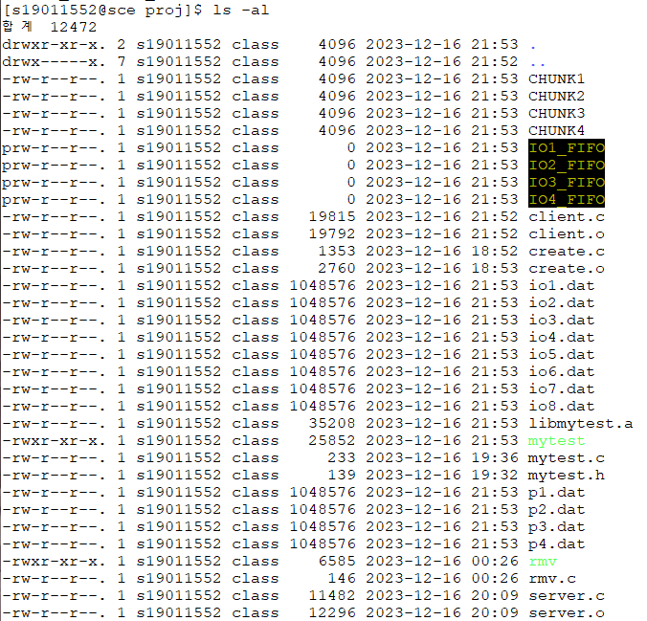
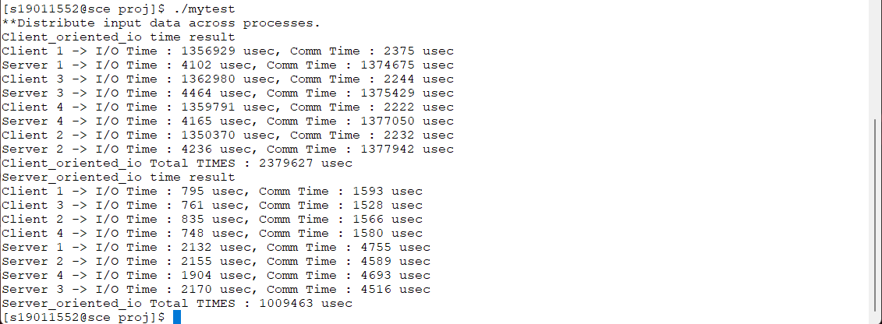
Client –oriented collective I/O 결과

Slide 14
05
Server –oriented collective I/O 결과

Slide 15
Server –oriented collective I/O 결과

Slide 16
06
Graph

Slide 17
Graph

Slide 18

Thanks!

