Slide 1
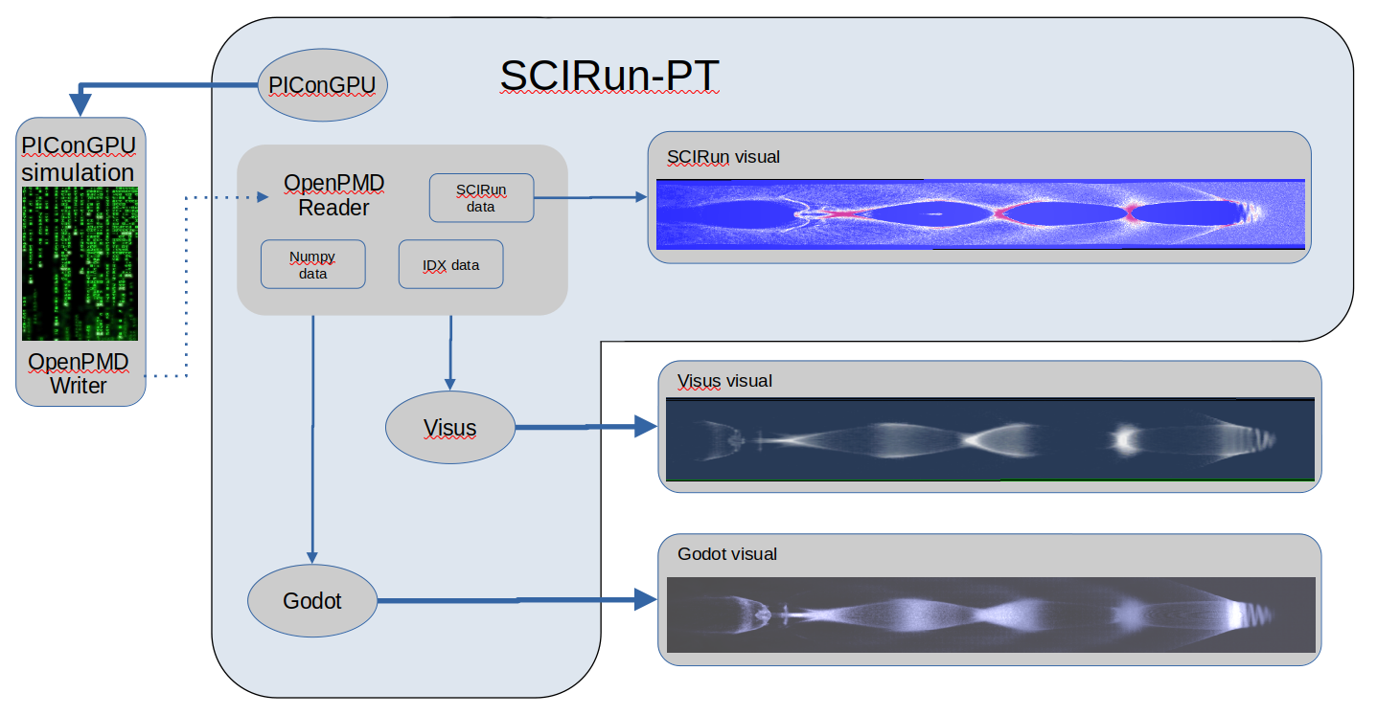
Interactive and Portable System for In Situ
Visualization of Particle In Cell Simulation Data
Introduction
The Project is:
Experimental Science
Hardware and Software
Kim Peterson, 28 April, 2025

Slide 2
Interactive and Portable System for In Situ
Visualization of Particle In Cell Simulation Data
Run a sophisticated physics simulation and produce a visual from the output as the simulation is running on a desktop PC
The Project
Kim Peterson, 28 April, 2025

Slide 3
Interactive and Portable System for In Situ
Visualization of Particle In Cell Simulation Data
Challenges:
  Simulation
  Framework
  In situ data transfer
  Container encapsulation
  Visualization – 2D, 3D, VR
  Data handling
Solutions:
  PIConGPU
  SCIRun-PT
  OpenPMD
  Singularity
  Visus, Godot
  IDX dataset
Kim Peterson, 28 April, 2025

Slide 4
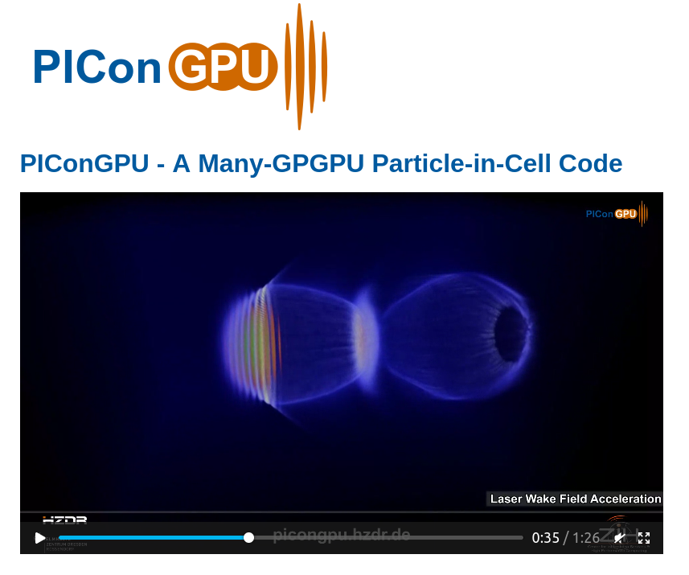
Interactive and Portable System for In Situ
Visualization of Particle In Cell Simulation Data
Solutions:
  PIConGPU
  SCIRun-PT
  OpenPMD
  Singularity
  Visus, Godot
  IDX dataset
https://www.hzdr.de/db/Cms?pOid=31887&pNid=3227&pLang=en
Kim Peterson, 28 April, 2025
Notes:
PIConGPU [1,2] is a relativistic Particle-in-Cell (PIC) code running on graphic processing units (GPUs). It is Open Source und is freely available for download [1]. PIConGPU is developed and maintained by the Junior Group Computational Radiation Physics at the Institute for Radiation Physics at HZDR in close collaboration with the Center for Information Services and High Performance Computing (ZIH) of the Technical University Dresden.
References
[1] PIConGPU repository https://github.com/ComputationalRadiationPhysics/picongpu
[2] H. Burau, et al, PIConGPU : A Fully Relativistic Particle-in-Cell Code for a GPU Cluster, IEEE Transactions on Plasma Science 38(10), 2831-2839, 2010

Slide 5
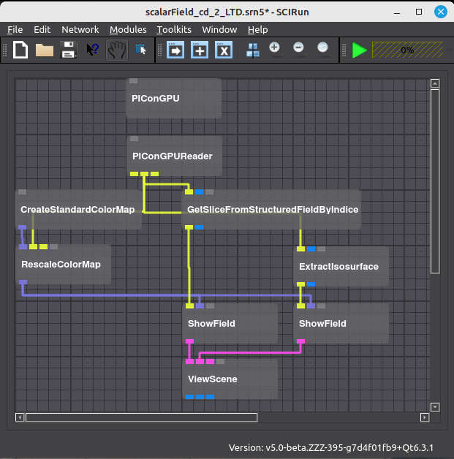
Interactive and Portable System for In Situ
Visualization of Particle In Cell Simulation Data
Solutions:
  PIConGPU
  SCIRun-PT
  OpenPMD
  Singularity
  Visus, Godot
  IDX dataset
Kim Peterson, 28 April, 2025

Slide 6
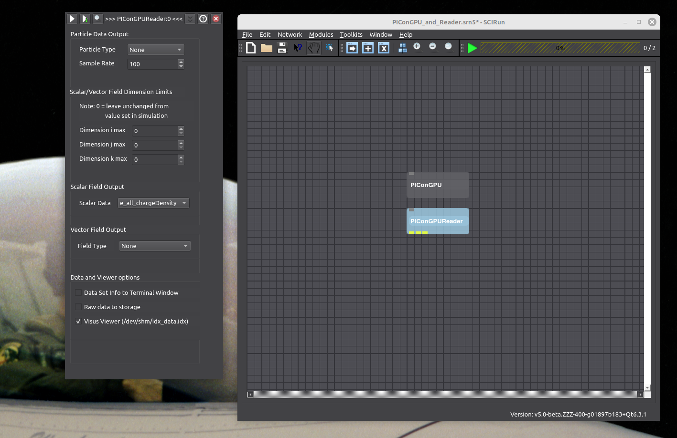
Interactive and Portable System for In Situ
Visualization of Particle In Cell Simulation Data
Solutions:
  PIConGPU
  SCIRun-PT
  OpenPMD
  Singularity
  Visus, Godot
  IDX dataset
Kim Peterson, 28 April, 2025

Slide 7
Interactive and Portable System for In Situ
Visualization of Particle In Cell Simulation Data
Solutions:
  PIConGPU
  SCIRun-PT
  OpenPMD
  Singularity
  Visus, Godot
  IDX dataset
Kim Peterson, 28 April, 2025

Slide 8
Interactive and Portable System for In Situ
Visualization of Particle In Cell Simulation Data
Solutions:
  PIConGPU
  SCIRun-PT
  OpenPMD
  Singularity
  Visus, Godot
  IDX dataset
Kim Peterson, 28 April, 2025

Slide 9
Interactive and Portable System for In Situ
Visualization of Particle In Cell Simulation Data
Solutions:
  PIConGPU
  SCIRun-PT
  OpenPMD
  Singularity
  Visus, Godot
  IDX dataset
Kim Peterson, 28 April, 2025

Slide 10
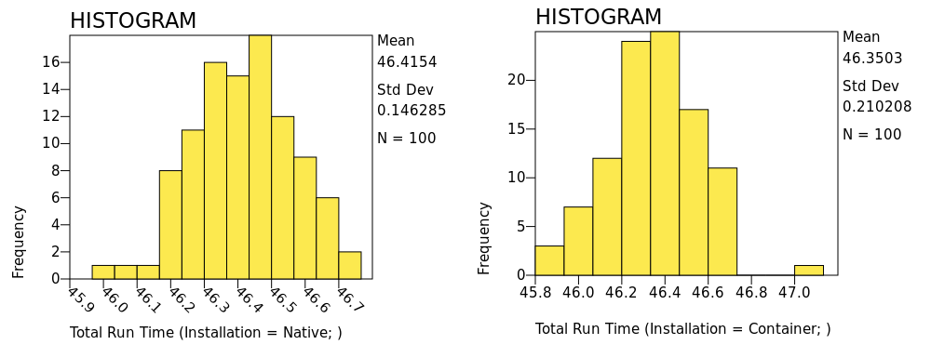
Interactive and Portable System for In Situ
Visualization of Particle In Cell Simulation Data
Analyses:
  Comparison Test
  Performance Tests
    Strong Scaling
    Weak Scaling
    Test To Fail
Kim Peterson, 28 April, 2025

Slide 11
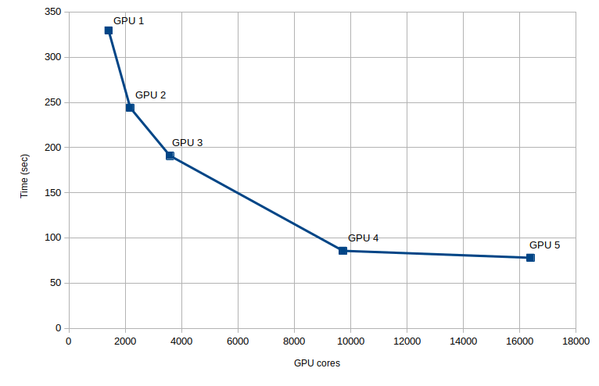
Interactive and Portable System for In Situ
Visualization of Particle In Cell Simulation Data
Analyses:
  Comparison Test
  Performance Tests
    Strong Scaling
    Weak Scaling
    Test To Fail
Kim Peterson, 28 April, 2025

Slide 12
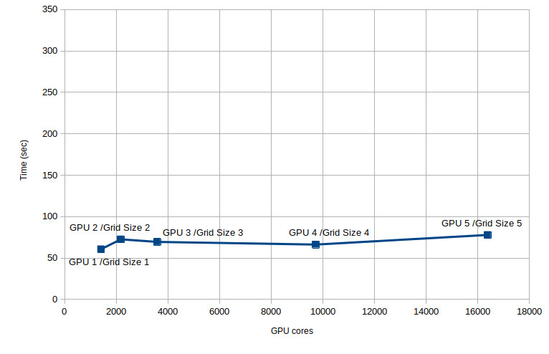
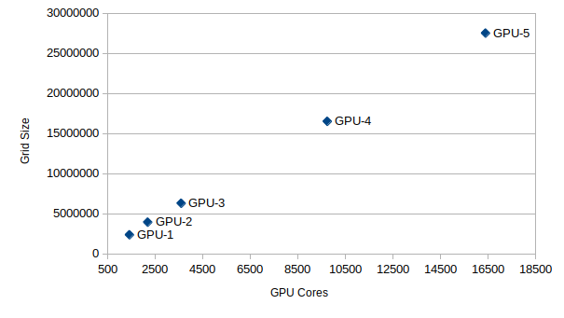
Interactive and Portable System for In Situ
Visualization of Particle In Cell Simulation Data
Analyses:
  Comparison Test
  Performance Tests
    Strong Scaling
    Weak Scaling
    Test To Fail
Kim Peterson, 28 April, 2025

Slide 13
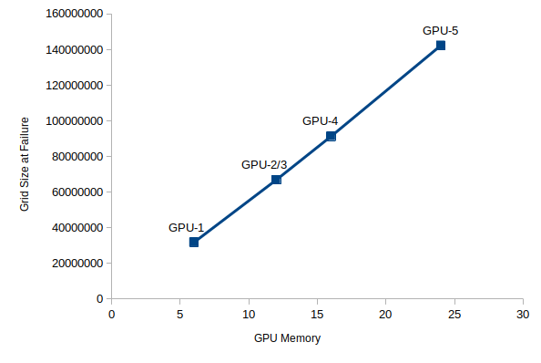
Interactive and Portable System for In Situ
Visualization of Particle In Cell Simulation Data
Analyses:
  Comparison Test
  Performance Tests
    Strong Scaling
    Weak Scaling
    Test To Fail
Kim Peterson, 28 April, 2025

Slide 14
Interactive and Portable System for In Situ
Visualization of Particle In Cell Simulation Data
  Visualization – 2D
    SCIRun-PT
    PIConGPU LWFA simulation
    In situ data transfer
    SCIRun-PT visualization
Kim Peterson, 28 April, 2025

Slide 15
Interactive and Portable System for In Situ
Visualization of Particle In Cell Simulation Data
  Visualization – 3D
    SCIRun-PT
    PIConGPU LWFA simulation
    In situ data transfer
    Visus viewer
Kim Peterson, 28 April, 2025

Slide 16
Interactive and Portable System for In Situ
Visualization of Particle In Cell Simulation Data
  Visualization – 3D
    SCIRun-PT
    PIConGPU LWFA simulation
    In situ data transfer
    Godot Game Engine
Kim Peterson, 28 April, 2025

Slide 17
Interactive and Portable System for In Situ
Visualization of Particle In Cell Simulation Data
  Visualization – VR
    SCIRun-PT
    PIConGPU LWFA simulation
    In situ data transfer
    Godot Game Engine
Kim Peterson, 28 April, 2025

Slide 18
Interactive and Portable System for In Situ
Visualization of Particle In Cell Simulation Data
Acknowledgments
SCIRun
  Jesse Tate
  Daniel White
PIConGPU
  Klaus Steinegar
  Rene Widera
  Franz Poeschel
OpenPMD
  Franz Poeschel
Singularity
  Dave Godlove
Visus, IDX, NumPy
  Steve Petruzza
Godot
  Mike McKay
Install, Test, Presentation
  Drew Peterson
PNG data format development
  Christopher Peterson
Kim Peterson, 28 April, 2025

Slide 19
Interactive and Portable System for In Situ
Visualization of Particle In Cell Simulation Data
Questions
Kim Peterson, 28 April, 2025

Slide 20
Interactive and Portable System for In Situ
Visualization of Particle In Cell Simulation Data
Resources
github Archive
SCIRun
PIConGPU
openPMD
Singularity
Visus
Godot
Kim Peterson, 28 April, 2025

Slide 21
Interactive and Portable System for In Situ
Visualization of Particle In Cell Simulation Data
Future Development
Develop SCIRun-PT to include Visus and VR
and/or
Develop Godot to allow Scientific visualization (3D and VR) to include Visus viewer as a shader and IDX data import
Kim Peterson, 28 April, 2025

