Slide 1
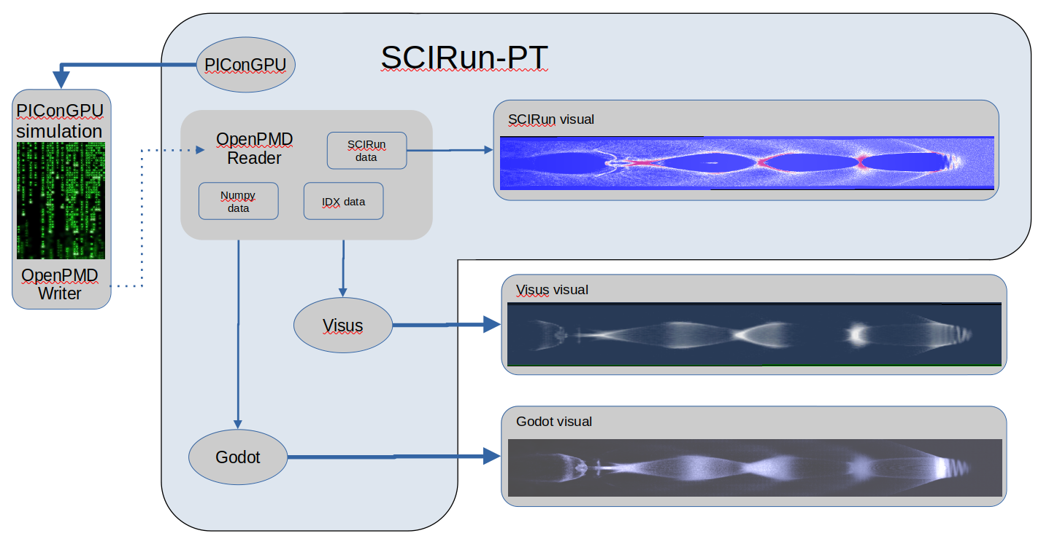
Interactive and Portable System for In Situ
Visualization of Particle In Cell Simulation Data
Introduction
The Project is:
Experimental Science
Hardware and Software
Kim Peterson, 28 April, 2025

Slide 2
Interactive and Portable System for In Situ
Visualization of Particle In Cell Simulation Data
The Project:
Run a sophisticated physics simulation and produce a visual from the output as the simulation is running on a desktop PC
Kim Peterson, 28 April, 2025

Slide 3
Interactive and Portable System for In Situ
Visualization of Particle In Cell Simulation Data
Challenges:
  Simulation
  Framework
  In situ data transfer
  Container encapsulation
  Visualization – 2D, 3D, VR
  Data handling
Solutions:
  PIConGPU
  SCIRun-PT
  OpenPMD
  Singularity
  Visus, Godot
  IDX dataset
Kim Peterson, 28 April, 2025

Slide 4
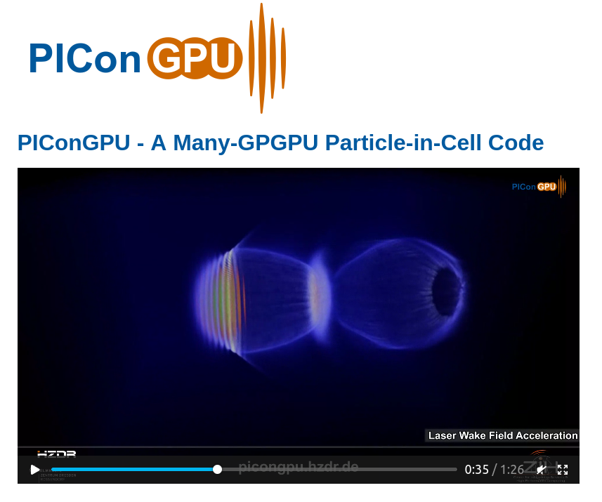
Interactive and Portable System for In Situ
Visualization of Particle In Cell Simulation Data
Solutions:
  PIConGPU
  SCIRun-PT
  OpenPMD
  Singularity
  Visus, Godot
  IDX dataset
https://www.hzdr.de/db/Cms?pOid=31887&pNid=3227&pLang=en
Kim Peterson, 28 April, 2025
Notes:
PIConGPU [1,2] is a relativistic Particle-in-Cell (PIC) code running on graphic processing units (GPUs). It is Open Source und is freely available for download [1]. PIConGPU is developed and maintained by the Junior Group Computational Radiation Physics at the Institute for Radiation Physics at HZDR in close collaboration with the Center for Information Services and High Performance Computing (ZIH) of the Technical University Dresden.
References
[1] PIConGPU repository https://github.com/ComputationalRadiationPhysics/picongpu
[2] H. Burau, et al, PIConGPU : A Fully Relativistic Particle-in-Cell Code for a GPU Cluster, IEEE Transactions on Plasma Science 38(10), 2831-2839, 2010

Slide 5
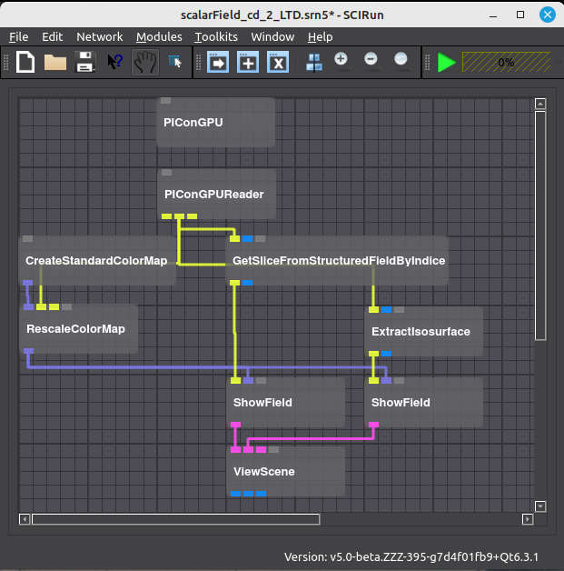
Interactive and Portable System for In Situ
Visualization of Particle In Cell Simulation Data
Solutions:
  PIConGPU
  SCIRun-PT
  OpenPMD
  Singularity
  Visus, Godot
  IDX dataset
Kim Peterson, 28 April, 2025

Slide 6
Interactive and Portable System for In Situ
Visualization of Particle In Cell Simulation Data
Solutions:
  PIConGPU
  SCIRun-PT
  OpenPMD
  Singularity
  Visus, Godot
  IDX dataset
Kim Peterson, 28 April, 2025

Slide 7
Interactive and Portable System for In Situ
Visualization of Particle In Cell Simulation Data
Solutions:
  PIConGPU
  SCIRun-PT
  OpenPMD
  Singularity
  Visus, Godot
  IDX dataset
Kim Peterson, 28 April, 2025

Slide 8
Interactive and Portable System for In Situ
Visualization of Particle In Cell Simulation Data
Solutions:
  PIConGPU
  SCIRun-PT
  OpenPMD
  Singularity
  Visus, Godot
  IDX dataset
Kim Peterson, 28 April, 2025

Slide 9
Interactive and Portable System for In Situ
Visualization of Particle In Cell Simulation Data
Solutions:
  PIConGPU
  SCIRun-PT
  OpenPMD
  Singularity
  Visus, Godot
  IDX dataset
Kim Peterson, 28 April, 2025

Slide 10
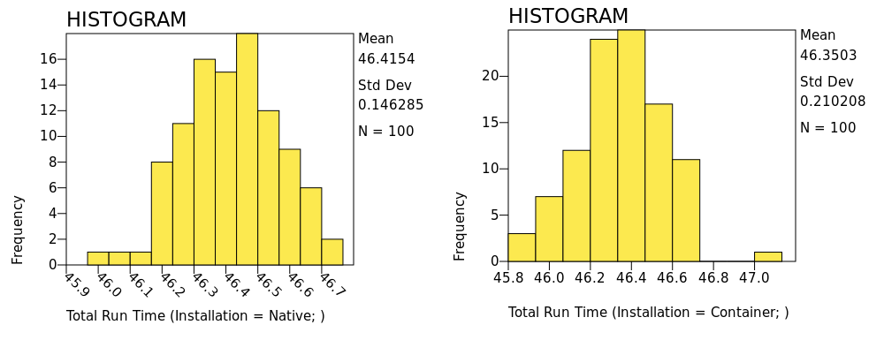
Interactive and Portable System for In Situ
Visualization of Particle In Cell Simulation Data
Analyses:
  Comparison Test
  Performance Tests
    Strong Scaling
    Weak Scaling
    Test To Fail
Kim Peterson, 28 April, 2025

Slide 11
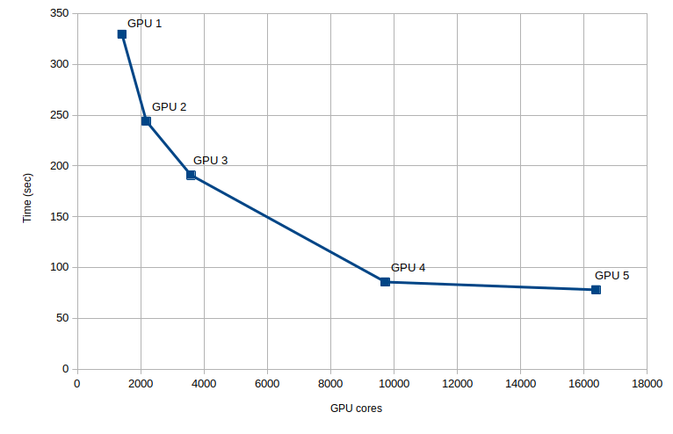
Interactive and Portable System for In Situ
Visualization of Particle In Cell Simulation Data
Analyses:
  Comparison Test
  Performance Tests
    Strong Scaling
    Weak Scaling
    Test To Fail
Kim Peterson, 28 April, 2025

Slide 12
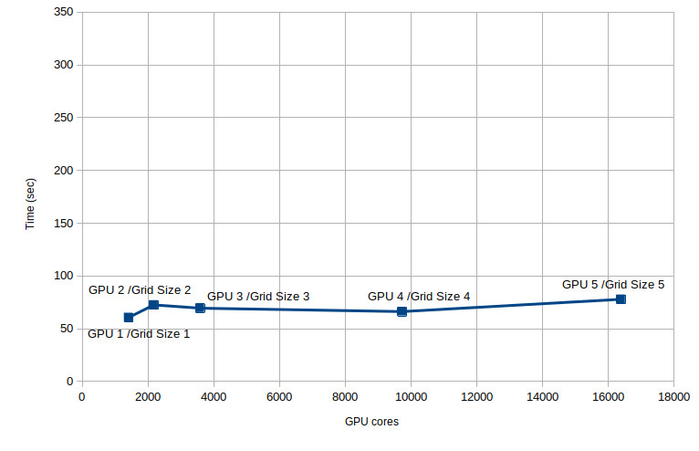
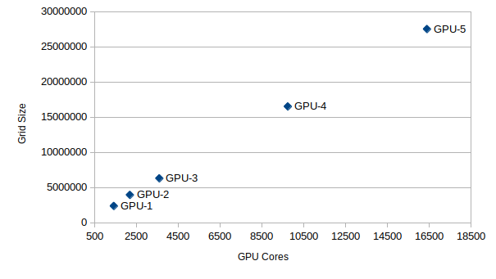
Interactive and Portable System for In Situ
Visualization of Particle In Cell Simulation Data
Analyses:
  Comparison Test
  Performance Tests
    Strong Scaling
    Weak Scaling
    Test To Fail
Kim Peterson, 28 April, 2025

Slide 13
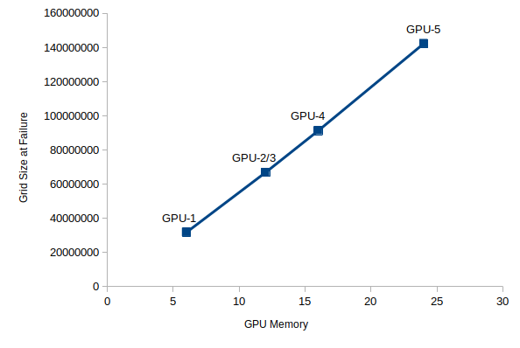
Interactive and Portable System for In Situ
Visualization of Particle In Cell Simulation Data
Analyses:
  Comparison Test
  Performance Tests
    Strong Scaling
    Weak Scaling
    Test To Fail
Kim Peterson, 28 April, 2025

Slide 14
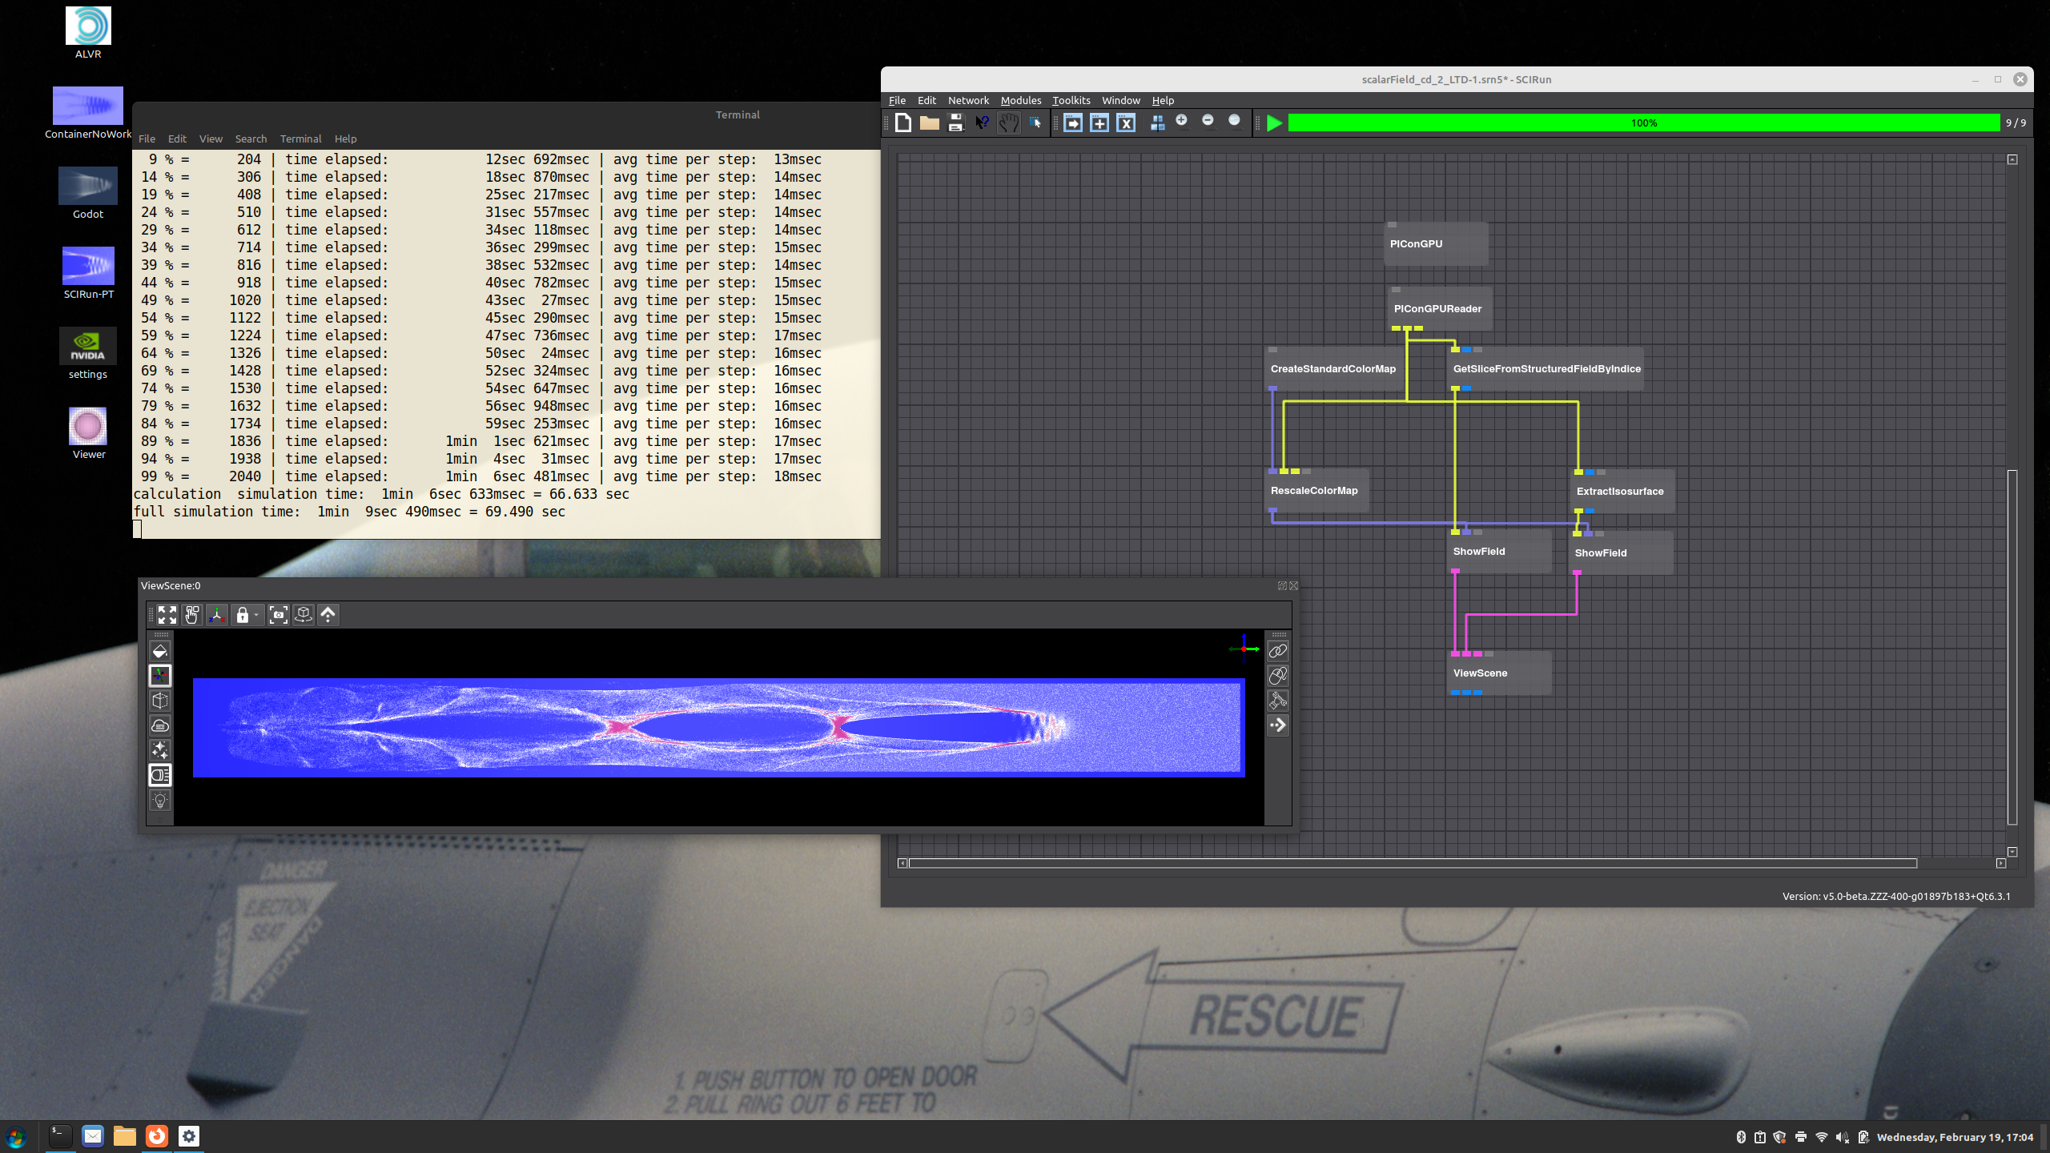
Interactive and Portable System for In Situ
Visualization of Particle In Cell Simulation Data
  Visualization – 2D
    SCIRun-PT
    PIConGPU LWFA simulation
    In situ data transfer
    SCIRun-PT view
Kim Peterson, 28 April, 2025

Slide 15
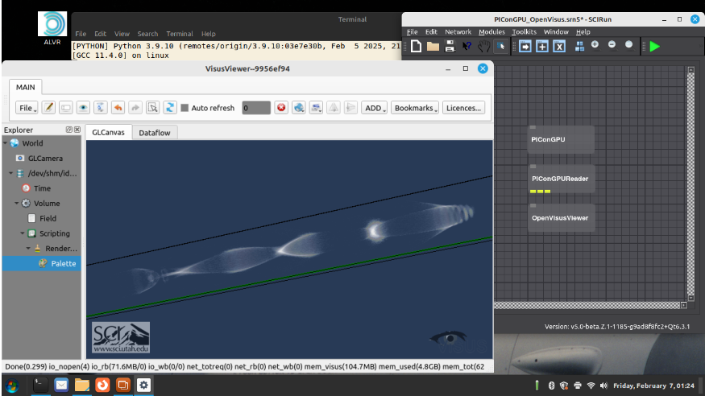
Interactive and Portable System for In Situ
Visualization of Particle In Cell Simulation Data
  Visualization – 3D
    SCIRun-PT
    PIConGPU LWFA simulation
    In situ data transfer
    Visus viewer
Kim Peterson, 28 April, 2025

Slide 16
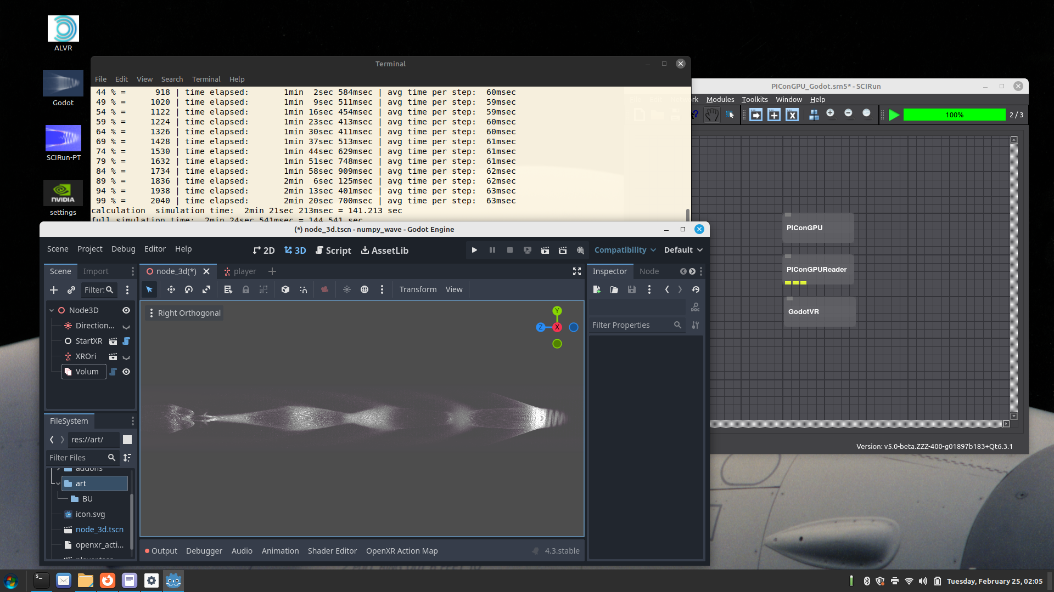
Interactive and Portable System for In Situ
Visualization of Particle In Cell Simulation Data
  Visualization – 3D, VR
    SCIRun-PT
    PIConGPU LWFA simulation
    In situ data transfer
    Godot Game Engine
Kim Peterson, 28 April, 2025

