Slide 1








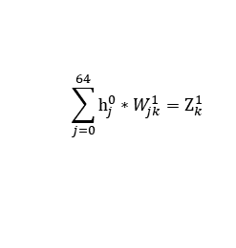











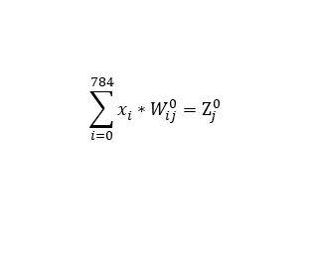





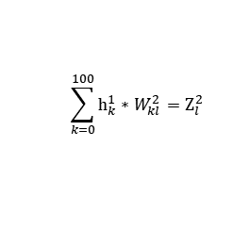








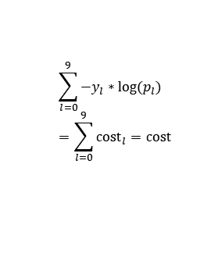












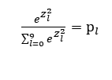






Forward Propagation
x_{i}
$$W_{ij}^{0}$$
$$Z_{j}^{0}$$
$$h_{j}^{0}$$
$$W_{jk}^{1}$$
$$Z_{k}^{1}$$
$$h_{k}^{1}$$
$$W_{kl}^{2}$$
$$Z_{l}^{2}$$
p_{l}
y_{l}
cost_{l}
cost
x₀
$$W_{00}^{0}$$
$$Z_{0}^{0}$$
$$W_{00}^{1}$$
$$Z_{0}^{1}$$
$$W_{00}^{2}$$
$$Z_{0}^{2}$$
p₀
y₀
cost₀
$$h_{0}^{0}$$
$$h_{0}^{1}$$
x₁
$$W_{10}^{0}$$
$$W_{10}^{1}$$
$$W_{10}^{2}$$
$$Z_{1}^{0}$$
$$h_{1}^{0}$$
$$Z_{1}^{1}$$
$$h_{1}^{1}$$
$$Z_{1}^{2}$$
p₁
y₁
cost₁
$$W_{20}^{0}$$
$$W_{j0}^{1}$$
$$W_{j0}^{2}$$
x₂
$$W_{i0}^{0}$$
$$Z_{2}^{0}$$
$$h_{2}^{0}$$
$$Z_{2}^{1}$$
$$h_{2}^{1}$$
$$W_{990}^{2}$$
$$Z_{2}^{2}$$
p_{l}
y_{l}
cost_{l}
∙
∙
∙
∙
∙
∙
∙
∙
∙
∙
∙
∙
x_{i}
∙
∙
∙
∙
$$W_{630}^{1}$$
$$\sum_{k=0}^{100}{h_{k}^{1}}∗W_{kl}^{2}{=Z}_{l}^{2}$$
$$\tanh{Z_{j}^{0}}=h_{j}^{0}$$
$$\tanh{Z_{k}^{1}}=h_{k}^{1}$$
$$b_{0}^{2}=W_{1000}^{2}$$
∙
∙
∙
$$b_{0}^{1}=W_{640}^{1}$$
$$W_{7830}^{0}$$
$$Z_{9}^{2}$$
p₉
y₉
cost₉
$$Z_{63}^{0}$$
$$h_{63}^{0}$$
$$Z_{99}^{1}$$
$$h_{99}^{1}$$
$$b_{0}^{0}=W_{7840}^{0}$$
$$\sum_{j=0}^{64}{h_{j}^{0}}∗W_{jk}^{1}{=Z}_{k}^{1}$$
$\frac{e^{Z_{l}^{2}}}{\sum_{l=0}^{9}{e^{Z_{l}^{2}}}}$ ${=p}_{l}$
$$e_{l}=p_{l}{− y}_{l}$$
$$h_{64}^{0}=1$$
$$h_{100}^{1}=1$$
$$\sum_{l=0}^{9}{{−y}_{l}∗log(p_{l})} \\ =\sum_{l=0}^{9}{{cost}_{l}}=cost$$
x₇₈₃
$$x_{784}=1$$
$$\sum_{i=0}^{784}{x_{i}^{}}∗W_{ij}^{0}=Z_{j}^{0}$$

