Slide 1





























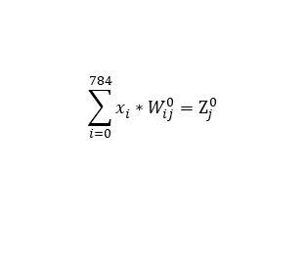










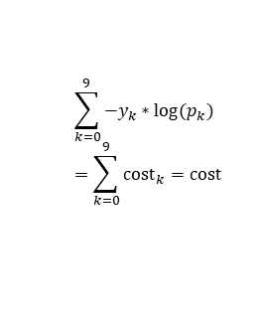
Forward Propagation
x_{i}
$$W_{ij}^{0}$$
$$Z_{j}^{0}$$
$$h_{j}^{0}$$
$$W_{jk}^{1}$$
$$Z_{k}^{1}$$
$$W_{jk}^{1}$$
$$Z_{k}^{1}$$
p_{k}
y_{k}
cost_{k}
cost
x₀
$$W_{00}^{0}$$
$$Z_{0}^{0}$$
$$W_{00}^{1}$$
$$Z_{0}^{1}$$
$$W_{00}^{1}$$
$$Z_{0}^{1}$$
p₀
y₀
cost₀
$$h_{0}^{0}$$
x₁
$$W_{10}^{0}$$
$$W_{10}^{1}$$
$$W_{10}^{1}$$
$$Z_{1}^{0}$$
$$h_{1}^{0}$$
$$Z_{1}^{1}$$
$$Z_{1}^{1}$$
p₁
y₁
cost₁
$$W_{20}^{0}$$
$$Z_{1}^{0}$$
$$W_{j0}^{1}$$
$$W_{j0}^{1}$$
x₂
$$W_{i0}^{0}$$
$$h_{j}^{0}$$
$$W_{630}^{1}$$
$$Z_{k}^{1}$$
$$W_{630}^{1}$$
$$Z_{k}^{1}$$
p_{k}
y_{k}
cost_{k}
∙
∙
∙
∙
∙
∙
∙
∙
∙
∙
x_{i}
∙
∙
∙
∙
$$\tanh{Z_{j}^{0}}=h_{j}^{0}$$
$$b_{0}^{1}=W_{640}^{1}$$
∙
∙
∙
$$b_{0}^{1}=W_{640}^{1}$$
$$W_{7830}^{0}$$
$$Z_{9}^{1}$$
$$Z_{9}^{1}$$
p₉
y₉
cost₉
$$Z_{63}^{0}$$
$$h_{63}^{0}$$
$\frac{e^{Z_{k}^{1}}}{\sum_{k=0}^{9}{e^{Z_{k}^{1}}}}$ ${=p}_{k}$
$$e_{k}=p_{k}{− y}_{k}$$
$$b_{0}^{0}=W_{7840}^{0}$$
$$h_{64}^{0}=1$$
$$\sum_{k=0}^{9}{{−y}_{k}∗log(p_{k})} \\ =\sum_{k=0}^{9}{{cost}_{k}}=cost$$
x₇₈₃
$$\sum_{j=0}^{64}{h_{j}^{0}}∗W_{jk}^{1}{=Z}_{k}^{1}$$
$$x_{784}=1$$
$$\sum_{i=0}^{784}{x_{i}^{}}∗W_{ij}^{0}=Z_{j}^{0}$$

Slide 2
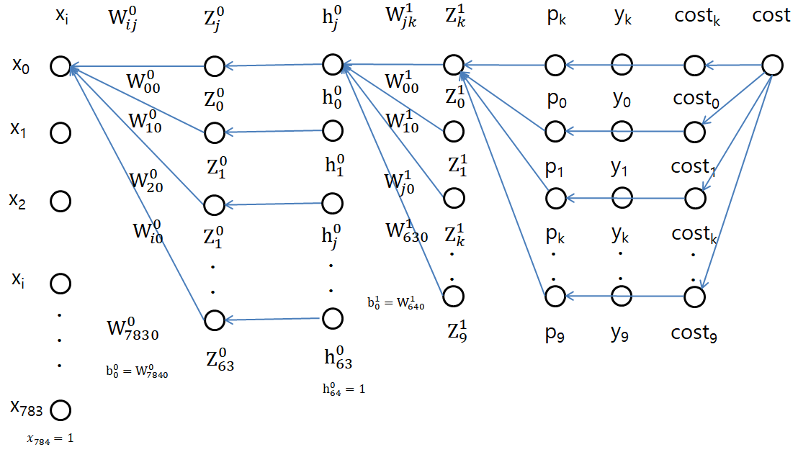

Backward Propagation 1

Slide 3

Backward Propagation 2

Slide 4
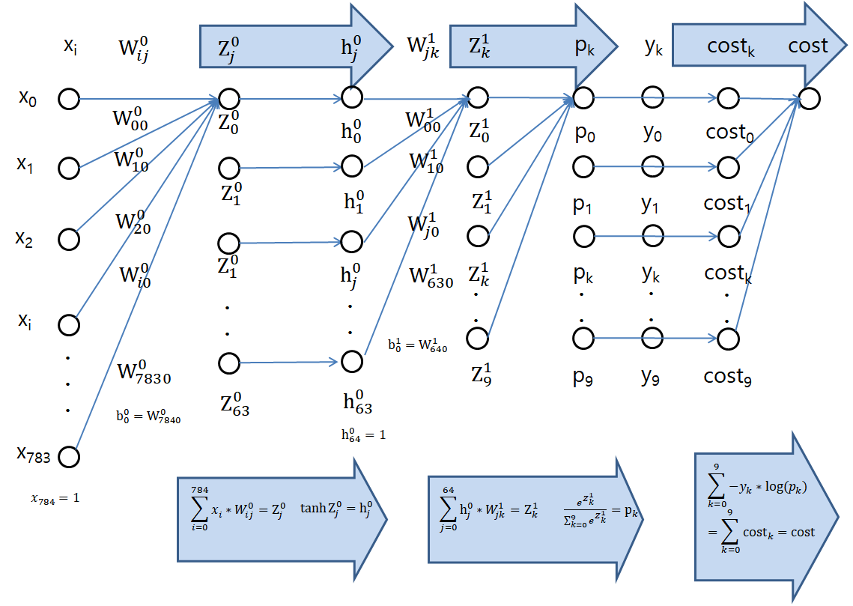
Forward Propagation

Slide 5
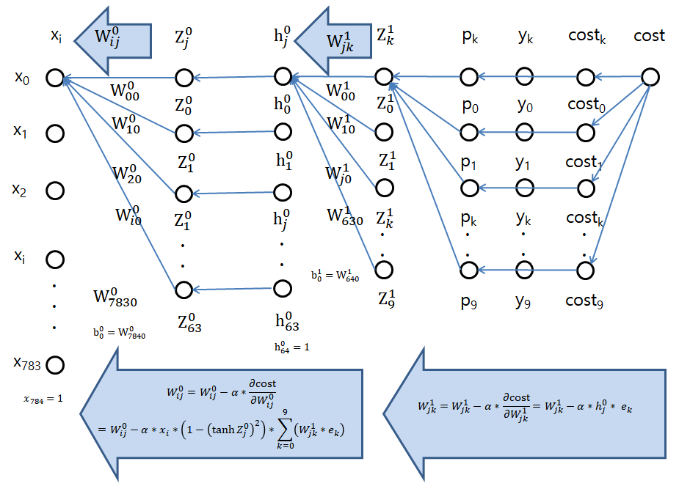
Backward Propagation

