Slide 1
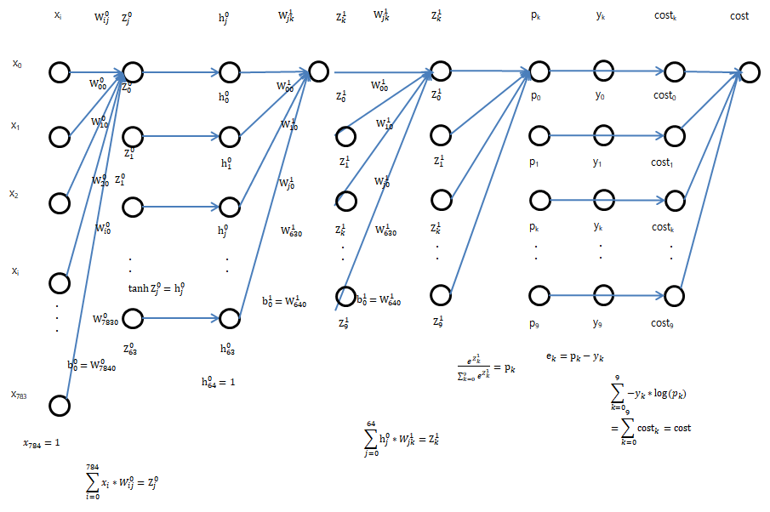
Forward Propagation

Slide 2
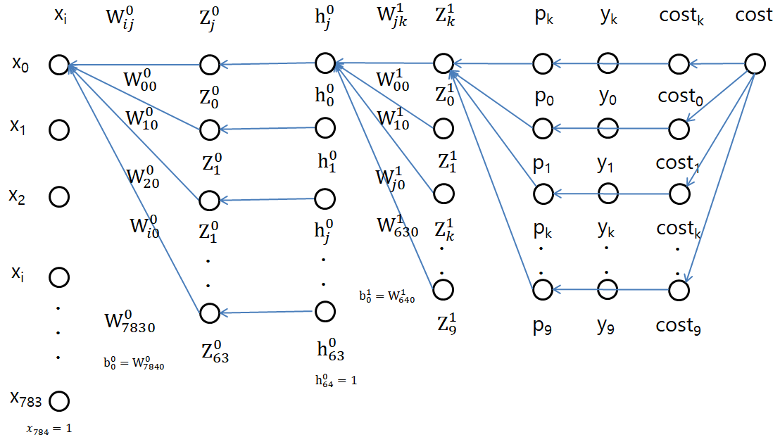

Backward Propagation 1

Slide 3

Backward Propagation 2

Slide 4
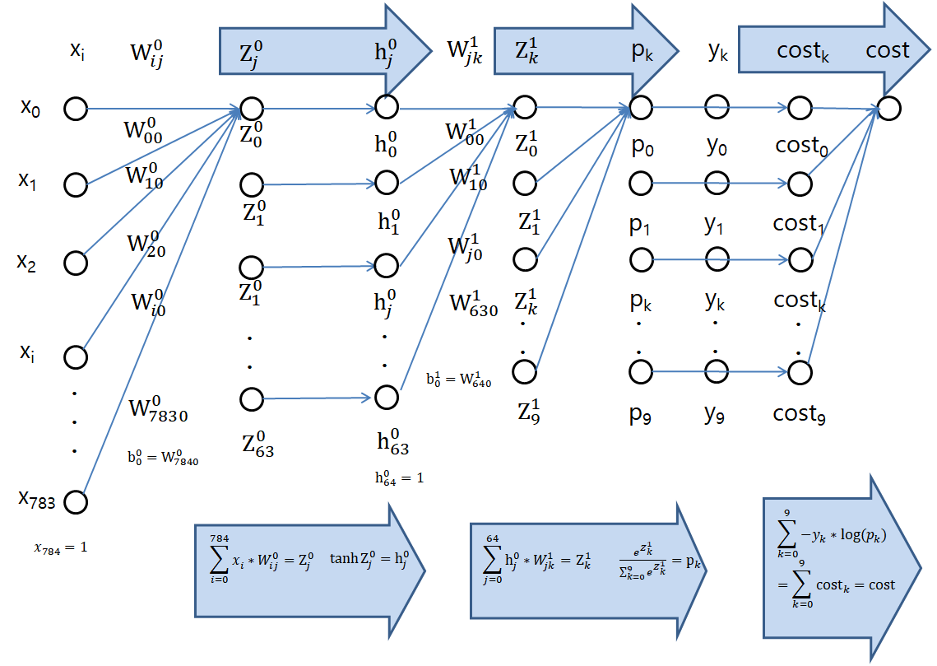
Forward Propagation

Slide 5
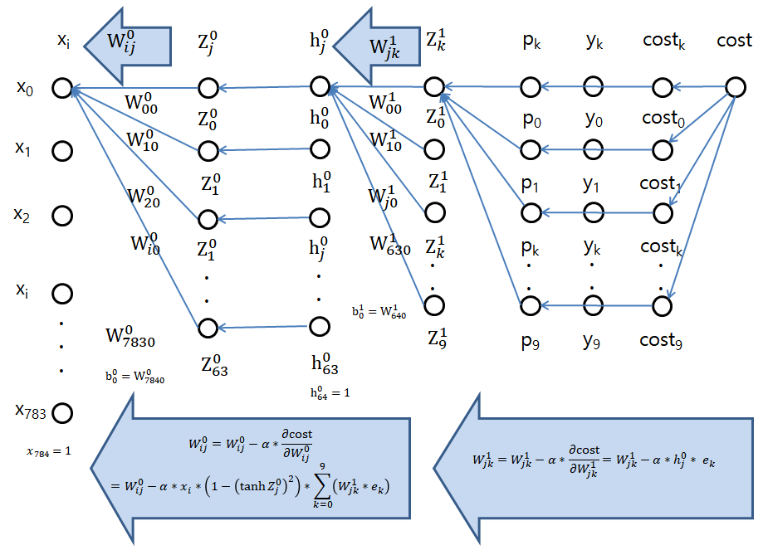
Backward Propagation

