Slide 1
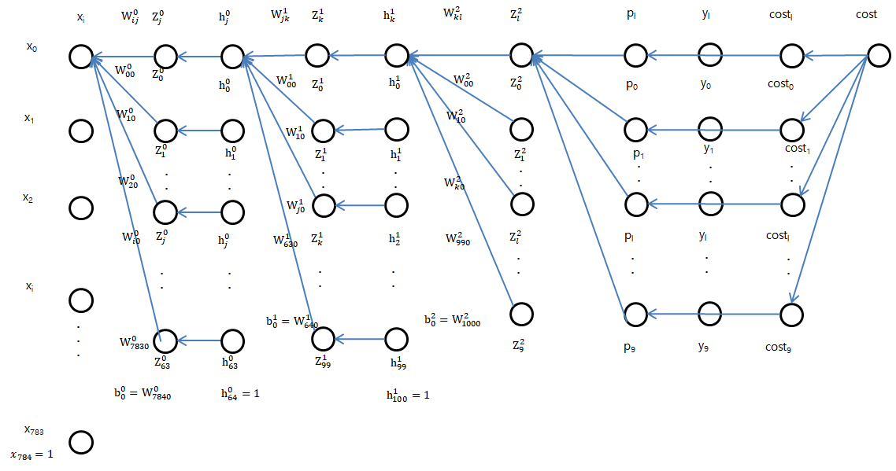
Backward Propagation 3

