Slide 1








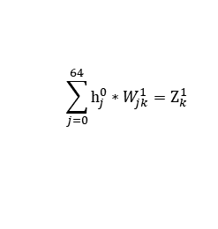




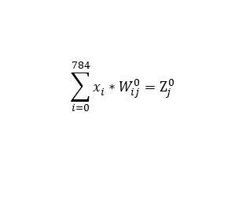


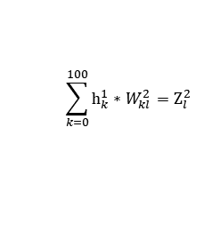
















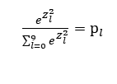



















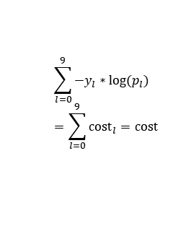

Forward Propagation
x_{i}
$$W_{ij}^{0}$$
$$Z_{j}^{0}$$
$$h_{j}^{0}$$
$$W_{jk}^{1}$$
$$Z_{k}^{1}$$
$$h_{k}^{1}$$
$$W_{kl}^{2}$$
$$Z_{l}^{2}$$
p_{l}
y_{l}
cost_{l}
cost
x₀
$$W_{00}^{0}$$
$$Z_{0}^{0}$$
$$W_{00}^{1}$$
$$Z_{0}^{1}$$
$$W_{00}^{2}$$
$$Z_{0}^{2}$$
p₀
y₀
cost₀
$$h_{0}^{0}$$
$$h_{0}^{1}$$
x₁
$$W_{10}^{0}$$
$$W_{10}^{1}$$
$$W_{10}^{2}$$
$$Z_{1}^{0}$$
$$h_{1}^{0}$$
$$Z_{1}^{1}$$
$$h_{1}^{1}$$
$$Z_{1}^{2}$$
p₁
y₁
cost₁
$$W_{20}^{0}$$
$$Z_{1}^{0}$$
$$W_{j0}^{1}$$
$$W_{j0}^{2}$$
x₂
$$W_{i0}^{0}$$
$$h_{j}^{0}$$
$$W_{630}^{1}$$
$$Z_{k}^{1}$$
$$h_{2}^{1}$$
$$W_{990}^{2}$$
$$Z_{l}^{2}$$
p_{l}
y_{l}
cost_{l}
∙
∙
∙
∙
∙
∙
∙
∙
∙
∙
∙
∙
x_{i}
∙
∙
∙
∙
$$\tanh{Z_{j}^{0}}=h_{j}^{0}$$
$$\tanh{Z_{k}^{1}}=h_{k}^{1}$$
$$b_{0}^{2}=W_{1000}^{2}$$
∙
∙
∙
$$b_{0}^{1}=W_{640}^{1}$$
$$W_{7830}^{0}$$
$$Z_{9}^{2}$$
p₉
y₉
cost₉
$$Z_{63}^{0}$$
$$h_{63}^{0}$$
$$Z_{99}^{1}$$
$$h_{99}^{1}$$
$$\sum_{k=0}^{100}{h_{k}^{1}}∗W_{kl}^{2}{=Z}_{l}^{2}$$
$$b_{0}^{0}=W_{7840}^{0}$$
$$\sum_{j=0}^{64}{h_{j}^{0}}∗W_{jk}^{1}{=Z}_{k}^{1}$$
$\frac{e^{Z_{l}^{2}}}{\sum_{l=0}^{9}{e^{Z_{l}^{2}}}}$ ${=p}_{l}$
$$e_{l}=p_{l}{− y}_{l}$$
$$h_{64}^{0}=1$$
$$h_{100}^{1}=1$$
$$\sum_{l=0}^{9}{{−y}_{l}∗log(p_{l})} \\ =\sum_{l=0}^{9}{{cost}_{l}}=cost$$
x₇₈₃
$$x_{784}=1$$
$$\sum_{i=0}^{784}{x_{i}^{}}∗W_{ij}^{0}=Z_{j}^{0}$$

Slide 2



























Backward Propagation
x_{i}
$$W_{ij}^{0}$$
$$Z_{j}^{0}$$
$$h_{j}^{0}$$
$$W_{jk}^{1}$$
$$Z_{k}^{1}$$
$$h_{k}^{1}$$
$$W_{kl}^{2}$$
$$Z_{l}^{2}$$
p_{l}
y_{l}
cost_{l}
cost
x₀
$$W_{00}^{0}$$
$$W_{00}^{1}$$
$$W_{00}^{2}$$
$$Z_{0}^{0}$$
$$h_{0}^{0}$$
$$Z_{0}^{1}$$
$$h_{0}^{1}$$
$$Z_{0}^{2}$$
p₀
y₀
cost₀
$$W_{01}^{0}$$
$$W_{01}^{1}$$
$$W_{01}^{2}$$
x₁
$$W_{0j}^{0}$$
$$Z_{1}^{1}$$
$$h_{1}^{1}$$
$$W_{0l}^{2}$$
$$Z_{1}^{2}$$
p₁
y₁
$$Z_{1}^{0}$$
$$h_{1}^{0}$$
$$W_{0j}^{1}$$
∙
∙
∙
∙
cost₁
∙
∙
∙
∙
∙
∙
x₂
$$W_{063}^{0}$$
$$Z_{j}^{0}$$
$$h_{j}^{0}$$
$$Z_{k}^{1}$$
$$h_{2}^{1}$$
$$W_{09}^{2}$$
$$Z_{l}^{2}$$
p_{l}
y_{l}
cost_{l}
∙
∙
∙
∙
∙
∙
∙
∙
∙
∙
x_{i}
∙
∙
∙
∙
$$W_{063}^{1}$$
∙
∙
∙
∙
∙
$$Z_{9}^{2}$$
p₉
y₉
cost₉
$$Z_{63}^{0}$$
$$h_{63}^{0}$$
$$Z_{99}^{1}$$
$$h_{99}^{1}$$
$$b_{0}^{0}=W_{7840}^{0}$$
$$h_{64}^{0}=1$$
$$b_{0}^{1}=W_{640}^{1}$$
$$h_{100}^{1}=1$$
$$b_{0}^{2}=W_{1000}^{2}$$
x₇₈₃
$$x_{784}=1$$

Slide 3
Backward Propagation
x_{i}
$$W_{ij}^{0}$$
$$Z_{j}^{0}$$
$$h_{j}^{0}$$
$$W_{jk}^{1}$$
$$Z_{k}^{1}$$
$$h_{k}^{1}$$
$$W_{kl}^{2}$$
$$Z_{l}^{2}$$
p_{l}
y_{l}
cost_{l}
cost
x₀
$$W_{00}^{0}$$
$$W_{00}^{1}$$
$$W_{00}^{2}$$
$$Z_{0}^{0}$$
$$h_{0}^{0}$$
$$Z_{0}^{1}$$
$$h_{0}^{1}$$
$$Z_{0}^{2}$$
p₀
y₀
cost₀
$$W_{01}^{0}$$
$$W_{01}^{1}$$
$$W_{01}^{2}$$
x₁
$$W_{0j}^{0}$$
$$Z_{1}^{1}$$
$$h_{1}^{1}$$
$$W_{0l}^{2}$$
$$Z_{1}^{2}$$
p₁
y₁
$$Z_{1}^{0}$$
$$h_{1}^{0}$$
$$W_{0j}^{1}$$
∙
∙
∙
∙
cost₁
∙
∙
∙
∙
∙
∙
x₂
$$W_{063}^{0}$$
$$Z_{j}^{0}$$
$$h_{j}^{0}$$
$$Z_{k}^{1}$$
$$h_{2}^{1}$$
$$W_{09}^{2}$$
$$Z_{l}^{2}$$
p_{l}
y_{l}
cost_{l}
∙
∙
∙
∙
∙
∙
∙
∙
∙
∙
x_{i}
∙
∙
∙
∙
$$W_{063}^{1}$$
∙
∙
∙
∙
∙
$$Z_{9}^{2}$$
p₉
y₉
cost₉
$$Z_{63}^{0}$$
$$h_{63}^{0}$$
$$Z_{99}^{1}$$
$$h_{99}^{1}$$
$$b_{0}^{0}=W_{7840}^{0}$$
$$h_{64}^{0}=1$$
$$b_{0}^{1}=W_{640}^{1}$$
$$h_{100}^{1}=1$$
$$b_{0}^{2}=W_{1000}^{2}$$
x₇₈₃
$$x_{784}=1$$

Slide 4


Backward Propagation
x_{i}
$$W_{ij}^{0}$$
$$Z_{j}^{0}$$
$$h_{j}^{0}$$
$$W_{jk}^{1}$$
$$Z_{k}^{1}$$
$$h_{k}^{1}$$
$$W_{kl}^{2}$$
$$Z_{l}^{2}$$
p_{l}
y_{l}
cost_{l}
cost
x₀
$$W_{00}^{0}$$
$$Z_{0}^{0}$$
$$W_{00}^{1}$$
$$Z_{0}^{1}$$
$$h_{0}^{1}$$
$$W_{00}^{2}$$
$$Z_{0}^{2}$$
p₀
y₀
cost₀
$$h_{0}^{0}$$
x₁
$$W_{10}^{0}$$
$$W_{10}^{1}$$
$$W_{10}^{2}$$
$$Z_{1}^{0}$$
$$h_{1}^{0}$$
$$Z_{1}^{1}$$
$$h_{1}^{1}$$
$$Z_{1}^{2}$$
p₁
y₁
cost₁
$$W_{20}^{0}$$
$$Z_{1}^{0}$$
$$W_{j0}^{1}$$
$$W_{k0}^{2}$$
x₂
$$W_{i0}^{0}$$
$$h_{j}^{0}$$
$$W_{630}^{1}$$
$$Z_{k}^{1}$$
$$h_{2}^{1}$$
$$W_{990}^{2}$$
$$Z_{l}^{2}$$
p_{l}
y_{l}
cost_{l}
∙
∙
∙
∙
∙
∙
∙
∙
∙
∙
∙
∙
x_{i}
∙
∙
∙
∙
∙
∙
∙
$$b_{0}^{1}=W_{640}^{1}$$
$$b_{0}^{2}=W_{1000}^{2}$$
$$W_{7830}^{0}$$
$$Z_{9}^{2}$$
p₉
y₉
cost₉
$$Z_{63}^{0}$$
$$h_{63}^{0}$$
$$Z_{99}^{1}$$
$$h_{99}^{1}$$
$$b_{0}^{0}=W_{7840}^{0}$$
$$h_{64}^{0}=1$$
$$h_{100}^{1}=1$$
x₇₈₃
$$\frac{∂cost}{∂W_{jk}^{1}}=\frac{∂cost}{∂Z_{k}^{1}} \frac{∂Z_{k}^{1}}{∂W_{jk}^{1}}=\sum_{l=0}^{9}{\left(\sum_{l^{′}=0}^{9}{\frac{∂{cost}_{l^{′}}}{∂p_{l^{′}}} \frac{∂p_{l^{′}}}{∂Z_{l}^{1}} \frac{∂Z_{l}^{1}}{∂h_{k}^{0}} \frac{∂h_{k}^{0}}{∂Z_{k}^{0}}}\right)}\frac{∂Z_{k}^{1}}{∂W_{jk}^{1}}$$
$$x_{784}=1$$

Slide 5
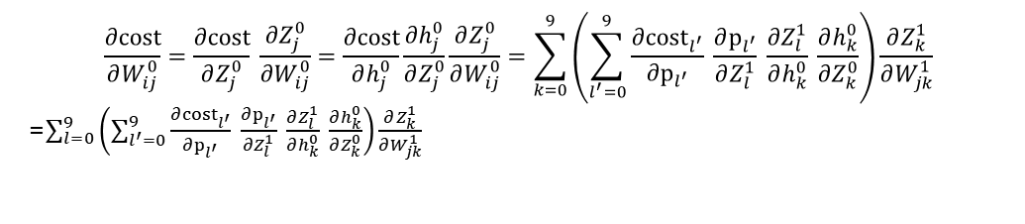

Backward Propagation
x_{i}
$$W_{ij}^{0}$$
$$Z_{j}^{0}$$
$$h_{j}^{0}$$
$$W_{jk}^{1}$$
$$Z_{k}^{1}$$
$$h_{k}^{1}$$
$$W_{kl}^{2}$$
$$Z_{l}^{2}$$
p_{l}
y_{l}
cost_{l}
cost
x₀
$$W_{00}^{0}$$
$$Z_{0}^{0}$$
$$W_{00}^{1}$$
$$W_{00}^{2}$$
$$h_{0}^{0}$$
$$Z_{0}^{1}$$
$$h_{0}^{1}$$
$$Z_{0}^{2}$$
p₀
y₀
cost₀
x₁
$$W_{10}^{0}$$
$$W_{10}^{1}$$
$$W_{10}^{2}$$
$$Z_{1}^{0}$$
$$h_{1}^{0}$$
$$Z_{1}^{1}$$
$$h_{1}^{1}$$
$$Z_{1}^{2}$$
p₁
y₁
cost₁
$$W_{20}^{0}$$
$$Z_{1}^{0}$$
$$W_{j0}^{1}$$
$$W_{j0}^{2}$$
x₂
$$W_{i0}^{0}$$
$$h_{j}^{0}$$
$$W_{630}^{1}$$
$$Z_{k}^{1}$$
$$h_{2}^{1}$$
$$W_{990}^{2}$$
$$Z_{l}^{2}$$
p_{l}
y_{l}
cost_{l}
∙
∙
∙
∙
∙
∙
∙
∙
∙
∙
∙
∙
x_{i}
∙
∙
∙
∙
∙
∙
∙
$$b_{0}^{1}=W_{640}^{1}$$
$$b_{0}^{2}=W_{1000}^{2}$$
$$W_{7830}^{0}$$
$$Z_{9}^{2}$$
p₉
y₉
cost₉
$$Z_{63}^{0}$$
$$h_{63}^{0}$$
$$Z_{99}^{1}$$
$$h_{99}^{1}$$
$$b_{0}^{0}=W_{7840}^{0}$$
$$h_{64}^{0}=1$$
$$h_{100}^{1}=1$$
x₇₈₃
$$x_{784}=1$$
$$\frac{∂cost}{∂W_{ij}^{0}}=\frac{∂cost}{∂Z_{j}^{0}} \frac{∂Z_{j}^{0}}{∂W_{ij}^{0}}=\frac{∂cost}{∂h_{j}^{0}}\frac{∂h_{j}^{0}}{∂Z_{j}^{0}}\frac{∂Z_{j}^{0}}{∂W_{ij}^{0}}=\sum_{k=0}^{9}{\left(\sum_{l^{′}=0}^{9}{\frac{∂{cost}_{l^{′}}}{∂p_{l^{′}}} \frac{∂p_{l^{′}}}{∂Z_{l}^{1}} \frac{∂Z_{l}^{1}}{∂h_{k}^{0}} \frac{∂h_{k}^{0}}{∂Z_{k}^{0}}}\right)}\frac{∂Z_{k}^{1}}{∂W_{jk}^{1}}$$
=$\sum_{l=0}^{9}{\left(\sum_{l^{′}=0}^{9}{\frac{∂{cost}_{l^{′}}}{∂p_{l^{′}}} \frac{∂p_{l^{′}}}{∂Z_{l}^{1}} \frac{∂Z_{l}^{1}}{∂h_{k}^{0}} \frac{∂h_{k}^{0}}{∂Z_{k}^{0}}}\right)}\frac{∂Z_{k}^{1}}{∂W_{jk}^{1}}$

Slide 6






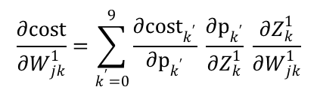
























Backward Propagation 1
x_{i}
$$W_{ij}^{0}$$
$$Z_{j}^{0}$$
$$h_{j}^{0}$$
$$W_{jk}^{1}$$
$$Z_{k}^{1}$$
p_{k}
y_{k}
cost_{k}
cost
x₀
$$W_{00}^{0}$$
$$W_{00}^{1}$$
$$Z_{0}^{0}$$
$$h_{0}^{0}$$
$$Z_{0}^{1}$$
p₀
y₀
cost₀
x₁
$$W_{10}^{0}$$
$$W_{10}^{1}$$
$$Z_{1}^{0}$$
$$h_{1}^{0}$$
$$Z_{1}^{1}$$
p₁
y₁
cost₁
$$W_{20}^{0}$$
$$W_{j0}^{1}$$
x₂
$$W_{i0}^{0}$$
$$Z_{1}^{0}$$
$$h_{j}^{0}$$
$$W_{630}^{1}$$
$$Z_{k}^{1}$$
p_{k}
y_{k}
cost_{k}
∙
∙
∙
∙
∙
∙
∙
∙
∙
∙
x_{i}
∙
∙
∙
∙
∙
$$b_{0}^{1}=W_{640}^{1}$$
$$W_{7830}^{0}$$
$$Z_{9}^{1}$$
p₉
y₉
cost₉
$$Z_{63}^{0}$$
$$h_{63}^{0}$$
$$b_{0}^{0}=W_{7840}^{0}$$
x₇₈₃
$$h_{64}^{0}=1$$
$$\frac{∂cost}{∂W_{jk}^{1}}=\sum_{k^{′}=0}^{9}{\frac{∂{cost}_{k^{′}}}{∂p_{k^{′}}} \frac{∂p_{k^{′}}}{∂Z_{k}^{1}} \frac{∂Z_{k}^{1}}{∂W_{jk}^{1}}}$$
$$x_{784}=1$$

Slide 7

Backward Propagation 2
x_{i}
$$W_{ij}^{0}$$
$$Z_{j}^{0}$$
$$h_{j}^{0}$$
$$W_{jk}^{1}$$
$$Z_{k}^{1}$$
p_{k}
y_{k}
cost_{k}
cost
x₀
$$W_{00}^{0}$$
$$W_{00}^{1}$$
$$Z_{0}^{0}$$
$$h_{0}^{0}$$
$$Z_{0}^{1}$$
p₀
y₀
cost₀
x₁
$$W_{10}^{0}$$
$$W_{10}^{1}$$
$$Z_{1}^{0}$$
$$h_{1}^{0}$$
$$Z_{1}^{1}$$
p₁
y₁
cost₁
$$W_{20}^{0}$$
$$W_{j0}^{1}$$
x₂
$$W_{i0}^{0}$$
$$Z_{1}^{0}$$
$$h_{j}^{0}$$
$$W_{630}^{1}$$
$$Z_{k}^{1}$$
p_{k}
y_{k}
cost_{k}
∙
∙
∙
∙
∙
∙
∙
∙
∙
∙
x_{i}
∙
∙
∙
∙
∙
$$b_{0}^{1}=W_{640}^{1}$$
$$W_{7830}^{0}$$
$$Z_{9}^{1}$$
p₉
y₉
cost₉
$$Z_{63}^{0}$$
$$h_{63}^{0}$$
$$b_{0}^{0}=W_{7840}^{0}$$
x₇₈₃
$$h_{64}^{0}=1$$
$$\frac{∂cost}{∂W_{ij}^{0}}=\frac{∂cost}{∂Z_{j}^{0}} \frac{∂Z_{j}^{0}}{∂W_{ij}^{0}}=\sum_{k=0}^{9}{\left(\sum_{k^{′}=0}^{9}{\frac{∂{cost}_{k^{′}}}{∂p_{k^{′}}} \frac{∂p_{k^{′}}}{∂Z_{k}^{1}} \frac{∂Z_{k}^{1}}{∂h_{j}^{0}} \frac{∂h_{j}^{0}}{∂Z_{j}^{0}}}\right)} \frac{∂Z_{j}^{0}}{∂W_{ij}^{0}}$$
$$x_{784}=1$$

Slide 8



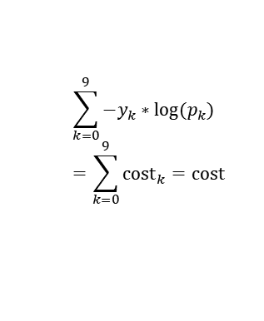



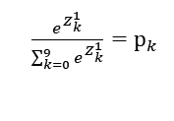







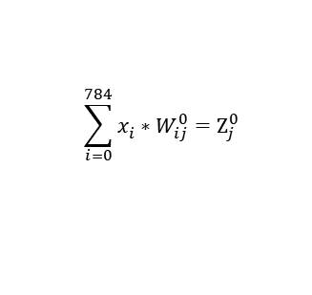
Forward Propagation
x_{i}
$$W_{ij}^{0}$$
$$Z_{j}^{0}$$
$$h_{j}^{0}$$
$$W_{jk}^{1}$$
$$Z_{k}^{1}$$
p_{k}
y_{k}
cost_{k}
cost
x₀
$$W_{00}^{0}$$
$$Z_{0}^{0}$$
$$h_{0}^{0}$$
$$W_{00}^{1}$$
$$Z_{0}^{1}$$
p₀
y₀
cost₀
x₁
$$W_{10}^{0}$$
$$W_{10}^{1}$$
$$Z_{1}^{0}$$
$$h_{1}^{0}$$
$$Z_{1}^{1}$$
p₁
y₁
cost₁
$$W_{20}^{0}$$
$$W_{j0}^{1}$$
x₂
$$W_{i0}^{0}$$
$$Z_{1}^{0}$$
$$h_{j}^{0}$$
$$W_{630}^{1}$$
$$Z_{k}^{1}$$
p_{k}
y_{k}
cost_{k}
∙
∙
∙
∙
∙
∙
∙
∙
∙
∙
x_{i}
∙
∙
∙
∙
∙
$$b_{0}^{1}=W_{640}^{1}$$
$$W_{7830}^{0}$$
$$Z_{9}^{1}$$
p₉
y₉
cost₉
$$Z_{63}^{0}$$
$$h_{63}^{0}$$
$$b_{0}^{0}=W_{7840}^{0}$$
x₇₈₃
$$h_{64}^{0}=1$$
$$\sum_{k=0}^{9}{{−y}_{k}∗log(p_{k})} \\ =\sum_{k=0}^{9}{{cost}_{k}}=cost$$
$$x_{784}=1$$
$$\sum_{i=0}^{784}{x_{i}^{}}∗W_{ij}^{0}=Z_{j}^{0}$$
$$\sum_{j=0}^{64}{h_{j}^{0}}∗W_{jk}^{1}{=Z}_{k}^{1}$$
$\frac{e^{Z_{k}^{1}}}{\sum_{k=0}^{9}{e^{Z_{k}^{1}}}}$ ${=p}_{k}$
$$\tanh{Z_{j}^{0}}=h_{j}^{0}$$

Slide 9


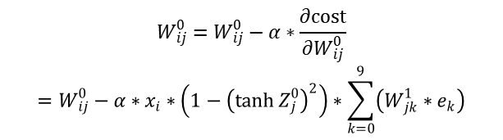
Backward Propagation
x_{i}
$$W_{ij}^{0}$$
$$Z_{j}^{0}$$
$$h_{j}^{0}$$
$$W_{jk}^{1}$$
$$Z_{k}^{1}$$
p_{k}
y_{k}
cost_{k}
cost
x₀
$$W_{00}^{0}$$
$$W_{00}^{1}$$
$$Z_{0}^{0}$$
$$h_{0}^{0}$$
$$Z_{0}^{1}$$
p₀
y₀
cost₀
x₁
$$W_{10}^{0}$$
$$W_{10}^{1}$$
$$Z_{1}^{0}$$
$$h_{1}^{0}$$
$$Z_{1}^{1}$$
p₁
y₁
cost₁
$$W_{20}^{0}$$
$$W_{j0}^{1}$$
x₂
$$W_{i0}^{0}$$
$$Z_{1}^{0}$$
$$h_{j}^{0}$$
$$W_{630}^{1}$$
$$Z_{k}^{1}$$
p_{k}
y_{k}
cost_{k}
∙
∙
∙
∙
∙
∙
∙
∙
∙
∙
x_{i}
∙
∙
∙
∙
∙
$$b_{0}^{1}=W_{640}^{1}$$
$$W_{7830}^{0}$$
$$Z_{9}^{1}$$
p₉
y₉
cost₉
$$Z_{63}^{0}$$
$$h_{63}^{0}$$
$$b_{0}^{0}=W_{7840}^{0}$$
x₇₈₃
$$h_{64}^{0}=1$$
$$W_{ij}^{0}=W_{ij}^{0}−α∗\frac{∂cost}{∂W_{ij}^{0}}$$
$$=W_{ij}^{0}−α∗x_{i}∗\left(1−{\left(\tanh{Z_{j}^{0}}\right)}^{2}\right)∗\sum_{k=0}^{9}{\left(W_{jk}^{1}∗e_{k}\right)}$$
$$x_{784}=1$$
$$W_{jk}^{1}=W_{jk}^{1}−α∗\frac{∂cost}{∂W_{jk}^{1}}=W_{jk}^{1}−α∗h_{j}^{0}∗ e_{k}$$

