Slide 1
로봇 3d 모델링 &stl파일 불러오기

Slide 2
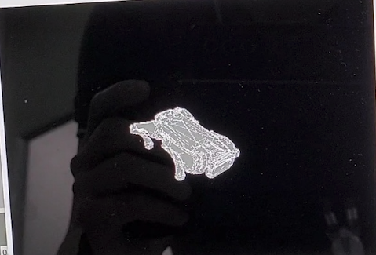
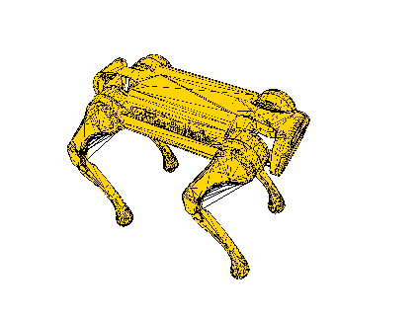
로봇 3d 모델링 불러오기
from robot3dmodel_4 import robot3d
#opengl 관련
self.open_gl = robot3d(parent=self.frame_gl)
# create class instance, passing in the tab as parent
self.open_gl.setMinimumSize(441, 411)
#로봇과 관련된 값 넣기
def openglset(self):
self.open_gl.robotRPY3d([self.isungb1.hstateRPY[0],self.isungb1.hstateRPY[1],self.isungb1.hstateRPY[2]])
self.open_gl.robotMotor3d([self.isungb1.motorQ])
self.open_gl.update()
실제 적용된 모습

Slide 3
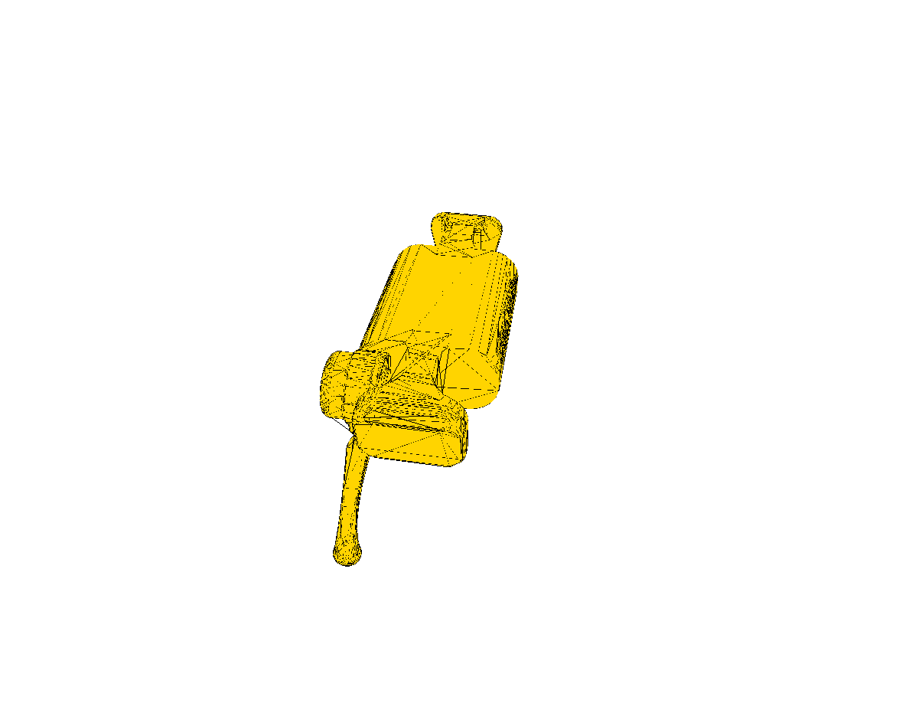
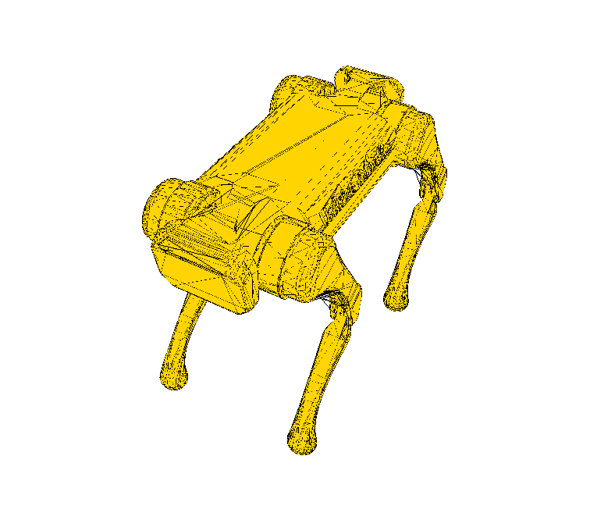
robot3dmodel_4 구성
#==================================================================
glMatrixMode(GL_MODELVIEW)
glLoadIdentity()
gluLookAt(10,-10,10, 0,0,0, 0,-1,0) #카메라
glCallList(self.planeList)
#drawAxes()
glTranslatef(self.base_position[0], 0, self.base_position[1])
glTranslatef(1, 0.5, 2) # 몸통을 평면으로 들어올리는 변환
glRotatef(self.yaw, 0, 1, 0)
glRotatef(self.roll, 0, 0, 1)# 몸통을 회전
glRotatef(self.pitch, 1, 0, 0)
glPushMatrix()
glScalef(2, 2, 4) # 몸통의 크기 변경
#drawAxes()
glColor3f(1,1,1)
drawCube()
glPopMatrix()
### Base: 전후 좌우로 이동 가능
# 제어를 통해 옮겨간 위치
glTranslatef(self.base_position[0], 0, self.base_position[1])
glTranslatef(2.1, 0, 4.4) # 몸통을 평면으로 들어올리는 변환
#glRotatef(self.yaw, 0, -1, 0)
#glRotatef(self.roll, 0, 0, -1)# 몸통을 회전
#glRotatef(self.pitch, -1, 0, 0)
#glRotatef(self.arm1X3, 1, 0, 0)
glRotatef(self.shoulder3, 0, 0, 1)# 몸통을 회전
glPushMatrix()
glScalef(0.5, 0.5, 1) # 몸통의 크기 변경
#drawAxes()
glColor3f(1,1,1)
drawCube()
glPopMatrix()
glTranslatef(0, 0, 0)# 몸통을 평면으로 들어올리는 변환
#glRotatef(self.yaw, 0, -1, 0)
#glRotatef(self.roll, 0, 0, -1)# 몸통을 회전
#glRotatef(self.pitch, -1, 0, 0)
glRotatef(self.arm1X3, 1, 0, 0)
#glRotatef(self.shoulder1, 0, 0, 1)# 몸통을 회전
glPushMatrix()
glScalef(0.5, 0.5, 1) # 몸통의 크기 변경
#drawAxes()
glColor3f(1,1,1)
drawCube()
glPopMatrix()
### 팔 1을 그리자
# 몸통의 반 만큼 올린다 (중심이 관절 위치)
glTranslatef(0, -0.5, 0)
### 회전 적용
#glRotatef(self.arm1Y, 0, 1, 0)
#glRotatef(self.arm1X3, 1, 0, 0)
# 팔의 아래쪽을 관절에 맞추기 (팔의 길이 반 만큼 올리기)
glTranslatef(0, 2, 0)
glPushMatrix()
glScalef(1, 3, 1)
#drawAxes()
glColor3f(1,1,0)
self.model2.draw()
self.model2.draw2()
drawCube()
glPopMatrix()
glTranslatef(0, 1.5, 0)
# 회전 실시
glRotatef(self.arm2X3, 1, 0, 0)
# 팔 2의 끝을 관절로 옮김 (팔 2의 반 이동)
glTranslatef(0, 1.5, 0)
# 팔 2: 높이가 3인 육면체
glPushMatrix()
glScalef(1, 3, 1)
#drawAxes()
glColor3f(0,1,1)
self.modelL.draw()
self.modelL.draw2()
drawCube()
glPopMatrix()
#==================================================================
X4
몸통
허벅지
다리
어깨

Slide 4
Stlro3d 구성
def load_stl(self,filename):
#read start of file to determine if its a binay stl file or a ascii stl file
fp=open(filename,'rb')
h=fp.read(80)
type=h[0:5]
fp.close()
print(type)
if type==b'solid':
print ("reading text file"+str(filename))
self.load_text_stl(filename)
else:
print ("reading binary stl file "+str(filename,))
self.load_binary_stl(filename)
def load_binary_stl(self,filename):
fp=open(filename,'rb')
h=fp.read(80)
l=struct.unpack('I',fp.read(4))[0]
count=0
while True:
try:
p=fp.read(12)
if len(p)==12:
n=struct.unpack('f',p[0:4])[0],struct.unpack('f',p[4:8])[0],struct.unpack('f',p[8:12])[0]
p=fp.read(12)
if len(p)==12:
p1=struct.unpack('f',p[0:4])[0],struct.unpack('f',p[4:8])[0],struct.unpack('f',p[8:12])[0]
p=fp.read(12)
if len(p)==12:
p2=struct.unpack('f',p[0:4])[0],struct.unpack('f',p[4:8])[0],struct.unpack('f',p[8:12])[0]
p=fp.read(12)
if len(p)==12:
p3=struct.unpack('f',p[0:4])[0],struct.unpack('f',p[4:8])[0],struct.unpack('f',p[8:12])[0]
new_tri=(n,p1,p2,p3)
if len(new_tri)==4:
tri=createtriangle(p1,p2,p3,n)
self.model.append(tri)
count+=1
fp.read(2)
if len(p)==0:
break
except EOFError:
break
fp.close()
class loader:
def __init__(self):
self.model=[]
#return the faces of the triangles
def get_triangles(self):
if self.model:
for face in self.model:
yield face
#draw the models faces
def draw(self):
glBegin(GL_TRIANGLES)
for tri in self.get_triangles():
glColor3f(1,0.83,0)
glNormal3f(tri.normal.x,tri.normal.y,tri.normal.z)
#glColor3fv(1.0,0,0,0)
glVertex3f(tri.points[0].x,tri.points[0].y,tri.points[0].z)
#glColor3fv(1.0,0,0,0)
glVertex3f(tri.points[1].x,tri.points[1].y,tri.points[1].z)
#glColor3fv(0,0,0,0)
glVertex3f(tri.points[2].x,tri.points[2].y,tri.points[2].z)
glEnd()
def draw2(self):
glBegin(GL_LINES)
for tri in self.get_triangles():
glColor3f(0,0,0)
glNormal3f(tri.normal.x,tri.normal.y,tri.normal.z)
#glColor3fv(1.0,0,0,0)
glVertex3f(tri.points[0].x,tri.points[0].y,tri.points[0].z)
#glColor3fv(1.0,0,0,0)
glVertex3f(tri.points[1].x,tri.points[1].y,tri.points[1].z)
#glColor3fv(0,0,0,0)
glVertex3f(tri.points[2].x,tri.points[2].y,tri.points[2].z)
glEnd()
파일불러오기
Binary로 된 stl파일 분석
def load_text_stl(self,filename):
fp=open(filename,'r')
for line in fp.readlines():
words=line.split()
if len(words)>0:
if words[0]=='solid':
self.name=words[1]
if words[0]=='facet':
center=[0.0,0.0,0.0]
triangle=[]
normal=(eval(words[2]),eval(words[3]),eval(words[4]))
if words[0]=='vertex':
triangle.append((eval(words[1]),eval(words[2]),eval(words[3])))
if words[0]=='endloop':
#make sure we got the correct number of values before storing
if len(triangle)==3:
self.model.append(createtriangle(triangle[0],triangle[1],triangle[2],normal))
fp.close()
Text로 된 stl파일 분석
Stl 그리기

