Slide 2
Using Source Control effectively
Nothing is ever “gone forever”
Hoa Hoang

Slide 3

Agenda
Problems
Version Control System
Subversion - Tortoise SVN
7 habits of using SVN
Best Practices
Q & A

Slide 4
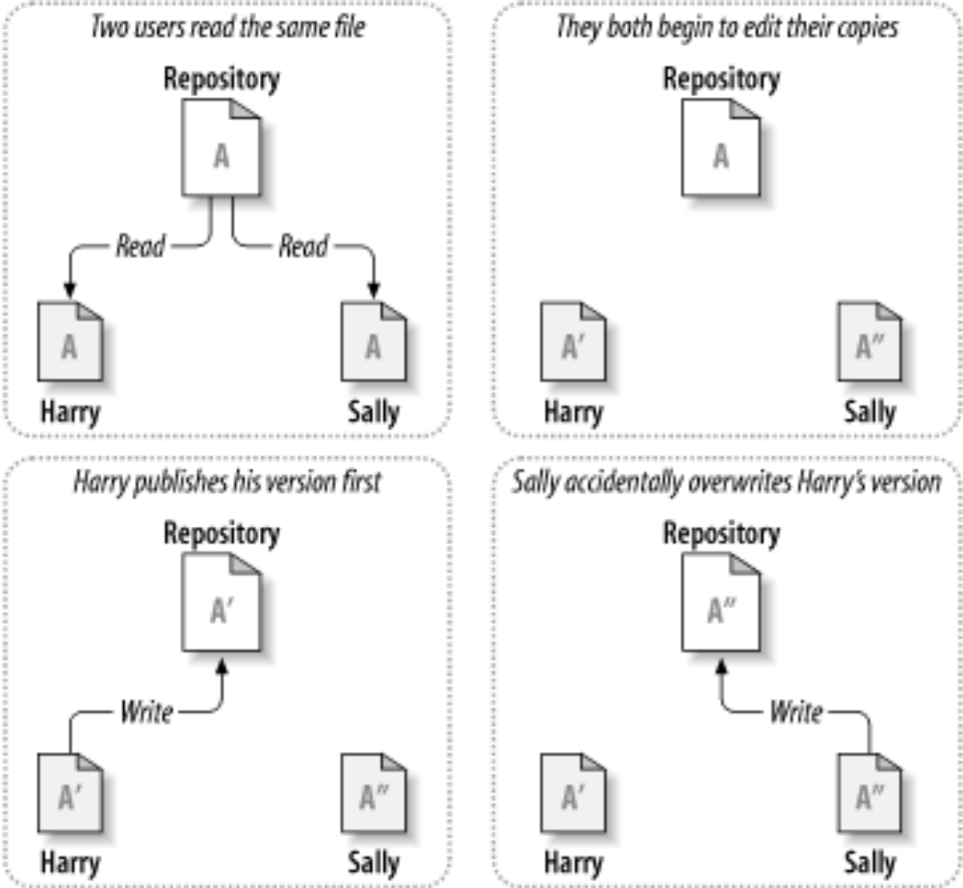
Problems
Users editing the same file concurrently overwriting each other

Slide 5
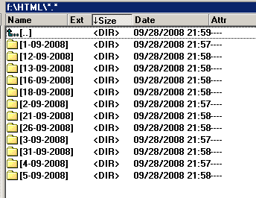
Problems
Many copy of source code on file server and local machine

Slide 6






Problems
Accident of deletion, overwriting
  Data lost forever
  Unknown who, how, what, why, when, where files changed
index.aspx

Slide 7
Problems
Problem & more…

Slide 8

Agenda
Problems
Version Control System
Subversion -Tortoise SVN
7 habits of using SVN
Best Practices
Q & A

Slide 9
Version control system
VCS is crucial to engineering and software development projects
  Repository
  Team-based collaboration
  Record changes
  Revision
  History
  Trunk
  Branches / Tag

Slide 10




Version control system
Repository
  Centralized stores of data. In SVN, data stored in the form of a filesystem tree by a hierarchy of files and directories
Client
Client
Working copy
Working copy
Client
Version control server
Repository
Client
Working copy
Working copy

Slide 11

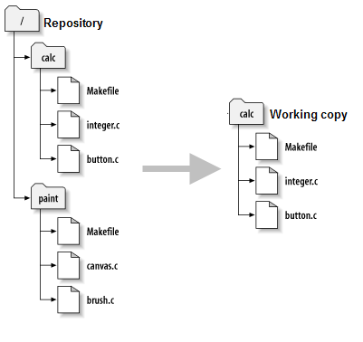
Version control system
Working copy
  A ordinary directory tree of source code for projects checkout to your local hard drive. Were you can freely make changes => Creating revision

Slide 12
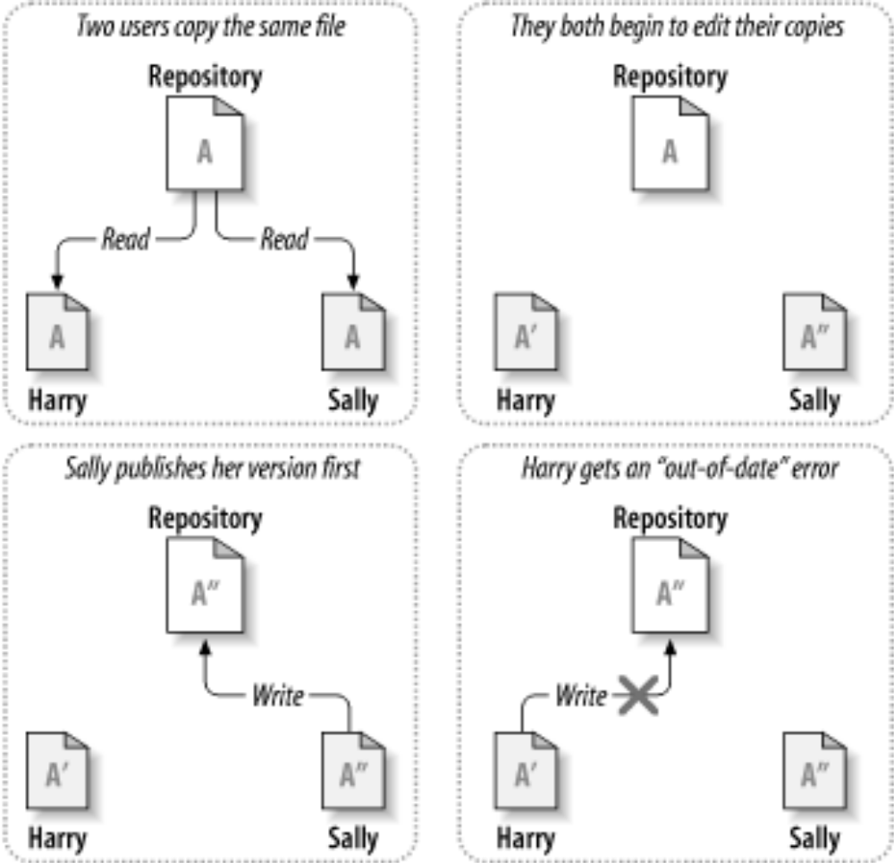
Version control system
Team-based collaboration

Slide 13
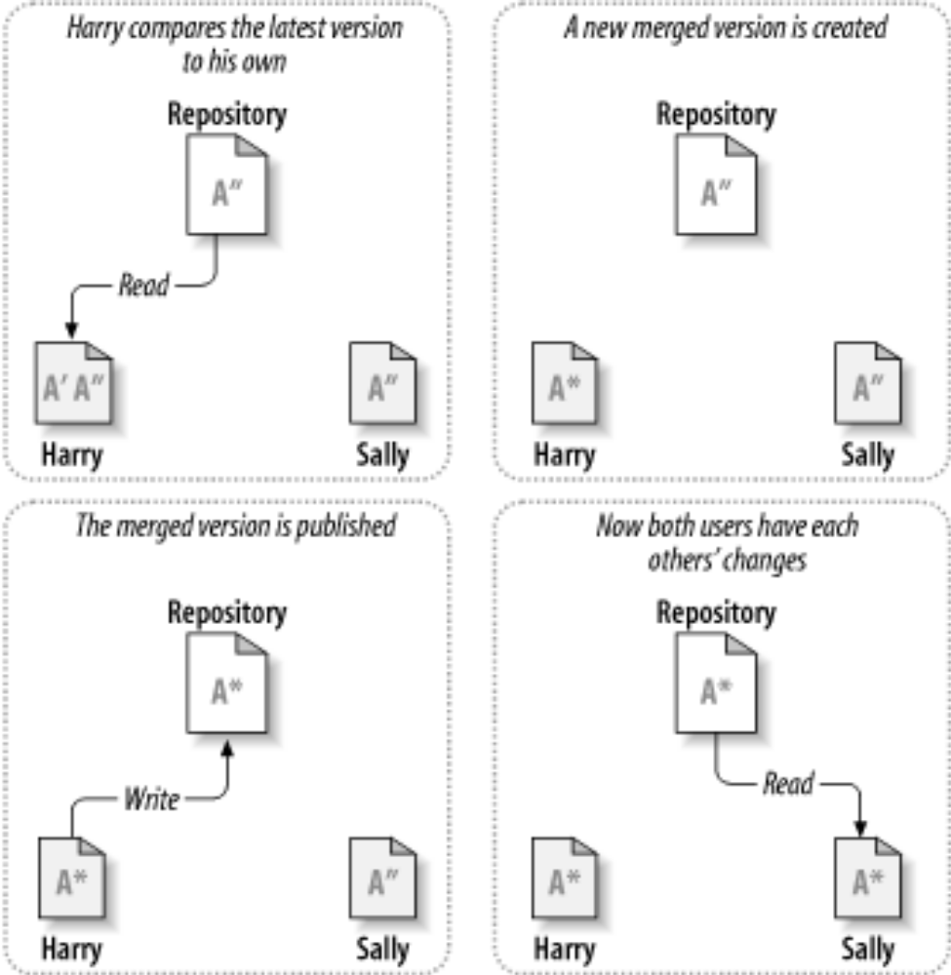
Version control system
Team-based collaboration

Slide 14

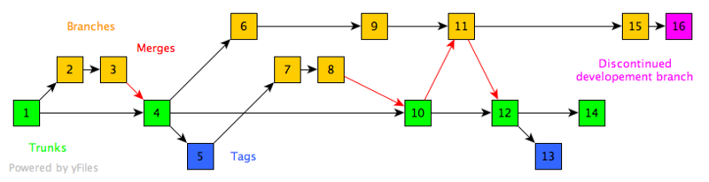
Version control system
Revision
  A version number associated with a chain of changes to the contents of a single or multiple Files/Directories in the Repository

Slide 15

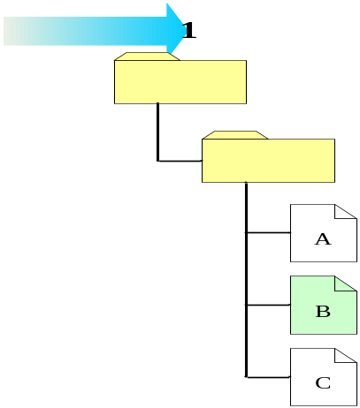
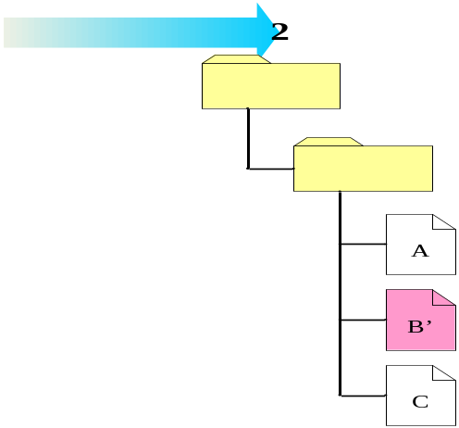
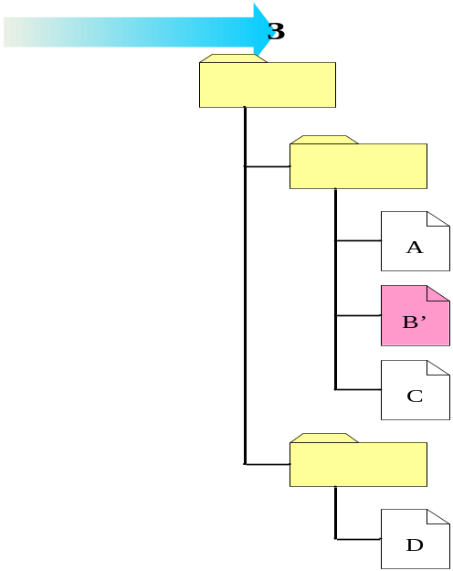
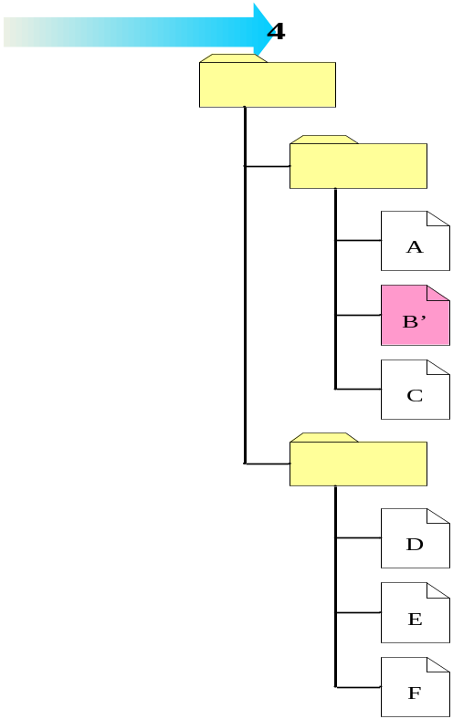
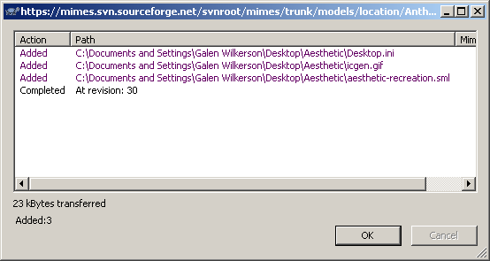
Version control system
Revision
revision 415
revision 430
revision 472
revision 473
revision 477
Index.html

Slide 16
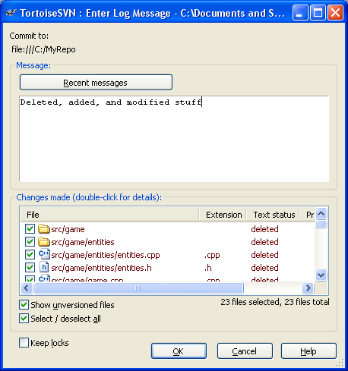
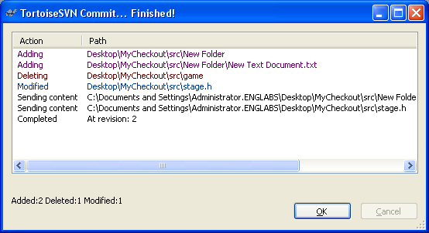
Version control system
Record changes
  who, what, why, when, where files changed

Slide 17
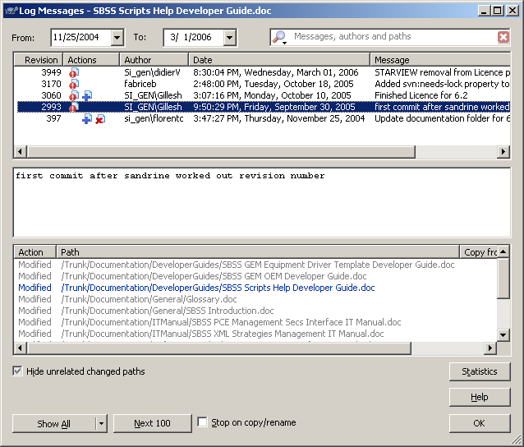
Version control system
History

Slide 18

Version control system
Project
  Project = directory
  Grouping of files/directories contained within repository
  Usually multiple Projects per Repository
  Project usually created as a named directory with the following structure
project
  branches
  tags
  trunk

Slide 19

Version control system
Trunk
tag
347
merge
trunk
342
421
426
release
branch
maintenance
branch
425
434

Slide 20

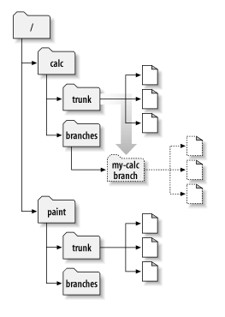
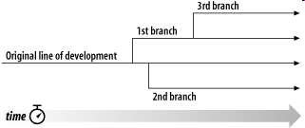
Version control system
Branchs
  A second copy of your document directory (project), maintaining separately and worked in parallel to the main codeline (Trunk)

Slide 21

Version control system
Tag
  A labeled snapshot of the directory (project) in time, or a Branch, at a particular Revision.
Notes:
`

Slide 23

VCS Work-cycle
Start
Check out
  To retrieve a directory from the Repository to view and/or edit the Resource. Allow to choose resource at a specific point
    Head: Most recent revision
    Revision#: most recent a specific revision number
    Tag: A revision# marked as tag (Release)
    Date: Specific date
Check Out
Clean up
Delete
Modify
Revert
Rename
Update
Add
Conflict
Yes
No
Merge
Branch
Commit
Mark resolved
Tag
End

Slide 24
VCS Work-cycle
Start
Modify
  Modify: Doing your work on working copy
  Lock file no nobody else can edit.
  Unlock when done
Check Out
Clean up
Delete
Modify
Revert
Rename
Update
Add
Conflict
Yes
No
Merge
Branch
Commit
Mark resolved
Tag
End

Slide 25
VCS Work-cycle
Start
Revert
  When your changes become messy, want to get the good copy from repository overwrite back to working copy
Check Out
Clean up
Delete
Modify
Revert
Rename
Update
Add
Conflict
Yes
No
Merge
Branch
Commit
Mark resolved
Tag
End

Slide 26
VCS Work-cycle
Start
Cleanup
Rename
Delete
Add
Check Out
Clean up
Delete
Modify
Revert
Rename
Update
Add
Conflict
Yes
No
Merge
Branch
Commit
Mark resolved
Tag
End

Slide 27
VCS Work-cycle
Start
Update
  Downloading and merging all latest changes from repository into your working copy – (prevent conflict)
Check Out
Clean up
Delete
Modify
Revert
Rename
Update
Add
Conflict
Yes
No
Merge
Branch
Commit
Mark resolved
Tag
End

Slide 28
VCS Work-cycle
Start
Conflict
  Resolve conflict: Chose/modify if there some lines editing both by theirs and mine
Check Out
Clean up
Delete
Modify
Revert
Rename
Update
Add
Conflict
Yes
No
Merge
Branch
Commit
Mark resolved
Tag
End

Slide 29

VCS Work-cycle
Start
Merge/Different
  Merge: Often automatically done by subversion. If theirs code and mine code change on different line
Check Out
Clean up
Delete
Modify
Revert
Rename
Update
Add
Conflict
Yes
No
Merge
Branch
Commit
Mark resolved
Tag
End

Slide 30

VCS Work-cycle
Start
Commit
  Check in/Commit: pushing edited files to repository (with a log message saying what you did)
Check Out
Clean up
Delete
Modify
Revert
Rename
Update
Add
Conflict
Yes
No
Merge
Branch
Commit
Mark resolved
Tag
End

Slide 31
VCS Work-cycle
Start
Branches
Tags
Import
Export
Check Out
Clean up
Delete
Modify
Revert
Rename
Update
Add
Conflict
Yes
No
Merge
Branch
Commit
Mark resolved
Tag
End

Slide 32
Revision control software
Subversion
Visual SourceSafe
StarTeam
CVS
AccuRev
…
http://en.wikipedia.org/wiki/List_of_revision_control_software

Slide 33

Agenda
Problems
Version Control System
Subversion Tortoise SVN
7 habits of using SVN
Best Practices
Q & A

Slide 34
Subversion
A version control system, it handles any types of files, documents, or directories with these features
  Atomic Commits
  Windows-integrated (Tortoise SVN)
  Directory base (not project-base)
  Import directory (Project)
  2 versioning models
  Copy-Modify-Merge
  Lock-Modify-Unlock
  Renaming revision
  Branch/Tag/Merge/Different

Slide 35
Subversion
Benefit
  Better binary file support
  File/directory renaming
  Metadata versioning
  Better bandwidth usage
  Multiple protocal (svn://, http://)
  Efficient branching and tagging
  Many client tool & add-in support Eclipse, AnkSVN, InterliJ Idea, Visual Studio…Tortoise SVN
  Ignoring
  Revert/Cleanup
  Comparing/Different

Slide 36
Subversion
Repository View
  Connecting to repository
  Browsing
  Making revision link
  Checking out
Synchronize View
  Updating
  Committing
  Reverting
  Conflict resolution
History View
  Reviewing changes

Slide 37
Subversion
Apache base server
  http://linuxtwo:8080/repository/ABCProject
SVN base server
  svn://linuxtwo/repository/ABCProject
File system base server
  file:///D:/repository/ABCProject

Slide 38







Tortoise SVN
Status of version controlled files/folders
 | Green checkmark: normal status, under control
 | Red exclamation: file has been modified since last update and needs to be committed.
 | Yellow exclamation: a conflict occurs during an update.
 | Grey checkmark: this file needs to be locked first before editing.
 | Locked lock: file is locked. Need to unlock for other to commit.
 | Red deletion: missing file or file to be deleted under version control.
 | Blue plus: File to be added to version control.

Slide 39

Demo

Slide 40

Agenda
Problems
Version Control System
Subversion - Tortoise SVN
7 habits of using SVN
Best Practices
Q & A

Slide 41
7 habits of using SVN
1
Update/Commit source code every good changes
Give comments for the commit

Slide 42
7 habits of using SVN
2
Update/Merge/Resolve conflict before Commit

Slide 43
7 habits of using SVN
3
Do not shy, do not stupid, do not blame when conflict. Quickly find ‘theirs’ and resolve together

Slide 44
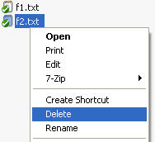
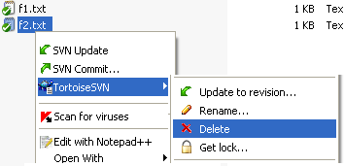
7 habits of using SVN
4
Use TortoiseSVN commands (delete, rename, copy) Do not use the Windows Explorer commands.
Donot changes or remove the added svn files/folders

Slide 45
7 habits of using SVN
5
Delete your working copy and checkout new source every Monday

Slide 46
7 habits of using SVN
6
Don’t versioning by yourself

Slide 47
7 habits of using SVN
7
Use revert and cleanup when thing are messy
Make ignore garbage files/directories before commit

Slide 48

Agenda
Problems
Version Control System
Subversion - Tortoise SVN
7 habits of using SVN
Best Practices
Q & A

Slide 49
Best Practices
Avoiding Conflicts
Commit Often!
  The less time you spend with code you haven't committed, the less likely someone will edit a line you’ve not committed.
Commit in small chunks!
  The less code you change and don’t commit, the less likely someone will edit a line you’ve not committed.
Split your project into more than one file!
  You should be doing this anyways ?

Slide 50
Best Practices
What not to do…
Don’t commit broken code
  If someone else updates, they will have broken code too and will be unable to work unless they fix your mess
Don’t commit temporary/binary files
  We don’t need files like vore.vcproj.SNOWFIRE.philipd.user or any .exe or .obj files. They waste space!
  You MAY commit graphics as long as they aren’t too big.
  Binary files don’t get merged.
Don’t commit ginourmous files
  Remember, if you put it in the repository you force people to download it!
  A good alternative for optional files that are big is to put them on a web server – particularly if they don’t change

Slide 51
Best Practices
What to do..
When you commit, describe in the log as succinctly and clearly what you changed as possible
  This information will help others know what you did to the code
Add your new files
  If you make a new file, make sure to right click and add it to source control. If you don’t, others won’t be able to get it.
  EXAMPLE: In a game, you add a bitmap file. If you forget to add it to the subversion, when others synchronize, they download your code but not the bitmap. Now when they run the game, it crashes because it can’t find your file.

Slide 52
Agenda
Problems
Version Control System
Subversion - Tortoise SVN
7 habits of using SVN
Best Practices
Q & A

Slide 53
Q & A
How to obtain a “clean” working copy (original sources only) and exclude .svn folders.
  Select working copy>right-click>TortoiseSVN>Export
  Provide the destination folder for the “clean” working copy
How to leave (ignore) the files/folders not in source control
  Select files/folders in working copy not in source control
  Right-click>TortoiseSVN>Add to ignore list
How to add “free” files/folders (in working copy) into source control
  Select fils/folders>right-click>TortoiseSVN>Add
  Commit the working copy

Slide 54
Q & A
How to break/steal lock
  This is to break the locking on file by override the locking author.
  Check for modifications>select locked files>break lock, OR
  Right click>TortoiseSVN>Get lock, check the Steal option, OK.
  Recommend: should not use this function unless you have agreement of the PM.
Cannot login because of wrong SSL cache: clear cache
  First login to a wrong/forbidden link failed => wrong SSL is cached
  Later login (to correct link) also failed because the TortoiseSVN use the wrong cached SSL.
  Solution: right click>TortoiseSVN>Settings>Saved data>Authentication Data>Clear

Slide 55
Q & A
How to check out an SVN directory (recursively) to local existing folder? (Similar to get latest version in VSS & overwrite all local)
  Should checkout to an empty working copy.
  Existing working copy may cause file conflict or leave files not under source control.
How to get specific version of code from SVN?
  Select file/folder in the working copy
  TortoiseSVN>Update to revision…
  Select the option Revision, input desired revision
  You can Show log to know the log message.

Slide 56
More question?

Slide 57
Thank you !!!

