Slide 1
Float Pointe Numbers
Instructor Dr. Jianhui Yue
Fall 2015 CSE, Miami Univ.
Notes adapted from James Ward
Reading Textbook P196~210

Slide 2
Real Numbers
Two’s complement representation deal with signed integer values only.
Without modification, these formats are not useful in scientific or business applications that deal with real number values.
Floating-point representation solves this problem.

Slide 3
Floating Point
Representation for non-integral numbers
Including very small and very large numbers
Like scientific notation
–2.34 × 10⁵⁶
+0.002 × 10^{–4}
+987.02 × 10⁹
In binary
±1.xxxxxxx₂ × 2^{yyyy}
Types float and double in C
normalized
not normalized

Slide 4
Floating-Point Representation
Floating-point numbers allow an arbitrary number of decimal places to the right of the decimal point.
For example: 0.5 × 0.25 = 0.125
They are often expressed in scientific notation.
For example:
0.125 = 1.25 × 10⁻¹
5,000,000 = 5.0 × 10⁶

Slide 5
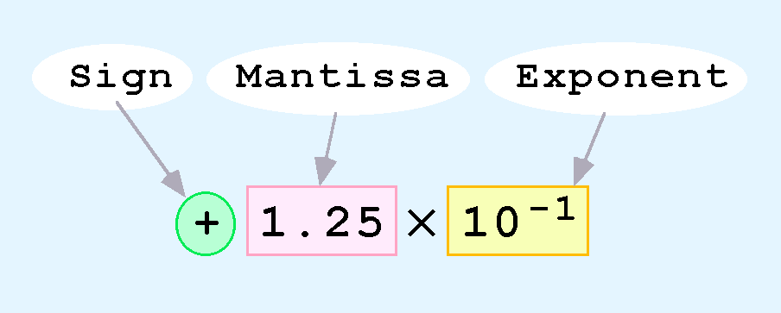
Numbers in scientific notation
Computers use a form of scientific notation for floating-point representation
Numbers written in scientific notation have three components:

Slide 6
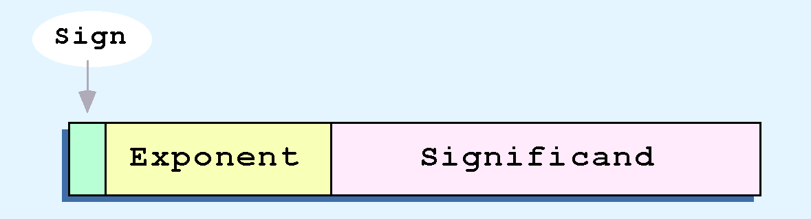
Floating-Point Representation
Computer representation of a floating-point number consists of three fixed-size fields:
This is the standard arrangement of these fields.
Note: Although “significand” and “mantissa” do not technically mean the same thing, many people use these terms interchangeably. We use the term “significand” to refer to the fractional part of a floating point number.

Slide 7
Floating-Point Representation
The one-bit sign field is the sign of the stored value.
The size of the exponent field determines the range of values that can be represented.
The size of the significand determines the precision of the representation.

Slide 8
Floating-Point Representation
We introduce a hypothetical “Simple Model” to explain the concepts
In this model:
A floating-point number is 14 bits in length
The exponent field is 5 bits
The significand field is 8 bits

Slide 9
Floating-Point Representation
The significand is always preceded by an implied binary point.
Thus, the significand always contains a fractional binary value.
The exponent indicates the power of 2 by which the significand is multiplied.

Slide 10
Calculate Significand
Significand is also called fraction
The significand is a faction with base 2
Assume significand to be s1s2s3…
Its value is 0.s1s2s3…₂
= ( s1*2⁻¹ + s2*2⁻² + s3*2⁻³+ …)₁₀
0.1011₂
= (1*2⁻¹ + 1*2⁻³ + 1*2⁻⁴)₁₀

Slide 11
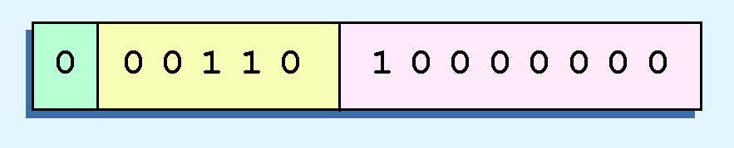
An Example
Exponent
Significand
(-1)^{s}*(Significand)*2^{Exponent}
= 1 * (0.1)₂ *2⁽⁶⁾=2⁽⁻¹⁾ *2⁽⁶⁾= 2⁵
A decimal
A binary fraction

Slide 12
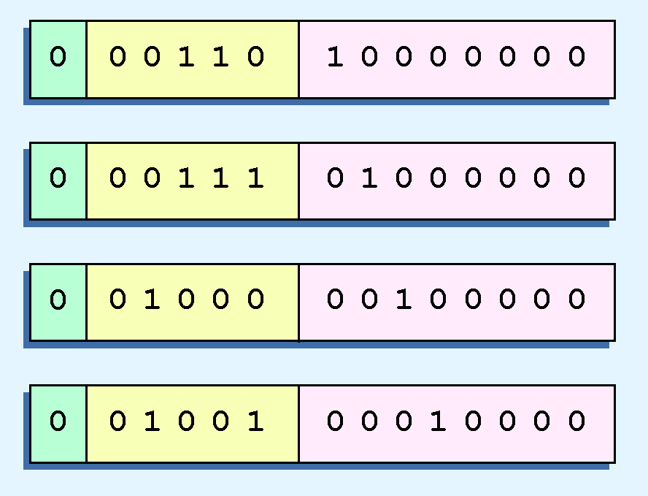
Synonymous Representations
The illustrations shown at the right are all equivalent representations for 32 using our simplified model.
(-1)^{s}*(Significand)*2^{Exponent}
(0.1)₂ *2⁽⁶⁾=2⁽⁻¹⁾ *2⁽⁶⁾
= 2⁵
(0.01)₂ *2⁽⁷⁾=2⁽⁻²⁾ *2⁽⁷⁾
= 2⁵
(0.001)₂ *2⁽⁸⁾=2⁽⁻³⁾ *2⁽⁸⁾
= 2⁵
(0.0001)₂ *2⁽⁹⁾=2⁽⁻⁴⁾ *2⁽⁹⁾
= 2⁵
Not only do these synonymous representations waste space, but they can also cause confusion.

Slide 13
No Negative Exponents
Another problem with our system is that we have made no allowances for negative exponents. We have no way to express 0.5 (=2 ⁻¹)! (Notice that there is no sign in the exponent field.)
All of these problems can be fixed with no changes to our basic model.

Slide 14
Normalization
To resolve the problem of synonymous forms, we establish a rule that the first digit of the significand must be 1, with no ones to the left of the radix point.
This process, called normalization, results in a unique pattern for each floating-point number.
For example,
4.5 = 100.1 x 2⁰ (1)
4.5 = 1.001 x 2² (2)
4.5 = 0.1001 x 2³ (3)
all significands must have the form 0.1xxxxxxxx
Q: which one is normalized?
In our simple instructional model, we use no implied bits.

Slide 15
How to normalize?
As you left shift the significand by N , increase exponent by N
100.1 x 2⁵
⁼ 0.1001 x 2⁵⁺²
As you right shift the significand by N , decrease exponent by N
0.001 x 2⁵
⁼ 0.1 x 2⁵⁻²

Slide 16
Biased Exponent
To provide for negative exponents, we will use a biased exponent.
A bias is a number that is approximately midway in the range of values expressible by the exponent. We subtract the bias from the value in the exponent to determine its true value.
In our case, we have a 5-bit exponent. We will use 16 for our bias. This is called excess-16 representation.
In our model, exponent values less than 16 are negative, representing fractional numbers.

Slide 17
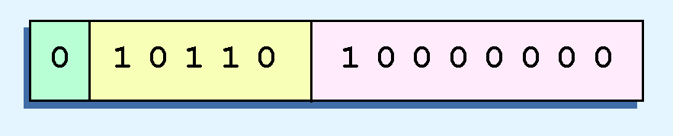
Example 1
Example:
Express 32₁₀ in the revised 14-bit floating-point model.
We know that 32 = 1.0 x 2⁵ = 0.1 x 2⁶.
To use our excess 16 biased exponent, we add 16 to 6, giving 22₁₀ (=10110₂).
So we have:

Slide 18

Example 2
Example:
Express 0.0625₁₀ in the revised 14-bit floating-point model.
We know that 0.0625 is 2⁻⁴. So in (binary) scientific notation 0.0625 = 1.0 x 2⁻⁴ = 0.1 x 2 ⁻³.
To use our excess 16 biased exponent, we add 16 to -3, giving 13₁₀ (=01101₂).

Slide 19

Example 3
Example:
Express -26.625₁₀ in the revised 14-bit floating-point model.
We find 26.625₁₀ = 11010.101₂. Normalizing, we have: 26.625₁₀ = 0.11010101 x 2 ⁵.
To use our excess 16 biased exponent, we add 16 to 5, giving 21₁₀ (=10101₂). We also need a 1 in the sign bit.

Slide 20
Floating Point Standard
Defined by IEEE Std 754-1985
Developed in response to divergence of representations
Portability issues for scientific code
Now almost universally adopted
Two representations
Single precision (32-bit)
Double precision (64-bit)

Slide 21
IEEE Floating-Point Format
single: 8 bits double: 11 bits
single: 23 bits double: 52 bits
S
Exponent
Fraction
S: sign bit (0 ⇒ non-negative, 1 ⇒ negative)
Normalize significand: 1.0 ≤ |significand| < 2.0
Always has a leading pre-binary-point 1 bit, so no need to represent it explicitly (hidden bit)
Significand is Fraction with the “1.” restored
Exponent: excess representation: actual exponent + Bias
Ensures exponent is unsigned
Single: Bias = 127; Double: Bias = 1203

Slide 22
Single-Precision Range
Exponents 00000000 and 11111111 reserved
Smallest value
Exponent: 00000001 ⇒ actual exponent = 1 – 127 = –126
Fraction: 000…00 ⇒ significand = 1.0
±1.0 × 2^{–126} ≈ ±1.2 × 10^{–38}
Largest value
exponent: 11111110 ⇒ actual exponent = 254 – 127 = +127
Fraction: 111…11 ⇒ significand ≈ 2.0
±2.0 × 2⁺¹²⁷ ≈ ±3.4 × 10⁺³⁸

Slide 23
Double-Precision Range
Exponents 0000…00 and 1111…11 reserved
Smallest value
Exponent: 00000000001 ⇒ actual exponent = 1 – 1023 = –1022
Fraction: 000…00 ⇒ significand = 1.0
±1.0 × 2^{–1022} ≈ ±2.2 × 10^{–308}
Largest value
Exponent: 11111111110 ⇒ actual exponent = 2046 – 1023 = +1023
Fraction: 111…11 ⇒ significand ≈ 2.0
±2.0 × 2⁺¹⁰²³ ≈ ±1.8 × 10⁺³⁰⁸

Slide 24
Floating-Point Precision
Relative precision
all fraction bits are significant
Single: approx 2^{–23}
Equivalent to 23 × log₁₀2 ≈ 23 × 0.3 ≈ 6 decimal digits of precision
Double: approx 2^{–52}
Equivalent to 52 × log₁₀2 ≈ 52 × 0.3 ≈ 16 decimal digits of precision

Slide 25
Floating-Point Example
Represent –0.75
–0.75 = (–1)¹ × 1.1₂ × 2^{–1}
S = 1
Fraction = 1000…00₂
Exponent = –1 + Bias
Single: –1 + 127 = 126 = 01111110₂
Double: –1 + 1023 = 1022 = 01111111110₂
Single: 1011111101000…00
Double: 1011111111101000…00

Slide 26
Floating-Point Example
What number is represented by the single-precision float
11000000101000…00
S = 1
Fraction = 01000…00₂
Fxponent = 10000001₂ = 129
x = (–1)¹ × (1 + 01₂) × 2^{(129 – 127)}
= (–1) × 1.25 × 2²
= –5.0

Slide 27
Denormal Numbers
Exponent = 000...0 ⇒ hidden bit is 0
Smaller than normal numbers
allow for gradual underflow, with diminishing precision
Denormal with fraction = 000...0
Two representations of 0.0!

Slide 28
Infinities and NaNs
Exponent = 111...1, Fraction = 000...0
±Infinity
Can be used in subsequent calculations, avoiding need for overflow check
Exponent = 111...1, Fraction ≠ 000...0
Not-a-Number (NaN)
Indicates illegal or undefined result
e.g., 0.0 / 0.0
Can be used in subsequent calculations

Slide 29
Floating-Point Addition for decimal
Consider a 4-digit decimal example
9.999 × 10¹ + 1.610 × 10^{–1}
1. Align decimal points
Shift number with smaller exponent
9.999 × 10¹ + 0.016 × 10¹
2. Add significands
9.999 × 10¹ + 0.016 × 10¹ = 10.015 × 10¹
3. Normalize result & check for over/underflow
1.0015 × 10²
4. Round and renormalize if necessary
1.002 × 10²

Slide 30
Floating-Point Addition for Binary
Now consider a 4-digit binary example
1.000₂ × 2^{–1} + –1.110₂ × 2^{–2} (0.5 + –0.4375)
1. Align binary points
Shift number with smaller exponent
1.000₂ × 2^{–1} + –0.111₂ × 2^{–1}
2. Add significands
1.000₂ × 2^{–1} + –0.111₂ × 2–1 = 0.001₂ × 2^{–1}
3. Normalize result & check for over/underflow
1.000₂ × 2^{–4}, with no over/underflow
4. Round and renormalize if necessary
1.000₂ × 2^{–4} (no change) = 0.0625

Slide 31
Floating-Point add/sub
The first thing that we do is express both operands in the same exponential power, then add the numbers, preserving the exponent in the sum.
If the exponent requires adjustment, we do so at the end of the calculation.

Slide 32
Floating-Point Multiplication for Decimal
Consider a 4-digit decimal example
1.110 × 10¹⁰ × 9.200 × 10^{–5}
1. Add exponents
For biased exponents, subtract bias from sum
New exponent = 10 + –5 = 5
2. Multiply significands
1.110 × 9.200 = 10.212 ⇒ 10.212 × 10⁵
3. Normalize result & check for over/underflow
1.0212 × 10⁶
4. Round and renormalize if necessary
1.021 × 10⁶
5. Determine sign of result from signs of operands
+1.021 × 10⁶

Slide 33
Floating-Point Multiplication for Binary
Now consider a 4-digit binary example
1.000₂ × 2^{–1} × –1.110₂ × 2^{–2} (0.5 × –0.4375)
1. Add exponents
Unbiased: –1 + –2 = –3
Biased: (–1 + 127) + (–2 + 127) = –3 + 254 – 127 = –3 + 127
2. Multiply significands
1.000₂ × 1.110₂ = 1.1102 ⇒ 1.110₂ × 2^{–3}
3. Normalize result & check for over/underflow
1.110₂ × 2^{–3} (no change) with no over/underflow
4. Round and renormalize if necessary
1.110₂ × 2^{–3} (no change)
5. Determine sign: +ve × –ve ⇒ –ve
–1.110₂ × 2^{–3} = –0.21875

Slide 34
Floating-Point Multiplication
Floating-point multiplication is also carried out in a manner akin to how we perform multiplication using pencil and paper.
We multiply the two operands and add their exponents.
If the exponent requires adjustment, we do so at the end of the calculation.

