Slide 1
Instruction Set Architecture
Instructor Dr. Jianhui Yue
Fall 2015 CSE, Miami Univ.
Notes adapted from MK

Slide 2
Instruction Set
§2.1 Introduction
The repertoire of instructions of a computer
Different computers have different instruction sets
But with many aspects in common
Early computers had very simple instruction sets
Simplified implementation
Many modern computers also have simple instruction sets

Slide 3
The MIPS Instruction Set
Used as the example throughout the book
Stanford MIPS commercialized by MIPS Technologies (www.mips.com)
Large share of embedded core market
Applications in consumer electronics, network/storage equipment, cameras, printers, …
Typical of many modern ISAs
See MIPS Reference Data tear-out card, and Appendixes B and E

Slide 4
Arithmetic Operations
Add and subtract, three operands
Two sources and one destination
add a, b, c # a gets b + c
All arithmetic operations have this form
Design Principle 1: Simplicity favours regularity
Regularity makes implementation simpler
Simplicity enables higher performance at lower cost
§2.2 Operations of the Computer Hardware

Slide 5
Arithmetic Example
C code:
f = (g + h) - (i + j);
Compiled MIPS code:
add t0, g, h # temp t0 = g + h add t1, i, j # temp t1 = i + j sub f, t0, t1 # f = t0 - t1

Slide 6
Register Operands
Arithmetic instructions use register operands
MIPS has a 32 × 32-bit register file
Use for frequently accessed data
Numbered 0 to 31
32-bit data called a “word”
Assembler names
$t0, $t1, …, $t9 for temporary values
$s0, $s1, …, $s7 for saved variables
Design Principle 2: Smaller is faster
c.f. main memory: millions of locations
§2.3 Operands of the Computer Hardware

Slide 7
Register Operand Example
C code:
f = (g + h) - (i + j);
f, …, j in $s0, …, $s4
Compiled MIPS code:
add $t0, $s1, $s2 add $t1, $s3, $s4 sub $s0, $t0, $t1

Slide 8
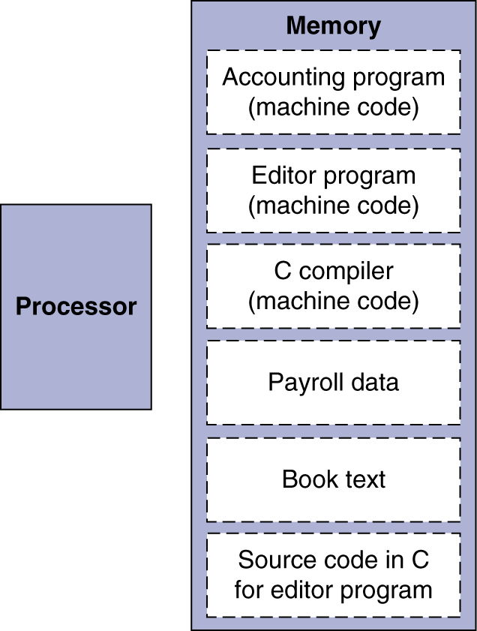
Stored Program Computers
The BIG Picture
Instructions represented in binary, just like data
Instructions and data stored in memory
Programs can operate on programs
e.g., compilers, linkers, …
Binary compatibility allows compiled programs to work on different computers
Standardized ISAs

Slide 9
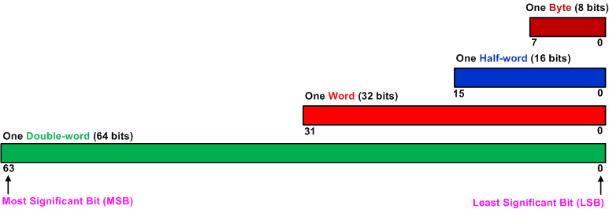
Bit, Byte, Half-word, Word, Double-Word

Slide 10
Logic View of Memory
By grouping bits together we can store more values
8 bits = 1 byte
16 bits = 2 bytes = 1 halfword
32 bits = 4 bytes = 1 word
From software perspective, memory is an array of bytes, each of which is addressable.
The byte stored at the memory address 0x20000004 is 10000100
8 bits
High Address
0x20000007
01110010
0x20000006
00100101
0x20000005
11100010
0x20000004
10000100
0x20000003
01100001
0x20000002
10001111
0x20000001
00010010
0b10000100
0x84
132
0x20000000
10010100
Binary
Hexadecimal
Decimal
Low Address

Slide 11
Logic View of Memory
When we refer to memory locations by address, we can only do so in units of bytes, halfwords or words
Words
32 bits = 4 bytes = 1 word
We have two words:
0x20000000
0x20000004
Can you store a word anywhere? NO.
A word can only be stored at an address that's divisible by 4.
Memory address of a word is the lowest address of all four bytes in that word.
8 bits
High Address
0x20000007
01110010
0x20000006
00100101
0x20000005
11100010
0x20000004
10000100
0x20000003
01100001
0x20000002
10001111
0x20000001
00010010
0x20000000
10010100
Word-address mod 4 = 0
Low Address

Slide 12
Logic View of Memory
Cannot store a word at address 0x20000002.
When we refer to memory locations by address, we can only do so in units of bytes, halfwords or words
Words
32 bits = 4 bytes = 1 word
We have two words:
0x20000000
0x20000004
Can you store a word anywhere? NO.
A word can only be stored at an address that's divisible by 4.
Memory address of a word is the lowest address of all four bytes in that word.
8 bits
High Address
0x20000007
01110010
0x20000006
00100101
0x20000005
11100010
0x20000004
10000100
0x20000003
01100001
0x20000002
10001111
0x20000001
00010010
0x20000000
10010100
Word-address mod 4 = 0
Low Address

Slide 13
Logic View of Memory
When we refer to memory locations by address, we can only do so in units of bytes, halfwords or words
Halfwords
16 bits = 2 bytes = 1 halfword
We have four halfwords:
0x20000000
0x20000002
0x20000004
0x20000006
Can you store a halfword anywhere? NO.
A halfword can only be stored at an address that's divisible by 2.
Memory address of a halfword is the lowest address of its two bytes.
8 bits
High Address
0x20000007
01110010
0x20000006
00100101
0x20000005
11100010
0x20000004
10000100
0x20000003
01100001
0x20000002
10001111
0x20000001
00010010
0x20000000
10010100
Low Address
Halfword-address mod 2 = 0

Slide 14
Logic View of Memory
Cannot store a halfword at address 0x20000001.
When we refer to memory locations by address, we can only do so in units of bytes, halfwords or words
Halfwords
16 bits = 2 bytes = 1 halfword
We have four halfwords:
0x20000000
0x20000002
0x20000004
0x20000006
Can you store a halfword anywhere? NO.
A halfword can only be stored at an address that's divisible by 2.
Memory address of a halfword is the lowest address of its two bytes.
8 bits
High Address
0x20000007
01110010
0x20000006
00100101
0x20000005
11100010
0x20000004
10000100
0x20000003
01100001
0x20000002
10001111
0x20000001
00010010
0x20000000
10010100
Halfword-address mod 2 = 0
Low Address

Slide 15
Question
32-bit
Words
Bytes
Addr.
0015
Addr
=
??
0014
Word 3
0013
0012
What are the memory address of these four words?
0011
Addr
=
??
0010
Word 2
0009
0008
0007
Addr
=
??
0006
Word 1
0005
0004
0003
Addr
=
??
0002
Word 0
0001
0000

Slide 16
Question (Answer)
32-bit
Words
Bytes
Addr.
0015
Addr
=
0x0012
0014
Word 3
0013
0012
What are the memory address of these four words?
0011
Addr
=
0x0008
0010
Word 2
0009
0008
0007
Addr
=
0x0004
0006
Word 1
0005
0004
0003
Addr
=
0x0000
0002
Word 0
0001
0000

Slide 17
Endianess
Big Endian: address of most significant byte = word address (xx00 = Big End of word)
Little Endian: address of least significant byte = word address (xx00 = Little End of word)
Intel is Little Endian. MIPS is Big Endian.
byte 3 byte 2 byte 1 byte 0
Little endian
msb
lsb
Big endian
byte 0 byte 1 byte 2 byte 3

Slide 18
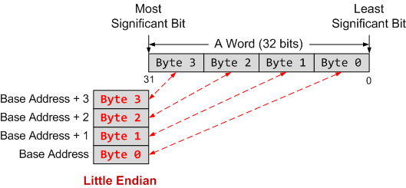
Endianess
Little Endian: address of least significant byte = word address (xx00 = Little End of word)
Big Endian: address of most significant byte = word address (xx00 = Big End of word)
Intell is Little Endian. MIPS is Big Endian.

Slide 19
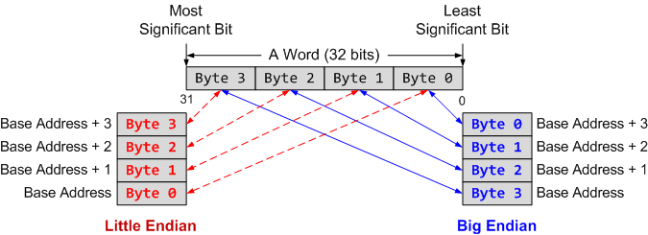
Endianess
Little Endian: The little end comes first.
Big Endian: The big end comes first.

Slide 20
Example
If big endianess is used
The word stored at address 0x20008000 is
Memory Address | Memory Data
0x20008003 | 0xA7
0x20008002 | 0x90
0x20008001 | 0x8C
0x20008000 | 0xEE
0xEE8C90A7
Notes:
Halfword access and signed halfword/byte accesses were added to the architecture in v4T, this is the reason the offset field is not as flexible as the normal word/byte load/store - not a problem because these accesses are less common.
Link: diagram on next slide

Slide 21
Example
If little endianess is used
The word stored at address 0x20008000 is
Memory Address | Memory Data
0x20008003 | 0xA7
0x20008002 | 0x90
0x20008001 | 0x8C
0x20008000 | 0xEE
0xA7908CEE
Endian only specifies byte order, not bit order in a byte!
Notes:
Halfword access and signed halfword/byte accesses were added to the architecture in v4T, this is the reason the offset field is not as flexible as the normal word/byte load/store - not a problem because these accesses are less common.
Link: diagram on next slide

Slide 22
Memory Operands
Main memory used for composite data
Arrays, structures, dynamic data
To apply arithmetic operations
Load values from memory into registers
Store result from register to memory
Memory is byte addressed
Each address identifies an 8-bit byte
Words are aligned in memory
Address must be a multiple of 4
MIPS is Big Endian
Most-significant byte at least address of a word
c.f. Little Endian: least-significant byte at least address (Intel processor)

Slide 23
Registers vs. Memory
Registers are faster to access than memory
Operating on memory data requires loads and stores
More instructions to be executed
Compiler must use registers for variables as much as possible
Only spill to memory for less frequently used variables
Register optimization is important!

Slide 24
Memory Load / Store Instructions
Load a word from memory:
lw R_{t}, offset(R_{s})
Load a byte from memory
lb R_{t}, offset(R_{s})
Store a word to memory
sw R_{t}, offset(R_{s})
Store a byte to memory
sb R_{t}, offset(R_{s})
Compute effective memory address
[R_{s}] + offset

Slide 25
Memory Operand Example 1
C code:
g = h + A[8];
g in $s1, h in $s2, base address of A in $s3
Compiled MIPS code:
Index 8 requires offset of 32
4 bytes per word
lw $t0, 32($s3) # load word add $s1, $s2, $t0
offset
base register

Slide 26
Memory Operand Example 2
C code:
A[12] = h + A[8];
h in $s2, base address of A in $s3
Compiled MIPS code:
Index 8 requires offset of 32
lw $t0, 32($s3) # load word add $t0, $s2, $t0 sw $t0, 48($s3) # store word

Slide 27
Immediate Operands
Constant data specified in an instruction
addi $s3, $s3, 4
No subtract immediate instruction
Just use a negative constant
addi $s2, $s1, -1
Design Principle 3: Make the common case fast
Small constants are common
Immediate operand avoids a load instruction

Slide 28
The Constant Zero
MIPS register 0 ($zero) is the constant 0
Cannot be overwritten
Useful for common operations
E.g., move between registers
add $t2, $s1, $zero

Slide 29
How store a byte to a 32-bit register?
lb R_{t}, offset(R_{s})
R_{t} is a register with 4 bytes
offset(R_{s}) is byte whose content is 0x12 ?
offset(R_{s}) is byte whose content is 0x72 ?
1 byte
32-bit Register

Slide 30
Unsigned Binary Integers
Given an n-bit number
§2.4 Signed and Unsigned Numbers
Range: 0 to +2^{n} – 1
Example
0000 0000 0000 0000 0000 0000 0000 1011₂ = 0 + … + 1×2³ + 0×2² +1×2¹ +1×2⁰ = 0 + … + 8 + 0 + 2 + 1 = 11₁₀
Using 32 bits
0 to +4,294,967,295

Slide 31
2s-Complement Signed Integers
Given an n-bit number
Range: –2^{n – 1} to +2^{n – 1} – 1
Example
1111 1111 1111 1111 1111 1111 1111 1100₂ = –1×2³¹ + 1×2³⁰ + … + 1×2² +0×2¹ +0×2⁰ = –2,147,483,648 + 2,147,483,644 = –4₁₀
Using 32 bits
–2,147,483,648 to +2,147,483,647

Slide 32
2s-Complement Signed Integers
Bit 31 is sign bit
1 for negative numbers
0 for non-negative numbers
–(–2^{n – 1}) can’t be represented
Non-negative numbers have the same unsigned and 2s-complement representation
Some specific numbers
0: 0000 0000 … 0000
–1: 1111 1111 … 1111
Most-negative: 1000 0000 … 0000
Most-positive: 0111 1111 … 1111

Slide 33
Signed Negation
Complement and add 1
Complement means 1 → 0, 0 → 1
Example: negate +2
+2 = 0000 0000 … 0010₂
–2 = 1111 1111 … 1101₂ + 1 = 1111 1111 … 1110₂

Slide 34
Sign Extension
Representing a number using more bits
Preserve the numeric value
In MIPS instruction set
addi: extend immediate value
lb, lh: extend loaded byte/halfword
beq, bne: extend the displacement
Replicate the sign bit to the left
c.f. unsigned values: extend with 0s
Examples: 8-bit to 16-bit
+2: 0000 0010 => 0000 0000 0000 0010
–2: 1111 1110 => 1111 1111 1111 1110

Slide 35
Representing Instructions
Instructions are encoded in binary
Called machine code
MIPS instructions
Encoded as 32-bit instruction words
Small number of formats encoding operation code (opcode), register numbers, …
Regularity!
Register numbers
$t0 – $t7 are reg’s 8 – 15
$t8 – $t9 are reg’s 24 – 25
$s0 – $s7 are reg’s 16 – 23
§2.5 Representing Instructions in the Computer

Slide 36
MIPS R-format Instructions
op
rs
rt
rd
shamt
funct
6 bits
5 bits
5 bits
5 bits
5 bits
6 bits
Instruction fields
op: operation code (opcode)
rs: first source register number
rt: second source register number
rd: destination register number
shamt: shift amount (00000 for now)
funct: function code (extends opcode)

Slide 37
R-format Example
op
rs
rt
rd
shamt
funct
6 bits
5 bits
5 bits
5 bits
5 bits
6 bits
add $t0, $s1, $s2
special
$s1
$s2
$t0
0
add
0
17
18
8
0
32
000000
10001
10010
01000
00000
100000
00000010001100100100000000100000₂ = 02324020₁₆

Slide 38
Hexadecimal
Base 16
Compact representation of bit strings
4 bits per hex digit
0 | 0000 | 4 | 0100 | 8 | 1000 | c | 1100
1 | 0001 | 5 | 0101 | 9 | 1001 | d | 1101
2 | 0010 | 6 | 0110 | a | 1010 | e | 1110
3 | 0011 | 7 | 0111 | b | 1011 | f | 1111
Example: eca8 6420
1110 1100 1010 1000 0110 0100 0010 0000

Slide 39
MIPS I-format Instructions
op
rs
rt
constant or address
6 bits
5 bits
5 bits
16 bits
Immediate arithmetic and load/store instructions
rt: destination or source register number
Constant: –2¹⁵ to +2¹⁵ – 1
Address: offset added to base address in rs
Design Principle 4: Good design demands good compromises
Different formats complicate decoding, but allow 32-bit instructions uniformly
Keep formats as similar as possible

Slide 40
Logical Operations
Instructions for bitwise manipulation
§2.6 Logical Operations
Operation | C | Java | MIPS
Shift left | << | << | sll
Shift right | >> | >>> | srl
Bitwise AND | & | & | and, andi
Bitwise OR | | | | | or, ori
Bitwise NOT | ~ | ~ | nor
Useful for extracting and inserting groups of bits in a word

Slide 41
Bitwise operations
And &
1 & 1 = 1; 1 & 0 = 0 ; 0 & 1 = 0; 0 & 0 = 0
Or |
1 | 1 = 1; 1 | 0 = 1 ; 0 | 1 = 1; 0 | 0 = 0
Not ~
~ 1 = 0; ~ 0 =1
Left shift x<<n (Think of x as a bitstring)
x << n shifts the value of x left by n bits
4 << 2 = 16
Right shift x>>n (Think of x as a bitstring)
x >> n shifts the value of x right by n bits
8 >> 2 = 2

Slide 42
MIPS Instruction Coding

Slide 44
Shift Operations
op
rs
rt
rd
shamt
funct
6 bits
5 bits
5 bits
5 bits
5 bits
6 bits
shamt: how many positions to shift
Shift left logical
Shift left and fill with 0 bits
sll by i bits multiplies by 2^{i}
Shift right logical
Shift right and fill with 0 bits
srl by i bits divides by 2^{i} (unsigned only)

Slide 45
Left Shift Example
4 Bits Left Shift Operation
0000 0000 0000 0000 0000 0000 0000 1001
0000 0000 0000 0000 0000 0000 1001 0000
MIPS instruction
sll $t2, $s0, 4 # reg $t2 = reg $s0 << 4 bits
Machine code
op
rs
rt
rd
shamt
funct
6 bits
5 bits
5 bits
5 bits
5 bits
6 bits
0
0
16
10
4
0

Slide 46
Right Shift Example
4 Bits Right Shift Operation
0000 0000 0000 0000 0000 0000 0001 0000
0000 0000 0000 0000 0000 0000 0000 0001
MIPS instruction
srl $t2, $s0, 4 # reg $t2 = reg $s0 >> 4 bits
Machine code
op
rs
rt
rd
shamt
funct
6 bits
5 bits
5 bits
5 bits
5 bits
6 bits
0
0
16
10
4
2

Slide 47
AND Operations
Useful to mask bits in a word
Select some bits, clear others to 0
and $t0, $t1, $t2
$t2
0000 0000 0000 0000 0000 1101 1100 0000
$t1
0000 0000 0000 0000 0011 1100 0000 0000
$t0
0000 0000 0000 0000 0000 1100 0000 0000

Slide 48
OR Operations
Useful to include bits in a word
Set some bits to 1, leave others unchanged
or $t0, $t1, $t2
$t2
0000 0000 0000 0000 0000 1101 1100 0000
$t1
0000 0000 0000 0000 0011 1100 0000 0000
$t0
0000 0000 0000 0000 0011 1101 1100 0000

Slide 49
NOT Operations
Useful to invert bits in a word
Change 0 to 1, and 1 to 0
MIPS has NOR 3-operand instruction
a NOR b == NOT ( a OR b )
nor $t0, $t1, $zero
Register 0: always read as zero
$t1
0000 0000 0000 0000 0011 1100 0000 0000
$t0
1111 1111 1111 1111 1100 0011 1111 1111

Slide 50
Conditional Operations
Branch to a labeled instruction if a condition is true
Otherwise, continue sequentially
beq rs, rt, L1
if (rs == rt) branch to instruction labeled L1;
bne rs, rt, L1
if (rs != rt) branch to instruction labeled L1;
j L1
unconditional jump to instruction labeled L1
§2.7 Instructions for Making Decisions

Slide 51
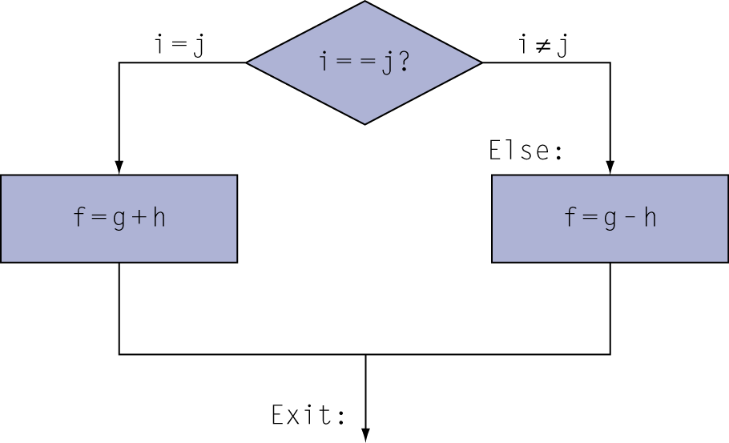
Compiling If Statements
C code:
if (i==j) f = g+h; else f = g-h;
f, g, … in $s0, $s1, …
Compiled MIPS code:
bne $s3, $s4, Else add $s0, $s1, $s2 j Exit Else: sub $s0, $s1, $s2 Exit: …
Assembler calculates addresses

Slide 52
Compiling Loop Statements
C code:
while (save[i] == k) i += 1;
i in $s3, k in $s5, address of save in $s6
Compiled MIPS code:
Loop: sll $t1, $s3, 2 # i<<2 = i*4 add $t1, $t1, $s6 # t1 = addr. Of save[i] lw $t0, 0($t1) # t0 = save[i] bne $t0, $s5, Exit # go to Exit if cond. false addi $s3, $s3, 1 # i = i+1 j Loop # go to Loop Exit: …

Slide 53
Basic Blocks
A basic block is a sequence of instructions with
No embedded branches (except at end)
No branch targets (except at beginning)
A compiler identifies basic blocks for optimization
An advanced processor can accelerate execution of basic blocks

Slide 54
More Conditional Operations
Set result to 1 if a condition is true
Otherwise, set to 0
slt rd, rs, rt
if (rs < rt) rd = 1; else rd = 0;
slti rt, rs, constant
if (rs < constant) rt = 1; else rt = 0;
Use in combination with beq, bne
slt $t0, $s1, $s2 # if ($s1 < $s2) bne $t0, $zero, L # branch to L

Slide 55
Branch Instruction Design
Why not blt, bge, etc?
Hardware for <, ≥, … slower than =, ≠
Combining with branch involves more work per instruction, requiring a slower clock
All instructions penalized!
beq and bne are the common case
This is a good design compromise

Slide 56
Signed vs. Unsigned
Signed comparison: slt, slti
Unsigned comparison: sltu, sltui
Example
$s0 = 1111 1111 1111 1111 1111 1111 1111 1111
$s1 = 0000 0000 0000 0000 0000 0000 0000 0001
slt $t0, $s0, $s1 # signed
–1 < +1 ⇒ $t0 = 1
sltu $t0, $s0, $s1 # unsigned
+4,294,967,295 > +1 ⇒ $t0 = 0

Slide 57
Procedure Calls
Basic functionality
Transfer of parameters & control to procedure
Transfer of results & control back to the calling program
Support for nested procedures
What is so hard about this?
Consider independently compiled code modules
Where are the inputs?
Where should I place the outputs?
Recall: What do you need to know when you write procedures in C?
§2.8 Supporting Procedures in Computer Hardware

Slide 58
Specifics
Where do we pass data
Preferably registers → make the common case fast
Memory as an overflow area
Nested procedures
The stack, $fp, $sp and $ra
Saving and restoring machine state
Set of rules that developers/compilers abide by
Which registers can am I permitted to use with no consequence?
Caller and callee save conventions for MIPS

Slide 59
Basic Parameter Passing
Jal saves the next instruction address, which is return address, to $ra.
.data
arg1: .word 22, 20, 16, 4
arg2: .word 33,34,45,8
.text
addi $t0, $0, 4
move $t3, $0
move $t1, $0
move $t2, $0
loop: beq $t0, $0, exit
addi $t0, $t0, -1
lw $a0, arg1($t1)
lw $a1, arg2($t2)
jal func
add $t3, $t3, $v0
addi $t1, $t1, 4
addi $t2, $t2, 4
j loop
func: sub $v0, $a0, $a1
jr $ra
exit: ---
Register usage
What about nested calls?
What about excess arguments?
PC
+
4
$31
PC
$31
Jal restore return address from $ra.

Slide 60
Register Usage
$a0 – $a3: arguments (reg’s 4 – 7)
$v0, $v1: result values (reg’s 2 and 3)
$t0 – $t9: temporaries
Can be overwritten by callee
$s0 – $s7: saved
Must be saved/restored by callee
$gp: global pointer for static data (reg 28)
$sp: stack pointer (reg 29)
$fp: frame pointer (reg 30)
$ra: return address (reg 31)

Slide 61
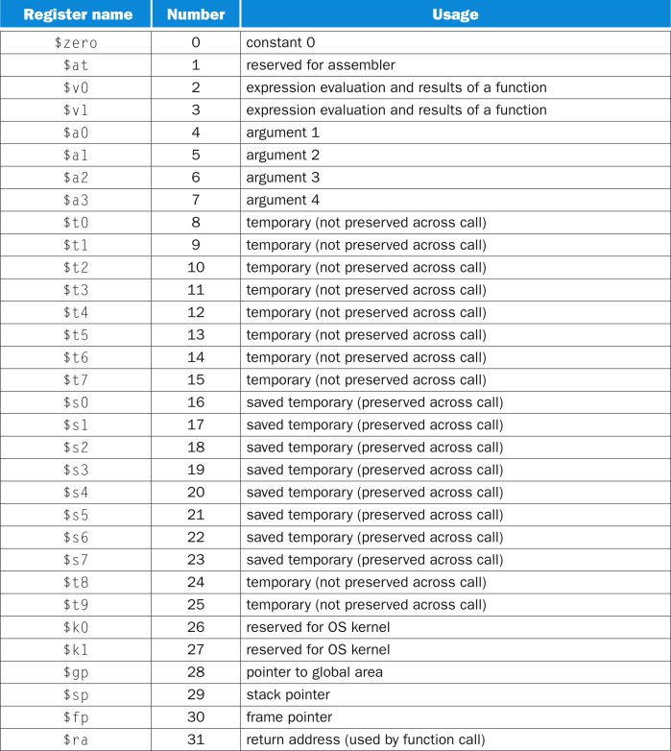
MIPS Register Usage Convention

Slide 62
Leaf Procedure Example
C code:
int leaf_example (int g, h, i, j) { int f; f = (g + h) - (i + j); return f; }
Arguments g, …, j are passed in $a0, …, $a3
f in $s0 (we need to save $s0 on stack – we will see why later)
Results are returned in $v0, $v1
$a0
result registers
argument registers
$a1
procedure
$v0
$a2
$v1
$a3

Slide 63
Procedure Call Instructions
Procedure call: jump and link
jal ProcedureLabel
Address of following instruction put in $ra
Jumps to target address
Procedure return: jump register
jr $ra
Copies $ra to program counter
Can also be used for computed jumps
e.g., for case/switch statements

Slide 64
Stack and Operations
M
C
C
C
R
push(M)
R
item = pop()
item = M
R
X
X
X
A
A
A
Allows access to only the last item inserted.
An item is inserted or removed from the stack from one end called the “top” of the stack.
This mechanism is called Last-In-First-Out (LIFO).
Push
the operation to place a new item at the top of the stack
Pop
the operation to remove the next item from the top of the stack

Slide 65
Stack Implementation
Stack Pointer(SP)
High address
Stack top
Low address
Stack bottom
High address
Stack top
Pop: SP++
Stack Pointer(SP)
High address
Stack top
Low address
Stack bottom
Stack Pointer(SP)
Low address
Stack bottom
Push: SP--

Slide 66
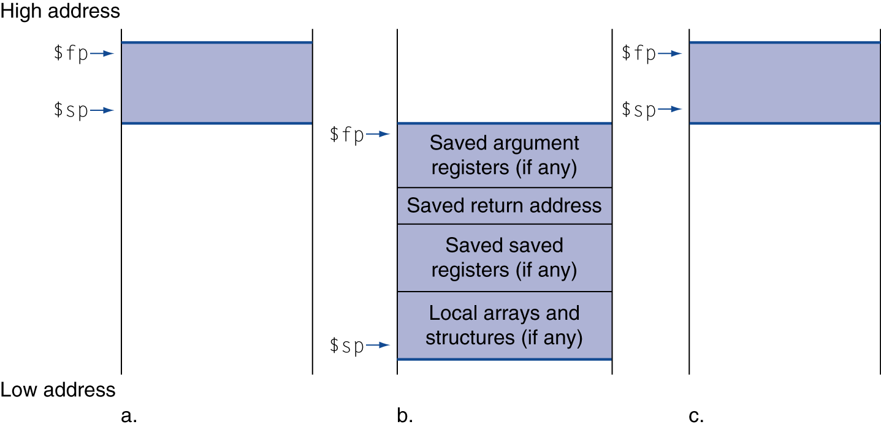
Local Data on the Stack
Local data allocated by callee
e.g., C automatic variables
Procedure frame (activation record)
Used by some compilers to manage stack storage

Slide 67
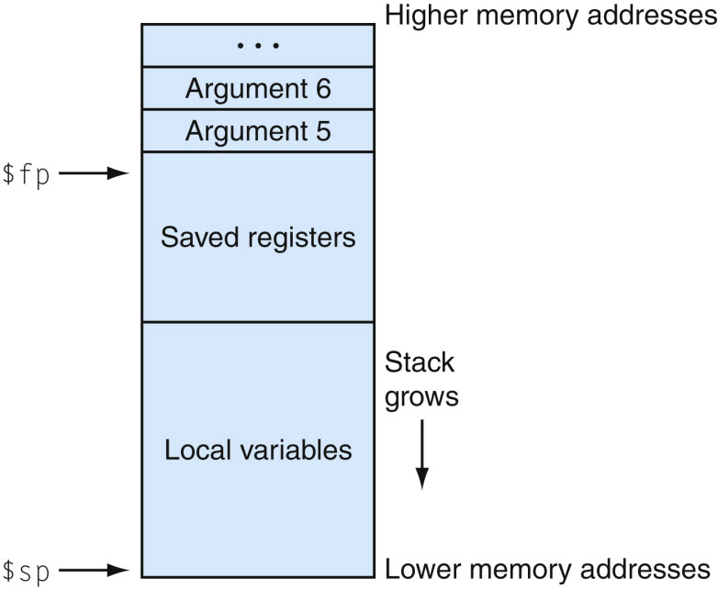
Layout of a Stack Frame
Frame pointer ($fp) points to the first word in the currently executing procedure’s stack frame.
The stack pointer ($sp) points to the last word of the frame.

Slide 68
Procedure Call Mechanics
High Address
System Wide Memory Map
$fp
Old Stack Frame
$sp
stack
$sp
$fp
arg registers
dynamic data
return address
$gp
static data
New Stack
Frame
text
Saved registers
PC
local variables
reserved
$sp
compiler
compiler
ISA
addressing
Low Address
HW

Slide 69
Example of the Stack Frame
Call Sequence
arg 1
1. place excess arguments
arg 2
2. save caller save registers
$fp
..
($a0-$a3, $t0-$t9)
callee
saved
registers
3. jal
$s0-$s9
4. allocate stack frame
5. save callee save registers
caller
saved
registers
($s0-$s9, $fp, $ra)
$a0-$a3
$t0-$t9
6 set frame pointer
Return
local
variables
1. place function argument in $v0
2. restore callee save registers
..
3. restore $fp
$fp
$sp
4. pop frame
$ra
5. jr $31

Slide 70
Leaf Procedure Example
MIPS code:
leaf_example: addi $sp, $sp, -4 sw $s0, 0($sp) add $t0, $a0, $a1 add $t1, $a2, $a3 sub $s0, $t0, $t1 add $v0, $s0, $zero lw $s0, 0($sp) addi $sp, $sp, 4 jr $ra
Save $s0 on stack
Procedure body
Result
Restore $s0
Return

Slide 71
Leaf Procedure Example
$sp
High addr.
Low addr.
MIPS code:
leaf_example: addi $sp, $sp, -4 sw $s0, 0($sp) add $t0, $a0, $a1 add $t1, $a2, $a3 sub $s0, $t0, $t1 add $v0, $s0, $zero lw $s0, 0($sp) addi $sp, $sp, 4 jr $ra
Save $s0 on stack
$sp
$s0
High addr.
Procedure body
Low addr.
Result
Restore $s0
$sp
$s0
High addr.
Return
Low addr.

Slide 72
Template for a Procedure
Allocate stack frame (decrement stack pointer)
Save any registers (callee save registers)
Procedure body (remember some arguments may be on the stack!)
Restore registers (callee save registers)
Pop stack frame (increment stack pointer)
Return (jr $ra)

Slide 73
Non-Leaf Procedures
Procedures that call other procedures
For nested call, caller needs to save on the stack:
Its return address
Any arguments and temporaries needed after the call
Restore from the stack after the call

Slide 74
Non-Leaf Procedure Example
C code:
int fact (int n) { if (n < 1) return f; else return n * fact(n - 1); }
Argument n in $a0
Result in $v0

Slide 75
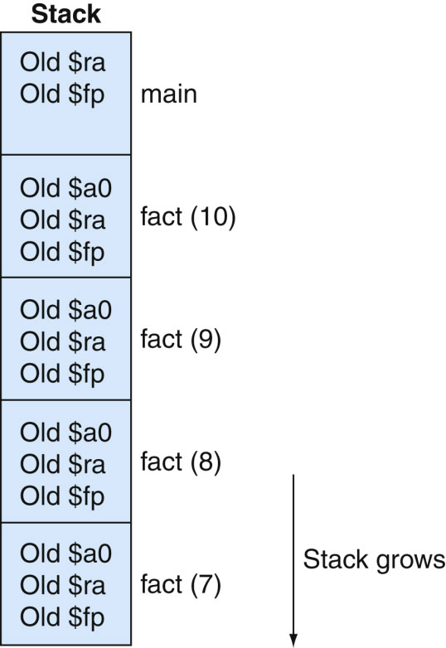
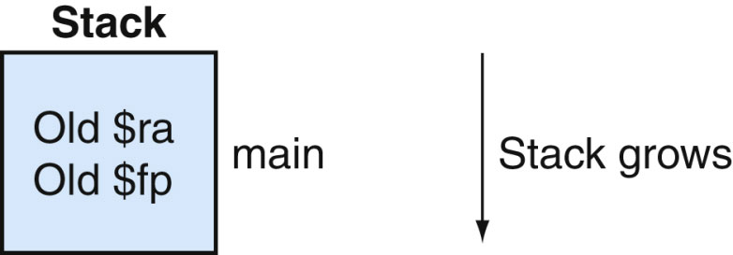
Stack frames during the call of fact(7).
75

Slide 76
Non-Leaf Procedure Example
MIPS code:
fact: addi $sp, $sp, -8 # adjust stack for 2 items sw $ra, 4($sp) # save return address sw $a0, 0($sp) # save argument slti $t0, $a0, 1 # test for n < 1 beq $t0, $zero, L1 addi $v0, $zero, 1 # if so, result is 1 addi $sp, $sp, 8 # pop 2 items from stack jr $ra # and return L1: addi $a0, $a0, -1 # else decrement n jal fact # recursive call lw $a0, 0($sp) # restore original n lw $ra, 4($sp) # and return address addi $sp, $sp, 8 # pop 2 items from stack mul $v0, $a0, $v0 # multiply to get result jr $ra # and return

Slide 77
Procedure Calling
Steps required
Place parameters in registers
Transfer control to procedure
Acquire storage for procedure
Perform procedure’s operations
Place result in register for caller
Return to place of call

Slide 78
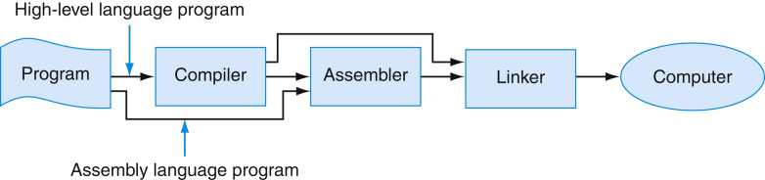
Assembly Language and Assemblers
Assembly language is the symbolic representation of a computer’s binary encoding( machine language)
More readable
Assembler translates assembly language to machine codes.
Facilities in Assembler
Macro, assembler directive, label
§Appendix A Assembly Language Programming

Slide 79
An Example of assembly language program
.data
myArray: .word 0:100 # Array of 100 ints initialized all to 0
.text
li $t0, 30 # x = 30
la $t1, myArray # $t1 is base address
mul $t2, $t0, 4 # $t2 is the offset (4x30)
add $t3, $t2, $t1 # $t3 = address of myArray[30]
li $t4, -19 # set $t4 = value to save (-19)
sw $t4, ($t3) # Store value at address stored in $t3

Slide 80
Program Structure
Basics
Simple text file with data declaration, program code (name of file should end with .s or .asm to be used in SPIM or MARS simulator)
Data declaration section followed by program code section.
Data Declarations
Placed in section of program identified with assembler directive .data
Declares variable names used in program; storage allocated in main memory (RAM)
Code
Placed in section of text identified with assembler directive .text
Contains program code (instructions)
Starting point for code (this is not required) is marked by label main:
Ending point of main code should use exit system call (see System Calls below)

Slide 81
Program Structure
The sections of our environment:
.data
Allows us to set up “global” variable data that is stored on the computer’s stack.
myArray: .word -1:10 # create a 10 word array
msg1: .asciiz “hello” # creates a message for printing on screen
isMale .byte ‘n’ # creates a byte variable and assigns ‘n’
.text
This is where our code begins.
We can add labels to our source code like this
main:
swapLoop:
Etc…

Slide 82
Comment
Comments
Anything following number sign (#) on a line
# This is a comment… Say anything here…
Template for a MIPS assembly language program:
####################################################################### Author: [Your name goes here]
# Creation Date: [Date you created this program]
# Last Modified By and Date: [Who was the last to modify this file and date of modification]
# Program Name: [name of your program]
# Objective: [describe what program is designed to do]
######################################################################
.data
.text
main:
exit:
# End of program. SPIM like it if you leave a blank line

Slide 83
MIPS Assemble Language Data Types
Data Types
Instructions are all 32 bits
byte(8 bits), halfword(2 bytes), word(4 bytes)
A character requires 1 byte of storage
An integer requires 1 word (4 bytes) of storage
Literals
Numbers entered as is (4, 5, etc.)
Characters enclosed in single quotes (‘a’, ‘b’, ‘c’, etc)
Strings enclosed in double quotes (“hello world”)

Slide 84
Declare variables
Format
name: storage_type value(s)
Create storage for variable of specified type with given name and specified value
Value(s) usually gives initial value(s); for storage type .space, gives number of spaces to be allocated
Note: labels always followed by colon (:)
Example:
var1: .word 3 # create a single integer variable with initial value 3
array1: .byte ‘a’,’b’ # create a 2-element character array with elements initialized to ‘a’ and ‘b’
array2: .space 40 # allocate 40 consecutive bytes, with storage uninitialized. Could be
# used as a 40-element character array, or a 10-element integer
# array; a comment should indicate which it is.

Slide 85
More MIPS assembler directives
.word w1,…wn Store n words in memory
.byte b1,…, bn, Store the n bytes
.ascii str: Store the string str in memory without null
.asciiz str: Store the string str in memory and null terminate it
.double d1,…,dn, Store the n double floating-point number
.float f1, …, fn, Store the n floating-point number
.data <addr> Subsequent items are stored in data segment
.text<addr> Subsequent items are stored in code segment

Slide 86
System Call -- syscall
System call is a set of operating system-like services through the syscall instruction
Make system call
Put the system call code to the register $v0 or $f0
Put the arguments to register $a0-$a3 or $f0
Syscall
Return results are stored in register $v0
You can use syscall to input/output information

Slide 87
System Call Examples
Print integer value contained in register $t1
li $t1, 55 # set $t1 = 55
li $v0, 1 # load appropriate system call code into register $v0
# code for printing is 1
move $a0, $t1 # move integer to be printed into $a0: $a0 = $t1
syscall # call operating system to perform operation
Read integer from user and store it in RAM
li $v0, 5 # load appropriate system call code into register $v0
# code for reading integers is 5
syscall # call operating system to perform operation
sw $v0, int_val # store what user entered into RAM at address int_val
Print out string (useful for prompts)
.data
String1: .asciiz “Print this.” # declaration for string variable
.text
main:
li $v0, 4 # load code for printing strings
la $a0, string1 # load address of string to be printed into $a0
syscall # call operating system to perform print operation

Slide 88
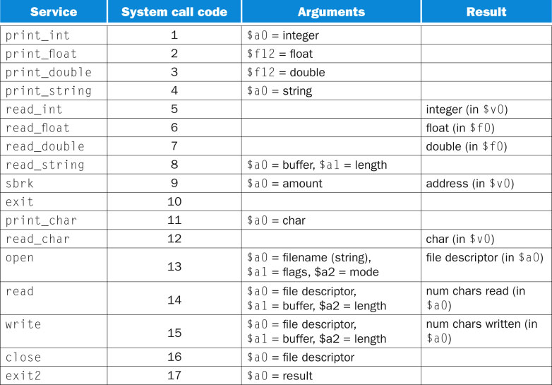
MIPS System services
88
Copyright © 2014 Elsevier Inc. All rights reserved.

Slide 89
Macros!
The addition of macros was introduced in one of the latest releases of the Mars MIPS Simulator. This was a very useful feature.
A macro file is just like any other assembly file (note: you do not have to have a separate file for this but you should)
Macros have the following format:
.macro macro_name( parameter list )
your code goes here
.end_macro

Slide 90
Macros!
You can build a macro file and then include this file in your code.
The syntax for including a macro file in your program is:
.include “macro_file_name”
Once you include the file you can call macros just like you call methods
macro_name( parameters )
Lets try one…

Slide 91
Macro Example-define marco
######################################### Print an Integer
.macro print_int ($x)
li $v0, 1
add $a0, $zero, $x
syscall
.end_macro
######################################### Swap values in registers
.macro swap_int($a, $b)
sw $a, -4($sp)
move $a, $b
lw $b, -4($sp)
.end_macro
##################################### Exit
.macro exit()
li $v0, 10
syscall
.end_macro

Slide 92
Macro Example – useMacros.asm
.include "macros.asm"
.data
nums: .word 0:20
.text
main:
la $t0, nums # Start address of array
addi $t1, $t0, 80 # End end address of array
li $t2, 10 # Start num to enter into memory
loop:
sw $t2, ($t0) # Store whatever is in $t2 to address stored in $t0
print_int($t2)
newLine()
addi $t2, $t2, 1 # Add one to our variable we will bee saving to memory
addi $t0, $t0, 4 # Update the address of the next element of the array
blt $t0, $t1, loop # loop back up if we have not filled the array
swap:
print_str("\nSwap Numbers...\n")
li $t5, 100
li $t6, 50
print_int($t5)
print_str(", ")
print_int($t6)
print_str("\n=============== Call the swap.\n")
swap_int($t5,$t6)
print_int($t5)
print_str(", ")
print_int($t6)
exit() ########################################## End the program

Slide 93
Declaring Char Arrays
chrArray: .byte 0:20
The above allocates 20 bytes of memory and initializes each to 0 (the null character)
Initialization happens before program execution.
chrArray2: .space 20
This is an alternative method of allocating 20 bytes of memory.
No initialization of data so could result in undesired results.
chrArray3: .byte ‘A’, 20
Allocate 20 bytes (5 words in length) and initialize all to ‘A’
chrArray4: .byte 65, 20
Same as above but uses the ASCII value of A (65)

Slide 94
Declaring Int Arrays
intArray: .word 100:25
Create 25 words (integer memory chunks) located at word-aligned addresses. Initialize each to 100.
intArray2: .space 100
Create 100 bytes (or 25 integer-sized elements) of space

Slide 95
Arrays vs. Pointers
§2.14 Arrays versus Pointers
Array indexing involves
Multiplying index by element size
Adding to array base address
Pointers correspond directly to memory addresses
Can avoid indexing complexity

Slide 96
Example: Clearing and Array
clear1(int array[], int size) { int i; for (i = 0; i < size; i += 1) array[i] = 0; } | clear2(int *array, int size) { int *p; for (p = &array[0]; p < &array[size]; p = p + 1) *p = 0; }
move $t0,$zero # i = 0 loop1: sll $t1,$t0,2 # $t1 = i * 4 add $t2,$a0,$t1 # $t2 = # &array[i] sw $zero, 0($t2) # array[i] = 0 addi $t0,$t0,1 # i = i + 1 slt $t3,$t0,$a1 # $t3 = # (i < size) bne $t3,$zero,loop1 # if (…) # goto loop1 | move $t0,$a0 # p = & array[0] sll $t1,$a1,2 # $t1 = size * 4 add $t2,$a0,$t1 # $t2 = # &array[size] loop2: sw $zero,0($t0) # Memory[p] = 0 addi $t0,$t0,4 # p = p + 4 slt $t3,$t0,$t2 # $t3 = #(p<&array[size]) bne $t3,$zero,loop2 # if (…) # goto loop2

Slide 97
Comparison of Array vs. Ptr
Multiply “strength reduced” to shift
Array version requires shift to be inside loop
Part of index calculation for incremented i
c.f. incrementing pointer
Compiler can achieve same effect as manual use of pointers
Induction variable elimination
Better to make program clearer and safer

Slide 98
Using Arrays
Assembly, as with other languages, can access arrays in a sequential order or in random order. Consider the following C code and the equivalent MIPS version.
int myArray[100]; // Create an int array of 100 elements
int x; // Declare x to be the index of element to change
x = 30 // Set x to the 31th index of array
myArray[x] = -19 // Set array element[30] to -19
.data
myArray: .word 0:100 # Array of 100 ints initialized all to 0
.text
li $t0, 30 # x = 30
la $t1, myArray # $t1 is base address
mul $t2, $t0, 4 # $t2 is the offset (4x30)
add $t3, $t2, $t1 # $t3 = address of myArray[30]
li $t4, -19 # set $t4 = value to save (-19)
sw $t4, ($t3) # Store value at address stored in $t3

Slide 99
Using Arrays Example1
.data
myArray: .word 0:100 # myArray of 100 integers
.text
li $t0, 0 # $t0 is the index, and loop variable
li $t5, 100 # $t5 is the sentinel value for the loop
Loop: bge $t0, $t5, Exit_Loop
la $t1, myArray # $t1 is the base address of myArray
mul $t2, $t0, 4 # $t2 is the offset
add $t3, $t2, $t1 # $t3 is the address of desired element
li $t4, 44 # $t4 is the value 44, to be put in desired element
sw $t4, ($t3) # save the value of 44 to the array element
add $t0, $t0, 1 # increment loop variable
b Loop
Exit_Loop:
li $v0, 10
syscall

Slide 100
Using Arrays Example 2
.data
myArray: .word 0:100 # myArray of 100 integers
.text
li $t0, 0 # $t0 is the loop variable
li $t5, 100 # $t5 is the sentinel value for the loop
li $t4, 44 # $t4 is the value 44, to be put in desired element
la $t1, myArray # $t1 starts as the base address of myArray
# and is the address of each element
Loop:bge $t0, $t5, Exit_Loop
sw $t4, ($t1) # Save 44 to the array element at address stored in $t1
add $t1, $t1, 4 # Add 4 to address to get the next myArray element
add $t0, $t0, 1 # increment loop induction variable
b Loop
Exit_Loop:
li $v0, 10
syscall

Slide 101
Using Arrays Example 3
.data
myArray: .word 0:100 # myArray of 100 integers
.text
li $t2, 44 # $t2 is the value 44, to be put in desired element
la $t1, myArray # $t1 starts as the base address of myArray
# and is the address of each element
li $t0, 100 # Use $t0 to calculate the address of the last element
mul $t0, $t0, 4 # Multiple 100 elements by word size (4)
add $t0, $t0, $t1 # Add address of myArray to 100 x 4 (400)
# to get last element
Loop: beq $t1, $t0, Exit_Loop # We check address of $t1
#(current “pointer”) with last element
sw $t2, ($t1) # Save 44 to the array element
# at address stored in $t1
add $t1, $t1, 4 # Add 4 to address to get the next myArray element
b Loop
Exit_Loop:
li $v0, 10
syscall

Slide 102
Character Data
§2.9 Communicating with People
Byte-encoded character sets
ASCII: 128 characters
95 graphic, 33 control
Latin-1: 256 characters
ASCII, +96 more graphic characters
Unicode: 32-bit character set
Used in Java, C++ wide characters, …
Most of the world’s alphabets, plus symbols
UTF-8, UTF-16: variable-length encodings

Slide 103
Byte/Halfword Operations
Could use bitwise operations
MIPS byte/halfword load/store
String processing is a common case
lb rt, offset(rs) lh rt, offset(rs)
Sign extend to 32 bits in rt
lbu rt, offset(rs) lhu rt, offset(rs)
Zero extend to 32 bits in rt
sb rt, offset(rs) sh rt, offset(rs)
Store just rightmost byte/halfword

Slide 104
String Copy Example
C code (naïve):
Null-terminated string
void strcpy (char x[], char y[]) { int i; i = 0; while ((x[i]=y[i])!='\0') i += 1; }
Addresses of x, y in $a0, $a1
i in $s0

Slide 105
String Copy Example
MIPS code:
strcpy: addi $sp, $sp, -4 # adjust stack for 1 item sw $s0, 0($sp) # save $s0 add $s0, $zero, $zero # i = 0 L1: add $t1, $s0, $a1 # addr of y[i] in $t1 lbu $t2, 0($t1) # $t2 = y[i] add $t3, $s0, $a0 # addr of x[i] in $t3 sb $t2, 0($t3) # x[i] = y[i] beq $t2, $zero, L2 # exit loop if y[i] == 0 addi $s0, $s0, 1 # i = i + 1 j L1 # next iteration of loop L2: lw $s0, 0($sp) # restore saved $s0 addi $sp, $sp, 4 # pop 1 item from stack jr $ra # and return

Slide 106
32-bit Constants
Most constants are small
16-bit immediate is sufficient
For the occasional 32-bit constant
lui rt, constant
Copies 16-bit constant to left 16 bits of rt
Clears right 16 bits of rt to 0
§2.10 MIPS Addressing for 32-Bit Immediates and Addresses
lhi $s0, 61
0000 0000 0111 1101 0000 0000 0000 0000
ori $s0, $s0, 2304
0000 0000 0111 1101 0000 1001 0000 0000

Slide 107
Branch Addressing
Branch instructions specify
Opcode, two registers, target address
Most branch targets are near branch
Forward or backward
op
rs
rt
constant or address
6 bits
5 bits
5 bits
16 bits
PC-relative addressing
Target address = PC + offset × 4
PC already incremented by 4 by this time, which points to the following instruction.

Slide 108
Jump Addressing
Jump (j and jal) targets could be anywhere in text segment
Encode full address in instruction
op
address
6 bits
26 bits
(Pseudo)Direct jump addressing
Target address = PC_{31…28} : (address × 4)

Slide 109
Target Addressing Example
Loop code from earlier example
Assume Loop at location 80000
Loop: sll $t1, $s3, 2 | 80000 | 0 | 0 | 19 | 9 | 4 | 0
add $t1, $t1, $s6 | 80004 | 0 | 9 | 22 | 9 | 0 | 32
lw $t0, 0($t1) | 80008 | 35 | 9 | 8 | 0
bne $t0, $s5, Exit | 80012 | 5 | 8 | 21 | 2
addi $s3, $s3, 1 | 80016 | 8 | 19 | 19 | 1
j Loop | 80020 | 2 | 20000
Exit: … | 80024

Slide 110
Branching Far Away
If branch target is too far to encode with 16-bit offset, assembler rewrites the code
Example
beq $s0,$s1, L1
↓
bne $s0,$s1, L2 j L1 L2: …
Question1: what is the range of L1?
L1: 16 bits
Question2: what are the range of L1 ?
L1: 26 bits

Slide 111
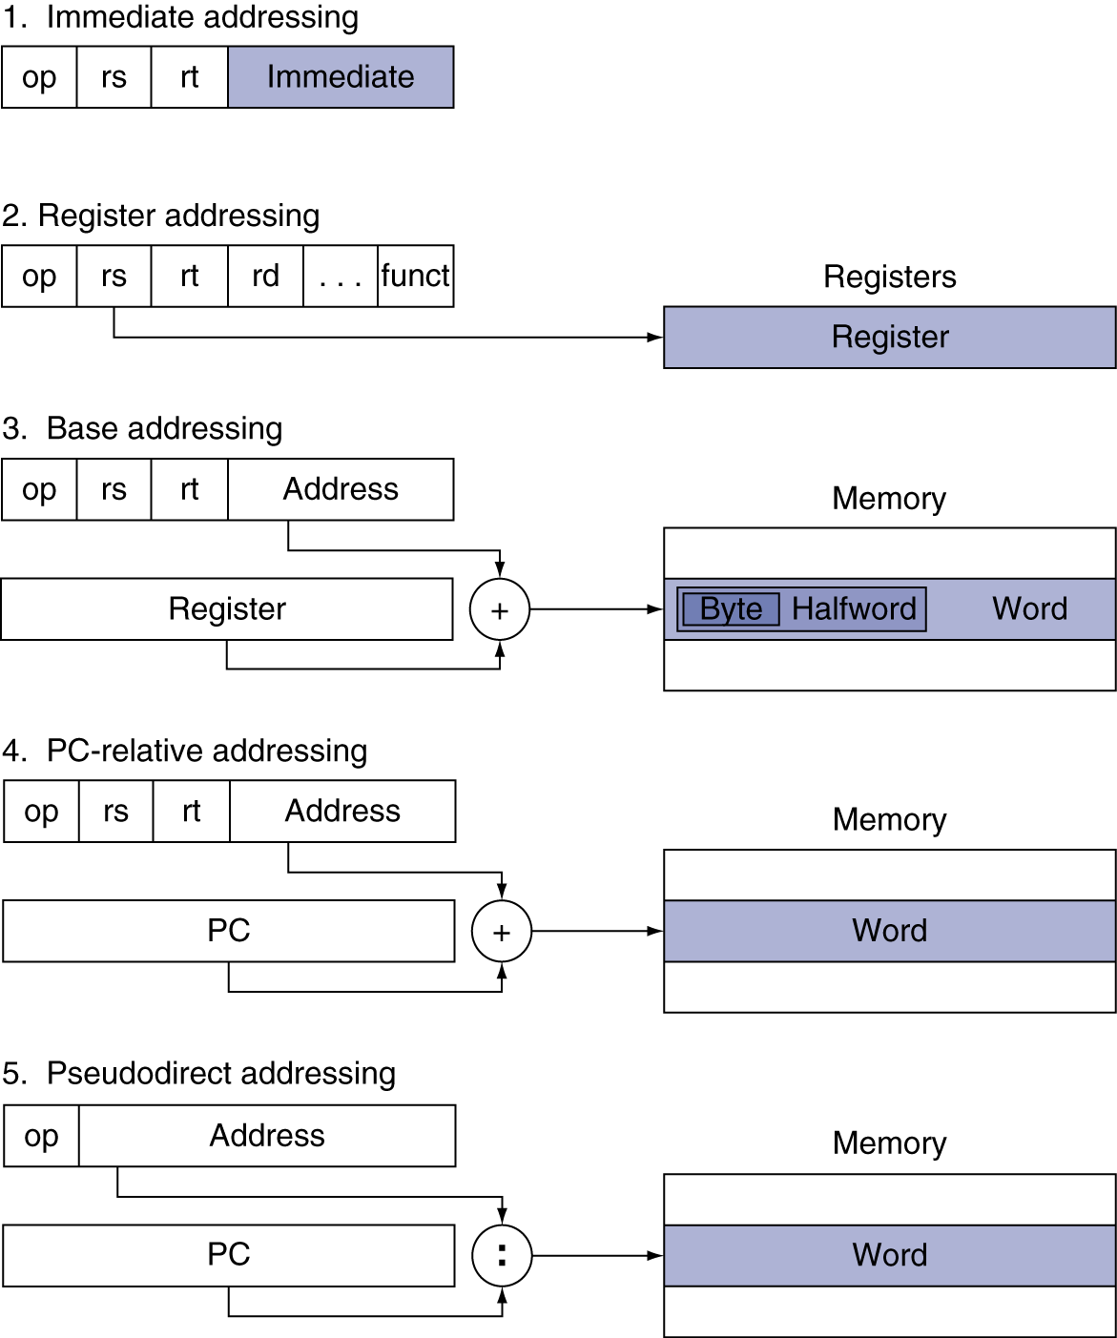
Addressing Mode Summary

Slide 112
Return Address
.data
arg1: .word 22, 20, 16, 4
arg2: .word 33,34,45,8
.text
addi $t0, $0, 4
move $t3, $0
move $t1, $0
move $t2, $0
loop: beq $t0, $0, exit
addi $t0, $t0, -1
lw $a0, arg1($t1)
lw $a1, arg2($t2)
jal func
add $t3, $t3, $v0
addi $t1, $t1, 4
addi $t2, $t2, 4
j loop
func: sub $v0, $a0, $a1
jr $ra
exit: ---
Jal saves the next instruction address, which is a return address, to $ra.
PC
+
4
$31
PC
$31
Jr restores a return address from $ra.

Slide 113
C Sort Example
Illustrates use of assembly instructions for a C bubble sort function
Swap procedure (leaf)
void swap(int v[], int k) { int temp; temp = v[k]; v[k] = v[k+1]; v[k+1] = temp; }
v in $a0, k in $a1, temp in $t0
§2.13 A C Sort Example to Put It All Together

Slide 114
The Procedure Swap
swap: sll $t1, $a1, 2 # $t1 = k * 4
add $t1, $a0, $t1 # $t1 = v+(k*4)
# (address of v[k])
lw $t0, 0($t1) # $t0 (temp) = v[k]
lw $t2, 4($t1) # $t2 = v[k+1]
sw $t2, 0($t1) # v[k] = $t2 (v[k+1])
sw $t0, 4($t1) # v[k+1] = $t0 (temp)
jr $ra # return to calling routine
Steps to write a procedure
1 Allocate registers to program variables
v -> $a0, k ->$a1, temp->$t0
2 Body of procedure
3 Preserve registers across the procedure invocation.

Slide 115
The Sort Procedure in C
Non-leaf (calls swap)
void sort (int v[], int n)
{
int i, j;
for (i = 0; i < n; i += 1) {
for (j = i – 1;
j >= 0 && v[j] > v[j + 1];
j -= 1) {
swap(v,j);
}
}
}
v in $a0, k in $a1, i in $s0, j in $s1

Slide 116
The Procedure Body
Move params
move $s2, $a0 # save $a0 into $s2
move $s3, $a1 # save $a1 into $s3
move $s0, $zero # i = 0
for1tst: slt $t0, $s0, $s3 # $t0 = 0 if $s0 ≥ $s3 (i ≥ n)
beq $t0, $zero, exit1 # go to exit1 if $s0 ≥ $s3 (i ≥ n)
addi $s1, $s0, –1 # j = i – 1
for2tst: slti $t0, $s1, 0 # $t0 = 1 if $s1 < 0 (j < 0)
bne $t0, $zero, exit2 # go to exit2 if $s1 < 0 (j < 0)
sll $t1, $s1, 2 # $t1 = j * 4
add $t2, $s2, $t1 # $t2 = v + (j * 4)
lw $t3, 0($t2) # $t3 = v[j]
lw $t4, 4($t2) # $t4 = v[j + 1]
slt $t0, $t4, $t3 # $t0 = 0 if $t4 ≥ $t3
beq $t0, $zero, exit2 # go to exit2 if $t4 ≥ $t3
move $a0, $s2 # 1st param of swap is v (old $a0)
move $a1, $s1 # 2nd param of swap is j
jal swap # call swap procedure
addi $s1, $s1, –1 # j –= 1
j for2tst # jump to test of inner loop
exit2: addi $s0, $s0, 1 # i += 1
j for1tst # jump to test of outer loop
Outer loop
Inner loop
Pass params & call
Inner loop
Outer loop

Slide 117
The Full Procedure
sort: addi $sp,$sp, –20 # make room on stack for 5 registers
sw $ra, 16($sp) # save $ra on stack
sw $s3,12($sp) # save $s3 on stack
sw $s2, 8($sp) # save $s2 on stack
sw $s1, 4($sp) # save $s1 on stack
sw $s0, 0($sp) # save $s0 on stack
… # procedure body
…
exit1: lw $s0, 0($sp) # restore $s0 from stack
lw $s1, 4($sp) # restore $s1 from stack
lw $s2, 8($sp) # restore $s2 from stack
lw $s3,12($sp) # restore $s3 from stack
lw $ra,16($sp) # restore $ra from stack
addi $sp,$sp, 20 # restore stack pointer
jr $ra # return to calling routine
Save affected registers on stack
Restore affected registers on stack

Slide 118
Non-Leaf Procedure Example
C code:
int fact (int n) { if (n < 1) return f; else return n * fact(n - 1); }
Argument n in $a0
Result in $v0

Slide 119
Stack frames during the call of fact(7).
119

Slide 120
Non-Leaf Procedure Example
MIPS code:
fact: addi $sp, $sp, -8 # adjust stack for 2 items sw $ra, 4($sp) # save return address sw $a0, 0($sp) # save argument slti $t0, $a0, 1 # test for n < 1 beq $t0, $zero, L1 addi $v0, $zero, 1 # if so, result is 1 addi $sp, $sp, 8 # pop 2 items from stack jr $ra # and return L1: addi $a0, $a0, -1 # else decrement n jal fact # recursive call lw $a0, 0($sp) # restore original n lw $ra, 4($sp) # and return address addi $sp, $sp, 8 # pop 2 items from stack mul $v0, $a0, $v0 # multiply to get result jr $ra # and return

Slide 121
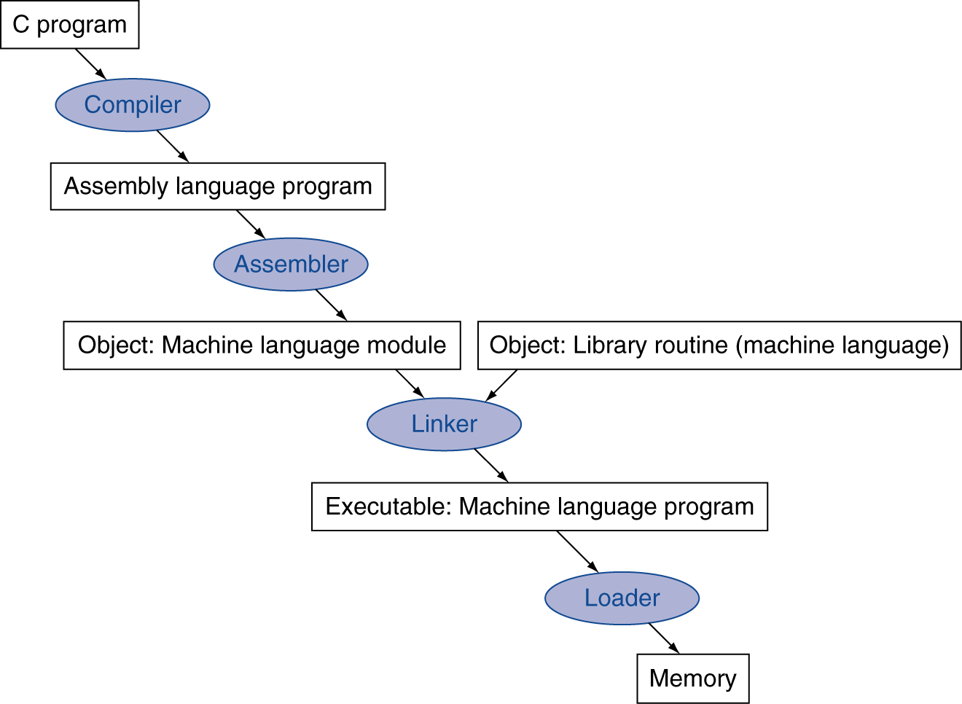
Translation and Startup
Many compilers produce object modules directly
§2.12 Translating and Starting a Program
Static linking

Slide 122
Assembler Pseudoinstructions
Most assembler instructions represent machine instructions one-to-one
Pseudoinstructions: figments of the assembler’s imagination
move $t0, $t1 → add $t0, $zero, $t1
blt $t0, $t1, L → slt $at, $t0, $t1 bne $at, $zero, L
$at (register 1): assembler temporary

Slide 123
Producing an Object Module
Assembler (or compiler) translates program into machine instructions
Provides information for building a complete program from the pieces
Header: described contents of object module
Text segment: translated instructions
Static data segment: data allocated for the life of the program
Relocation info: for contents that depend on absolute location of loaded program
Symbol table: global definitions and external refs
Debug info: for associating with source code

Slide 124
Linking Object Modules
Produces an executable image
1. Merges segments
2. Resolve labels (determine their addresses)
3. Patch location-dependent and external refs
Could leave location dependencies for fixing by a relocating loader
But with virtual memory, no need to do this
Program can be loaded into absolute location in virtual memory space

Slide 125
Loading a Program
Load from image file on disk into memory
1. Read header to determine segment sizes
2. Create virtual address space
3. Copy text and initialized data into memory
Or set page table entries so they can be faulted in
4. Set up arguments on stack
5. Initialize registers (including $sp, $fp, $gp)
6. Jump to startup routine
Copies arguments to $a0, … and calls main
When main returns, do exit syscall

Slide 126
Dynamic Linking
Only link/load library procedure when it is called
Requires procedure code to be relocatable
Avoids image bloat caused by static linking of all (transitively) referenced libraries
Automatically picks up new library versions

Slide 127
Effect of Compiler Optimization
Compiled with gcc for Pentium 4 under Linux

Slide 128
Effect of Language and Algorithm

Slide 129
Lessons Learnt
Instruction count and CPI are not good performance indicators in isolation
Compiler optimizations are sensitive to the algorithm
Java/JIT compiled code is significantly faster than JVM interpreted
Comparable to optimized C in some cases
Nothing can fix a dumb algorithm!

Slide 130
ARM & MIPS Similarities
ARM: the most popular embedded core
Similar basic set of instructions to MIPS
§2.16 Real Stuff: ARM Instructions
 | ARM | MIPS
Date announced | 1985 | 1985
Instruction size | 32 bits | 32 bits
Address space | 32-bit flat | 32-bit flat
Data alignment | Aligned | Aligned
Data addressing modes | 9 | 3
Registers | 15 × 32-bit | 31 × 32-bit
Input/output | Memory mapped | Memory mapped

Slide 131
Compare and Branch in ARM
Uses condition codes for result of an arithmetic/logical instruction
Negative, zero, carry, overflow
Compare instructions to set condition codes without keeping the result
Each instruction can be conditional
Top 4 bits of instruction word: condition value
Can avoid branches over single instructions

Slide 132
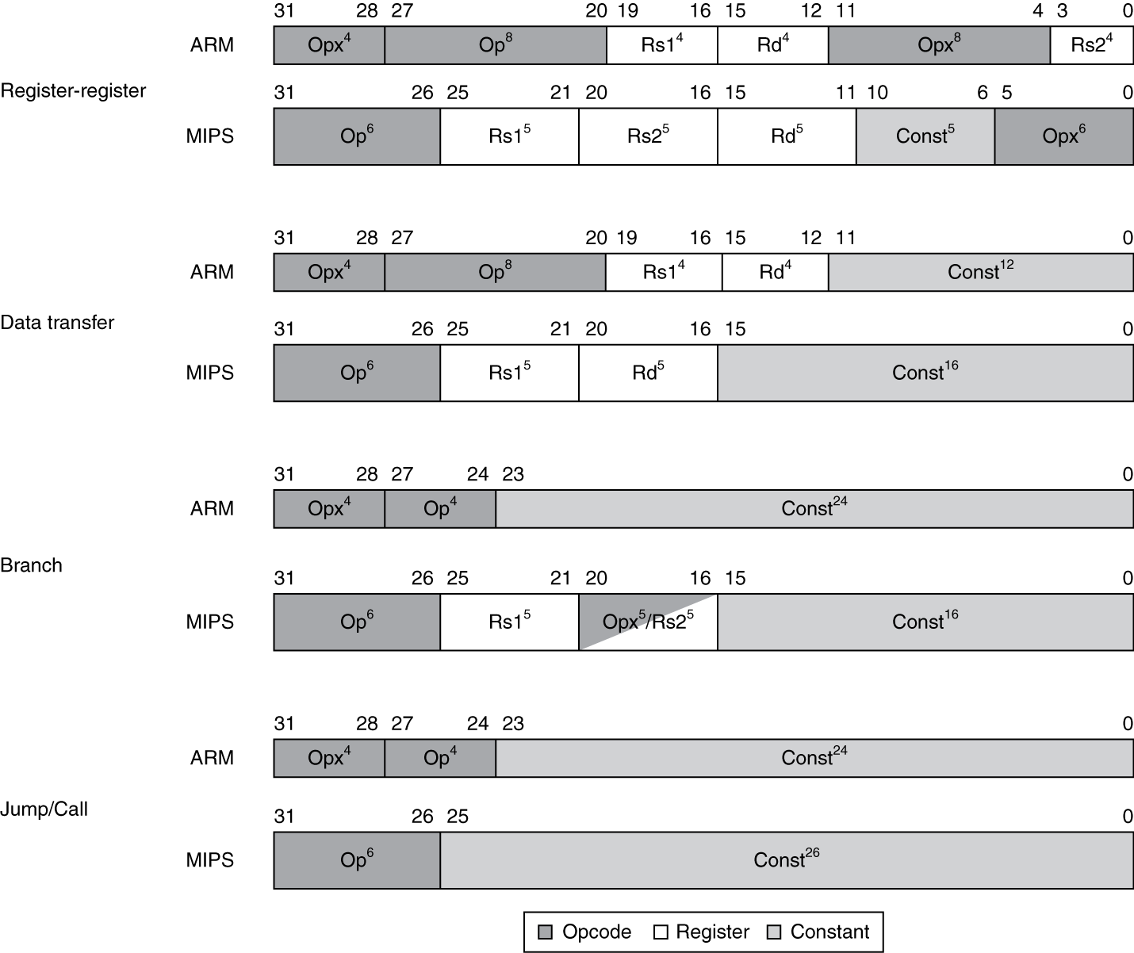
Instruction Encoding

Slide 133
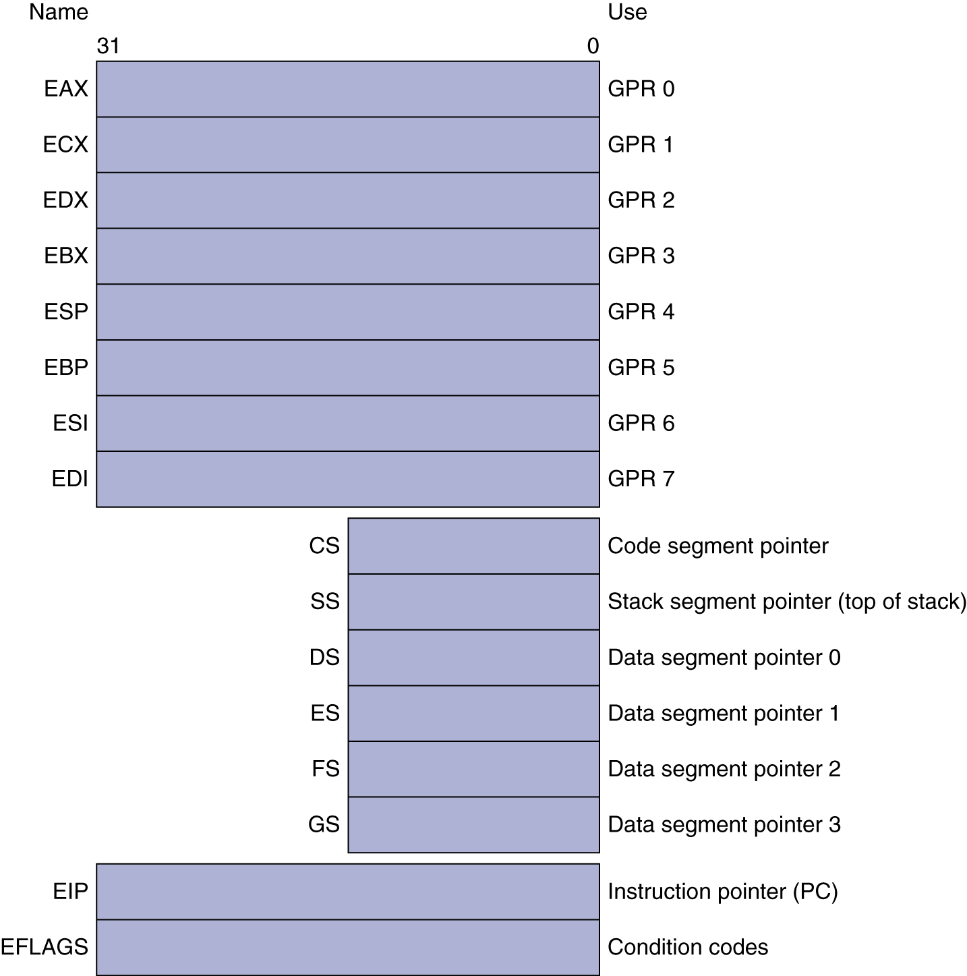
Basic x86 Registers
§2.17 Real Stuff: x86 Instructions

Slide 134
Basic x86 Addressing Modes
Two operands per instruction
Source/dest operand | Second source operand
Register | Register
Register | Immediate
Register | Memory
Memory | Register
Memory | Immediate
Memory addressing modes
Address in register
Address = R_{base} + displacement
Address = R_{base} + 2^{scale} × R_{index} (scale = 0, 1, 2, or 3)
Address = R_{base} + 2^{scale} × R_{index} + displacement

Slide 135
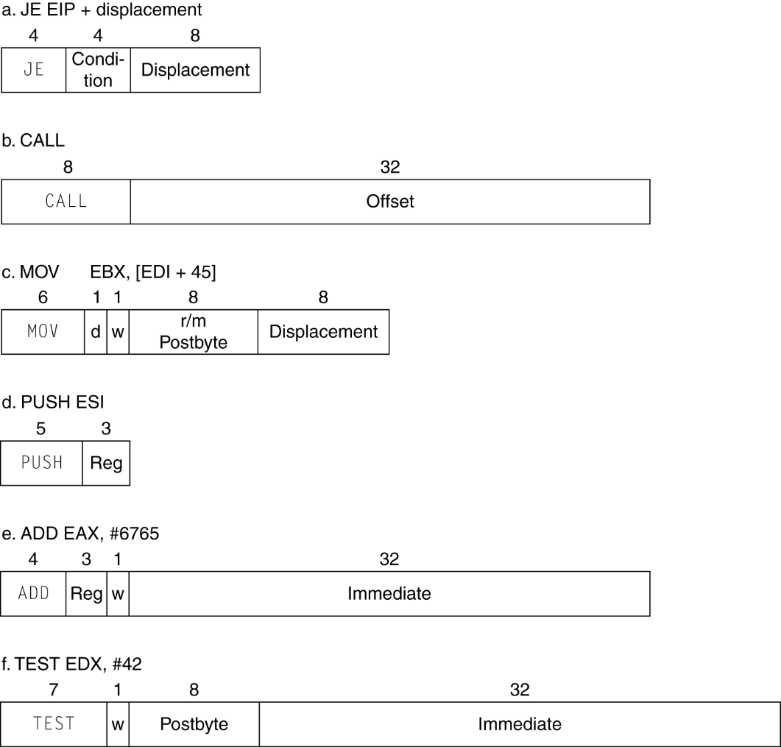
x86 Instruction Encoding
Variable length encoding
Postfix bytes specify addressing mode
Prefix bytes modify operation
Operand length, repetition, locking, …

Slide 136
Concluding Remarks
§2.20 Concluding Remarks
Design principles
1. Simplicity favors regularity
2. Smaller is faster
3. Make the common case fast
4. Good design demands good compromises
Layers of software/hardware
Compiler, assembler, hardware
MIPS: typical of RISC ISAs
c.f. x86

Slide 137
Concluding Remarks
Measure MIPS instruction executions in benchmark programs
Consider making the common case fast
Consider compromises
Instruction class | MIPS examples | SPEC2006 Int | SPEC2006 FP
Arithmetic | add, sub, addi | 16% | 48%
Data transfer | lw, sw, lb, lbu, lh, lhu, sb, lui | 35% | 36%
Logical | and, or, nor, andi, ori, sll, srl | 12% | 4%
Cond. Branch | beq, bne, slt, slti, sltiu | 34% | 8%
Jump | j, jr, jal | 2% | 0%

