Slide 1
Project 3
Instructor Dr. Jianhui Yue
Fall 2015 CSE, Miami Univ.

Slide 2
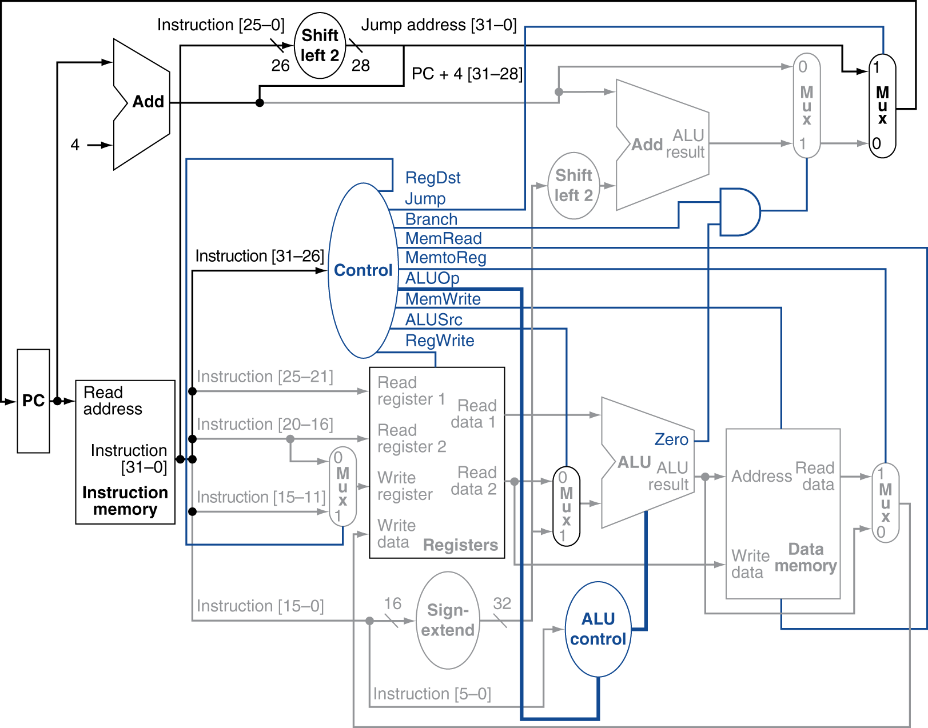
Datapath

Slide 3
ALU Control Signals

Slide 4
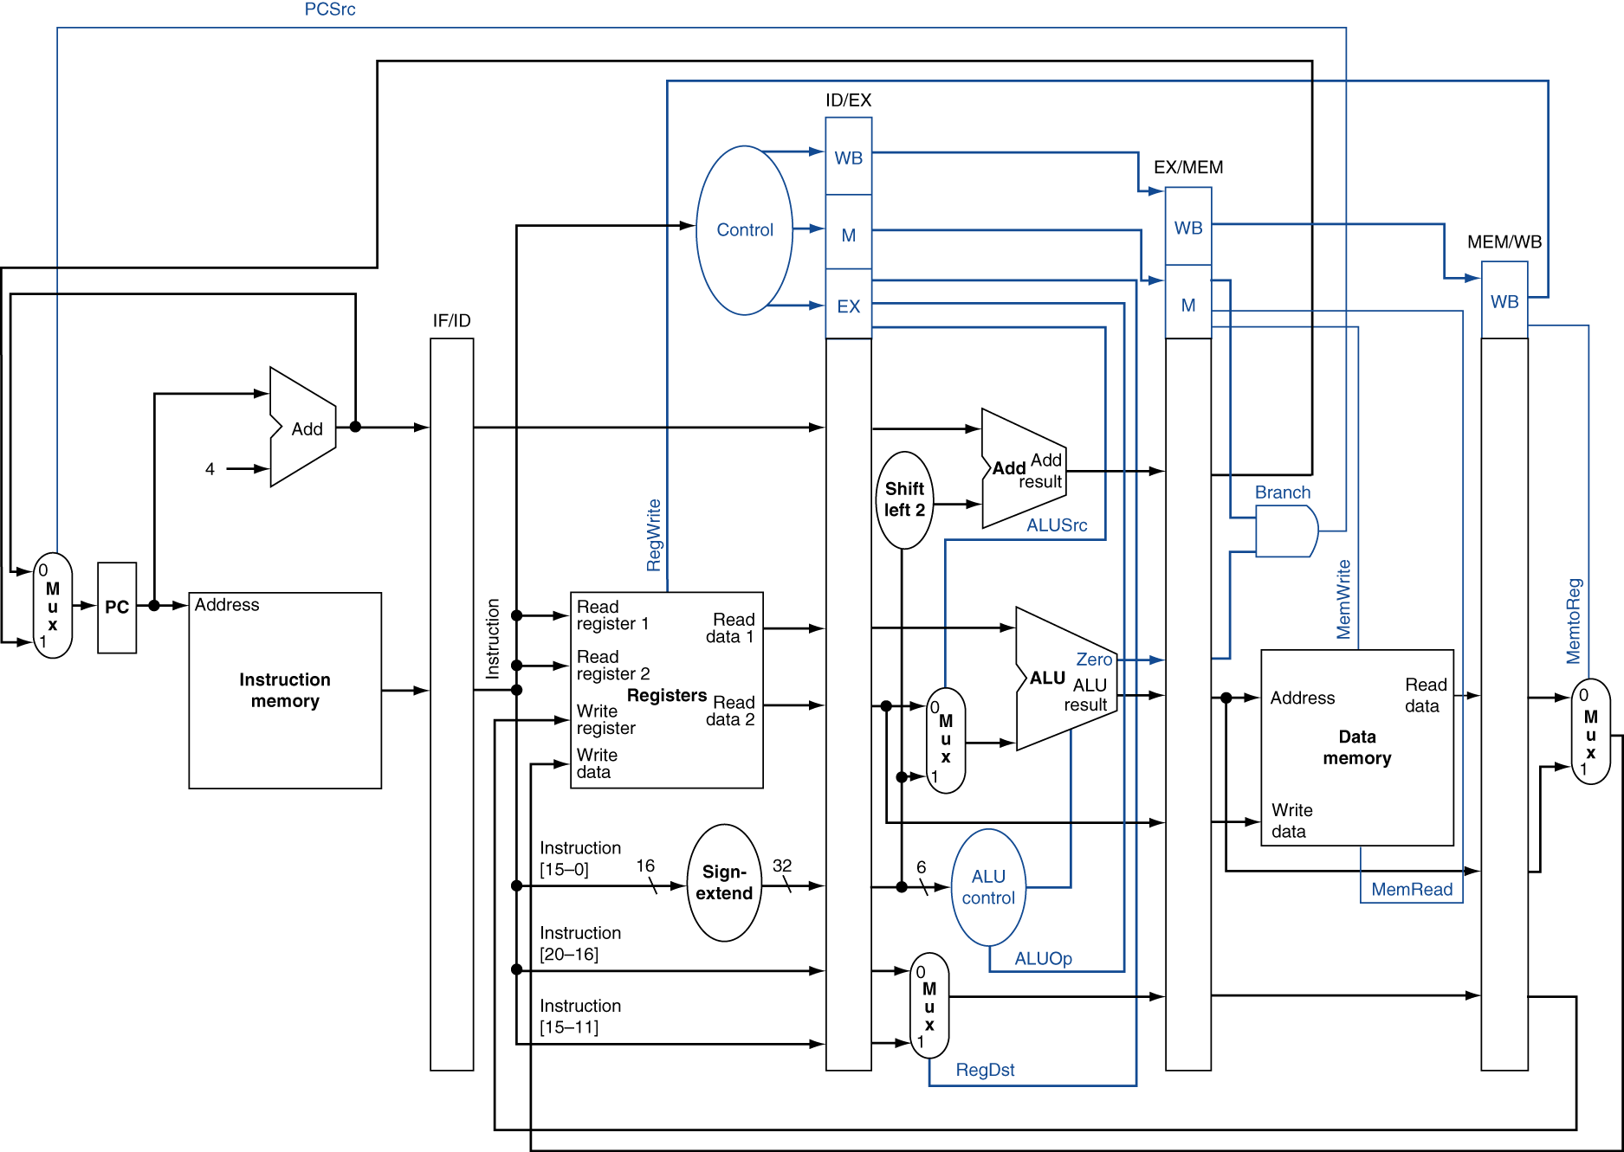
Pipelined Datapath
Figure 4.51 Pipelined datapath

